Slide 1
Calculating Dosage

Slide 2
Background
Relates drug dosage to animal body weight and period of treatment
Typically expressed as: mg/kg/day
Information needed for calculation
Strength of drug (in mg)
Weight of animal – may need to convert from pounds to kilograms
2.2 pounds per kilogram: 2.2lb/1kg or 1kg/2.2lb
Rate of dose – twice/day (b.i.d.), every 8 hours, etc.
Duration of treatment

Slide 3
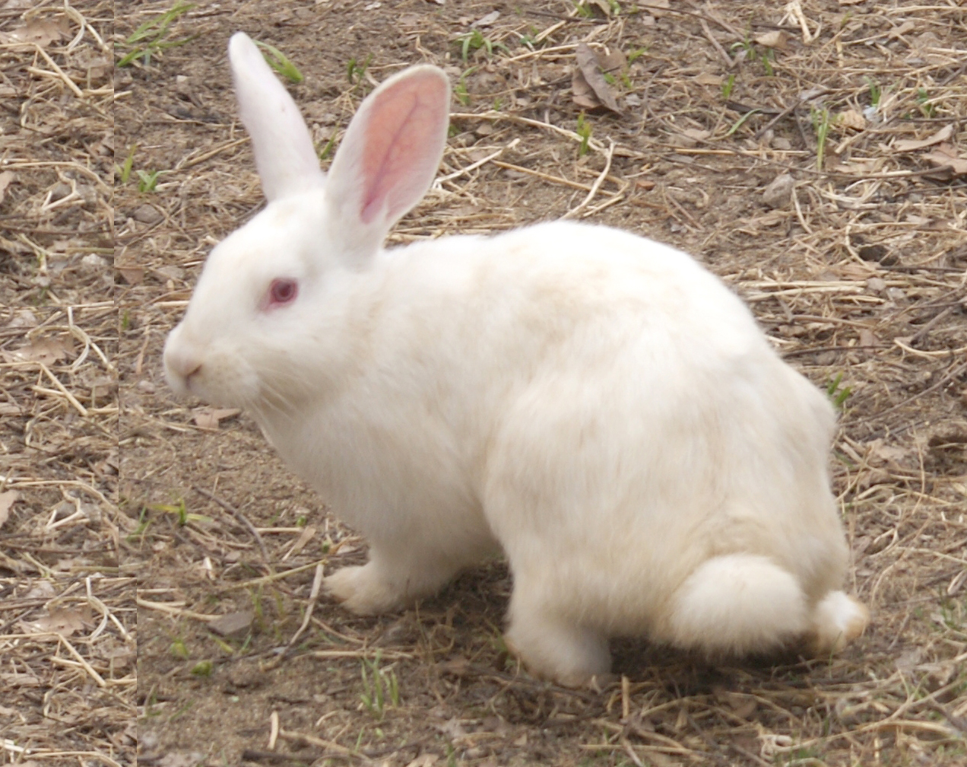
Scenario 1
Bugs, an 11 pound New Zealand Rabbit, has been prescribed Azithromycin 500mg tablets at the rate of 50mg/kg/day once a day (s.i.d.) for 7 days.
Calculate the daily dose required.

Slide 4
Solution
REMEMBER: dosage is expressed as mg/kg/day
Weight of Bugs must be converted from lb to kg
11lb X 1kg/2.2lb =
11kg/2.2
5kg
Required daily dosage:
5kg X 50mg/kg/day
5 X 50mg/day
250 mg/day

Slide 5
Scenario 1
Using your previous data, calculate the amount of medication per dose and the number of tablets needed per dose.

Slide 6
Solution Continued
Amount of Medication per dose:
250mg/day / 1 dose/day
250mg / 1 dose
250mg/dose
Number of tablets needed per dose – available in 500 mg tablets
250mg/dose / 500mg tablet
.5 tablet/dose
Notes:
Remind students to translate BID for clients
Students must determine which size bottle is needed for “Charlie” based on his dosage

Slide 7
Scenario 1
Now, calculate the tablets needed per day and the number of tablets needed to complete treatment.

Slide 8
Solution Continued
Number of tablets needed per day:
.5 tablet/dose X 1 dose/day
.5 tablet/day
Number of tablets needed to complete treatment:
.5 tablet/day X 7days
.5 tablets X 7
3.5 tablets

Slide 9
Scenario 1
Bugs will need 250mg/dose or .5 of the 500mg tablet/day and a total of 3.5 tablets to complete his course of treatment.

Slide 10
Scenario 2
“Toothless”, a 10kg Maine Coon, has a prescription for .5mg Triam Tabs to be taken twice daily (b.i.d.) for 14 days. The recommended daily dose is .1mg/kg/day
Calculate Toothless’ daily dose.

Slide 11
Solution
Dosage is expressed as mg/kg/day
Weight of Toothless is already in kg, no conversion necessary
Required daily dosage:
10kg X .1mg/kg/day
10 X .1mg/day
1 mg/day

Slide 12
Scenario 2
Using your previous data, calculate the amount of medication per dose and the number of tablets needed per dose.

Slide 13
Solution Continued
Amount of Medication per dose:
1mg/day / 2 doses/day
1mg / 2 doses
.5mg/dose
Number of tablets needed per dose – available in .5mg tablets
.5mg/dose / .5mg tablet
1 tablet/dose

Slide 14
Scenario 2
Now, calculate the tablets needed per day and the number of tablets needed to complete treatment.

Slide 15
Solution Continued
Number of tablets needed per day:
1 tablet/dose X 2 doses/day
2 tablets/day
Number of tablets needed to complete treatment:
2 tablets/day X 14 days
2 tablets X 14
28 tablets

Slide 16
Questions?

