Slide 1
Conversions
PEER Program, Texas A&M University

Slide 2
Procedure
Obtain the starting and ending unit
Obtain conversion factor(s)
Write the conversion unit as a fraction w/ ending units in the numerator and beginning units in denominator

Slide 3
Procedure (cont.)
4. Multiply the starting measurement and
unit by conversion fraction
5. Cancel like units
6. Simplify

Slide 4
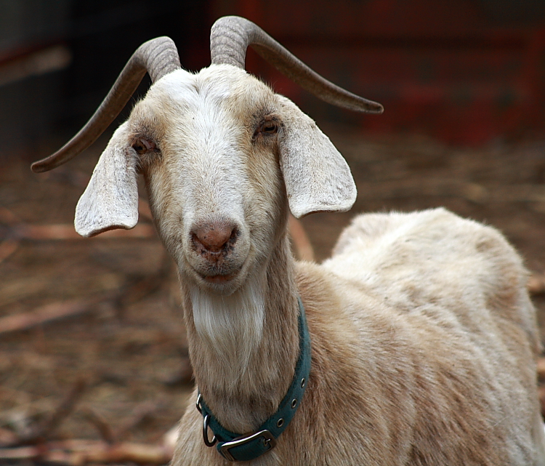
Example 1
Dixie is dispensed a 4 ounce bottle of antibiotic. She is to be given a 5 mL dose twice a day. How many mL does this bottle contain?

Slide 5
Solution
Starting: 4 ounces, Ending : 1 mL
1 ounce = 30 mL
30 mL/1 ounce
4 ounces X (30 mL/1 ounce)
4 ounces X (30 mL/1 ounce)
4 X 30 mL = 120 mL

Slide 6
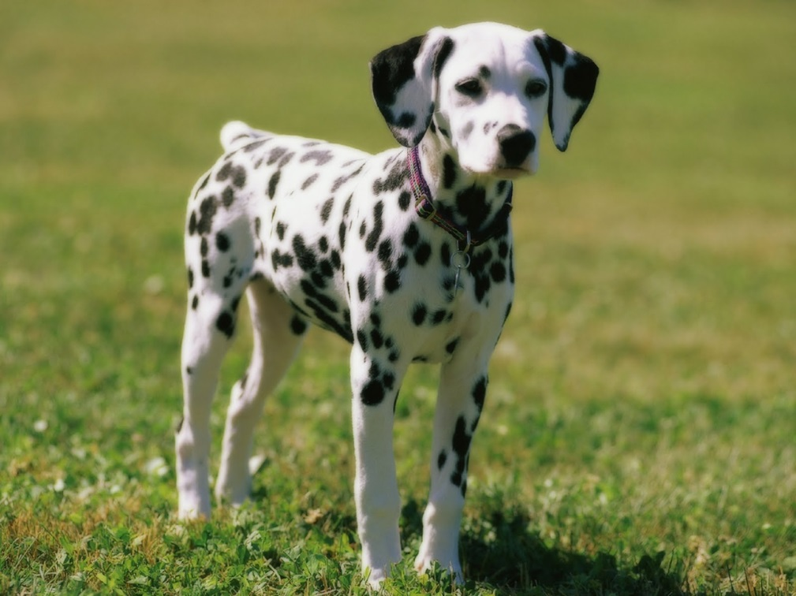
Example 2
Dottie is weighed in for his yearly examination. He weighs 13.2 kg. His owner would like to know what his weight is in pounds.

Slide 7
Solution
Starting: 13.2 kg, Ending: pounds (lbs)
1 kg = 2.2 lbs
2.2 lbs/1 kg
13.2 kgs X (2.2 lbs/1 kg)
13.2 kgs X (2.2 lbs/1 kg)
13.2 X 2.2 lbs = 29.04 lbs

Slide 8
Common Conversions
Units of Mass
1 kilogram (kg)= 2.2 pounds
1 pound = 0.45 kg
1 gram (g)= 1000 milligrams (mg)
1 pound = 453.59 g
60 grains (gr) = 1 dram (dr)
3 teaspoons (tsp) = 1 tablespoon (tbsp) = 1/2 oz = 14.3 g
2 tbsp = 1/8 cup = 1 oz = 28.3 g
4 tbsp =1/4 cup = 2 oz= 56.7 g
5 1/3 tbsp= 1/3 cup= 2.6 oz= 75.6 g
8 tbsp= 1/2 cup = 4 oz=113.4 g
12 tbsp= 3/4 cup = 6 oz= 0.375 pound
32 tbsp= 2 cups = 16 oz = 1 pound

Slide 9
Common Conversions
Units of Volume
1 tsp = 5 milliliters(ml)
2 tbsp = 1 fluid ounce (fl oz)= 30 ml
1/4 cup =2 fl oz = 60 ml
1/2 cup = 4 fl oz = 125 ml
1 cup = 8 fl oz =250 ml
1 1/2 cups = 12 fl oz = 375 ml
2 cups or 1 pint = 16 fl oz = 500 ml
4 cups or 1 quart = 32 fl oz = 1000 ml =1 liter(L)
1 gallon = 128 fl oz= 4 L
2 pints =1 quart
4 quarts = 1 gallon

Slide 10
Common Conversions
Units of Length
1 millimeter (mm) = 0.001 of a meter (m)
25 mm = 1 inch

Slide 11
Common Conversions
Units of Temperature
Celcius (°C) and Fahrenheit (°F)
°C = 5/9 (°F-32) or (°F-32)x 5/9
°F = 9/5 (°C) +32 or °C x 9/5 + 32

