Slide 1
Diagnosis of Parasites
What do you need to know?

Slide 2
WHAT YOU NEED TO KNOW?
What does it look like?
WHERE WAS IT FOUND?

Slide 3
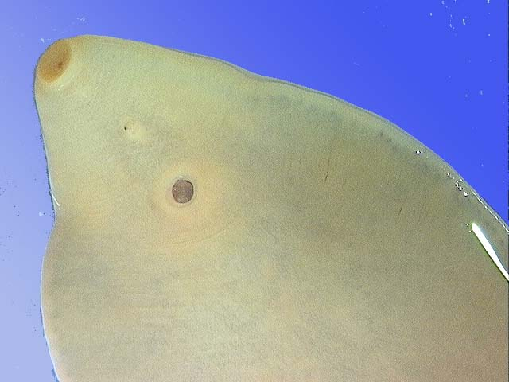
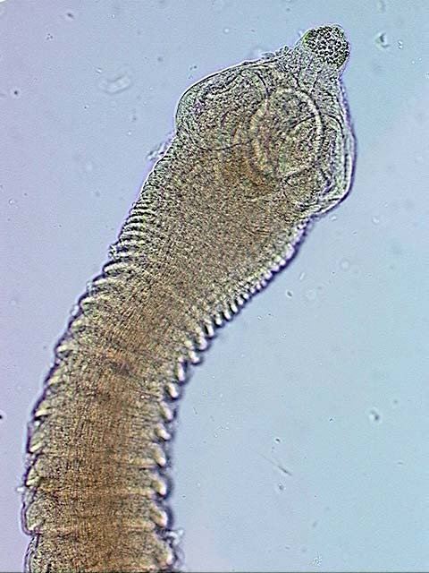
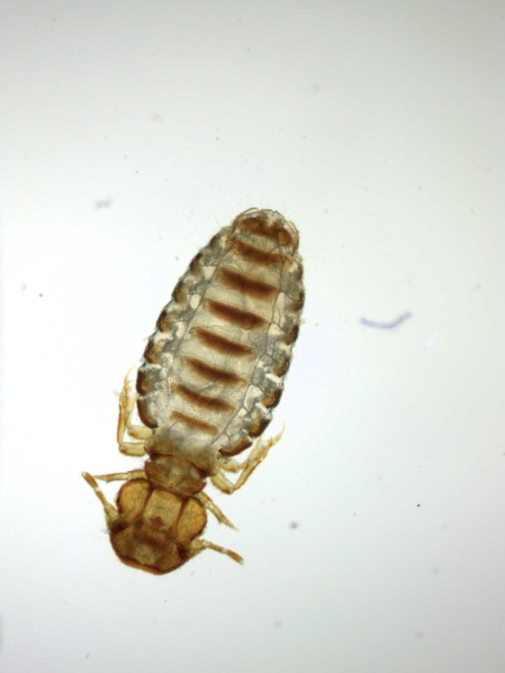
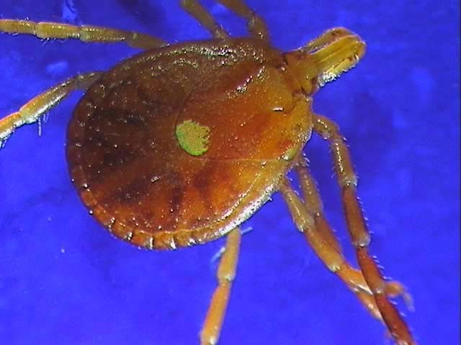
What does it look like?

Slide 4
Diagnosis by Morphology
How big is it and what does it look like? Grossly size and shape
Do you need a microscope to see it? High or low power? size and shape
Does it have legs? Six or eight? Is it segmented or smooth?
Male, female or both?

Slide 5
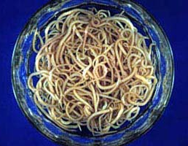
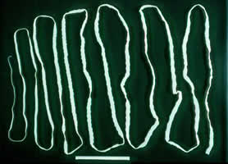
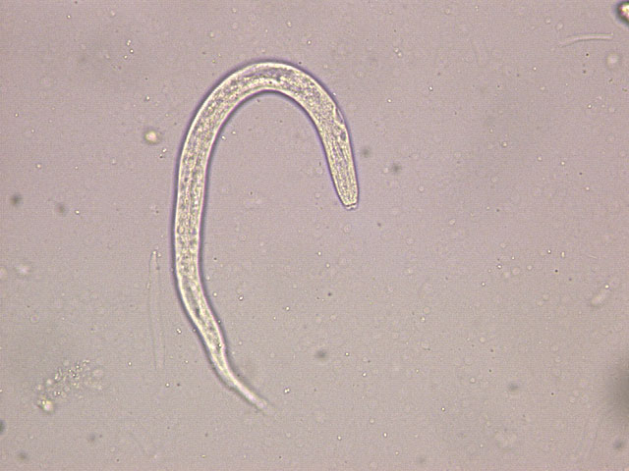
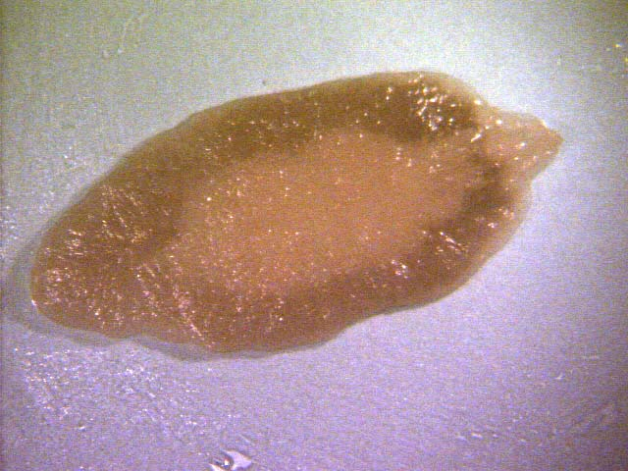
SIZE
Bowl full of worms each 6 to 8 inches One worm more than 6 feet long
Small intestine feeder pig Small intestine human
200 um seen at 400 magnifications adult fluke 1 inch long
Feces of 1 month piglet Liver cow

Slide 6
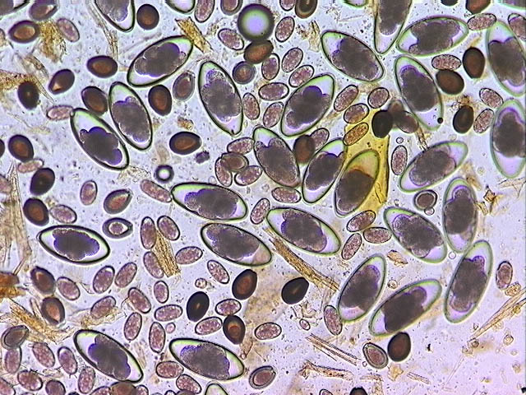
Microfilariae ca 300 um red blood cells lysed Eggs 250 and 65 um, Oocysts 65 um
Blood dog Feces Alpaca flotation
Eggs: Strongyloides (larvated)
Trichostrongyle type
Eggs, Moniezia (tapeworm)
Recently weaned
Goat kid fecal flotation
SIZE
SHAPE

Slide 7
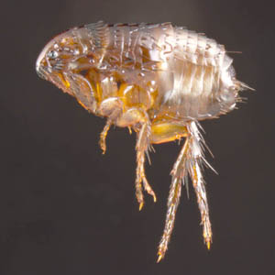
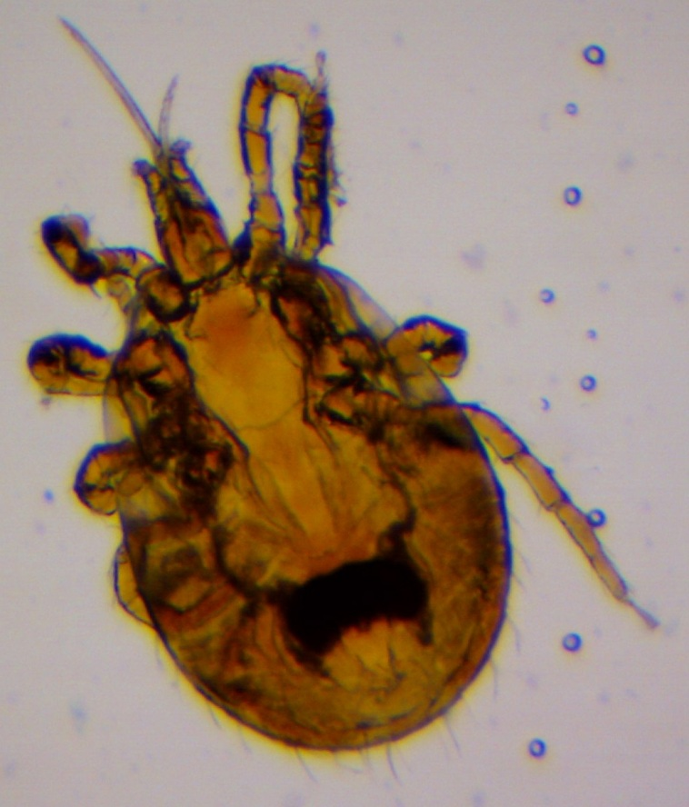
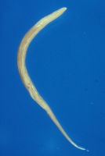
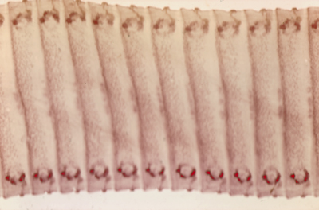
NUMBER OF LEGS
0 legs 6 legs 8 legs
Smooth
Segmented

Slide 8
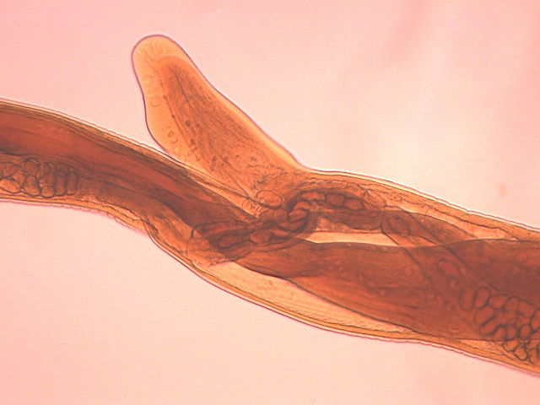
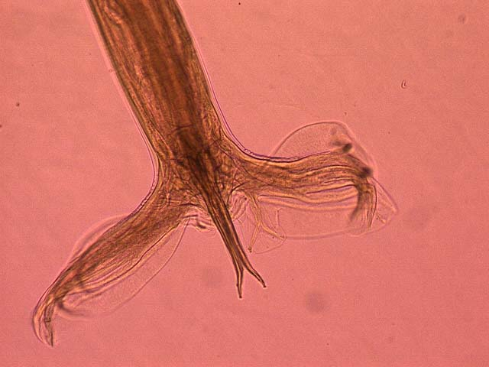
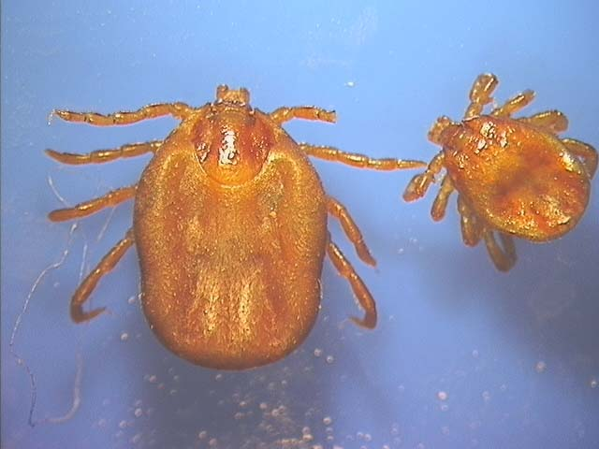
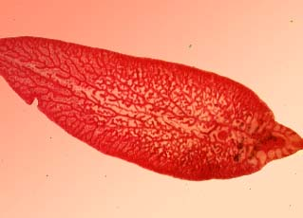
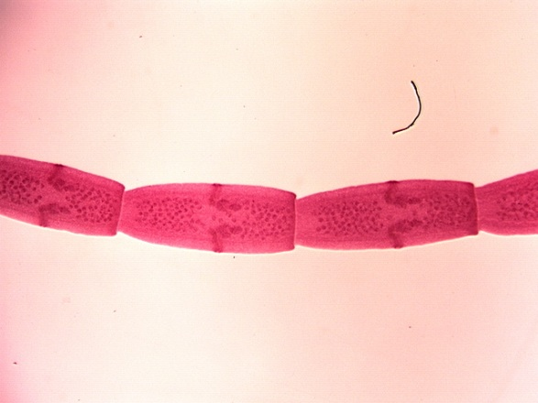
SEX
Female Haemonchus Male
both
both

Slide 9
Where was it found?
HOST? From which animal did it come: species, sex, age?
ORGAN or TISSUE? Where was it found: on the skin? where in the body? feces or urine?
ENVIROMENT? Geography? time of year? wild animal, pasture, barn or lot?

Slide 10
Host
Some parasite species are host specific, others environment specific
What other species are in contact with the host
How old is the host and where has it been
Male or female and when or if in the reproductive cycle

Slide 11
ORGAN
skin (where on body) digestive tract (where) reproductive tract cardiovascular tract (free or in cells) respiratory tract body cavity
Feces Blood Urine

Slide 12
ENVIRONMENT
The climate, soil and vegetation determine if a parasite can survive in a specific geographic locality outside the host
Weather conditions determine when they are transmitted
How does the host make a living (diet, protection from weather or predators, who else is in contact) Increasing or decreasing chances of exposure

