Slide 1
Dog Breeds
© Partnership for Environmental Education and Rural Health at
College of Veterinary Medicine & Biomedical Sciences, Texas A&M University
Funding support from the National Institutes of Health Office of Research Infrastructure Programs (ORIP)

Slide 2
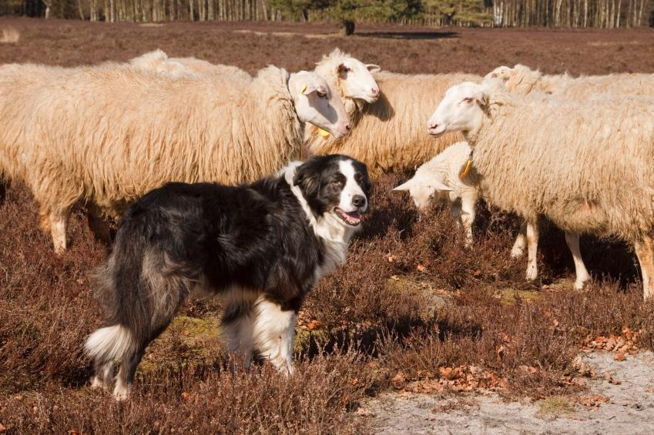
Herding Group:
A group created by the American Kennel Club (AKC) in 1983 for dogs with a natural instinct to herd livestock (sheep, cattle, ducks, etc.)
Many of these breeds have very high energy levels
This is the newest AKC group classification
Breeds under this group:
Australian Cattle Dog
Australian Shepherd
Border Collie
Collie
German Shepherd Dog
Old English Sheepdog
Pembroke Welsh Corgi
Shetland Sheepdog
Notes:
http://www.akc.org/dog-breeds/groups/herding/

Slide 3
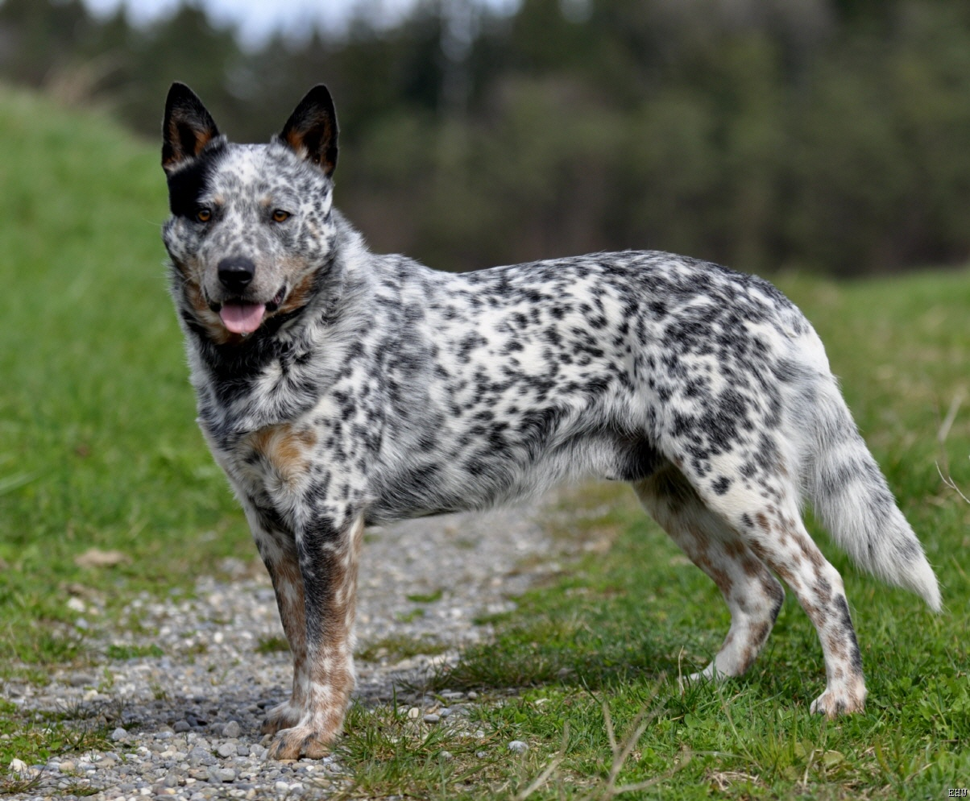
Australian Cattle Dog

Slide 4
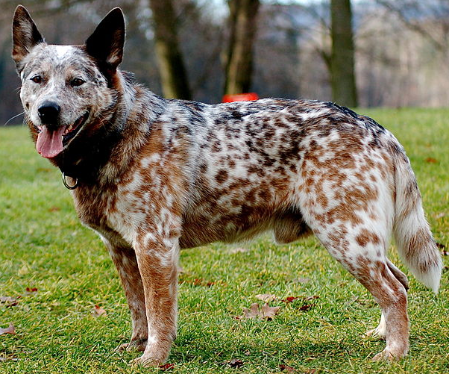
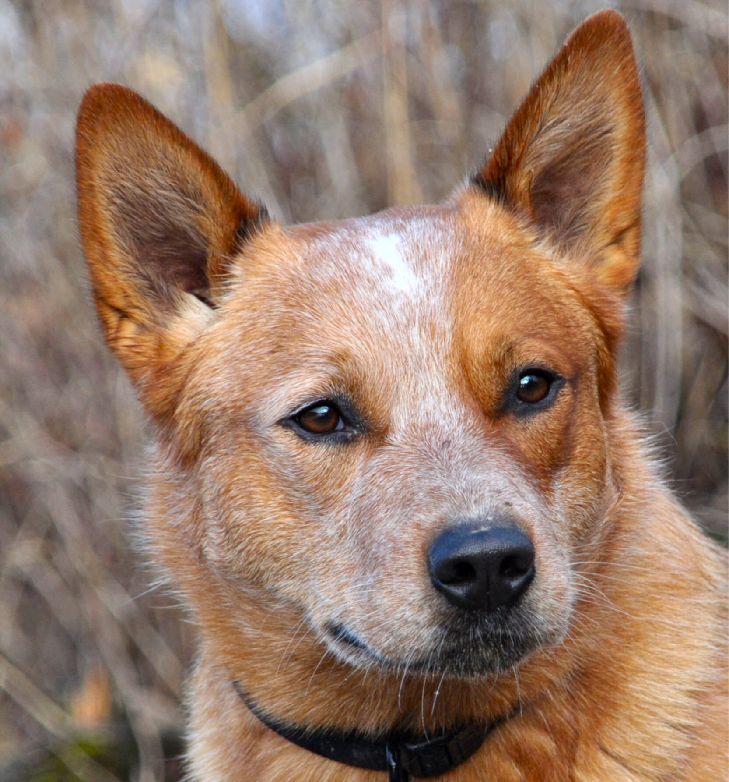
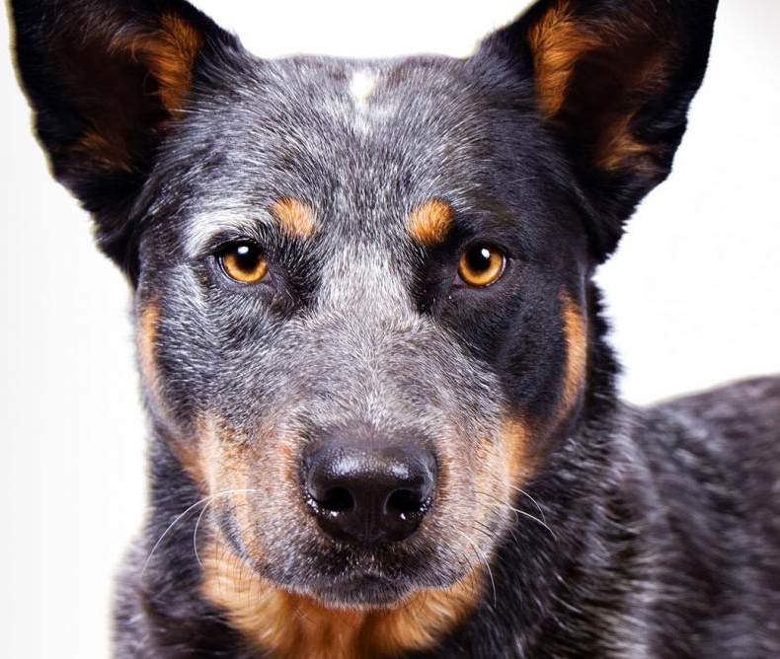
Australian Cattle Dog
AKC Recognized Colors:
Blue
Blue mottled
Blue speckled
Red mottled
Red speckled
AKC Recognized Markings:
Black and tan
Red
Tan
As their name implies, these dogs originate from Australia and are often used to herd cattle
Many people refer to this breed as “blue heeler” or “red heeler”
This breeds ancestor was cross-bred to a Dalmatian, giving many individuals in this breed the unique speckled pattern

Slide 5
Australian Cattle Dog – Dogs 101

Slide 6
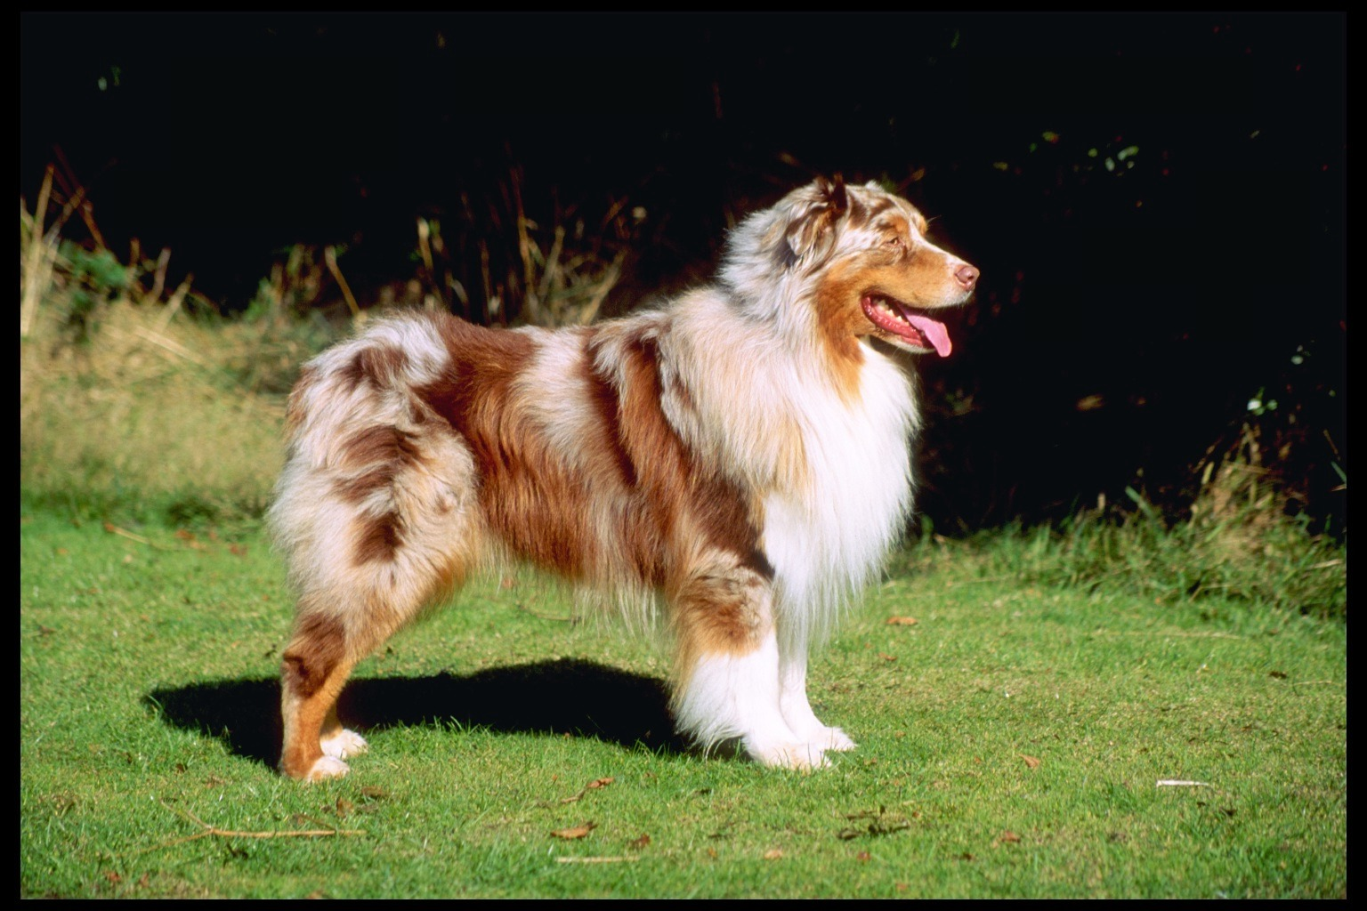
Australian Shepherd

Slide 7
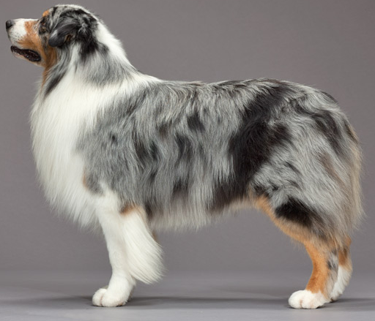
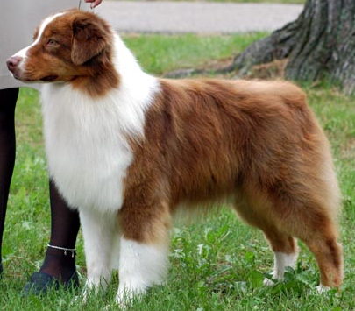
Australian Shepherd
AKC Recognized Colors:
Black
Blue merle
Red
Red merle
AKC Recognized Markings:
Tan points
White
White marking and tan points
Aussies originated in the western United States (despite its name!)
Medium length coat that is very thick
Docked tail or naturally bobbed
Often used at rodeos, ranches, and farms to herd horses, cattle, sheep, and ducks

Slide 8
Australian Shepherd – Dogs 101

Slide 9
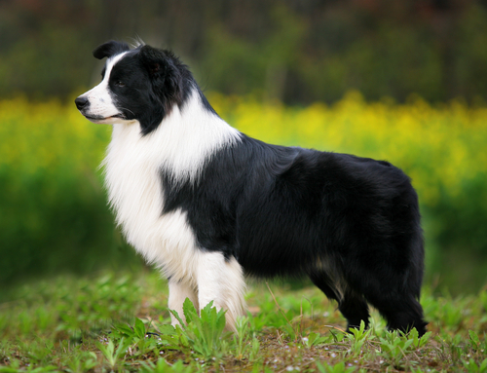
Border Collie

Slide 10
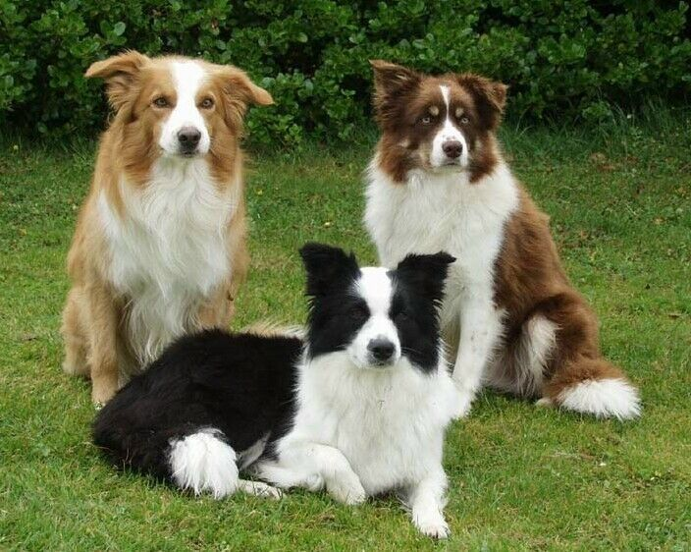
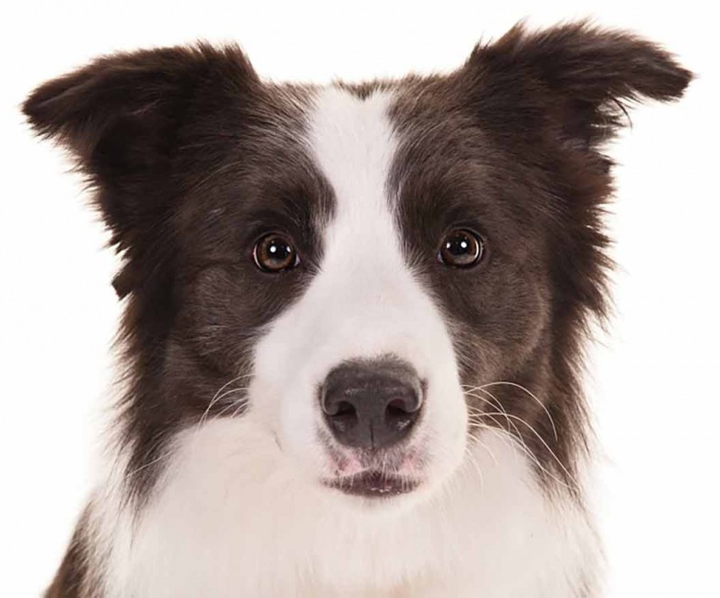
Border Collie
AKC Recognized Colors:
17 recognized colors (there is a wide variety)
AKC Recognized Markings:
7 recognized markings
Originated on the border between Scotland and England
Highly intelligent and energetic
Strong herding instincts, often herd cattle and sheep (many believe they are the best herding breed)
This breed does NOT have a docked tail (AKC standard)
Notes:
Many students mix up Border Collies and Australian Shepherds (Aussies have a docked tail where BC do not!)

Slide 11
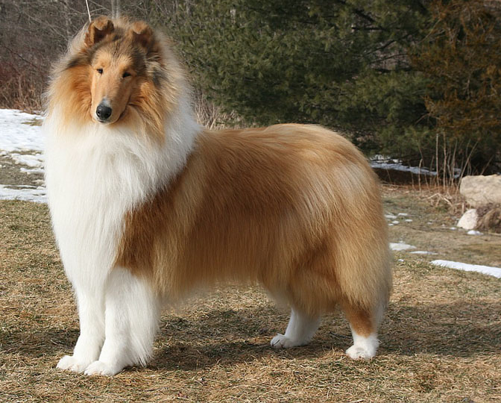
Collie

Slide 12
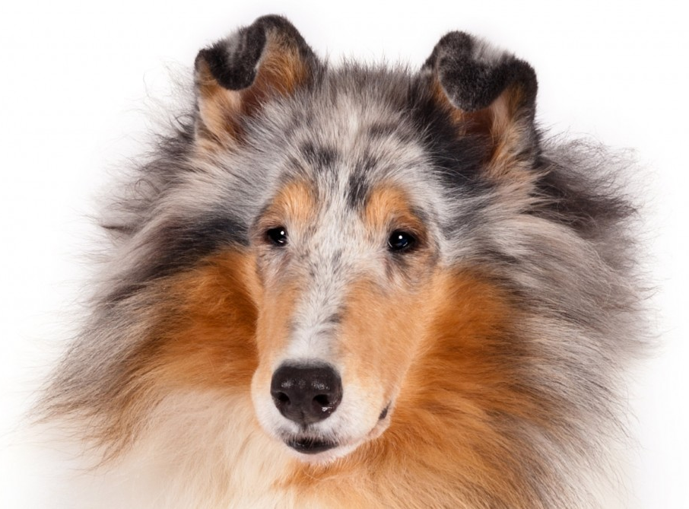
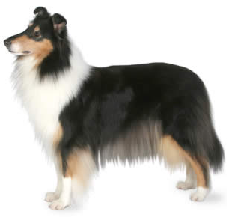
Collie
AKC Recognized Colors:
10 recognized colors (there is a wide variety)
AKC Recognized Markings:
Black and tan
Blue merle
Sable
Sable merle
Originated in Scotland/Northern England
Medium size (50-70lbs), long and pointed snout
Traditionally used to herd cattle and sheep
Notes:
Many students confuse Collies and Shelties, shelties are much smaller (less than 30lbs).

Slide 13
Reveille - Collie

Slide 14
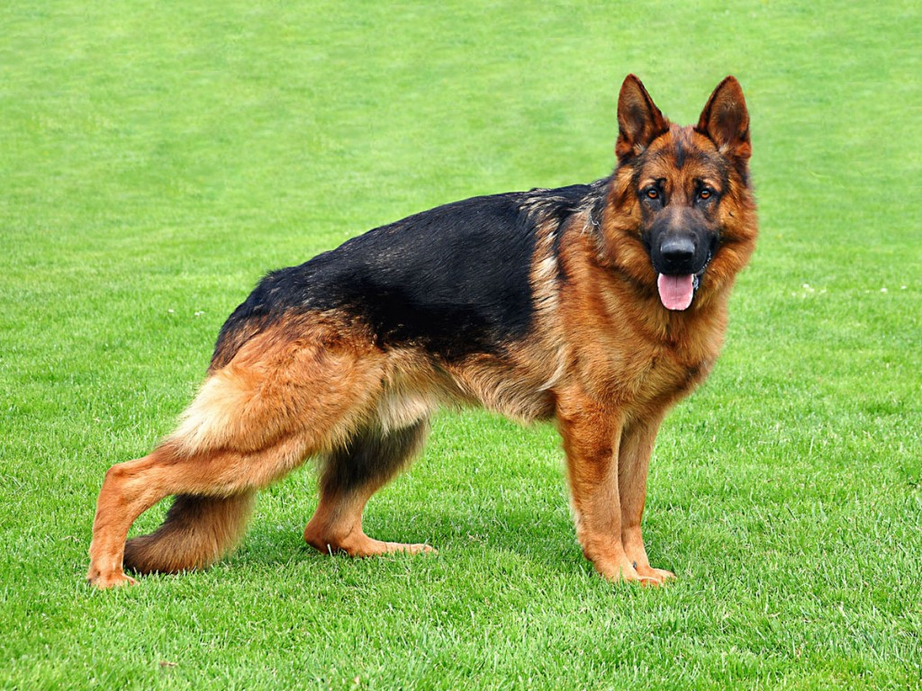
German Shepherd Dog

Slide 15
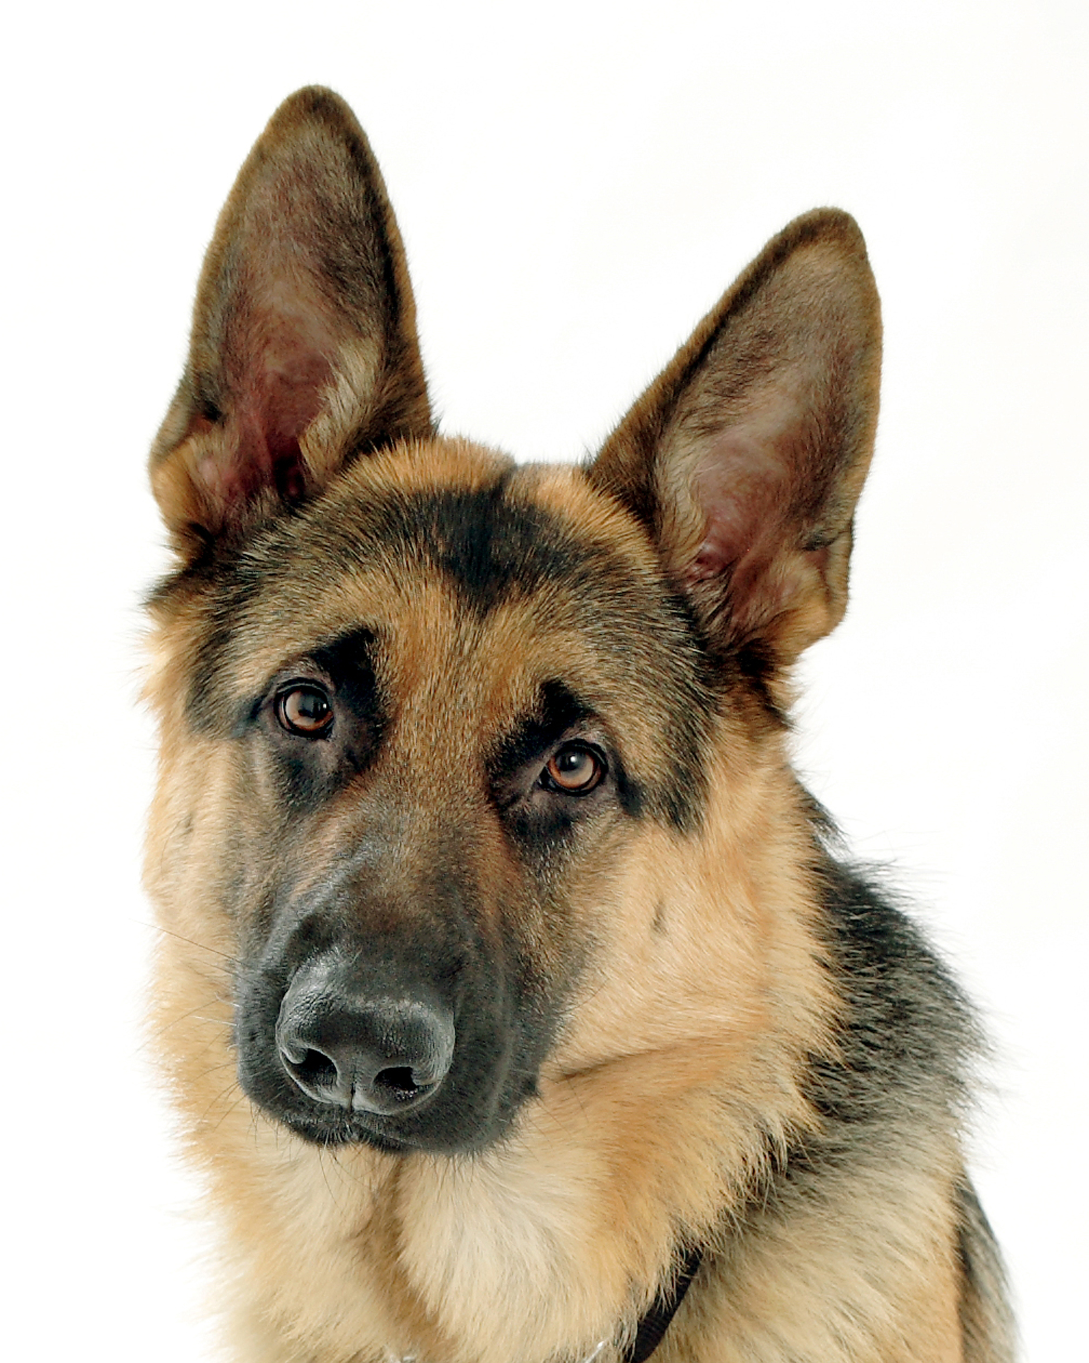
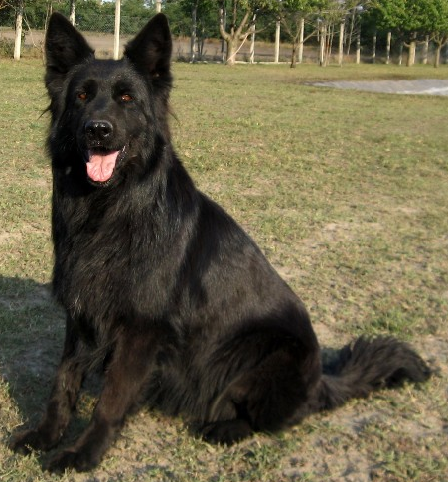
German Shepherd Dog
AKC Recognized Colors:
11 recognized colors (there is a wide variety)
AKC Recognized Markings:
No recognized markings
GSD originated in Germany to herd sheep
Large size (50-90lbs) and a medium energy level
Today, this breed is often used for police work, disability services, search-and-rescue, and military work.

Slide 16
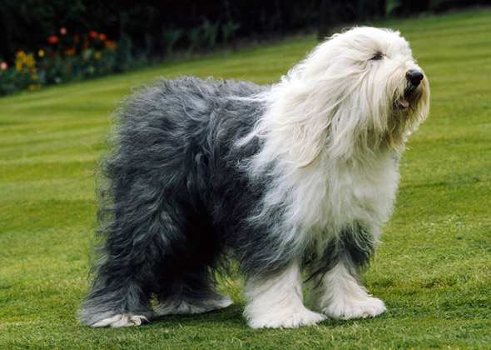
Old English Sheepdog

Slide 17
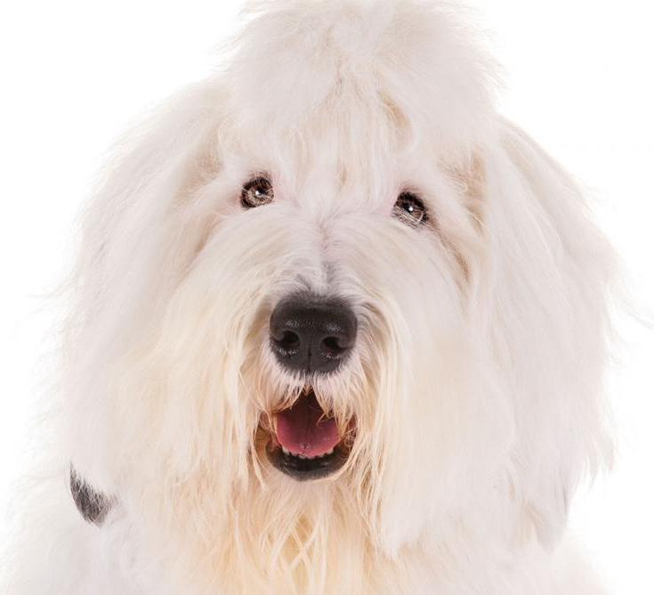
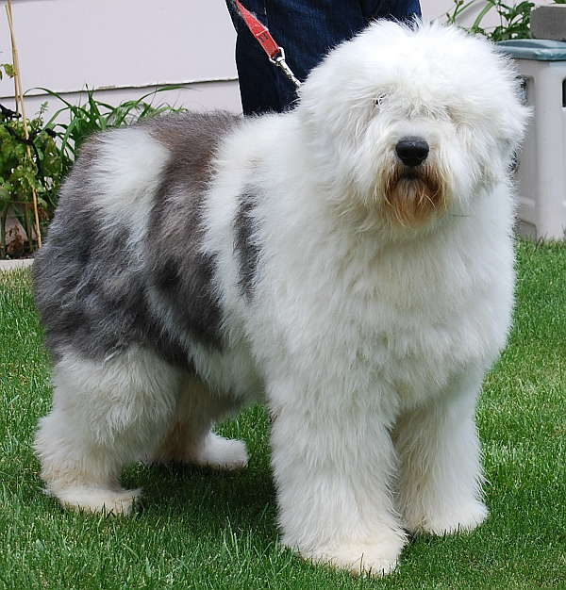
Old English Sheepdog
AKC Recognized Colors:
Blue and white
Blue grey & white
Blue merle & white
Grey and white
Grizzle & white
AKC Recognized Markings:
No recognized markings
Developed in England
Large size (60-100lbs) and medium energy level
This breed helped farmers drive cattle and sheep to the market
Long, shaggy coat

Slide 18
OES - The Shaggy dog (1957)

Slide 19
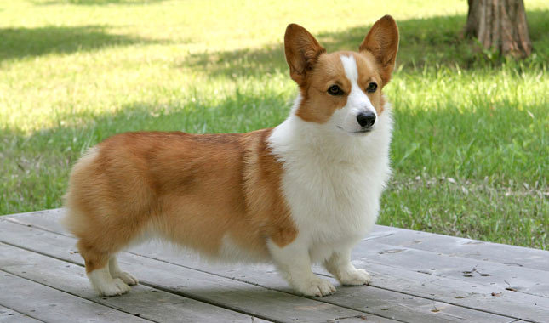
Pembroke Welsh Corgi

Slide 20
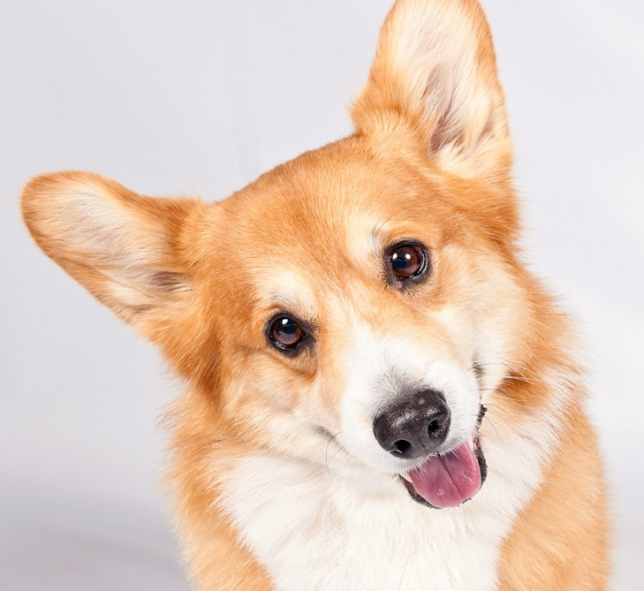
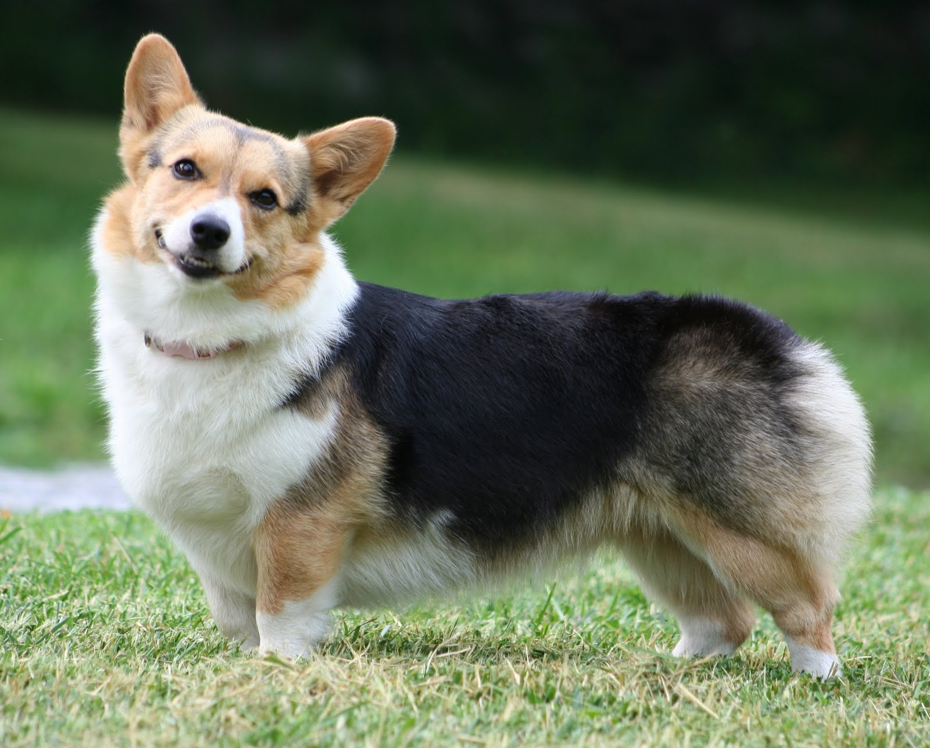
Pembroke Welsh Corgi
AKC Recognized Colors:
Black and tan
Fawn
Red
Sable
AKC Recognized Markings:
White
Originated in Wales (British decedents of Viking dogs)
Medium energy and size (25-30lbs)
Were used for herding cattle and sheep
Long body with short legs and big, erect ears (being low to the ground was an advantage when the cows would kick at the dogs!)

Slide 21
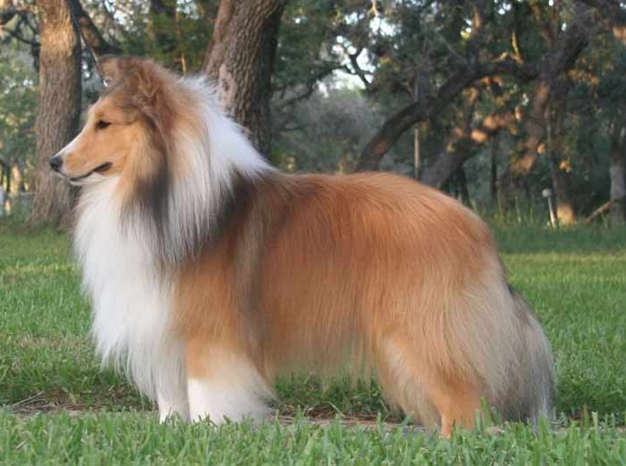
Shetland Sheepdog

Slide 22
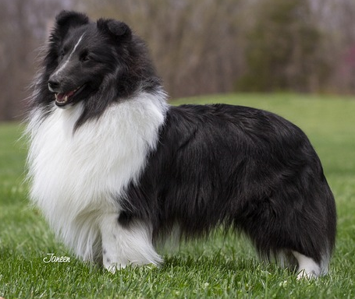
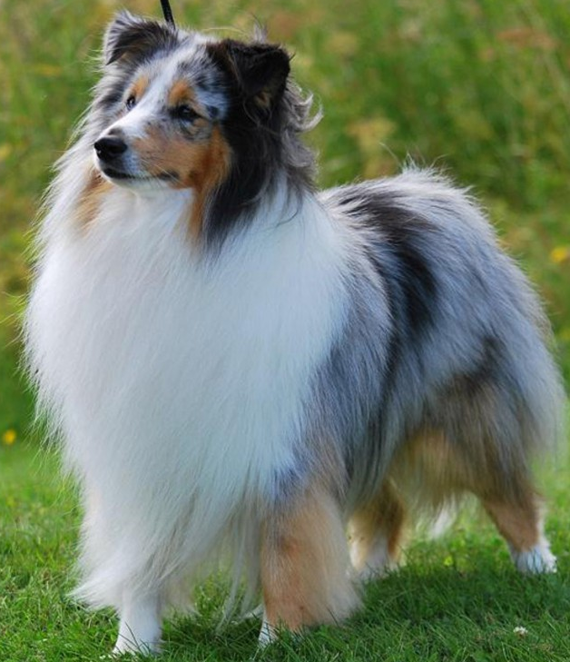
Shetland Sheepdog
AKC Recognized Colors:
Black & white
Black, white & tan
Blue merle & white
Blue merle, white, & tan
Sable & white
Sable, merle, & white
AKC Recognized Markings:
None
Shelties originated on the Shetland Islands to herd sheep
They are medium sized (<30lbs)
Pedigree is not well known, but likely a descendent of the Scottish Collie and the King Charles Spaniel
Notes:
Not a miniature collie, it is recognized as its own breed.

Slide 23
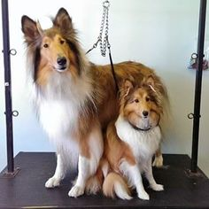
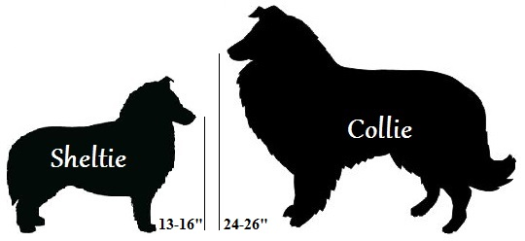
Sheltie vs. Collie
Shelties are NOT miniature Collies, they are their own breed
Example: the head shape is different (Shelties have a slight elevation at the forehead, where Collies do not have this elevation)

Slide 24
Shetland Sheepdog – Dogs 101

Slide 25
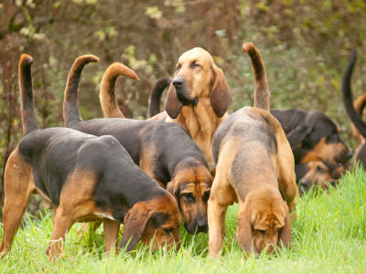
Hound Group:
Most breeds in this group are used for hunting, so many of these breeds have acute senses
Some make a distinct sound, called “baying”
Breeds under this group:
Afghan Hound
Basenji
Basset Hound
Beagle
Black and Tan Coonhound
Bloodhound
Dachshund
Greyhound
Rhodesian Ridgeback
Notes:
http://www.akc.org/dog-breeds/groups/herding/

Slide 26
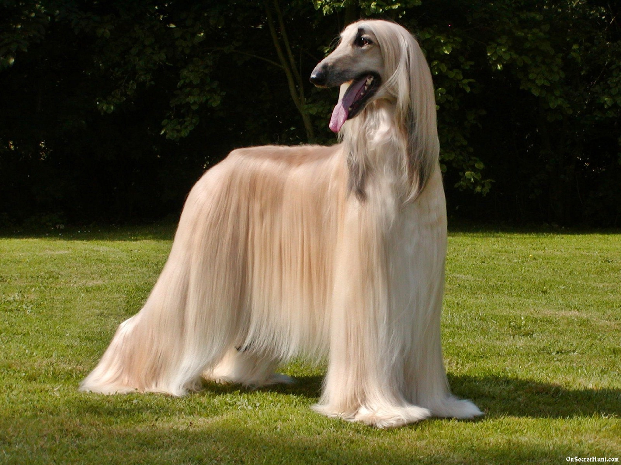
Afghan Hound

Slide 27
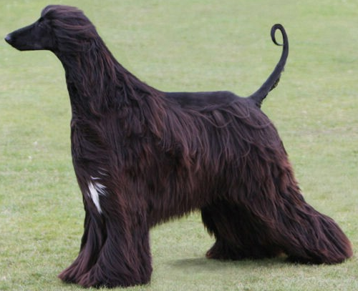
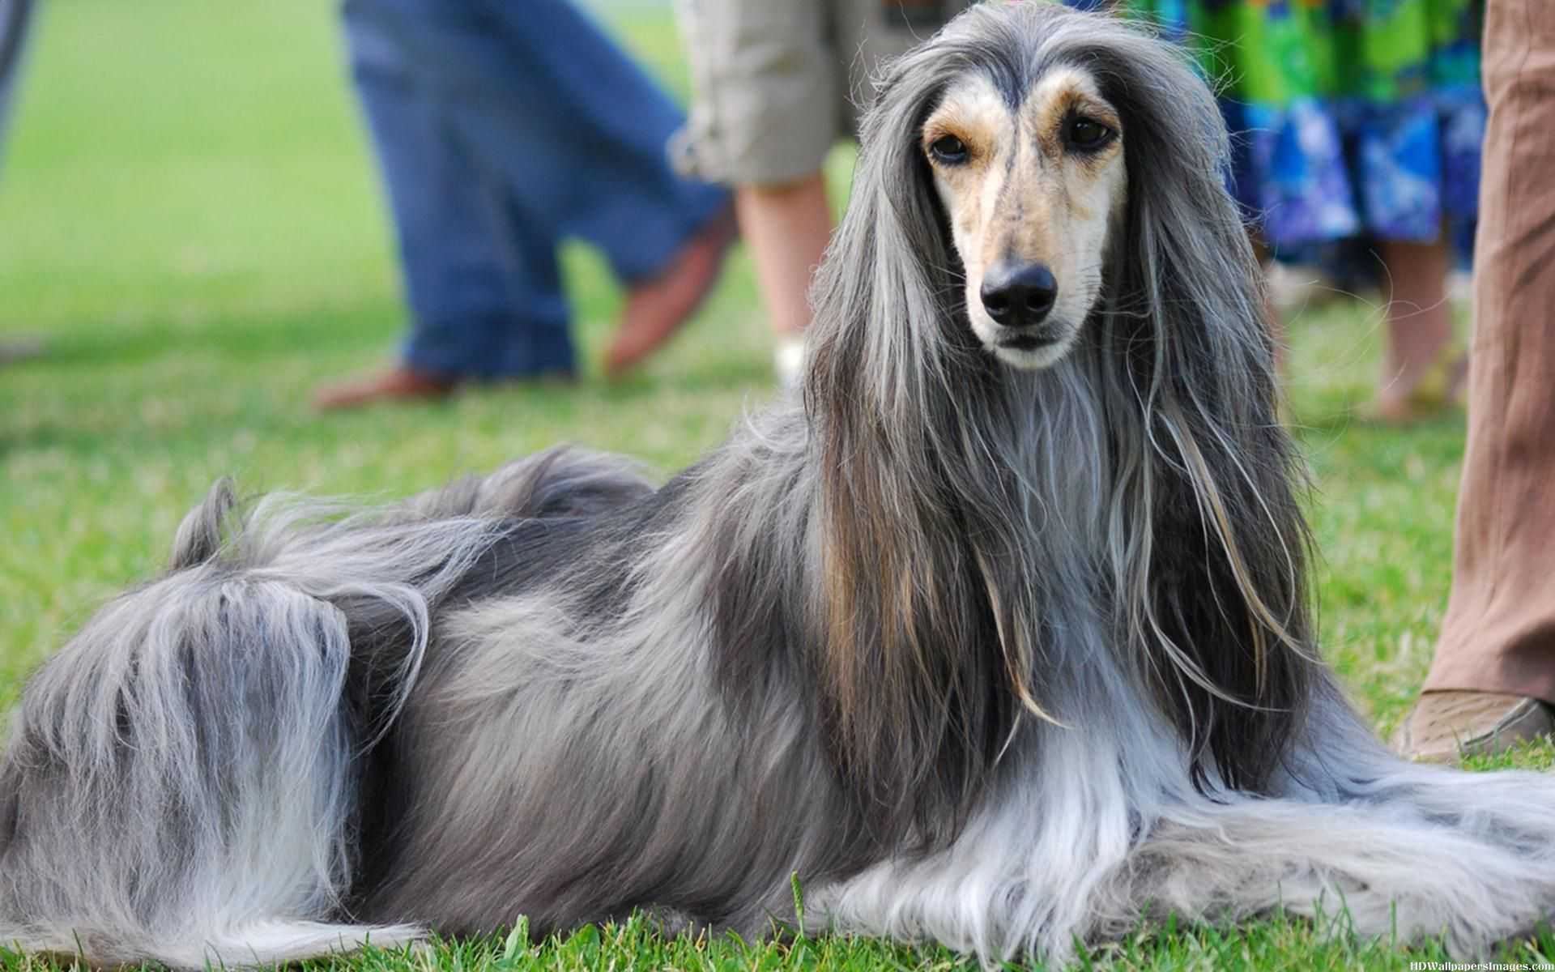
Afghan Hound
AKC Recognized Colors:
9 recognized colors (there is a wide variety)
AKC Recognized Markings:
5 recognized markings
As the name suggests, the Afghan hound originated from Afghanistan
Thick, fine, silky coat with a tail that has a curl at the end
No longer used for hunting, but was used by Afghan tribes to hunt gazelles

Slide 28
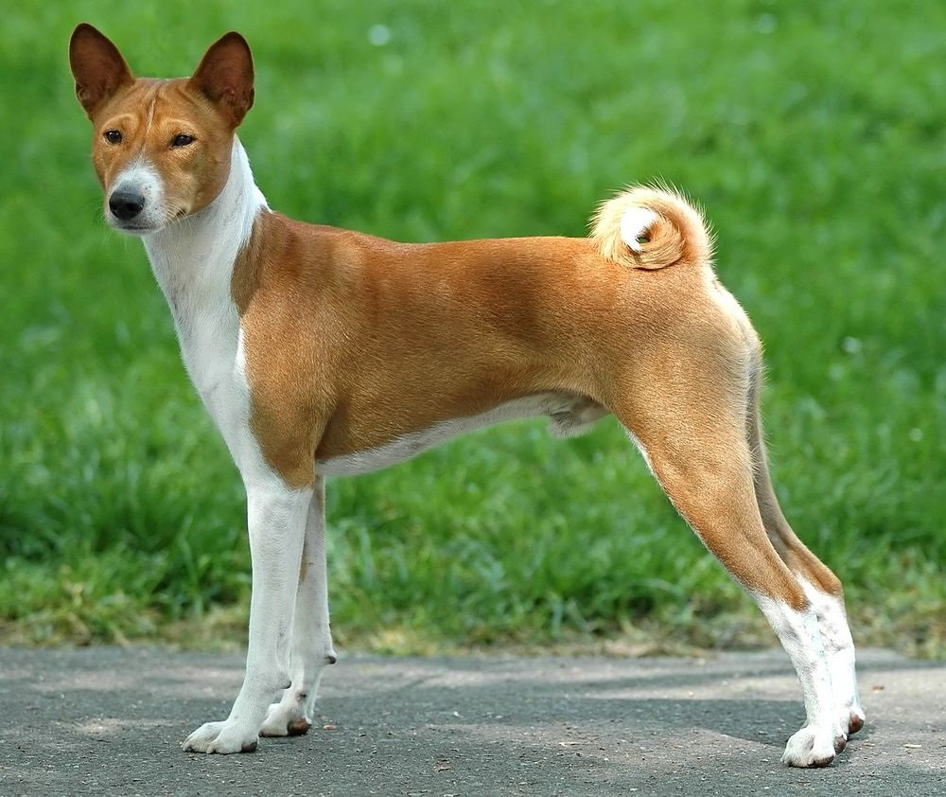
Basenji

Slide 29
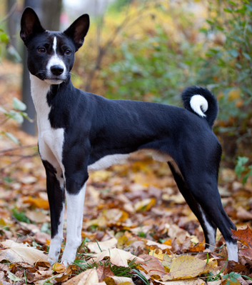
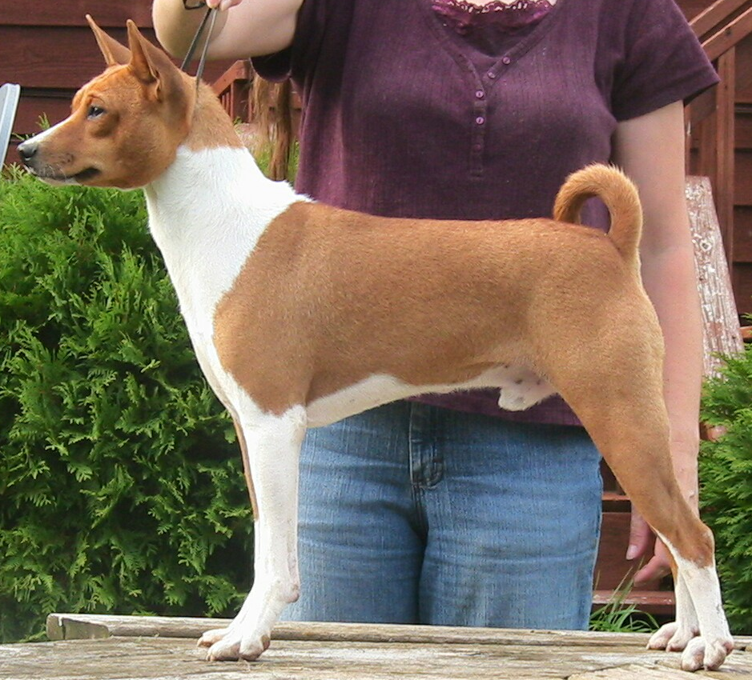
Basenji
AKC Recognized Colors:
Black & white
Black, tan, & white
Brindle & white
Red & white
AKC Recognized Markings:
Brindle
Modern breed originated in central Africa
This breeds job is to find large game and flush it out into nets
Large, erect ears and tail is curled onto their back

Slide 30
Basenji – Dogs 101

Slide 31
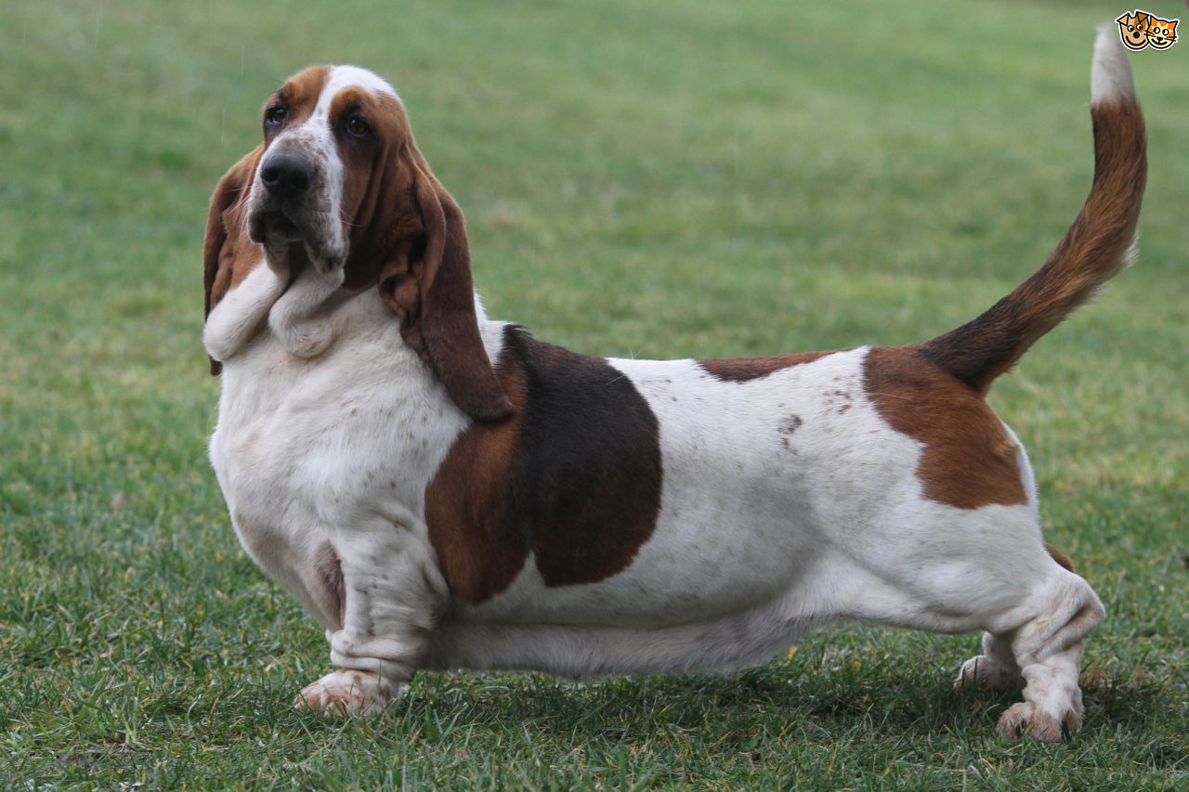
Basset Hound

Slide 32
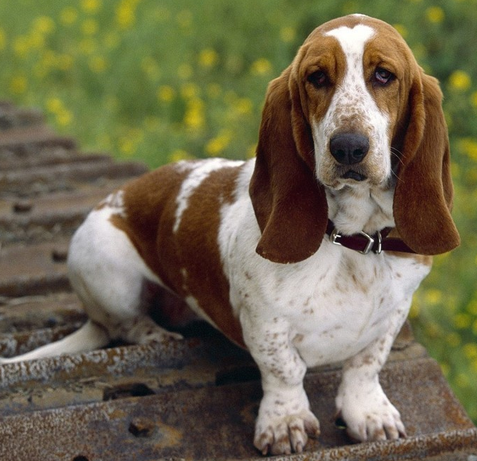
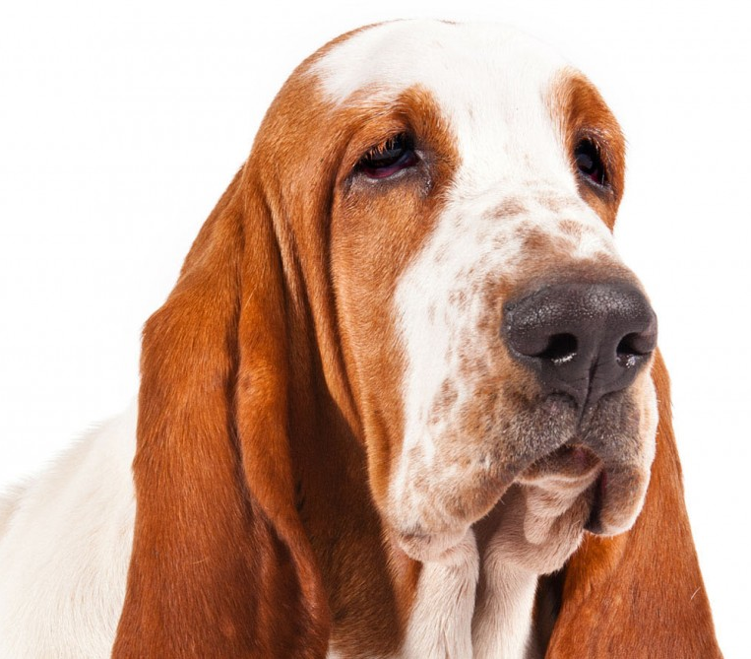
Basset Hound
AKC Recognized Colors:
9 recognized colors (all have at least some white)
AKC Recognized Markings:
None
Basset hounds originated in France
They have a long body and ears with short legs
Powerful scenting ability
Used for small game and people that hunt on their feet (as apposed to on horseback)

Slide 33
Basset Hound - Lafayette from Aristocats

Slide 34
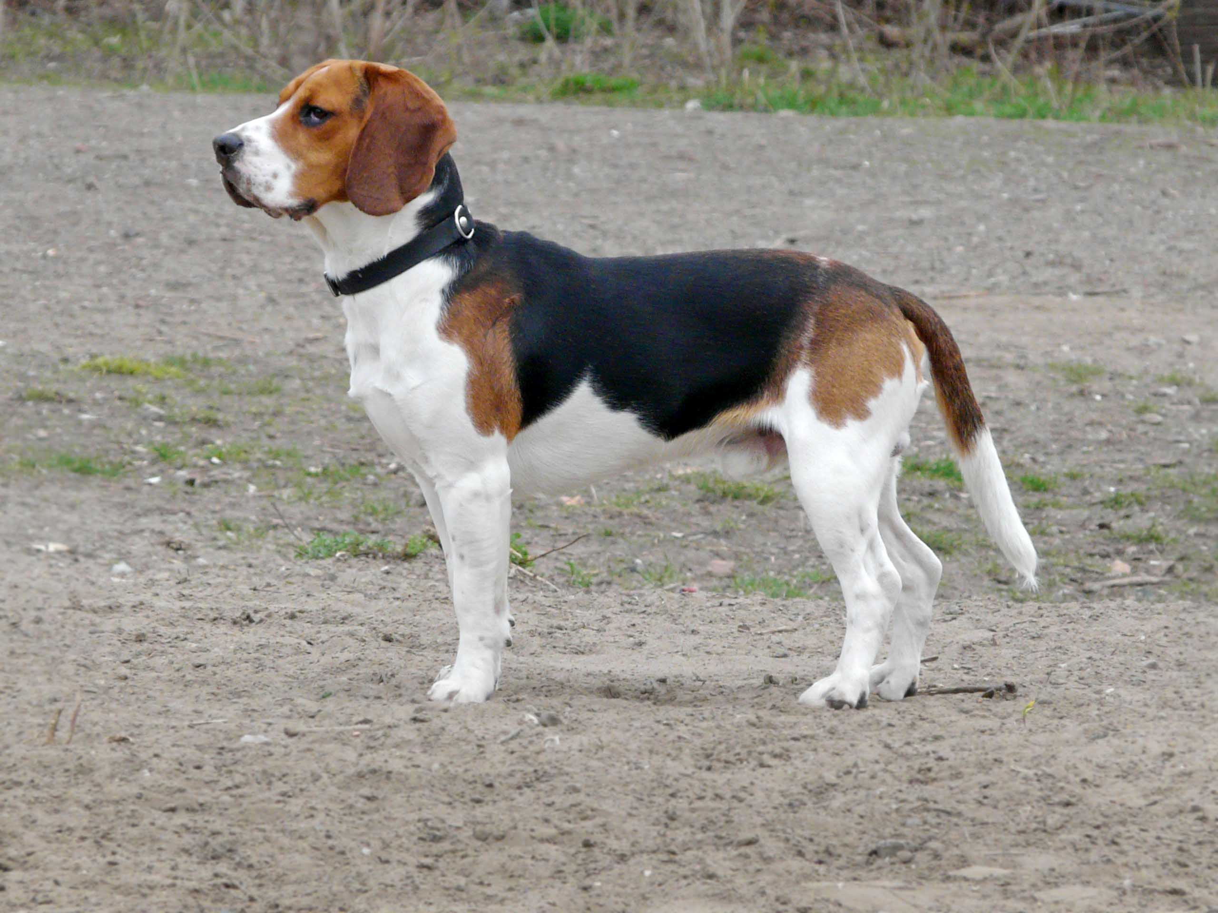
Beagle

Slide 35
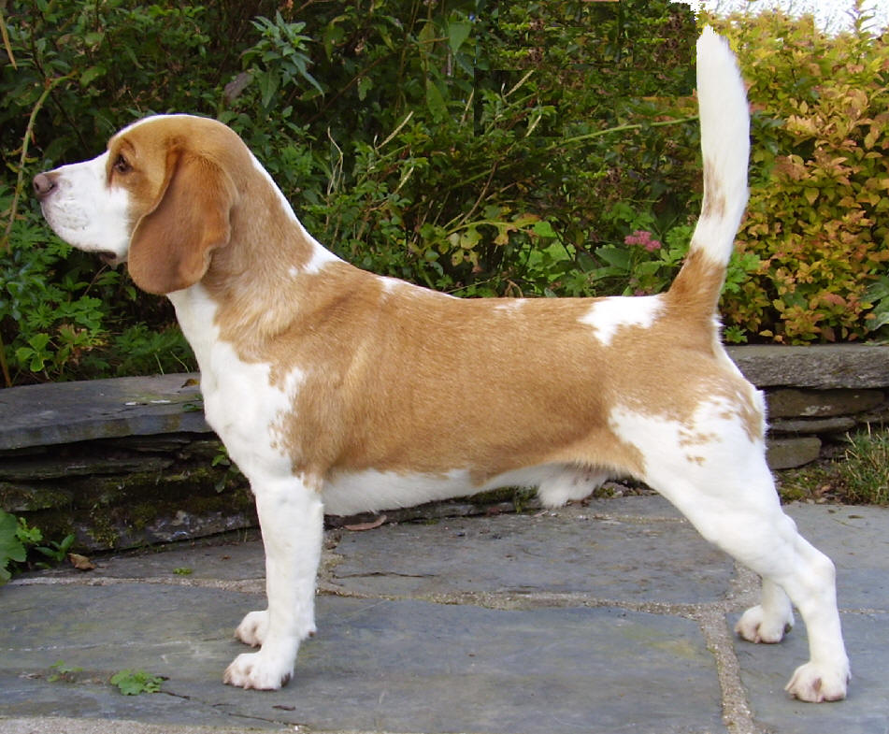
Beagle
AKC Recognized Colors:
11 recognized colors (there is a wide variety)
AKC Recognized Markings:
Ticked
Originated in England to hunt deer and hare (rabbits)
Scent hounds (use their nose to hunt)
Often bay when the catch scent of game

Slide 36
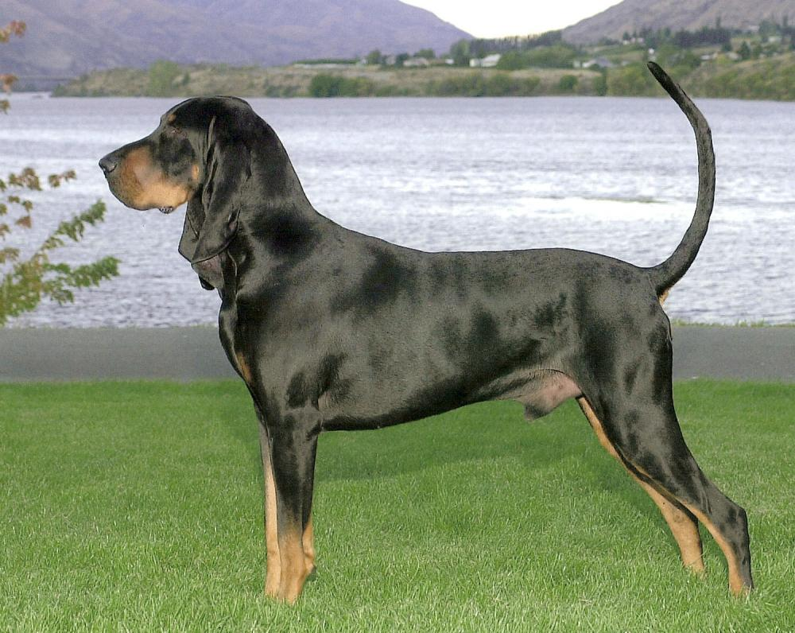
Black and Tan Coonhound

Slide 37
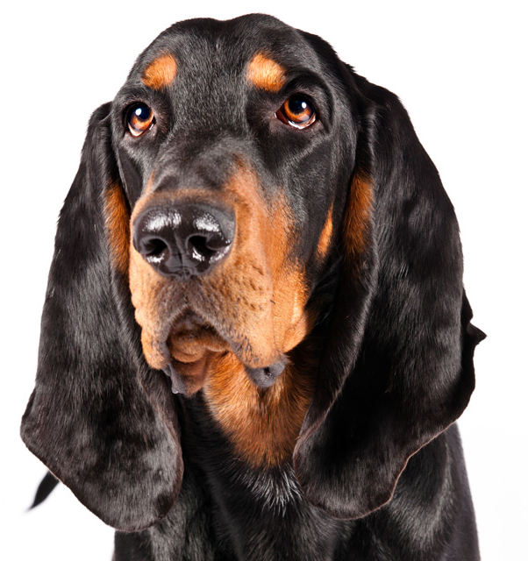
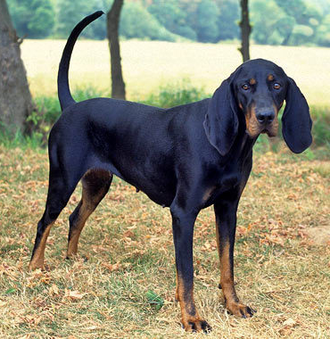
Black and Tan Coonhound
AKC Recognized Colors:
Black and tan
AKC Recognized Markings:
None
Originated in Southern America
Long ears with black and tan coat
Very good at following scent (scent hound)
Often used for trailing and treeing raccoons (like the name suggests)

Slide 38
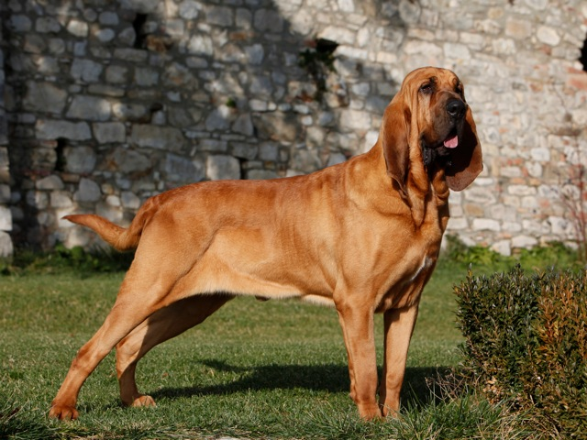
Bloodhound

Slide 39
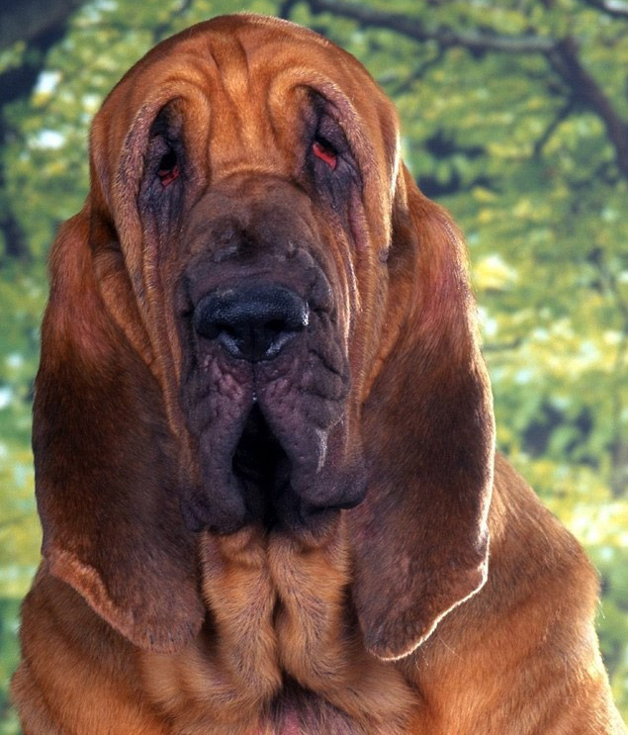
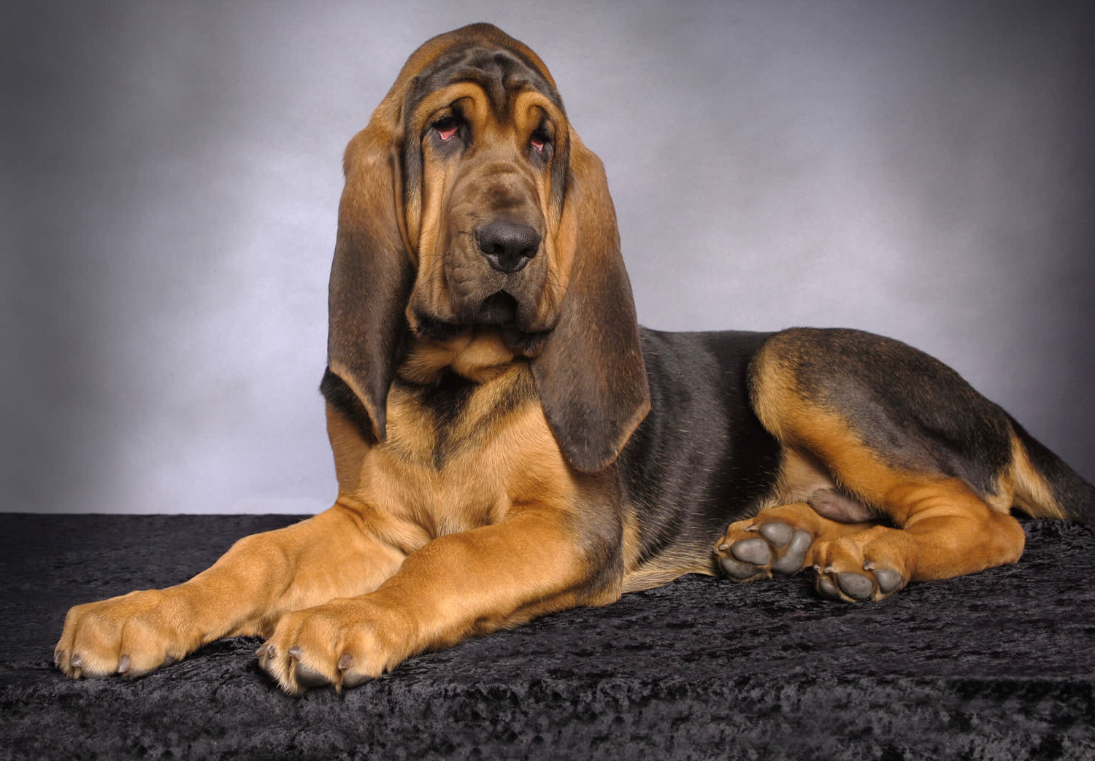
Bloodhound
AKC Recognized Colors:
Black and tan
Liver and tan
Red
AKC Recognized Markings:
None
Originated in France and is the largest scent hound
Originally used to hunt deer and wild boar, and to track people
Large, loose jowls, large snout, and long ears

Slide 40
Baying bloodhound - Fox and the Hound

Slide 41
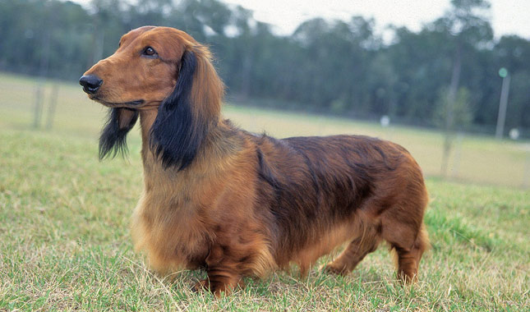
Dachshund

Slide 42
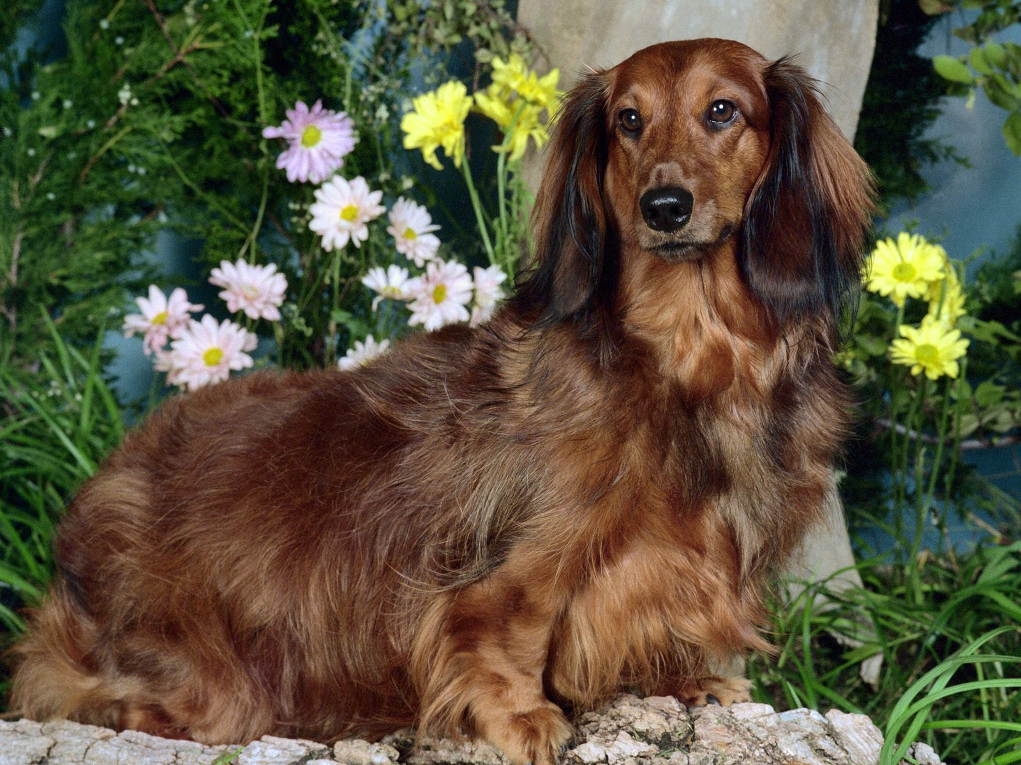
Dachshund
AKC Recognized Colors:
12 recognized colors (there is a wide variety)
AKC Recognized Markings:
Brindle
Dapple
Sable
“Weiner dogs” or Doxins originated in Germany
They have long bodies and ears, short legs, and can have either a long or short coat
Used to hunt many species, including otters, rabbits, badgers, and other burrowing pests
Good scenting ability and loves to dig

Slide 43
Dachshund – Buddy from Secret Life of Pets

Slide 44
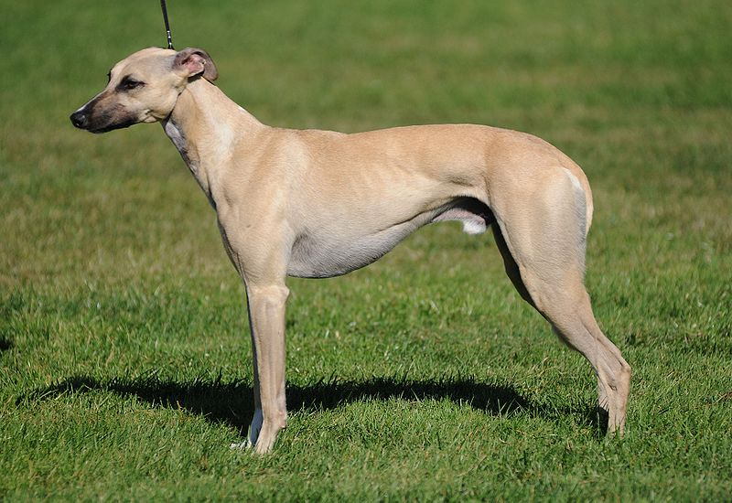
Greyhound

Slide 45
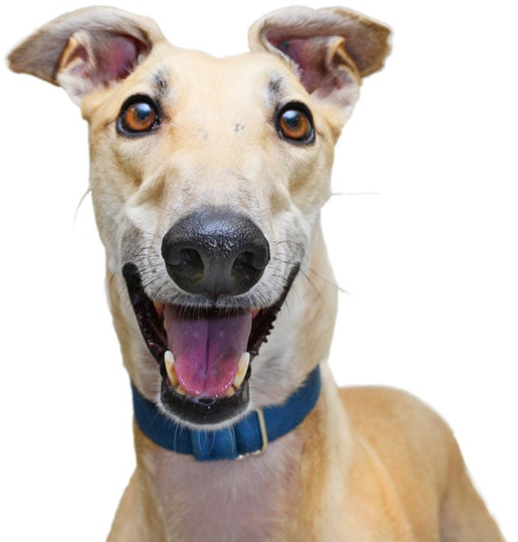
Greyhound
AKC Recognized Colors:
15 recognized colors (there is a wide variety)
AKC Recognized Markings:
Black mask
Parti-color
Solid
Ticked
One of the oldest breeds
Very lean bodies and fast (often used for dog racing)
Sight hounds (use their sight to hunt)
Used to hunt rabbits (mainly), wild boar, stag, deer, and fox

Slide 46
Rhodesian Ridgeback

Slide 47
Rhodesian Ridgeback
AKC Recognized Colors:
9 recognized colors (all variety of wheaten)
AKC Recognized Markings:
None
Developed in Rhodesia (now called Zimbabwe)
Distinctive hair pattern (creating a ridge on its back)
Used to distract lions, allowing hunters to shoot
Also used as bird dogs and guard dogs for livestock and family

Slide 48
Rhodesian Ridgeback – Dogs 101

Slide 49
Non-Sporting Group:
This group varies drastically in size, coat, temperament, and appearance
Kind of a “Miscellaneous” grouping of breeds
Breeds under this group:
Bichon Frise
Boston Terrier
Bulldog
Chinese Shar-Pei
Chow Chow
Dalmatian
Poodle
Notes:
http://www.akc.org/dog-breeds/groups/herding/

Slide 50
Bichon Frise

Slide 51
Bichon Frise
AKC Recognized Colors:
White
White & apricot
White & buff
White & cream
AKC Recognized Markings:
None
Originated in France
Small size and charming personality
Were often used as circus dogs and street performers
Known for their fluffy white coat

Slide 52
Boston Terrier

Slide 53
Boston Terrier
AKC Recognized Colors:
Black & white
Black, brindle, & white
Brindle & white
Seal & white
Seal, brindle, & white
AKC Recognized Markings:
None
The “American Gentleman” originated in Boston, Massachusetts (America)
Little dogs with round heads, large and erect ears, and screw tails

Slide 54
Bulldog

Slide 55
Bulldog
AKC Recognized Colors:
10 recognized colors (wide variety)
AKC Recognized Markings:
6 recognized markings
The breed we know today originated in England from dog breeders who selected for shorter legs and bigger heads
The earliest individuals of this breed were taller and used to grab a bull by the nose and hold him in place (used for actual purposes – ex. castration, and entertainment)

Slide 56
Chinese Shar-Pei

Slide 57
Chinese Shar-Pei
AKC Recognized Colors:
18 recognized colors (wide variety)
AKC Recognized Markings:
7 recognized markings
Originated in southern China
Wrinkly face and body, turned down ears, and curled tail
One of two breeds to have a blue tongue (the other is the Chow-Chow)

Slide 58
Chinese Shar-Pei – Dogs 101

Slide 59
Chow Chow

Slide 60
Chow Chow
AKC Recognized Colors:
Black
Blue
Cinnamon
Cream
Red
AKC Recognized Markings:
None
Originated in China (very old breed)
The second of two breeds to have a blue tongue
Likely descends from the Tibetan mastiff

Slide 61
Dalmatian

Slide 62
Dalmatian
AKC Recognized Colors:
White and black
White and liver brown
AKC Recognized Markings:
None
Originated in Croatia
Unique black and white spotting pattern
These dogs love to run and were often used to run alongside carriages and horseback riders, they discouraged stray dogs from tampering with the horses or carriage

Slide 63
Dalmatian – Separated at Birth Commercial

Slide 64
Poodle

Slide 65
Poodle (standard)
AKC Recognized Colors:
10 recognized colors (there is a wide variety)
AKC Recognized Markings:
None
Originated in Germany
Used as water retrievers
Very popular breed (Especially in France)

Slide 66
Sporting Group:
These breeds are active and alert and have good water and fowl hunting instincts
Many pointers, retrievers, setters, and spaniels are part of this group
Breeds under this group:
Brittany Spaniel
Cocker Spaniel
English Setter
German Shorthaired Pointer
Golden Retriever
Irish Setter
Labrador Retriever
Weimaraner
Notes:
http://www.akc.org/dog-breeds/groups/herding/

Slide 67
Brittany Spaniel

Slide 68
Brittany Spaniel
AKC Recognized Colors:
7 recognized colors (all variations of orange/liver)
AKC Recognized Markings:
None
Originated in France
Pointing breed (a gundog used to find game by stopping and “pointing” its muzzle toward the game)
Medium size, docked tail/tailless, dense coat

Slide 69
Brittany Spaniel – Dogs 101

Slide 70
Cocker Spaniel

Slide 71
Cocker Spaniel
AKC Recognized Colors:
13 recognized colors (there is a wide variety)
AKC Recognized Markings:
Merle
Roan
Flushes out game and retrieves it
Smallest dog in the Sporting Group
Known for cheery disposition, however, poor breeding has caused an increase in bad temperaments
Most popular AKC breed until 1990

Slide 72
English Setter

Slide 73
English Setter
AKC Recognized Colors:
Blue belton
Blue belton and tan (tri-color)
Lemon belton
Liver belton
Orange belton
AKC Recognized Markings:
None
Originated in England
Thought to have originated from crossing pointers and spaniels
Used as a gun dog (hunt birds)
Crouch (or “set”) when they locate birds

Slide 74
German Shorthaired Pointer

Slide 75
German Shorthaired Pointer
AKC Recognized Colors:
8 recognized colors (all black, liver, and white variations)
AKC Recognized Markings:
Patched
Patched & ticked
Ticked
The GSP originated in Germany
Pointing breed
Multipurpose hunting dog
Cross between bird dogs and scent hounds

Slide 76
Golden Retriever

Slide 77
Golden Retriever
AKC Recognized Colors:
Dark gold
Gold
Light golden
AKC Recognized Markings:
None
Originated in Scotland
Versatile breed (hunting dogs, companions, and working dogs)
5th most popular AKC breed

Slide 78
Irish Setter

Slide 79
Irish Setter
AKC Recognized Colors:
Mahogany
AKC Recognized Markings:
None
Originated in Ireland
Known for solid red feathered coat (only recognized color!)
Bird dog with long ears

Slide 80
Labrador Retriever

Slide 81
Labrador Retriever
AKC Recognized Colors:
Black
Chocolate
Yellow
AKC Recognized Markings:
None
Labs originated in Newfoundland
Only three AKC recognized colors (black, yellow, and chocolate) – silver is not recognized by the AKC
Versatile breed – avid water dog and great companion
Ranked the most popular purebred breed for the past 10 years

Slide 82
Labrador Retriever – Dogs 101

Slide 83
Weimaraner

Slide 84
Weimaraner
AKC Recognized Colors:
Blue
Gray
Silver Gray
AKC Recognized Markings:
None
Originated in Germany
Known for silver coat
Mainly used to hunt birds and waterfoul

Slide 85
Weimaraner - Dogs 101

Slide 86
Terrier Group:
Dog breeds with a wide range in size, low tolerance for other animals, and feisty personalities
Descendants from dogs that were bred to kill pests
Breeds under this group:
Bull Terrier
Cairn Terrier
Parson Russell Terrier
Scottish Terrier
West Highland White Terrier
Notes:
http://www.akc.org/dog-breeds/groups/herding/

Slide 87
Bull Terrier

Slide 88
Bull Terrier
AKC Recognized Colors:
13 recognized colors (there is a wide variety)
AKC Recognized Markings:
None
Originated in England (crossing bulldogs and terriers)
White and colored varieties
Strong muscle (from bulldog) and hunting instinct (from terrier), roman nose and large, erect ears

Slide 89
Cairn Terrier

Slide 90
Cairn Terrier
AKC Recognized Colors:
11 recognized colors (there is a wide variety)
AKC Recognized Markings:
Black markings
Black mask
Black points
Originated in Scotland
Coat color can change over time (usually becomes darker as they get older)

Slide 91
Cairn Terrier – Dogs 101

Slide 92
Parson Russell Terrier

Slide 93
Parson Russell Terrier
AKC Recognized Colors:
White
AKC Recognized Markings:
Black
Brown
Cream
Tan
Tri-color
Originated in England
Strong hunting instincts
Main body color is white with colored markings common

Slide 94
Scottish Terrier

Slide 95
Scottish Terrier
AKC Recognized Colors:
Black
Black brindle
Brindle
Red brindle
Silver brindle
Wheaten
AKC Recognized Markings:
None
The Scottie originated in Scotland and England
Purpose was to dig out and kill vermin
Short legs and long body
Most common color is black

Slide 96
West Highland White Terrier

Slide 97
West Highland White Terrier
AKC Recognized Colors:
White
AKC Recognized Markings:
None
Westies originate from Scotland
Small game hunters
Originally found in multiple colors, now white is the only recognized color

Slide 98
Toy Group:
Breeds with a small size and sweet personalities with the purpose of pleasing their owner with their company
Many of these breeds are protective of their owner/s
Breeds under this group:
Cavalier King Charles Spaniel
Chihuahua
Miniature Pinscher
Papillon
Pekingese
Pomeranian
Poodle
Pug
Shih Tzu
Yorkshire Terrier
Notes:
http://www.akc.org/dog-breeds/groups/herding/

Slide 99
Cavalier King Charles Spaniel

Slide 100
Cavalier King Charles Spaniel
AKC Recognized Colors:
Black and tan
Black and white
Blenheim
Ruby
AKC Recognized Markings:
Tan
Bred to be companions, these dogs were favored by royals (especially King Charles of England)
Sweet and affectionate personalities who love to be around people
Long, feathered coat and medium size
19th most popular breed

Slide 101
Cavalier King Charles Spaniel – Dogs 101

Slide 102
Chihuahua

Slide 103
Chihuahua
AKC Recognized Colors:
9 recognized colors (there is a wide variety)
AKC Recognized Markings:
6 markings
Originated in Mexico
Terrier-like attitude (aggressive and active)
Small size, can have a short or long coat

Slide 104
Miniature Pinscher

Slide 105
Miniature Pinscher
AKC Recognized Colors:
Black & rust
Black & tan
Chocolate & rust
Chocolate & tan
Red
Stag red
AKC Recognized Markings:
None
Min Pins originate from Germany
Used as a ratter in barns (despite their excellent ratting abilities, they are not classified as terriers)
Docked tail, erect ears, short coat

Slide 106
Papillon

Slide 107
Papillon
AKC Recognized Colors:
White and black
White and lemon
White and red
White and sable
White, black, and tan
AKC Recognized Markings:
None
Originated from Spain
Papillon = “butterfly” in French (name came from its characteristic butterfly shaped ears)
Long, fine, silky coat

Slide 108
Papillon – Dogs 101

Slide 109
Pekingese

Slide 110
Pekingese
AKC Recognized Colors:
10 recognized colors (there is a wide variety)
AKC Recognized Markings:
Black mask
Parti-color
White
Pekes originated in China
Large head, flat face, long coat
Strong personality that likes to be in charge (despite their small size)

Slide 111
Pomeranian

Slide 112
Pomeranian
AKC Recognized Colors:
18 recognized colors (there is a wide variety)
AKC Recognized Markings:
9 recognized markings
Poms originated in Pomerania (a region or Northern Europe)
Favored by Queen Victoria (Great Britain)
Small size, double-coated, short back

Slide 113
Poodle (miniature)

Slide 114
Poodle (miniature)
AKC Recognized Colors:
10 recognized colors (there is a wide variety)
AKC Recognized Markings:
None
Originated in Germany
Created by breeders who selected for smaller size
Show cuts originate from when the dogs were water dogs, it was used to keep the joints warm in cold water

Slide 115
Pug

Slide 116
Pug
AKC Recognized Colors:
Black
Fawn
AKC Recognized Markings:
None
Originated in China
Largest of the toy breeds, curled tail
Very flat face (leads to snoring and snorting)

Slide 117
Pug – Mel from Secret Life of Pets

Slide 118
Shih Tzu

Slide 119
Shih Tzu (SHEED-zoo)
AKC Recognized Colors:
14 recognized colors (there is a wide variety)
AKC Recognized Markings:
Black
Black mask
Tan
Thought to originate from Tibet
Bred to do nothing (companions) and look cute doing it
Long, silky double coat, tail carried over back

Slide 120
Yorkshire Terrier

Slide 121
Yorkshire Terrier
AKC Recognized Colors:
Black and gold
Black and tan
Blue and gold
Blue and tan
AKC Recognized Markings:
None
Yorkies were used as ratters in England wool-mills
Fierce attitude in a small frame, glossy, fine, silky coat that is long
7th most popular breed in the USA

Slide 122
Working Group:
Bred to work! (ex. guarding, pulling sleds, rescuing people)
Large size and very strong dogs
Breeds under this group:
Bernese Mountain Dog
Boxer
Doberman Pinscher
Great Dane
Great Pyrenees
Mastiff
Newfoundland
Portuguese Water Dog
Rottweiler
Saint Bernard
Siberian Husky
Standard Schnauzer
Notes:
http://www.akc.org/dog-breeds/groups/herding/

Slide 123
Bernese Mountain Dog

Slide 124
Bernese Mountain Dog
AKC Recognized Colors:
Black, rust, and white
Black, tan, and white
AKC Recognized Markings:
None
Berners originated in Switzerland
Pulled milk carts, acted as watchdogs, and drove cattle
Calm and patient temperament, large size (70-120lbs)

Slide 125
Bernese Mountain Dog – Dogs 101

Slide 126
Boxer

Slide 127
Boxer
AKC Recognized Colors:
Brindle
Fawn
AKC Recognized Markings:
Black mask
Black mask, white markings
White markings
Originated in Germany
Sweet but stubborn temperament, docked tail, medium size
10th most popular breed in America

Slide 128
Doberman Pinscher

Slide 129
Doberman Pinscher
AKC Recognized Colors:
Black & rust
Blue & rust
Fawn & rust
Red & rust
AKC Recognized Markings:
None
Dobies originated in Germany
Used as a guard dog
Intelligent and reliable personality, dark body color with rust points, docked tail, erect ears (usually cropped)

Slide 130
Great Dane

Slide 131
Great Dane
AKC Recognized Colors:
9 recognized colors (there is a wide variety)
AKC Recognized Markings:
Black markings
Black mask
White markings
Danes originated in Germany
Designed to hunt boar
One of the largest breeds (110-190lbs), powerful, muscular frame, short coat

Slide 132
Great Pyrenees

Slide 133
Great Pyrenees
AKC Recognized Colors:
White
AKC Recognized Markings:
Badger
Gray
Reddish brown
Tan
Originated in France
Often used for pulling carts and guarding flocks of sheep from predators (large breed)
Descendants of mastiff-type dogs

Slide 134
Mastiff

Slide 135
Mastiff
AKC Recognized Colors:
Apricot
Brindle
Fawn
AKC Recognized Markings:
Black mask
Originated in Central Asia, but the ones we see today originated in England (sometimes called an English Mastiff)
Old breed used to protect estates, hunt, and fight
Large breed, sturdy frame

Slide 136
Mastiff – Dogs 101

Slide 137
Newfoundland

Slide 138
Newfoundland
AKC Recognized Colors:
Black
Brown
Gray
White & black
AKC Recognized Markings:
None
Newfies originated in Newfoundland
Known for their sweet disposition and friendly nature
Loves to swim (make excellent lifeguards), large size, heavy coat, muscular, and strong

Slide 139
Newfoundland – Dogs 101

Slide 140
Portuguese Water Dog

Slide 141
Portuguese Water Dog
AKC Recognized Colors:
Black
Brown
White
AKC Recognized Markings:
White
Porties originated in Portugal
This breed loves water and is a coastal retriever (was important in the fishing industry)
Thick, curly/wavy coat

Slide 142
Portuguese Water Dog – Dogs 101

Slide 143
Rottweiler

Slide 144
Rottweiler
AKC Recognized Colors:
Black and mahogany
Black and rust
Black and tan
AKC Recognized Markings:
None
Rotties originated in Europe during roman times and saved by the Germans
Large head and muscular body
Used by butchers to protect them from robbers and drive cattle to the market

Slide 145
St. Bernard

Slide 146
St. Bernard
AKC Recognized Colors:
9 recognized colors (there is a wide variety)
AKC Recognized Markings:
Black mask
Saints originated in the Swiss valleys
Used to pull carts, guard livestock, and alert the family to danger
Very large breed (130-180lbs) with a short or long coat

Slide 147
St. Bernard - Beethoven

Slide 148
Siberian Husky

Slide 149
Siberian Husky
AKC Recognized Colors:
Agouti & white
Black & white
Grey & white
Red & white
Sable & white
White
AKC Recognized Markings:
Black points
Piebald
Pinto
Originated in America
Designed to pull sleds quickly and over long distances
Many (not all) members of this breed have blue eye(s)

Slide 150
Standard Schnauzer

Slide 151
Standard Schnauzer
AKC Recognized Colors:
Black
Pepper & salt
AKC Recognized Markings:
None
Originated in Germany
All purpose dogs that guarded livestock, killed vermin, and protected the family
Medium size with a beard, feathered coat, and docked tail. Ears can be erect or lay down.

Slide 152
Can you guess the dog breeds? - Up
Alpha (high voice)– Doberman Pinscher, Beta – Rottweiler, Gamma (short) - Bulldog

