Slide 1
Filling a Syringe
PEER Program
Texas A&M University

Slide 2
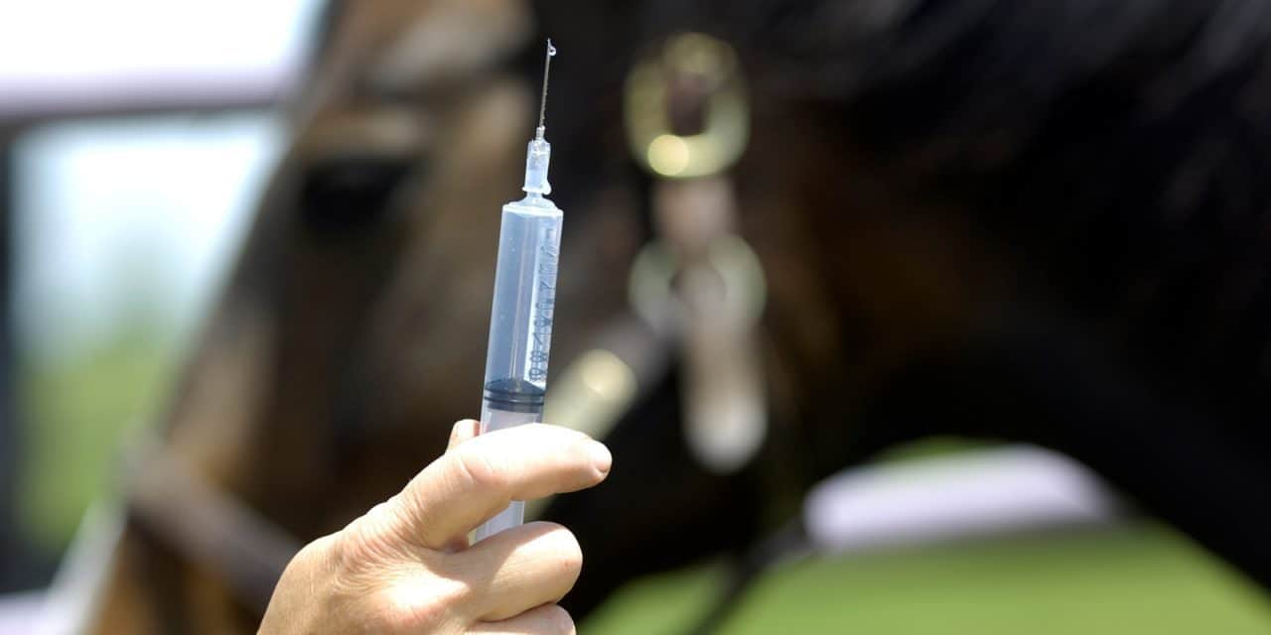
Why is it important to select the right size syringe and needle?
Get the correct dose of medicine
Inject the medication properly
Minimize pain

Slide 3
Syringe Anatomy

Slide 4
Types of Syringe Tips

Slide 5
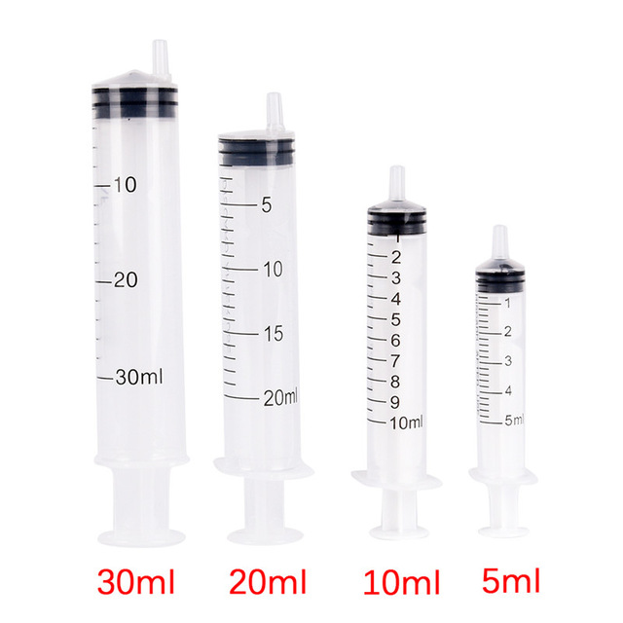
Syringe sizes
Labeled based on how much liquid they can hold
Milliliters (mL) describe liquid volume
Cubic centimeters (cc) describe the volume of solids
1 mL=1 cc
Example:
If you need to give a patient 3 cc of a drug, then you need a syringe that holds exactly 3 cc or a little more. Using a syringe that only holds 2 cc will make you have to inject the patient twice – causing unnecessary pain.

Slide 6
Needle Anatomy

Slide 7
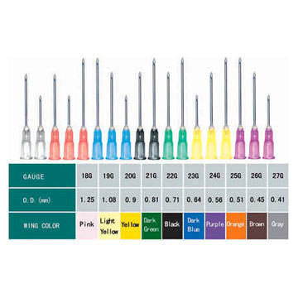
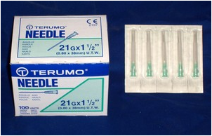
Needle Sizes
Needles are labeled differently than syringes
Package will have a number, then a “G”, and then another number
First number in front of the letter G indicates the gauge of the needle
Higher number = thinner the needle
Second number indicates the length of the needle in inches

Slide 8
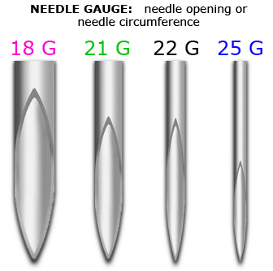
Comparing Needle Gauges
Thin, high gauge needles:
- for small amounts of medication
- less pain
- small animal
Wide, low gauge needles:
- for large amounts of medication
- thick medications like penicillin
- more painful
- larger patients
- faster delivery

Slide 9
Needle Length
Subcutaneous injections: go into the fatty tissue just below the skin. Since these are relatively shallow shots, the needle required is small and short—typically one-half to an inch long with a gauge of 16 to 25
Intramuscular injections: go directly into muscle. Muscle is deeper than the subcutaneous layer of skin, so the needle used for intramuscular injections must be thicker and longer. The size needles that usually are best are 20 or 22 G needles that are an inch or an inch-and-a-half-long

Slide 10
Provided for you to use!

Slide 11
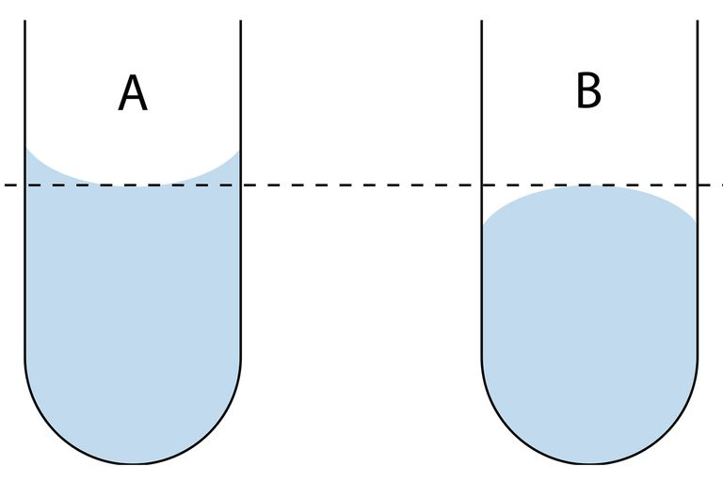
Where should I be measuring the amount of liquid I have?

Slide 12
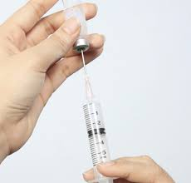
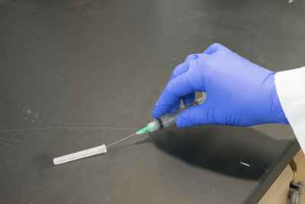
Why do I have to dispose of the needle that I just pulled the medication up with?
The needle is not sterile anymore once it has been inserted through the rubber top
Needle will not be as sharp and could cause pain when inserted into the patient

Slide 13
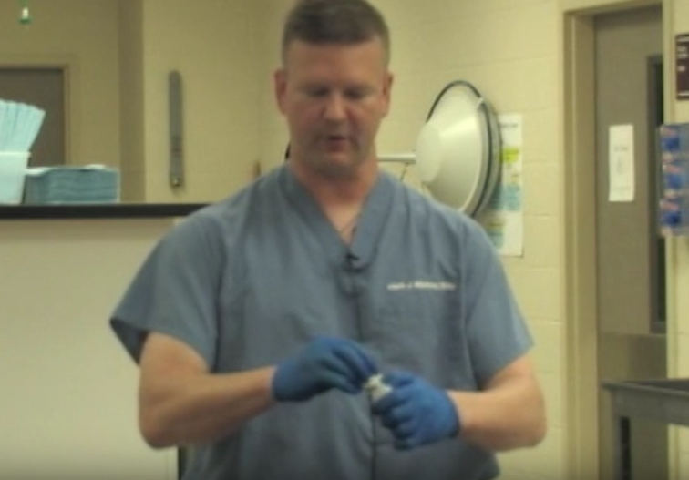
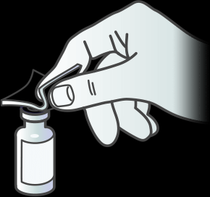
Sterilizing the top of the bottle
Disinfect the surface of the medication bottle
Gets rid of any foreign substance that may make the medication non-sterile
Swab with alcohol if the medication is open or has been sitting on a shelf

Slide 14
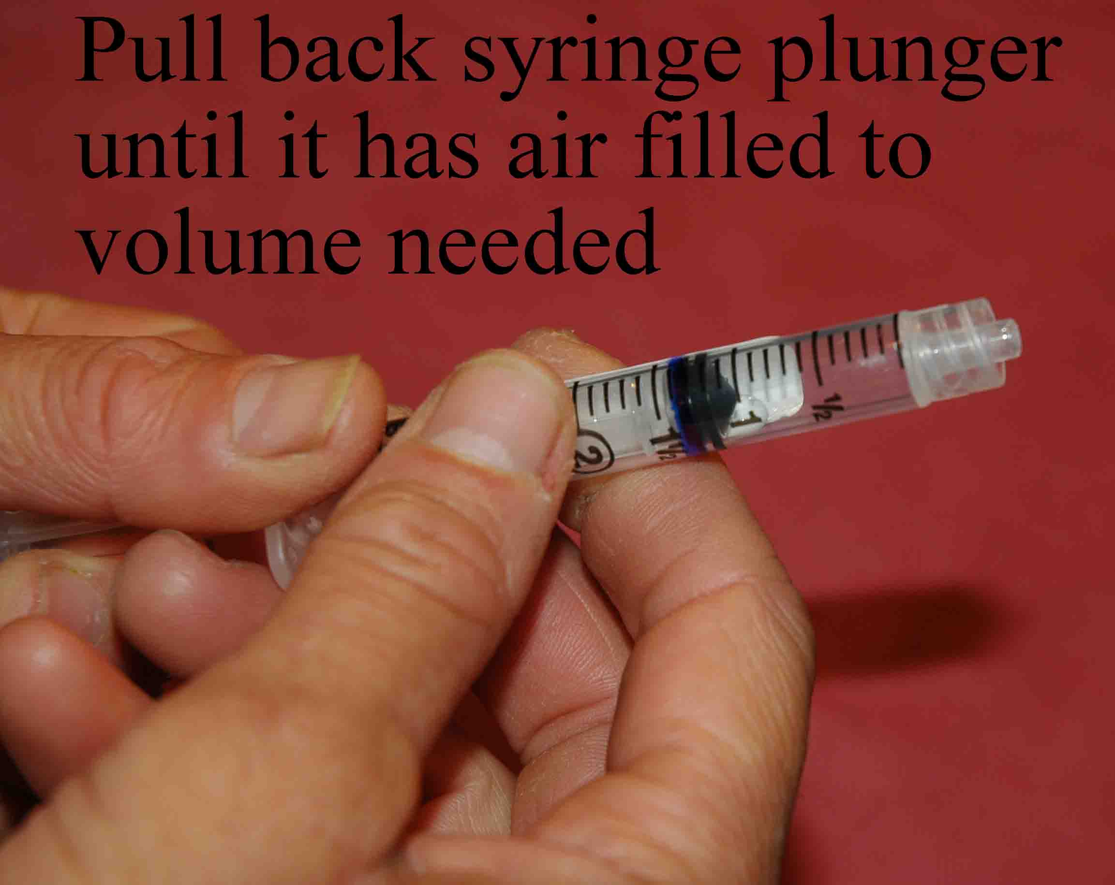
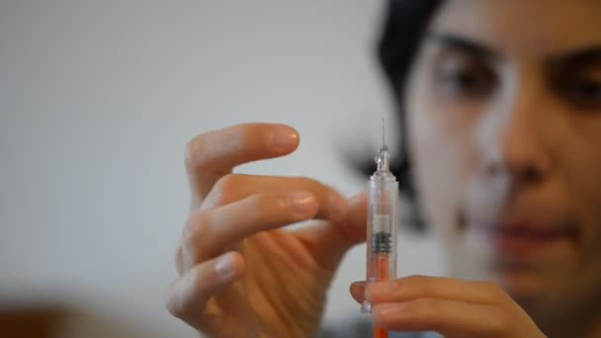
An Airy Situation: Air in the Syringe
Prevents a vacuum from forming when trying to pull up the medication
Too little air: will be hard to pull back the plunger
Too much air: medication may be forced out of the syringe
Remove any air bubbles after the medication has been drawn up

Slide 15
Practice Time!

