Slide 1
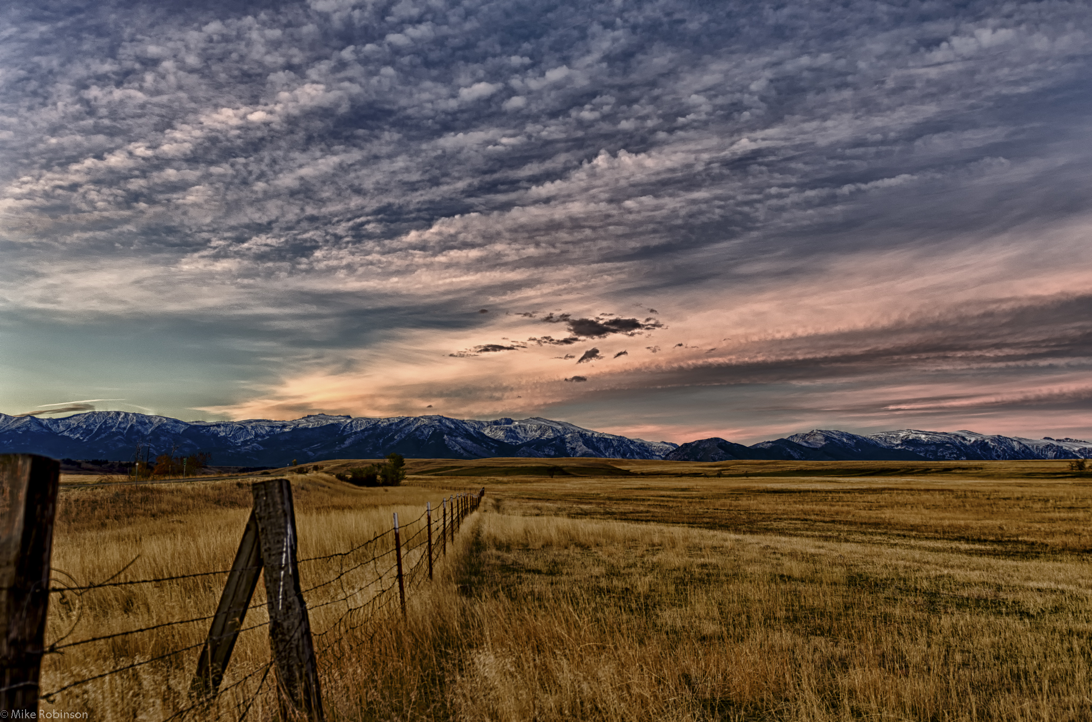
Livestock Breeds:
Cattle, goats, sheep, swine
© Partnership for Environmental Education and Rural Health at
College of Veterinary Medicine & Biomedical Sciences, Texas A&M University
Funding support from the National Institutes of Health Office of Research Infrastructure Programs (ORIP)

Slide 2
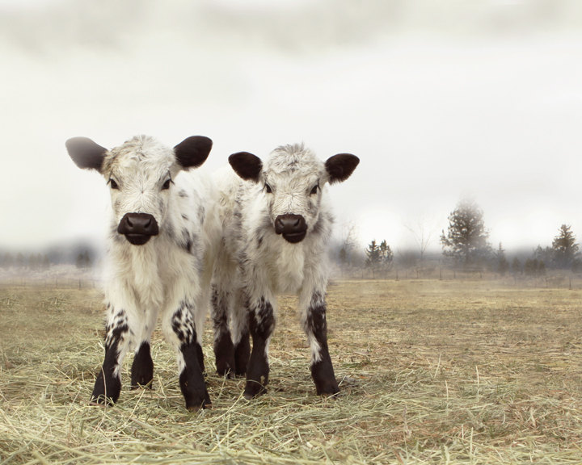
Cattle Breeds

Slide 3
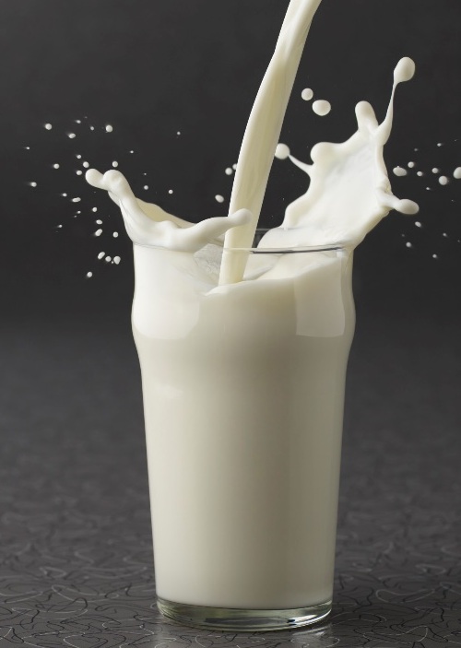
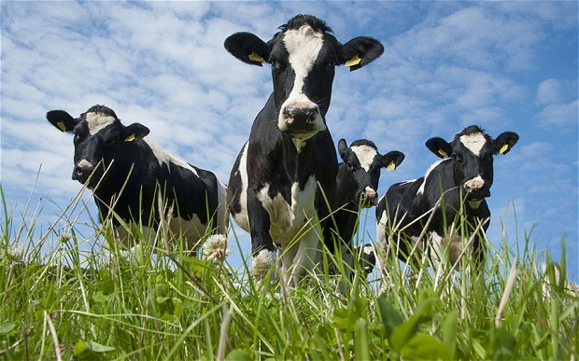
Dairy Cattle:
Dairy cattle are used to produce milk
These breeds produce a high volume of milk or have a high butterfat percentage in their milk
The cows are more valuable to the dairy farmers than the bulls (in large numbers)
There are five main breeds of dairy cattle in the US:
Ayrshire
Brown Swiss
Guernsey
Holstein
Jersey
Holstein and Jersey cattle are the two most popular breeds in the U.S.

Slide 4
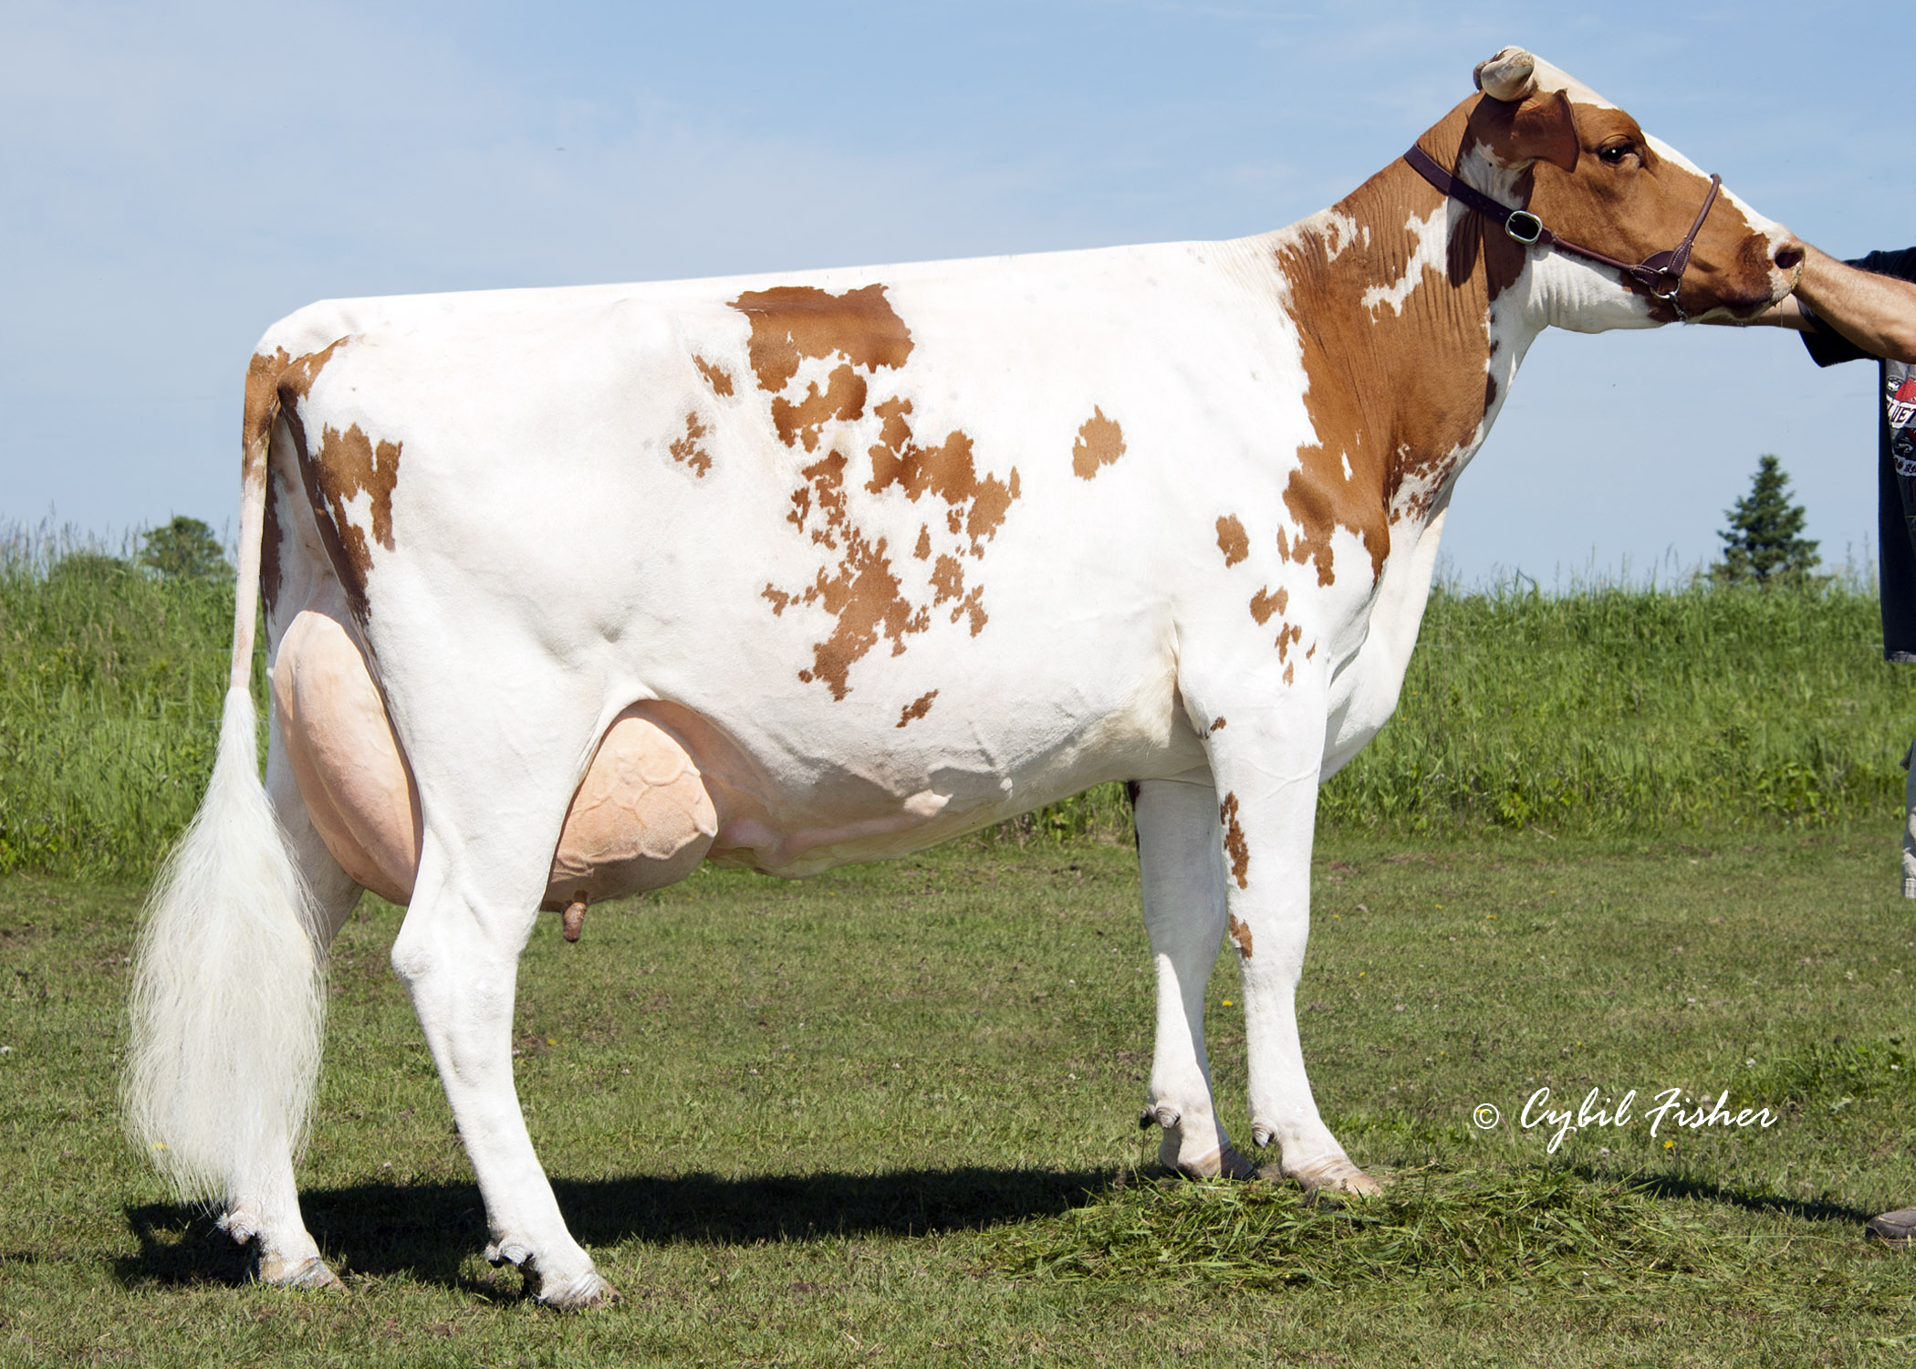
Ayrshire

Slide 5
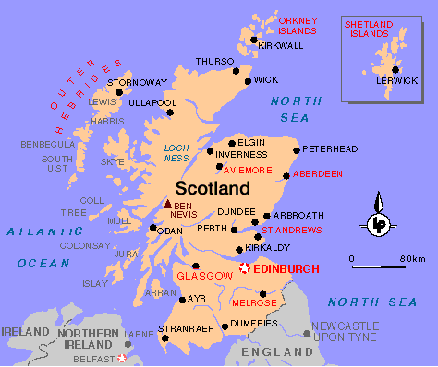
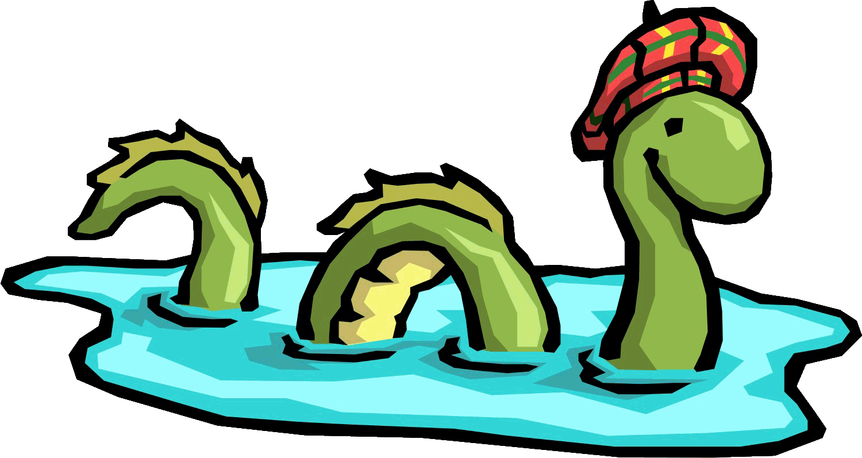
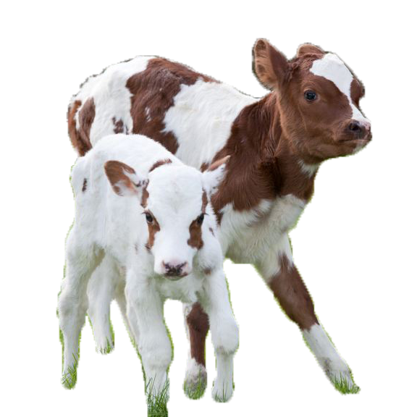
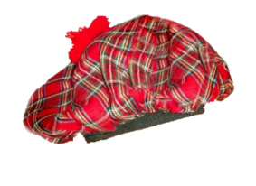
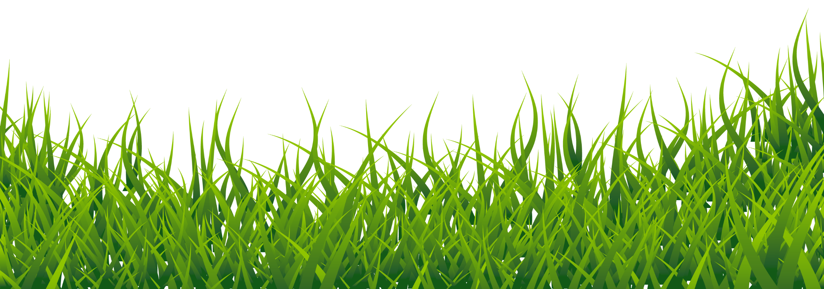
Ayrshire (Scotland)
Medium/dark red and white coat (darker than Guernsey)
Medium sized breed
Large variation in color patters (can be almost all red or almost all white)
Spots are usually jagged and small
Known for being excellent grazers
Can be used on pasture dairy’s

Slide 6
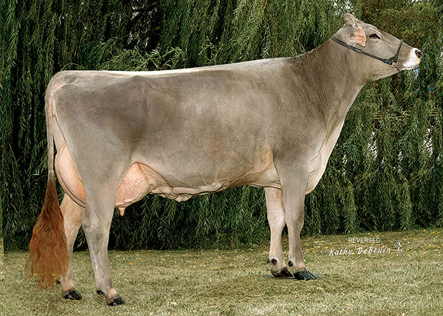
Brown Swiss

Slide 7
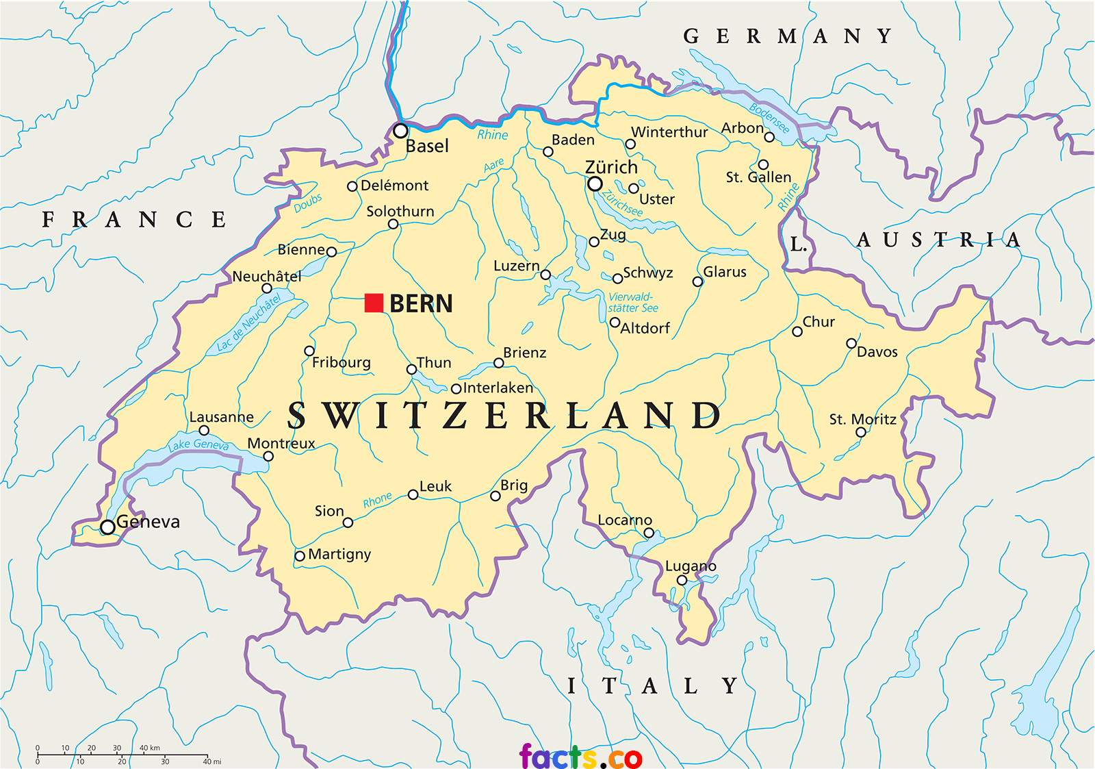
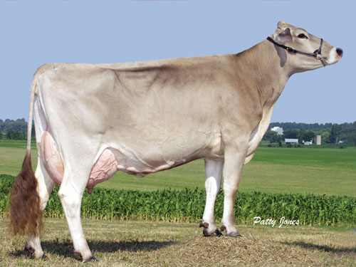
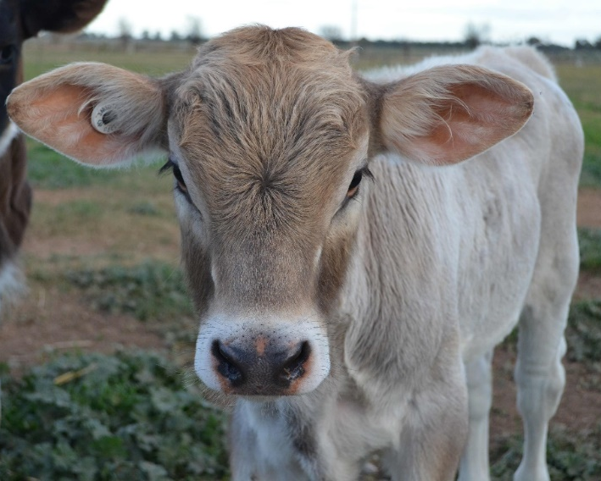
Brown Swiss (Switzerland)
Brown Swiss cows have a brown coat of various shades, often with a silvery tone (don’t have dark points like Jersey)
Large frame
Hooves, muzzle, and switch are usually black
Known for longevity
Long life expectancy
Strong legs and hooves

Slide 8
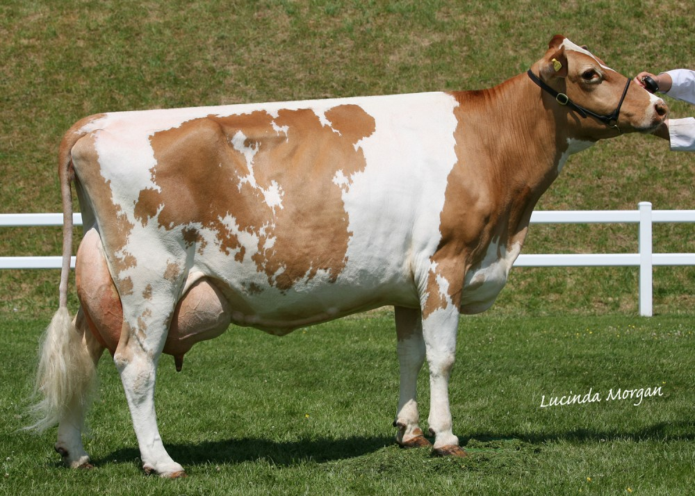
Guernsey

Slide 9
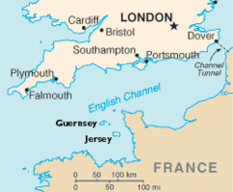
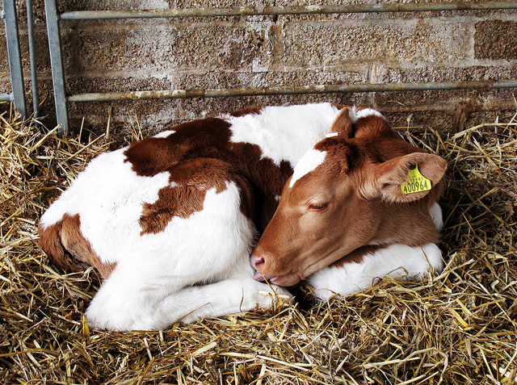
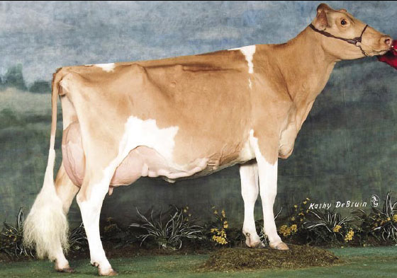
Guernsey (Isle of Guernsey – England)
Guernsey are various shades of fawn and have white markings with a white switch (lighter than Ayrshire)
Medium frame
Second highest butterfat percentage
Can be completely solid fawn color to almost all white
Known for golden colored milk
Notes:
The golden color is due to high beta-carotene concentrations (like carrots!)

Slide 10
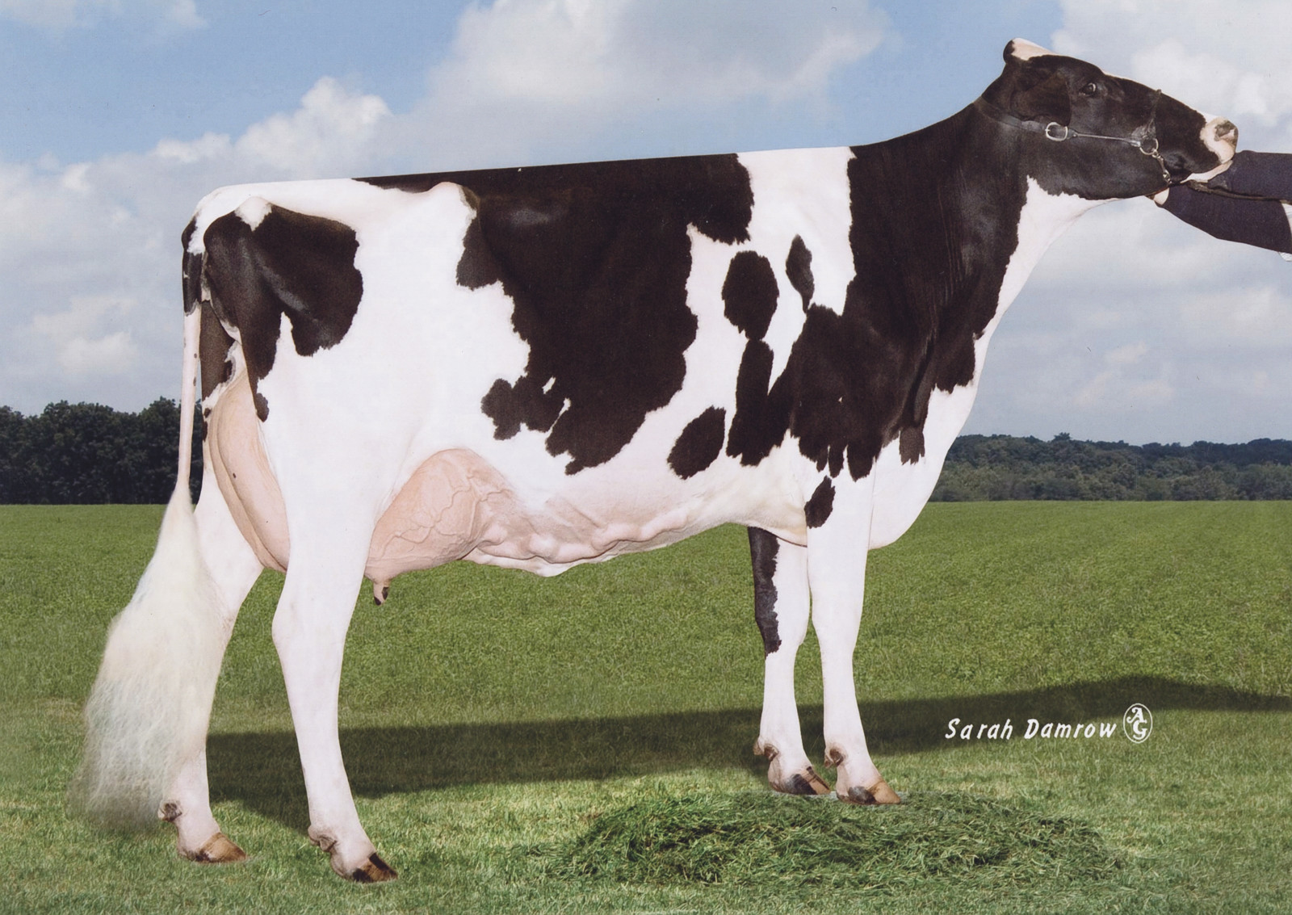
Holstein

Slide 11
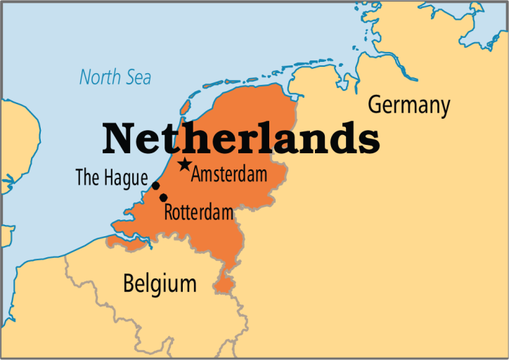
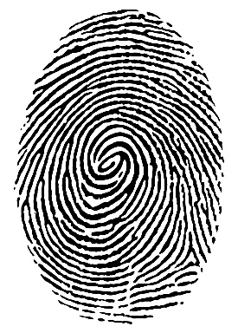
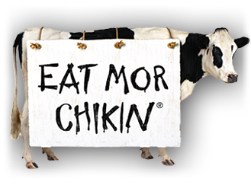
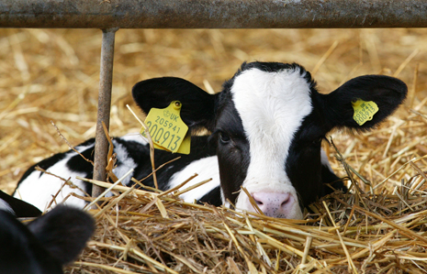
Holstein (Netherlands)
Holsteins are the black and white cows that you typically think of
Like the chick-fil-a cow!
Spotted with a unique pattern (like a thumbprint!)
Most popular milking cow
Known for volume of milk produced
approx. 20,000lbs in 305 days
Notes:
Holsteins produce more gallons of milk on average than any other breed of cattle!

Slide 12
Happy Cows Commercial

Slide 13
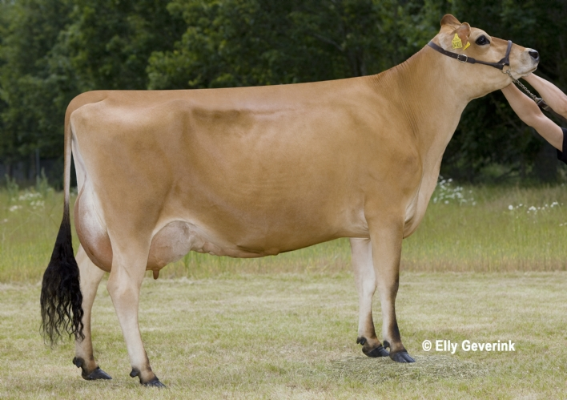
Jersey

Slide 14
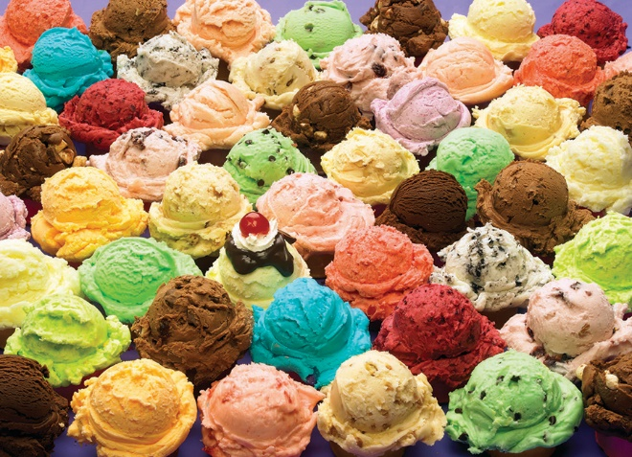
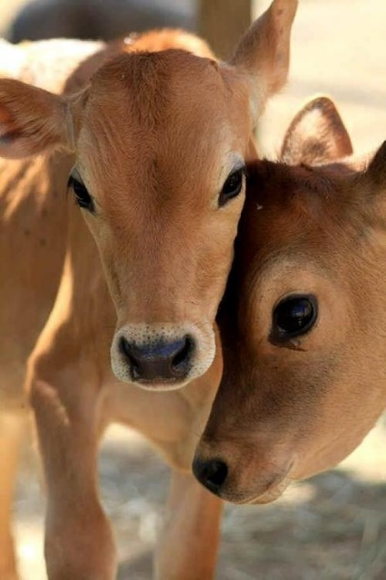
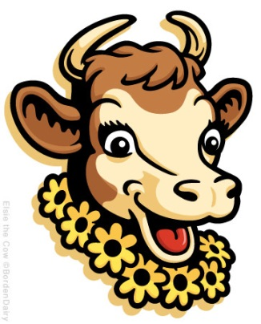
Jersey (Isle of Jersey - England)
Jersey cows are brown (light tan to dark fawn) with darker points around the head and legs
Like Borden’s Elsie!
Adapted for a warmer climate (popular in the south)
Smaller frame and feminine features (ex. big eyes)
Known for producing high butterfat content in milk (approx. 5%)
Butterfat is desirable for flavor
My high butterfat helps your ice cream taste good!

Slide 15
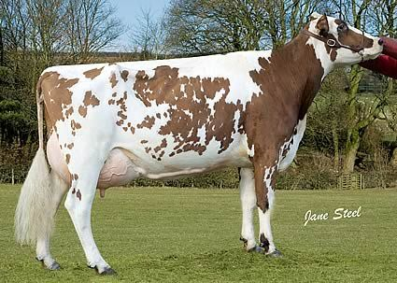
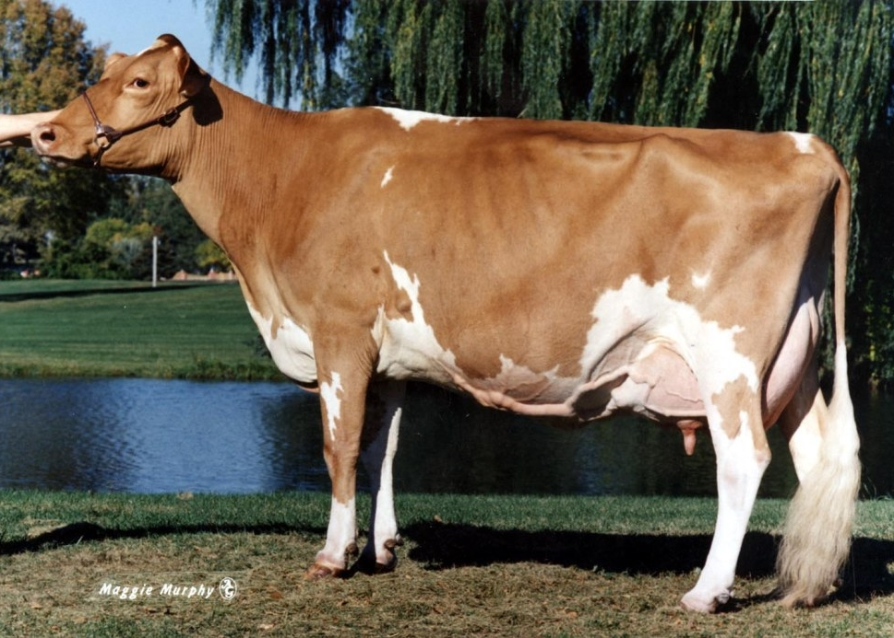
Ayrshire vs. Guernsey
Ayrshire: darker colored spots (usually a liver color)
More broken spotting
Guernsey: lighter colored spots (usually sand/tan color)
Ayrshire
Guernsey

Slide 16
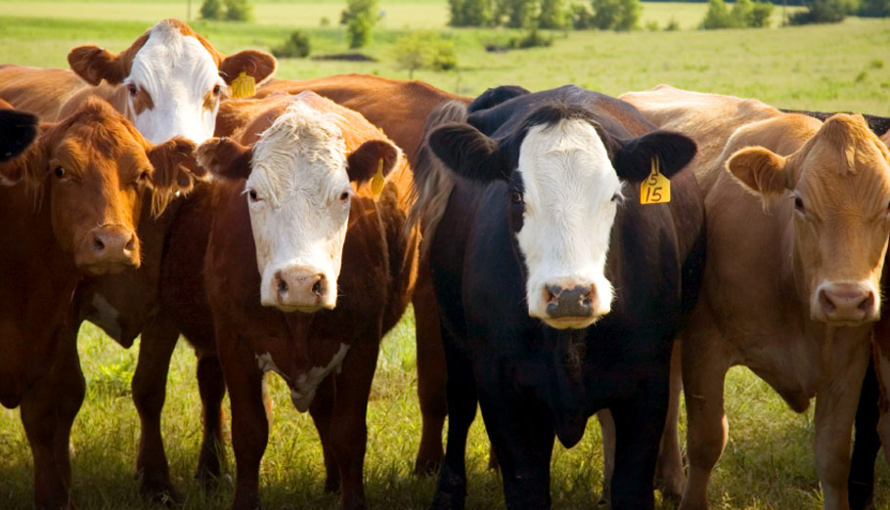
Beef Cattle:
Raised for meat (beef) production
These breeds usually have high marbling ability and easily lay on muscle/fat
There are two main types of beef cattle breeds:
Bos Taurus
British breeds
Exotic breeds
Bos Indicus

Slide 17
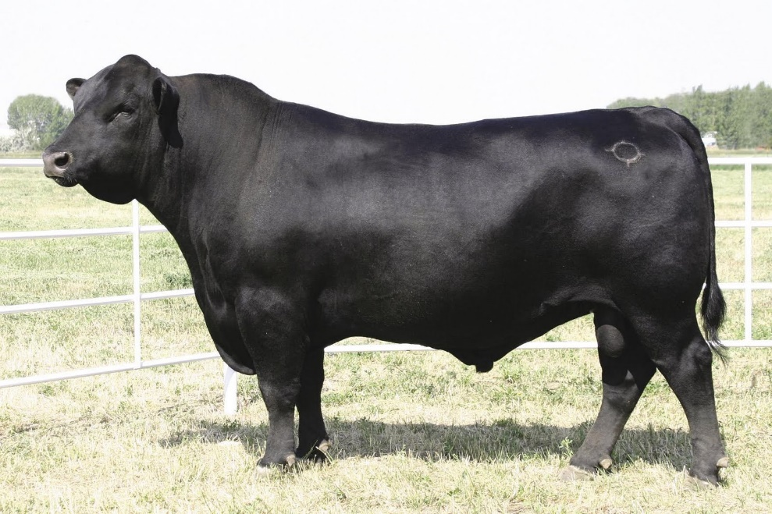
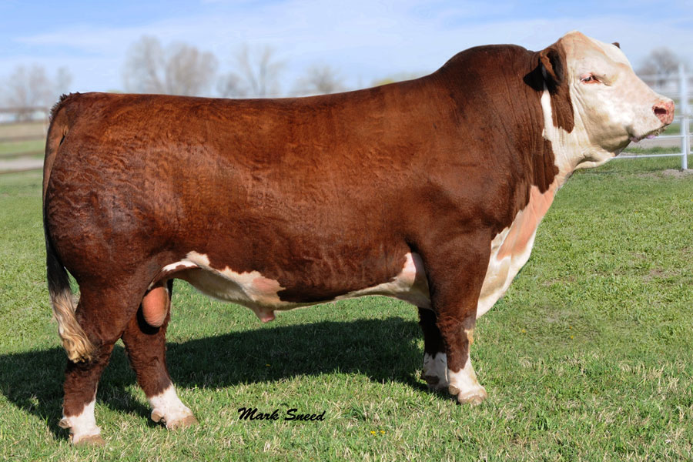
British (maternal) Breeds
These breeds fall under the Bos Taurus category
Generally smaller than exotic breeds
Developed in the British Isles
You should be able to identify the following breeds:
Angus
Hereford
Shorthorn

Slide 18
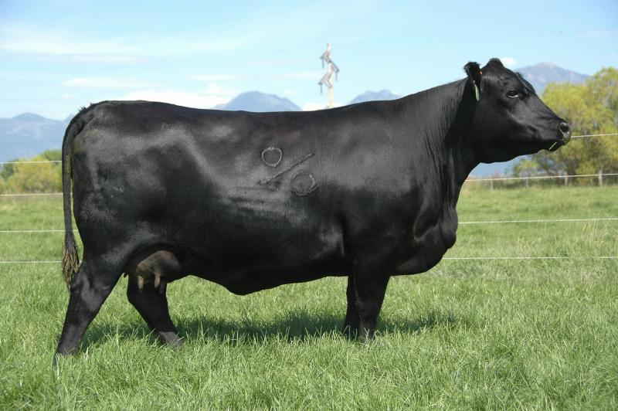
Angus

Slide 19
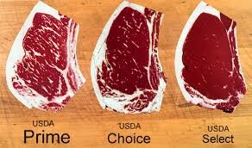
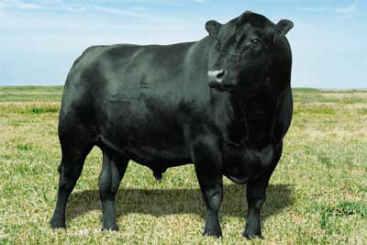
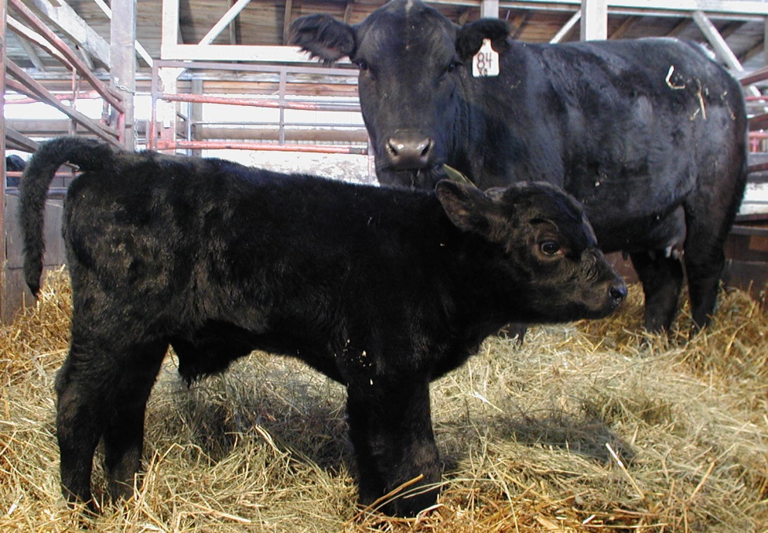
Angus (Scotland)
Marbling is a highly desirable trait in beef cattle, it increases the grade of the meat (Prime > Choice > Select)
Black coat (Red Angus is a different breed!)
ALL Naturally polled (no horns)
Superior marbling ability (hence Certified Angus Beef)
Muscular and compact

Slide 20
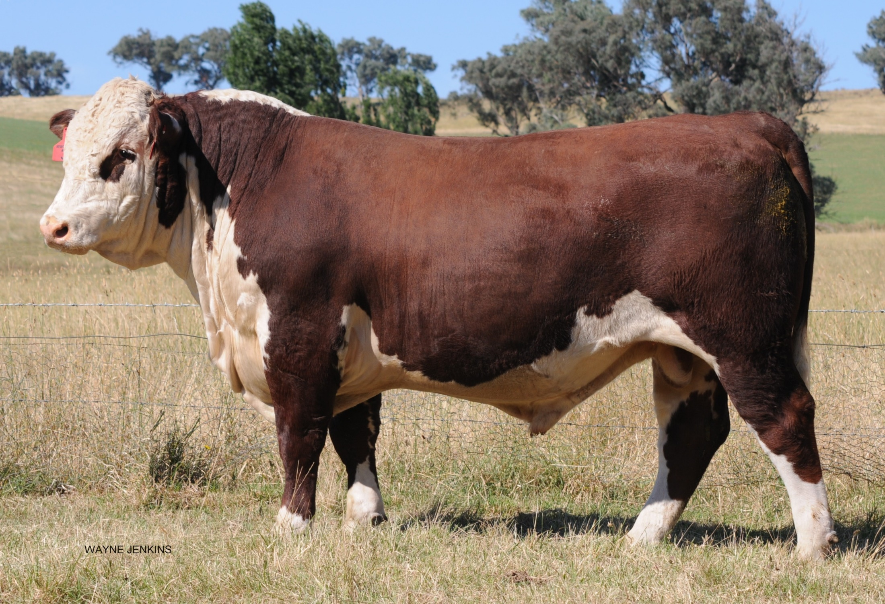
Hereford

Slide 21
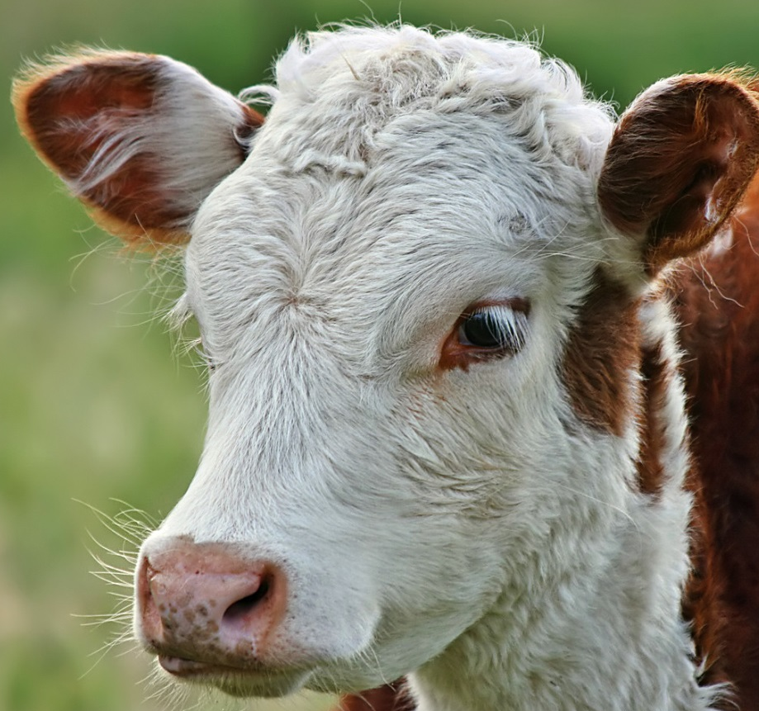
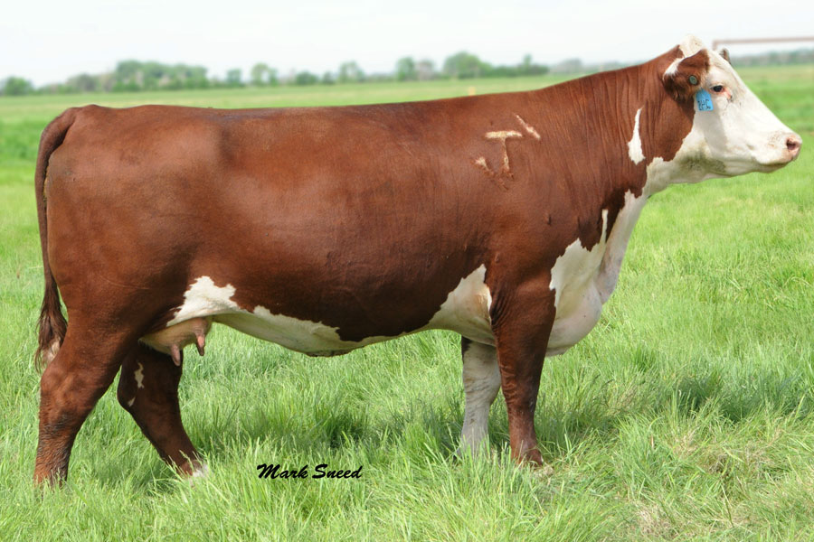
Hereford (England)
Red and white coat color
White on face, all four feet, switch, and underline
High foraging ability
Naturally horned or polled

Slide 22
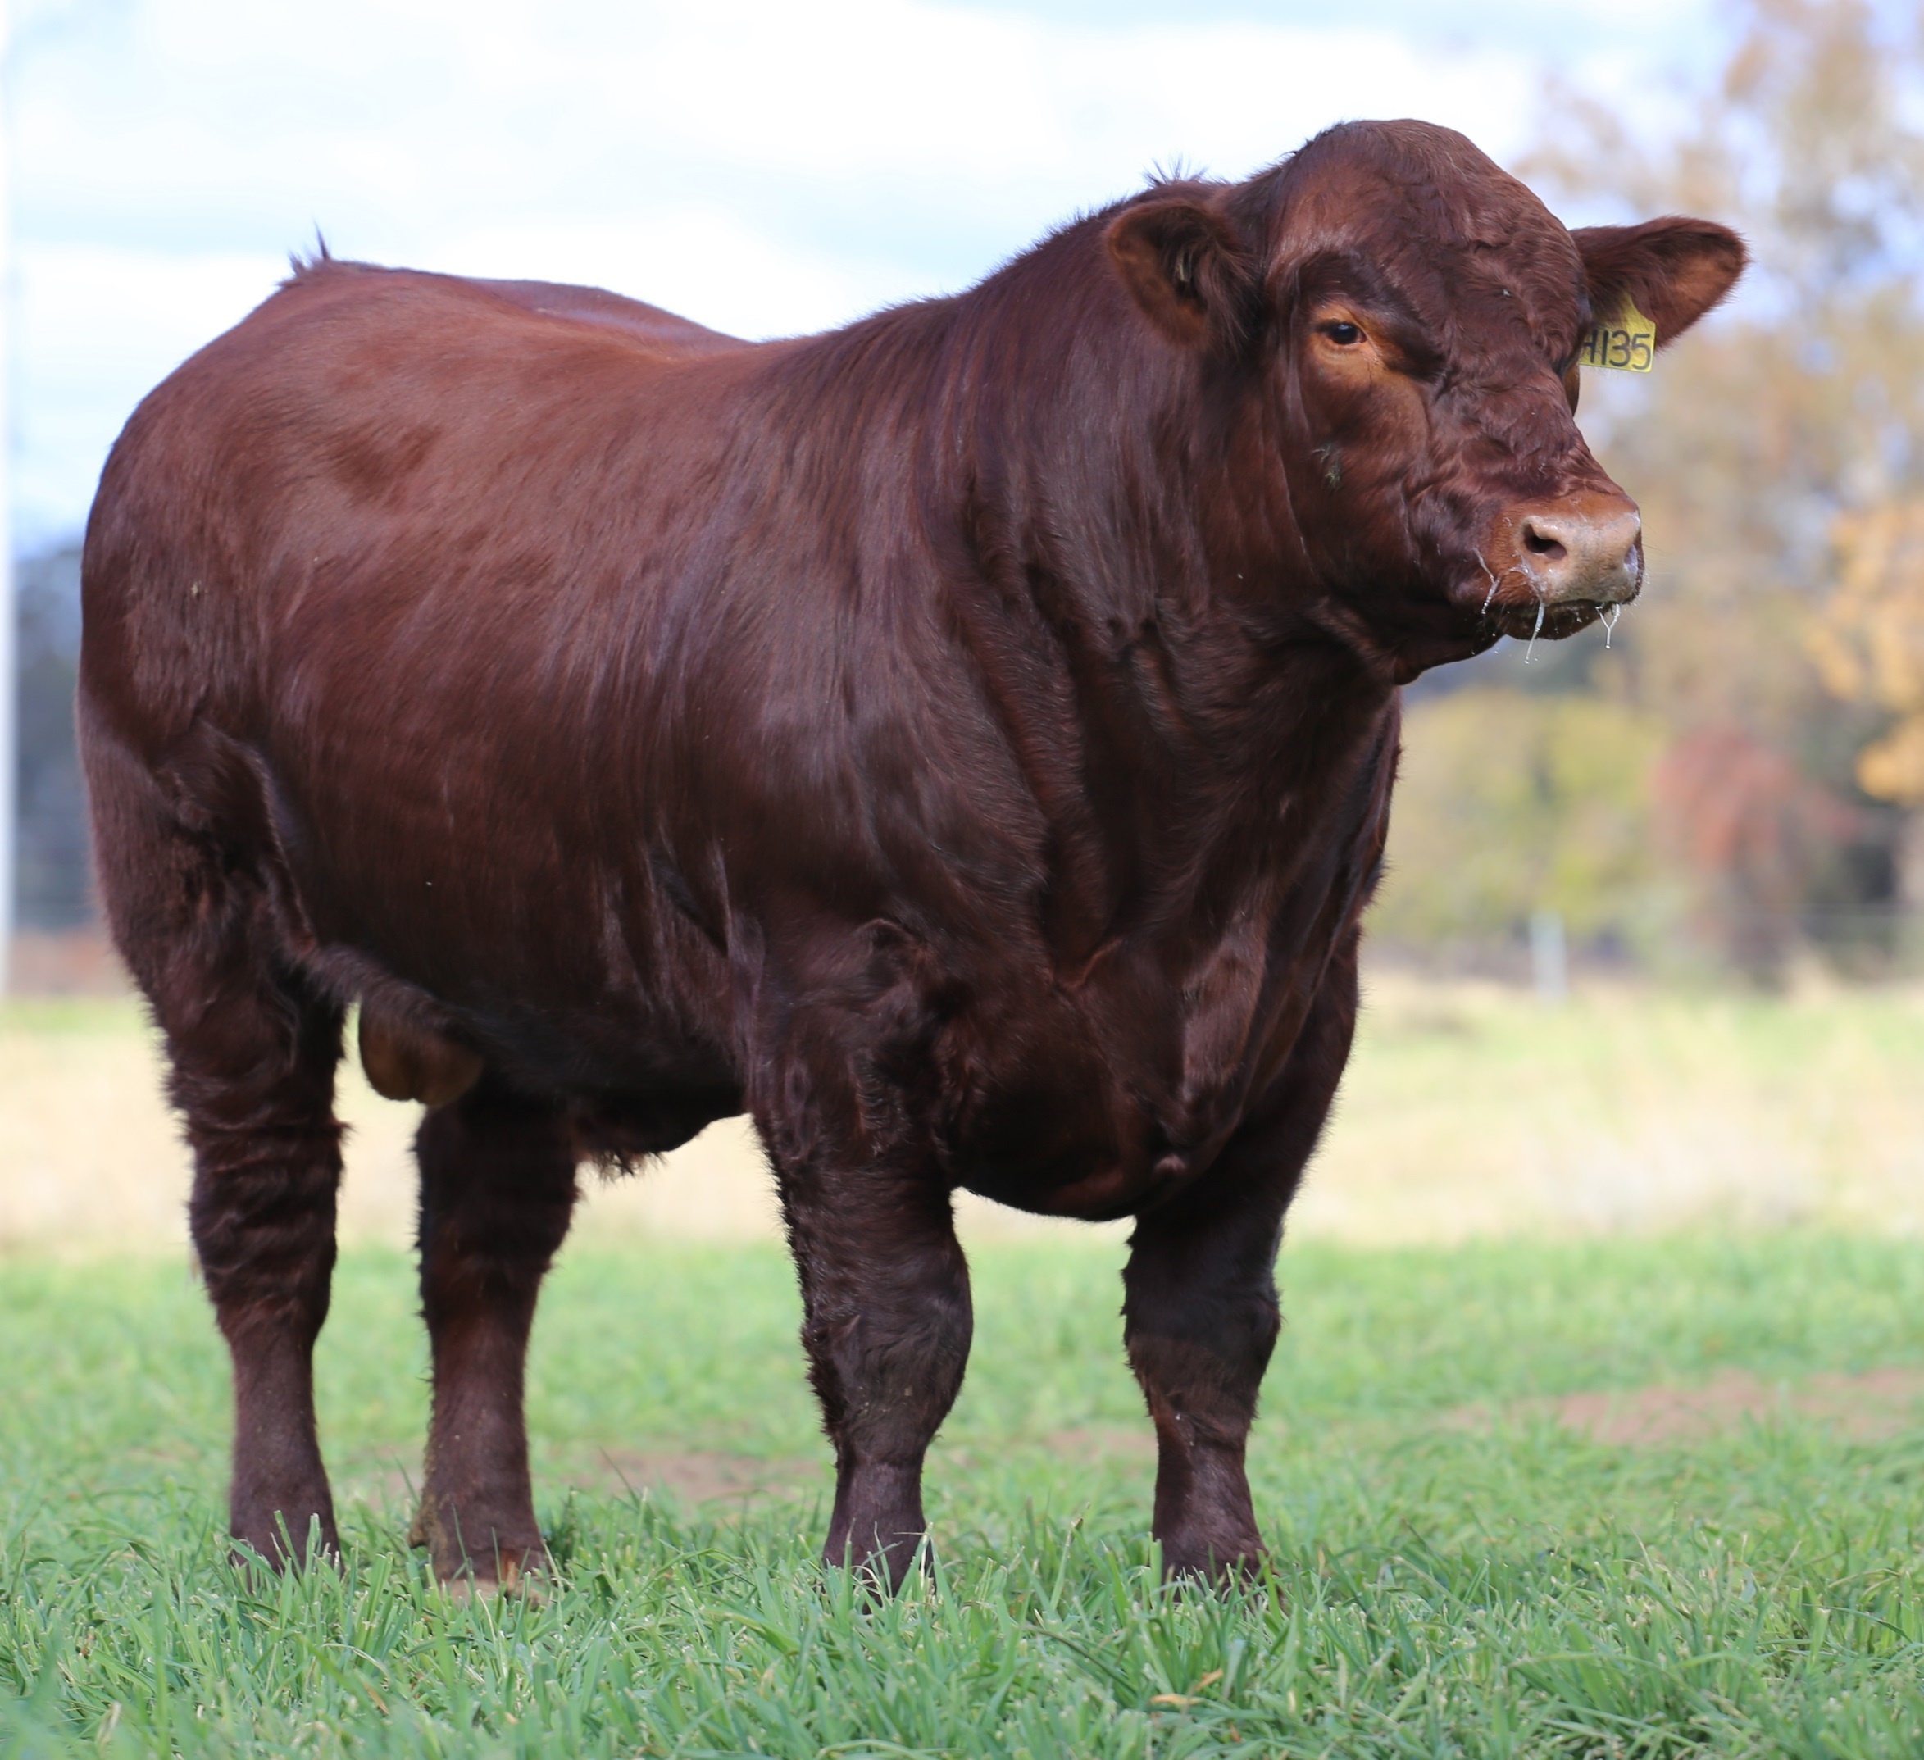
Shorthorn

Slide 23
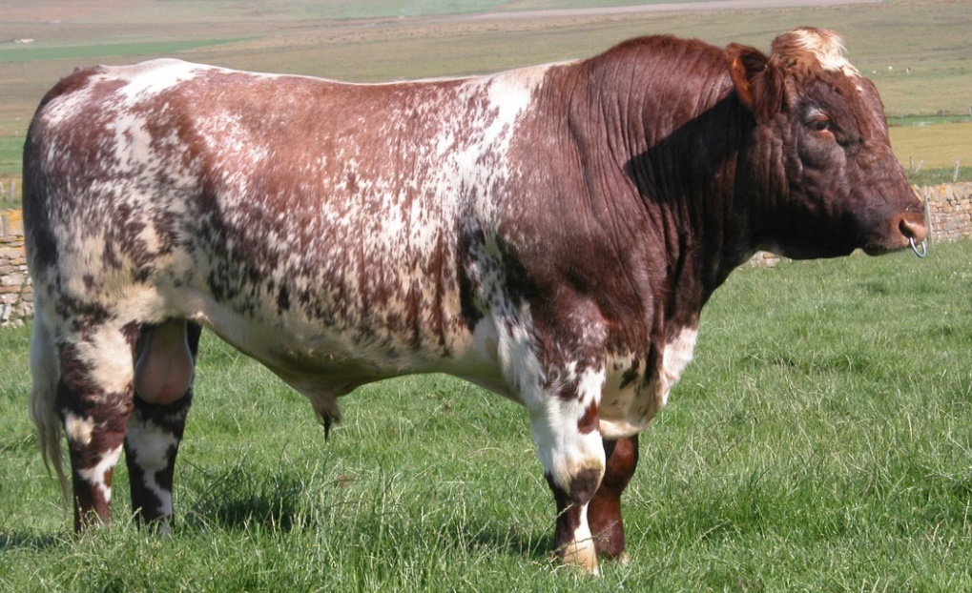
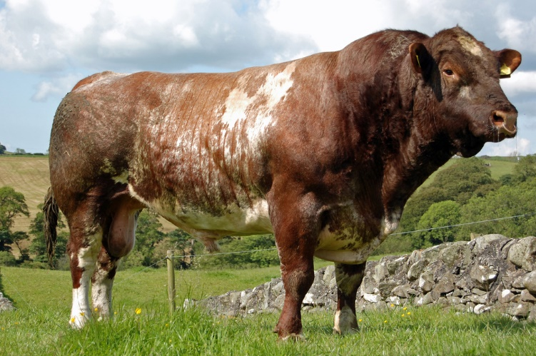
Shorthorn (England)
Red, white, or roan coat color
Naturally polled or horned
Good marbling ability

Slide 24
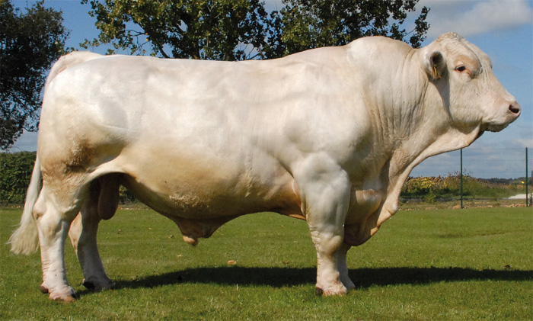
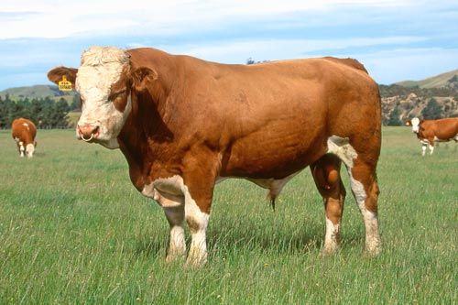
Exotic (Sire) Breeds
High growth rate and leanness
Larger in size than British breeds and produce less fat
You should be able to identify the following breeds:
Charolais
Simmental

Slide 25
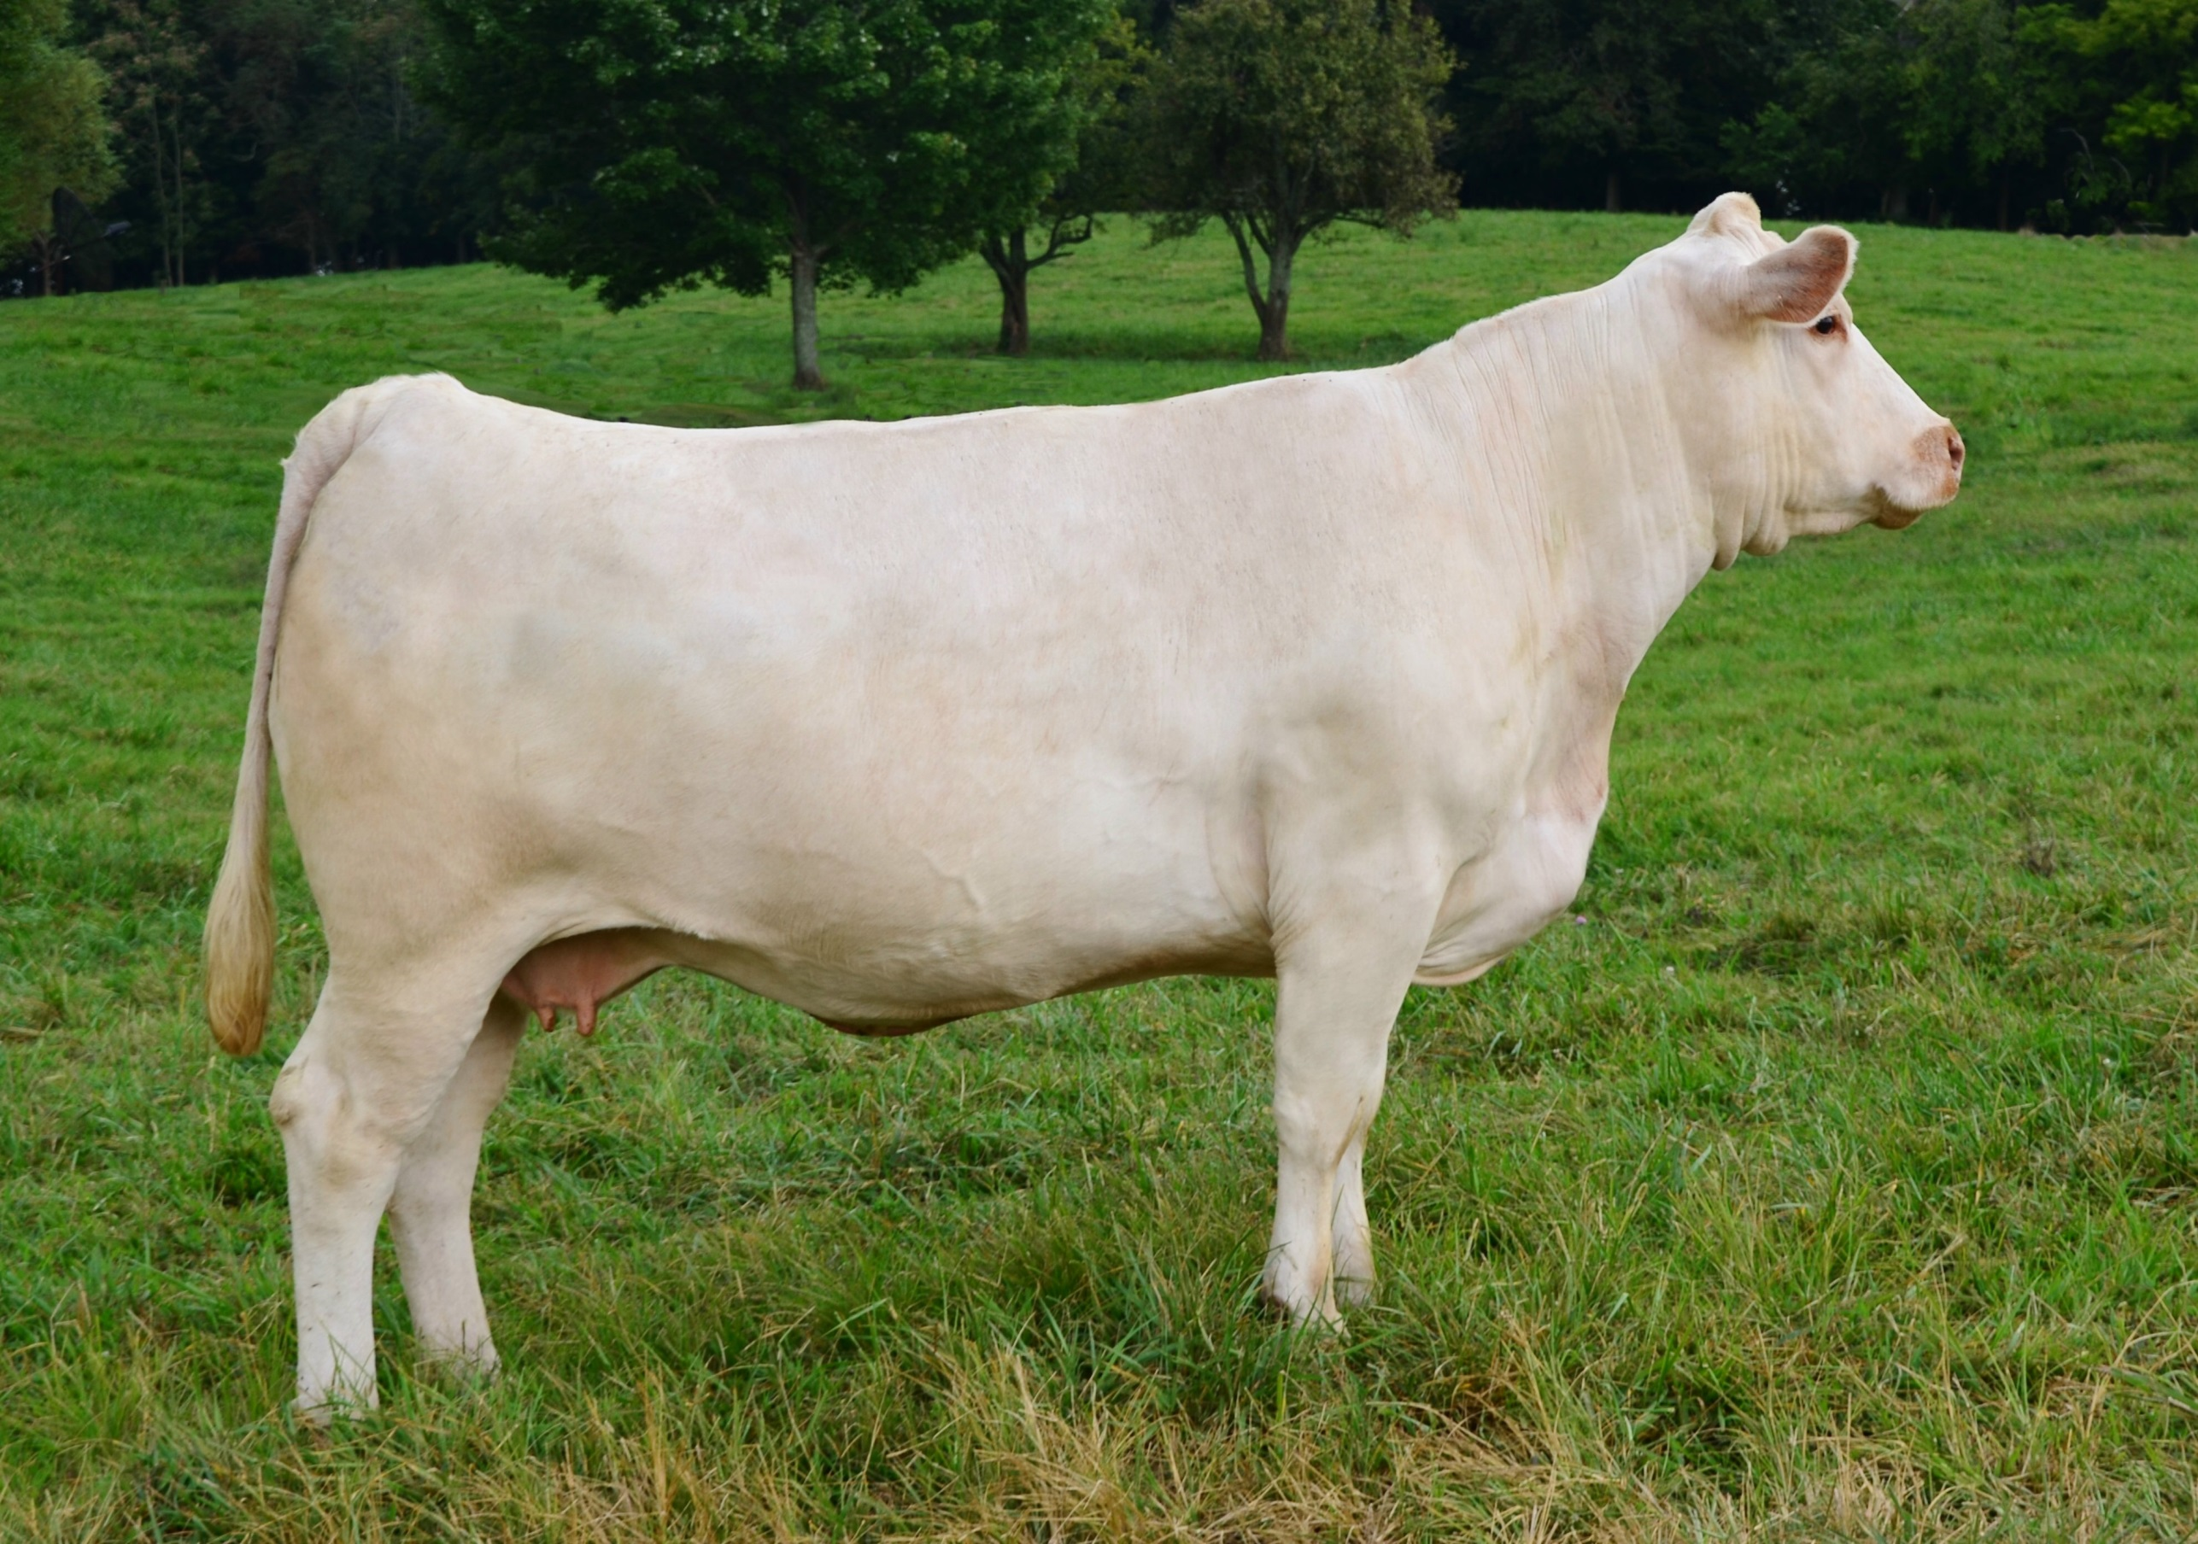
Charolais

Slide 26
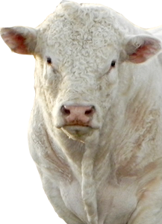
Charolais (France)
Coat is white to light straw color
Large frame with long bodies
Naturally horned or polled
White skin pigmentation with tan colored noses
Heavy muscling

Slide 27
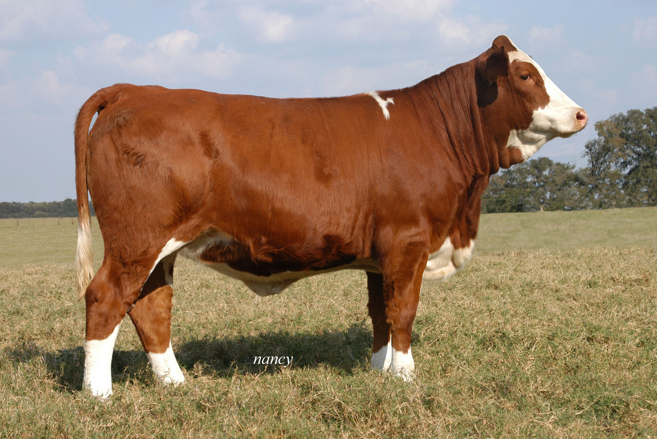
Simmental

Slide 28
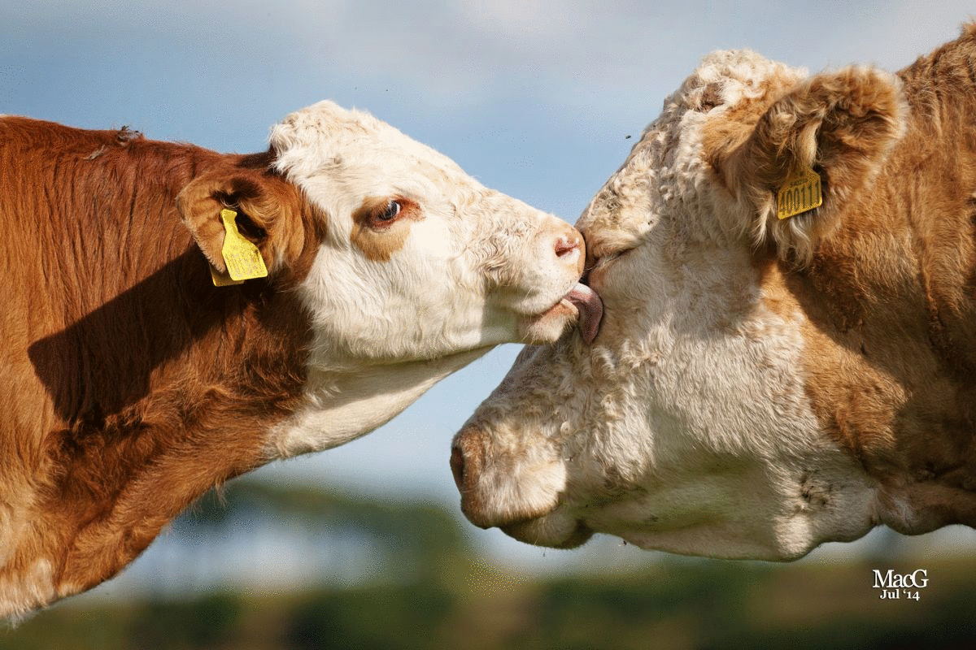
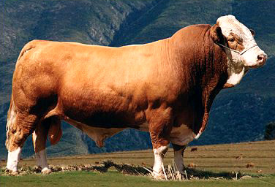
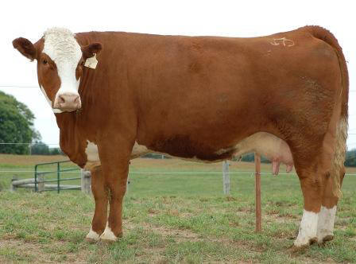
Simmental (Switzerland)
Brown, straw, or red coat color. Can be solid or have white markings/spotting on the legs, brisket, face, switch, underline, and back.
Naturally horned
Often have red pigmentation around the eyes
Notes:
Make sure the students can identify the difference between Herefords and Simmental!!!

Slide 29
Hereford vs. Simmental
Hereford: Red with white markings on the face, underline, legs, and switch
All four legs should have white on them
The white on the face should connect to the white on the underline with a white strip down the neck and brisket
White curled around the ears
Simmental: Straw to red and many have white markings (some are solid)
Will almost always have coloration around the eyes that matches the color of the body
If present, white on the face WILL NOT connect to the white on the underline down the brisket and neck

Slide 30
Bos Indicus Breeds
These breeds have humps between their withers and originated from India
Known for their heat tolerance
Lots of loose skin, especially around their neck and brisket
You should be able to identify the following breeds:
Brahman

Slide 31
Brahman

Slide 32
Brahman (USA - Texas)
Descendant from Indian cattle breeds
Gray or red coat color
Black skin pigmentation (black noses and hooves)
Lots of loose, excess skin with “hump” over withers
Extremely heat tolerant
Large, droopy ears. Naturally horned or polled

Slide 33
Goat Breeds

Slide 34
Goat Breeds
You will need to be able to identify the following goat breeds:
Alpine
Angora
Boer (NOT boar!)
LaMancha
Nubian
Saanen
Toggenburg
All goats are naturally horned!

Slide 35
Buttermilk the Goat:

Slide 36
Alpine

Slide 37
Alpine (French Alps)
Medium-large size (>135lbs - female, >170lbs - male)
Erect ears with straight face
Many color variations
Dairy goat breed

Slide 38
Angora

Slide 39
Angora (Turkey)
Lop ears
White hair
Known for mohair production
Mohair is thinner and smoother than wool

Slide 40
Boer

Slide 41
Boer (South Africa)
Lop ears
Large size, often grow to be 300lbs!
Brown/red on head and around neck with a predominantly white body
Meat breed

Slide 42
LaMancha

Slide 43
LaMancha (USA - Oregon)
Originated from Spanish breeds
Distinctive ears, either “gopher ears” or “elf ears”
Both types of ears are nonexistent or very short
Variety of colors seen
Dairy goat breed

Slide 44
Nubian

Slide 45
Nubian (England)
Medium-large size (>135lbs - female, >175lbs - male)
Lop ears with convex (roman) nose
Many color variations
All-purpose breed (used for milk and meat)

Slide 46
Saanen

Slide 47
Saanen (Switzerland)
Erect ears with straight or dished face
White or light cream in color (white preferred)
Dairy goat breed

Slide 48
Toggenburg

Slide 49
Toggenburg (Switzerland)
Erect ears with straight or dished face
Light fawn to chocolate color with distinct white markings on the ears, two white stripes down the face, hind legs from hocks to hooves, forelegs from knee down, triangle on each side of the tail
Dairy goat breed

Slide 50
Sheep Breeds

Slide 51
Sheep Breeds
Two easy ways to distinguish between swine breeds:
White face (dam breed) vs. Black face (sire breed)
Fine wool vs. medium wool vs. long wool

Slide 52
Fine Wool Breeds
These breeds are known for their excellent wool quality and are often used for wool production
Breeds you will need to identify include:
Merino
Rambouillet

Slide 53
Merino

Slide 54
Merino (Spain)
Most dominant breed in the sheep industry worldwide
White face, wool on legs
Typically smaller than other wool breeds and slow growing
Long, fine wool (often prized)

Slide 55
Rambouillet

Slide 56
Rambouillet (France)
Descendant of the Merino, but larger and faster growing
Dual purpose breed (used for wool and meat)
White face with wool on legs
Rams horned and ewes polled or scurred

Slide 57
Medium Wool (Meat) Breeds
These breeds are known for their excellent growth characteristics and are often used for meat production
Breeds you need to identify include:
Columbia
Dorper
Dorset
Hampshire
Southdown
Suffolk
All medium wool breeds are polled!

Slide 58
Columbia

Slide 59
Columbia (USA)
Wool cap on head
White face with wool on legs

Slide 60
Dorper

Slide 61
Dorper (South Africa)
Black or white head with white body
Hair breed (does not require shearing)

Slide 62
Dorset

Slide 63
Dorset (England)
White face with wool on the legs
Known to be able to breed out of season

Slide 64
Hampshire

Slide 65
Hampshire (England)
White body with black face, legs, and sometimes belly
Large wool cap present on head
One of the most popular sire breeds in sheep production

Slide 66
Southdown

Slide 67
Southdown (England)
White color with tan/gray face (NOT black)
One of the oldest breeds
Both the face and legs are covered with wool

Slide 68
Suffolk

Slide 69
Suffolk (England)
White body with black face, legs, and sometimes belly
Small wool cap on head or no wool cap
No wool on legs

Slide 70
Swine Breeds

Slide 71
Swine Breeds
There are two easy ways to distinguish between swine breeds:
Dam breeds (white) vs. Sire breeds (colored)
Erect ears vs. down ears
With hogs, “shire” in the breed name means that the ears will be erect, so you can assume that all breeds that end in “shire” will have erect ears

Slide 72
Dam Breeds (white):
These breeds all have white hair and pink skin
Often harder to distinguish between than the colored breeds
Breeds that you will need to know:
American Landrace
Chester White
Yorkshire

Slide 73
American Landrace

Slide 74
American Landrace (USA)
Large breed with long bodies
White color
Large droopy ears that run parallel to head (bigger than Chester White)

Slide 76
Chester White

Slide 77
Chester White (USA)
Medium/Large breed
White color
Droopy ears (smaller than Landrace)
Large liter sizes

Slide 78
Yorkshire

Slide 79
Yorkshire (England)
AKA “Large White”
Large/very large breed
White color
Erect ears
Called the “mother breed”
Large litters and lean carcass

Slide 81
What breed is Babe?
Answer: Yorkshire

Slide 82
Sire Breeds:
These breeds have large sections of dark pigmented skin and a majority of the hair with colors other than white
Breeds that you will need to know:
Berkshire
Duroc
Hampshire

Slide 83
Berkshire

Slide 84
Berkshire (England)
Medium sized breed
Black color with white snout, boots, and tail
Erect ears with a short face

Slide 85
Duroc

Slide 86
Duroc (USA)
Large breed
Reddish brown skin and hair
Droopy ears
Excellent growth rate and feed efficiency

Slide 88
Hampshire

Slide 89
Hampshire (USA)
Large breed
Black with a white belt encompassing their front legs
Erect ears

