Slide 1
Dilution Calculations

Slide 2
Background
Process of reducing the concentration of a product by adding more solvent
Information needed for calculation
Volume (active ingredient and/or solvent)
Concentration (percent concentration or strength in grams)
% concentration is equivalent to X grams/100 mL
Volume of final solution

Slide 3
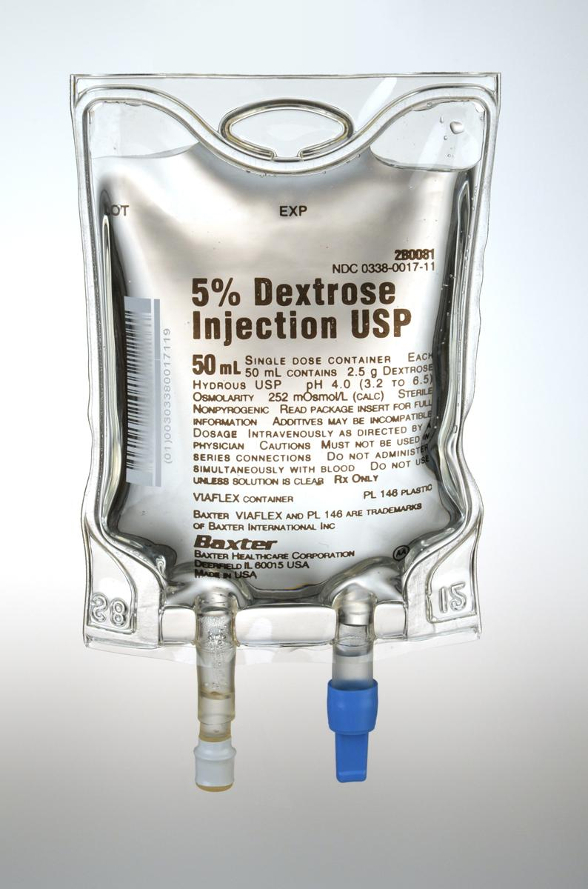
Scenario 1
You have been asked to make 500 mL of 5% dextrose solution from a 50% dextrose stock solution. What volume of the stock dextrose and what volume of water do you need?
Step one – determine the unknown
2 unknowns
Volume of dextrose and volume of solvent (water)

Slide 4
Solution
Set up your equation – this problem does not require conversions
C₁V₁ = C₂V₂
C is concentration and V is volume
1 is starting materials and 2 is final
Let’s look at the problem again!
Notes:
Remind students that if conversions were required it would be best to use dimensional analysis.

Slide 5
Scenario 1
V₂
C₂
You have been asked to make 500 mL of 5% dextrose solution from a 50% dextrose stock solution. What volume of the stock dextrose and what volume of water do you need?
C₁
V₁
50% x V₁ = 5% x 500 mL
V₁ = 5% x 500 mL
50%
V₁ = 2500 mL
50
V₁ = 50 mL
This is the volume of DEXTROSE needed.

Slide 6
Scenario 1
Final volume of solution
You have been asked to make 500 mL of 5% dextrose solution from a 50% dextrose stock solution. What volume of the stock dextrose and what volume of water do you need?
Your final volume should be 500 mL
You calculated that you need 50 mL of dextrose
500 mL – 50 mL = 450 mL of water

Slide 7
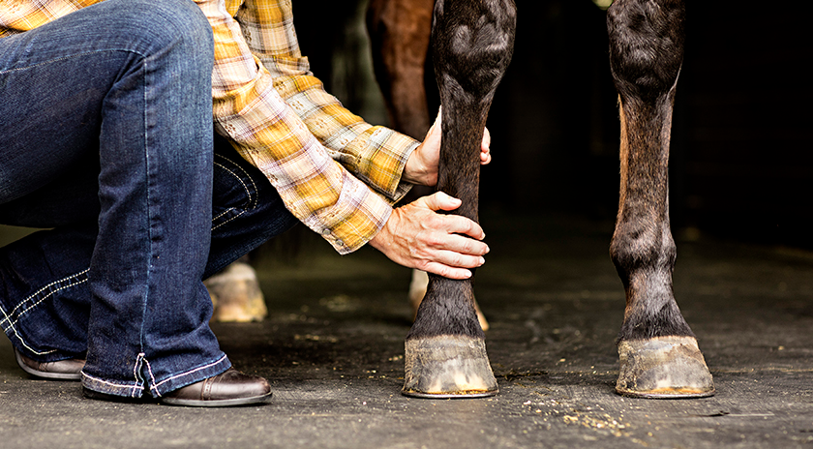
Scenario 2
500 mL of a 15% solution of methyl salicylate in alcohol is diluted to 1.5 L to be used on Beauty for post-exercise leg rubs. What is the percentage strength of the diluted solution?
Step one – determine the unknown
Percentage strength (concentration)

Slide 8
Solution
Set up your equation – note that the units for the beginning and ending volumes are NOT the same.
C₁V₁ = C₂V₂
You must convert units before using this equation or use dimensional analysis which includes unit conversions within the problem
Let’s look at the problem again!

Slide 9
Scenario 2
V₁
C₁
500 mL of a 15% solution of methyl salicylate in alcohol is diluted to 1.5 L to be used on Beauty for post-exercise leg rubs. What is the percentage strength of the diluted solution?
V₂
C₂
15% x 500 mL = C₂ x 1.5 L
Convert to like units
500 mL x __1 L__ = .5 L
1000 mL
C₂ = 15% x .5 L
1.5 L
C₂ = 7.5 %
1.5
C₂ = 5 %

Slide 10
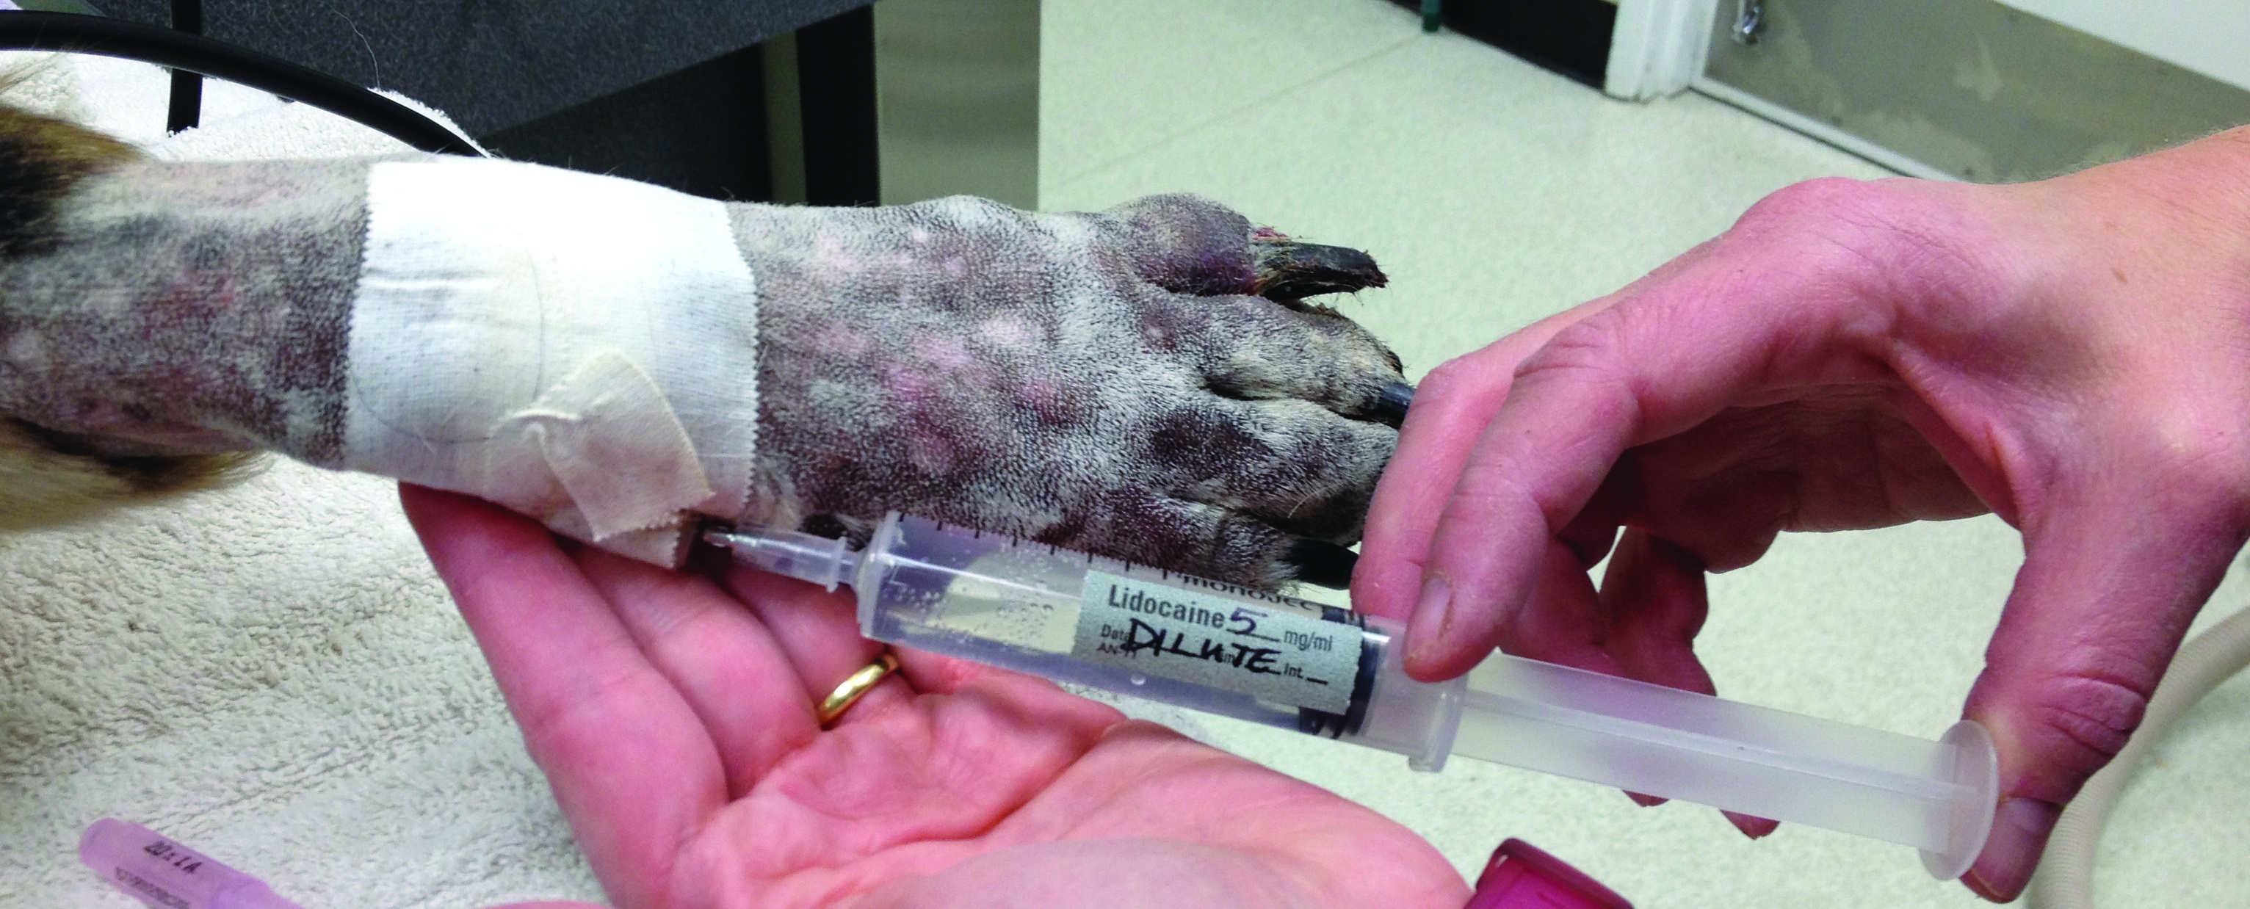
Scenario 3
Dr. Vonn needs 300 mL of 2% lidocaine solution from a 50 mg lidocaine stock solution. What volume of the stock lidocaine is needed?
Step one – determine the unknown
Volume of stock lidocaine

Slide 11
Solution
Set up your equation – note that the units for the beginning and ending concentrations are NOT the same.
C₁V₁ = C₂V₂
You must convert units before using this equation or use dimensional analysis which includes unit conversions within the problem
REMEMBER: X % solution = X g/100 mL
Let’s look at the problem again!

Slide 12
Scenario 3
Dr. Vonn needs 300 mL of 2% lidocaine solution from a 50 mg/mL lidocaine stock solution. What volume of the stock lidocaine is needed?
Dimensional analysis method
300 mL x _2 g__ x 1000 mg x 1 mL
100 mL 1 g 50 mg
= 120 mL of stock lidocaine

Slide 13
Scenario 3
V₂
C₂
Dr. Vonn needs 300 mL of 2% lidocaine solution from a 50 mg/mL lidocaine stock solution. What volume of the stock lidocaine is needed?
C₁
V₁
C₁V₁ = C₂V₂ method
50 mg/mL (V₁) = 300 mL (2%)
2% = 2 g__ - need mg not g
100 mL
2 g__ x 1000mg = 20 mg/mL
100 mL 1 g
50 mg/mL (V₁) = 300 mL (20 mg/mL)
V₁ = 600 mg__
50 mg/mL
V₁ = 120 mL

Slide 14
Questions?

