Slide 1
Patient Charts

Slide 2
Objective
Collect, classify, and record required patient information
Complete, accurate, orderly, legible, and permanent (pen only)
This information may impact:
Diagnosis
Treatment
Nursing care
Patient progress
Notes:
You may want to discuss why blue or black ink is primarily used (easier to read/copy)
Discuss that the exact information you record will be determined, in part, by the form type used by the clinic.

Slide 3
Signalment
Systematic description of the patient
Patient Identification: name, chip number, tattoo, etc.
Species
Breed
Gender & reproductive status: neutered, spayed, intact
Age
Color
Markings: both genetic & acquired (ear notches, croppings, scars, etc.)

Slide 4
Client Information
Client name
Contact information
Address
Phone
Email
Emergency contact
If applicable:
Co-owner
Referring veterinarian
Notes:
Address also give geographical history of patient which may help in assessment

Slide 5
Presenting Chief Complaint
Reason for visit
Obtain a detailed narrative of events/behaviors leading to current health condition
Ask open ended questions
Record information in client’s own words
Distinguish between facts and interpretations – “Ranger is licking his paw” vs. “Ranger’s paw must hurt because he is licking it”

Slide 6
Presenting Chief Complaint
Onset of problem – when did it start
Anatomical location or body system
Character of problem:
Quality: what does it look like (i.e. hot swollen limb)
Severity
Duration: how long has the problem existed
Time of day: when does it usually occur
Frequency: how often does it occur
Triggers: what seems to start the problem, make it better/worse

Slide 7
Scenario 1
Chip is an 8-year-old male, intact Lhasa Apso belonging to Lisa Watkins (a long time client). She has brought Chip to the clinic because of a harsh cough whenever he is excited. This has been going on for about 6 months.
Notes:
Note that Ms. Watkins is a long time client and already has a record on file. Student should still verify the this information is up-to-date. Remind them to ask: “Are you still at (insert address) and is the best number to reach you at still (insert phone number). Has Chip’s diet changed? Is he still receiving monthy heartworm preventative?, etc.
Ask students what other information needs to added to this chart.
Remind them of proper questioning and recording techniques.

Slide 8
Scenario 1
Upon interviewing Ms. Watkins you learn that she has recently changed employment. What updates to her chart should be made and how? What else needs to be added to Chip’s chart?
Notes:
Ms. Watkins’ work phone should be updated by placing one line through the old phone number, recording the new phone number in blue or black ink, and initialing
The reason for Chip’s visit and symptoms should also be recorded on his chart.

Slide 9
Chip’s Chart
04/02/2016
Lisa Watkins
123-45-6789
4568 Holly Lane
Seminole, TX 78954
456-832-4569
456-832-9584
Tom Jones
456 – 832-1598
x
Sally Field
3
1
2 llamas
Chip
x
Lhasa Apso
White & Brown
11/2008
x
DHLPP & Rabies 05/02/2015
Monthly heartworm preventative
Adult maintenance dry dog food
Notes:
Students should update and complete any missing information on this chart

Slide 10
Chip’s Updated Chart
04/02/2016
Lisa Watkins
123-45-6789
4568 Holly Lane
Seminole, TX 78954
tw
456-832-4569
456-832-2223
456-832-9584
Tom Jones
456 – 832-1598
x
Sally Field
3
1
2 llamas
Coughing when excited for about 6 months
Chip
x
Lhasa Apso
White & Brown
11/2008
x
DHLPP & Rabies 05/02/2015
X
Monthly heartworm preventative
Adult maintenance dry dog food
Notes:
Corrections should be made using a single line to mark through incorrect information. Then write the new information in pen and initial. This correction should later be updated in the electronic chart.
Remember to be as specific as possible about the reason for visit (this is where good questioning skills are important)
Mark any other signs/symptoms even if they seem unrelated

Slide 11
Scenario 2
“Stormlight”, a 14 year-old Hanoverian gelding, was recently purchased by new clients Dorothy and Steve Brown. This sale is contingent upon a normal wellness exam. They have called to schedule an appointment and would particularly like to assess any potential lameness issues.

Slide 12
Scenario 2
Consider the information which should be included on a new client/patient chart and complete as much as you can based on the scenario details. What additional information would you need to obtain?
Notes:
The scenario details provide:
names of clients and patient
Species, breed, age, gender, and reproductive status
Picture provides color/marking identification
Reason for vet visit
You still need to obtain personal information about the clients (address, phone number, etc.)

Slide 13
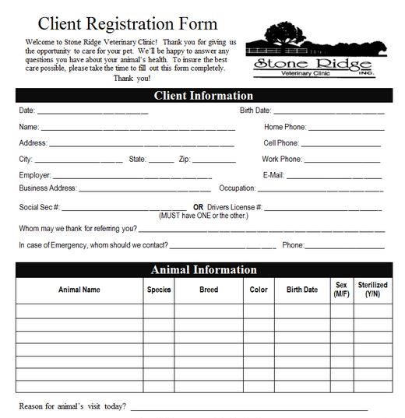
Fill in the Blanks!

Slide 14
Completed Chart
04/02/2016
04/22/1986
Steve Brown
704-022-0161
102 Timber Creek
704-802-2016
Palo Pinto
TX
76484
704-802-8516
Texas AgriLife Extension
sbrown@tae.com
7048 Pinto Drive
Research associate
704-80-201
Wind Swept Farms
Dorothy Brown
704-802-2010
Stormlight
Eq
Hanoverian
Bay
3 socks & blaze
03/15/2002
Y
M
Wellness/lameness exam

Slide 15
Questions?

