Slide 1
Scientific Method
TEKS 8.3 (A)
TEKS 8.3 (B)
TEKS 8.4 (A)
TEKS 8.4 (B)

Slide 2
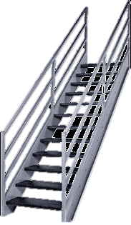
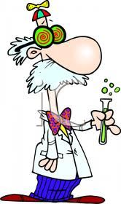
What is the Scientific Method?
It is a series of steps that scientists use to search for cause and effect relationships.
It is a way for an experiment to be designed so that only one item is changed to cause something else to happen in a predictable way

Slide 3
Key terms
Before we get started…

Slide 4
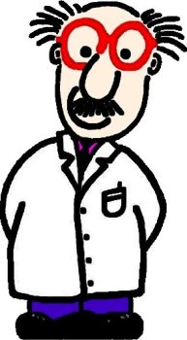
Hypothesis
Typically formed using “IF …… THEN …..” statements
An educated guess about what causes something to happen
Uses few observations
Is an idea based on observations without experimental evidence
  What you believe will happen
  What you are testing to find out
Hmm! I think that if I change X then Y will occur!
Notes:
Reiterate that a hypothesis is NOT an guess -> it should make logical sense and build on knowledge about an observation.

Slide 5
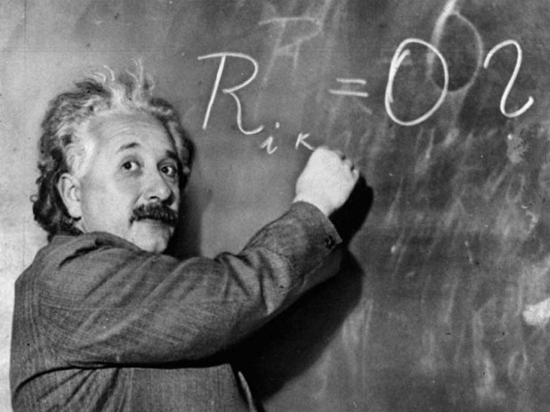
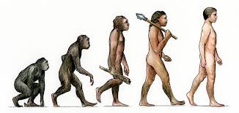
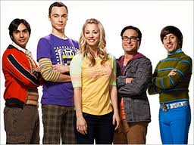

Theory
Uses many observations based on experimental evidence
Can be applied to unrelated data and new ideas
Is flexible and can be modified if new information is collected
Common examples:
General Relativity
Evolution
Big Bang Theory

Slide 6
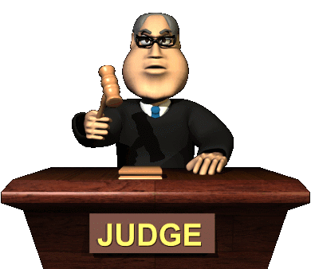
Law
Has been experimentally proven over and over
  Has stood the test of time with little to no change
Can create predictions for different circumstances
Has uniformity and is universal
These laws are NOT the same as laws made in court. They are much harder to break than laws made in court (speeding!).

Slide 7



Fair Test, Variables, and Controls
To conduct a fair test in an experiment, you must only change one factor at a time while all other factors are kept the same
Changing factors in experiments are called variables
Factors that are kept the same in an experiment are called controlled variables
What can be a variable?
Notes:
Let students know that anything involved in an experiment can be a variable, have them fill in the scientists thought bubble with examples before continuing.
Weather, time (how long something is preformed/exposed), sound, age, light, etc.
-depends on the experiment!

Slide 8


Dependent vs. Independent
Independent variables are the ones that are selected to be changed in an experiment
  A valid experiment only has one independent variable to ensure that it is a fair test (too many independent variables lead to inconclusive results)
Dependent variables are the factors that respond to the independent variable
  Their response depends on the independent variable
  Consider it to be what is being observed through testing and measuring
THINK ON IT: A researcher wanted to see if music had an effect on heart rate. Identify the dependent and independent variables and the controlled variable.
Answer:
Independent variable: Music
Dependent variable: Heart rate
Notes:
http://www.sciencebuddies.org/science-fair-projects/project_variables.shtml - this website has many helpful examples of these variables and their controls
You can use the hypothesis format as a tool. The "if" part of the hypothesis is the independent variable; the "then" part is the dependent. For example, “If I increase the amount of time the flowers get light, then they will bloom in a shorter amount of time." The if part is your independent, the then part is your dependent

Slide 9


“A researcher wanted to see if music had an effect on heart rate”
Independent variable
  What are we changing?
    presence of music
Dependent variable
  What are we observing?
    heart rate
Controlled variable
  What can we refer to see if there was a change?
    heart rate before music was played

Slide 10
Now the researcher wants to see if type of music has an effect on heart rate
Independent variable
  Genre of music (classical, pop, hip-hop, country)
Dependent variable
  Heart rate
Controlled variable
  Heart rate with no music playing
  Can you think of other variables that need to be controlled in this experiment?
    Person undergoing test must be the same
    Ensure that heart rate is resting rate (person was not running or doing activities before the test)
    Noise level of music
    Environment of test

Slide 11

Sample Size
When doing an experiment using people, you want to have a large enough sample size to eliminate personal bias
In the music genre and heart rate example, you would want to have a large sample of people to see the effects of music on a variety of people.
  You could break it into even smaller groups : children, teenagers, adults, elderly or a group of people that prefer the music genre

Slide 12
The Scientific Method

Slide 13

1: Ask a Question
How, what, when, who, why, where?
For the method to work, the question has to be about something that can be measured
  Quantifiable (can be counted – weight, age, height, amounts)

Slide 14
2: Do Background Research
Use the library or Internet tools to help find the best way to plan your experiment
Be sure to do your research so you can avoid repeating past mistakes

Slide 15
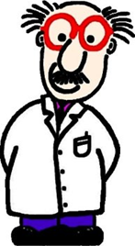
3: Construct a Hypothesis
Must be stated in a way that can be easily measured, and must help you answer your original question
“If [this happens], then [this will occur].”
Hmm! I think that if I change X, then Y will occur!
Notes:
How to create a strong hypothesis: http://www.sciencebuddies.org/blog/2010/02/a-strong-hypothesis.php

Slide 16
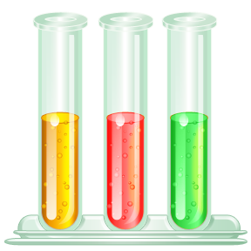
4: Experiment
By doing an experiment, you are testing whether your hypothesis is true or false
Should be able to be repeated
Must be a fair test
  Only one variable is changed, while all other variables are constant
A good experiment should have…
  An independent variable
  A dependent variable
  Other variables that are held constant
  A control

Slide 17

5: Analyze
Review the data you have collected and compare it to your hypothesis
  Does it support or not support your hypothesis?
Regardless of the outcome, you should repeat your experiment to make sure you did not get a false positive, or if you need to tweak your original hypothesis to test in a different way.

Slide 18


6: Report Results
Create a final report or display board to show how you came to your conclusions
Notes:
Remind students that as you experiment, you can go back if you see something needs changing, or if new information becomes available and affects the experiment at hand. Explain to them that the method commonly involves going back and making changes to experiment design or tweaking the hypothesis.

Slide 19

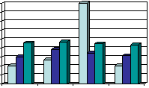

In Summary…
Publish
Purpose/Question
Research
Analysis/Conclusions
What happened?
Hypothesis
Analyze data
"I think..."
Experiment!

