Slide 1

Homeostasis
Homeo = same Stasis = standing
Greek for “standing still”

Slide 2

Homeostasis is…
“the state of balance within our bodies”
Living organisms require a balance of certain variables within their bodies to stay alive.
= Homeostasis is necessary for life.
When homeostasis is disrupted and these variables become imbalanced, disease or death can occur.
Notes:
Note: Animation on this slide, click to make see-saw gif disappear
Example of when an imbalance in a homeostatic variables is covered later in the PowerPoint

Slide 3
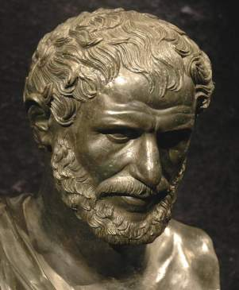
A History of Homeostasis
Ancient Greeks believed that harmony, balance, equilibrium, and a steady-state were all fundamental to life and death. They were right!
Greek philosopher Heraclitus
postulated that people are not
fixed and unchanging but rather
undergo constant change.

Slide 4
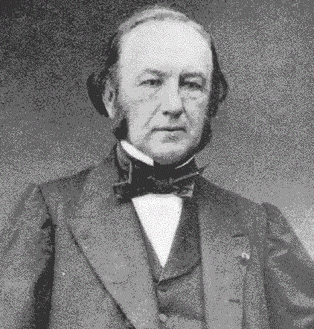
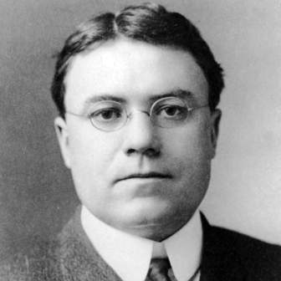
Claude Bernard theorized that achieving a balance of these changes within organisms is essential for life.
Walter B. Cannon named this “homeostasis” and further theorized that it was a process of “synchronized adjustments in the internal environment…to normal ranges.”

Slide 5
Unicellular to Multicellular
From the unicellular amoeba to the ̴100 trillion cells in the human body, all living things have basic needs.
Humans need:
Water - for many metabolic processes
Food - to supply energy, raw materials & chemicals for vital reactions
Oxygen- to release energy from food materials
Heat- to promote chemical reactions
Pressure- to allow breathing
These materials are not found inside our bodies, and we must interact with our environments to get them. Without them we couldn’t survive.
Notes:
Note: ~100 trillion cells in the human body is an estimate

Slide 6
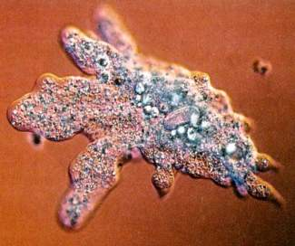
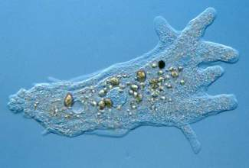
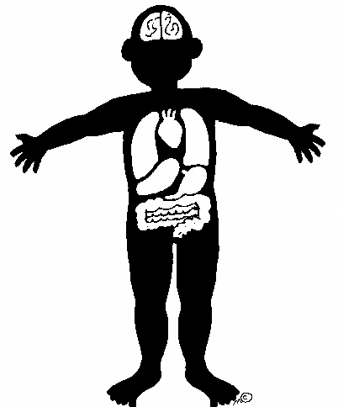
These amoeba take in nutrients & O₂ from their external environment and eliminate wastes generated inside, like CO₂, back out.
All life requires these constant exchanges between their internal & external environments.
External Environment:
Everything outside the body
Wastes are eliminated out
Internal Environment:
Everything inside the body
Nutrients are brought in
Notes:
Note: O₂ = oxygen CO₂ = carbon dioxide
Animation on slide: Click to reveal bottom half of slide

Slide 7

Despite the constant exchanges between our internal & external environment and a constantly changing external environment,
our internal environment must be kept balanced and stable so that our cells can perform their metabolic functions at maximum efficiency.
This state of internal balance in our bodies is homeostasis.

Slide 8

The Homeostasis Fish Bowl
To illustrate homeostasis, we will use a fish bowl metaphor –
where the fish bowl is the human body holding our living cells
& the fish are the living cells inside our body.
The fish bowl is the boundary between what is inside and what is out.
Our internal environment is the water inside the fishbowl.
Our external environment is everything outside the fish bowl.
If you’ve ever had a pet fish, you know it is very important that the water (internal environment) is maintained at certain levels.
For example: there is an optimum temperature level, high oxygen and low carbon dioxide levels, low waste concentration, & plenty of food to feed the fish
We use specific devices to help maintain each level- like a heater to maintain the temperature, an air pump to maintain the oxygen and carbon dioxide levels, and a filter to keep waste concentration low.
In the human body, we also need to keep variables balanced at certain levels
but we use organ systems instead of devices.
Notes:
Note: Click to reveal each panel
The Homeostasis Fishbowl
Copyright Kevin Patton, lionden.com
http://www.lionden.com/homeostasis.htm

Slide 9
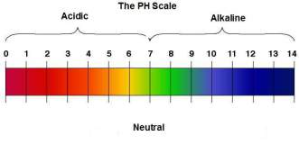
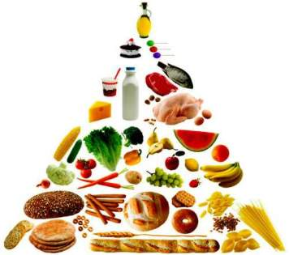
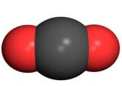
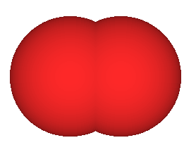
Variables in Hemostasis
What are the variables we must regulate
to maintain homeostasis?
1. pH
The relative amount of acid in the body.
The human body has a pH range of 6.8 – 7.8.
An imbalance in pH would cause our cells to
cease functioning and we would die.
2. Concentration of Nutrients
Cells in our body need a constant supply of
nutrients and energy.
3. O₂ & CO₂ Levels
Cells need O₂ to generate energy but this process also
produces CO₂ byproducts which must be removed.
Too much CO₂ would make our pH levels acidic.
O = O
O = C = O
Notes:
Note: the process that cells undergo to generate energy using O₂ is called cellular respiration and occurs in the mitochondria

Slide 10
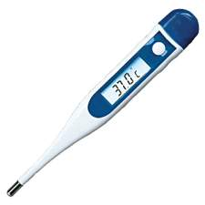
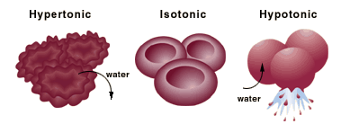
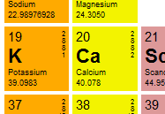
Variables in Hemostasis
4. Temperature
Cells also have an optimum temperature range.
If cells are too cold, their processes slow down.
If they get too hot, their proteins will lose their shape (denature)
and stop working.
5. Water, Salts & Electrolyte Levels
The concentration of salt in our internal
environment regulates water levels in cells.
This is important to maintain proper volume
in cells or they will either shrivel up or burst.
Different electrolytes have different important
functions e.g., potassium (K+) controls the rhythmic
beating of the heart so we need a relatively
constant concentration.
shrivel up
normal
burst
Notes:
Note: What is an electrolyte http://www.youtube.com/watch?v=1XWnovm6JLs
Electrolytes are important in our bodies to help our nervous system to send signals to our body – our nervous system uses electrical signals called action potentials to send messages across neurons and these electrolytes are important for helping carry that electrical signal across fluids

Slide 11

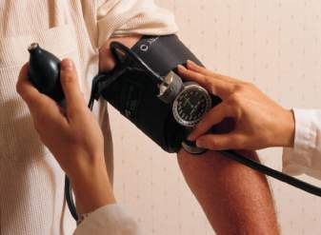
Variables in Hemostasis
6. Waste Removal
Chemical reactions often produce byproducts
called cellular waste that have a toxic effect on
the body if they accumulate.
7. Volume & Pressure
Our blood vessels deliver oxygen & nutrients to all the
cells in our body.
These vessels must have a certain volume & pressure
to stay open and allow blood to flow through.
Too little volume/pressure in blood vessels is called
Hypotension and the body does not get enough blood.
Too much volume/pressure in blood vessels is called
Hypertension which can lead to heart attacks or stroke.

Slide 12
Maintaining Homeostasis
Our cells perform their metabolic processes best at a certain level called set point – the target level that a variable is regulated around to maintain homeostasis.
The homeostatic variables listed (pH, temperature, etc.) all have set points in homeostasis.
When these variables fall too low or too high from the set point our cells’ may cease functioning.

Slide 13
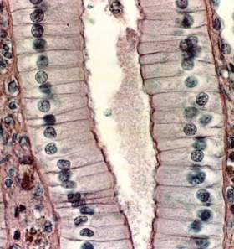
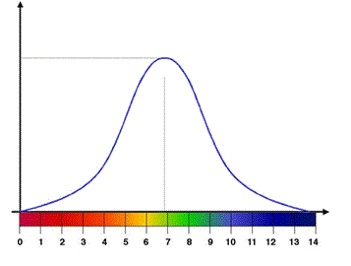
Set Point
For example:
As our stomach digests and breaks down foodstuffs, the cells that line our intestine have proteins that bring these nutrients into the cell to be used.
Intestine lining cell
Outside the cells
These proteins must transport the nutrients across the cell membrane to get into the cell.
These proteins operate best at a pH set point If the pH deviates from this point, the proteins will not be able to carry nutrients effectively across the plasma membrane.
Enzyme Activity Rate
Set Point
This is a photomicrograph of intestine lining cells
What causes pH to deviate from the set point?
A photomicrograph is a picture taken through a microscope
Too low
pH
Too high
Notes:
Review: The function of the plasma membrane is to act as a barrier for the cell and is impermeable to most molecules, hence these proteins are important transporters of much needed nutrients
Note: The enzyme activity rate chart on the slide is not specific for stomach cells because stomach cells pH set point is more acidic then the one pictured which shows an set point pH 7 which is neutral pH
Animation on slide: click and question box will appear in bottom right hand corner as a segue for the next slide

Slide 14
Threats to Hemostasis
Threats to homeostasis are imbalances in any of the hemostatic variables.
Walter B. Cannon theorized that these threats to homeostasis must come from the external environment.
For instance we maintain our bodies temperature at 98.7° (our temperature set point).
If you leave an air conditioned room for a hot, summer day in Texas of +100°, your body can’t function at a temperature above the set point. So to balance the external heat threatening your internal environment’s homeostasis, you produce sweat to cool down.

Slide 15
Threats to Hemostasis
In the case of a bacterial infection, toxins released by the bacteria & our immune response to the bacteria can change our temperature’s set point upward
which raises our body’s temperature.
This is called pyrexia or fever.
This raising of temperature is believed to
be a defense mechanism to help our
immune system better kill the bacteria.
However, if the temperature becomes too high
for too long, the proteins will be damaged
(denature) and the cells may die.

Slide 16
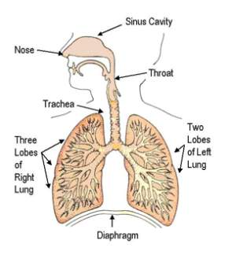
Regulation of Homeostatic Variables
Humans use organ systems to make sure our homeostatic variables (pH, temperature, etc.) are kept in balance.
What is an organ system?
Organ systems are made up of individual and separate organs that work together as a unit.
e.g., the Respiratory System
Parts: nasal & oral cavity, pharynx,
larynx, trachea, left & right lung,
& diaphragm
All these parts/organs work together as an
system to exchange gas with air when breathing.

Slide 17
Organ Systems – Parts & Function
Organ System | Parts | Function
1. Nervous system & 2. Endocrine system | - brain, spinal cord, nerves - all endocrine glands | Sensory input and integration; command and control
3. Muscular system | muscles | Strength, balance, posture, movement & heat
4. Skeletal system | skeleton | Support, movement & protect organs
5. Cardiovascular system | heart, blood vessels & blood | Transports nutrients between all tissues, organs and environmental interfaces
6. Gastrointestinal system (digestive system) | esophagus, stomach, liver, pancreas, gallbladder, intestines, & colon | Digestion of food and absorption of nutrients
7. Respiratory system | nasal & oral cavity, pharynx, larynx, esophagus, trachea, left & right lung, & diaphragm | Regulation of blood gases and exchange of gas with the air
8. Renal system | kidneys, ureters, urethra, & bladder | Regulation of volume and composition of body fluids
9. Integumentary system (skin) | skin, hair & nails | Protection from microbial invasion and water vapor barrier
10. Reproductive system | reproductive organs | Pass life on to the next generation
11. Immune system | spleen, lymph nodes, bone marrow, & thymus | Removal of microbes and other foreign materials
Notes:
Note: In the table, the Nervous system & Endocrine system share a row because their function is the same but they are two distinct organ systems.

Slide 18
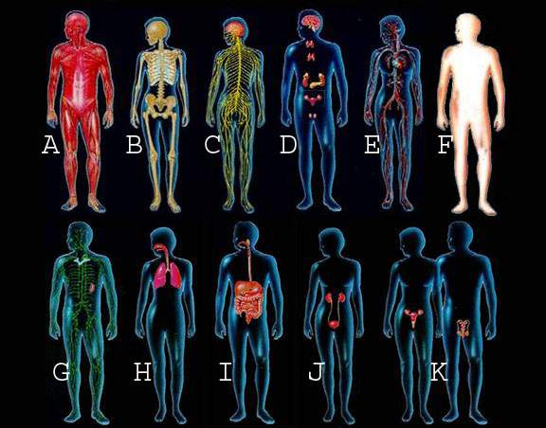
Organ Systems Quiz
Identify each organ system based on what you know about its function.
Notes:
Key: A – Muscular system, B – Skeletal system, C – Nervous system, D – Endocrine system, E – Cardiovascular system, F – Integumentary/skin system, G – Lymphatic system, H – Respiratory system, I – Digestive system, J – Urinary system, K – Reproductive system

Slide 19
Variables Regulation
To keep the hemostatic variables balanced we have control centers that 1) detect imbalances, 2) coordinate correcting responses and 3) bring the variable back to the set point.
Effector produces the response needed to balance out the variable’s deviation.
Variable
Sensor detects changes in the variable either above or below the set point.
Effector
Sensor
Integrator
Integrator receives information from the sensor & coordinates a correcting response for the effector that will bring the variable back to set point.
Notes:
Note: Animation on slide, click to make description appear

Slide 20
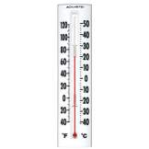
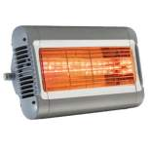
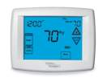
Temperature Regulation
Temperature of a house
Temperature of our bodies
Room Temperature
Body Temperature
Nerve receptors in our skin detect when temperatures fall above or below 98.7° as our sensors
Muscles will produce quick flexing responses known as shivering to generate heat and balance our body temperature back to normal as the effector
Thermometers detect changes in temperature acting as the sensor
Heaters will produce the effect that brings the temperature back up acting as the effector
Heater
Nerve Receptors
Muscles
Thermometer
Thermostat
Brain
Thermostats receive the thermostat’s readings and decide if the temperature should be raised or lowered to maintain the temperature acting as the integrator
Our Brain receive signals from our nerve receptors and coordinate the response needed to bring our temperature back to 98.7° as our integrator
Analogy Video
Notes:
Note: Click the hyperlink Analogy Video in the bottom right hand corner, this link will take you to a website – to navigate there is a side bar on the left, click play on the second one ‘Analogy’ for a video explanation, the video will play for a few minutes then stop and you must hit play again to start the second example video
Video at: http://www.phys.unsw.edu.au/biosnippets/

Slide 21


Control Centers
Control centers regulate variables to maintain homeostasis.
There are two main control centers in our bodies:
The Nervous System & the Endocrine system
These systems are important to homeostasis because they determine
& maintain the variables’ set point.
They receive signals from their sensors about imbalances and send out corrective signals to their effectors (organ systems) to balance out any threats to homeostasis and return variables to their set point.

Slide 22
Nervous System
The Nervous System receives sensory information from the body.
e.g., our stomach sends the message to our brain via nerves “Golly I’m hungry. I need food!”
The Nervous System coordinates how to bring our concentration of nutrients back up to the set point → consume some nutritious snacks.
The Nervous System then sends the signal to our muscles via other nerves to tell them “Reach for that apple and take a bite!”

Slide 23

Endocrine System
The endocrine system does not use nerves to send signals but rather chemical messengers called hormones.
Hormones travel to organs and their presence activate homeostatic mechanisms to be the effector.
e.g., Insulin
Insulin is a hormone that is released by the endocrine system whenever we eat, it signals cells to absorb the excess glucose that is released from broken down foodstuffs so our blood-glucose levels will remain normal.
When our body fails to maintain homeostasis disease or death can occur, here is a look at the disease Diabetes.
Homeostasis & Diabetes
Diabetes & Insulin
Notes:
Glucose – is the sugar that is used as energy within the body
Note: First hyperlink to an interactive video on Homeostasis and is for a high school audience the second is a more detailed college level explanation of diabetes and insulin. The first link takes you to a website with an interactive video, you must click to answer a few questions (e.g. click on the pancreas) to move forward
http://www.bbc.co.uk/schools/gcsebitesize/science/add_ocr_pre_2011/homeostasis/homeosts.shtml
The second hyperlink is to a YouTube link video is 4:19 long and talks about how insulin works http://www.youtube.com/watch?v=IrotOPgSkR4
Question: When you have diabetes what is the variable that becomes imbalanced?
Answer: Concentration of nutrients or too much glucose in your blood

Slide 24
Regulation Mechanisms
Our Nervous System & Endocrine System use two mechanisms to bring imbalanced variables back to their set point called Feedback & Feedforward
Feedback
When the sensors detect deviations in the variables they send this information to the integrators for a corrective response.
Feedforward
When the integrators preemptively send messages to the effectors to make a response before a deviation occurs.
Feedback has two directions:
Positive Feedback & Negative Feedback
Deviation
Sensor
Integrator
Integrator
Effector
Deviation
Notes:
Example:
Feedback – you receive a grade back on an assignment that says “you got a bad grade, you didn’t studied enough” this is after you’ve already taken the test, it is feedback on how you did
Feedforward – you decide to study extra before a test so that you get a good grade – this is before you’ve taken your test and is preemptive feedforward to push your grade up

Slide 25

Negative Feedback
Negative Feedback
When feedback (the signal from sensor to integrator) causes the variable to change in the opposite direction of the deviation.
So the corrective response counteracts the imbalance.
If the hot sun raises our temperature,
negative feedback means our effector will
lower our temperature to restore balance.
Sweating lowers the temperature to counteract
the raising temperature resulting in a return to the set point.
Negative Feedback is the most common regulatory mechanism.
Notes:
Question for class: In the example on the slide, the hot sun is the threat to homeostasis, our negative feedback response to lower our temperature by sweating. If we were to get caught in a snow storm and the snow lowered our temperature would it be negative feedback if our body began shivering to warm us back up?
Answer: Yes! Even though the directions of the imbalance and corrective response have switched, now the threat to homeostasis is a lowering of our temperature and our corrective response is a raising of our temperature this is negative feedback because our corrective response to the imbalance is in the reverse direction

Slide 26
Positive Feedback
Unlike negative feedback, which counteracts deviations to balance variables back to set points, positive feedback does the opposite. It increases the deviation sending the imbalanced variable further away from the set point.
Positive Feedback is a rare regulatory mechanism because pushing variables outside their set point is dangerous.
For example during child birth:
When in labor, contractions stimulate the release of the hormone oxytocin which cause more contractions which leads to more released oxytocin culminating in delivery of the baby.
In this example, the mechanism increased the deviation in oxytocin levels to aid in delivery & once over the variable can return to its set point.

Slide 27
Feedforward
Feedforward is a mechanism that occurs before a deviation is made, so in anticipation of a deviation.
This ‘forewarning’ allows organ systems to compensate for the deviation before it varies too much.
For example:
When you see that it snowed,
you put on a coat before you leave for school
instead of getting cold first and coming back in
for a coat.
When you smell delicious food while hungry, your saliva output increases. Saliva has enzymes that aid in digestion. Your saliva output increases in anticipation of a rise in foodstuffs needing to be broken down into nutrients.
Notes:
Notes: Feedforward control is a mechanism for minimizing lag time
The Feedforward mechanism helps maintain stability by anticipating the need for changes by integrating information and acting to promote change before the direct stimulus signals for that specific need is received as either 1) signals sent for rates of change beyond normal or 2) signals from associated systems.
e.g.
Eating – sight or smell of food causes feedforward mechanisms to increase saliva production and increase HCl production to prepare the body to ingest food.
Muscle needs to react quickly – less time than it takes to send message to the brain and back. Feed-forward system causes the movement and then retrospectively the information is communicated to the brain. Also one to play fast paced sports, react to changes in environment quickly “before thinking about it”. Bicycle riding and balance – can anticipate the need to compensate and carry out the action before it is needed.
Exercise – when begin exercise muscles send signal to brain of activity. Efferent signals go to cardiovascular, respiratory, and limbic systems causing increase in ventilation, vasodilate blood vessels in the muscles, and slightly increase BP in other parts of the body. Anticipates changes in need for oxygen and need to excrete carbon dioxide before chemoreceptors stimulate changes.

Slide 28
Homeostatic Imbalance
When a variable becomes imbalanced and our control centers cannot maintain homeostasis, disease or death can occur.
These imbalances are called a homeostatic imbalance.
Common diseases that occur due to homeostatic imbalance are diabetes, dehydration, gout, & hypo/hyperglycemia.
Not all diseases are caused by homeostatic imbalance.

Slide 29


