Slide 1
Agricultural and Biological Engineering
An Overview

Slide 2
What is Engineering?
en·gi·neer·ing
[en-juh-neer-ing]
Noun
1. The art or science of making practical application of the knowledge of pure sciences, as physics or chemistry, as in the construction of engines, bridges, buildings, mines, ships, and chemical plants
2. skillful or artful contrivance; maneuvering

Slide 3
What is Engineering?
“Engineering problems are under-defined. There are many solutions - good, bad and indifferent. The art is to arrive at a good solution. This is a creative activity, involving imagination, intuition and deliberate choice.” - Ove Arup
“Engineering refers to the practice of organizing the design and construction [and, I would add operation] of any artifice which transforms the physical world around us to meet some recognized need.” - GFC Rogers The Nature of Engineering, A Philosophy of Technology.
“To the optimist, the glass is half full. To the pessimist, the glass is half empty. To the engineer, the glass is twice as big as it needs to be.” - Unknown

Slide 4
What is Engineering?
“Engineers create a better future. They use high-technology like robotics, sensors, computer models, and satellites to make a cleaner, more sustainable environment. They maintain plentiful, clean water; make healthier and safer foods. They provide clean, efﬁcient energy; and develop innovative machines. They solve problems, they make science useful, they make a difference!”
- http://baen.tamu.edu/files/academics/BAEN_FactSheet.pdf

Slide 5
Engineering in Biology and Agriculture: Intro
http://www.youtube.com/watch?v=WM16bY0W8o8

Slide 6
Engineering in Biology and Agriculture: The Basics
Biological and agricultural engineers. . .
Devise practical, efficient solutions for producing, storing, transporting, processing, and packaging agricultural products
Solve problems related to systems, processes, and machines that interact with humans, plants, animals, microorganisms, and biological materials.
Develop solutions for responsible, alternative uses of agricultural products, byproducts and wastes and of our natural resources - soil, water, air, and energy.

Slide 7
Engineering in Biology and Agriculture: The Basics
There are four different focuses within Biological and Agricultural Engineering:
Machine Systems Engineering
Environmental and Natural Resources Engineering
Renewable Energy Engineering
Food and Bioprocess Engineering

Slide 8
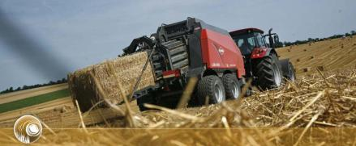
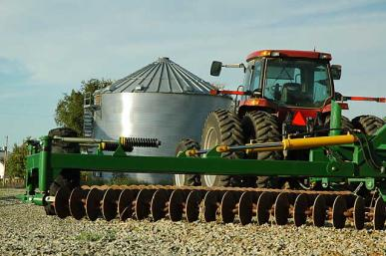
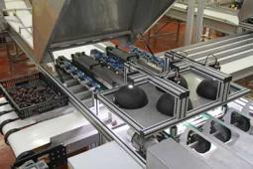
Machine Systems Engineering: design and development of machines and machine systems for food, feed and fiber production and processing.
http://www.kuhn.co.uk/
Engineering in Biology and Agriculture: Application
http://agnewsonline.blogspot.com/2011/06/farmers-share-farm-machinery-to-save.html
http://www.vision-systems.com

Slide 9
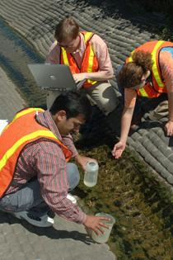
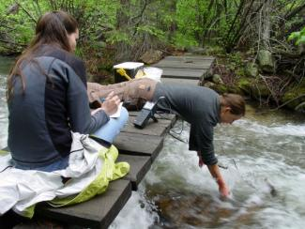
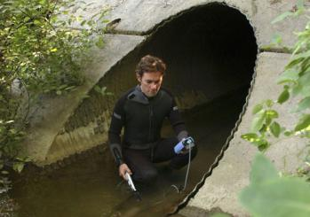
Engineering in Biology and Agriculture: Application
Environmental and Natural Resources Engineering: design and management of systems affecting soil, water, and air resources.
“…if you want to save more lives, become an environmental engineer rather than an M.D.” – Tom Hess, University of Idaho http://www.asabe.org/media/45658/p28water.pdf
http://www.colorado.edu/engineering/k-12/what-is-engineering
http://www.vtnews.vt.edu/articles/2010/03/2010-158.html
http://www.unl.edu/gradstudies/prospective/programs/EnvironmentalEngineering

Slide 10
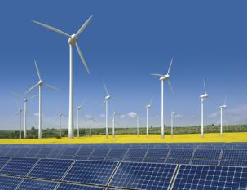
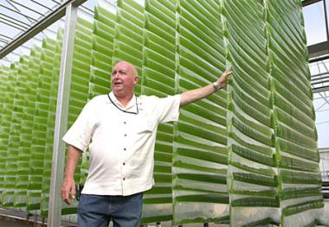
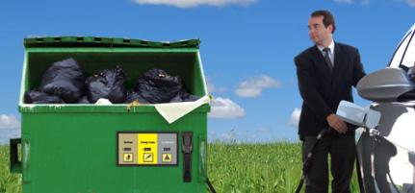
Engineering in Biology and Agriculture: Application
Renewable Energy Engineering: design and development of biomass, wind and solar energy systems.
https://oag.ca.gov/environment/green-energy/renewable
http://newwaystosave.net/algae-can-save-the-world-from-global-warming-while-producing-biofuel/
http://research.che.tamu.edu/groups/Holtzapple/mixalco.html

Slide 11
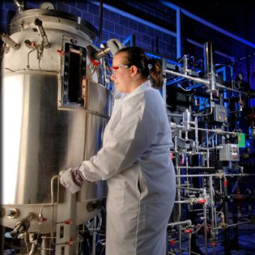
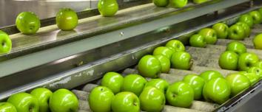
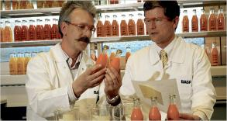
Food and Bioprocess Engineering: design and development of systems for processing and handling of food and agricultural products and processes involving cells, enzymes, or other biological components.
http://coas.siu.edu/academics/bachelors/agsystems/food-and-process-engineering-technology/index.html
Engineering in Biology and Agriculture: Application
http://www.esf.edu/pbe/bpe/
http://www.nytimes.com/2006/10/10/technology/10nano.html?_r=2&pagewanted=1&

Slide 12
Engineering in Biology and Agriculture: Employers
Companies that Employ BAE’s:
3M Abbott Labs AGCO Anheuser Busch Archer Daniels Midland BASF Briggs & Stratton Campbell's Soup Caterpillar CH2M Hill Case Corp Dole Dow Chemical Exxon Mobil Florida Light & Power Ford Motor Co
General Mills
Grinnell Mutual Reinsurance John Deere Kellogg's Lockheed Martin M & M Mars Monsanto
Morton Buildings NASA New Holland Ralston Purina Sunkist USDA Agricultural Research Service USDA Natural Resource Conservation Service US Department of Energy US Environmental Protection Agency

Slide 13
Engineering in Biology and Agriculture: Education
Top Biological and Agricultural Engineering Programs in the U.S.:
Texas A&M University at College Station
Purdue University
University of Illinois at Champagne-Urbana
Iowa State University
North Carolina State University at Raleigh
University of Florida
University of California at Davis
University of Nebraska at Lincoln
Cornell University
Ohio State University at Columbus

Slide 14
Engineering in Biology and Agriculture: More Resources
www.asabe.org
www.baen.tamu.edu
Individual examples of the profession - http://www.asabe.org/media/professional-profiles.aspx

