Slide 1
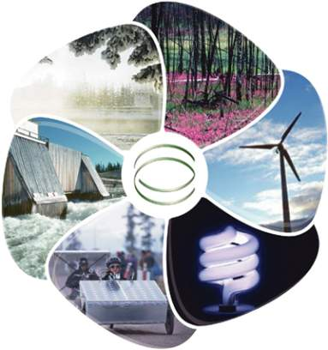
An Energy Debate
Alternative?
Geothermal?
Inexhaustible?
Renewable?
Fossil Fuels?
Nonrenewable?
Go green?

Slide 2
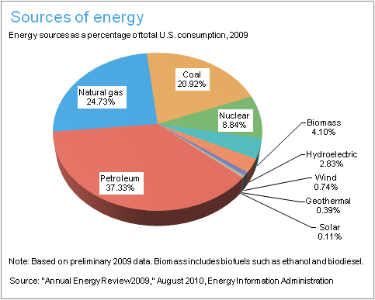
Current Sources of Energy
Can you explain what the most common source of energy is in the United States?
Do you think this type of energy is renewable or nonrenewable?

Slide 3
Sources of Energy Are Classified As:
Nonrenewable: energy that comes from a natural resource which cannot be produced, grown, generated. Once used there is no more remaining. These resources often exist in a fixed amount and are consumed much faster than nature can create them. Examples are fossil fuels and nuclear power.
Renewable: energy which comes from natural resources such as sunlight, wind, rain, tides, and geothermal heat, which are renewable (naturally replenished).
Inexhaustible: energy unable to be used up because existing in abundance. Examples are wind and tidal energy.

Slide 4
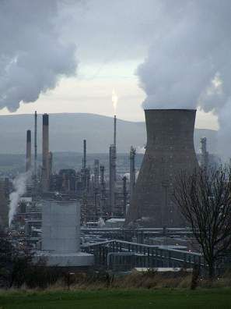
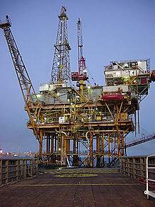
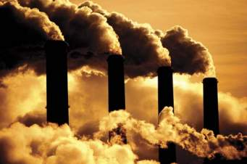
Fossil Fuels
Are fuels formed by natural processes such as decomposition of buried dead organisms. The age of the organisms and their resulting fossil fuels is typically millions of years, and sometimes exceeds 650 million years.
The fossil fuels, usually contain high percentages of carbon, include coal, petroleum, and natural gas.
Renewable or Nonrenewable form of energy?

Slide 5
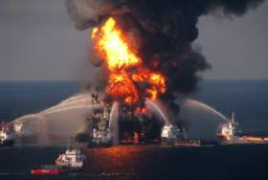
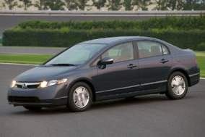
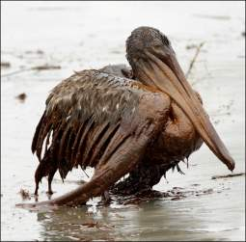
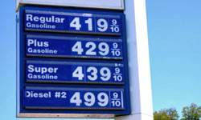
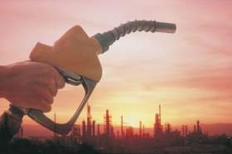
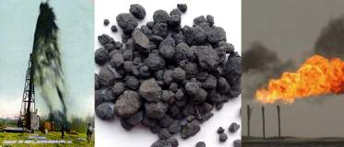
Debate – Fossil Fuels
Advantages
Currently very economical to produce
Burned to produce significant amounts of energy
Disadvantages
90% of greenhouse gases come from their combustion
Produces CO₂ That pollutes the atmosphere
Nonrenewable
Energy Source

Slide 6
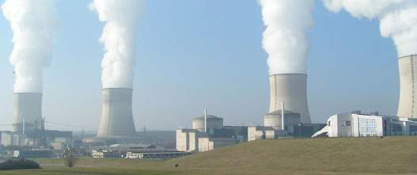
Nuclear Power
Nuclear energy originates from the splitting of uranium atoms in a process called fission. At the power plant, the fission process is used to generate heat for producing steam, which is used by a turbine to generate electricity.
Nuclear electric plants, ships, and submarines use controlled nuclear energy.
Actually a form of fossil fuels.
Renewable or nonrenewable form of energy?

Slide 7
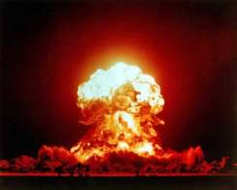
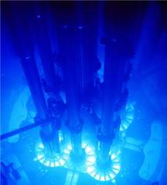
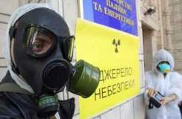
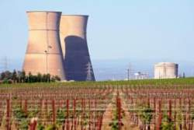
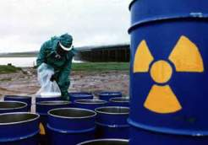
Debate – Nuclear Power
Advantages
Available technology that does not need to be developed
Can generate high amount of electrical energy in a single plant
Disadvantages
Produces radioactive waste that is EXTREMELY dangerous
Nuclear power plants could be preferred targets for terrorist attacks
Emits low amounts of CO₂
The energy source for nuclear energy is uranium, this is a scarce resource. (Only a 30-60 year supply at current demands).

Slide 8
A Look Into The Past - Chernobyl
Nuclear Power is being marketed today as a cleaner and more efficient source of power.
Do you believe this is accurate?
What are some other advantages and disadvantages of using nuclear power?
April 26, 1986 – The Chernobyl Nuclear Power Plant in the Ukraine exploded during a systems test.
The explosion sent a radioactive cloud of debris into the air that was spread across Europe due to weather conditions.
Officials say it could be up to 100 years before the station is completely decommissioned.
A 30-km (19-mile) exclusion zone is in place round the disaster site
Approximately 134 power station workers were exposed to extremely high doses of radiation directly after the accident. About 31 of these people died within 3months.
Another 25,000 “liquidators” – the soldiers and firefighters who were involved in clean up operations – have died since the disaster of diseases such as lung cancer, leukemia, and cardiovascular disease.
Large families in rural areas – people who farm and collect their food – continue to receive large doses of radiation from the food supply.

Slide 9
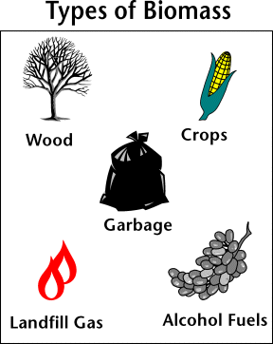
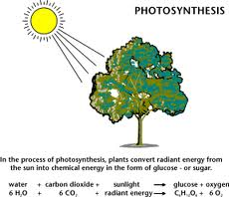
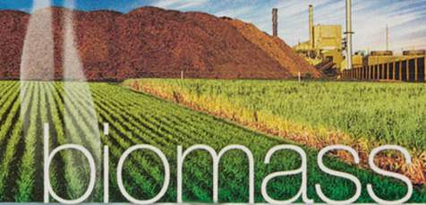
Biomass
Biomass is organic material made from plants and animals (microorganisms). Biomass contains stored energy from the sun.
Plants absorb the sun's energy in a process called photosynthesis. The chemical energy in plants gets passed on to animals and people that eat them.
Renewable or Nonrenewable?
Renewable energy source because we can always grow more trees and crops, and waste will always exist.
Ex of biomass fuels: wood, crops, manure, and some garbage.

Slide 10
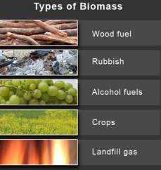
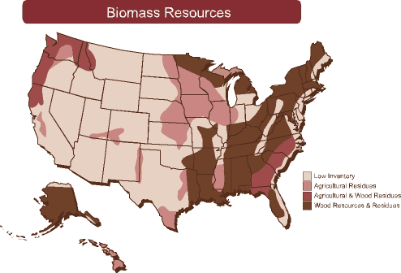
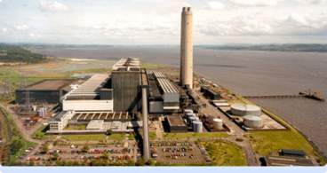
Debate - Biomass
Advantages
Available throughout the world, and theoretically inexhaustible
Minimal environmental impact
Disadvantages
Still an expensive source of energy
On a small scale there is actually a net energy loss, because energy must be put in to grow the plant mass

Slide 11
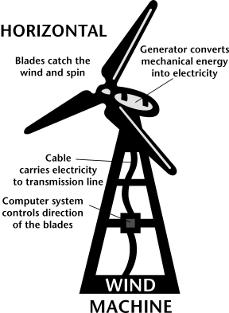
Wind Energy
Wind is simply air in motion. It is caused by the uneven heating of the Earth's surface by the sun.
Like old fashioned windmills, today’s wind machines (also called wind turbines) use blades to collect the wind’s kinetic energy.
The wind flows over the blades creating lift, like the effect on airplane wings, which causes them to turn. The blades are connected to a drive shaft that turns an electric generator to produce electricity.
Renewable or Nonrenewable?
Wind is a renewable energy source because the wind will blow as long as the sun shines.

Slide 12
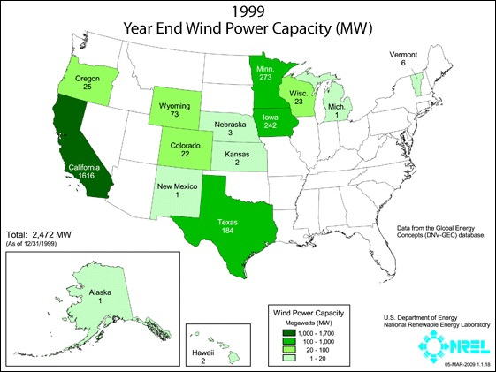
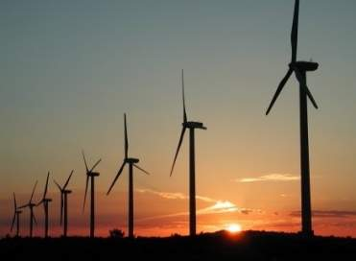
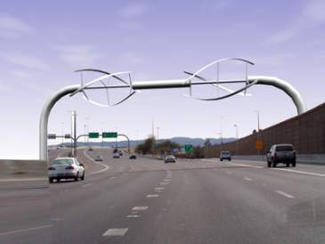
Debate – Wind Energy
Advantages
Inexhaustible fuel source
Produces no pollution
Disadvantages
Geographically limited, only areas with lots of wind are suitable for wind power generation
Relatively expensive to maintain

Slide 13
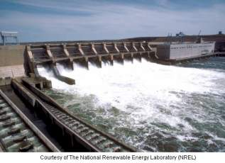
Hydropower
Hydropower is the renewable energy source that produces the most electricity in the United States. It accounted for 7% of total U.S. electricity generation and 35% of generation from renewable energy in 2009.
Water flowing rapidly from a high point, like Niagara Falls, or quickly in a big river has lots of energy. The water flows through a pipe, or penstock, then pushes against and turns blades in a turbine to spin a generator to produce electricity.
In a run-of-the-river system, the force of the current applies the needed pressure, while in a storage system, water is accumulated in reservoirs created by dams, then released as needed to generate electricity.
Renewable or Nonrenewable energy source?

Slide 14
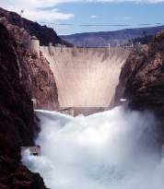
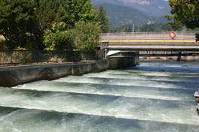
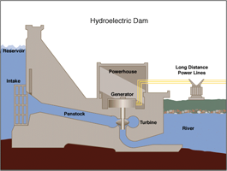
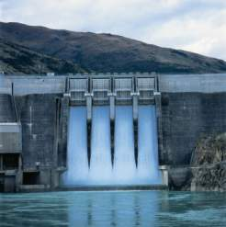
Debate - Hydropower
Advantages
Inexhaustible fuel source
Minimal environmental impact, and can be used throughout the world
Disadvantages
Smaller models depend on availability of fast flowing rivers or streams
Run-of-the-river plants can impact the mobility of fish and other river life

Slide 15
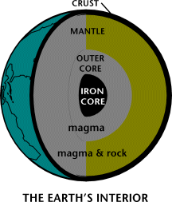
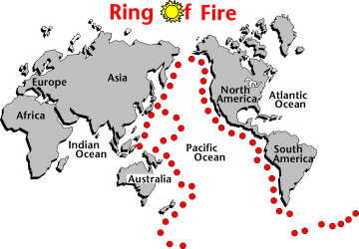
Geothermal
The word geothermal comes from the Greek words geo (earth) and therme (heat). So, geothermal energy is heat from within the Earth. We can recover this heat as steam or hot water and use it to heat buildings or generate electricity.
Naturally occurring large areas of hydrothermal resources are called geothermal reservoirs. Most geothermal reservoirs are deep underground with no visible clues showing above ground.
But geothermal energy sometimes finds its way to the surface in the form of: Volcanoes, Hot springs, and Geysers.
Renewable or Nonrenewable source of energy?

Slide 16
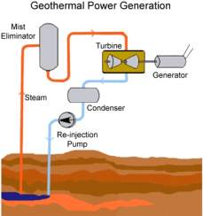
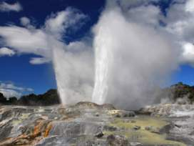
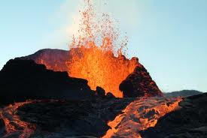
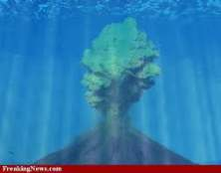
Debate – Geothermal Power
Advantages
Inexhaustible energy source with no pollution
Does not require structures such as solar panels or windmills to collect the energy, it can directly produce heat/energy
Disadvantages
Geographically limited – not available in many locations
Not much power per vent

Slide 17
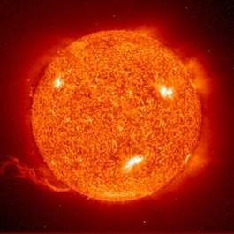
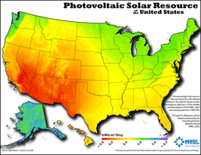
Solar Resources
The sun has produced energy for billions of years. Solar energy is the sun’s rays (solar radiation) that reach the Earth. This energy can be converted into other forms of energy, such as heat and electricity.
Photovoltaic (PV devices) or “solar cells” change sunlight directly into electricity. Individual PV cells are grouped into panels and arrays of panels that can be used in a wide range of applications ranging from single small cells that charge calculator and watch batteries, to systems that power single homes, to large power plants covering many acres.
Concentrating Solar Power Plants generate electricity by using the heat from solar thermal collectors to heat a fluid which produces steam that is used to power the generator.
Renewable or Nonrenewable form of energy?
Solar energy is by far the Earth's most available energy source. Solar power is capable of providing many times the total current energy demand. But it is an intermittent energy source, meaning that it is not available at all times.

Slide 18
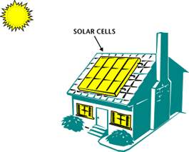
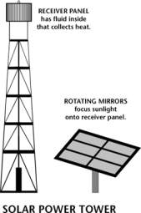
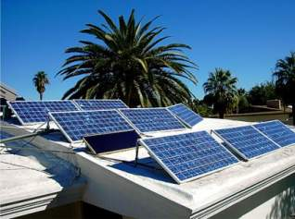
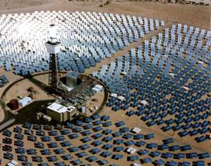
Debate – Solar Resources
Advantages
Inexhaustible fuel source with no pollution
Versatile- it is often used for powering items as diverse as solar cars and satellites
Disadvantages
Low energy production, large numbers of solar panels and large land areas are required to produce useful amounts of heat or electricity
Only areas of the world with lots of sunlight are suitable for solar power generation

