Slide 1
Anesthesia

Slide 2
Intro
http://youtu.be/Ig-pZ4OyidY
Notes:
http://youtu.be/Ig-pZ4OyidY
Because the video is a little long, end it whenever you feel necessary.

Slide 3
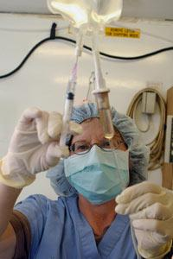
Meaning
Derived from the Greek term for “loss or lack of sensation”
3 Types of Anesthesia
Local
Regional
General
Notes:
http://science.howstuffworks.com/anesthesia.htm

Slide 4
Local Anesthesia
Remain awake and conscious
Insensitivity to pain, but can still feel pressure and sensation
Given in the form of spray, shot or ointment
Only numbs small, specific areas of the body
Notes:
http://directionsindentistry.net/category/local-anesthesia/

Slide 5
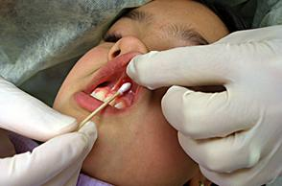
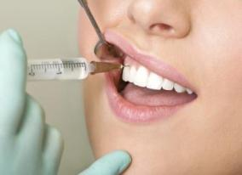
Local Anesthetic
Often used in dental offices when numbing an area of the oral cavity
Can be topical (on the surface)
Topical often applied before needle injection of local anesthetic
Notes:
http://www.dentalcare.com/en-US/dental-education/continuing-education/ce325/ce325.aspx?ModuleName=coursecontent&PartID=6&SectionID=2
http://www.speareducation.com/spear-review/2013/08/a-brief-history-of-dental-anesthesia/#.U0WjP6g_B8E

Slide 6
Local Anesthesia
Drugs used include lidocaine, Novocaine, and tetracaine
Originally, cocaine was used
Had to find alternatives because of its addictive qualities
Notes:
https://www.healthtap.com/user_questions/184668-i-am-allergic-to-novacain-septocaine-and-lidocaine-what-options-can-the-dentist-use

Slide 7
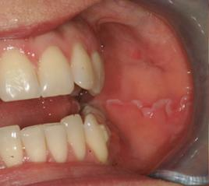
Local Anesthesia
Used in minor outpatient surgeries
Effects wear off in 4 to 5 hours
Need to be cautious around numb area afterwards to prevent harm
For example, biting a numb cheek
Notes:
http://chefintrainingwallpaper.blogspot.com/2012/10/biting-inside-of-cheek.html

Slide 8
Regional Anesthesia
Numbs a wider region of the body than local
Peripheral regional anesthesia blocks a nerve or nerve bundle to numb a limb
Central anesthesia injects anesthetic into cerebrospinal fluid or into space outside spinal canal

Slide 9
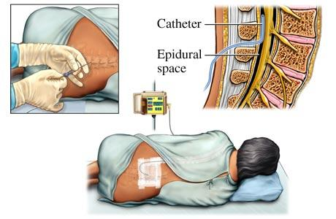
Regional Anesthesia
Epidurals
Central anesthetic given to women in labor
Drugs are continuously fed into epidural space via catheter
Loss of sensation from waist down
Notes:
http://www.drgharoun.com/pointofinterest.aspx?POIID=4

Slide 10
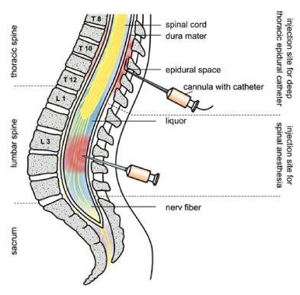
Regional Anesthesia
Spinal block
Drugs injected into cerebrospinal fluid
One time injection; no catheter needed
Waist-down paralysis (more than epidurals)
Notes:
http://www.scielo.br/scielo.php?pid=S1677-55382012000500009&script=sci_arttext
Take time here to point out how the injection sites differ between a spinal block and an epidural (cerebrospinal fluid of spinal cord vs. epidural space), as well as injection types (catheter insertion vs one-time injection)

Slide 11
Regional Anesthesia
More risky than local
Possible seizure or heart attack because of involvement with Central Nervous System
If more paralysis is needed, may switch to general anesthesia
Strict monitoring of patients under regional anesthesia

Slide 12
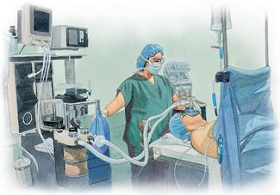
General Anesthesia
Completely unconscious and immobilized
Administered via IV (needle into vein) or gas (mask or tube) or a combination of both
Notes:
http://www.fairview.org/healthlibrary/Article/40007

Slide 13
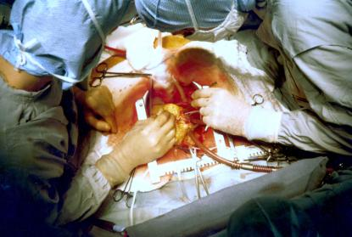
General Anesthesia
Used in major surgeries that require long lengths of time
For example, knee replacement or heart bypass
Notes:
http://en.wikipedia.org/wiki/Coronary_artery_bypass_surgery

Slide 14
General Anesthesia
Use a combination of medications to
Relieve anxiety
Keep you asleep
Minimize pain
Relax muscles to prevent movement
Block out memory of surgery

Slide 15
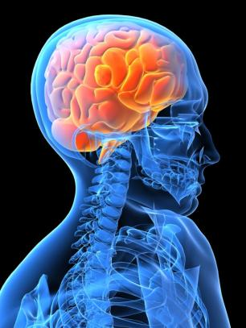
General Anesthesia
General anesthesia affects
The spinal cord, causing immobility
Brain stem, causing unconsciousness
Cerebral cortex, causing changes in brain’s electrical activity

Slide 16
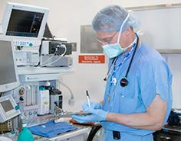
General Anesthesia
An anesthesiologist is present before, during, and after operation
Medical history is reviewed before hand
Anesthesia requires certain conditions for patients with low blood pressure or those that are alcohol/drug users
Notes:
http://www.macllp.com/patient_education/scope.cfm

Slide 17
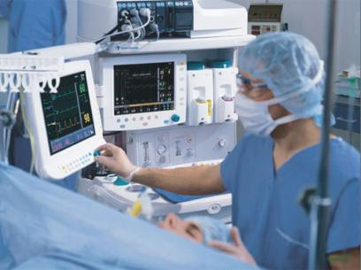
General Anesthesia
Monitors during operation
Pulse oximetry (oxygen levels in blood), heart rate, blood pressure, respiratory rates, carbon dioxide exhalation levels, temperature, concentration of anesthetic, brain activity
Notes:
http://shortwhitecoats.com/tag/spotlights-anesthesia

Slide 18
General Anesthesia
Stages
1. Induction: starting to feel the effects, but not yet unconscious
2. Excitement: unconscious, short period of irregular breathing and heart rate
3. Anesthetized: muscle relaxation, regular breathing
4. Overdose: does not regularly occur, but swift action should be taken to prevent heart/breathing stoppage, brain damage, or death

Slide 19
General Anesthesia
Side effects afterwards
Vomiting
Nausea
Numbness in area operated on
Disorientation
Notes:
http://medicalstuttering.com/2013/02/nausea-and-vomiting.html

Slide 20
General Anesthesia
Serious risks
Suffocation
Allergic reaction
Organ failure
Stroke
Death

Slide 21
Which Type to Use?
Depends on:
Type of Surgery
Location of Surgery
Length of Surgery
Current and previous medical conditions
Allergies
Reaction to anesthesia
Medications currently taking
Age, height, weight

Slide 22
References
http://science.howstuffworks.com/anesthesia.htm
http://kidshealth.org/teen/your_body/medical_care/anesthesia_types.html#

