Slide 1
Animal Images
Notes:
Students will view each picture. Discuss with students what adaptations the animals have that suit their environment and what benefits/advantages those adaptations give those animals.

Slide 2
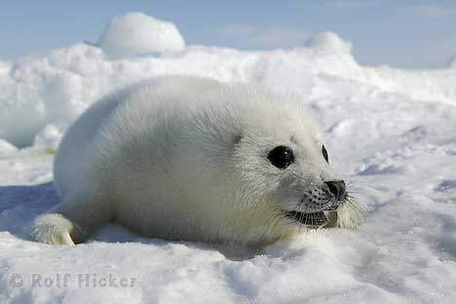
Notes:
http://questgarden.com/62/02/4/080307123457/process.htm

Slide 3
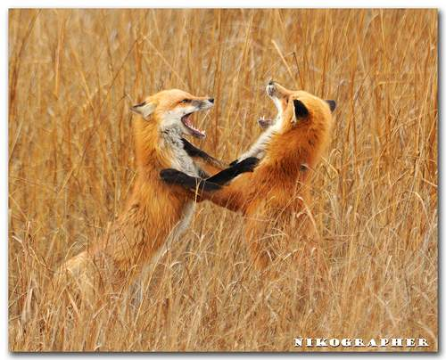
Notes:
http://www.flickr.com/groups/voices/discuss/72157605962659431/

Slide 4
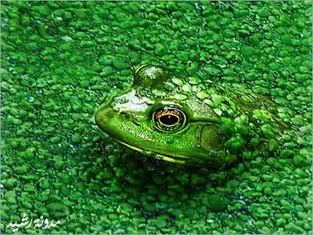
Notes:
http://www.metrolic.com/the-art-of-deception-camouflage-in-the-animal-kingdom-142141/

Slide 5
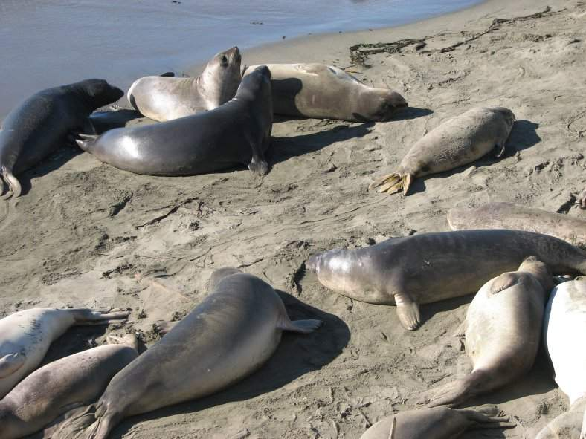
Notes:
http://luvmyanimals.com/Pittsfield-uchida-hydraulic-seal/

Slide 6
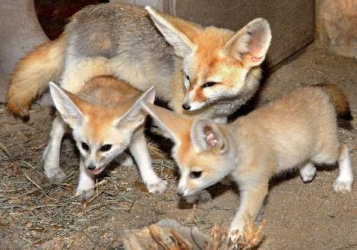
Notes:
http://www.zooborns.typepad.com/zooborns/fennec-fox/

Slide 7
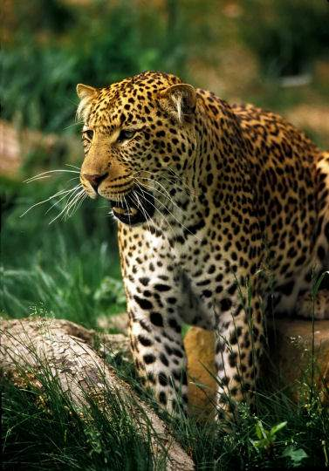
Notes:
http://haleybomhs.edublogs.org/2010/05/05/wildlife-scare-animals-of-costa-rica/

Slide 8
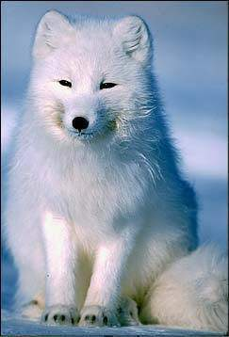
Notes:
http://www.alexandgregory.com/arcticfox.html

Slide 9
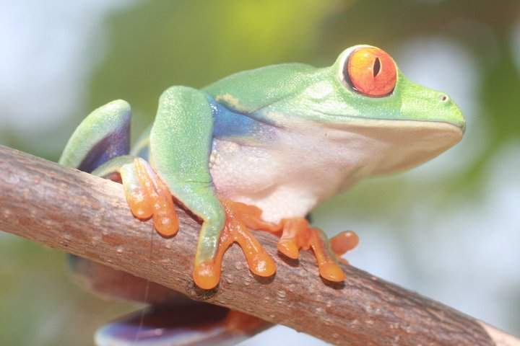
Notes:
http://www.animalembassy.com/page/librariesnature-centers

Slide 10
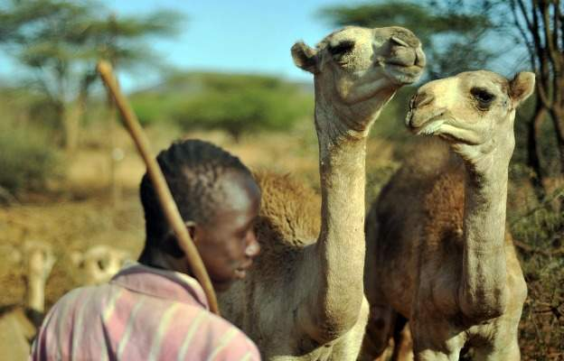
Notes:
http://blog.foreignpolicy.com/category/topic/food/agriculture

Slide 11
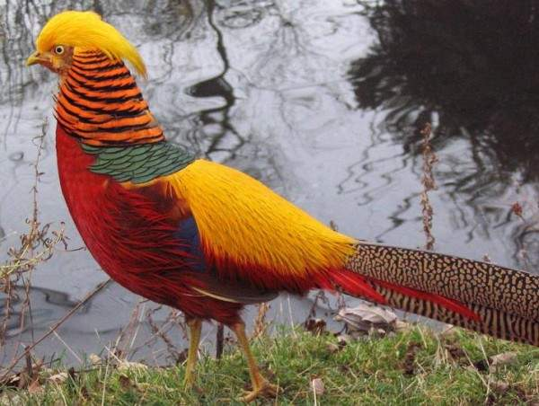
Notes:
http://wonderstube.com/tags/Animals+Wonders/

Slide 12
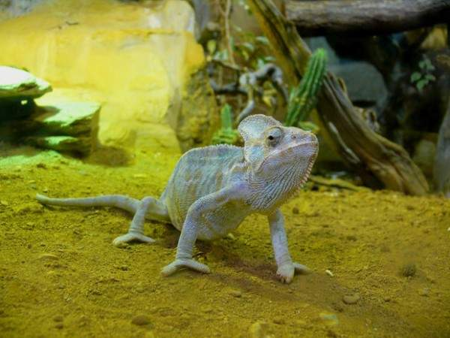
Notes:
http://wonderstube.com/tags/Animals+Wonders/

Slide 13
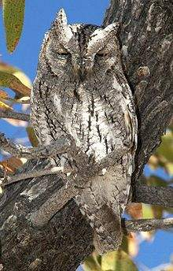
Notes:
http://en.wikipedia.org/wiki/African_Scops_Owl

