Slide 1
Animal Teeth Game
© Partnership for Environmental Education and Rural Health at
College of Veterinary Medicine & Biomedical Sciences, Texas A&M University
Funding support from the National Institutes of Health Office of Research Infrastructure Programs (ORIP)

Slide 2
Lions, and Tigers, and … Kittens?
Who let the dogs out?
All the king’s horses
Apes
Miscellaneous
10
10
10
10
10
20
20
20
20
20
30
30
30
30
30
40
40
40
40
40
50
50
50
50
50

Slide 3
Carnivore Questions Follow

Slide 4
Lions, and Tigers, and … Kittens?
Felids (domestic and otherwise) must eat meat in their diet to survive. What term do we use for animals that are required to eat meat in their diet?
Hint: This is a two word answer!
10

Slide 5
Lions, and Tigers, and … Kittens?
Obligate Carnivores!
Obligate: restricted to a particular function or mode of life
Carnivore: meat eater
10

Slide 6
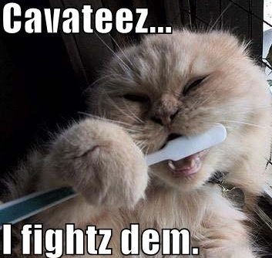
Lions, and Tigers, and … Kittens?
What dental disease commonly found in cats and dogs is caused by bacteria of the mouth?
Hint: frequent dental cleanings can help to prevent this disease
20

Slide 7
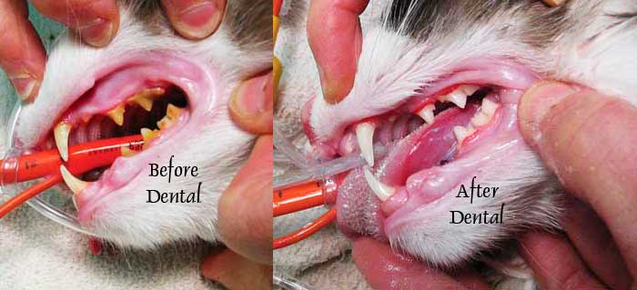
Lions, and Tigers, and … Kittens?
Periodontal disease!
20

Slide 8
Lions, and Tigers, and … Kittens?
How many total adult teeth do felids have?
30

Slide 9
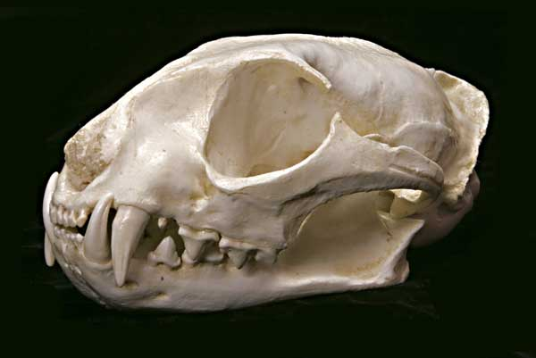
Lions, and Tigers, and … Kittens?
Adult felids have 30 teeth
30

Slide 10
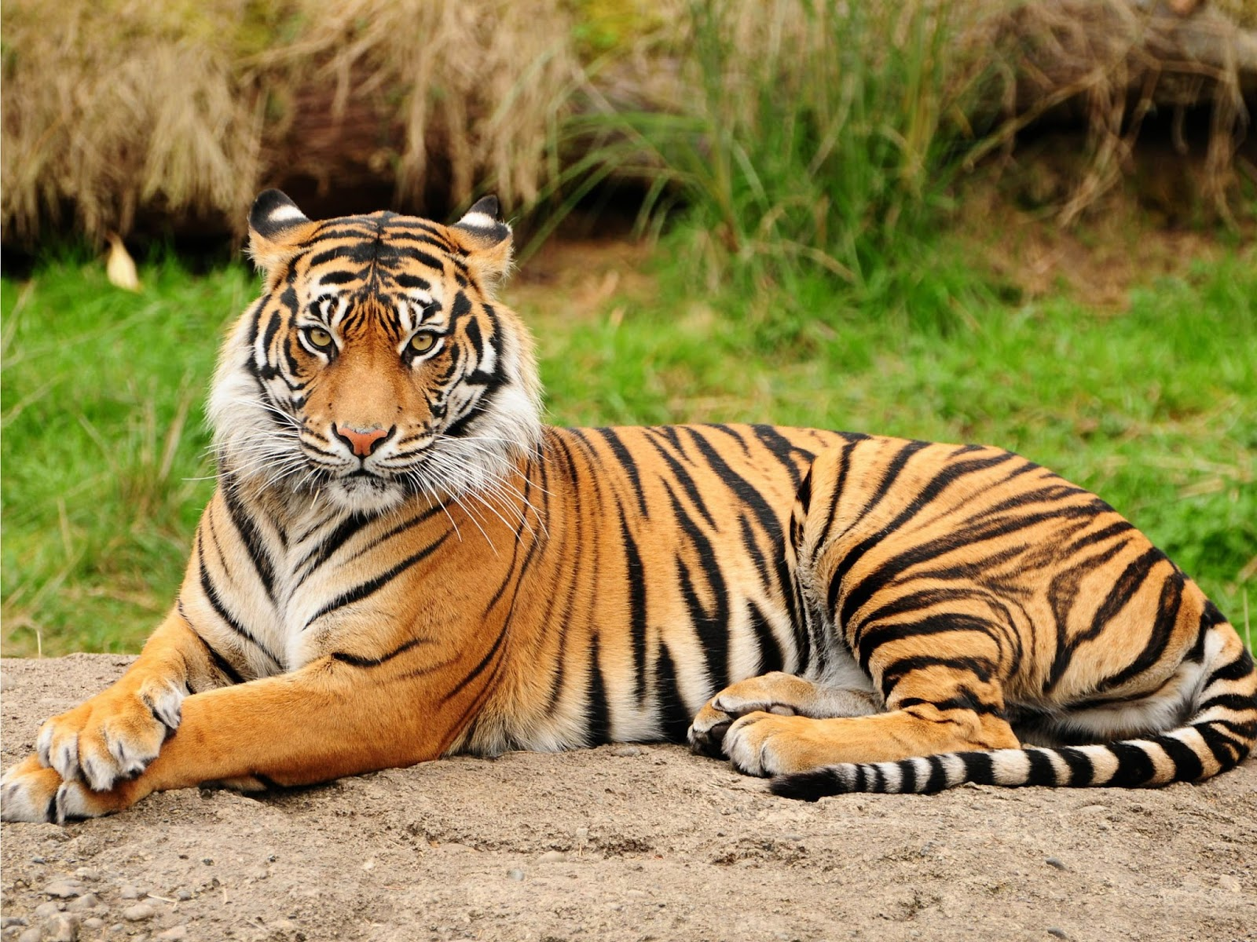
Lions, and Tigers, and … Kittens?
How many of each of the four kinds of teeth do adult felids have?
40

Slide 11
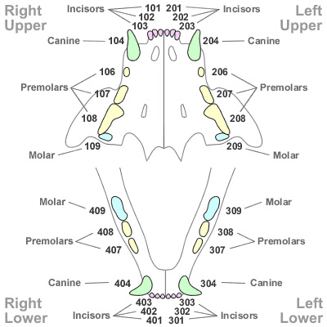
Lions, and Tigers, and … Kittens?
Incisors | Canines | Premolars | Molars
12 | 4 | 10 (3 top, 2 bottom) | 4
40

Slide 12
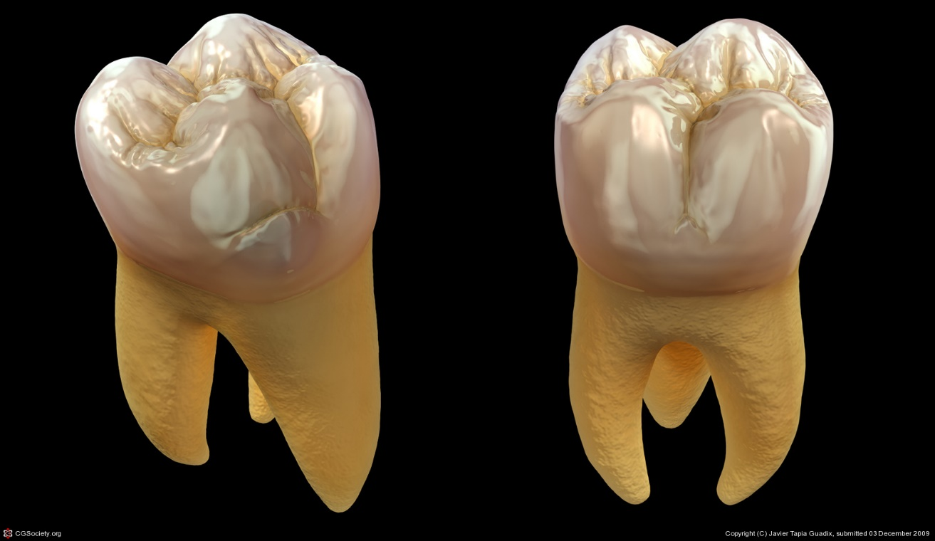
Lions, and Tigers, and … Kittens?
How do felid molars differ from molars present in herbivores and omnivores?
50

Slide 13
Lions, and Tigers, and … Kittens?
There are two correct answers:
Felids only have one set of molars
Carnivorous molars are smaller and less flat than the molars found in herbivores and omnivores
(points are awarded for either answer)
50

Slide 14
Canine Questions Follow

Slide 15
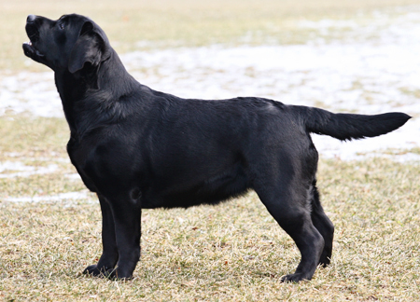
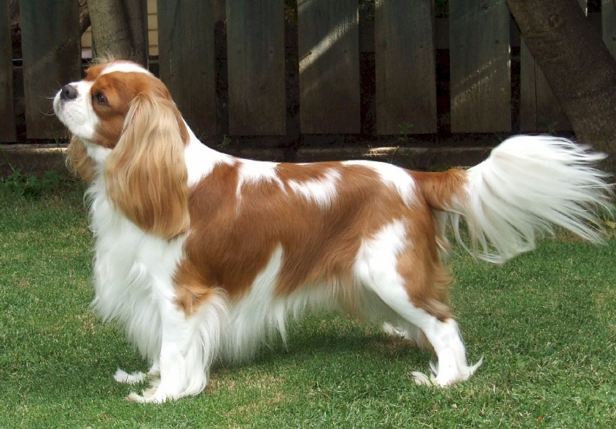
Who let the dog’s out?
Are large dog breeds or small dog breeds more prone to periodontal disease? (examples shown are a Labrador Retriever and a Cavalier King Charles Spaniel)
10

Slide 16
Who let the dog’s out?
Small dog breeds are more prone to periodontal disease!
10

Slide 17
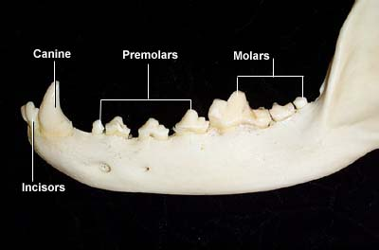
Who let the dog’s out?
Most dogs have 42 adult teeth, but one breed of dog can have 44 teeth, like bears. What breed is this?
20

Slide 18
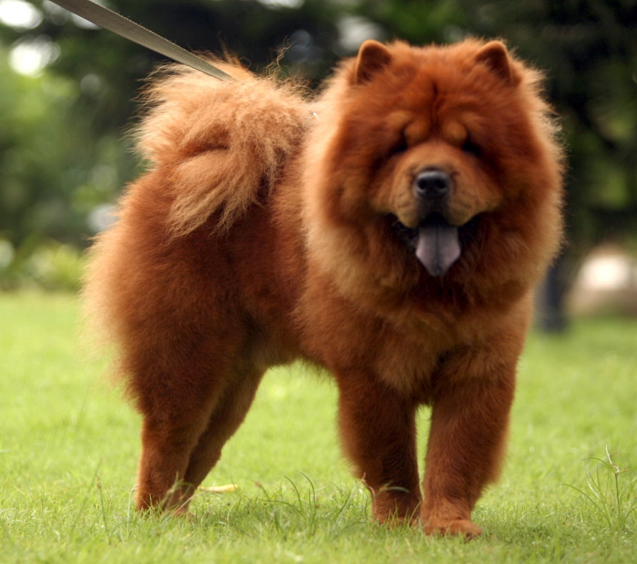
Who let the dog’s out?
Chow Chow’s
20

Slide 19
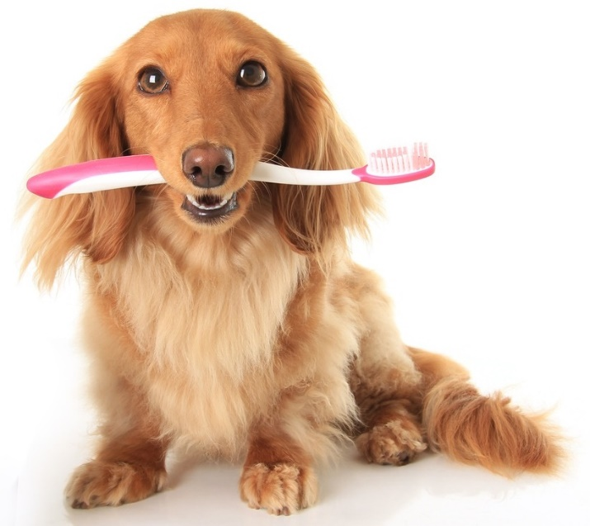
Who let the dog’s out?
What ratio (or percentage) of adult dogs have periodontal disease?
What is the best way to prevent dogs from getting periodontal disease?
30

Slide 20
Who let the dog’s out?
2/3 (or 66.666%) of adult dogs have periodontal disease
Routine dental exams are the best way to prevent periodontal disease!
30

Slide 21
Who let the dog’s out?
According to the dental video from the presentation, what is the difference between plaque and tartar?
40

Slide 22
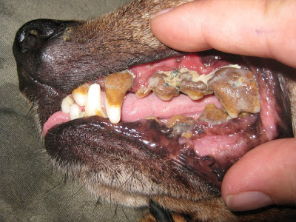
Who let the dog’s out?
Plaque can be brushed off but turns into tartar after 36 hours. Once tartar has formed, brushing will not remove tartar.
40

Slide 23
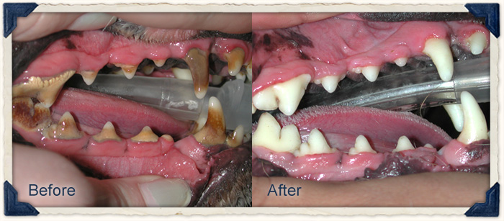
Who let the dog’s out?
How often should a dental be performed on a dog?
Periodontal disease has been linked to what other disease?
50

Slide 24
Who let the dog’s out?
Each dog varies, but most dogs should have their teeth cleaned every 6-12 months
Periodontal disease has been linked to heart disease
50

Slide 25
Equine Questions Follow

Slide 26
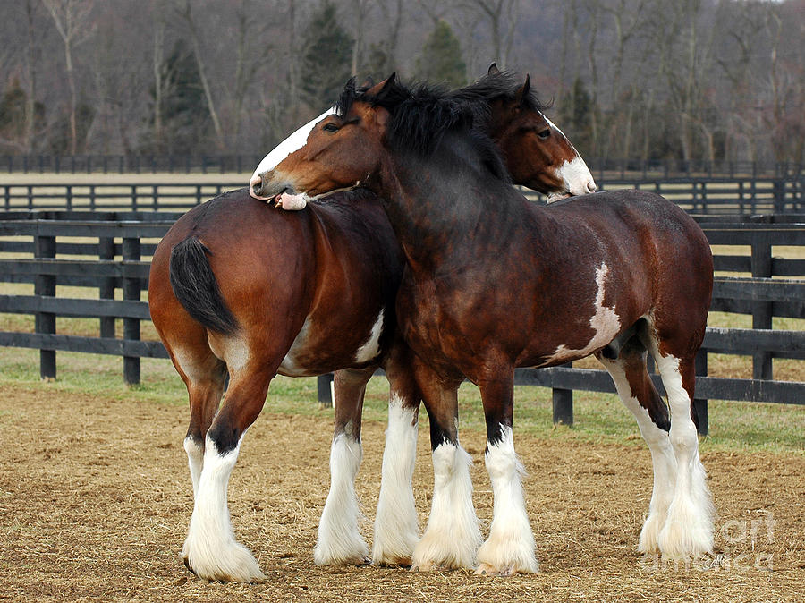
All the King’s Horses
What is the annual dental procedure performed on a horse called?
10

Slide 27
All the King’s Horses
Float, due to the name of the rasp the veterinarian’s use when performing this procedure
10

Slide 28
All the King’s Horses
What common dental problem is likely to occur when a tooth is missing or broken?
20

Slide 29
All the King’s Horses
“Step Mouth”: this occurs because the opposing tooth doesn’t have anything to grind against
20

Slide 30
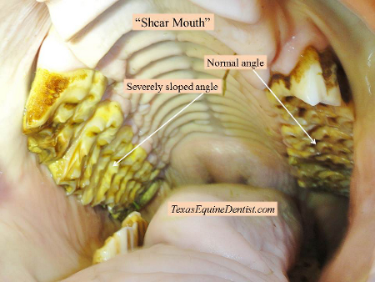
All the King’s Horses
What common dental problem is likely to occur when one side of the tooth is much higher than the other?
30

Slide 31
All the King’s Horses
“Shear Mouth”
30

Slide 32
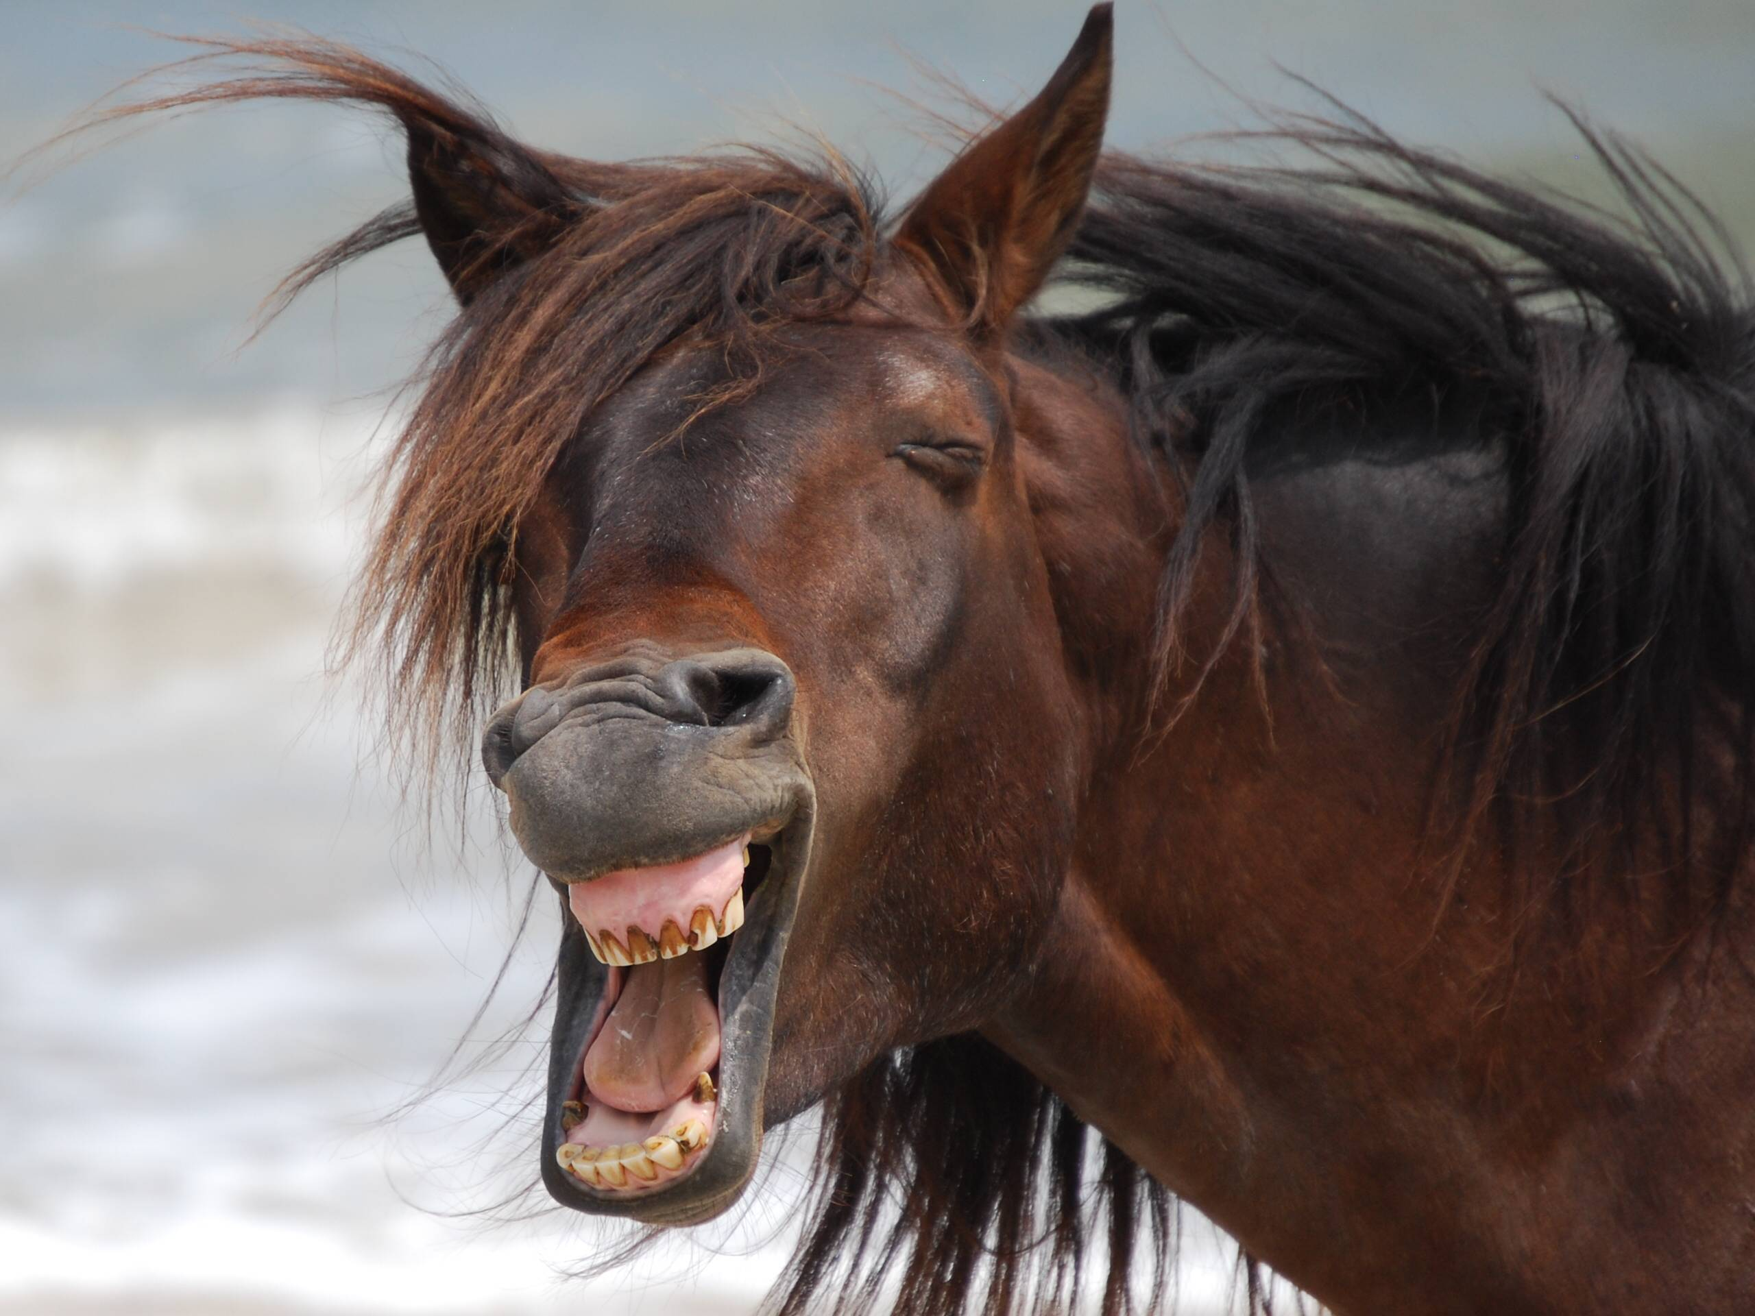
All the King’s Horses
There are teeth shown in the following picture that are more commonly found in one equine gender over the other.
Give the name of this kind of teeth
Identify where on the following picture these teeth are located
Would these teeth be seen in mares or geldings more often?
40

Slide 33
All the King’s Horses
Canine teeth
They are more commonly seen in geldings, only 28% of mares have canine teeth
40

Slide 34
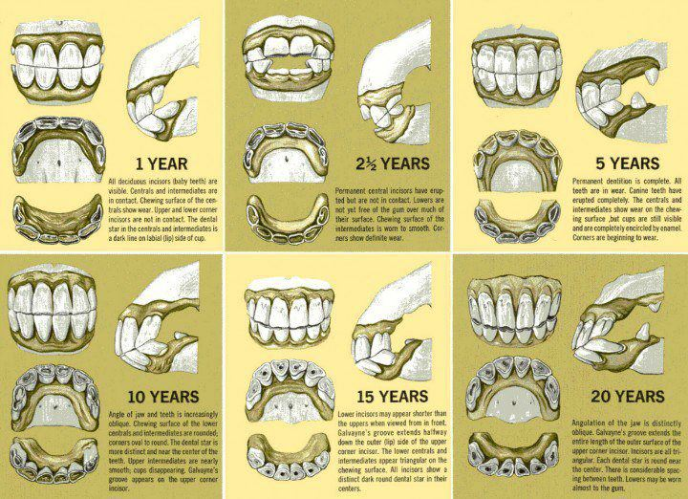
All the King’s Horses
Why do herbivores, like horses, have teeth that continually grow throughout their life?
50

Slide 35
All the King’s Horses
Because herbivores chew their food much more than omnivores and carnivores. Therefore, their teeth erode away much faster.
50

Slide 36
Ape Questions Follow

Slide 37
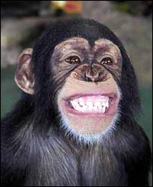
Apes
How many teeth do apes typically have as adults?
10

Slide 38
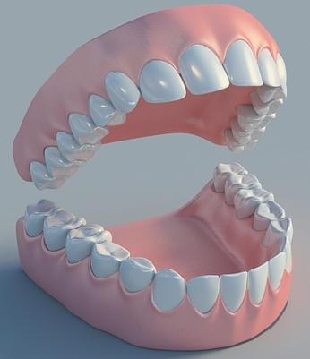
Apes
Apes have 32 adult teeth
(they have 20 baby teeth)
Top jaw: 16 teeth
Bottom jaw: 16 teeth
16+16=32
10

Slide 39
Apes
What taxonomic family do apes fall under?
Hint: this family name was used often in the presentation
__________
20

Slide 40
Apes
Hominoidea
20

Slide 41
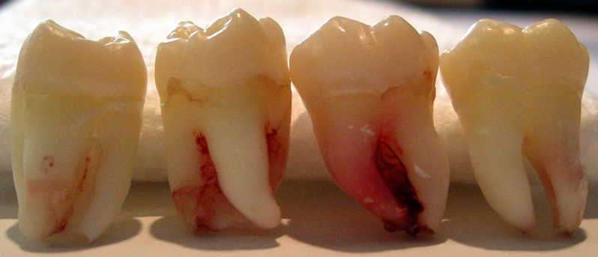
Apes
What type of teeth are “wisdom teeth”?
What set of this type of teeth are they?
Hint: wisdom teeth are either the 1st, 2nd, or 3rd set of one of the 4 types of teeth we discussed!
30

Slide 42
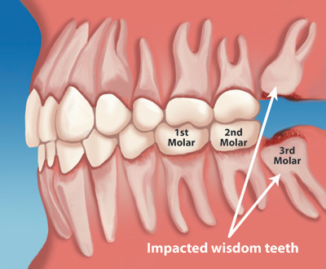
Apes
Wisdom teeth = 3rd molars!
30

Slide 43
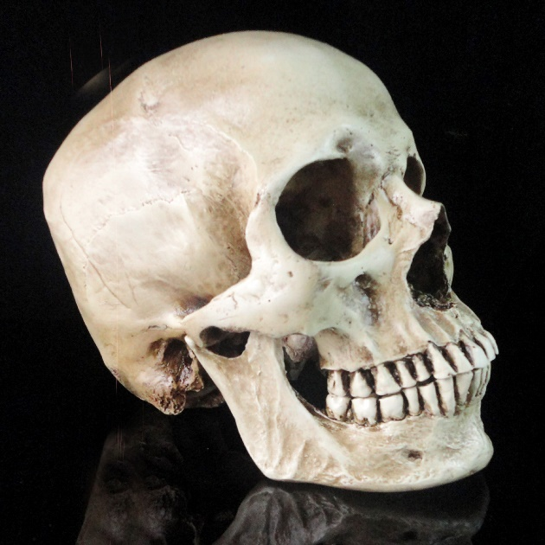
Apes
Apes, along with dogs and pigs, are omnivores. An omnivores teeth are designed to ____ like a herbivores, and _____, like carnivores.
Fill in the blanks.
40

Slide 44
Apes
Apes, along with dogs and pigs, are omnivores. An omnivores teeth are designed to GRIND like a herbivores, and TEAR, like carnivores.
Fill in the blanks.
40

Slide 45
Apes
How many of each of the four kinds of teeth do apes have?
Incisors | Canines | Premolars | Molars
50

Slide 46
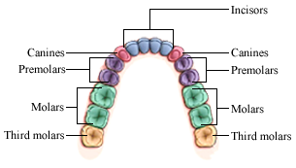
Apes
Apes have:
Incisors | Canines | Premolars | Molars
8 | 4 | 8 | 12
The bottom jaw and top jaw have the same number of each type of tooth, just multiple this diagram by 2 and you have the total number of each kind of teeth!
50

Slide 47
Miscellaneous Questions Follow

Slide 48
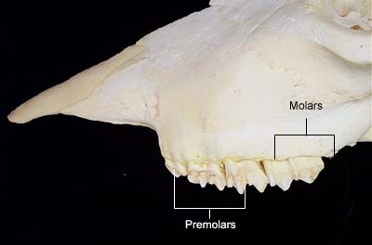
Miscellaneous
What group of animals doesn’t have incisors on the upper jaw?
What do these animals have instead?
10

Slide 49
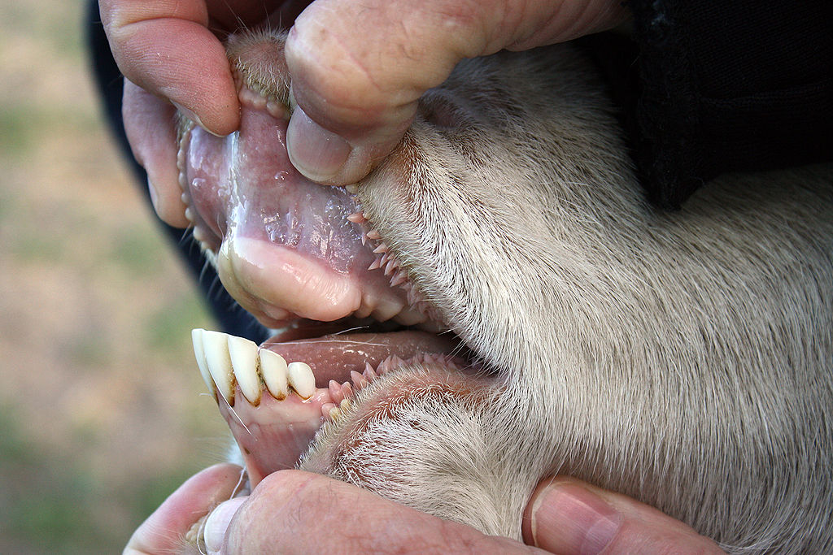
Miscellaneous
Ruminant animals, they have a dental pad instead of incisors
10

Slide 50
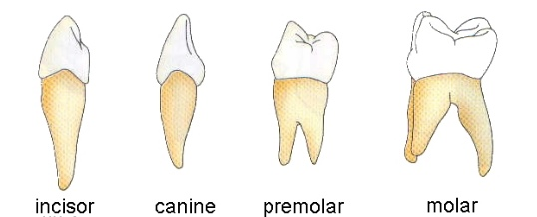
Miscellaneous
What are the four types of teeth and their functions?
Category 5 question for 20 points
20

Slide 51
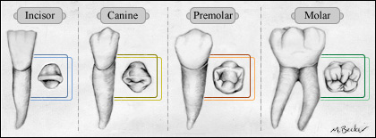
Miscellaneous
Incisor: used to take bites of food, sharp and blade-like
Canine: used to tear food (especially meat), pointed and sharp
Premolar: chew and grind food, intermediate between canine and molar
Molar: chew and grind food, broad and flat
Incisor
Canine
Premolar
Molar
20

Slide 52
Miscellaneous
Which species discussed in this presentation has needle teeth?
Are needle teeth deciduous or adult teeth?
30

Slide 53
Miscellaneous
Baby pigs (swine) have 8 needle teeth present at birth (they are deciduous). They are clipped soon after birth to prevent injury to littermates and the sow.
30

Slide 54
Miscellaneous
Determine which group each of the following species belongs to. Each dietary group may be used more than once!
Herbivore
Omnivore
Carnivore
Horses
Domestic dogs
Humans
Cow
Domestic cat
Wild hog
Chimpanzee
Wolf
Goat
40

Slide 55
Miscellaneous
Determine which group each of the following species belongs to. Each dietary group may be used more than once!
Herbivore
Omnivore
Carnivore
Horses
Domestic dogs
Humans
Cow
Domestic cat
Wild hog
Chimpanzee
Wolf
Goat
40

Slide 56
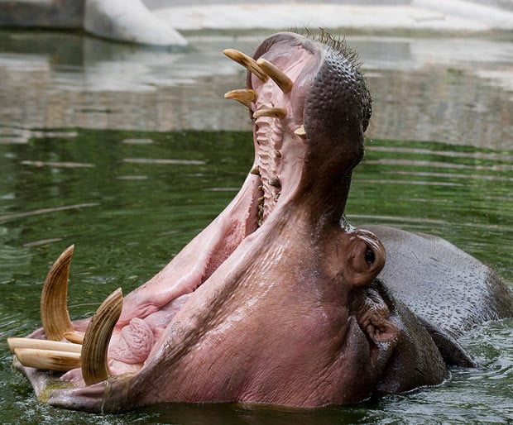
Miscellaneous
Why do some herbivores and omnivores have large canine teeth?
What is the process called that enhances the development of larger canine teeth in these animals?
Fun Fact: hippopotamuses are considered herbivores
50

Slide 57
Miscellaneous
Large canines may be present in omnivores and herbivores for threat displays and mating rights.
Natural selection enhances the species genetics for a certain trait (ex. Large canine teeth) over many generations.
Think about this: if only men and women over 6ft tall were allowed to have children, then the average height of the human population would increase drastically over a few generations!
50

