Slide 1
Atmospheric Movement

Slide 2
Teacher Demonstration
What do you think will happen when the warm air trapped inside the container meets with the surface of the cold plate?
Notes:
Demonstration adapted from: http://www.weatherwizkids.com/experiments-make-rain.htm

Slide 3
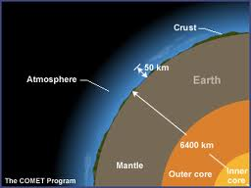
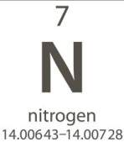
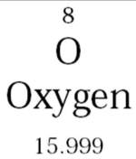
What is the Atmosphere?
The atmosphere is a mixture of gases surrounding the Earth.
It is held in place by gravity.
The atmosphere contains the gases necessary for life on planet Earth!
The atmosphere is composed primarily of nitrogen (78%), oxygen (21%), and traces of other gases.

Slide 4
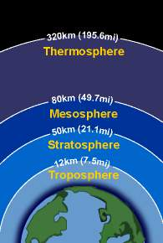
The Atmospheres’ Layers
The Earth’s atmosphere is made up of several layers:
Troposphere
Stratosphere
Mesosphere
Thermosphere
Exosphere
Closest to Earth is the troposphere.
The troposphere is where all weather occurs.
Exosphere
Come up with a mnemonic to remember the layers!
‘Tepid sasquatch makes tractors everyday’
Notes:
Students can right their mnemonic on a piece of paper to turn in or tell you their mnemonic to leave the room.

Slide 5
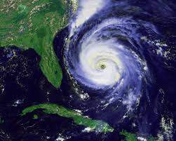
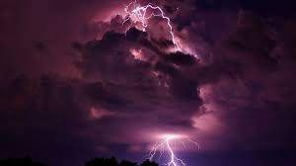
What does the atmosphere do?
The atmosphere acts like a giant blanket, keeping the Earth warm.
Things like hurricanes, lightning and thunderstorms, hail, flooding, and tornadoes are caused by changes in the atmosphere.

Slide 6
Quick Check!
What is one of the gases that makes up Earth’s atmosphere?
Nitrogen or Oxygen
What layer of the atmosphere does weather occur in?
Troposphere
Name one example of weather that occurs because of atmospheric movement.
Hurricane, thunderstorm, hail, etc.
Notes:
Students can answer the questions either raising their hand or writing them on paper to turn in after the presentation for a grade.

Slide 7
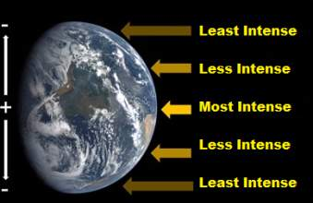
What’s so special about the sun?
The sun heats the earth at different levels of intensity.
The sun is always shining perpendicular to the equator, but at different angles to the rest of the Earth.
The intensity of the suns’ rays vary from the Northern Hemisphere to the Southern Hemisphere over a year
causing seasons.

Slide 8
Earth’s Seasons

Slide 9
Earth’s Tilt Causes Seasons

Slide 10
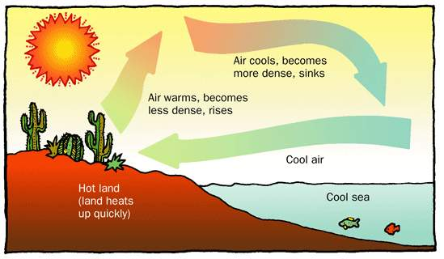
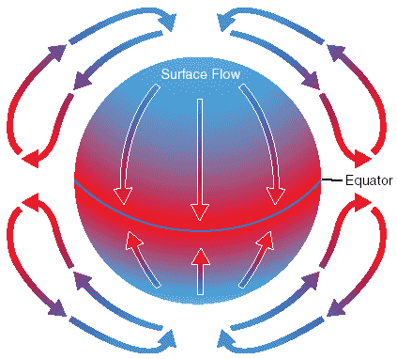
Air Movement
The equator is hot year round, but the polar regions stay cooler than the equator.
This uneven global heat distribution gives rise to convection currents that attempt to equalize the heat distribution.

Slide 11
What’s so special about the sun?
The heat that comes from the sun shining on the Earth causes air to move!
The air in our atmosphere is always moving!

Slide 12
Convection Currents Demonstration
Stop for demonstration!
Based on what you learned about convection currents, explain what happened?
Notes:
This is an example of atmospheric convection. The heat of the hot water and the cool temperature of the cold water in the 1st pair do not mix because heat rises and cold sinks in. In the 2nd pair, where initially the heat is at the bottom while the cold is at the top, the heat moves upwards in a convectional cycle. The warm water molecules have more energy and move around at higher rates than cold water molecules. This causes them to have less density compared to the cold water molecules, resulting in the warm water molecules to rise up in the 2nd pair.

Slide 13
Quick Check!
Convection currents attempt to equalize the heat distribution.
When convection currents move air what temperature of air rises and what temperature of air sinks?
Hot air rises
Cold air sinks

Slide 14
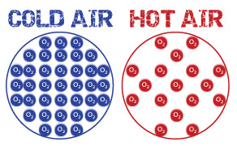
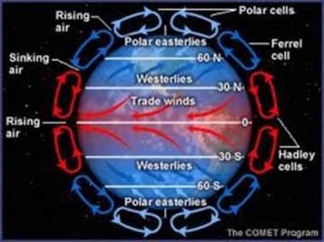
Convection Currents
Convection currents refer to the up and down movement of air.
Hot air rises! As air is heated by the sun over the equator it rises up and spreads towards the poles.
When air is heated the molecules spread far out from each other becoming less dense and move faster.

Slide 15
Convection Currents
Cold air sinks! As the air moves north it begins to cool and sinks back down to Earth.
Cold air compresses, the molecules get more dense and slow down.
The cool air then flows back towards the equator and the cycle starts again!

Slide 16
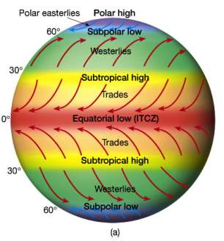
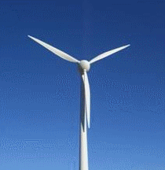
Wind
When convection currents start to move air, we get wind close to the surface of the Earth.
Wind is atmospheric movement that causes a lot of the weather we experience.
Notes:
The arrows show the movement of the wind and how the wind can be effected by pressure systems

Slide 17
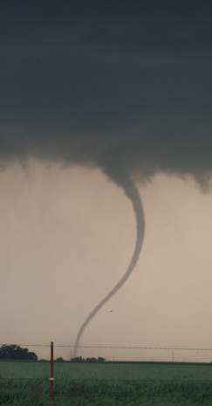
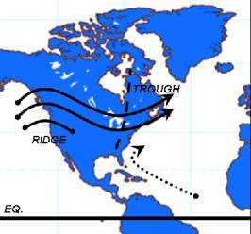
Westerly Winds
The Westerlies are the prevailing winds in the middle latitudes between 35° - 65 ° latitude.
These winds often cause a cyclone effect that creates tornadoes and hurricanes across these latitudes.

Slide 18
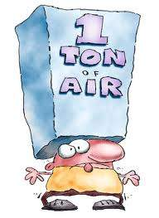
Atmospheric Pressure
Atmospheric pressure is the weight of the air in the atmosphere pressing down on the Earth, the ocean, and on the air below.
Air pressure changes the weather.

Slide 19
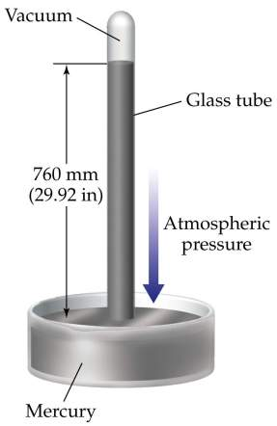
Air Pressure
Measured with a barometer
Barometers measure the pressure of the atmosphere at a particular spot

Slide 20
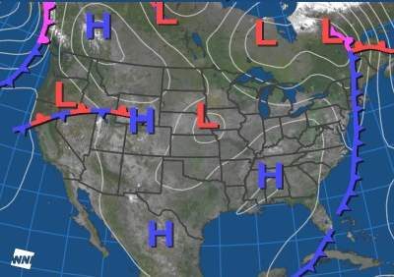
What does it mean when there is an H on the map?
H is an area of high pressure, which means the air is more dense.
What does it mean when there is an L on the map?
L is an area of low pressure, which means the air is less dense.
More Dense
Less Dense

Slide 21
Air Pressure Demonstration
Stop for demonstration!
Based on what you learned about convection currents, explain what happened?
Notes:
What happens? The lighted newspaper heat the air inside the bottle above. When air is heated it expands and takes up more room. As the heated air expands, some of it escapes out of the bottle. When the newspaper goes out, the air inside the bottle cools and contracts, which takes up less room. This creates a lower pressure inside the bottle than outside the bottle. The greater pressure outside the bottle forces the egg to get sucked into the bottle.
To remove the egg: blowing air into the bottle raises the air pressure to push the egg back out.

Slide 22
What is a high pressure system?
A high pressure system is a whirling mass of cool, dry air that generally brings fair weather and light winds.
When viewed from above, winds spiral out of a high-pressure center in a clockwise rotation.
These bring sunny skies!

Slide 23
What is a low pressure system?
A low pressure system is a whirling mass of warm, moist air that generally brings stormy weather with strong winds.
When viewed from above, winds spiral into a low-pressure center in a counterclockwise rotation.

Slide 24
High vs. Low

Slide 25
Quick Check!
What kind of weather are Montana, Nevada, and New Mexico most likely experiencing in this picture?
What kind of weather are Louisiana, North Carolina, and Michigan most likely experiencing in this picture?
Notes:
Answer:
Montana, Nevada, and New Mexico are experiencing stormy weather and strong winds.
Louisiana, North Carolina, and Michigan are experiencing cool, dry weather with fair winds.

Slide 26
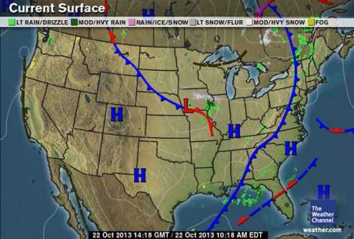
What is a front?
An air mass is a large body of air that has similar moisture and temperature characteristics.
A front is a transition zone between two air masses.

Slide 27
Cold Front
A cold front is a boundary between two air masses, one cold and the other warm, moving so that the colder air replaces the warmer air.
A cold front is represented as a blue line with triangles.
Cold fronts often can bring severe thunderstorms, hailstorms or tornadoes.
Identify the cold front on this map.

Slide 28
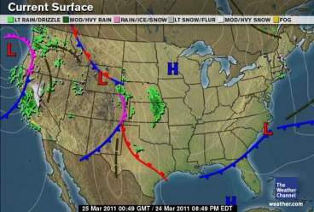
Warm Front
A warm front is a boundary between two air masses, one cool and the other warm, moving so that the warmer air replaces the cooler air.
A warm front is represented as a red line with half circles.
Along the warm front rainfall will increase and clouds can extend all the way to the earth’s surface as fog.
Identify the warm front on this map.

Slide 29
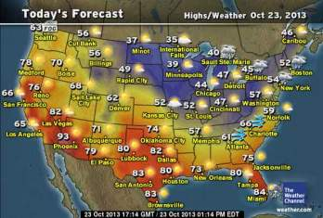
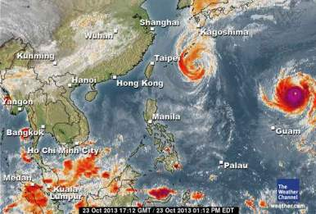
Weather
What makes up the weather where we live?
Weather is the state of the atmosphere with respect to wind, temperature, cloudiness, moisture, and pressure.

Slide 30
Weather
What kind of weather is happening at point 1?
What kind of weather is happening at point 2?
2
1
http://teacher.scholastic.com/activities/wwatch/investigate/weather_maker.htm
Notes:
Answer:
Point 1 – Warm front, foggy rainfall
Point 2 – Cold front, thunderstorm maybe hailstorm or tornado

Slide 31
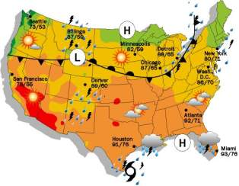
Closing Questions
http://www.sercc.com/education_files/wxmap/wxmap.html
This activity will test your knowledge of what type of weather occurs around areas of high and low pressure as well as around weather fronts!

Slide 32
References
https://nisd.schoolnet.com/Outreach
http://earth.rice.edu/mtpe/atmo/atmosphere/atmosphere_why.html
jpostema.napsk12.org/blob/download/1376‎
https://fp.auburn.edu/fire/atmosphere.htm
http://www.learner.org/interactives/weather/atmosphere.html
http://www.indiana.edu/~geol105/1425chap4.htm
http://usatoday30.usatoday.com/weather/tg/whighlow/whighlow.htm
http://usatoday30.usatoday.com/weather/wbarocx.htm
http://en.wikipedia.org/wiki/Wind#Global_climatology
http://www.weatherwizkids.com

