Slide 1
ATOMS
Building blocks of life

Slide 2
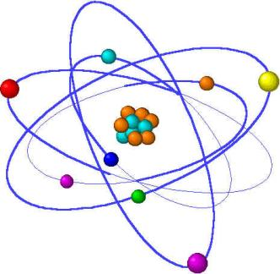
What are Atoms?
Atoms are the building blocks of matter made up of Protons, Neutrons & Electrons.

Slide 3
Inside the Atom
A proton is a positively charged (+) particle in the center of the atom
An electron is a negatively charged (-) particle on the outside of the atom and are the smallest.
A neutron is “neutral” and has no charge. It is found in the center of the atom with the protons.

Slide 4

ELECTRON
NEUTRON
PROTON

Slide 5
Atomic Theory
All matter is made of atoms. They cannot be destroyed.
Compounds are made by combining two or more atoms.
A chemical reaction is a rearrangement of atoms.

Slide 6
Atoms make up elements
An element is a substance made up of one type of atom
The number of protons in an atom decide which element that atom will be.
If you change the number of protons then you change the element.

Slide 7
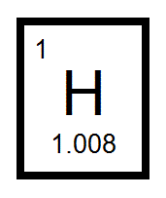
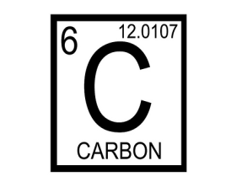

Example:
Hydrogen has 1 proton but…. if you ADD 5 more protons then you make Carbon
+ 5 protons

Slide 8
The periodic table
The periodic table is a chart that has information about all atoms
It’s like the alphabet. When you combine different atoms or “letters”, you make different substances or “words”

Slide 9
The periodic table
The atomic number tells us how many protons are in the atom.
The # of protons = the # of electrons.
The atomic mass tells us how many protons AND neutrons are in the atom.
  Atomic mass= Protons + Neutrons

Slide 10
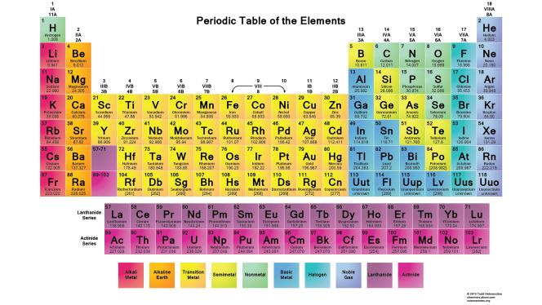
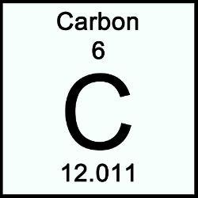
The periodic table
We know carbon has 6 protons. Atomic mass is protons + neutrons, so there are 6 neutrons.
The atomic number tells us Carbon has 6 protons and 6 electrons.
Atomic number
Atomic mass

Slide 11
Molecules vs. Compounds
Molecules
Compounds
Molecules are made by combining atoms of the same element
Combining two Hydrogens together makes an H2 molecule
A compound is made by combining molecules from different elements
  Combining H2 and Oxygen makes H2O or a “water” compound

Slide 12

Memory Check
The center of an atom is composed of?
  Protons
  Neutrons
  Electrons

Slide 13
Memory Check
If an element has 6 neutrons, 4 protons, and 4 electrons… What is the Atomic Mass?
Atomic Mass= neutrons + protons
  6+4= 10
  The Atomic Mass is 10

Slide 14
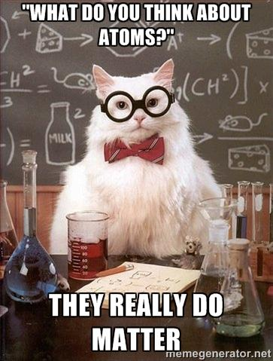
Atoms combine to make matter!!

Slide 15
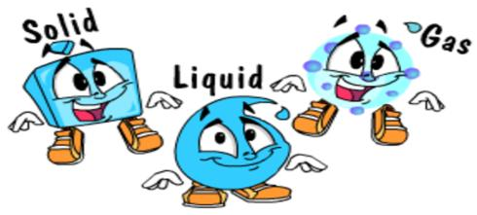
Matter
Matter is anything that has mass (weight) and takes up space
Everything is made up of matter; your desk, your pencil, and your water are all made of matter.
3 common states of matter:
  Solid
  Liquid
  Gas

Slide 16
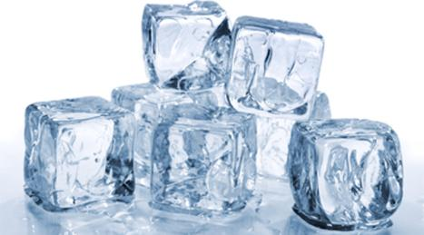
Solid, liquid, or gas?
If something is a solid:
  The molecules are packed tightly together
  Think of ice cubes. It has a shape.

Slide 17
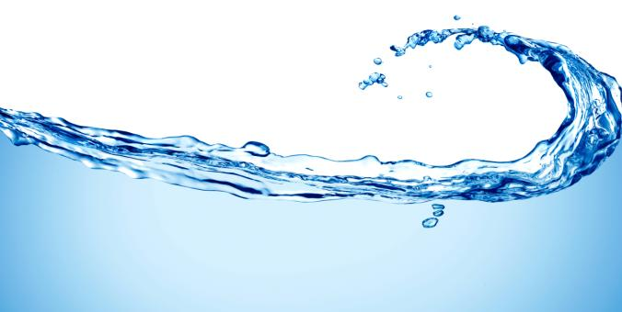
Solid, liquid, or gas?
If something is a liquid:
  The molecules can flow easily and take the shape of the container
  Think of water. It has no shape.

Slide 18

Solid, liquid, or gas?
If something is a gas:
  The molecules can’t be contained and fly around everywhere
  Think of the air we breathe. Can you grab it? NO, because the molecules are spread out and flying quickly

Slide 19
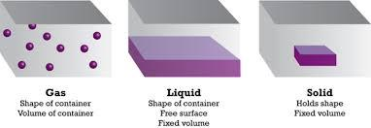
If you tried to put these molecules in a jar…
Gas
Shape of container
Volume of container
Liquid
Shape of container
Free surface
Fixed volume
Solid
Holds shape
Fixed volume

Slide 20
Solid vs. Liquid
SOLID
LIQUID
Has no shape
Takes the shape of the container it is in
Molecules not packed tightly
Has a shape
Molecules are packed tightly together

Slide 21
Gas
Gas is different
It takes the shape of the container
The molecules are spread very far apart
Example:
  When you blow up a balloon, all the air takes the shape of the balloon

Slide 22

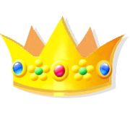


Can you figure out what is a solid?
book
crown
water
tea
cloud
duck
Air in a balloon
Frozen ice cream
Notes:
Solids: book, frozen ice cream, crown, duck
Liquids: tea, water
Gas: cloud, air in a balloon

Slide 23
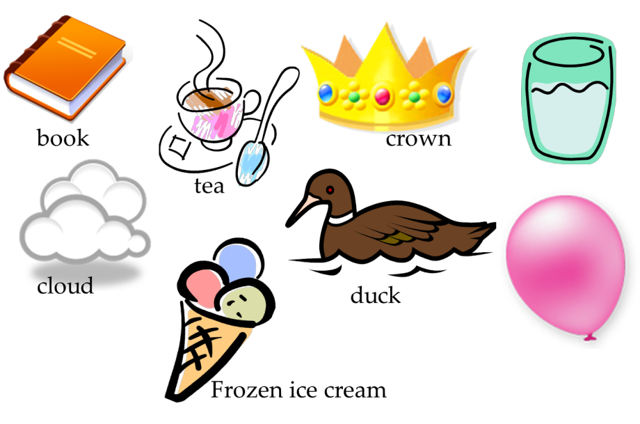
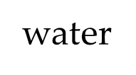
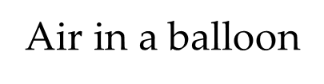
Can you figure out what is liquid?

Slide 24
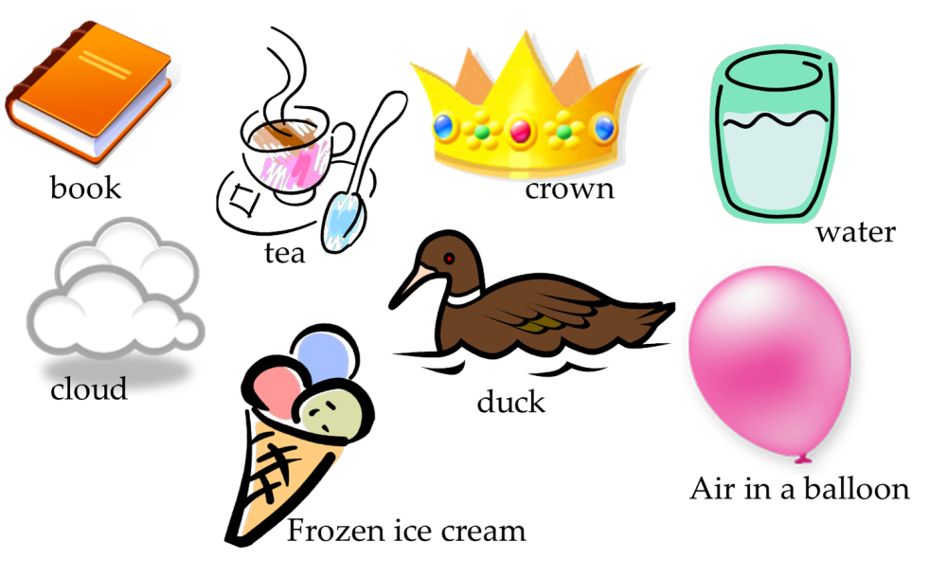
Can you figure out what is a gas?

Slide 25
REVIEW
Atoms make up everything we see
Atoms have protons, neutrons, and electrons
You change what an atom is by adding protons
The periodic table is a list of all the atoms in the world

Slide 26
REVIEW
When you combine the same atoms you make molecules. When you combine different molecules you make compounds.
Matter is anything that takes up space.
Matter can be solid, liquid, or gas.

