Slide 1
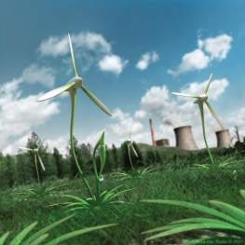
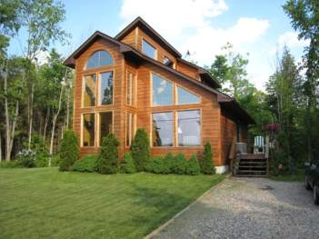
Be The Change
Solving Energy Inefficiencies in the Home

Slide 2
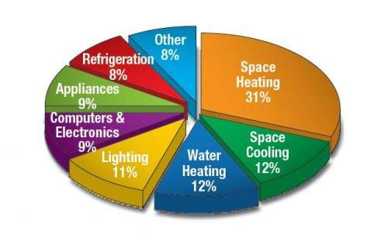
The Typical House
Energy inside your home is used for all sorts of things, your TV, computers, and refrigerator, to name a few. Using this nonrenewable energy is the cheapest way to get energy to your home, but when coal is burned it creates air pollution. When you save energy, you reduce pollution and save money on your energy bill too!
The diagram to the right represents where the most energy is spent in the typical home.

Slide 3
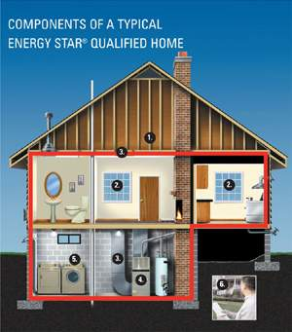
Ways to Save!
Effective Insulation
High-Performance Windows
Tight Construction and Ducts
Efficient Heating and Cooling Equipment
Lighting and Appliances

Slide 4
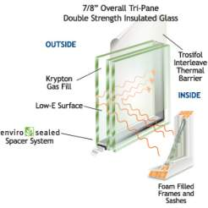
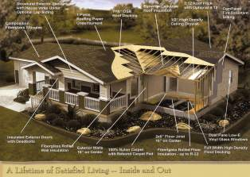
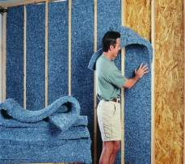
Why?
Effective Insulation- Properly installed, climate-appropriate insulation in floors, walls, and attics ensures even temperatures throughout the house, less energy consumption, and increased comfort.
High-Performance Windows- Energy-efficient windows employ advanced technologies, such as protective coatings and improved frame assemblies, to help keep heat in during winter and out during summer
Tight Construction and Ducts- Sealing holes and cracks in the home’s “envelope” and in duct systems helps reduce drafts, moisture, dust, pollen, and noise. A tightly sealed home improves comfort and indoor air quality while reducing utility bills.

Slide 5
Why? Continued…
Efficient Heating and Cooling Equipment- Less energy to operate, quieter, reduce indoor humidity, and improve the overall comfort of the home. Typically, more durable and requires less maintenance than standard models.
Lighting and Appliances- lighting fixtures, compact fluorescent bulbs, ventilation fans, and appliances, such as refrigerators, dish washers, and washing machines are all appliances that are produced in energy efficient models. Check the product information and make sure your parents only buy energy smart!

Slide 6
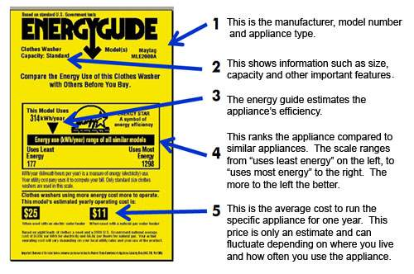
Look for the Energy Star Guide
Energy Star is a joint program of the U.S. Environmental Protection Agency and the U.S. Department of Energy helping us all save money and protect the environment through energy efficient products and practices. Results are already adding up. Americans, with the help of Energy Star, saved enough energy in 2006 alone to avoid greenhouse gas emissions equivalent to those from 25 million cars all the while saving $14 billion on their utility bills.

Slide 7
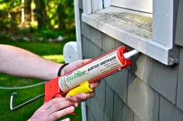
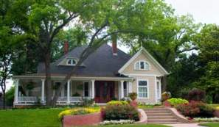
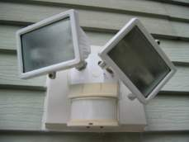
Outside Your House
Plant a tree!
Mature shade trees look beautiful, and can save energy in the summer by shielding your house from the sun and cutting cooling energy needed. Plant them on the southern and western sides of your home for extra efficiency.
Seal all windows, gaps, and cracks on your house to decrease energy wasted.
Use an electric lawn mower!
Install motion detector outside lights or solar lights.

Slide 8
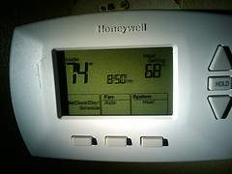
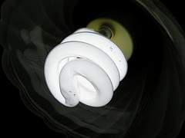
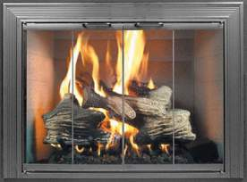
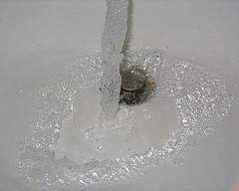
Inside Your House
Change your light bulbs– Switch to compact fluorescents, they use 75% less energy than incandescent bulbs.
Electronics- When you are not using it, unplug it! They use electricity even if turned off.
Use a high tech thermostat that is programmable. It can run cooler in the day and warmer at night.
Install low flow shower heads and reduce your water use.
Put glass doors on your fireplace to reduce heat loss from the house.

Slide 9
Now it’s your turn!
Your teacher will put you into groups. You and your group get to design an energy efficient home on graph paper! Be sure to explain all parts of the home that make it energy efficient. This is a contest; the home that has the most energy efficient qualities will win the “Energy Star” Award!

