Slide 1

BIODIVERSITY

Slide 2
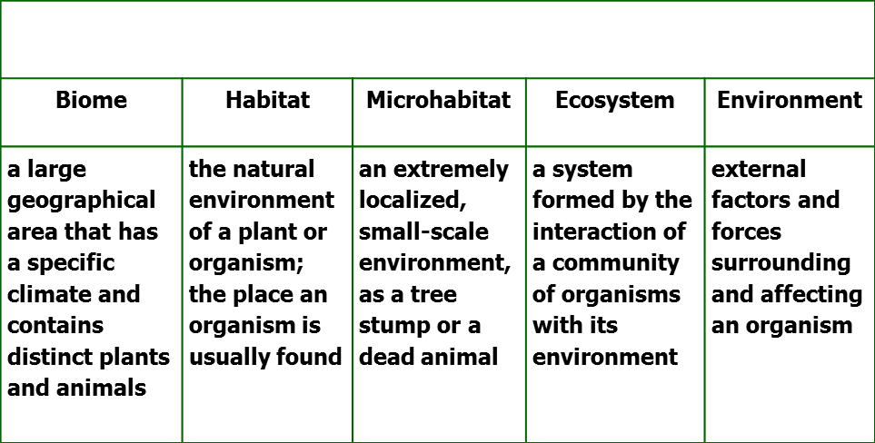

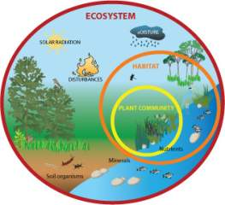
Breaking it down!
Different environments allow for →
Different species of plants and animals (biodiversity) which are ALL needed together to contribute to the →
Sustainability of the ecosystem
(even the ants!!)

Slide 3
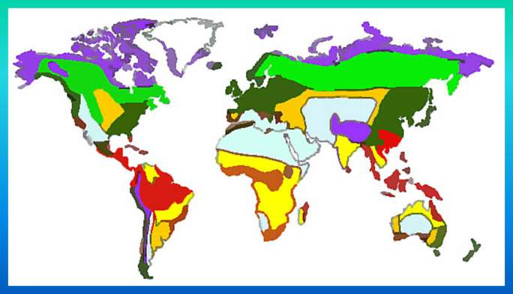
BIOME MAP
TERRESTRIAL BIOMES!! (to name a few)
Rainforest
Temperate Deciduous Forest
Taiga Forest
Chaparral
Grasslands
Savanna
Desert
Tundra

Slide 4

Biome Biodiversity
click to play!

Slide 5
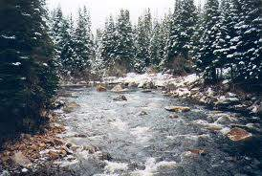
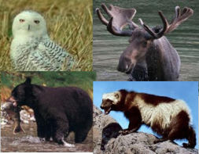
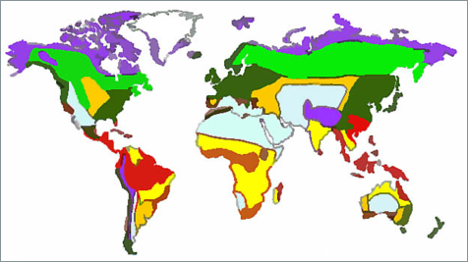
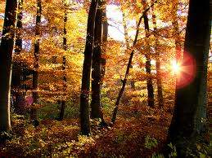
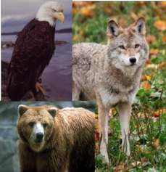

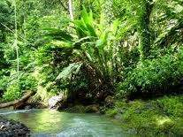
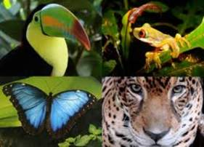
Terrestrial Biomes!
TAIGA
DECIDUOUS
RAINFOREST

Slide 6
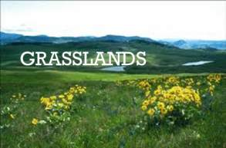
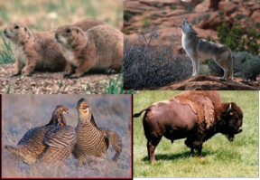


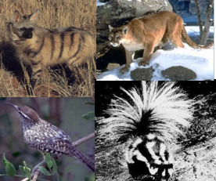
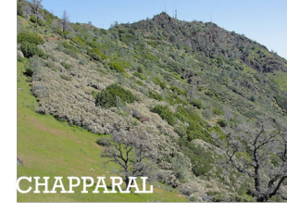
Terrestrial Biomes
Again!

Slide 7
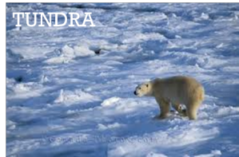
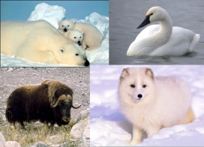

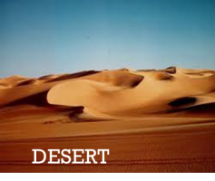
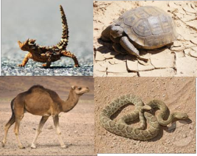
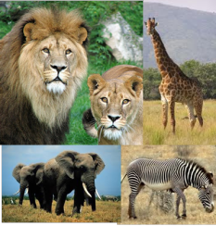
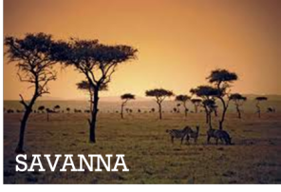
Terrestrial Biomes!
Even more

Slide 8

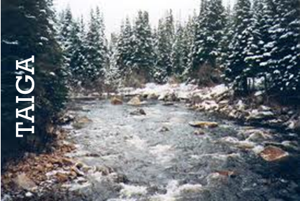
Biodiversity of the Biomes:
All the different environments support different varieties of organisms.
The climate, location, and soil are examples of biome-specific characteristics that support the unique plants and animals of the area!
An African Savanna is no place for a moose!
You won’t find a giraffe in the Taiga!

Slide 9
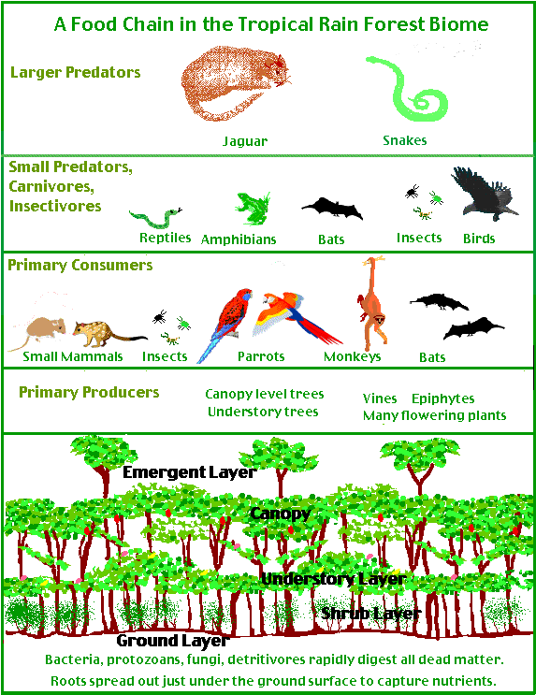
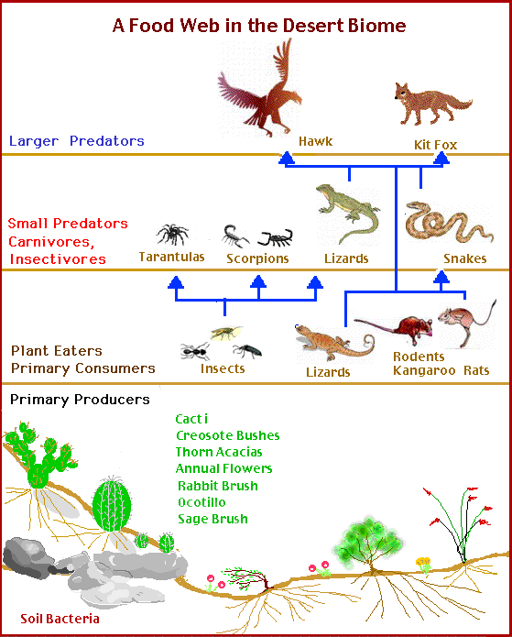
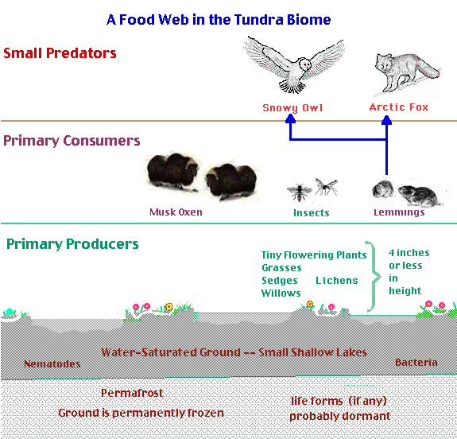
Check out some FOOD WEBS!
See how biodiversity of the animal and plant species is necessary to sustain the very unique environments of each biome!”
A food web shows the succession of organisms in an environment that contributes to the continuation of food energy from one organism to another as each consumes a lower member and in turn is preyed upon by a higher member. A balanced , bio diverse food web assures the sustainability of the environment.

Slide 10
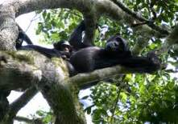
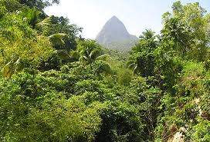
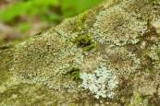
Biomes and Microhabitats
SO, a BIOME is a large geographical area that has a specific climate and contains some very particular plants and animals.
Biomes themselves are very large habitats. However, inside of each habitat there are even smaller microhabitats.
Rainforest Biome Habitat
Rainforest Biome
Rainforest Biome Microhabitat:
moss on a tree

Slide 11

Microhabitat
Definition:
A microhabitat is the smallest part of the environment that supports
a distinct flora and fauna;
the microenvironment in which an organism lives.
“A log rotting in the forest creates a microhabitat for insects.”

Slide 12
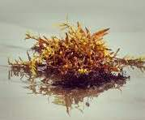
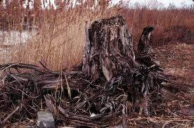
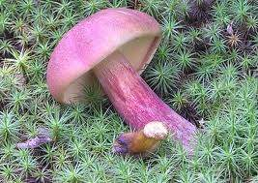
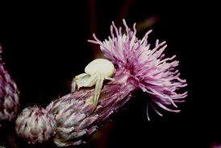
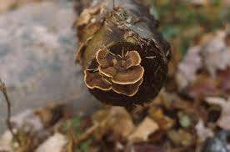
Microhabitats NEAR YOU!
A log rotting in a forest
A decomposing animal
A clump of seaweed
A space between rocks
A fallen tree or branches
A flower

Slide 13
Schoolyard microhabitats
Now it’s YOUR turn!!
Get outside and identify microhabitats in your very own school yard!

