Slide 1
Bioterrorism and Biosecurity
THE AGRICULTURAL INDUSTRY AND YOU

Slide 2
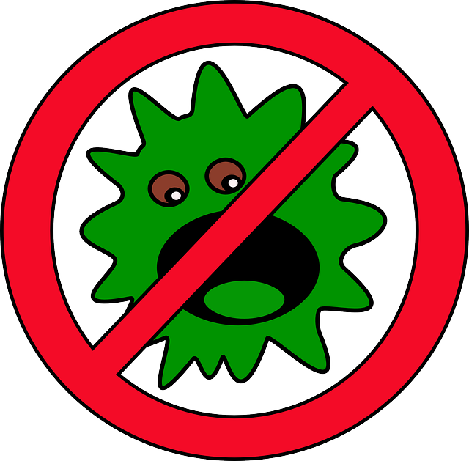
What is Bioterrorism?
A bioterrorism attack is the intentional release of infectious agents in order to harm or kill humans, plants, animals, etc. (CDC, 2007)

Slide 3
What is Bioterrorism?
Bioterrorism might be used because it is extremely hard to detect in a short period of time
Categorized in three categories

Slide 4
What is Bioterrorism?
Category A: Pose the highest risk to society
Can be easily spread or transmitted
Can result in high death rate or high public illness
Require special action to prepare the public
They might cause public panic and social disruption

Slide 5
What is Bioterrorism?
Category B: These agents are the second highest priority
They are fairly easy to spread between people
Low death rates and moderate illness are common
Require CDC labs to enhance monitoring of disease control

Slide 6
What is Bioterrorism?
Category C: These are the third highest priority agents because they could be engineered in the future and:
They are easily available
They are easily produced and spread
They have potential for high morbidity and mortality rates and major health impact.

Slide 7
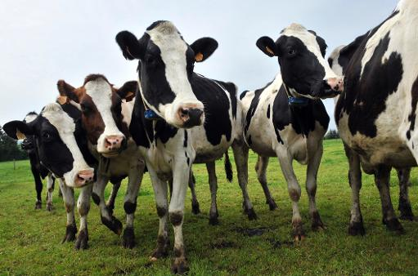
Bioterrorism in Agriculture
This type of bioterrorism is directed toward livestock and crops
Food terrorism is the act of or fear of contamination of food sources of people. Can be accomplished through:
Targeting food sources during production
Targeting foods during processing or targeting other places in the food chain

Slide 8
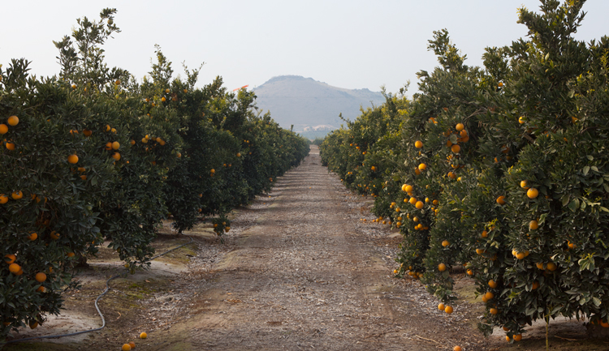
Bioterrorism in Agriculture
Where could bioterrorists strike in agriculture?
Livestock or crops, transportation methods for agricultural products, water supplies, producers, storage units, grocery stores, etc.

Slide 9
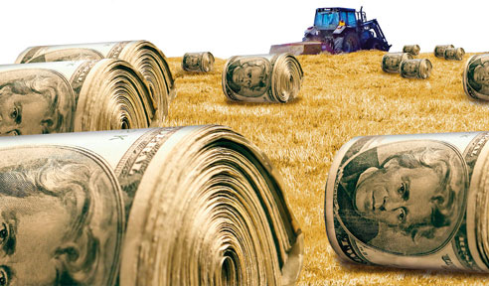
Bioterrorism in Agriculture
According to some, agriculture is the best place to strike
American economy would be devastated if a strike was made on a major commodity

Slide 10
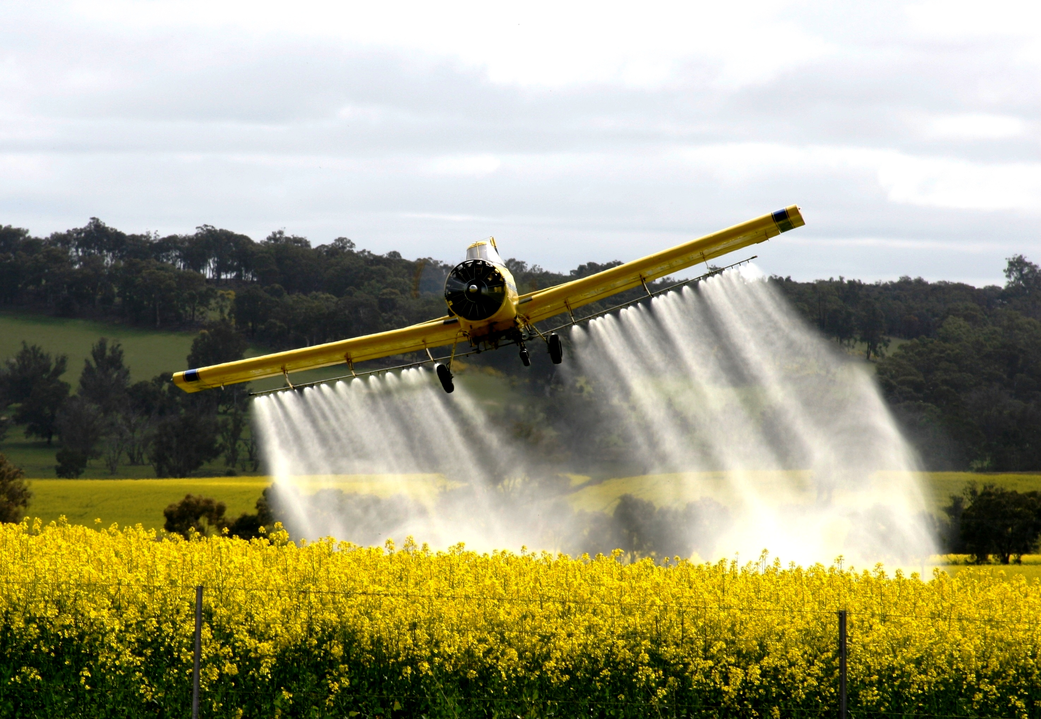
Bioterrorism in Agriculture
Ways to introduce infectious agents:
Aerosol – crop dusters or hand spray pumps
Coating feathers of birds with infectious agent
Introduce infected animal to a herd
Walking with infected shoes

Slide 11
Bioterrorism in Agriculture
The United States Government currently has methods to prevent and control agricultural bioterrorism outbreaks
LEGISLATION:
Public Health Security and Bioterrorism Preparedness Act of 2002, specifically the subpart Agricultural Bioterrorism Protection Act of 2002 – “designed to improve the ability of the U.S. government to prevent, prepare for and respond to bioterrorism and other public health emergencies that could threaten American agriculture” (John Hopkins University, 2016)

Slide 12
Bioterrorism in Agriculture
Agencies and organizations:
U.S. Department of Agriculture Responsibilities
Protecting U.S. borders, increased surveillance of slaughter houses and processing plants, protecting agricultural products at the source (livestock, crops, natural resources).

Slide 13
Bioterrorism in Agriculture
Animal and Plant Health Inspection Service (APHIS)
Has been designated by the Secretary of the USDA as the implementing agency for the provisions of the Agricultural Bioterrorism Protection Act of 2002

Slide 14
Bioterrorism in Agriculture
Centers for Disease Control and Prevention (CDC)
“Designated by the Secretary of the Department of Health and Human Services (DHHS) as the agency to implement the provisions of the Public Health Security Act of 2002” (John Hopkins University, 2016)
Also involved in outbreak and research investigation, prevention, and treatment of food source bioterrorism

Slide 15
Bioterrorism in Agriculture
Environmental Protection Agency (EPA)
In charge of pesticide security

Slide 16
Bioterrorism in Agriculture
Food and Drug Administration (FDA)
The FDA is in charge of Title III of the Public Health Security and Bioterrorism Preparedness Act of 2002: Protecting the safety and security of the food and drug supply
Must be notified of all food imports
All food facilities must be registered with FDA
Maintain records of food distribution
Authority to remove foods from market thought to harm humans or animals without court hearings

Slide 17
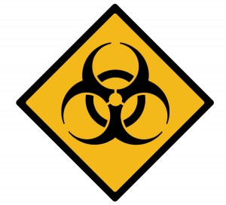
What is Biosecurity?
Definition: procedures intended to protect humans or animals against disease or harmful biological agents
In the agricultural world:
biosecurity is the series of preventative steps taken to prevent the introduction of bacteria, viruses, or other infectious agents into a herd or flock

Slide 18
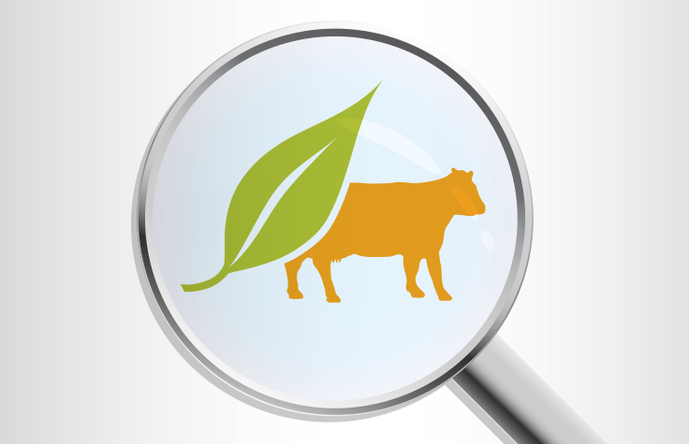
Biosecurity in Agriculture
Biosecurity usually involves
Process of screening or testing animals coming into the herd or flock
Isolation or quarantine of new or returning animals
Evaluation or monitoring system of some sort

Slide 19
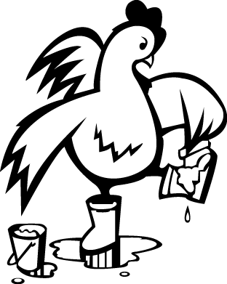
Biosecurity in Agriculture
Why is biosecurity important?
High-quality food products are important to the health and well-being of consumers
The farming community becomes more productive and economically efficient
Huge economic implications if outbreaks are widespread

Slide 20
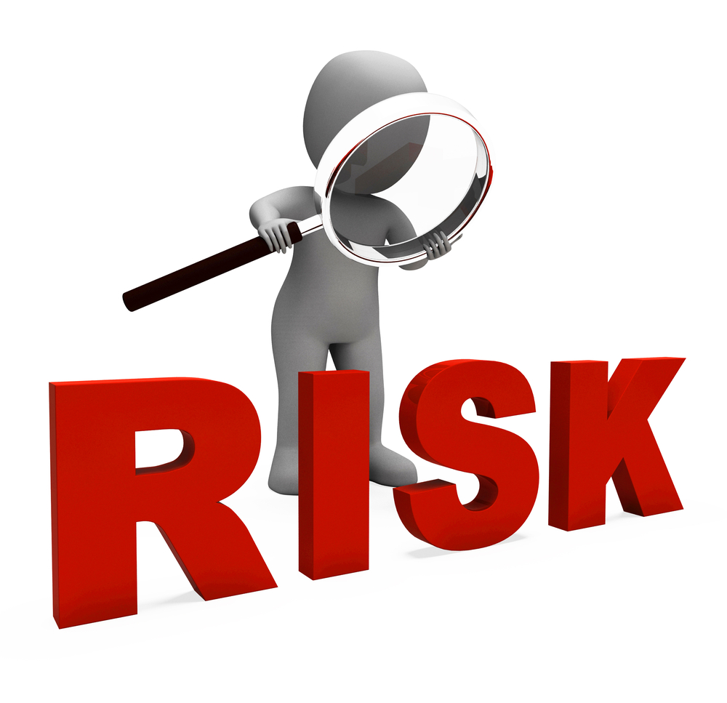
Biosecurity in Agriculture
How do you start a biosecurity plan for your farm or ranch?
Create a plan first by determining which diseases are most important to prevent based on goals and concerns
Foreign animal diseases require a special set of biosecurity plans
Risk assessment completion

Slide 21
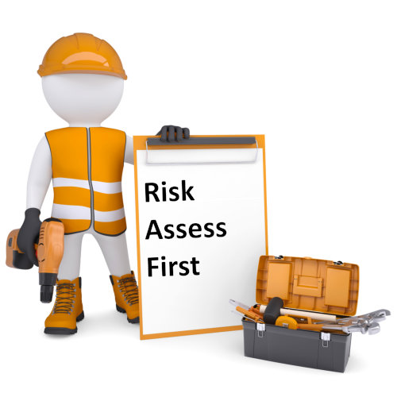
Biosecurity in Agriculture
What is a risk assessment?
Risk assessment is a method of determining the threat of a given disease in specific situations
Risk assessment must be completed before appropriate control methods can be enacted

Slide 22
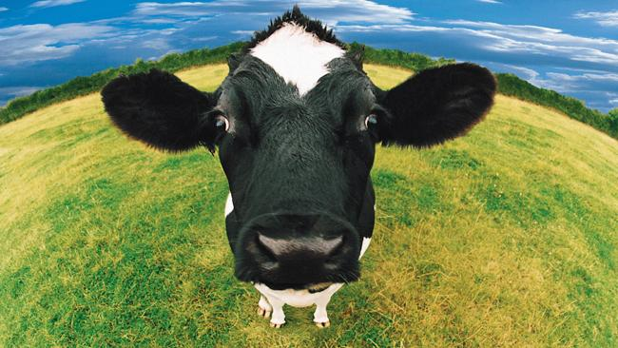
Biosecurity in Agriculture
What is a risk assessment cont.
Acceptable levels of risk for a farm will be determined by:
Products sold
Products which may be sold in the future
Farm location
Entry methods should be closely evaluated

Slide 23
Biosecurity in Agriculture
What is a risk assessment cont.
Key points that are determined through evaluation of entry methods are called critical points
“Actions taken at these critical control points are the most effective way of implementing a biosecurity plan” (Hutchinson, Jayarao, Van Saun, and Wolfgang, 2016)

Slide 24
Putting it All Together
Should we be fearful of disease in agriculture?
No! Biosecurity plans that are implemented correctly, as well as government agencies are effective measures against disease

Slide 25
Reviewing Concepts
What is Bioterrorism?
What is Biosecurity?
How does bioterrorism affect agriculture?
Bioterrorism is the intentional release of infectious agents in order to harm or kill humans, plants, animals, etc.
Biosecurity is the procedures intended to protect humans or animals against disease or harmful biological agents
Affects agriculture by depleting crops and livestock, which in turn hurts the economy

Slide 26
Reviewing Concepts
Name three organizations the U.S. Government has used in the fight against bioterrorism
Name three of the ways discussed to introduce infectious agents in bioterrorism
How are levels of risk assessed by a farm?
Three of five of: USDA, APHIS, CDC, EPA, FDA
Three of four of: aerosol, coating feathers of birds, introducing an infected animal to a herd, walking with infected shoes around crops or livestock
Risk assessed by what products are sold, what products may be sold in the future, and the location in which the farm is located

Slide 27
Work Cited
CDC. (2007, February 12). Bioterrorism Overview. Retrieved February 11, 2016, from http://emergency.cdc.gov/bioterrorism/overview.asp
Davis, R. G. (2001, October). Agricultural Bioterrorism. Retrieved February 11, 2016, from http://www.actionbioscience.org/biotechnology/davis.html
Hutchinson, Jayarao, Van Saun, & Wolfgang. (2016). Biosecurity Fundamentals (Farm Biosecurity). Retrieved February 11, 2016, from http://extension.psu.edu/animals/health/biosecurity/fundamentals/biosecurity-fundamentals
John Hopkins University. (2016). Bioterrorism and Food Safety. Retrieved February 10, 2016, from http://www.jhsph.edu/research/centers-and-institutes/johns-hopkins-center-for-public-health-preparedness/tips/topics/food_security.html

