Slide 1
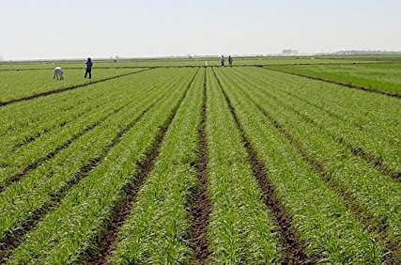
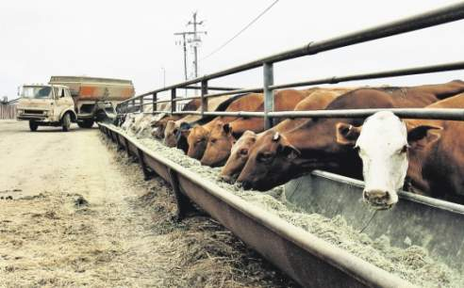
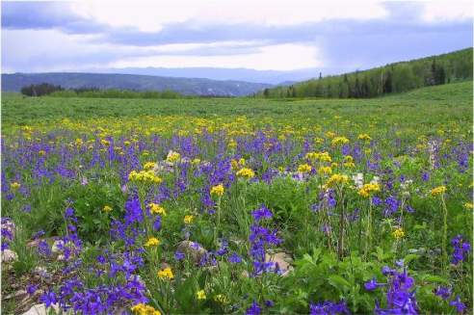
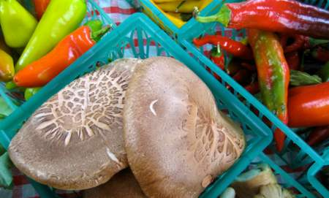
Careers In Agriculture
Innovative-Exciting-Challenging-Rewarding

Slide 2
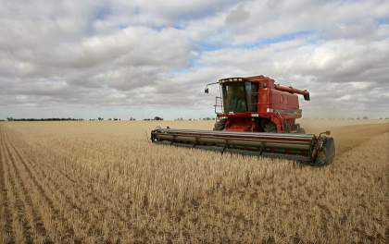
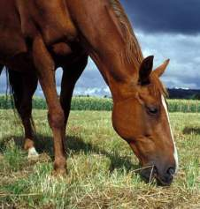
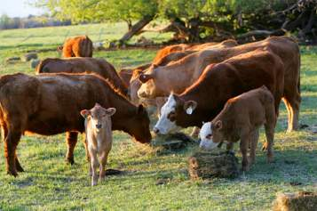
Careers in Agriculture
Most people hear the word “agriculture” and immediately think of a farm or ranch, but did you know that only 10% of Americans are involved in traditional farming?
Today agriculture offers over 200 different careers.
Can you think of any agricultural careers besides a farmer or a rancher?

Slide 3
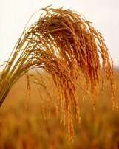
Career Categories…So Many Choices!
Veterinarian

Slide 4
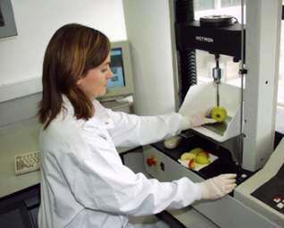
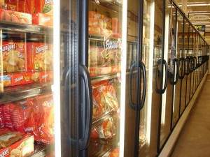
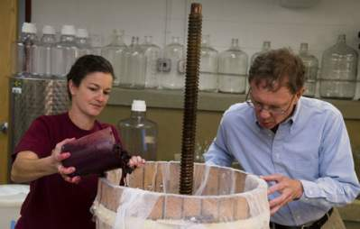
An Area of Job Growth
According to Farm Bureau News, “Food Scientists and engineers will be in the greatest demand in the agricultural market in the next four years.”
Job openings exceed the number of graduates for those jobs, creating a demand for you the student!

Slide 5
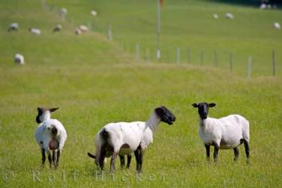
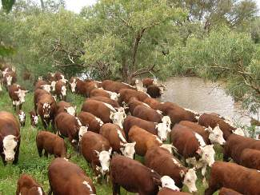
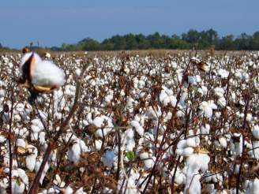
Agriculture is Everywhere!
Agriculture is a part of your daily life already, here’s how it plays a role in your life each day:
7:00 am - Rise shine, brush your teeth, sheep helped to make that toothbrush.
7:05 am - Put on your tennis shoes made form cattle or sheep, and your blue jeans and a shirt made from cotton.
8:15 am - Read the newspaper printed with ink made from soybeans.
9:00 am - Art class with paints from cattle, sheep and soybeans; brushes from cattle pigs and sheep and glue from pigs cattle and corn.
12:00 pm - Enjoy a cheeseburger, potato chips an apple and milk for lunch from dairy cattle, beef cattle, wheat, corn fruit and vegetables.
Continue your day on the next slide!
Notes:
http://www.sdagclassroom.org/students/index.htm

Slide 6
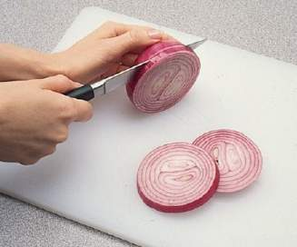
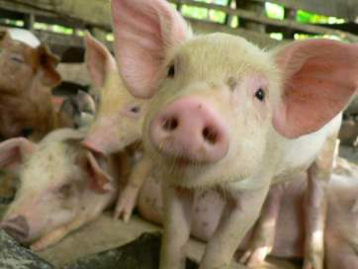
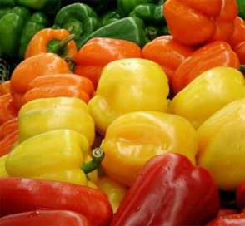
Agriculture is Everywhere!
12:45 pm - Go to doctor's appointment where 4 patients learned about insulin for diabetics , a medicine made from pigs and cattle.
3:30 pm - Soccer practice — kick that cowhide!
6:00 pm - Family pizza night — cheese, tomato sauce, wheat crust, onions, peppers and mushrooms! All of these ingredients are produced on farms!
9:00 pm - Curl up under a wool blanket in cotton pajamas. You guessed it, from sheep and cotton.
Your entire day depends on agriculture and the people involved in agriculture related jobs and careers!
Notes:
http://www.sdagclassroom.org/students/index.htm

Slide 7
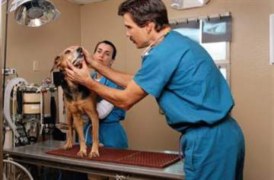
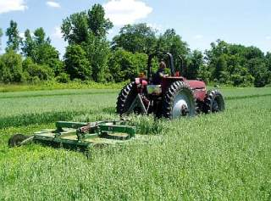
A Closer Look
Click through the next few slides to learn the job descriptions of a few agricultural career categories!
Imagine yourself in each job.
Think of what types of classes in high school and college would be useful to attain each job.
Pick a favorite job and investigate it further!

Slide 8
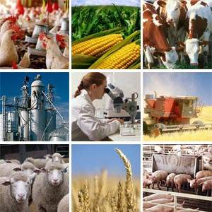
Agribusiness Management
Job Description:
Focuses on the managerial needs of organizations throughout the food system.
Job Titles:
Commodity Trader, Agriculture Production Specialist, Financial Manager, and Purchasing Manager.
Companies Hiring for this Position:
Seneca Food Corporation, Ralston Purina Co., Farm Bureau Mutual Insurance.
Ag Fun Fact:
Notes:
http://www.agday.org/education/careers.php

Slide 9
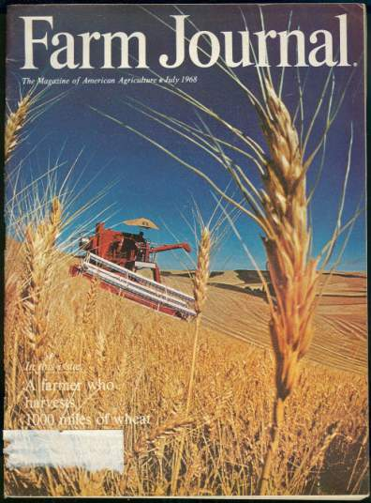
Agricultural and Natural Resources Communications
Job Description:
Involves careers in journalism, public relations, and advertising/marketing for agriculture.
Job Titles:
Marketing Communications, Manager, District Sales Representative, Reporter, and Editor.
Companies Hiring for this Position:
USDA, National Dairy Council, Michigan Farm Bureau.
Ag Fun Fact: One bushel of wheat will produce 73 one-pound loaves of bread.
Notes:
http://www.agday.org/education/careers.php

Slide 10
Building Construction Management
Job Description:
Work on land development, and building structures.
Job Titles:
Project Manager, Field Engineer, Land Developer, Real Estate Appraiser, and Estimator.
Companies Hiring for this Position:
Turner Construction Company, Pulte Homes, General Motors Corporation.
Ag Fun Fact: Every year in the United States each person uses the equivalent of one tree, 100 feet tall and 16 inches in diameter, to fulfill their wood and paper needs
Notes:
http://www.agday.org/education/careers.php

Slide 11
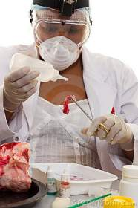
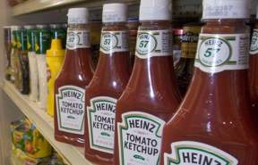
Food Science
Job Description:
Involves developing new foods, investigation of new production and processing methods, and research of ways to ensure a safe, nutritious, and economical food supply.
Job Titles:
Food Technician, Food Chemist, and Quality Control Manager.
Companies Hiring for this Position:
Pepsicola, Kraft/General Foods, Kellogg Company, General Mills, Heinz USA, and Pillsbury.
Ag Fun Fact: Ethanol and new bio-diesel fuels made from corn, soybeans and other grains are beneficial to the environment and helps contribute to energy independence for the U.S.
Notes:
http://www.agday.org/education/careers.php

Slide 12
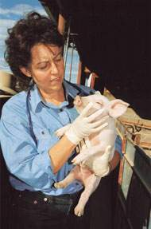
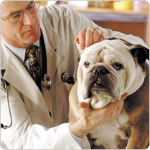
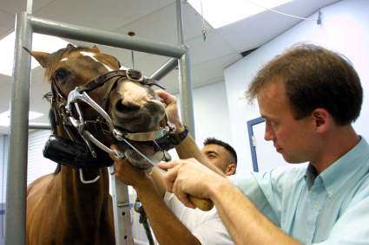
Veterinarian
Job Description:
Veterinarians study, treat, and control animal injuries and diseases.
Job Titles:
Doctor of Veterinary Medicine.
Companies Hiring for this Position:
Banfield, Private Practices, Hills/Purina
Ag Fun Fact: Pigs can't sweat. Pigs have no sweat glands, that is why they roll around in mud to cool off.
Notes:
http://careers.stateuniversity.com/pages/77/Veterinarian.html

Slide 13
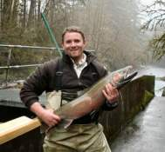
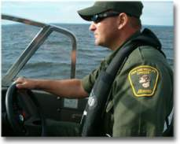
Fisheries and Wildlife
Job Description:
To focus on environmental management, conservation, and wildlife ecology and management.
Job Titles:
Water Quality Specialist, Fish Hatchery Manager, Habitat Specialist.
Companies Hiring for this Position:
US Forest Service, Bureau of Land Management, State and local divisions of surface water quality, US Fish and Wildlife Services.
Ag Fun Fact: Fish don't have ears. They hear or feel vibrations along the lateral line of their bodies.
Notes:
http://www.agday.org/education/careers.php

Slide 14
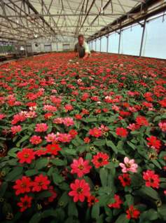
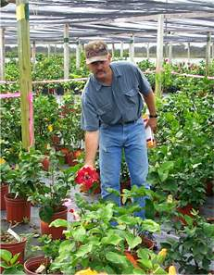
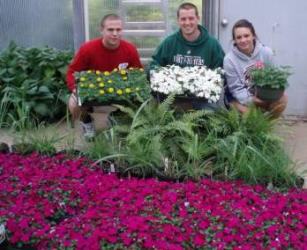
Horticulture
Job Description:
Work with the science and art concerned with culture, marketing, and utilization of fruits, flowers, vegetables, and ornamental plants.
Job Titles:
Retail Manager, Landscape Designer, Florist, Entrepreneur, Nursery Grower, and Contractor.
Companies Hiring for this Position:
Gerber, Mawby Fruit Farms, Ball Corporation, Pan American Seed.
Ag Fun Fact: Grapes are one of the oldest cultivated fruits. They have been around for more than 8,000 years!
Notes:
http://www.agday.org/education/careers.php

Slide 15
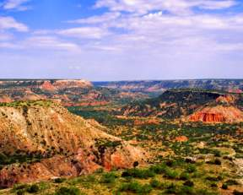
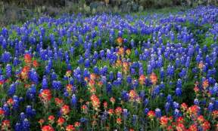
Parks, Recreation and Tourism Resources
Job Description:
This job entails planning and managing programs, areas, and facilities that are designed to meet people's leisure needs and enhance quality of life.
Job Titles:
Park Ranger, Interpreter/Naturalist, Environmental Educator, Travel and Convention Planner, Youth Program Director, Camp Counselor, Park and Recreation Director, and Tourism Consultant.
Companies Hiring for this Position:
Hilton and Marriott Resorts, Hospitals, YMCA, Golf Courses, Six Flags Great Adventure, and the Walt Disney Company.
Ag Fun Fact: Only about 1% of all Earth’s water is fresh water.
Notes:
http://www.agday.org/education/careers.php

Slide 16
Packaging
Job Description:
This job entails food packaging, health care and pharmaceutical packaging, and industrial packaging.
Job Titles:
Packaging Engineer, Quality Control Coordinator, Laboratory Manager, and Package Designer.
Companies Hiring for this Position:
Coca-Cola Co., Hershey Chocolate USA, Johnson and Johnson, 3M, IBM Corp., and Amway Corp.
Ag Fun Fact: Genetic engineering with plants and animals has resulted in new antibodies for immunizations. Other research has developed surgical techniques and pharmaceuticals from agriculture that help save lives.
Notes:
http://www.agday.org/education/careers.php

Slide 17
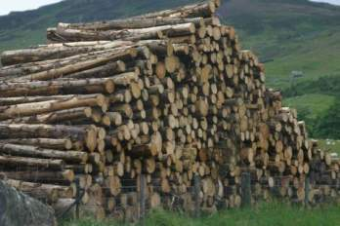
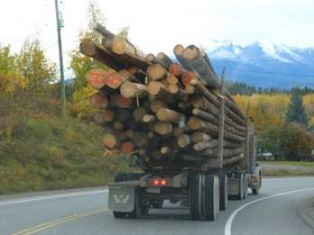
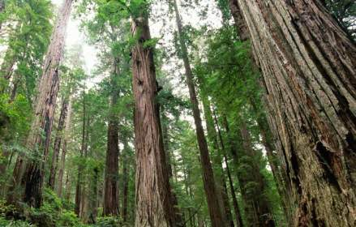
Forestry
Job Description:
This job entails learning the science and art of managing natural resources that occur on forest lands.
Job Titles:
Forester, Forest Ranger, Consulting Forester, District Ranger, Arborist, Naturalist, Timber Buyer, and Forest Nursery Manager.
Companies Hiring for this Position:
The Mead Corporation, John Hancock Financial Services, City Governments, and USDA Forest Service.
Ag Fun Fact: An acre of trees can remove about 13 tons of dust and gases every year from the surrounding environment, and almost a third of the world’s total land area is covered by forests.
Notes:
http://www.agday.org/education/careers.php

Slide 18
National Ag Day!
Celebrate National Ag Day with your friends and family!
March 15, 2012
Appreciate the role agriculture plays in providing safe, abundant and affordable products. Agriculture provides almost everything we eat, use, and wear on a daily basis, but too few people truly understand this contribution. So spread agriculture awareness in your community on Ag Day and everyday!
Notes:
http://www.agday.org/media/faqs.php

