Slide 1
Caring for Wildlife

Slide 2
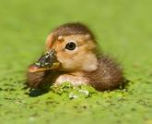
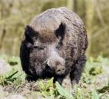
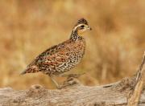
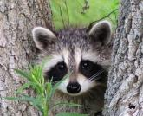
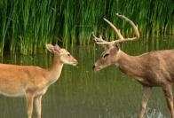
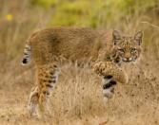
What’s Going to be Covered?
The student will:
Describe when to help a wild animal.
Understand when NOT to help a wild animal.
Know the ethical responsibilities of rehabilitating wildlife.
Describe different observable diseases in wildlife.
Know who to contact when in the presence of a sick or injured animal.

Slide 3
Safety First!
Is it ever ok to approach a wild animal?
NO!

Slide 4
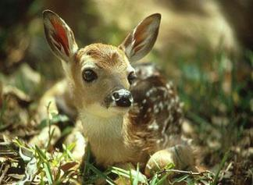
Is it REALLY an orphan?
It is crucial to know if the baby is an orphan.
Do NOT assume the baby is an orphan if found alone!
Example: It’s common for deer to bed down their fawns while they go graze and return periodically.
This is a defense mechanism against predators.
If the mother does not return to her baby in 24 hours, consider orphan status.

Slide 5
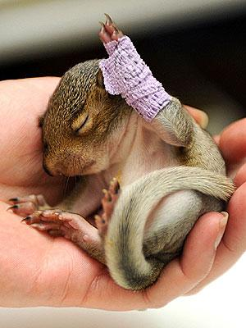
When to Help!
Does the baby animal look distressed or abandoned?
Wandering around
Calling for its mother
Very young (no/little hair, feathers, or closed eyes)
Are there any visible injuries?
Broken limbs
Evidence of bleeding
Is there a deceased mother nearby?

Slide 6
What to do…
If you find an injured or abandoned baby animal, what should you do?
Call local animal control, game warden, veterinarian or humane society.
If instructed to bring the animal in, use caution to avoid being bitten or scratched.
Be gentle and cautious while handling or transporting the baby animal.

Slide 7
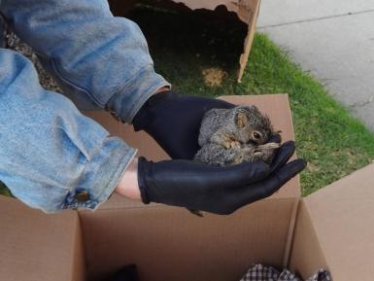
Handling Injured Baby Wildlife
The species and size determines how to properly handle the animal:
Wear thick gloves while handling the baby animal.
Place a towel over the animal.
Put the animal in a container that has a lid.
Make sure the animal can breathe while in the box!
Keep noise to a minimum.
Transport the animal immediately!

Slide 8
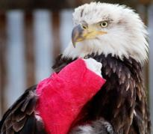
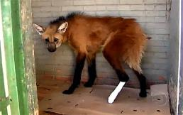
Injured Adult Wildlife
Never attempt to handle adult wildlife!
Even the smallest of animals can hurt you.
Immediately call local animal control, game warden, veterinarian, or humane society.
Be sure to report the location and your observation of the animal’s condition.

Slide 9
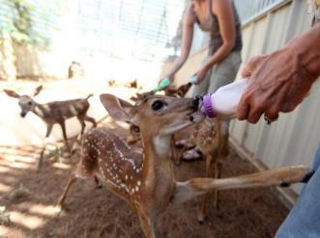
Rehabilitation
Goals of Rehabilitation Facilities:
Heal and release injured animals back into their natural habitat.
Care for injured animals that cannot be released back into the wild.
Educate the public about the different species of wildlife.
All wildlife species and animals of all ages are welcome to a rehabilitation facility.
Texas Parks and Wildlife Rehabilitation Video
There are rehabilitation facilities all over the world helping all species of animals!
Africa Rehabilitation Center Video

Slide 10
What are Some Diseases
Wild Animals can Carry?
Notes:
Example:
Animal:
-rabies
-chronic wasting disease
-mange
-White Nose
-foot and mouth disease
-Avian Influenza
-West Nile

Slide 11
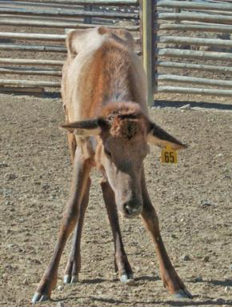
Observable Diseases in Wild Animals
Chronic Wasting Disease
Found mostly in deer, mule-deer, and elk
Neurological disease that attacks the brain
Symptoms
Low Body Weight
behavior abnormalities
Increased Salivation
Causes Death
Similar to mad cow disease

Slide 12
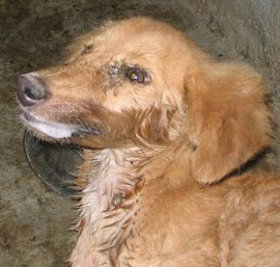
Observable Diseases in Wild Animals
Rabies
Commonly found in skunks, bats, and raccoons but can affect any mammal
Saliva carries the virus
Humans or pets can contract rabies from a bite
Rabies is a virus that attacks the brain and causes death
Symptoms:
Foaming of the mouth
Out of the ordinary behaviors
About Rabies Video

Slide 13
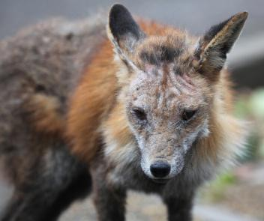
Observable Diseases in Wild Animals
Mange
Found in squirrels, coyote, raccoons, any species with hair
A class of skin diseases caused by parasitic mites which burrow into the skin
Causes hair loss
Transmissible to humans or pets

Slide 14
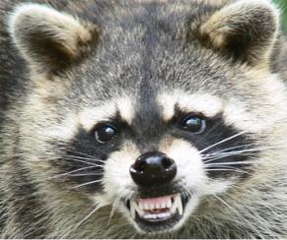
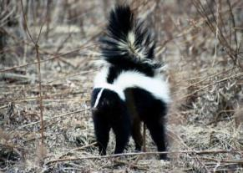
Threatening Situations
Do NOT approach animals that are not behaving normally.
e.g., nocturnal animals roaming during the day or overly friendly behavior in a wild animal
Do NOT attempt to handle any animals that could be injured or carrying diseases!
Remove yourself from the animal’s presence immediately if they are displaying defensive or threatening behavior!

Slide 15
Who You Gonna Call?
Who should you call?
Call your local game warden, animal control, or Parks and Wildlife office.
Be able to fully describe what you witnessed and the general location of your sighting.
If you feel threatened leave the area immediately.

Slide 16
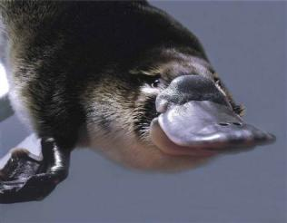
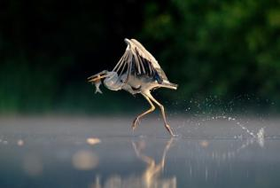
Ethical Responsibilities
When rescuing a wild animal ask yourself “what is best for the animal?”
The goal for every animal in rehabilitation is to get released back into the wild.
It is ethical to euthanize an animal if their injuries or diseases will cause continued suffering.

Slide 17
More information about Texas Wildlife, Rehabilitation centers, and Contact can be found here:
http://www.tpwd.state.tx.us/
If you want to help wildlife animals, volunteer at your nearest Wildlife Rehabilitation Center!

Slide 18
Video Resources
http://www.youtube.com/watch?v=NyZpN_C3exM
http://www.youtube.com/watch?v=4pIujcGyZto
http://www.youtube.com/watch?v=BZiBZkNxsp8

Slide 19
Website References
http://www.humanesociety.org/animals/resources/tips/injured_orphaned_wildlife.html
http://www.cdc.gov/rabies/
http://www.tpwd.state.tx.us/huntwild/wild/rehab/orphan/
http://www.tpwd.state.tx.us/

