Slide 1
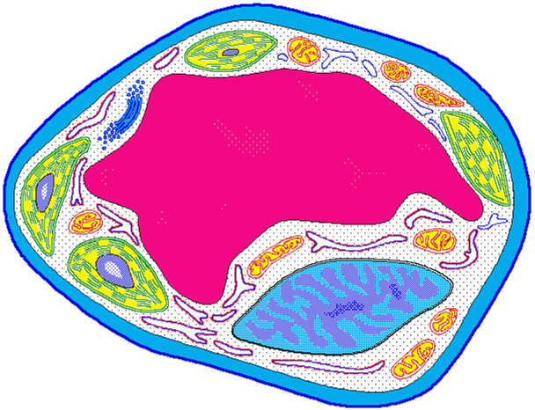
Cell Structure
& Function
http://koning.ecsu.ctstateu.edu/cell/cell.html

Slide 2
Cell Theory
All living things are made up of cells
  Bacteria, plants, YOU!
  Viruses are not cells and cannot live alone
A cell is the simplest living thing that can have a “life of its own”
All cells come from preexisting cells
  Cells divide to form new copies of themselves

Slide 3
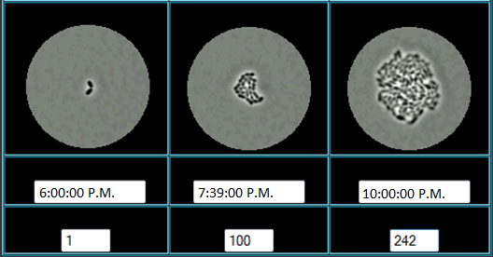
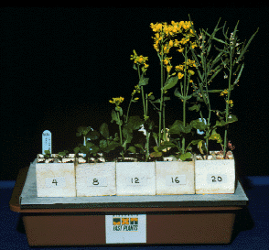
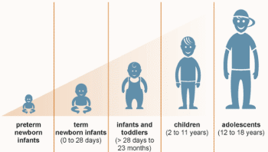
Bacterial growth over 4 hours
Plant growth over 20 days
Human growth over 18 years
Notes:
Differences in growth of organisms of increasing complexity.

Slide 4
Cells: “Life factories”
Energy Consumption
Protein Production
A cell is the smallest unit that is capable of performing life functions.
Waste Management
http://glencoe.mcgraw-hill.com/sites/dl/free/0078617022/164155/00035804.html
Notes:
Link goes to video relating cell to a factory, it goes a little fast. The site also contains a quiz which is at a good level for after viewing the video.

Slide 5


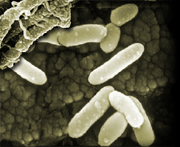
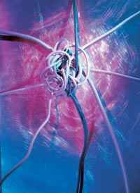

Examples of Cells
Amoeba Proteus
Plant Stem
Bacteria
Red Blood Cell
Nerve Cell

Slide 6
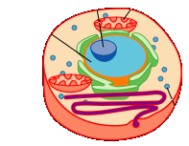
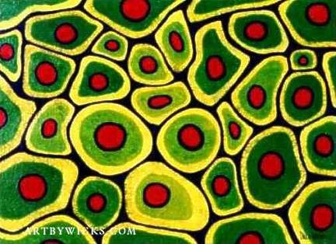
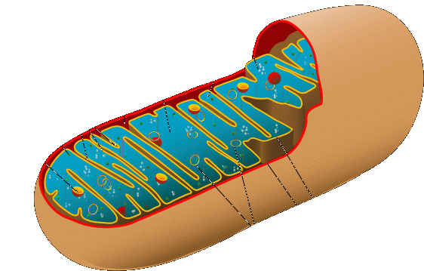

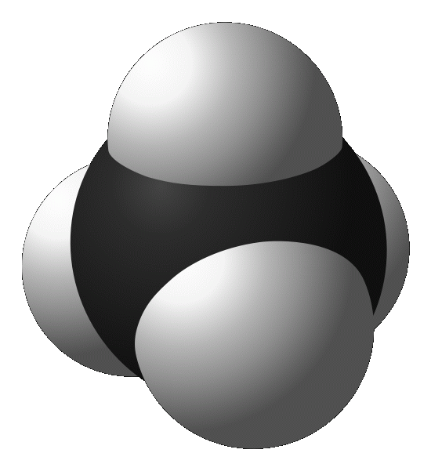
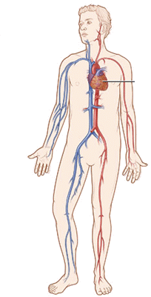
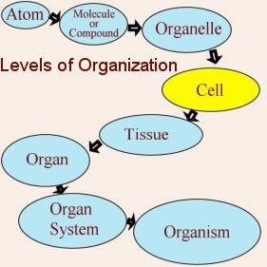
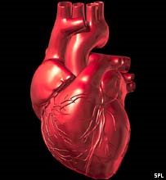
http://www.cellsalive.com/howbig.htm
Notes:
Link goes to interactive demo of sizes of different things on a pin head.

Slide 7
Two Types of Cells
Prokaryotic – usually single-celled (unicellular) organisms
Eukaryotic – usually found with other cells to make up more complex tissues

Slide 8
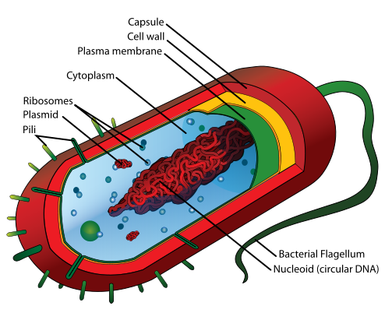
Prokaryotic cells (prokaryotes)
Few internal structures
Where is the nucleus?!?
Single-celled organisms, bacteria
Notes:
Pili: attach to one another to transfer plasmid DNA and reproduce. Ribosomes: make proteins from amino acids. Flagellum (flagella): propels bacterial cell. Nucleoid: contains genetic material, not surrounded by nuclear membrane (unlike eukaryotes).

Slide 9
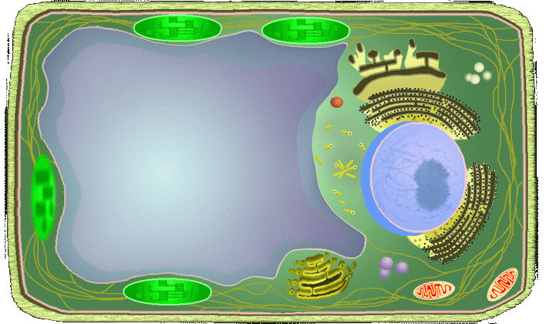
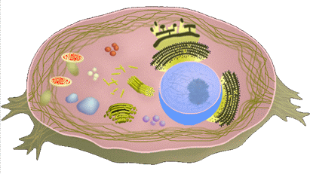
Eukaryotic cells (eukaryotes)
Contain organelles surrounded by membranes
Most living organisms are made of eukaryotic cells
Two types: Plant and animal
Plant
Animal
http://www.cellsalive.com/cells/cell_model.htm
Notes:
Link goes to interactive models of plant and animal cells with name of each organelle appearing when scrolled over. With a click a description of the organelle is presented.

Slide 10
Cell Parts
Organelles

Slide 11
Surrounding the Cell

Slide 12
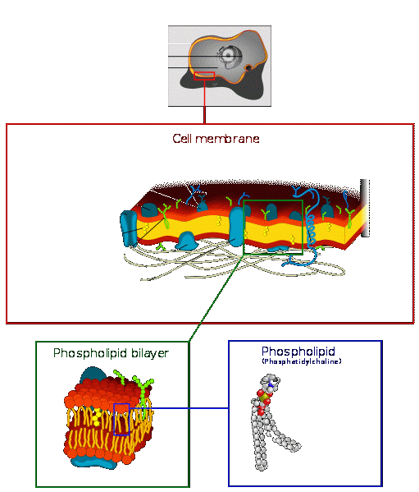
Cell Membrane
The walls/security
Outer membrane of cell that controls movement in and out of the cell
Double layer
Notes:
Serves as a wall (guard) to allow access in and out of the cell. The double layer is formed by hydrophobic interactions between the two layers and hydrophilic interactions on both surfaces of the membrane. Like likes like. That is, hydrophobic parts of molecules like to interact with other hydrophobic parts and don’t like to interact with hydrophilic parts. This causes grouping of phospholipids in an organized manner to form the cell membrane.

Slide 13
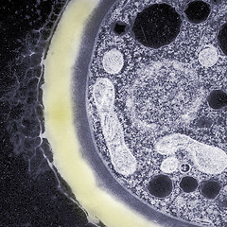
Cell Wall
Most commonly found in plant cells & bacteria
Supports & protects cells
Notes:
Responsible for the rigid shape of plant cells. Key difference between plant and animal cells.

Slide 14
Inside the Cell

Slide 15
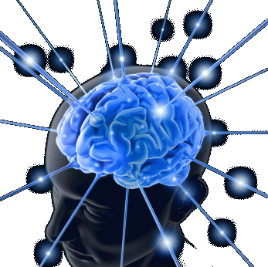
Nucleus
Directs cell activities
Separated from cytoplasm by nuclear membrane
Contains genetic material - DNA

Slide 16
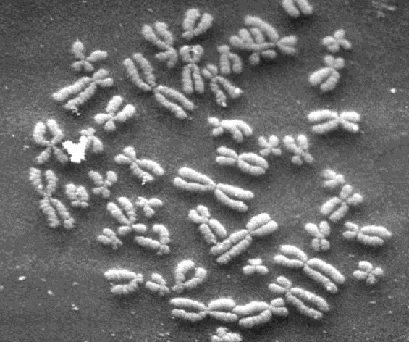
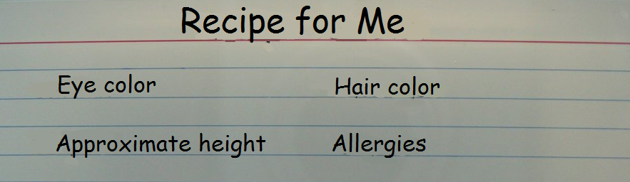
Chromosomes
Everything “in a nutshell”
In nucleus
Made of DNA
Contain instructions for traits & characteristics

Slide 17
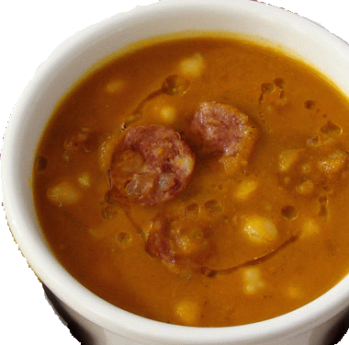
Cytoplasm
Gel-like mixture
Surrounded by cell membrane
Contains hereditary material
Notes:
The soup that everything within the cell membrane “floats” in.

Slide 18
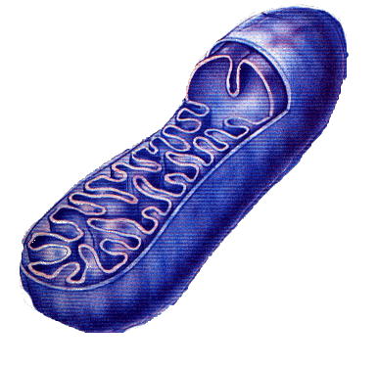
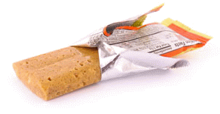
Mitochondria
The energy powerhouse
Breaks down fats & carbohydrates to produce energy
Controls level of water and other materials in cell
Recycles and decomposes proteins, fats, and carbohydrates

Slide 19
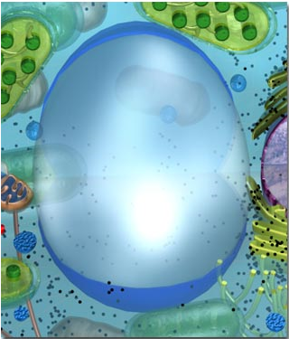
Vacuoles
Storage and waste departments
Membrane-bound sacs for storage, digestion, and waste removal
Contains water solution
Help plants maintain shape (internal pressure)

Slide 20
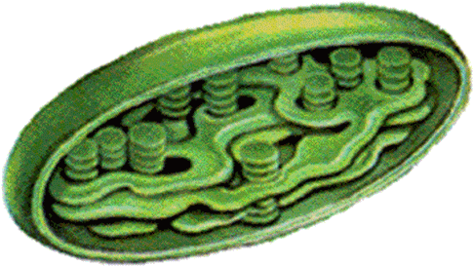
Chloroplast
Usually found in plant cells
Contains chlorophyll – GREEN!
Where photosynthesis takes place

Slide 21
How are you like a cell?
What functions does your body perform that are similar to those of a cell?

