Slide 1
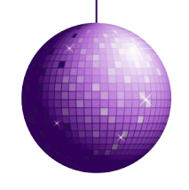
Cellular Respiration
Metabolism is the set of chemical reactions that happen in all cells of living organisms to sustain life.
Metabolism is all about staying alive.
The reactions of metabolism that take place in our bodies are to maintain growth and normal functioning.
Notes:
Note: YouTube clip hyperlink “staying alive” is the song Stayin’ Alive by the Bee Gees performed on the tv show Glee stop after 1:00 min.

Slide 2
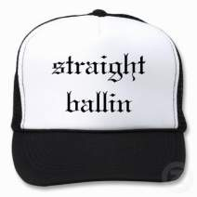
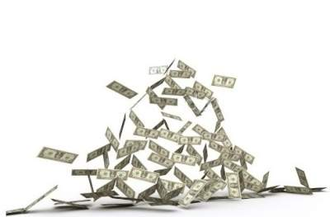
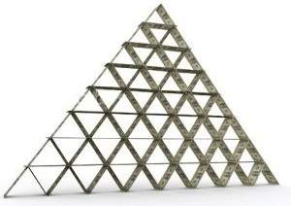
There are two parts to metabolism:
Anabolism
Catabolism
Anabolism derives from the Greek words “ana” for upward and “ballein”
Catabolism derives from the Greek words “kata” for downward and “ballein.”
for to throw.
Anabolism is the building up of molecules needed in our body made from nutrients in our food.
not this
Catabolism is the breakdown of molecules to obtain energy.
An example of anabolism is photosynthesis. Plants and other photosynthetic organisms build glucose molecules for energy.
An example of catabolism is cellular respiration, the breakdown of food into energy.

Slide 3

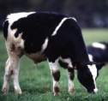
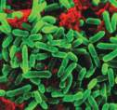
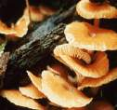
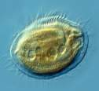
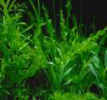
Cellular Energy
Cells, like all living things, need energy to operate.
Your calculator uses batteries for energy,
but our cells don’t need batteries.
In fact, our cells create their own energy in the form of molecules called adenosine triphosphate or ATP for short.
ATP is a high energy molecule and acts like cellular currency. You must spend (use up) ATP to power most of the reactions taking place in cells.
adenosine triphosphate
“ATP”
When the third phosphate group is broken off of ATP, a burst of energy is released that the cell harnesses to do work.
A
P
P
P
R
three phosphate groups
adenosine =
ATP powers all living organisms in every kingdom:
adenine + ribose
animalia
monera
fungi
protista
plantae
Notes:
Note: YouTube clip at “ATP” is a hyperlink to short video explaining ATP 2:45 min.

Slide 4
Cellular Respiration
The process in which cells make ATP is known as cellular respiration.
It is the breakdown of chemical bonds in food molecules for energy.
(catabolism)
Once food has been broken down cellular respiration occurs in three stages:
Glycolysis
Krebs Cycle
Electron Transport Chain
The conversion of glucose to pyruvate.
The conversion of pyruvate into ATP and charging of NADH.
The passing of excited electrons to generate ATP.

Slide 5
The Cellular Respiration reaction:
C₆H₁₂O₆ + 6 O₂ → 6 CO₂ + 6 H₂O + ATP
1 Sugar
(glucose)
6 Oxygen
molecules
6 Carbon
dioxide
molecules
6 Water
molecules
Cellular Respiration is essentially the opposite of Photosynthesis.
(Catabolic reaction: breakdown of molecules we need to live)
(Anabolic reaction: building of molecules we need to live)
The Photosynthesis reaction:
6 CO₂ + 12 H₂O + sunlight → C₆H₁₂O₆ + 6 O₂
6 Carbon
dioxide
molecules
12 Water
molecules
1 Sugar
(glucose)
6 Oxygen
molecules

Slide 6
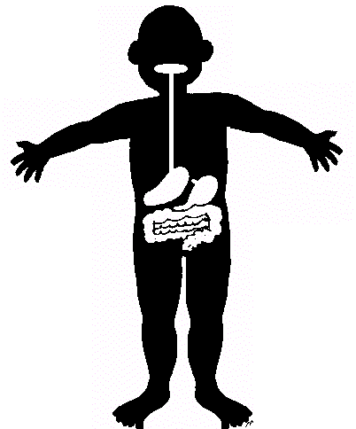
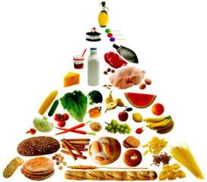
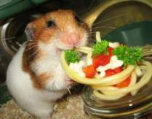
The Breakdown of Food
The breakdown of food occurs in our digestive system.
Our digestive system includes our mouth, esophagus, stomach, liver, pancreas, gallbladder and intestines.
When we digest our food, it is broken down into its smallest, basic units.
Complex Food Molecules | Basic Units
Proteins | Amino Acids
Fats (lipids) | Fatty acids and glycerol
Carbohydrates (polysaccharides) | Glucose (a simple sugar)
Amino acids are the building blocks our cells use to make proteins, an example of anabolism.
Cells turn fatty acids into many things like the enzymes used in glycolysis.
Glucose is turned into ATP.
1 glucose molecule makes about 38 ATP molecules.
Notes:
Note: YouTube clip hyperlink at “broken down” to short video on the break down of food it’s smaller units about 1:57 min.

Slide 7
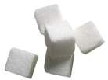
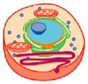
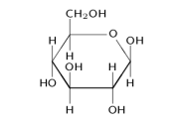

Stage 1. Glycolysis
Glycolysis starts with glucose and takes place in the cytoplasm.
Glycolysis is an anaerobic reaction this means it does not need oxygen to occur.
Glycolysis splits glucose, a 6 carbon ring, in half.
This makes 2 molecules of pyruvate, a 3 carbon molecule.
In order to split the glucose molecule, glycolysis needs to spend some energy. 2 ATPs are used to break glucose in half into 2 pyruvate molecules.
Each pyruvate molecule makes 2 ATPs and 1 NADH.
This is a total of 4 ATPs made and with 2 ATPs spent the net gain of glycolysis is 2 ATP. (–2 + 4 = 2)
Glycolysis Video

Slide 8
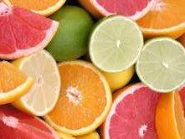

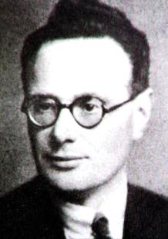


Pyruvate
O₂
O₂
If oxygen is present, pyruvate undergoes the Krebs Cycle.
If oxygen is not present, pyruvate undergoes Fermentation.
With oxygen present, pyruvate can turn into Acetyl-CoA
which is needed in the Krebs Cycle.
Acetyl-CoA (Acetyl-Coenzyme A) is a “crossroads compound” because when all three food molecules are broken down into their basic units some will become Acetyl-CoA and start the Krebs Cycle.
Stage 2. Krebs Cycle
The Krebs Cycle is also called, the Citric Acid Cycle because citric acid is involved.
Citric acid is also found in citrus fruits!
The Krebs Cycle is an aerobic reaction, this means it requires oxygen to occur.
The Krebs cycle was discovered in the 1930s by Albert Szent-Györgyi and Hans Adolf Krebs.
Bro fist!

Slide 9

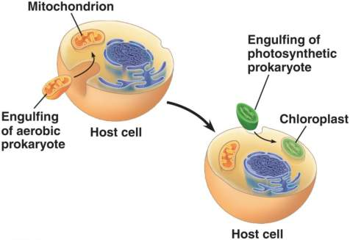
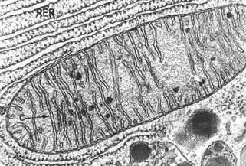
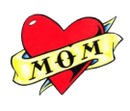
Mitochondrial Endosymbiosis
The Krebs Cycle takes place in an organelle called the mitochondria which is nicknamed the power house of the cell because it provides the energy the cell needs to live.
Remember ATP powers all eukaryotic cells. This means there are mitochondria in plants undergoing cellular respiration.
A long time ago, our cells were once ancient eukaryotic cells that enveloped a prokaryote. Eventually, the prokaryote became a part of the cell and dependent upon it for life which in turn gave our cell the ability to generate ATP.
This theory about how mitochondria got inside eukaryotic cells is the endosymbiotic theory.
All your mitochondria came from your mother. Thank your mom for all the mitochondria!
Notes:
Note: YouTube clip hyperlinked at “endosymbiotic theory” 1:35 minutes briefly reviews mitochondria.

Slide 10
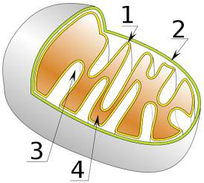
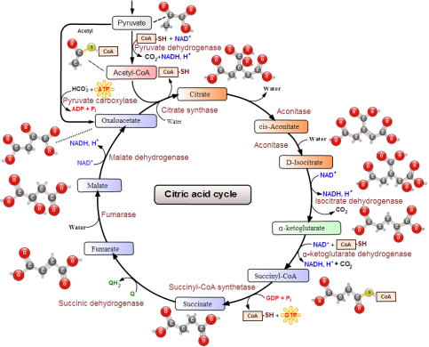
Stage 2. The Krebs Cycle
The Krebs Cycle involves the breakdown of pyruvate and occurs in the mitochondrial matrix.
Inner Membrane
Outer Membrane
Stage 3 the Electron Transport Chain will take place in the inner mitochondrial membrane.
Intermembrane Space
Mitochondrial Matrix (innermost space)
The breakdown of pyruvate involves many enzymes breaking off carbons. These carbons bond with oxygen making the byproduct carbon dioxide that we breathe out.
As pyruvate is broken down into small packets of energy , that are released in the form of excited electrons ( ).
This energy is used to make ATP and charge up NADH and FADH₂ molecules.
e-
Krebs Cycle Video

Slide 11
Stage 3. The Electron Transport Chain
During the stages of the Krebs Cycle the high energy molecule ATP is generated but so are energy carrier molecules NADH and FADH₂.
NAD+ can hold excited electrons made during the Krebs Cycle, becoming NADH.
e-
nicotinamide adenine dinucleotide
“NAD+”
FAD+ is another high energy molecule made during the Krebs Cycle that carries 2 excited electrons becoming FADH₂.
N
P
P
A
flavin adenine dinucleotide
R
R
“FAD+”
N
Eventually, both pass the excited electrons they’re carrying to power up protein complexes in the mitochondria membrane. Once empty handed, they revert back to NAD+ and FAD+ and undergo the Krebs Cycle again.
e-
P
P
F
R
Both energy carrier molecules are very complex, these diagrams are simplifications.
Notes:
Note: On the Krebs cycle diagram FADH₂ is not seen.

Slide 12

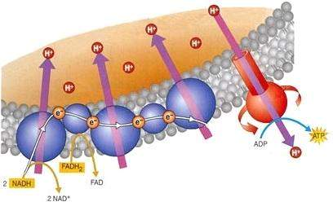
Stage 3. The Electron Transport Chain
The protein complexes in the mitochondrial membrane sit next to each other like links in a chain.
z
z
z
z
z
z
e-
H+
When an excited electron is passed to the protein complexes from either a NADH or FADH₂ energy carrier, the electron is passed from one protein complex to another down the chain powering up each one as it goes.
e-
H+
H+
H+
When powered up, the protein complexes pull a proton (H+) across the inner mitochondrial membrane into the intermembrane space of the mitochondria.
Once the concentration of protons is high enough in the intermembrane space, a proton will travel down its concentration gradient crossing the inner mitochondrial membrane. This crossing powers an ATPase protein complex that generates ATP.
Notes:
Note: YouTube clip hyperlink at “mitochondrial” discusses mitochondria’s role in Krebs Cycle 2:21 min.
YouTube clip hyperlink at “concentration gradient” discusses how hydrogen ions travel down their concentration gradient to make ATP 2:46 min long.

Slide 13
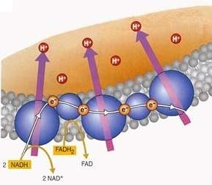
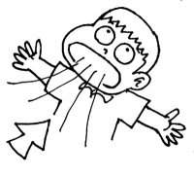
Stage 3. The Electron Transport Chain
At the end of the chain, the excited electron is not so excited as it lost a lot of energy being passed along.
The electron joins up with oxygen and protons inside the mitochondrial matrix to form a molecule of water.
O
O
H+
H+
e-
This is why we breath in oxygen.
We need oxygen to accept the electrons at the end of the electron transport chain.
Without oxygen to accept these electrons, the Krebs cycle would stop and no more ATP would be made.
Remember the Electron Transport Chain needs oxygen so it is aerobic (with oxygen) respiration.
Notes:
Note: Hyperlink electron transport chain leads to a website with flash animation of the Electron Transport Chain to help students visualize the process. Click on Electron Transport Chain to the right. Questions will pop-up throughout the video you can answer as a class.

Slide 14
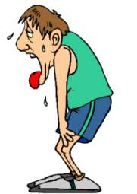
Fermentation
Pyruvate
O₂
Fermentation
After glycolysis if oxygen is not present, pyruvate will undergo fermentation.
Fermentation is also known as anaerobic (without oxygen) respiration.
Fermentation is a very quick processes with a net gain of 2 ATP.
So why undergo fermentation? The Krebs Cycle makes ~38 ATP per glucose molecule and Fermentation only makes 2 ATP per glucose molecule!
Fermentation is a quick way to make ATP when you really need it.
For example, when you exercise the oxygen available for your cells is used up in the Krebs Cycle making ATP.
That’s why we run out of breathe during exercise and we take deep breaths to try and replenish oxygen to our cells.
When not enough oxygen is reaching our cells they will undergo fermentation to make some quick ATP to keep us moving.
Notes:
Note: ~38 ATP molecules are made per every glucose at ideal conditions, in real life around 38 ATP molecules are made maybe a few less.

Slide 15
Cellular Respiration Summary
Glycolysis
2 ATP
2 ATP
Glycolysis
oxygen
no oxygen
Krebs Cycle
ETC
+ 36 ATP
+ 2 ATP
Fermentation
38 ATP
4 ATP
Occurs in cytoplasm and mitochondria.
All occurs in cytoplasm.
Food molecules are broken down into glucose.
Carbon dioxide is a byproduct produced during the Krebs Cycle.
Water is a byproduct made during the electron transport chain.
C₆H₁₂O₆ + 6 O₂ → 6 CO₂ + 6 H₂O + 38 ATP
Oxygen is needed to accept the electrons at the end of the electron transport chain.

Slide 16
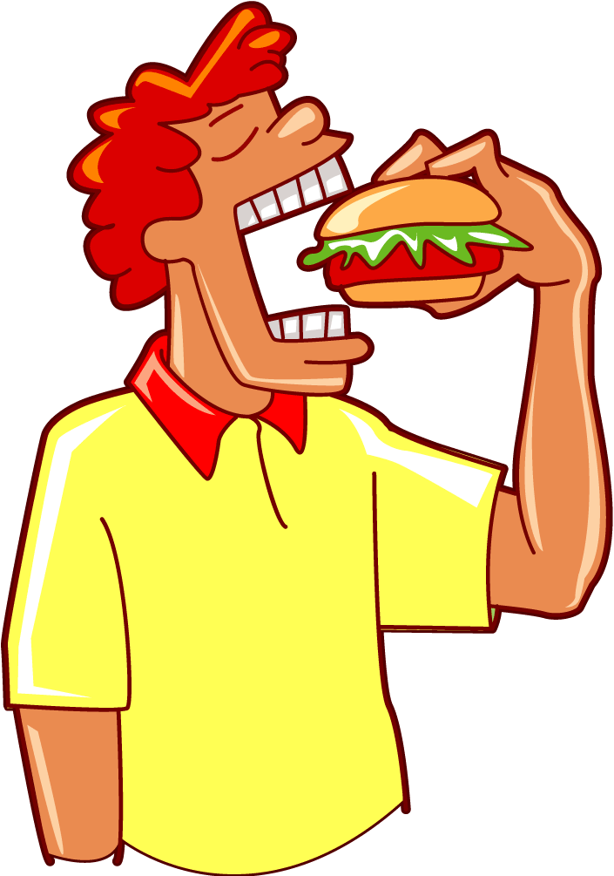
Cellular Respiration Review
Metabolism is the set of chemical reactions that happen in all cells of living organisms to sustain life.
We humans, undergo the catabolic metabolism reaction known as cellular respiration wherein the food we eat is broken down and converted into energy for our cells.
Cellular respiration has 3 steps after our food has been
broken down into basic units:
1. Glycolysis turns glucose into pyruvate
2. Krebs Cycle generates ATP molecules and charged energy carrier molecules
3. Electron Transport Chain excited electrons generate ATP
1 glucose can make ~38 ATP molecules.
Without oxygen, pyruvate cannot enter the Krebs Cycle and instead fermentation occurs.

