Slide 1
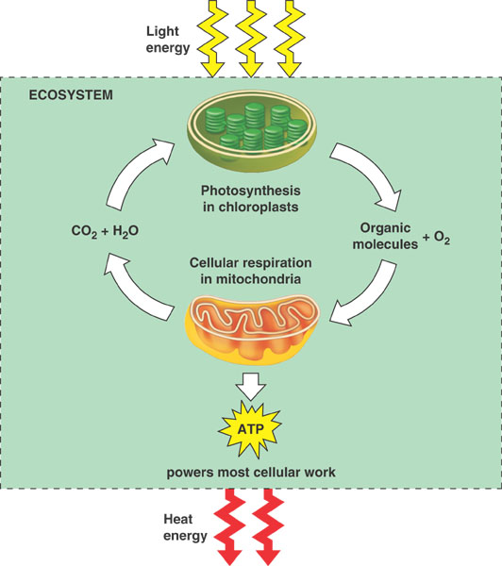
Cellular Respiration

Slide 2
What is Respiration?
Respiration can be considered the opposite process of photosynthesis
It is the transformation of food energy into chemical energy in the form of ATP
Plants and animals go through the same process of cellular respiration

Slide 3
Photosynthesis vs Respiration
Photosynthesis
Respiration
Produces food (glucose)
Stores energy
Consumes CO2
Releases O2
Light dependent
  Occurs only in plants
Consumes food (glucose)
Releases energy (ATP)
Produces CO2
Consumes O2
Light independent
  Occurs in all living organisms

Slide 4
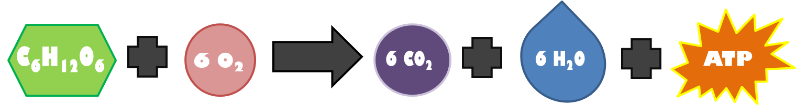
Reaction Formula
Glucose combined with six oxygen molecules
Six carbon dioxide molecules and six water molecules, and ATP molecules.
Notes:
Arrows connate “yield” as in produces

Slide 5
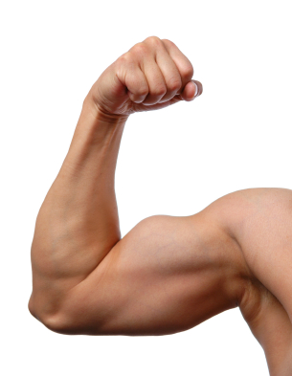
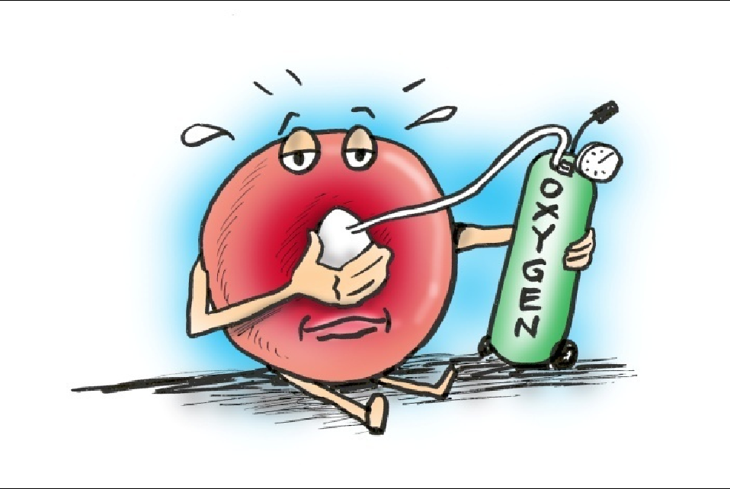
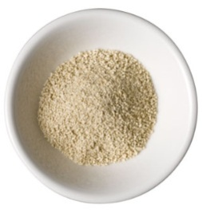
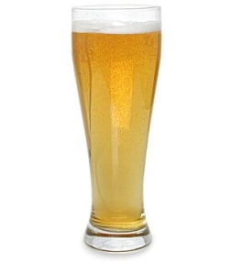
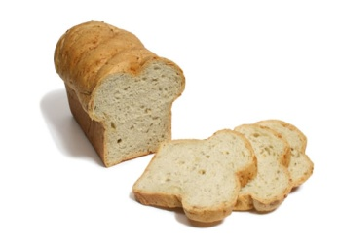
The Two Types of Respiration
Anaerobic
Aerobic
  Occurs when oxygen is not present
    When O2 is not available, fermentation occurs in the cytoplasm
Results in
  Ethanol and CO2
    Yeast, beer, and bread
  Lactic acid
    Muscle cells
  Occurs in the presence of oxygen (O2)
  The process is continued in the mitochondria of the cell
    Krebs Cycle
    Electron Transport Chain

Slide 6
Check Point!

Slide 7
What is Respiration the opposite process of?
Photosynthesis
Remember in photosynthesis that plant cells consume CO2 and produce O2, while at the basic level respiration consumes O2 and produces CO2

Slide 8
Aerobic
__________________________ respiration requires oxygen.
If oxygen is not required, the respiration process is called ____________________________.
Anaerobic
The fermentation process is characteristic of ___________________________ respiration.
anaerobic

Slide 9
Occurs in the cytoplasm
First step in both aerobic and anaerobic respiration
Glycolysis
Notes:
Is universal in organisms; therefore, most likely evolved before Krebs cycle and electron transport system.

Slide 10
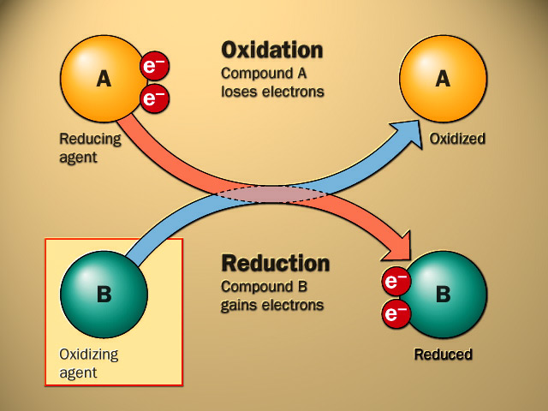
Oxidation
In respiration glucose is oxidized, and energy is released in the form of adenosine triphosphate
Oxidation is combining any molecule with a molecule of oxygen (O₂).
ADP is then further oxidized into the pyruvate

Slide 11
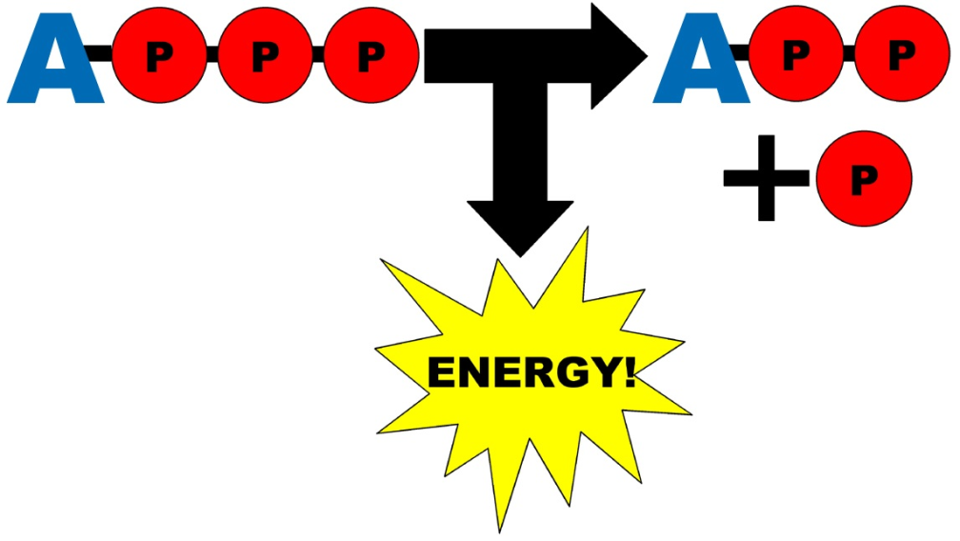
Energy Currency
Adenosine triphosphate, otherwise known as ATP is considered to be the major energy source of the cell
Energy is released from the conversion of ATP to adenosine diphosphate or ADP
ATP is the immediate source of energy in a cell – the more ATP that is produced, the more energy a cell has.

Slide 12
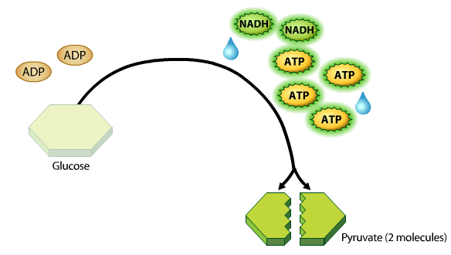
Breakdown of Pyruvate
A series of reactions break down the glucose molecule into pyruvate
  Pyruvate = two 3-carbon molecules
This process yields 2 ATP molecules for each molecule of glucose broken down and 2 NADH molecules
Notes:
Remember that glucose is a 6-carbon molecule

Slide 13
NADH the Electron Carrier
NADH is a reduced form of NAD+
  Meaning that the Hydrogen (H+) electron was released
NAD+ functions as an electron carrier from one step to the next in the respiration process

Slide 14
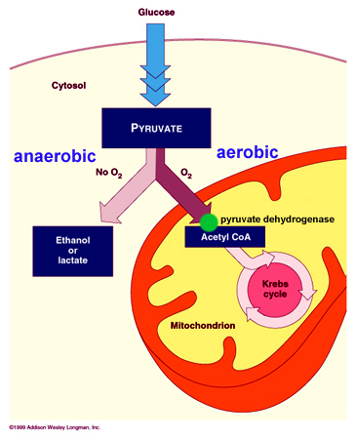
Where in the cell are we?
Notes:
Glycolysis occurs in the cytoplasm of the cell. The presence of oxygen determines where the next set of steps will occur. Anaerobic respiration continues in the cytoplasm, while aerobic respiration occurs in the mitochondrial matrix (in the mitochondria), which is what we will talk about next.

Slide 15
Check Point!

Slide 16
True or False?
Glycolysis only happens during anaerobic respiration
FALSE
                Glycolysis occurs during both the anaerobic and aerobic respiration processes

Slide 17
True or False?
The breakdown of pyruvate during the glycolysis process yields 2 ATP and 4 NADH molecules
FALSE
Only 2 NADH molecules are produced during glycolysis

Slide 18
Aerobic Respiration is a three step process
Glycolysis
Krebs cycle
Electron Transport

Slide 19
Oxygen required = aerobic process
Occurs in the mitochondria
Krebs Cycle

Slide 20
“Prep” Stage
During glycolysis, pyruvate is formed and 2 CO₂ molecules are formed as waste products
In the preparatory phase of the Krebs cycle the pyruvate is “prepped” into a usable form, known as Acetyl-CoA
Acetyl-CoA is produced through the oxidation of pyruvate
Notes:
Recall again that oxidation is combining a molecule with O2
This prep stage occurs twice for every original glucose molecule put in

Slide 21
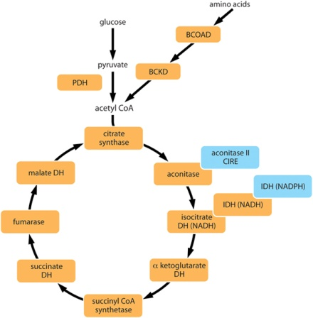
Krebs Cycle
The cycle is completed or “turned” twice per original glucose molecule
2 ATP molecules and 4 CO2 molecules are gained for each original glucose molecule in the cycle
Notes:
Remember that this is still occurring in the mitochondrial matrix

Slide 22
Third step in aerobic respiration
Occurs in membrane of mitochondria
Electron Transport Chain

Slide 23
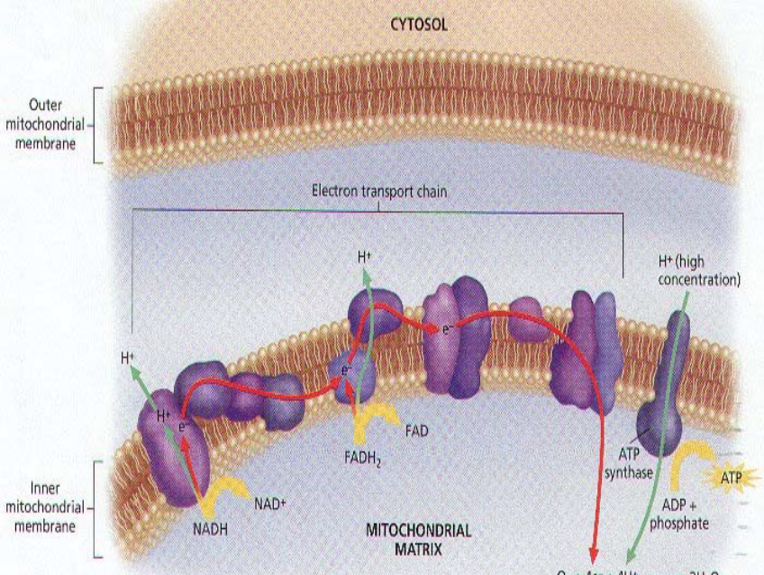
Electron Transport Chain
Electrons that have become “excited” are brought to the ETC by carriers such as NADH and FADH2
This releases the energy that cells need to make the most of their ATP so that it does not go to waste.
When the hydrogen ions flow back through the mitochondrial membrane, the energy is released.

Slide 24
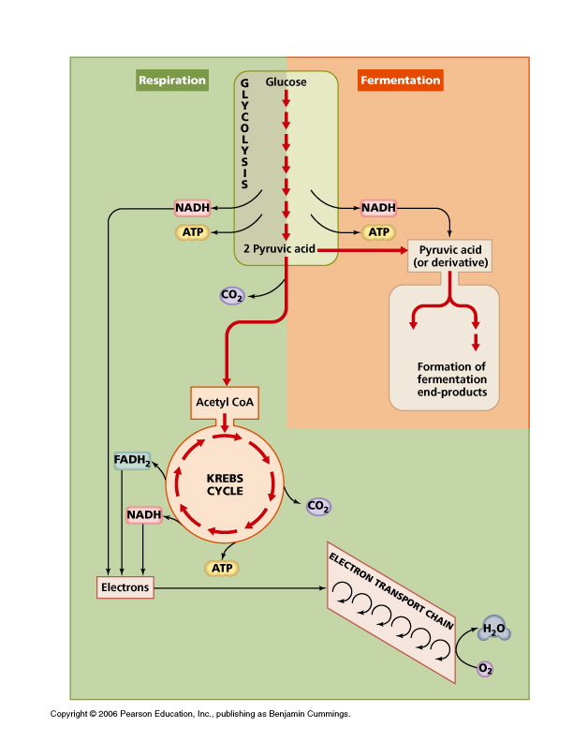
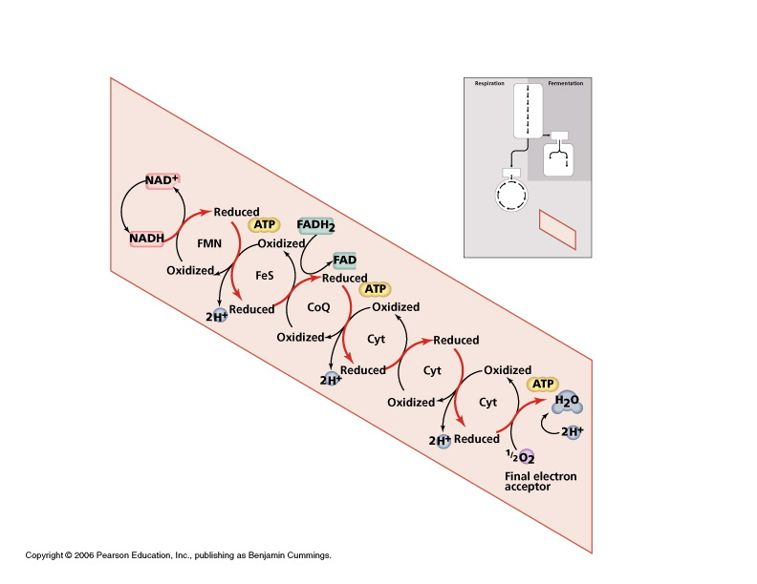
Electron Transport Chain: A Closer Look
Notes:
Review the diagram with students. Have them view the electron transport chain as a type of staircase, each stair step is where electrons are released.

Slide 25
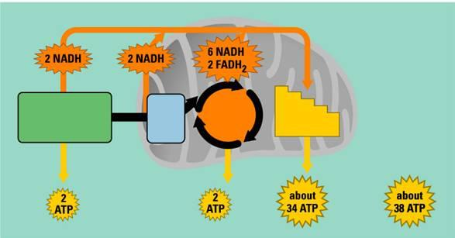
Aerobic Respiration
Summary
Prep stage
Krebs Cycle
Electron Transport Chain
Glycolysis
Total ATP Produced
Notes:
Optional Checkpoint: have students guess what each box represents in the process before showing them.

Slide 26
Check Point!

Slide 27
The first step in both aerobic and anaerobic respiration is _________________.
glycolysis
The Krebs cycle and the electron transport chain are steps only in ___________ respiration.
aerobic
“prep”
Acetyl-CoA is produced in the _______ stage of aerobic respiration from the pyruvate molecule.

Slide 28
Anaerobic respiration process
Fermentation

Slide 29
Two types of Fermentation
Alcoholic fermentation
  Carried out by yeast and some bacteria
  Results in ethanol and CO₂
    The trapped CO₂ is what causes bread to rise
Lactic acid fermentation
  Carried out by muscles when O₂ is not absorbed fast enough
    Also occurs in the bacteria found in yogurt
  Results in lactic acid
Remember that…
  Both begin with glycolysis
  Remember that in anaerobic processes, the pyruvate does not go through the Krebs cycle or through the electron transport chain

Slide 30
ATP Production
During anaerobic respiration, only 2 molecules of ATP are produced during the first and essentially only step; glycolysis.
The low ATP yield of glucose in fermentation occurs because the glucose molecule is not completely broken down, or metabolized.
Fermentation does not breakdown glucose to its full energy potential, but does provide a quick burst of necessary energy when oxygen cannot reach the cells fast enough

Slide 31

Lactic Acid
The partial breakdown of glucose in muscle cells results in lactic acid.
If the blood cells cannot remove lactic acid build up quickly enough from the muscle cells it causes muscle fatigue
  Lactate is removed by the oxygen cells found in the blood
  Have you ever been sore after playing a football game or from climbing stairs the day before?

Slide 32
Check Point!

Slide 33
absent
Oxygen is ________ during anaerobic respiration
Ethanol
CO₂
lactic acid
__________, _____, and ___________ are products of anaerobic respiration
more
Aerobic respiration produces ______ ATP molecules than anaerobic respiration
Notes:
Lactate or lactic acid would be acceptable answers for 2.C

