Slide 1
CELLULAR RESPIRATION

Slide 2
WHAT IS CELLULAR RESPIRATION?

Slide 3
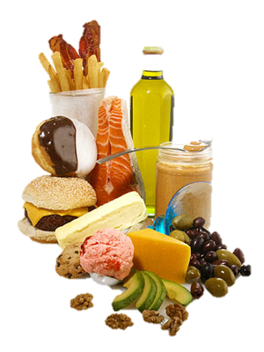
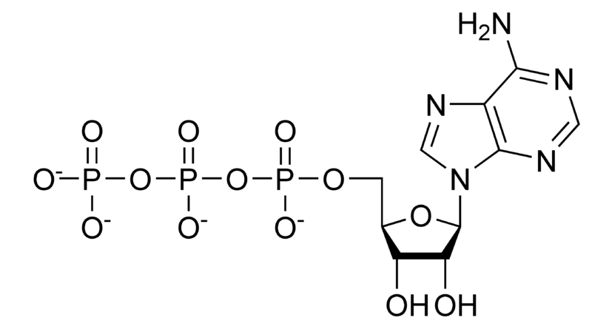
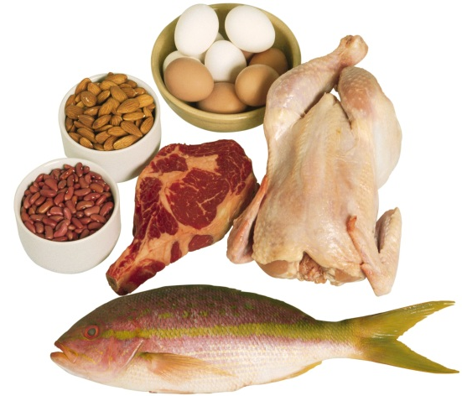
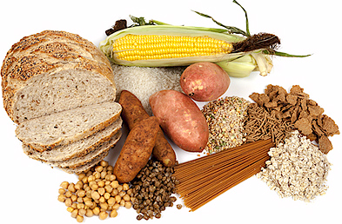
WHAT IS CELLULAR RESPIRATION?
Metabolic reactions in the cell that are designed to convert nutrients from food into Adenosine Triphosphate (ATP)
Carbohydrates, fats, and proteins can all be used as fuel
ATP is used to provide the body’s energy

Slide 4
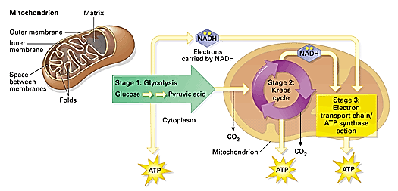
WHAT IS CELLULAR RESPIRATION?
Cellular respiration involves 3 different cycles:
Glycolysis
Citric Acid cycle or “Kreb’s” cycle
Oxidative phosphorylation

Slide 5
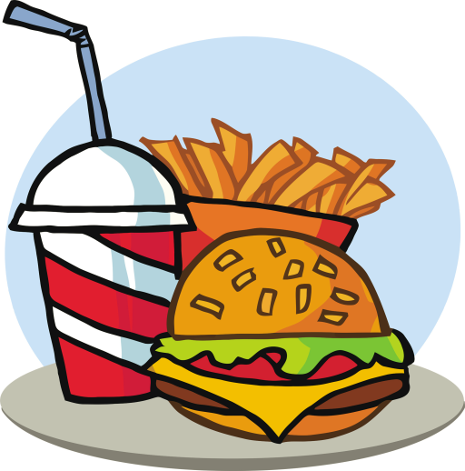
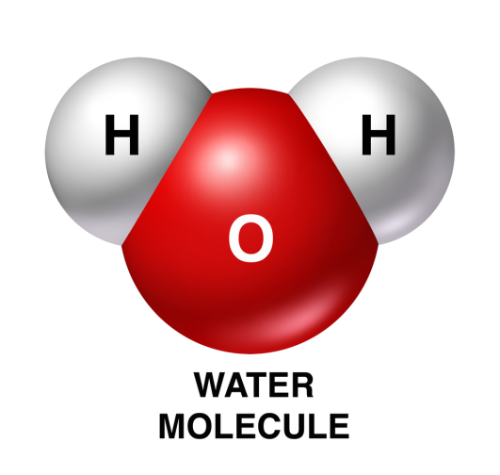
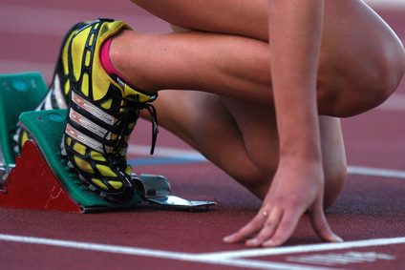
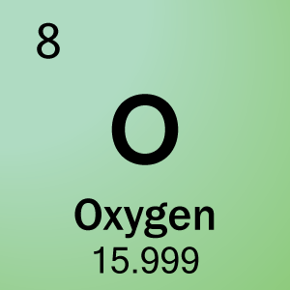
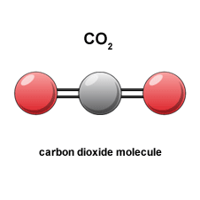
ENERGY

Slide 6
Aerobic Respiration
Requires O2 (oxygen)
Citric Acid cycle & Oxidative Phosphorylation
A cell uses O2 to oxidize (burn) molecules and release energy
C6H12O6 + 6O2 → 6CO2 + 6H2O + Energy
This is why we inhale O2 and exhale CO2

Slide 7
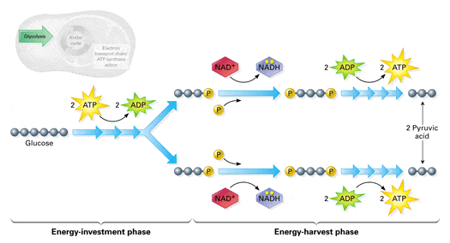
Glycolysis
Glyco= sugar; Lysis= breaking
Breaks down glucose→ 2 pyruvate
Occurs in the cytoplasm of the cell
Produces: 2 pyruvate, 2 net ATP, & 2 NADH
Notes:
An excellent website for students to practice and demonstrate understanding of glycolysis: http://www.sciencemusicvideos.com/glycolysis-interactive-lyrics-and-flashcards/

Slide 8
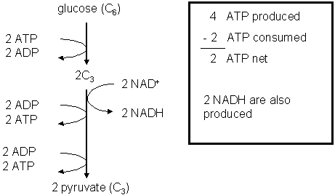
Glycolysis – Energy Investment
Requires 2 ATP input to start
Glucose (6 carbons) is split into two 3 carbon molecules
During the late stages of glycolysis, 4 ATP molecules are made
ATP INPUT
ATP PRODUCED

Slide 9
Glycolysis – Energy Harvest
We made a NET of 2ATP
NAD⁺ is converted to NADH which will be used later in Oxidative Phosphorylation
We end up with 2 Pyruvate molecules, 2 NADH & 2 ATP
NADH
NADH
GLUCOSE
ATP
ATP
Pyruvate
Pyruvate

Slide 10
Notes:
Yes, it’s a very cheesy song, but surprisingly effective in remembering the steps to Glycolysis. He also has a fantastic on-line tutorial: https://youtu.be/EfGlznwfu9U

Slide 11
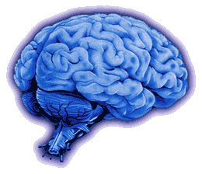
MEMORY CHECK!

Slide 12
Glucose breaks down into:
Phosphorus
Pyruvate
Polypeptides

Slide 13
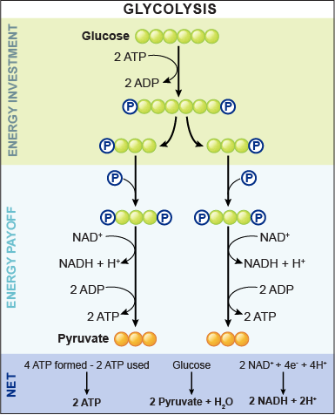
Glucose breaks down into:
PYRUVATE

Slide 14
Glycolysis
Since glycolysis is anaerobic, it is the sole source of energy for certain bacteria and yeasts
If O2 is present, then cellular respiration can continue to the next pathway….
Notes:
Click “Glycolysis” for a more detailed animated overview of glycolysis in the cell

Slide 15
GLUCOSE
Is used to produce
PYRUVATE
NADH
ATP
which
In the ABSENCE of oxygen
In the PRESENCE of oxygen
Krebs Cycle
are converted to either
are used to produce
ETHYL ALCOHOL
LACTIC ACID
CO2
ATP
NADH
FADH2
which transfer
and
ELECTRONS
CO2
and produces
ATP
WATER

Slide 16
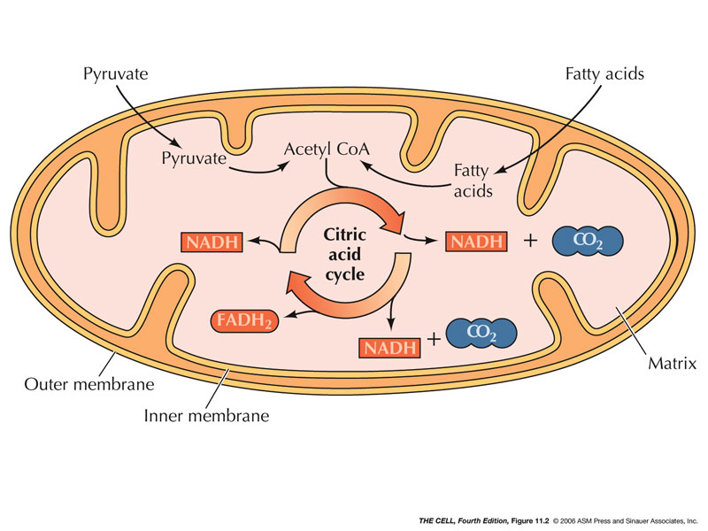
Krebs or Citric Acid Cycle (TCA)
Aerobic respiration
Occurs in the mitochondrial matrix
Oxidizes pyruvate to generate chemical energy
Produces: ATP, NADH, FADH2, CO2
Oxidation is the loss of electrons.
Pyruvate is oxidized during the transformation of pyruvate→ acetyl-CoA

Slide 17
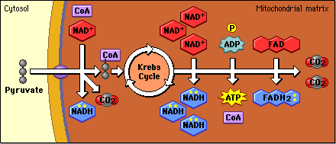
INPUT
OUTPUT

Slide 18
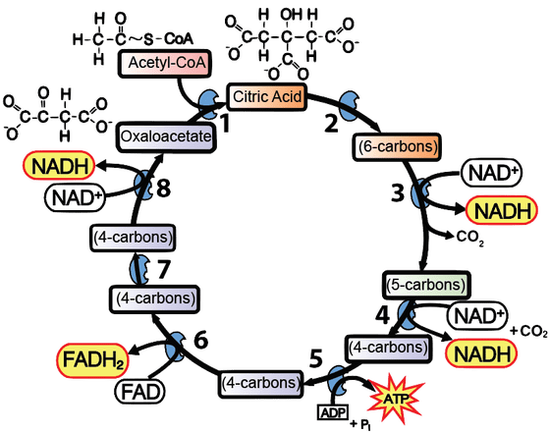
Krebs Cycle
Pyruvate is transformed into Acetyl-CoA, releasing CO2
8 reactions in the cycle:
Acetyl CoA brings chemical energy into the cycle in the form of a two carbon acetyl group.
Enzymes detach the two-carbon acetyl group from Acetyl CoA, and attach it to a four-carbon molecule called oxaloacetate The result is the six carbon molecule Citric Acid.

Slide 19
Krebs Cycle
Enzymes then do one or more of the following:
Molecular rearrangements: change citric acid or its derivatives into substrates for the next reaction.
Remove carboxyl groups: releasing of carbon dioxide; molecules in the cycle are losing carbons
Oxidation-Reduction reactions. The food-derived molecules in the cycle are oxidized. These oxidations power the reduction of the electron carriers NAD+ to NADH and FAD to FADH₂.
Substrate-level phosphorylations: Enzymes use the chemical energy that was provided by acetyl-CoA to phosphorylate an ADP, creating an ATP; immediate energy for the cell.

Slide 20
Remember!
Energy enters in the form of a two carbon molecule, brought in by acetyl Co-A.
This combines with a four-carbon molecule called oxalic acid, generating the six-carbon molecule citric acid.
During the course of the cycle, the cell harvests
1 ATP
3 NADHs
1 FADH₂.
Two CO₂ are released as a waste product.
The Krebs cycle runs twice for every glucose (glucose is broken down to two pyruvates, which become two Acetyl CoAs).
This is all occurring in the mitochondrial matrix.

Slide 21
Track your carbons…
Substrates for Oxidative Phosphorylation

Slide 22
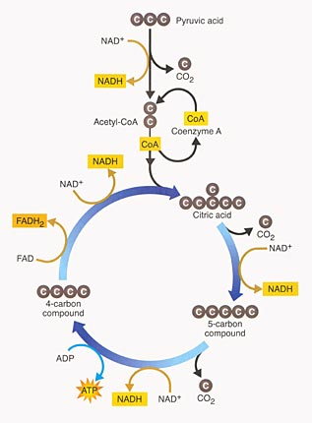
TCA: An Overview
Notes:
Click the header for a quick video about the citric acid cycle
http://youtu.be/F6vQKrRjQcQ

Slide 23
MEMORY CHECK!

Slide 24
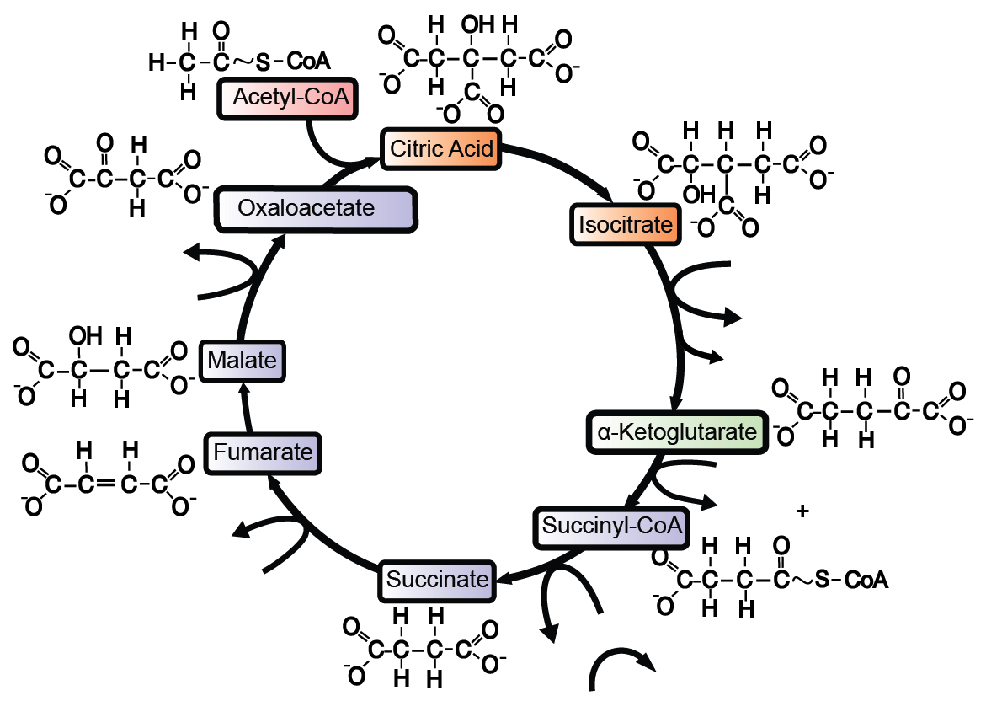
Fill in the diagram with the correct terms
NAD⁺
NADH
CO2
FADH2
FAD
ADP
ATP
GDP
GTP

Slide 25
Fill in the diagram with the correct terms
NAD⁺
NADH
CO2
FADH2
FAD
ADP
ATP
NADH
NAD
NAD
NADH
CO2
FADH2
FAD
GDP
GTP
GDP
ATP
ADP

Slide 26
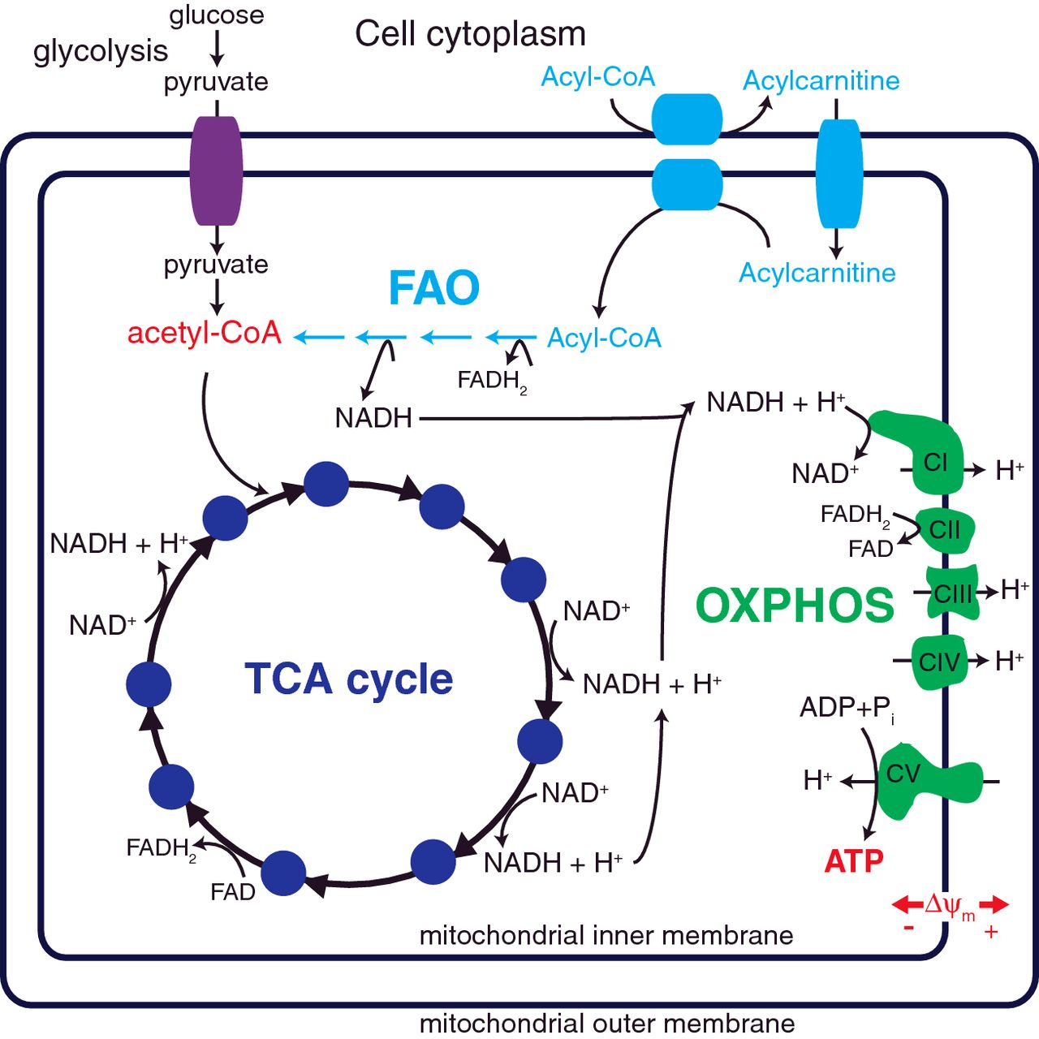
Oxidative Phosphorylation
Last step in cellular respiration
Inner mitochondrial membrane
Releases chemical energy stored in NADH & FADH2
1 NADH= 3ATP made
1 FADH2 = 2 ATP made
Notes:
The hyperlink takes you to an interactive diagram of the mitochondria (2. on the webpage). This is really helpful in building the students’ understanding of the process of respiration.

Slide 27
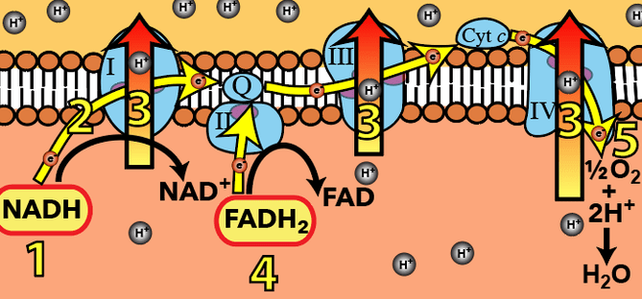
Electron Transport Chain (ETC)
A series of protein complexes located in the inner mitochondrial membrane
NADH and FADH2 are the electron donors (like rechargeable batteries)
Pumping of H+ ions create a gradient that drives ATP synthase

Slide 28
There are 3 major complexes in the ETC that aid in the transfer of electrons
II only deals with FADH2
Protein complexes are like a “wire” allowing electrons to flow

Slide 29
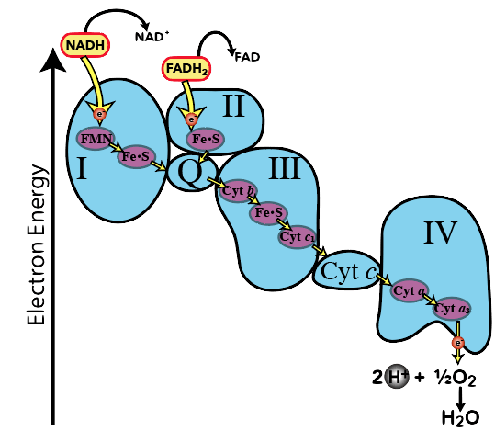
How it works:
Each electron donation is an oxidation resulting in NADH becoming NAD⁺, and FADH₂ becoming FAD
Electron carriers are organized in terms of electronegativity
the tendency to acquire electrons
Moving along the electron transport chain, each electron carrier has a greater electronegativity than the previous
Electrons are “falling down” an energy gradient. As they fall, they release energy.

Slide 30
How it works:
Oxygen is the final electron acceptor in the electron transport chain
Oxygen also grabs protons from the matrix
Oxygen is reduced to water
The second waste product of cellular respiration

Slide 31
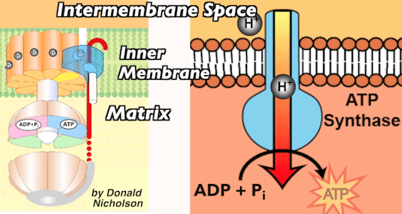
How it works:
Pumping protons from the matrix to the intermembrane space creates a potential energy gradient
Positively charged protons want to leave the positively charged intermembrane space (like charges repel) and move into the more negatively charged matrix (opposite charges attract)
Protons return to the matrix through a protein channel and the enzyme ATP synthase

Slide 32
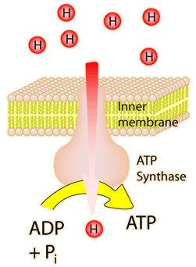
ATP Synthase
ATP synthase has binding sites for ADP and P_{i} (inorganic phosphate)
Protons diffusing through ATP synthase causes these binding sites to change shape
This catalyzes formation of a bond between ADP and Pi, transforming them into ATP

Slide 33
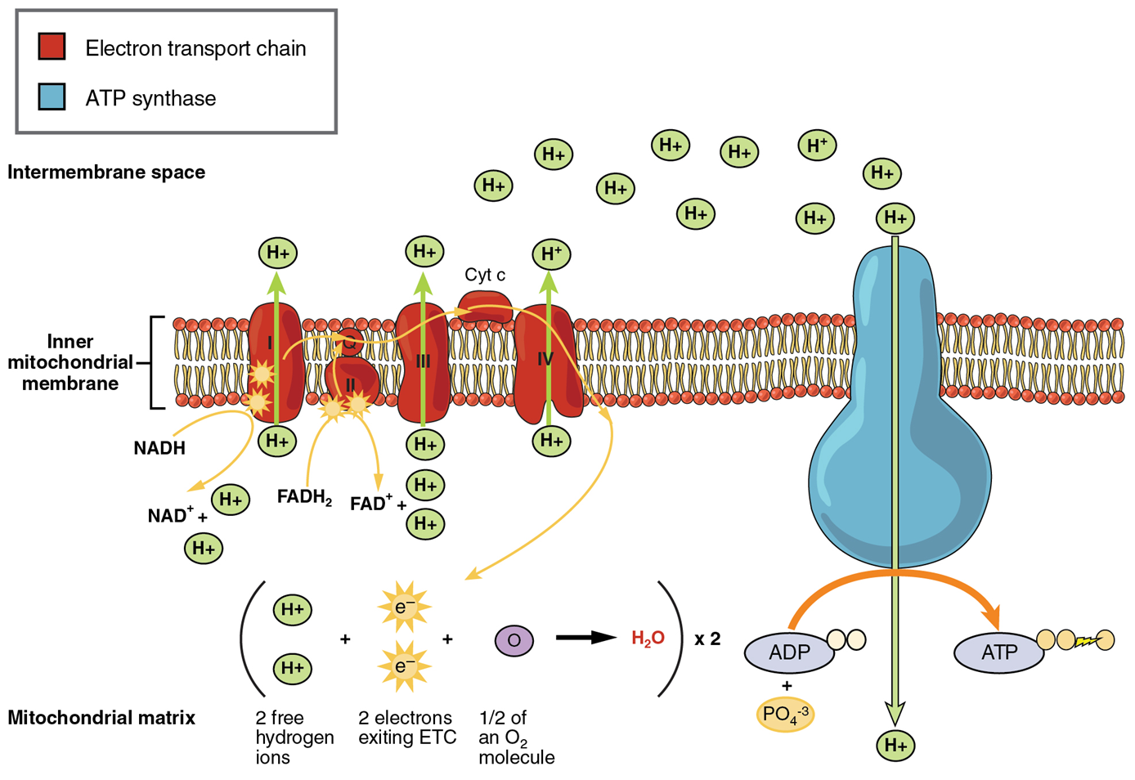
Oxidative Phosphorylation
About 32 ATP molecules are produced by the end of the electron transport chain
Oxidative Phosphorylation accounts for 90% of the body’s ATP
Quizzes!
Notes:
Click on “oxidative phosphorylation” for an animated musical overview of the process of oxidative phosphorylation and the creation of ATP
Click on quizzes for interactive quizzes to test your students knowledge of the Electron Transport Chain.

Slide 34
MEMORY CHECK!
The mitochondrial electron transport chain uses ______ energy for pumping ______ From the mitochondrial ________ to the intermembrane space increasing proton concentration in that place. The only way the protons can escape is through a channel and an enzyme, ATP __________. Which uses diffusing protons’ kinetic energy to make ATP, from ______ and P
synthase electron ADP matrix protons

Slide 35
Summary of Cellular Respiration
 | Glycolysis | Pyruvate→ Acetyl-CoA | Citric Acid Cycle | Oxidative Phosphorylation
Location | Cytoplasm | Mitochondrial Matrix | Mitochondrial Matrix | Inner mitochondrial membrane
Reactants | Glucose 2 ATP 2 NAD+ | 2 Pyruvate 2 NAD+ 2 CoA | 2 acetyl-CoA 6 NAD+ 2 FAD | 8 NADH 4 FADH2 6 O2
Products | 2 pyruvate 4 ATP 2 NADH | 2 Acetyl-Coa 2 NADH 2 CO2 | 4 CO2 6 NADH 2 FADH2 2 ATP | 8 NAD+ 4 FAD+ 32 ATP 6 H2O
ATP required | 2 | None | None | None
ATP produced | 4 | None | 2 | 32
Net ATP | 2 | None | 2 | 32

Slide 36
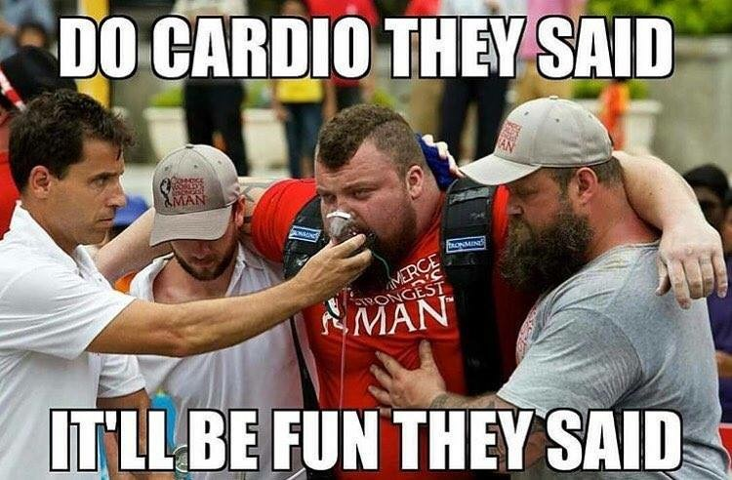
Anaerobic Respiration
Doesn’t require the use of O2
Glycolysis
Lactic acid fermentation (animals, humans)
Alcoholic fermentation (yeast)
Not sustainable

Slide 37
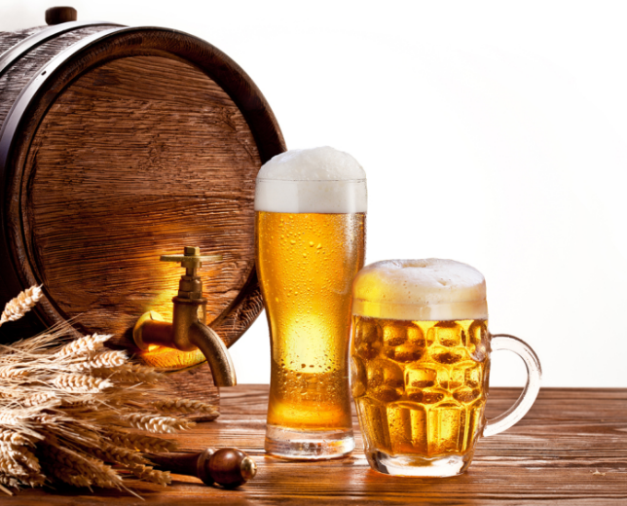
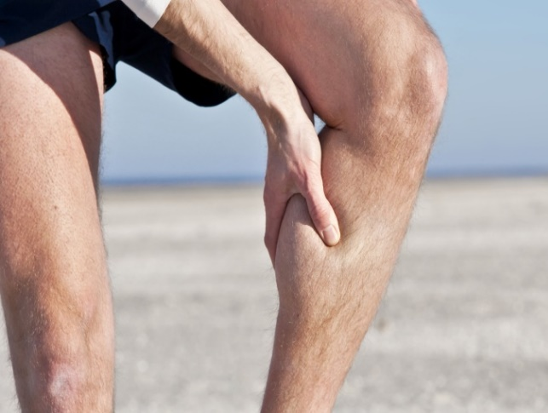
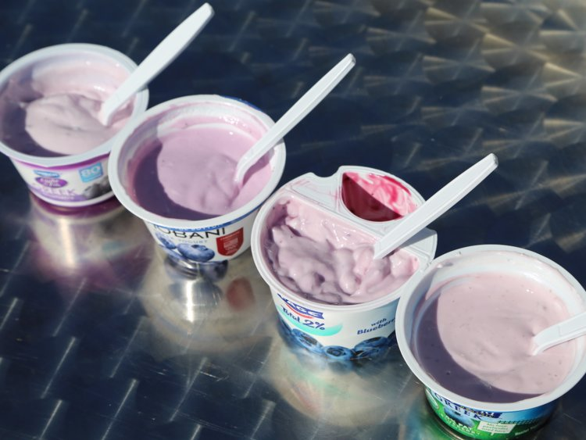
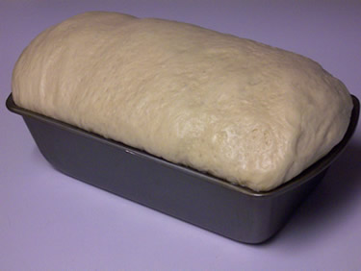
Fermentation
Oxidizes NADH to NAD+ so that glycolysis can continue
There are two forms: alcoholic & lactic acid fermentation
Pyruvic acid + NADH → Ethanol + CO2 + NAD⁺
Pyruvic acid + NADH → Lactic acid + NAD⁺

Slide 38
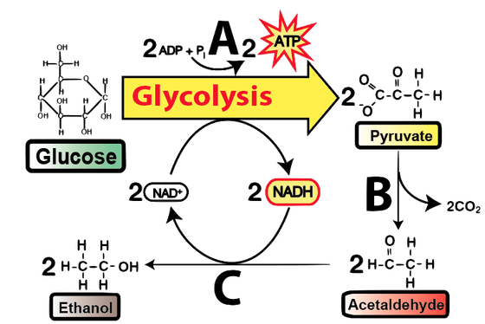
Alcohol Fermentation
“A” - glycolysis
“B” - enzymes break the carboxyl group off pyruvate, producing acetaldehyde. The carboxyl group becomes CO₂ (the bubbles in beer or bread)
“C” - regenerating NAD⁺ allowing glycolysis to continue, acetaldehyde is reduced to ethanol. This oxidation and reduction is paired together, with the electrons (and hydrogens) flowing from NADH (which is being oxidized) to acetaldehyde (which is being reduced).

Slide 39
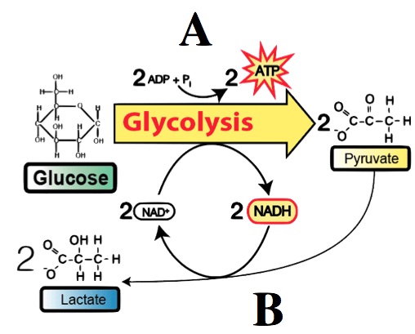
Lactic Acid Fermentation
“A” - glycolysis
“B” - absent oxygen, enzymes take pyruvate and reduce it to lactate, or lactic acid, accompanied by the simultaneous oxidation of NADH to NAD⁺.

Slide 40
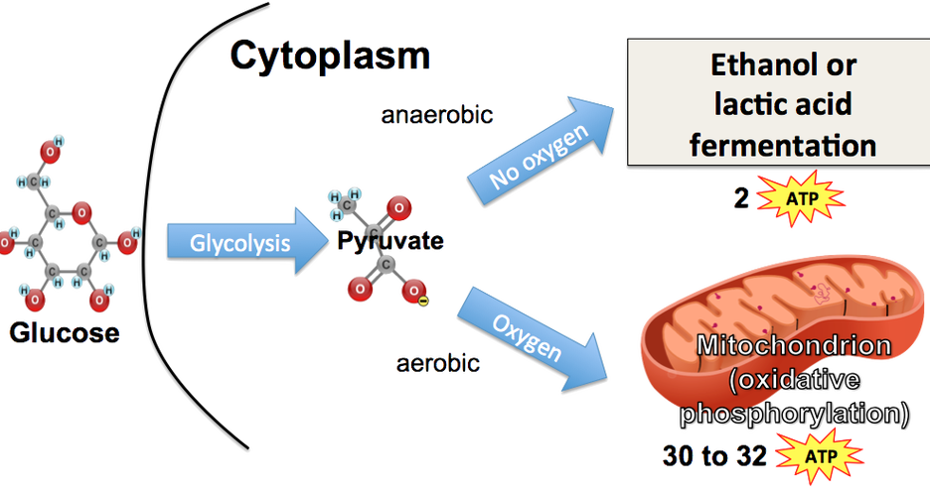
Glucose and Energy
Each molecule of glucose generates 36-38 ATP in aerobic respiration compared to only 2 ATP with anaerobic respiration

Slide 41
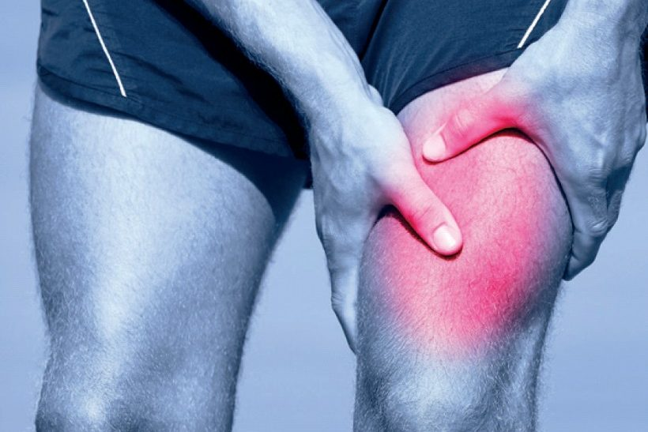
Fact or Myth?
Lactic Acid buildup in muscles is responsible for the feeling of “soreness” after a workout.
MYTH!
Accumulated lactic acid in your muscle tissue, leads to “lactic acid burn.”
Within 45 minutes the lactic acid diffuses out of your muscles into your blood, which carries it to your liver. Liver cells convert it into glucose, which diffuses back into the bloodstream to power cellular respiration.
Soreness occurs because exercise (lengthening & contracting muscles) creates microscopic tears in the muscle cells.

Slide 42
3 Minute Experiment

Slide 43
Other energy sources
Glucose is sugar from carbohydrates, but it is not the only energy source that can be used in cellular respiration.
Fat can be broken down to glycerol and fatty acids and used in glycolysis or TCA cycle, respectively.
Protein can be used when glucose/fat stores are depleted. Amino acids enter the TCA cycle directly.
Notes:
Click the title for a final review of cellular respiration and how it ties into the food we eat and energy we make

Slide 44
Review
Humans undergo cellular respiration, where our food is broken down and converted into energy for our cells.
Cellular respiration has 3 basic steps:
Glycolysis turns glucose into pyruvate
Citric Acid cycle generates ATP and NADH
Oxidative Phosphorylation uses the ETC to generate ATP
One glucose can make ~36 ATP molecules
Without oxygen, pyruvate can’t enter the citric acid cycle and undergoes fermentation instead.

