Slide 1
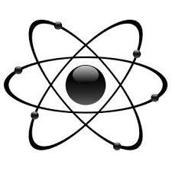
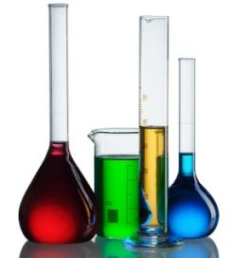
Common Chemistry Terms

Slide 2
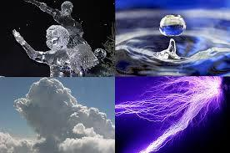
Matter
Definition: term for any type of material; anything that has mass and takes up space
4 primary states of matter
There may be limitless states of matter
Solid
Liquid
Gas
plasma
Notes:
Scientists are discovering many states of matter and believe that the states of matter may be limitless!
Extreme cold and pressure cause atoms to behave in unusual ways leading to these states of matter
Strange matter, Bose–Einstein condensates, degenerate matter, etc…

Slide 3
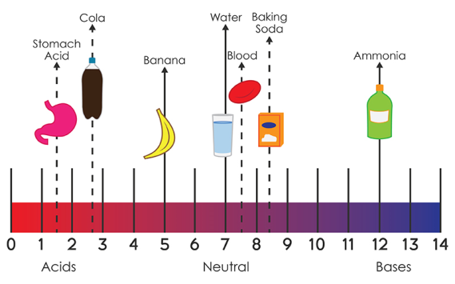
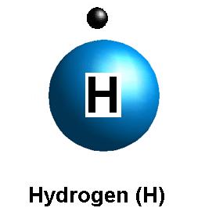
pH
Definition: measure of Hydrogen ion concentration
measure of the acidity or basicity of an
aqueous solution

Slide 4
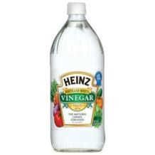
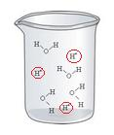
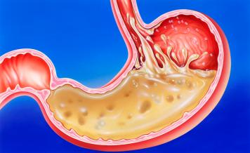
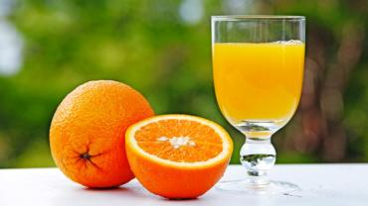
Acid
Definition: substance that gives off H⁺ ions in water and has a pH < 7
Notes:
Soda, vinegar, stomach acid, orange juice

Slide 5
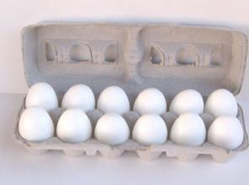
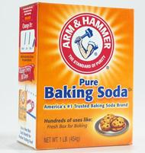
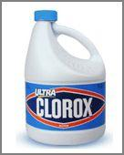
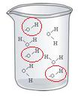
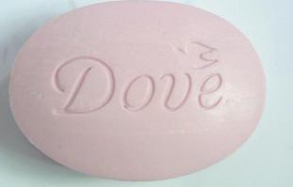
Base
Definition: A compound that gives off OH⁻ ions in water and have a pH > 7
Notes:
Baking soda, bleach, soap, eggs

Slide 6
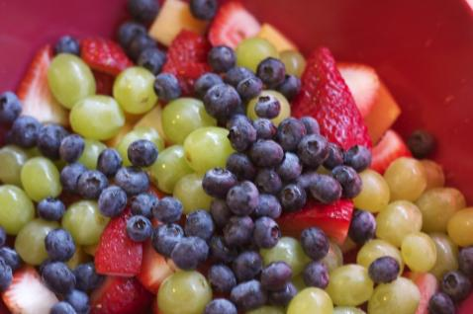
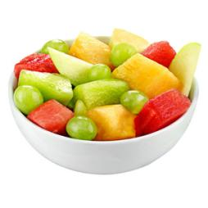
Mixture
Definition: A mixture is what you get when you combine two or more substances
No chemical reaction occurs
Can separate substances again
Example: different fruits

Slide 7
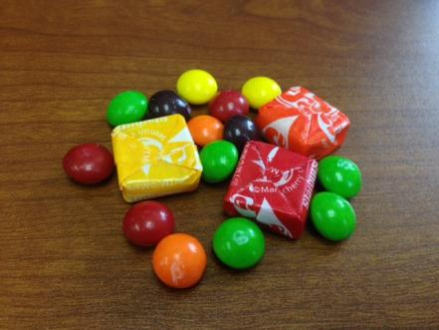
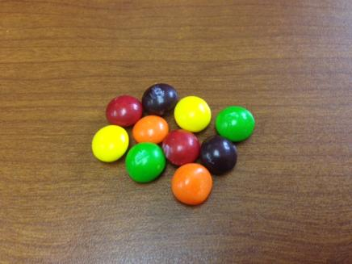
Mixture Types
Heterogeneous
Homogeneous
Definition: parts of a mixture that are not evenly distributed
Definition: parts of a mixture that are evenly distributed
Notes:
Skittles and Starburst

Slide 8
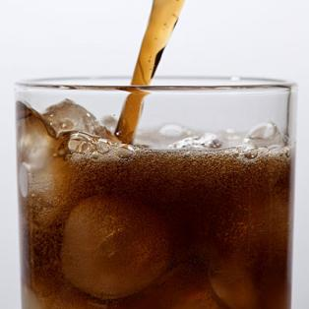
solution
Definition: where one substance is evenly and completely dissolved into another
Chemical reaction occurs
Substances can not be separated
Example: air Nitrogen + Oxygen
Example: carbon dioxide in soda

Slide 9
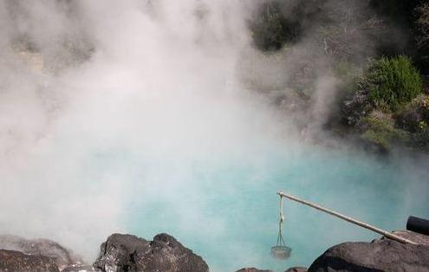
Vaporization
Definition: a change from liquid to gas
Example: Water

Slide 10
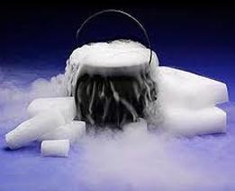
Sublimation
Definition: a change from solid to gas
Example: dry ice

Slide 11
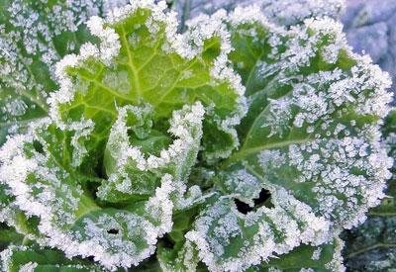
Deposition
Definition: a change from gas to solid
Example: frost
Notes:
Frost is the solid deposition of water vapor from saturated air. It is formed when solid surfaces are cooled to below the dew point of the adjacent air as well as below the freezing point of water

Slide 12
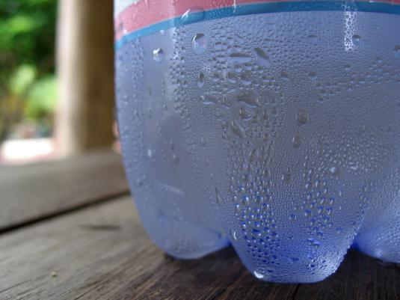
condensation
Definition: a change from a gas to liquid
Example: Water gathering on a cold bottle

Slide 13
Freezing
Definition: a change from liquid to solid
Example: ice

Slide 14
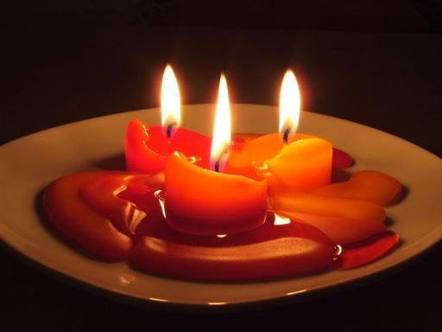
melting
Definition: a change from solid to liquid
Example: candle wax

Slide 15
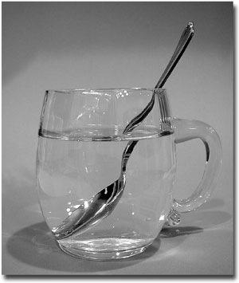
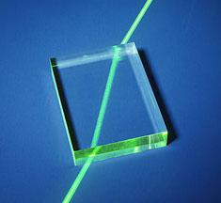
refraction
Definition: bending of light as it passes from one substance to another

Slide 16
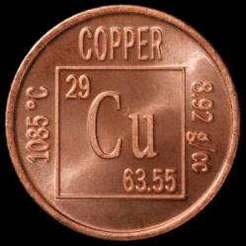
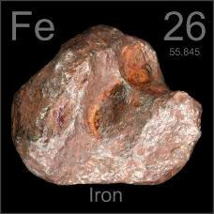
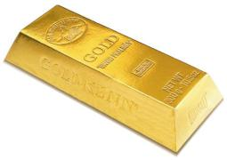
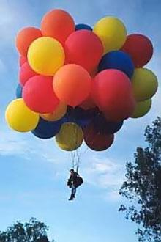
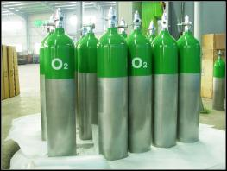
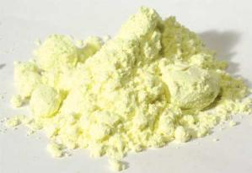
element
Definition: a substance that cannot be separated into simpler substances
Notes:
Elements: copper, gold, oxygen, sulfur, iron, helium

Slide 17
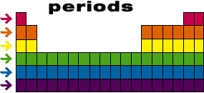
Period
Definition: a horizontal row of elements in the periodic table

Slide 18
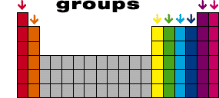
Families/groups
Definition: a vertical row of elements in the periodic table
These elements have similar properties

Slide 19
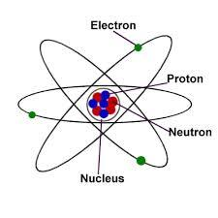
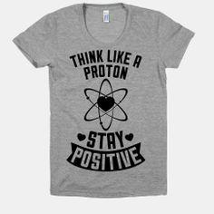
Protons
Definition: positively charged particles in the nucleus
Hydrogen ion, H⁺ is a proton

Slide 20
neutrons
Definition: neutrally charged particles in the nucleus

Slide 21
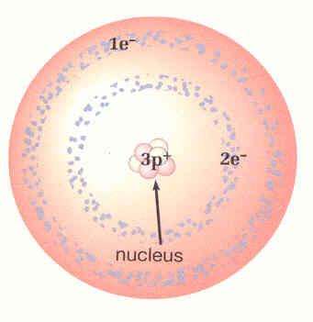
electrons
Definition: negatively charged particles outside the nucleus

Slide 22
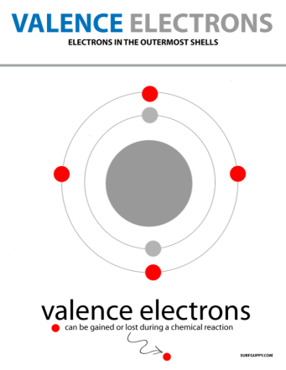
Valence electrons
Definition: electrons in the outer shell of an atom
Involved in forming bonds to adjacent atoms

Slide 23
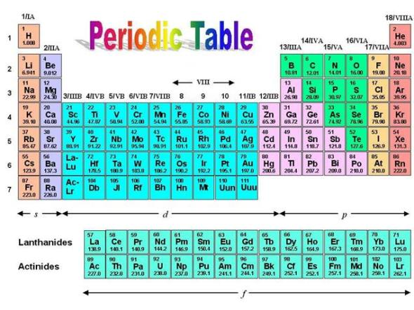
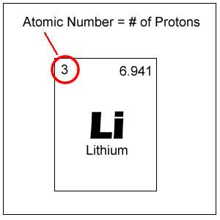
Atomic number
Definition: the number of protons in the nucleus of an atom

Slide 24
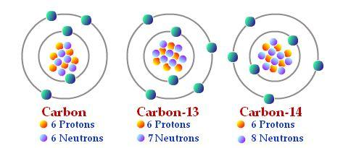
isotopes
Definition: atoms of the same element that have different numbers of neutrons

Slide 25
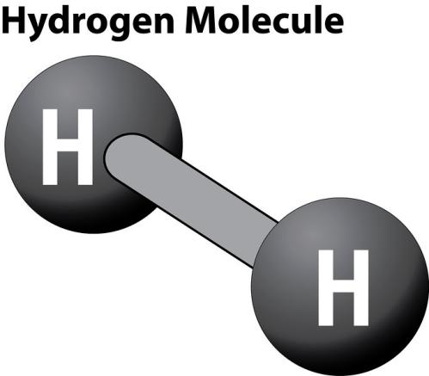
Molecule
Definition: atoms that are connected by chemical bonds

Slide 26
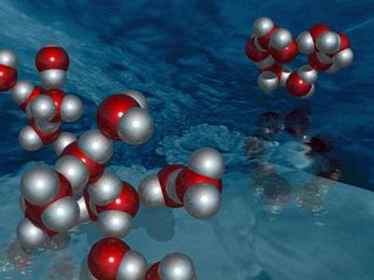
Compound
Definition: a pure chemical substance consisting of two or more different elements
Water, H₂O
Notes:
All compounds are molecules, but not all molecules are compounds!

Slide 27
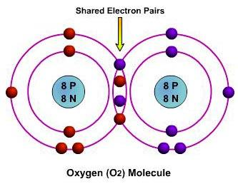
Covalent bond
Definition: a chemical bond that involves the sharing of electron pairs between atoms
Notes:
All compounds are molecules, but not all molecules are compounds!

Slide 28
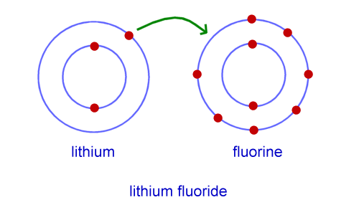
ionic bond
Definition: bonds in which atoms that have lost one or more electrons and atoms that have gained one or more electrons.
bonding animation
Notes:
Click link to see animations of various types of bonds with audio descriptions.

Slide 29
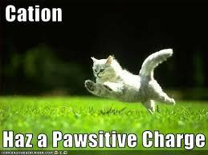
Cation
Definition: positively charged atom or group of atoms
Examples: Calcium Ca²⁺, Silver Ag⁺, Potassium K⁺

Slide 30
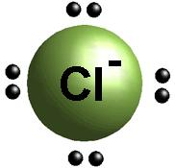
Anion
Definition: negatively charged atom or group of atoms
Examples: Fluoride F⁻, Chloride Cl⁻, Iodide I⁻

Slide 31
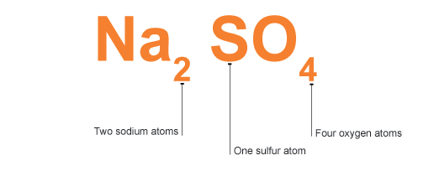
Chemical Formula
Definition: An expression which states the number and type of atoms present in a molecule of a substance.

Slide 32
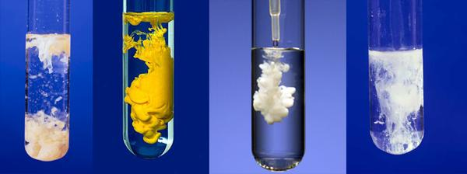
Chemical Reaction
Definition: A process where a set of substances undergo a chemical change to form a different substance.

Slide 33
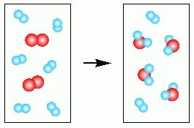
Reactant/Reagent
Definition: substances that are used to bring about a chemical reaction
any substance that is consumed or used up during the reaction
Reactant

Slide 34
Product
Definition: The substance that is produced by a chemical reaction
Product

Slide 35
Catalyst
Definition: substance that speeds up a chemical reaction but is chemically unchanged
Example: Enzymes are catalysts because they allow the reactions that take place in the body to occur fast enough that we can live

Slide 36
Conservation of Mass
Definition: matter can be neither created nor destroyed
The mass of an object or collection of objects never changes, no matter how the parts are rearranged

Slide 37
Stoichiometry
Definition: the part of chemistry that studies amounts of substances that are involved in reactions

Slide 38
Mole
Definition: measures the number of particles in a specific substance
Avogadro's number = 6.02 x 10²³
Used to convert between atoms/molecules and grams

Slide 39
Questions?

