Slide 1
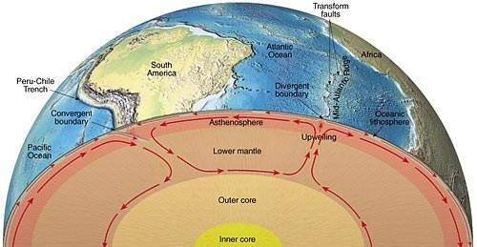
Convection Currents

Slide 2


Before continuing, brainstorm and write down what you think convection currents are...

Slide 3
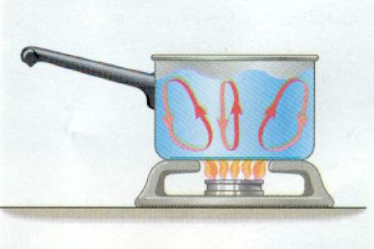
Convection
The movement of heat by a liquid or gas.
The liquid or gas moves from one location to another, carrying heat along with it.
This movement of a mass of heated liquid or gas is called a current.

Slide 4
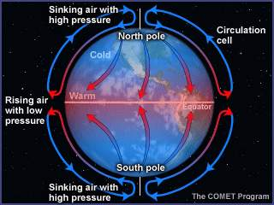
Currents in the Earth’s System
Convection currents occur within:
  The geosphere-Plate tectonics
  The atmosphere-Wind
  The hydrosphere-Ocean currents
Notes:
http://www.ucmp.berkeley.edu/education/dynamic/session1/sess1_earthcurrents.html
http://schools.bcsd.com/fremont/5th_Sci_weather_Wind.htm

Slide 5
Now write down what you think occurs in geosphere, atmosphere, and hydrosphere convection.

Slide 6
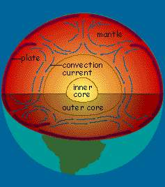
Geosphere Convection
Convection occurs because the density of a fluid is related to its temperature.
Hot rocks lower in the mantle are less dense than their cooler counterparts above.
The hot rock rises and the cooler rock sinks due to gravity.
Large convection systems in the mantle may carry along the plates of the lithosphere like a conveyer belt.
Video Link: http://youtu.be/ryrXAGY1dmE
Notes:
http://www.moorlandschool.co.uk/earth/convecti.htm
http://mediatheek.thinkquest.nl/~ll125/en/fullconvect.htm
http://www.pbs.org/wgbh/aso/tryit/tectonics/intro.html

Slide 7
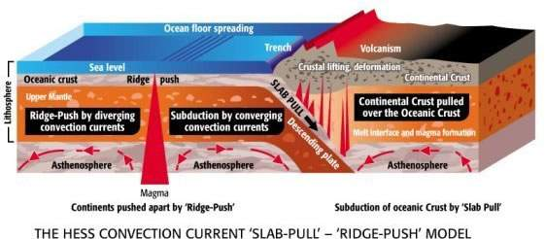
Plate Tectonics
The earth’s plates are pulled apart by the convection currents.
Notes:
http://www.tectonic-forces.org/pt13.htm

Slide 8
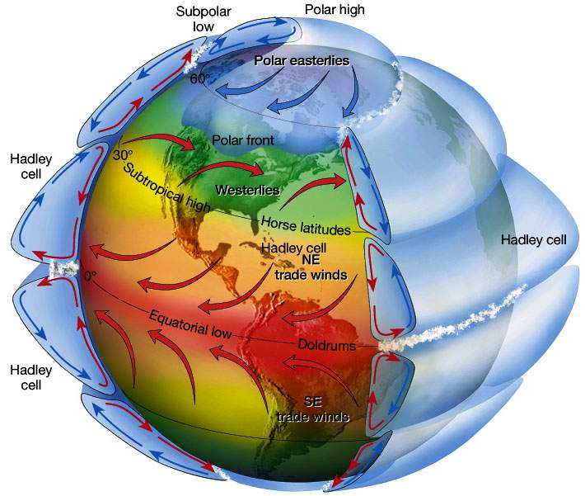
Atmospheric Convection
Process in which heat energy is transported through a medium, usually a gas or liquid.
Notes:
http://www.chemistry-dictionary.com/definition/atmospheric+convection.php
http://www.ux1.eiu.edu/~cfjps/1400/circulation.html

Slide 9
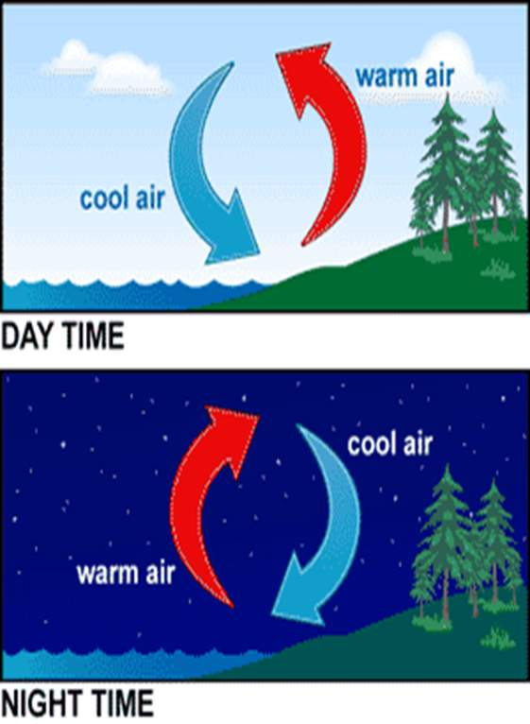
Air current
The heat that comes from the sun causes the currents of air to move.
This happens because the sun heats the earth’s surface causing the air near the surface to get warmer.
The air molecules move further away from each other making the warm air less dense which causes it to rise.
As it rises, the air begins to cool and then sinks back towards the surface.

Slide 10
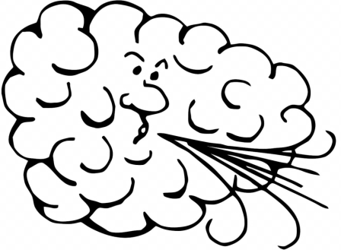
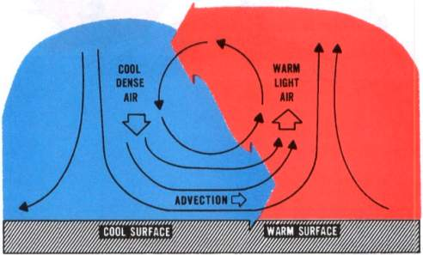
Wind
The horizontal air flow in a convective current is “wind.”
When two surfaces are heated unequally, they heat the overlying air unevenly. The warmer air expands and becomes lighter or less dense than the cool air.
The more dense, cool air is drawn to the ground by its greater gravitational force lifting or forcing the warm air upward.
The rising air spreads and cools, eventually descending to complete the convective circulation. As long as the uneven heating persists, convection maintains a continuous “convective current.”
Notes:
http://michelletang3b2physicsproject09.blogspot.com/2009/06/transfer-of-thermal-energy-convection.html
http://www.bing.com/images/search?q=wind+convection+currents&view=detail&id=95F35D5707A7E8FE3681DA6CFB7BBD79DD258757&first=0&FORM=IDFRIR
http://www.edupics.com/coloring-page-wind-i11400.html

Slide 11
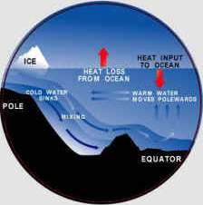
Hydrosphere convection
Convection in the hydrosphere circulates water, keeping the temperature gradients of the ocean stable.
Notes:
http://findarticles.com/p/articles/mi_gx5226/is_2002/ai_n19143879/
http://www.all-creatures.org/hope/gw/01_hydrosphere.htm

Slide 12
Were you right? How much did you know?
Share your thoughts with the class. See how much everyone else knew!

