Slide 1
Going With the Flow: Convection Currents

Slide 2
What is a Convection Current?
Convection is the transfer of heat energy in a fluid
A fluid can be either a gas or a liquid; convection cannot occur in a solid
A current is a body of water or air moving in a certain direction
A convection current is a body of water or air whose movement is driven by heat energy

Slide 3
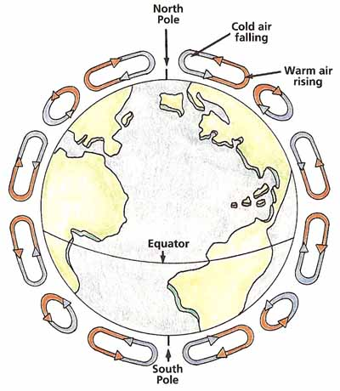
Convection Currents in the Natural World
All convection currents occurring in nature begin with the sun
The sun warms the air, and as the air heats up, it rises. The air then cools in the atmosphere and sinks back to earth’s surface again in convection currents

Slide 4
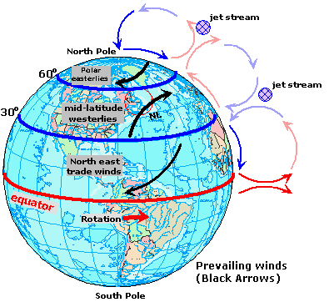
These convection currents create the Earth’s oceanic winds:
Warm air rises and spreads out in the upper layers of the atmosphere
As the air spreads out, it cools
Cool air sinks back to Earth’s surface
When the air reaches the surface, it spreads out again: wind!

Slide 5
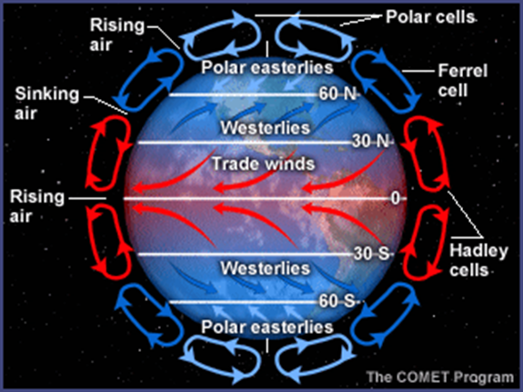
Wind Zones of the World
There are different names for winds based upon their latitude:
Polar Westerlies blow above and below 60 degrees latitude
Westerlies blow between 60 and 30 degrees latitude
Tradewinds blow along the equator between 30 and 0 degrees

Slide 6
Where the wind blows…
These winds blow across the surface of the oceans, creating currents
The ocean currents flow in the same direction as the winds are blowing

Slide 7
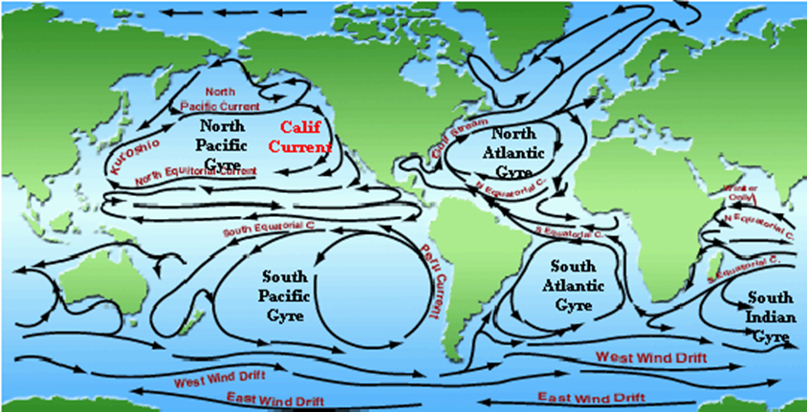
Just like air, water is also affected by convection currents:
Warm water at the ocean’s surface generally moves from the warm equator to the poles, where it then cools and cycles back to the equator
An area where an ocean current cycles is called a gyre

Slide 8
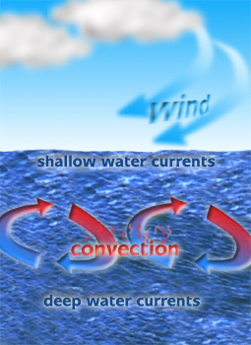
Currents aren’t just at the ocean’s surface
Deepwater currents are found below 400 meters of depth
Make up 90% of the ocean’s currents
Caused by temperature and density differences

Slide 9
Deepwater Currents: Temperature
Water molecules pack more closely together when it is cold, so cold water ‘sinks’
Water molecules are more spread out in arrangement when it is warm, so it ‘floats’

Slide 10
Deepwater Currents: Density
Warm water molecules are more spread out, so they are less ‘dense’, so it rises to the ocean’s surface
Cold water molecules are more dense because they are more closely packed together. Cold water can also hold more salt, which makes it even more dense so cold water sinks to the ocean floor

Slide 11
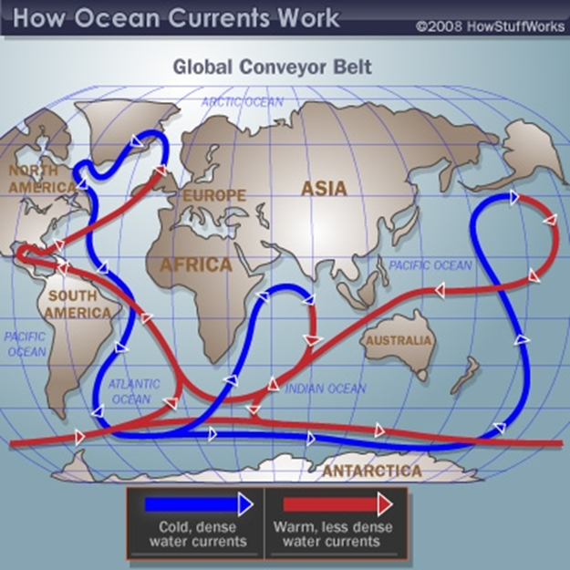
Deepwater Currents
As the cold/warm water sinks/rises, warm/cold water must take its place, creating the cycle that is a deepwater current

