Slide 1
Digital Imaging Equipment

Slide 2
Computed Tomography (CT)

Slide 3
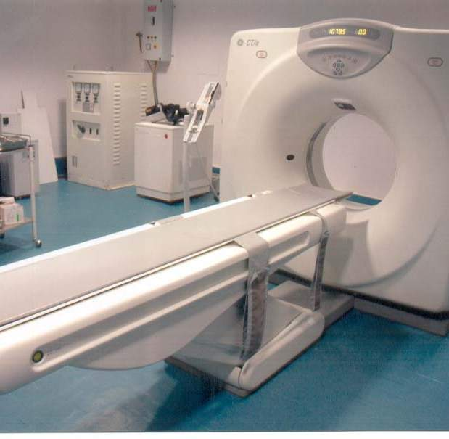
CT scanner

Slide 4
How it works
Provides high-resolution cross-sectional anatomical images
Table moves through a circular opening in the CT scanner called the gantry, while an x-ray tube emits x-rays as it spins 360 degrees inside the gantry
A detector array measures the amount of x-rays that pass through the anatomic part and cross-sectional images are generated from data.

Slide 5
uses
Detects and confirms the presence of tumor
Guides a biopsy
Helps plan and monitor radiation and surgical treatment
Helps diagnose problems with blood vessels and the heart
Used for diagnosing abnormalities of the:
Brain, nasal passages, musculo-skeletal system, spine, abdomen, lungs and mediastinum

Slide 6
Other facts
Average scanning time per anatomic region is only 10-20 seconds therefore many patients can be examined under sedation instead of anesthesia
General anesthesia and is necessary for thorax imaging to control respiration and for timed contrast imaging to control movement
Ensures the clearest and most accurate images

Slide 7
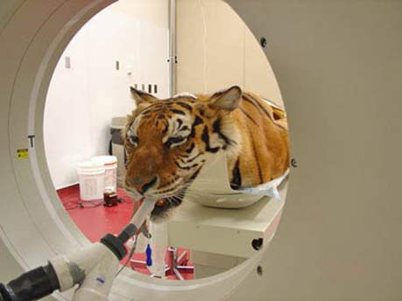
Risks
CT scans should be avoided during the first trimester of pregnancy
Animals must be sedated or under anesthesia

Slide 8
Magnetic resonance imaging (MRI)

Slide 9
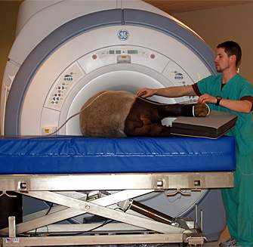
MRI Machine

Slide 10
How it works
Uses magnetic fields and radio waves to diagnose diseases and injury of soft tissue
The atoms comprising soft tissue align with the magnetic field in the machine
Radio waves pulsed into the field alter the atoms causing signals to be released and transmitted to a computer
Signals then show up as either light or dark areas in the computer image

Slide 11
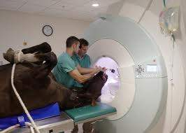
How it works cont’d.
Primarily used to examine internal organs for abnormalities
Imaging of large patients is limited to the limbs and head due to size constraints

Slide 12
uses
Diagnosing abnormalities of the brain, spinal cord, and musculoskeletal system
Diagnose or monitor treatment for conditions such as:
Tumors of the chest, abdomen or pelvis
Certain types of heart disease
Blockages, enlargements or anatomical variants of blood vessels
Diseases of the gastrointestinal tract
Cysts and solid tumors in the kidneys or other urinary tract organs

Slide 13
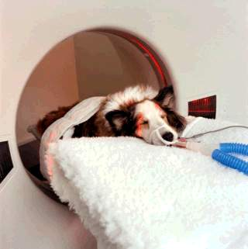
Risks
Radio-frequency energy to excite molecules is similar to those from a radio or TV station
Caution must be taken in patients with metal implants or pacemakers
Requires general anesthesia to ensure the clearest and most accurate image possible
.

Slide 14
Digital Fluoroscopy

Slide 15
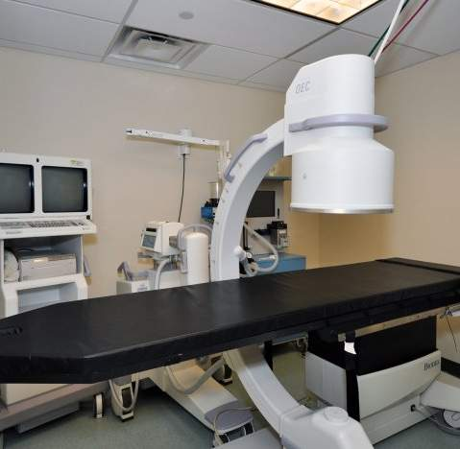

Slide 16
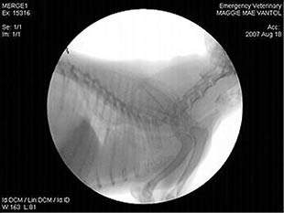
how it works
Digital images are acquired at a rate of 1-8 frames per second
The unit is used for myelography, contrast GI tract studies, and small animal general diagnostic imaging.

Slide 17
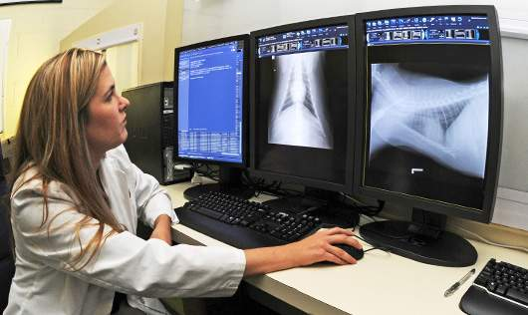
uses
Special procedures such as angiography, venography, cardiac fluoroscopy, or evaluation for dynamic tracheal disease

Slide 18
Safety while operating
Only persons required for a fluoroscopic procedure should be in the room during the procedure
Use the smallest possible beam area, thereby reducing the scatter radiation to personnel.
Fluoroscopic doses can also be minimized by reduction in the fluoroscopic time used
Use the shortest possible distance from the image intensifier to the animal to reduce scattered radiation levels.

Slide 19
Digital or computed Radiography

Slide 20
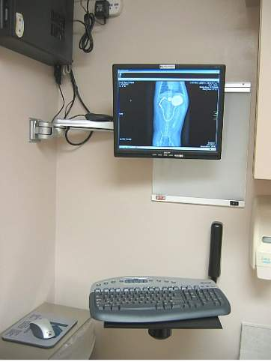
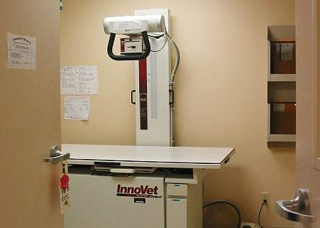

Slide 21
How it works
Computed Radiography uses a cassette system with imaging plate that contains photostimulable storage phosphors.
The phosphors detect and store energy from the x-rays that strike the cassette.
The light is captured, recorded, and processed into an image by a computer. The imaging plate is then erased by fluorescent light in the scanner, and is ready to be used again.

Slide 22
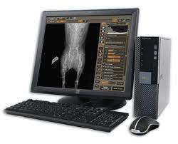
How it works
Digital Radiography has no processing or erasing step
Provides an instant digital image similar to a digital camera

Slide 23
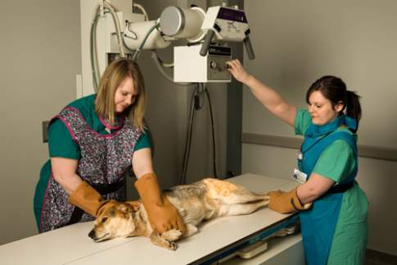
How it works Cont’d.
The digitized image can be manipulated: changing contrast and brightness, zoom in or out, and take measurements
Images are stored in a secure file that is difficult to alter

Slide 24
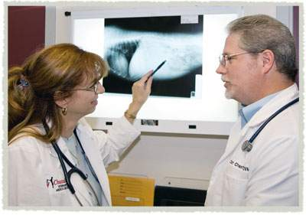
uses
Provides information about the internal architecture of abdominal organs, bones and areas such as the pelvic canal.

Slide 25
Safety While Operating
Limit the X-Ray beam to the smallest area possible
Align the X-ray beam properly with the animal and the image receptor
Remain behind a protective barrier during the entire radiographic exposure
Wear protective gloves and aprons having a lead equivalent of not less than 0.5 millimeter

Slide 26
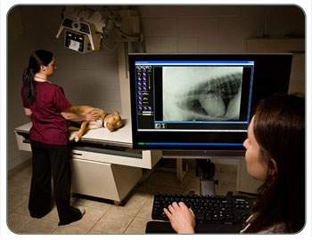
Risks
Some radiographs require sedation or general anesthesia

Slide 27
Ultrasound

Slide 28
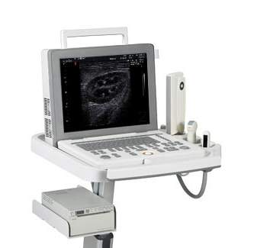

Slide 29
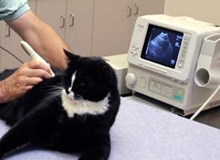
How it works
Uses sound waves to produce images of organs.
Sound waves sent into the body are reflected off of an internal tissue interface.
Hundred of these reflected signals provide an image of the organ, which can be visualized on the ultrasound machine monitor.

Slide 30
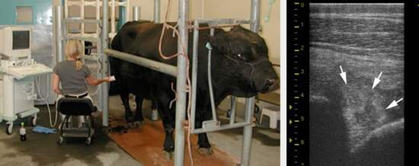
uses
Areas frequently viewed with ultrasound:
Thorax, abdomen, eyes, brain, and tendons
View abnormalities of organs and provides guidance for biopsies

Slide 31
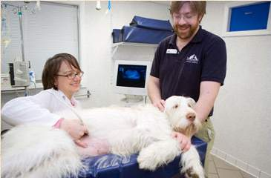
risks
The ultrasound exam is painless, most patients require no sedation or anesthesia, and tolerate the procedure well.

Slide 32
Nuclear Scintigraphy

Slide 33
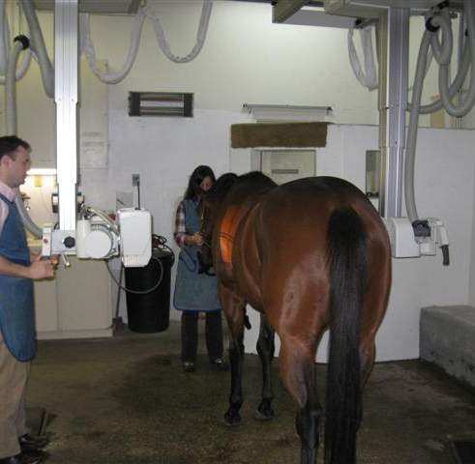

Slide 34
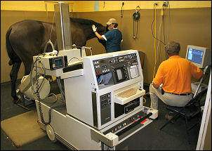
how it works
An animal is injected with a short-lived radioactive isotope which travels to specific organs/tissues

Slide 35
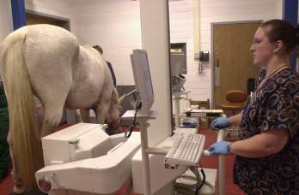
Uses
Identifying lameness in equine patients where the cause of the lameness is difficult to localize by conventional methods
Detects Porto systemic shunts, sub-clinical renal failure, and hyperthyroidism
Evaluation of mucociliary clearance

Slide 36
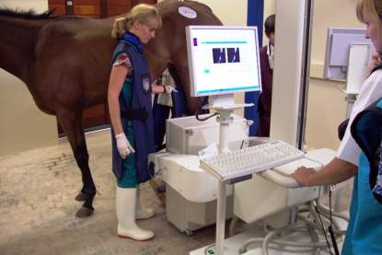
Risks
The animal is administered radioactive elements called isotopes or tracers that go through the bloodstream to the target organ
Patient is usually isolated 12-24 hours after the exam to allow the body to become clear of the radioactive tracers

Slide 37
Endoscope

Slide 38
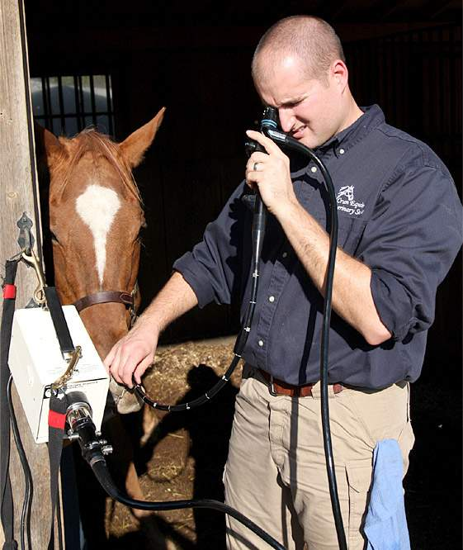

Slide 39
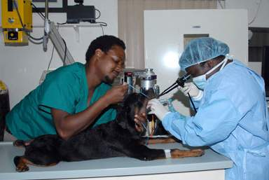
how it works
a small camera is guided throughout the body via naturally existing orifices (nose, mouth,etc)
Can reach most parts of the body without the need for open surgery

Slide 40
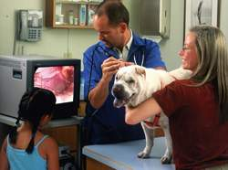
Uses
Observe internal structures without surgery
Assists with diagnosis
Minimally invasive surgeries (biopsy)

Slide 41
types of Endoscopy
Gastrointestinal Tract
Esophagogastroduodenoscopy: esophagus, stomach and duodenum
Enteroscopy: small intestine
Colonoscopy, sigmoidoscopy: large intestine/colon
Proctoscopy: rectum and anus
Respiratory tract
Rhinoscopy: nose
Bronchoscopy: lower respiratory tract

Slide 42
types of Endoscopy
Ear: otoscope
Urinary tract: cystoscopy
Female reproductive system: gynoscopy
Colposcopy: cervix
Hysteroscopy: uterus
Falloposcopy: fallopian tubes
Closed Body Cavities
Laparoscopy: abdominal or pelvic cavity
Arthroscopy: interior of a joint
Thoracoscopy and mediastinoscopy: chest organs

Slide 43
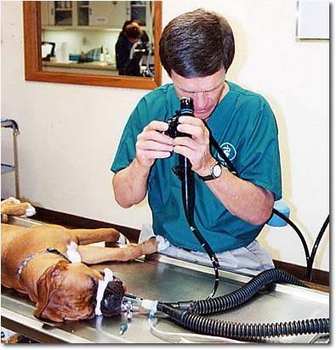
Risks
Patient is usually anesthetized
Complications (such as perforation of organs) due to the exam rarely occur
Tearing of tissue may require surgical repair

Slide 44
Electrocardiograph

Slide 45
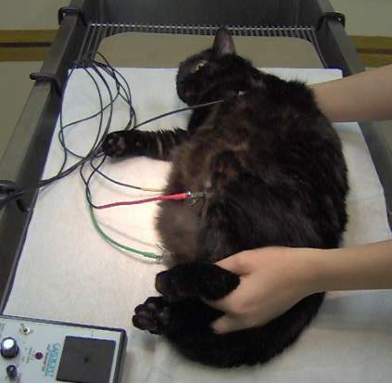

Slide 46
How it works
Pet lies on its right side or stands
Conductive gel or alcohol is applied to the skin to better transmit the electrical activity
Clip or plate electrodes are attached to the pets limbs and chest wall which are attached to thin lead cables connected to the machine
Typical recording duration is 30 seconds to 2 minutes

Slide 47
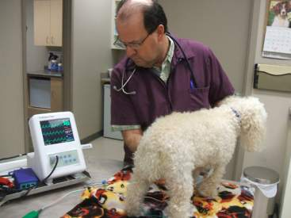
Uses
Reveals abnormalities of heart rate and electrical rhythm.
“Screening test” for serious heart disease, but should be used in conjunction with stethoscope exam, chest x-ray and echocardiogram

Slide 48
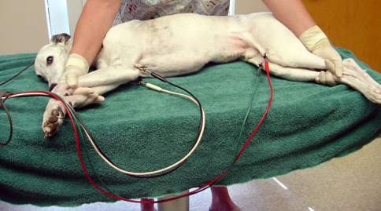
Safety AND RISK
Neither sedation or anesthesia is needed
Some animals resist restraint and may need to be sedated, but it is not recommended due to the potential influence on the heart
This exam is noninvasive and is not painful

Slide 49
Radiograph

Slide 50
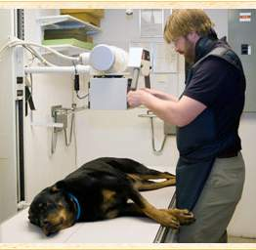

Slide 51
How does it work
Produced by transmitting x-rays through a patient
X-rays pass through less dense objects (fluid or air) and are absorbed by denser objects (bone)
A capture device converts x-rays into visible light which then forms an image
Denser objects (like bone) appear whiter, while less dense objects (air or fluid) appear black
Notes:
Providing students with a photo negative may help them understand this process better. Many have never seen photo negatives and may not be familiar with this phenomenon

Slide 52
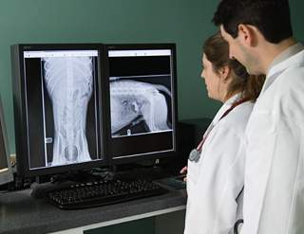
Uses
Used to examine and diagnose internal structures such as: bones, heart, lungs, and abdominal organs

Slide 53
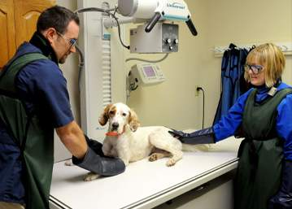
Safety and Risk
Radiography is painless
Sedation may be needed to reduce stress and properly position animals
Technicians restraining patients must wear protective apparel and monitor exposure

Slide 54
Safety with equipment

Slide 55
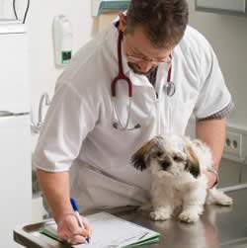
Identification
Verifying the identify of the patient is the most important first step in imaging

Slide 56
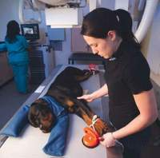
restraint
Whenever possible, use sandbags or other restraints instead of having persons hold patients during imaging

Slide 57
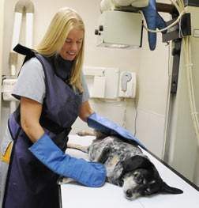
Access to imaging rooms
No unauthorized visitors during imaging exams
This includes the owners of the animals being imaged

Slide 58
Radiation safety
Control exposure levels by:
Maximization of distance from radiation source
Minimization of radiation exposure time
Proper shielding of radiation source
Proper shielding for personnel
Personnel staying in the exam room should be protected by proper shielding.
thyroid shields, leaded glasses, gloves, and aprons

Slide 59
References
http://www.ehrs.upenn.edu/media_files/docs/pdf/vetusersguide2012.pdf
http://www.peteducation.com/article.cfm?c=0+1302+1473&aid=1007
http://www.vetmed.vt.edu/vth/radiology.asp#tomo
http://largeanimal.vethospitals.ufl.edu/services/diagnostic-imaging/digital-computed-radiography-dr-cr/
http://www.vetmed.wsu.edu/depts-vth/radiology/
http://gvi.vetmed.ufl.edu/faq.html#Q10

