Slide 1
Biomes

Slide 2
Biomes
A large geographical area of distinctive plant and animal groups, which are adapted to that particular environment
Climate is also a major factor in determining the type of biome

Slide 3
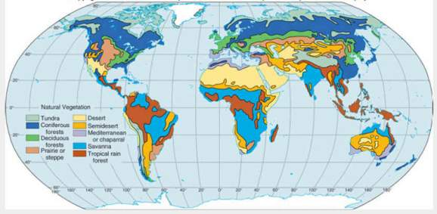
There are 7 major biomes:
Tundra
Taiga
Deciduous Forest
Grassland
Rainforest
Desert
Aquatic

Slide 4
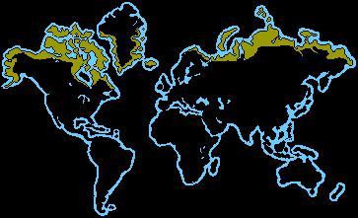
Tundra
Occur between 50-70 ° North, average annual temperature is -18° Farenheit
“tundra” comes from the Finnish word “tunturia” which means “barren land”
Ground is permanently frozen 10 inches to 3 feet below the surface (called the permafrost)
Main seasons are winter and summer – in winter, the sun almost never rises, and in summer, it almost never sets!

Slide 5
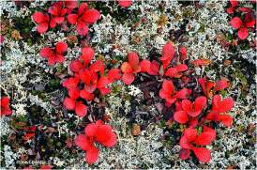
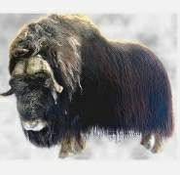
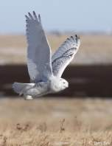
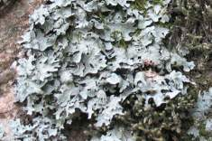
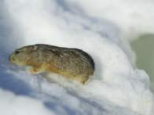
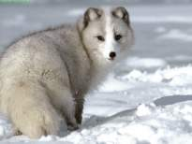
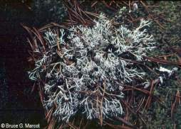
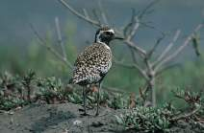
Tundra
Tundra plants
Tundra animals
It is so cold, and the permafrost is so deep that trees can't grow there - the bare ground can only support low growing plants like mosses, heaths, and lichen
Animals include caribou, musk oxen, arctic foxes, arctic hares, snowy owls, lemmings, wolves, bears, wolverines, mosquitoes, black flies, deer flies, and midges (“no-see-ums”)
The tundra is also a good place in summer for migratory birds such as plover, sandpipers, and ducks

Slide 6
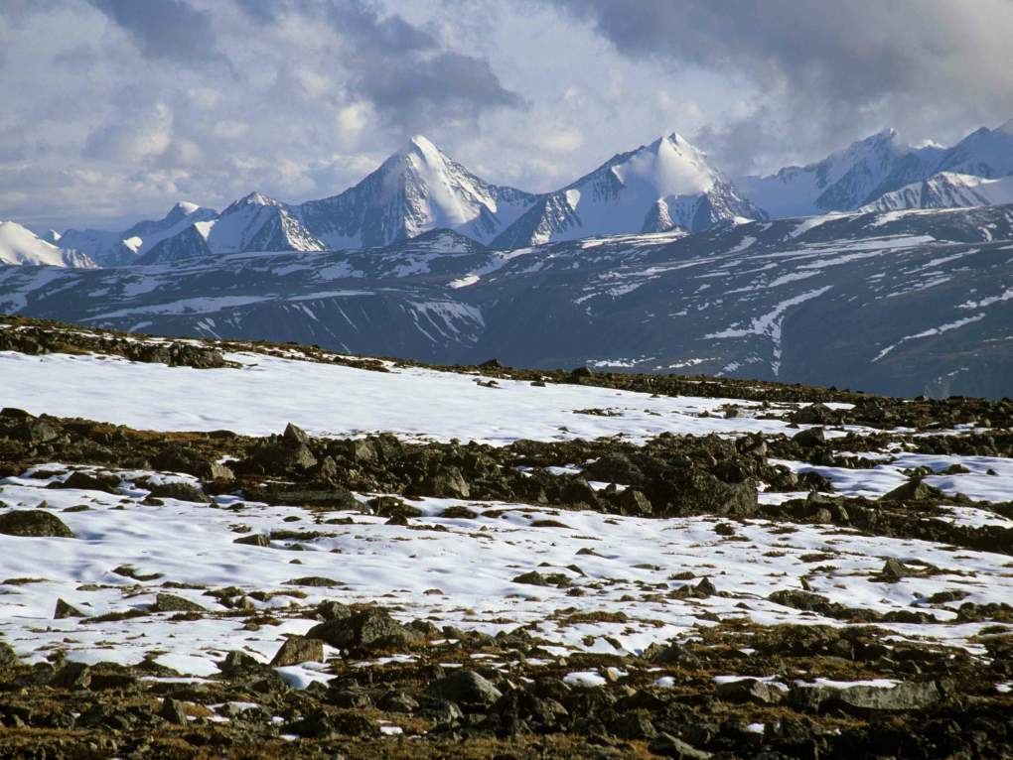
Tundra (winter)

Slide 7
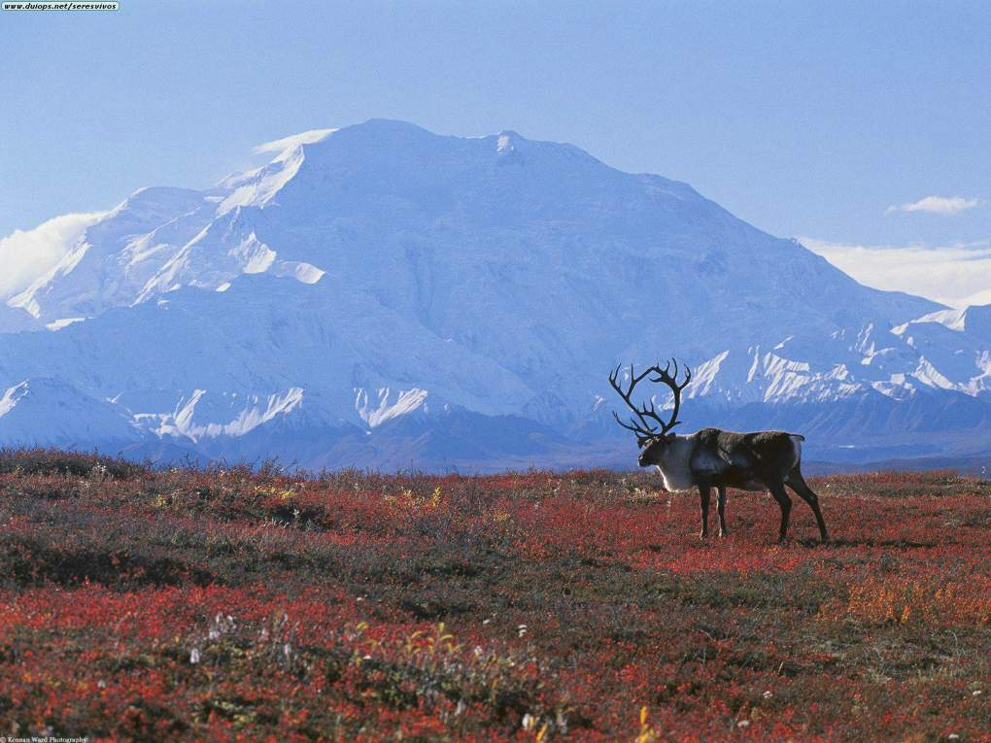
Tundra (summer)

Slide 8
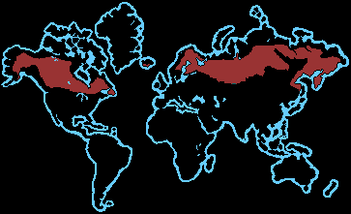
Taiga
The taiga is the coniferous forest and occurs in Northern latitudes
“Taiga” is the Russian word for “forest”
Main seasons are winter and summer – it is very cold in winter and warm and humid in the short summer

Slide 9
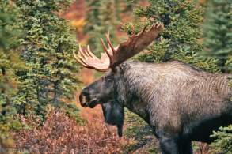
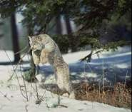
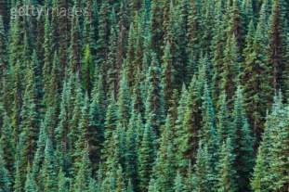
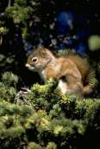
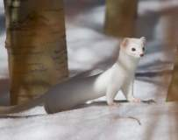
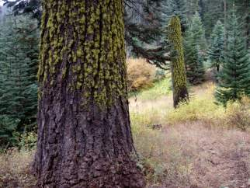
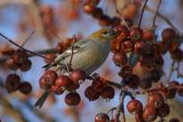
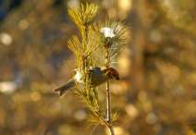
Taiga
Taiga plants
Taiga animals
Because of harsh conditions, few ground plants occur in the tiaga, but lichens and mosses are plentiful
Most plants are coniferous trees like pine, white spruce, hemlock and douglas fir.
Red deer, elk, moose, wolverines, bobcats, minks, and ermines, lynx, snowshoe hares, squirrels, voles, and plenty of insects
Birds of the taiga are either seasonal insect-eaters, or seed-eaters like sparrows and finches and stay all year

Slide 10
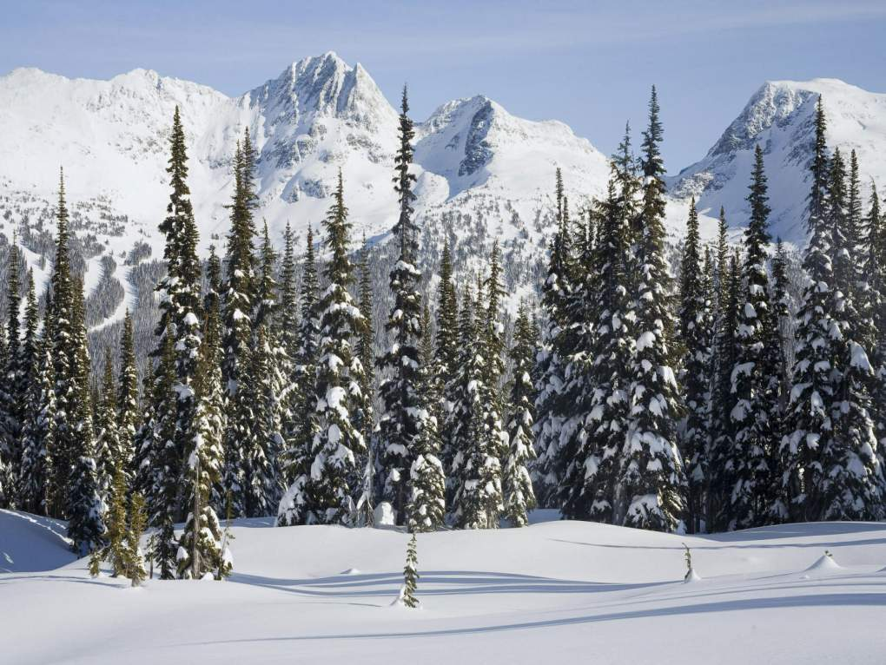
Taiga (winter)

Slide 11
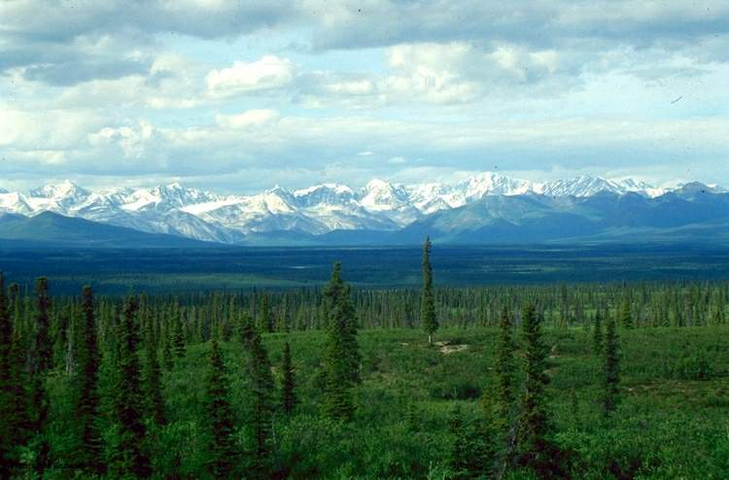
Taiga (summer)

Slide 12
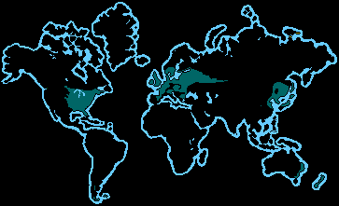
Deciduous Forest
Deciduous forests occur on several different contintents
These forests have four distinct seasons: spring, summer, autumn, and winter
Deciduous forests can have five different zones of plant life: trees, saplings, shrubs, herbs, and a ground zone
Animals live in all five of these zones

Slide 13
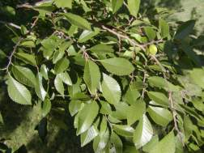
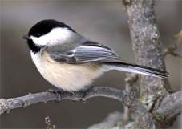
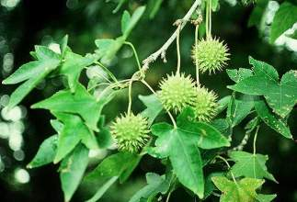
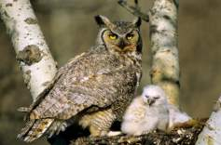
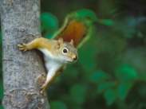
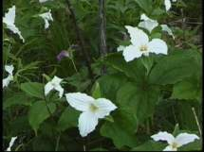
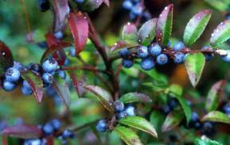
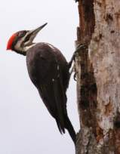
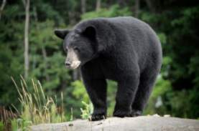
Deciduous Forest Life
Plants
animals
Deciduous trees such as oak, maple, elm, walnut, sweetgum, beech, chesnut
Other plants include mosses, lichen, huckleberry, blackberry, rhododendrons, etc.
Large mammals can live in the deciduous forest, such as deer, bears, and wolves. Smaller mammals also occur in abundance.
Birds include different species of songbirds, mockingbirds, and raptors such as hawks, owls, and eagles

Slide 14
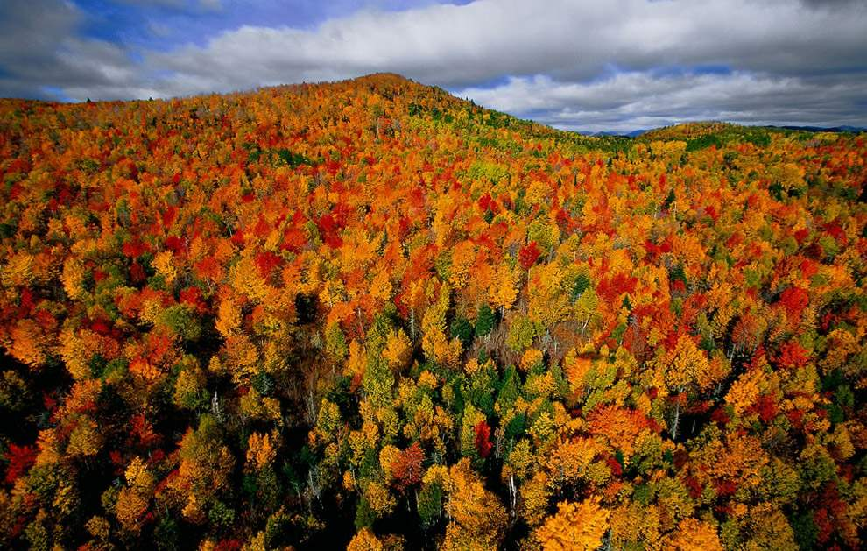
Deciduous Forest (autumn)

Slide 15
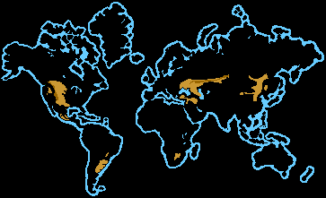
Grasslands
Grasslands are large, rolling terrains of grasses, flowers, and herbs.
Species of plants that occur depend on climate, soil type, and latitude.
Grasslands have two basic “seasons”: growing and dormant. These seasons can depend a great deal on rainfall.

Slide 16
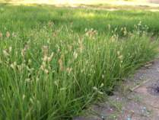
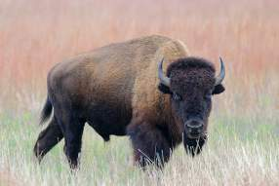
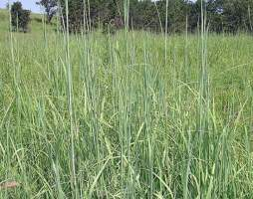
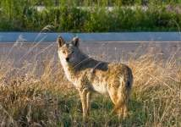
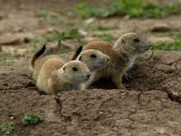
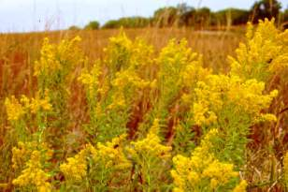
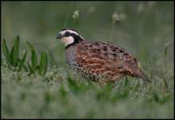
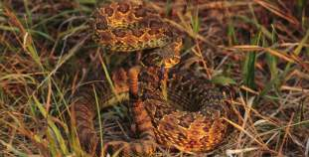
Grasslands
Grassland plants
Grassland animals
The most common plants on the North American prairie are buffalo grass, clover, sunflowers, and bluestem grass.
Trees rarely occur on grasslands because of naturally occurring wildfires – grasses can more easily recover from fires than can trees.
Common mammals living on grasslands in the Americas are prairie dogs, coyotes, small rodents, and bison.
Birds can include species of flycatchers, sparrows, wild turkey, quail, grouse, and prairie chickens.
Reptiles such as indigo snakes, rattlesnakes, and small lizards live in the grasslands.

Slide 17
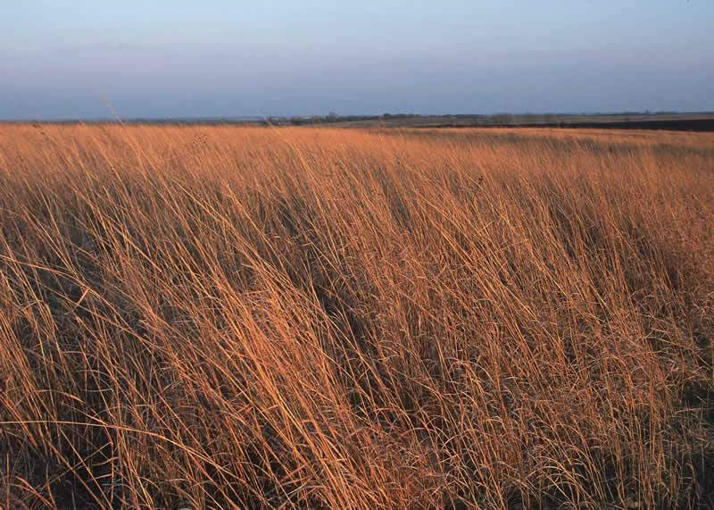
Grasslands

Slide 18
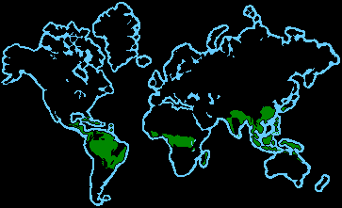
Rainforest
Rainforests are forests of tall trees in a region of year-round warmth
Rainfall is often more than 100 inches per year
Almost all rainforests lie near the equator
Rainforests cover about 6% of the earth’s surface and are thought to produce nearly 40% of Earth’s oxygen
Rainforests have extremely high biodiversity

Slide 19
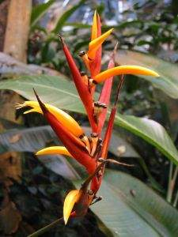
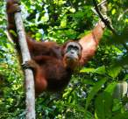
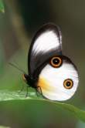
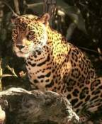
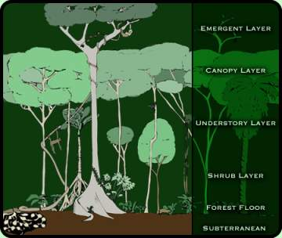
Rainforests
Rainforest plants
Rainforest animals
70 % of the plants in a rainforest are trees – a rainforest has more types of trees than anywhere else in the world!
There are several foliage layers in a rainforest: an emergent layer, upper canopy, understory, shrubs, and the forest floor.
Plants in the rainforest must have adaptations to deal with large amounts of rainfall, as well as a shallow soil – there is only a thin layer of nutritious soil in a rainforest.
Insects make up the largest group of animals in the rainforests – insects play an important role in plant pollination and nutrient recycling.
Many animals have adaptations for living in trees – such as prehensile tails.
May birds of the rainforest are brightly colored and have adaptations for being mainly insect and fruit eaters.

Slide 20
Rainforest

Slide 21
Desert
A desert is an area that receives less than 20 inches of rain a year
There are four major types of deserts: hot and dry, semiarid, coastal, and cold.
Desert plants and animals are extremely adapted to deal with the harsh environments of these four types of deserts

Slide 22
Desert
Desert Plants
Desert animals
Plants in desert environments are specialized to take in and retain as much water as possible – this can be done by having thick, waxy leaves, or by reducing leaf surface area (in plants, leaves typically release water). Desert plant leaves also store nutrients.
Many plants in the desert are called cacti, or succulent plants.
Most desert animals burrow underground and come out at night
The most common desert animals are typically reptiles.
There are relatively few large mammals in deserts because most are not capable of storing water and withstanding heat. Most desert mammals are small, and will spend the majority of their time burrowing underground.

Slide 23
Aquatic
Over 75% of Earth is covered in water, making the aquatic biome the largest biome on the planet.
The aquatic biome can be broken into two basic regions: freshwater and marine.
Aquatic biomes have high biodiversity.

Slide 24
Freshwater
Freshwater is defined as having a low salt concentration – less than 1%.
Lakes, ponds, streams, rivers, and wetlands are all considered freshwater.

Slide 25
Freshwater Life
Freshwater plants
Freshwater animals
Freshwater plants can either live completely submerged underwater, or rooted to the bottom and float on the water’s surface (these are called emergent or floating plants)
Freshwater plants provide a natural ‘filter system’ for the planet’s freshwater and serves as a habitat or food source for many different animals
All animals on Earth depend on freshwater in some way
Freshwater animals can include insects, fish, reptiles, amphibians, birds and mammals

Slide 26
Marine
The marine biome is the biggest biome in the world – it covers about 70% of the Earth
The marine biome is home to most of Earth’s biodiversity
The marine biome is also heavily used by humans in medicine, food, and other resources!

Slide 27
Marine Life
Marine plants
Marine algae provide much of the world’s oxygen through the process called photosynthesis
One type of marine plant is kelp. Others include seaweed and phytoplankton
Along coastal areas, some trees are even adapted to growing in salt water
Marine plants like kelp, seaweed, salt grass, and mangroves also provide habitats for marine animals to take cover and feed in.

Slide 28
Marine Animals
The oceans’ animals have special adaptations to deal with living in a salt-concentrated environment
Marine mammals have a thick layer of blubber to help them regulate body temperature because the oceans are often cold
Some animals have adaptations that allow them to travel great distances by surfing the ocean’s currents
Coral reefs are an amazing marine ecosystem – over 25% of all life in the oceans are found in coral reefs!

