Slide 1
Ecosystem Organization

Slide 2
Ecology
The branch of biology studying the relationships and interactions between organisms and the environment
In order to study ecology, scientists look at how organisms are related to one another and how they are related to the environment in which they live – the ecosystem

Slide 3
Ecosystem
An ecosystem includes all living organisms in a defined area and their nonliving environment.
Ecosystems are made up of living and nonliving factors:
Biotic factors - living
Abiotic factors - nonliving
Think about the biotic and abiotic factors in your environment!

Slide 4
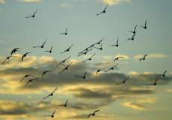
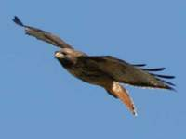
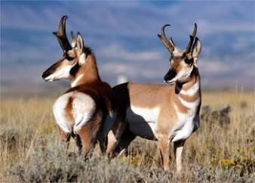
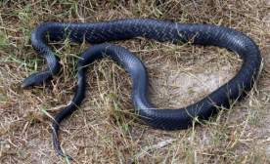
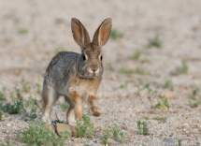
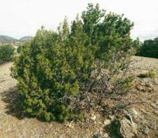
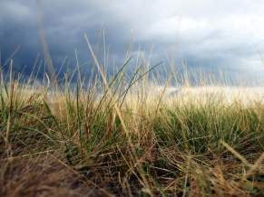
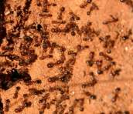
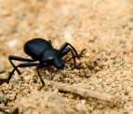
Biotic Factors
Anything living:

Slide 5
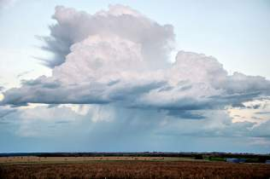
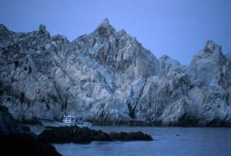
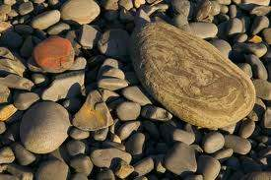
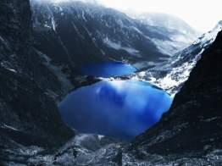
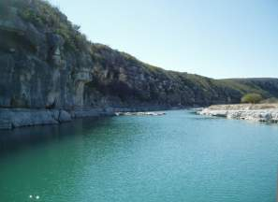
Abiotic Factors
Parts that make up the environment that are not living:

Slide 6
Order in Everything
Scientists have realized that life can be ordered in a hierarchy of ecosystem organization
A hierarchy is a system of things ranked one above the other
Let’s look at the ecosystem hierarchy going from simple to complex

Slide 7
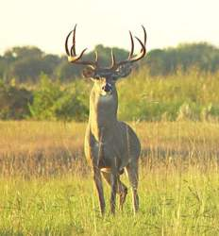
Level 1: Single Organism
An organism is any living thing – a plant, a germ, a human, a fish, a bird, etc.
One organism by itself is the simplest level of ecosystem organization
An organism is classified as being a member of a species – a distinct sort or kind of organism
Example: whitetail deer

Slide 8
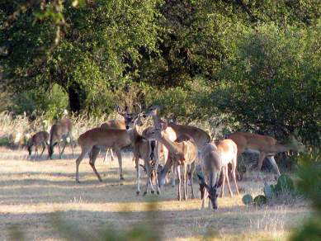
Level 2: Population
A population is made up of all the individuals of a given species in a specific area or region at a certain time.
A group of organisms of the same kind
Example: a herd of
whitetail deer

Slide 9
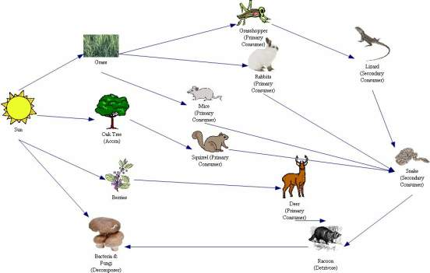
Level 3: Community
A community includes all organisms in a given area
Sizes of communities vary greatly
Populations within a community are interdependent because of the food webs that bind them together
Example:

Slide 10
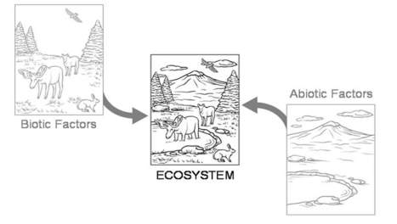
Level 4: Ecosystem
An ecosystem includes all organisms in a defined area and their nonliving environment
When you study an ecosystem, you look at how the living and nonliving parts interact and affect each other
The Earth is the largest of all ecosystems, called the biosphere

Slide 11
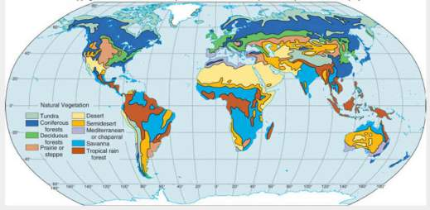
The Biosphere
The biosphere can be divided into smaller regions that have distinct characteristics. These regions are called biomes.
The major biomes include:
Desert
Rainforest
Grassland
Tundra
Taiga
Temperate forest
Aquatic

Slide 12
Let’s Review!
Starting at the bottom, the levels of ecosystem organization are:
Organism
Population
Community
Ecosystem
Biome
Biosphere
Can you give an examples of these levels, starting from the bottom? What does each level include?

Slide 13
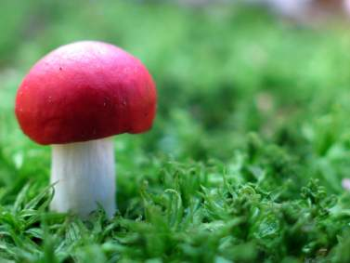
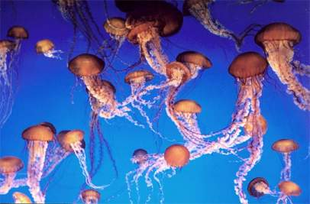
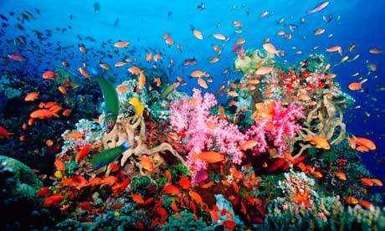
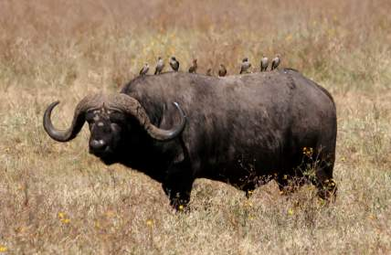
Guess which vocabulary word fits the picture the best:
This mushroom is a single organism
This is a population of jellyfish
These animals are part of a community
This is an ecosystem!

Slide 14
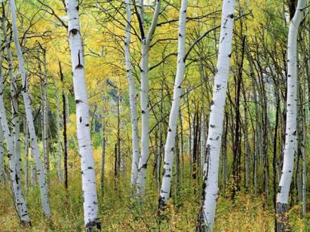
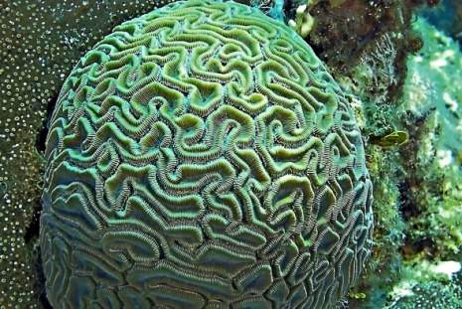
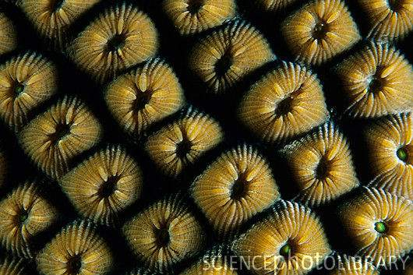
How about these?
Individual coral polyps
Aspen trees can actually clone themselves through a method called asexual propagation. In this picture, all of the aspens are really one tree sharing a large root system!
This brain coral is actually a colony of individual coral polyps. All corals are colonies of many organisms!

Slide 15
Ecology is not always what you expect…
Occasionally there are examples of a level of organization appearing to be a different level, such as the aspen appearing to be multiple trees and brain coral appearing to be one animal.
However, these occurrences are not common.

