Slide 1
Anatomy of Birds
TEKS 7.7 (C) TEKS 7.11 (B)
TEKS 7.10 (A) (B) TEKS 7. 12 (A)

Slide 2
Before we start…
All birds have essentially the same body design.
Different life styles and pressures from the environment in which they live in means that they have evolved into different variations.
How come some birds can
fly while others can’t??

Slide 3
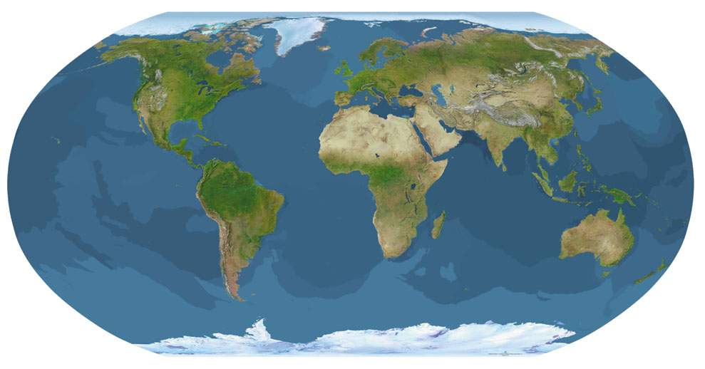
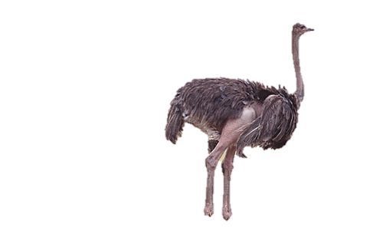
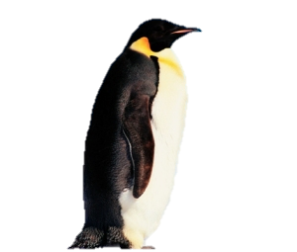
Habitats
The way a bird looks depends on the environment it lives in.
Arctic penguins would not do well living in the savannas of Africa, yet ostriches thrive there.
What do these birds have in common?

Slide 4
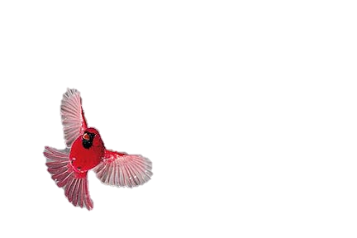
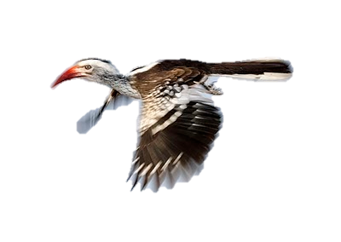
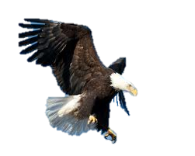
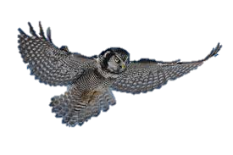
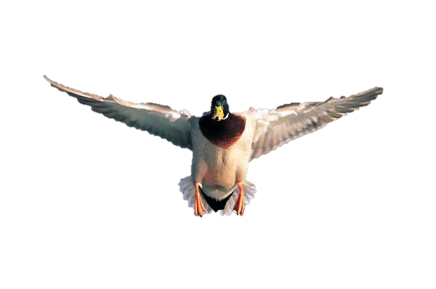
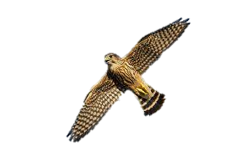
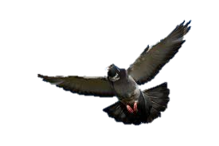
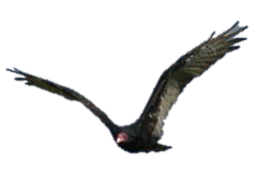
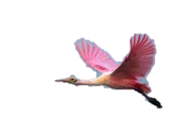
Habitats
While you won’t find many flying birds that live in the Antarctic, birds of flight can be found worldwide.

Slide 5
Habitats
Birds that can fly are usually found in places where there are many predators.
Flying allows for them to escape becoming a meal, but also makes it easier for them to find their meal (especially for birds of prey such as owls, hawks, and eagles).
Birds that cannot fly are found where there are few to no predators, so they don’t fly because they simply didn’t need to learn how to back in ancient history!

Slide 6
Habitats – Penguins vs Hawks
Penguins
Hawks
Major populations of penguins are found in Antarctica, Argentina, Australia, Chile, New Zealand, and South Africa – Southern Hemisphere
Prefers a coastal region with cold waters
Wide spread across North America and even into South America
Prefers a forest and field habitat with high trees or bluffs to perch

Slide 7
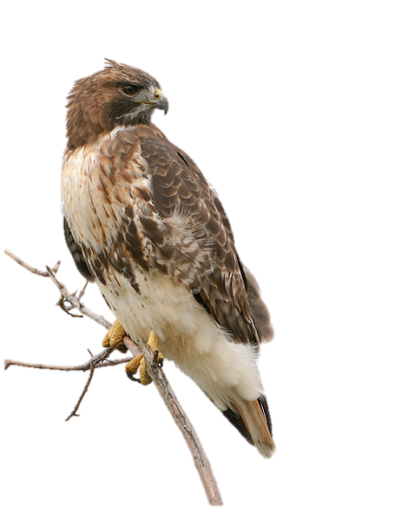
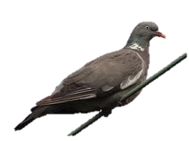
Birds of Flight
Red-tailed Hawks
Pigeons

Slide 8
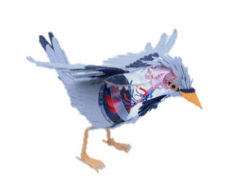
How do birds fly?
In order to fly, birds must be both light and strong. They have made several adaptations in order to be able to fly:
Skeletal system: lighter and bones are fused together
Respiratory system: larger and more efficient
Muscular system: red muscles (dark meat!) that get more oxygen are used for flight and are very powerful
Reproductive system: kept small until mating season
Feathers and wings

Slide 9
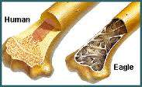
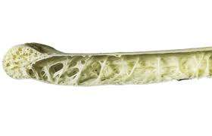
Skeletal Adaptations
To become more light weight, birds have hollow bones which allows for faster flight and uses less energy.
The more a bird weighs, the more energy it takes to fly.
The skeleton of an eagle is less than half a pound.
On average, a birds skeleton is 5% of it’s total body weight.
Our skeletons make up 15% of our total body weight!

Slide 10
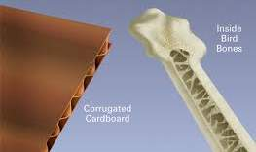
Skeletal Adaptations
Even though bird bones are hollow, they are still very strong to support the demands of flight and landing.
Compare:
Why do you think it is not a
good idea to let your dog
eat your leftover chicken bones?
Notes:
Answer: because when they chew on the bones, it splinters off and could cause choking or pain for your dog.

Slide 11
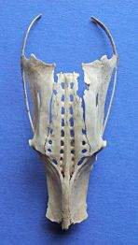
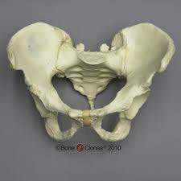
Skeletal Adaptations
Some of the bones in a birds skeletal system are fused together to make them more rigid and allow for greater muscle attachment.
Compare the bird “pelvis” (synsacrum) to a human pelvis:
The pelvis in a bird is long and has a forward opening to facilitate egg laying.

Slide 12
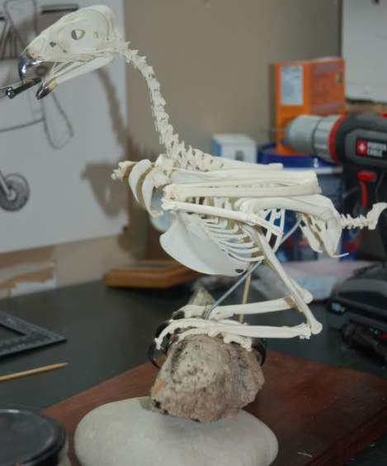
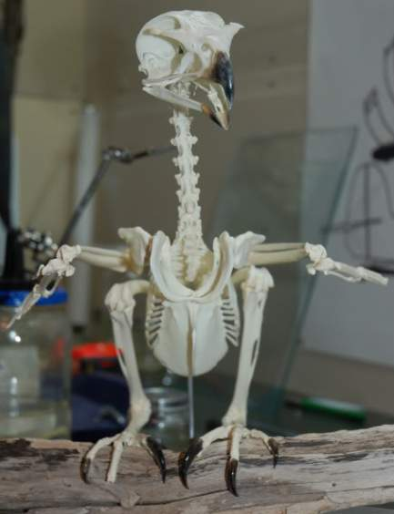
Skeletal Adaptations
Compare the sternum of a human and a chicken (depicted in an upright position).
The breastbone has a special addition in birds, called the keel that allows for the attachment of flight muscles.
Notes:
Notice how much larger it is (and therefore stronger), so that more muscles can be attached to it.
All skeletal pictures of the red-tailed hawk: http://www.taxidermy.net/forum/index.php?topic=250969.15

Slide 13
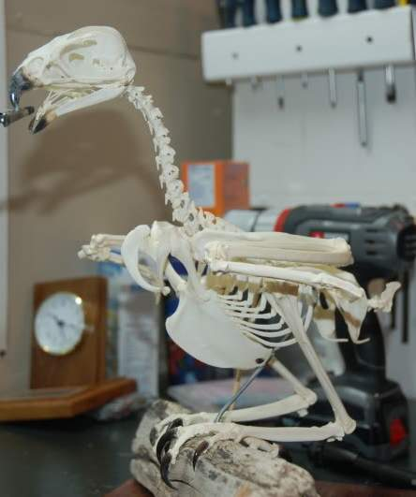
Skeletal Adaptations
The “wrist” bones of the wing are fused and elongated so that only three “finger” bones remain.
The thigh bones are generally short and sturdy.
The foot and ankle bones are fused and elongated.
The backward bend corresponds to the ankle joint in humans. Birds stand on their toes.

Slide 14
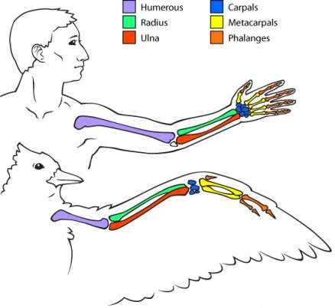
Skeletal Adaptations
Compare the bones in the human arm to the bones in a bird wing.
What do you notice?
The humerus is shortened to withstand the pulling of the flight muscles.
The radius and ulna provide support for the wing.
And what are phalanges in humans, in birds these bones are fused for strength and feather support.

Slide 15
Skeletal Adaptations
The pectoral girdle is made up of the sternum, clavicle, coracoid, and scapula.
The clavicles come together to form the furcula, or "wishbone."

Slide 16
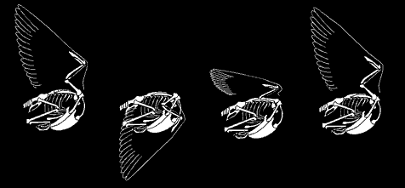
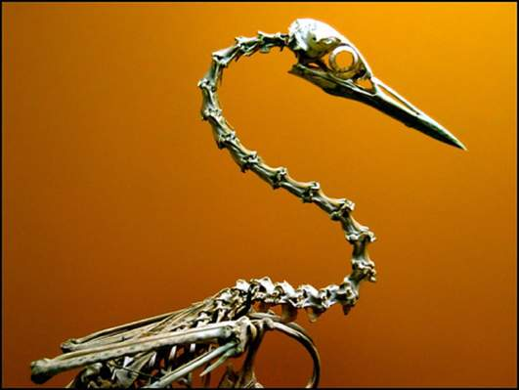
Skeletal Adaptations
Other bones are not fused together and provide greater mobility.
In flight:
To see and get food:

Slide 17
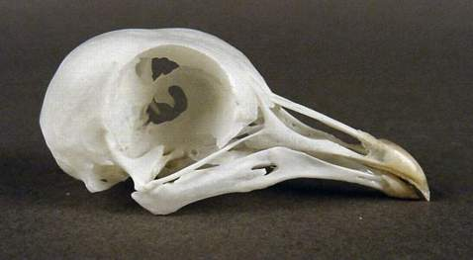
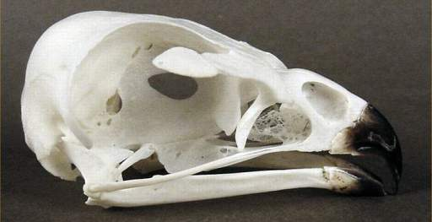
Skull
Bones in the skull are also pneumatized, or filled with air, the same way that their other bones are.
The skull is made more lightweight by lacking a heavy jaw bone and muscles, and also by the absence of teeth.
Wait, so how do birds chew and
digest their food?
Pigeon Skull – notice the large eye sockets and lack of jaw and teeth
Red-tailed Hawk Skull

Slide 18
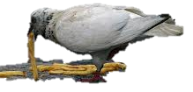
Digestive Adaptations
In the place of lips and teeth, a bird simply has a beak. Each beak is adapted to the types of food a bird eats.
In birds of prey, such as the red-tailed hawk, they have a powerful hooked beak for tearing apart flesh.
In birds like the pigeon, who consume mostly grains and seeds, (in the wild – not talking about city pigeons who will eat your french fry!) will have short beaks capable of cracking seeds.
Not their natural diet!
Notes:
Could introduce Darwin's study of finches on the Galapagos Islands

Slide 19
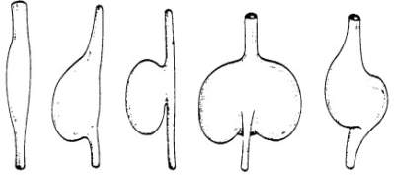
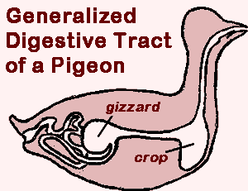
Digestive Adaptations
A birds mouth is unimportant when it comes to eating and digesting food (especially compared to all our mouths do to kick start digestion).
Once food is swallowed, it travels down the esophagus.
Most birds have a crop attached to their esophagus which acts as a temporary storage location for food and allows food to soften.
Various crop shapes
Notes:
Story example/illustration of how digestion works in birds and why a crop is necessary: http://www.backyardnature.net/birdguts.htm

Slide 20
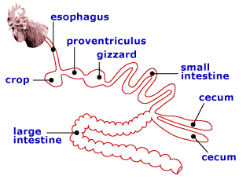
Digestive Adaptations
Food is only stored in the crop when the stomach is full and then continues down the digestive tract.
From the crop to the stomach, food travels down to the petroventriculus, the first chamber in a birds two chambered stomach.
Here, acid is secreted that breaks down the food.
In birds of prey that swallow bones, the petroventriculus is well developed and in some birds the pH levels are found as low as 0.2!
A shrike's well developed first stomach-chamber can digest an entire mouse in only three hours!

Slide 21
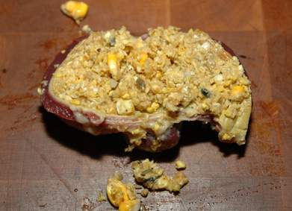
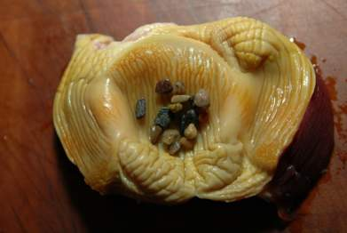
Digestive Adaptations
Once food is properly broken down in the petroventriculus, it moves to the second chamber of the stomach: the gizzard.
The gizzard is made of very powerful muscles, but depending on what the bird eats, it cannot pulverize everything consumed.
Birds will swallow small rocks and grit while eating, these small rocks and grit aid the gizzard in completely breaking down food.
Inside a gizzard
Stones in the gizzard

Slide 22
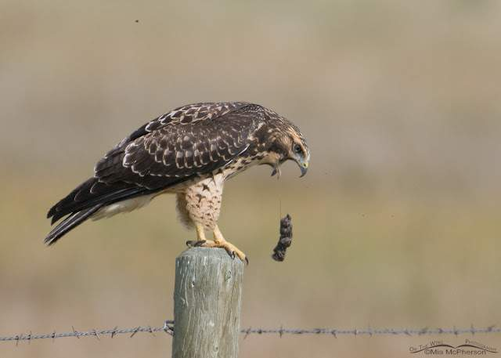
Digestive Adaptations
Not everything a bird of prey consumes is completely digestible (bones, fur, feathers, etc.).
Birds will pass pellets to remove this indigestible material from its stomach.
It will be stored in the crop for sometime until regurgitation.

Slide 23
Digestive Adaptations
From the gizzard, food travels into the intestines which are very short in birds that eat “simple” foods such as fruit and insects. In birds that eat “tough” foods such as seeds, plants, and fish their intestines are longer.
Birds usually have two caeca (singular: caecum) which aid in the absorption of water, proteins, and nutrients.
After absorption, waste is eliminated through the rectum.

Slide 24
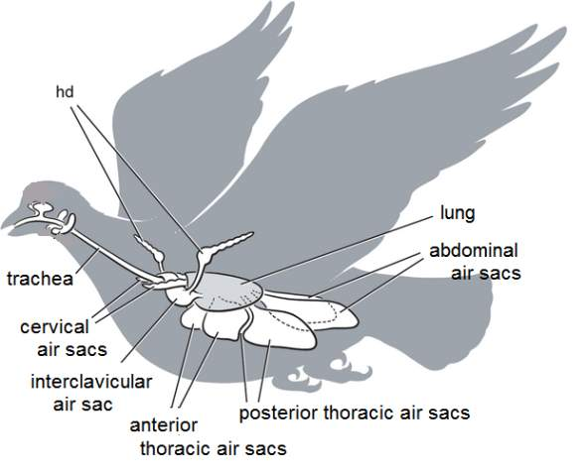
Respiratory Adaptations
An average bird devotes about one-fifth of its body volume to its respiratory system.
Birds have fairly small lungs, but make up for it by the addition of air sacs.
Air sacs allow for unidirectional flow of air through the lungs.
This means that the air in a birds respiratory system is freshly inhaled air and therefore has a higher oxygen content.
Notes:
In depth explanation of the process:
http://www.stanford.edu/group/stanfordbirds/text/essays/Adaptations.html
http://people.eku.edu/ritchisong/birdrespiration.html

Slide 25
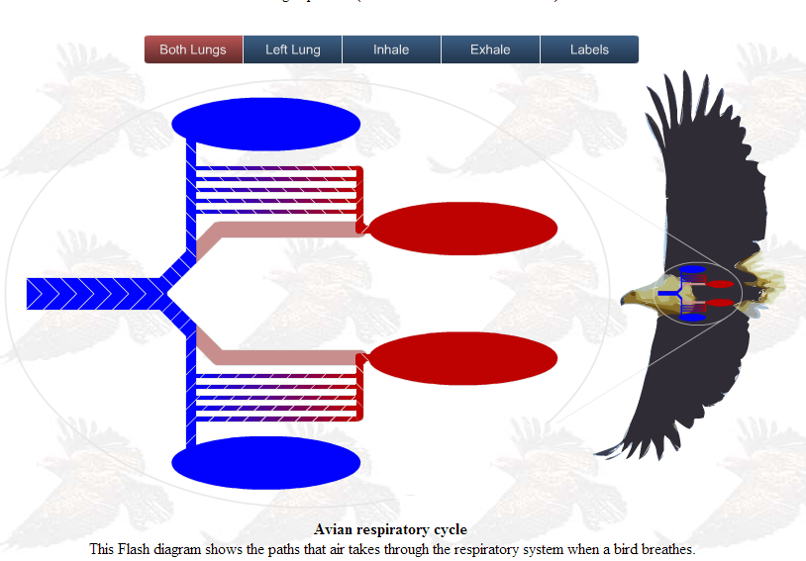
Respiratory Adaptations
Explore: http://people.eku.edu/ritchisong/birdrespiration.html
Notes:
Scroll about ¼ of the way down this webpage to the flash animations of how birds lungs work. Great for visualization of this complex process!

Slide 26
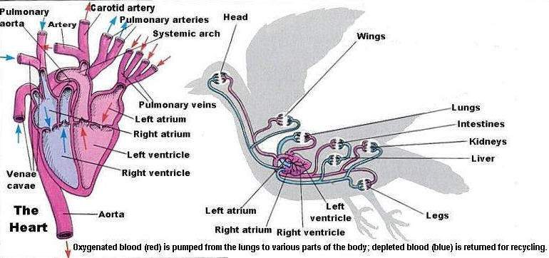
Circulatory Adaptations
Birds have four chambered hearts with two pumps.
One to take oxygen rich blood to organs.
One to remove oxygen poor blood to the lungs for exhalation.

Slide 27
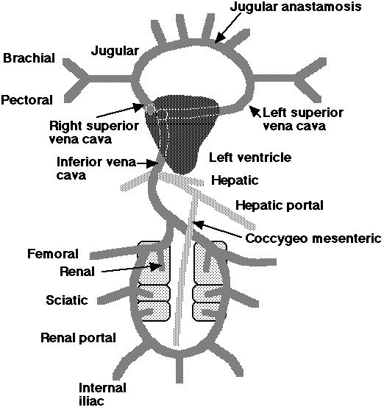
Circulatory Adaptations
The jugular anastomosis allows blood to flow from right to left side when the birds head is turned & one of the jugulars constricted. The jugular veins drain the head and neck.
The brachial veins drain the wings.
The pectoral veins drain the pectoral muscles and anterior thorax.
The superior vena cavae (or precavae) drain the anterior regions of the body.
The inferior vena cava (or postcava) drains the posterior portion of the body.
The hepatic vein drains the liver.
The hepatic portal vein drains the digestive system.
The coccygeomesenteric vein drains the posterior digestive system & empties in the hepatic portal vein.
The femoral veins drain the legs.
The sciatic veins drain the hip or thigh regions.
The renal & renal portal veins drain the kidneys.
Notes:
http://people.eku.edu/ritchisong/birdcirculatory.html

Slide 28
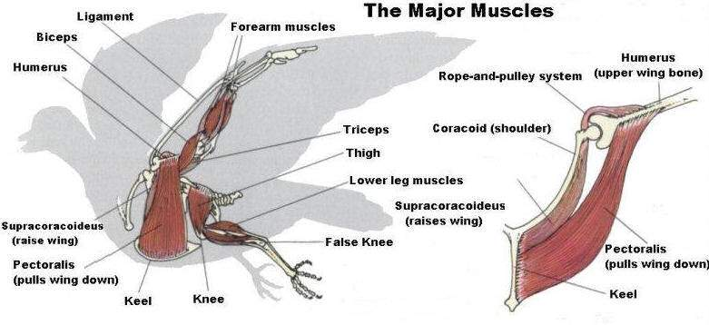
Muscular Adaptations
There are some 175 muscles in a bird that control the movement of it’s wings, legs, feet, head, and tail.
The large muscles are centered near the birds center of gravity for balance.
Muscle mass is divided between the wings and the legs.

Slide 29
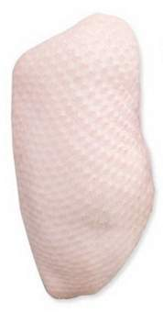
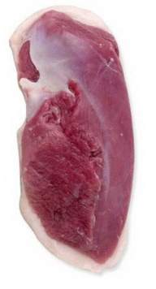
Muscular Adaptations
Most commonly people consider breast meat to be “white” which is common for chickens and turkeys – birds that do not fly.
Typically in birds that are long distance flyers, the breast meat (or flight muscles!) are “red” due to the abundance of oxygen carrying blood cells.

Slide 30
Muscular Adaptations
To fly, a bird moves it’s wings up and down, not by using muscles that work in pairs (as in our arms and legs), but rather as part of a pulley system.
A muscle that connects to the chest pulls the wing up and down.
Flight muscles are located in the breast area and are attached to the keel.

Slide 31
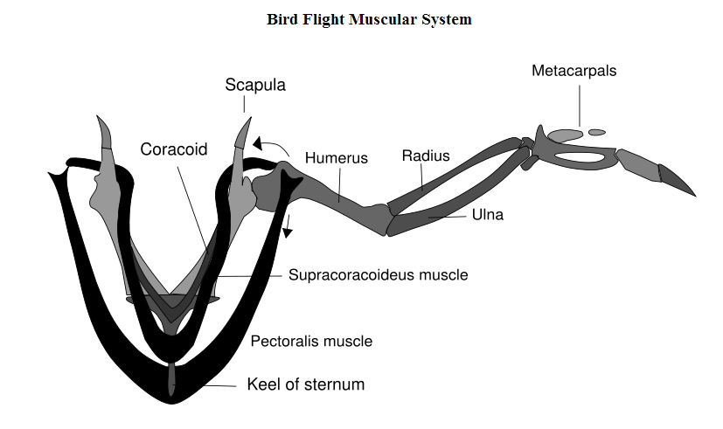
Muscular Adaptations
The supracoracoideus works using a pulley like system to lift the wing while the pectorals provide the down stroke.

Slide 32
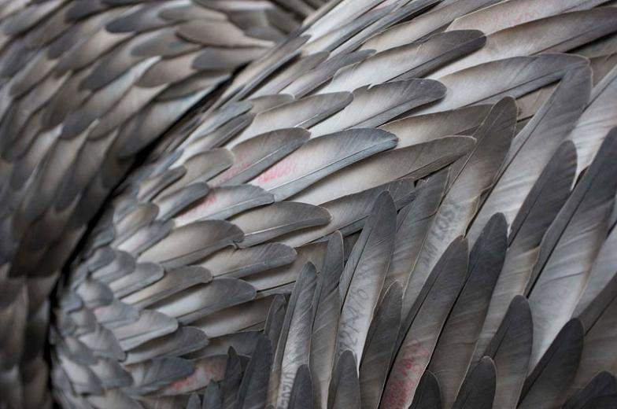
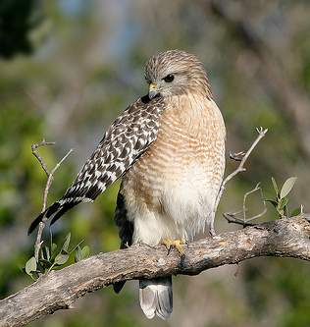
Feathers
Birds are the only species to have the adaptation of feathers.
They are made out of the same substance your finger nails are made of: keratin.
Feathers must all be in working condition for the bird to fly effectively, which is why you see birds preening their feathers so often.
Once a feather is broken it cannot be repaired, only removed.

Slide 33
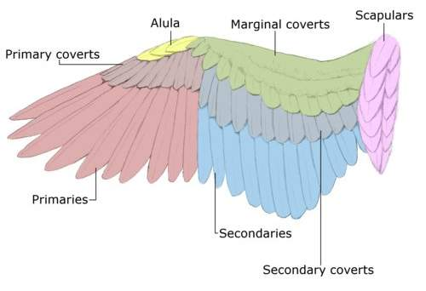
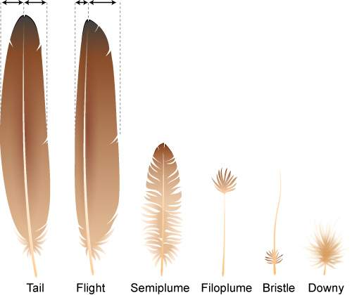
Feathers
There are many types of feathers that can be found on a bird, each is specialized for its own role.
Notes:
http://swartzentrover.com/cotor/Photos/Hiking/Birds/BirdPages/Anatomy/Anatomy.htm

Slide 34
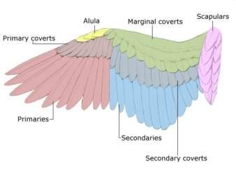
Types of Feathers
Rectrices (tail feathers)
Help provide lift, stability, and maneuverability in flight
Remiges (flight feathers)
Support the bird during flight
Primaries = outer remiges, the strongest flight feather
Secondaries = provide lift in soaring and flapping flight
Coverts = streamline the shape of the wing

Slide 35
Types of Feathers
Semiplume = found between other feathers, help maintain the streamlined shape of bird
Filoplume = are thought to provide birds with feedback on other feather activity to make sure the wing is streamlined properly
Bristle = have a tactile function, usually found on the face of the bird
Downy = keep the bird warm by creating a puffy tangle of insulating air pockets

Slide 36
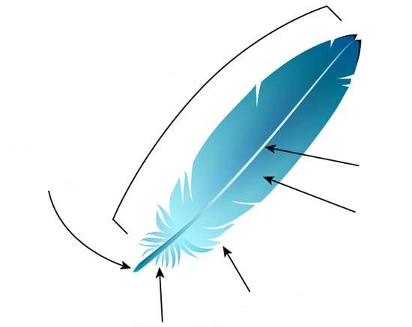
Feathers
The basic feather is similar to the one shown:
Vane = the feather
Calamus = hollow shaft that attaches feather to the birds skin
Rachis = central shaft of the feather where the vanes are attached
Barb = branches of the rachis that form the vanes
Afterfeather = provides extra warmth
Downy barbs = provides more insulation

Slide 37
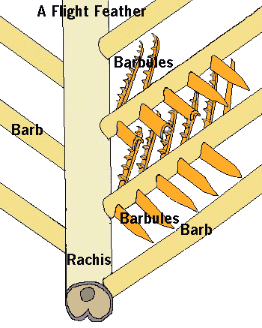
Feathers
A close up of the feather:
Barbules are tiny extensions from the barbs.
Barbicels are tiny hooks that interlock to hold the barbules together.

Slide 38
Wings
Birds use their wings for different types of flight!
Flapping
This is how birds produce the lift they need to take flight
Flapping also provides forward momentum
Twisting
Allows for the bird to maintain the right angle for best airflow, especially while soaring
Folding
Allows for birds to fly with less effort and reduces drag
Notes:
http://www2.unil.ch/biomapper/opengl/BirdFlight.html
How birds are able to fly: http://www.ccmr.cornell.edu/education/ask/index.html?quid=1283

Slide 39
Flightless Birds
Emperor Penguins
Chickens

Slide 40
Why can’t they fly?
They have wings, they have feathers… so why can’t penguins and chickens fly?

Slide 41
Emperor Penguins
As we’ve discussed earlier, birds need to be lightweight to fly.
On average, adult emperor penguins weigh about 66 pounds!
Red-tailed hawks weigh about 2.4 pounds and pigeons generally weigh less than a pound!
Notes:
* Note there are over 17 different types of living species of penguin, from here on out in the PowerPoint when I refer to “penguins” it is to mean Emperor Penguins.

Slide 42
Penguin Size
Emperor penguins are the largest of all living penguin species.
Compare:

Slide 43
Penguin Weight
Emperor penguins are found primarily in Antarctica, in one of the coldest regions known to any type of bird species.
Penguins have adapted to this extreme cold by acquiring large amounts of fat deposits all over their bodies.
Fat is a good insulator.
It is also an excellent energy reserve.
Notes:
http://www.gdargaud.net/Antarctica/PenguinFAQ.html

Slide 44
Penguin Skeleton
Unlike birds of flight, penguin bones are solid and dense which help them by being better at diving and swimming in the ocean for their food.
The top set of bones are the wing bones of a flying relative of the penguin. The bottoms bones are the wing bones of am emperor penguin.
Notes:
http://fossilpenguins.wordpress.com/tag/bones/

Slide 45
Skeleton
Penguins have unusually large sternums – despite the fact that they do not fly in the air, penguins still “fly” through the water.
In order to fly through the water, they still need a large attachment site for their powerful pectoral muscles.

Slide 46
Skull
Above the eye socket is a pitted region on the skull of the penguin.
These pits once held glands that helps penguins to remove excess salt acquired from the water.

Slide 47
Digestive System
Penguins also have beaks with no teeth, like all other birds, and they swallow their food whole.
Digestion is aided by consuming tiny pebbles to break down foods further in the stomach.
Pebbles and broken squid beaks found in the stomach of an emperor penguin

Slide 48
Digestive System
Most penguins can eat roughly ¼ of their body weight in one meal.
Penguins have a very long esophagus that connects to their stomach which is very low in their bodies.
They do not have a crop like other birds.
Digestion is very fast so they can transform their food into energy in the form of fat reserves in less than 6 hours.
Penguins can adjust the pH acid levels of their stomach to digest food quickly or slowly.

Slide 49
Respiratory System
Penguins also have a circular respiration process much like flying birds, through several air sacs which produces a constant air flow.
Air flows through the lungs into the posterior air sacs with the first inhalation.
The second inhalation pushes the first breath of air further into the anterior air sac.
Air continues to move into the interclavicular sac and is exhaled through the trachea.

Slide 50
How can penguins swim underwater if they breathe air?
Emperor penguins are known to dive rather deep (up to 1,870 feet!), and have been recorded staying underwater for 22 minutes!
Penguins are able to stay underwater for such extended periods of time because they are able to control the use of reserve oxygen in their lungs, muscles, and in their blood and use anaerobic respiration.
Notes:
More detailed information: http://www.livescience.com/14117-penguin-diving-feat-oxygen-trick.html

Slide 51
Circulatory System
Penguins have a closed circulatory system, much like other birds, with a four chambered heart.
Their veins and arteries run in what is called a countercurrent system – that is they run very close together.
This way heat is transferred from the “warm” blood in the artery to the “cooling” blood in the vein.

Slide 52
“Flying”
Technically, penguins don’t “fly” in the typical sense.
Rather they “fly” through the water.

Slide 53
Penguin flight
Penguins simply were not made for flight in the air, they were designed for flight in the water.
Check out these videos to compare how penguins use their wings on land and in the water!
They can swim at speeds of up to 3-8 miles per hour!

Slide 54
Feathers
Penguin feathers are highly specialized to keep them warm in the cold environment and also to aid them in swimming through the water.
They have more feathers than other species of birds, and their short stiff feathers are uniformly and closely spaced over their skin.
Feathers also appear “scale like” due to their stiffness.
Regular bird feathers would be too flexible underwater!

Slide 55
So what about chickens…
They are lightweight and have wings, why aren’t they good at flying?
STOP!
Take out a piece of paper and write down your thoughts on chickens and flight. Can chickens fly? Apply what you learned today!

Slide 56
Why chickens aren’t flight birds.
You may see a chicken fly up into a tree but you will not see them soaring across the sky like an eagle.
Chickens have white and dark meat muscles.
White meat muscles are found on the breast.
Dark muscles are used for nonstop activity, such as long periods of flight.
White muscles are used for short bursts of activity (like flying up into a tree).
Birds that can fly have mostly dark meat muscles, so they can fly for longer periods of time.
Notes:
Chickens do have keel bones and muscles located on their breasts, just as flight birds do. The reason why chickens are able to fly into a small tree is because their white meat muscles on their breast allow them to fly for a short and quick period of time. The reason why they cannot fly for longer distances is because they do not have dark/red meat muscles on their breast. Remember that the breast muscles are the muscles that allow for flight.
http://www2.ca.uky.edu/poultryprofitability/Production_manual/Chapter3_Anatomy_and_Physiology/Chapter3.pdf
http://scienceline.ucsb.edu/getkey.php?key=1859

