Slide 1
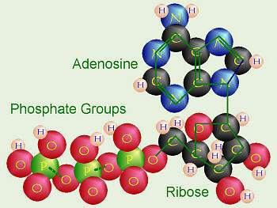
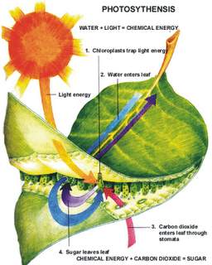
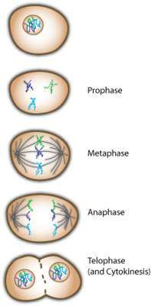
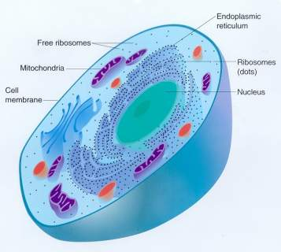
Cell Functions
TEK 7.4E, 7.12F

Slide 2
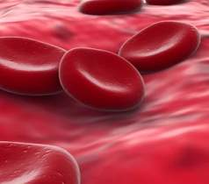
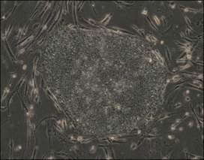
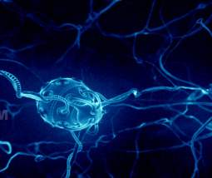
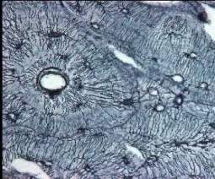
Cells and their functions
All organisms are made up of cells which are parts of all the body’s functions
There are many different types of cells with completely different functions
Nerve cells conduct nerve impulses
Cells in bones produce red blood cells
However, all cells use energy, get rid of waste, and contain genetic material

Slide 3
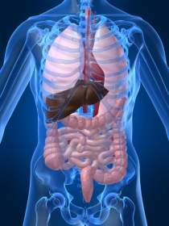
Metabolism
All cells need energy to operate
Metabolism is the chemical process by which cells get energy from food
Breaks down complex molecules so that the energy released can be used by various parts of the body

Slide 4
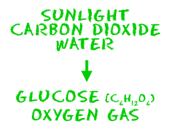
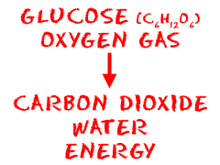
Photosynthesis vs. Cellular Respiration
Just like the plant process of photosynthesis, the process of cellular respiration involves converting various components (such as glucose and oxygen) into usable energy.
How Food is Converted into Energy
Cellular Respiration
Photosynthesis
Notes:
More in-depth explanation: http://www.angelfire.com/ga2/nestsite2/webunit8.html

Slide 5
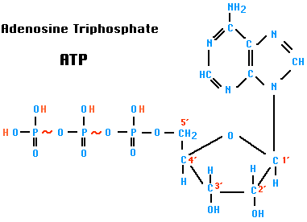
ATP
Stands for Adenonsine Triphosphate
Consists of adenine and 3 phosphate groups
Main form of energy that cells use
Mainly generated in the mitochondria

Slide 6
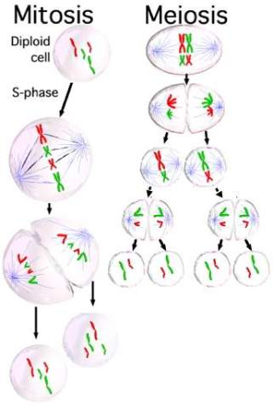
Cell Division
Two different processes
Mitosis
Meiosis
Necessary for:
Growth
Cell replacement (skin, red blood cells)
Regeneration
Reproduction

Slide 7
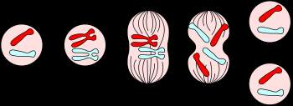
Mitosis
1 division produces 2 daughter cells
Daughter cells are identical to mother cell
Watch an Animation of Mitosis
Notes:
Animation of the stages of mitosis

Slide 8
Stages of Mitosis
Interphase – the period when the cell is not undergoing division but has replicated DNA
Prophase – Nuclear membrane is not visible, spindle has moved to opposite sides of cell
Metaphase – spindle fibers attach themselves to the chromosomes, which are lined in the middle of the cell
Anaphase – spindle pulls chromosome apart
Telophase – chromosomes are pulled to different sides by spindles and nuclear membrane begins to form around them
Notes:
Go back to previous slide and have students name each phase

Slide 9
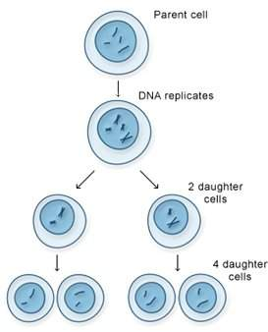
Meiosis
2 divisions occur
4 non-identical daughter cells
Like in mitosis, DNA is only duplicated once
Daughter cells have half the number of chromosomes of parent cell
Occurs only in reproductive organs

Slide 10
Mitosis vs. Meiosis
 | Mitosis | Meiosis
No. of divisions | A single division resulting in two cells. | Two divisions resulting in four cells.
Events in Prophase | Chromosomes do not associate with each other. | Paring of homologous chromosomes.
Events in metaphase | Individual chromosomes are arranged on the equator of the spindle. | Pairs of homologous chromosomes are arranged on the equator of the spindle.
Events in anaphase | Centromere splits and chromatids separate. | The chromatids stay joined and the homologous chromosomes separate.
Chromosome number in daughter cells | Daughter cells have the same number of chromosomes. | Daughter cells have half the number of chromosomes.
Genetic variation in daughter cells | Daughter cells are genetically identical with each cell and with the parent cell. | Daughter cells are genetically different with each cell and with the parent cell.
Occurrence | May occur in all parts of the body. | Meiotic division is restricted to the gonads.
Notes:
http://library.thinkquest.org/C0118084/Gene/Chromosomal_Inheritance/StagesMitosis.htm

Slide 11
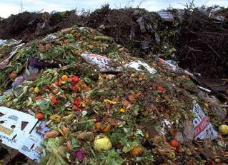
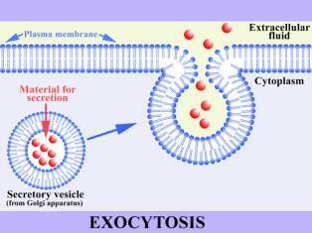
Removing Waste
Lysosome – found in cytoplasm, break up large molecules into smaller ones
Cell membrane – allows nutrients in while dumping waste out
Exocytosis – active transport; release of cellular substances out of membrane

