Slide 1
Domains and Kingdoms
And where we belong!

Slide 2
Where to start?
Dear King Philip Came Over For Good Spaghetti
This Italian-food-loving monarch shows us the direction of classification of life!
Domain Kingdom Phylum Class Order Family Genus Species
Dear Domain
King Kingdom
Philip Phylum
Came Class
Over Order
For Family
Good Genus
Spaghetti Species

Slide 3
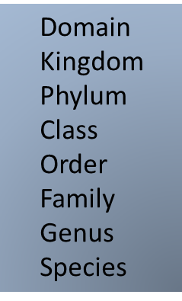
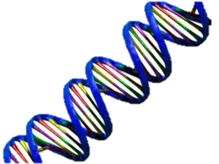
Let’s Start With the BIGGEST!
DOMAIN
Sounds big and fancy right?
Well, a DOMAIN is defined as any of three primary divisions of living systems, consisting of the eukaryotes, bacteria, and archaea, that rank above a kingdom in taxonomic systems that are based on similarities of DNA sequences.

Slide 4
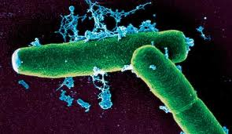
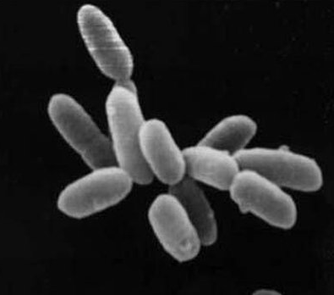
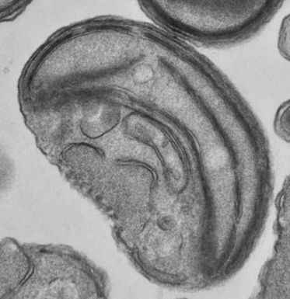
Three Domains
Domain Bacteria
Domain Archaea
Domain Eukarya
Domain Bacteria
Domain Archaea
Domain Eukarya
THREE DOMAINS

Slide 5
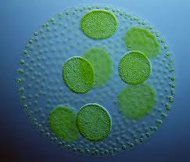
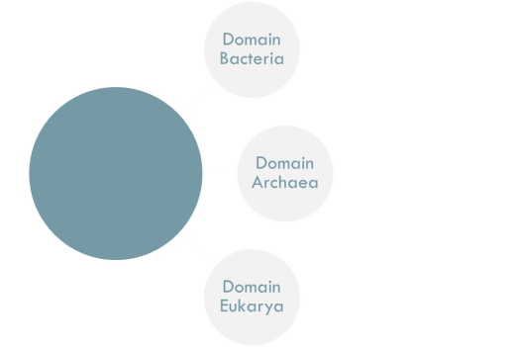

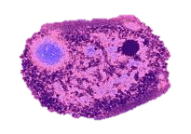
Domain Bacteria
Domain Bacteria
These are part of the large group of organisms commonly called "bacteria."
They include the
blue-green algae
purple sulfur bacteria
decomposing and disease-causing bacteria.
Examples: Salmonella and Nostoc
- prokaryote cells
- 1 or colonial cells
- mobile
- they can eat others or make food
- asexual, replicate by fission

Slide 6
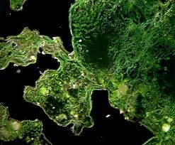


Domain Archaea
Also part of the large group of organisms commonly called
"bacteria.“
Prokaryote
Genetically similar to Eukarya
Single cell
Some of them move
Break down chemicals for food
Asexual, replicate by fission
Tolerate harsher environments than most other prokaryotes and all eukaryotes
Thermophilic (hot-water-loving)
Halophilic (brine-loving)
Sulfur-oxidizers
Anaerobic decomposers that produce methane.

Slide 7
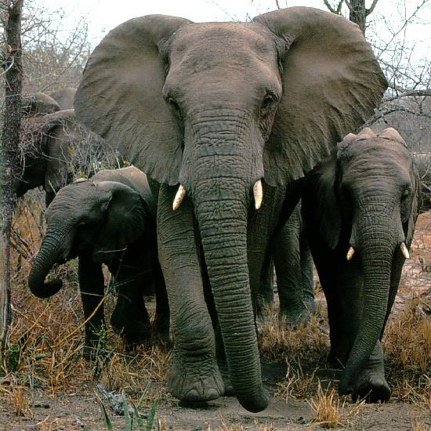



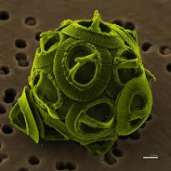
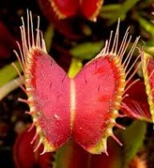
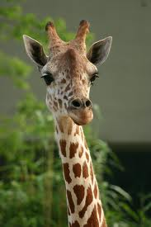

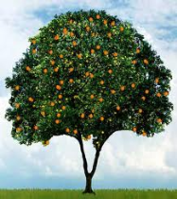
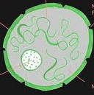
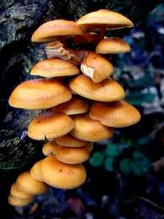
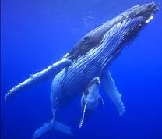
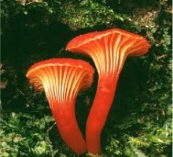

Domain Eukarya
Domain Eukarya
“simple nucleus”
Includes
Most kinds of algae
Plants
Fungi
Animals and YOU!
Nuclei surrounded by membranes.
Organized chromosomes undergo meiosis for sexual reproduction.
photoautotrophs have membrane-bound organelles called chloroplasts.

Slide 8
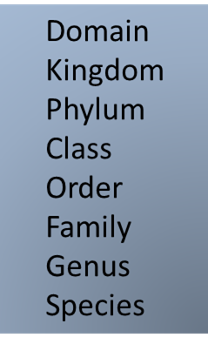

Moving on Down!
A KINGDOM is defined as the taxonomic category of the second highest rank, grouping together all forms of life having certain fundamental characteristics in common.
The four kingdoms introduced in this lecture are of the Domain EUKARYA. They are Kingdoms Protista, Fungi, Plantae, and Animalia (where WE belong!)

Slide 9
Kingdom Time!
Domain Bacteria
Domain Archaea
Domain Eukarya
Domain: Bacteria,
Kingdom Bacteria
Domain: Archaea,
Kingdom Archaea
Domain: Eukarya:
Kingdom Protista
Kingdom Fungi
Kingdom Plantae
Kingdom Animalia
Kingdom Protista
Kingdom Fungi
Kingdom Plantae
Kingdom Animalia
THREE DOMAINS

Slide 10
Let’s focus on Eukaryotes!
PROTISTA
FUNGI
PLANTAE
ANIMALIA
We will introduce 4 kingdoms in the Domain Eukarya:
Kingdom Protista
Kingdom Fungi
Kingdom Plantae
Kingdom Animalia
Domain Eukarya

Slide 11
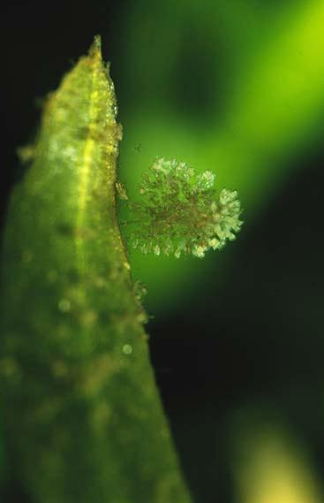
Kingdom Protista
Eukaryote cells
1 cell or more “colonial “
Mobile
Make their own food and eat others
Asexual, replicate by fission
*examples - amoeba, diatom, euglena, paramecium, some algae (unicellular), Chlorophyta: Kelp and other algae, etc.

Slide 12
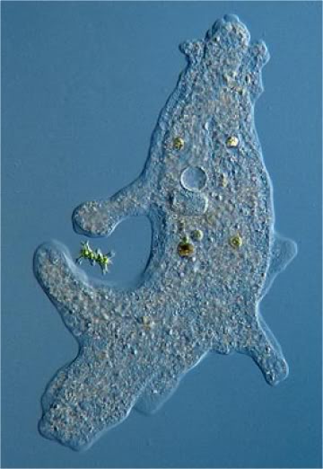
Kingdom Protista
Oldest of the Eukarya.
“catch-all” group; cannot be defined by shared derived characteristics
Most are Unicellular
Seaweeds algae are multicellular, but do not have specialized cells.

Slide 13
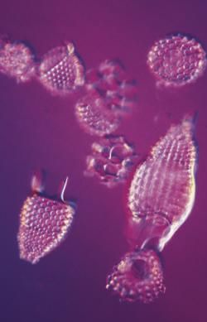
Kingdom Protista
LEFTOVERS
The simplest of the eukaryotes
Put together because they don't really seem to belong to any other group

Slide 14
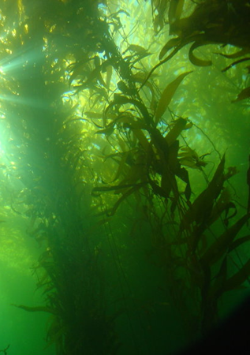

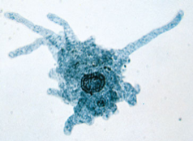
Kingdom Protista
Some perform photosynthesis like plants
Others move around like animals
They are neither plants nor animals; not fungi either!
You might not think a tiny one-celled amoeba
has much in common with a
giant sea kelp, but they're both members of this Kingdom!!

Slide 15
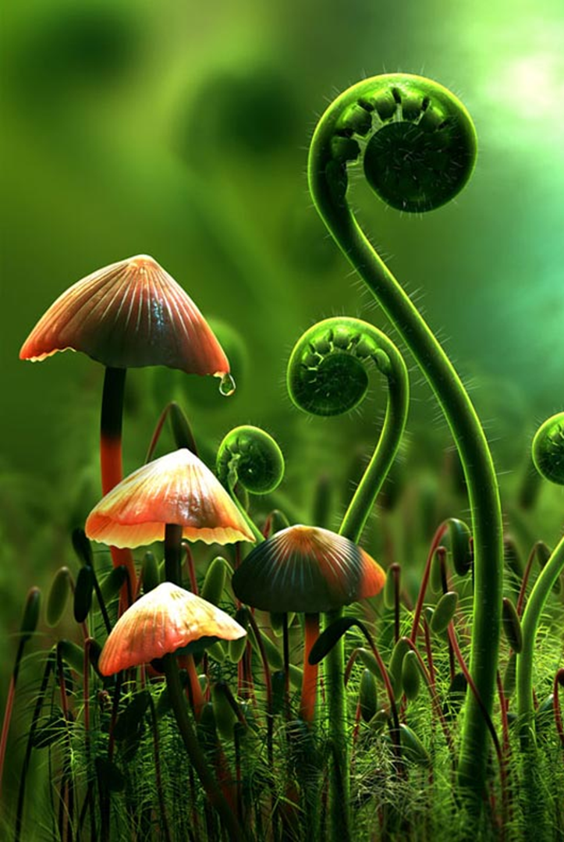
Kingdom Fungi
Eukaryote cells
Multi-cellular (yeasts are just 1 cell)
Immobile
Eat decaying matter
Sexual & asexual reproduction
*examples - mushrooms, molds, yeasts, mildew
FUN FACT!
We, in the Kingdom Animalia, are more closely related to the Fungi than we are to the Plantae.

Slide 16
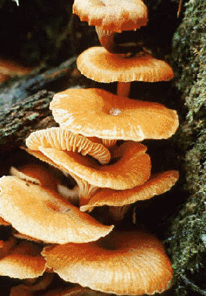
Kingdom Fungi
Fungi cannot perform photosynthesis, so they must get their nourishment from other sources…
Absorb nutrients directly from the soil
Feed on dead and decaying organisms
Recycle nutrients
Feed on living organisms
Athlete’s food is a common fungus which feeds on a living host – you!

Slide 17
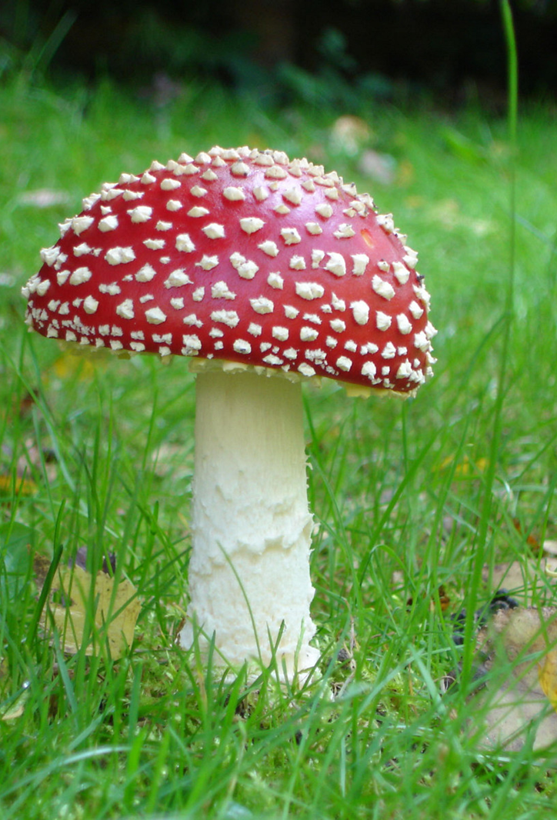
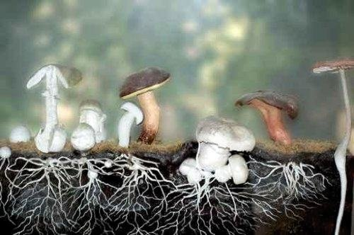
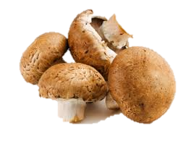
Fungi Structure
Kingdom Fungi
Fungi are specialized to be decomposers.
When you think of fungi, you probably think mushrooms. However, those "mushrooms" are really just special structures called "fruiting bodies."
A mushroom is a reproductive structure. It produces spores, but the bulk of the fungus is out of view.
The rest of the fungus (and the biggest part) lives below the ground!

Slide 18

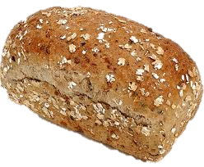

There’s a Fungus Among Us!
Kingdom Fungi
Fungi come in a wide variety of sizes and forms, and many have great economic importance.
Tiny, one-celled yeasts are important for baking breads and fermenting wines, beers and vinegars.
Many medicines are produced with the help of fungi, most notably, the antibiotic, Penicillin.
If you leave your bread on the counter too long, you'll be able to observe a relative of the Penicillium mold for yourself!
Penicillium fungi

Slide 19
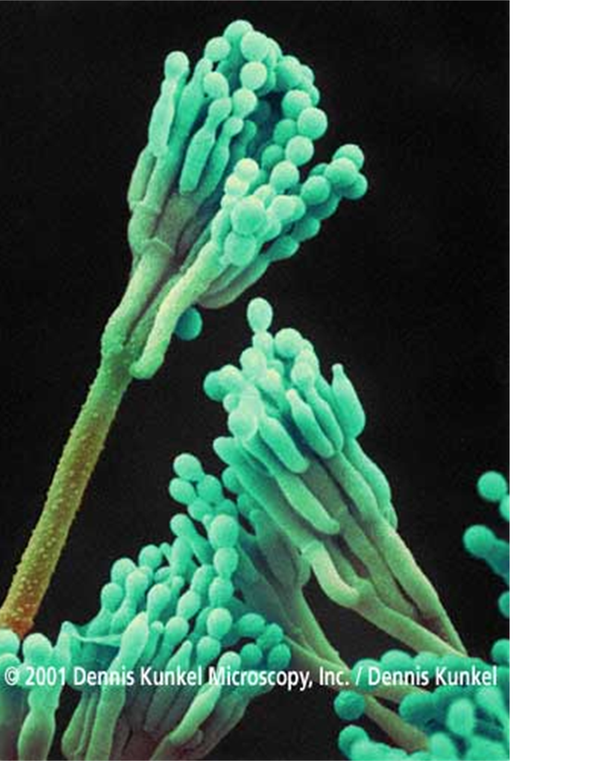

Fungi in Medicine
JUST FYI !
Many fungi produce antibiotics which kill bacteria. The first antibiotic, Penicillin, was discovered by Sir Alexander Fleming who isolated it from a mold.
In the past 50 years many bacteria have evolved resistance to antibiotics (natural selection in action). This has occurred in part because of the misuse of antibiotics for diseases that are not caused by bacteria (e.g. colds which are caused by a virus). As a result, many antibiotics are no longer effective and antibiotic resistant “super bugs” have become more common.
Penicillium fungi

Slide 20
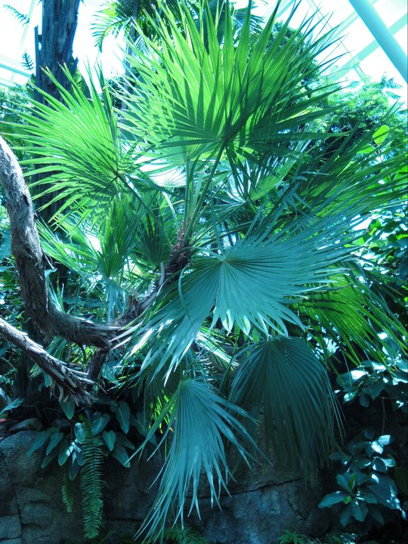


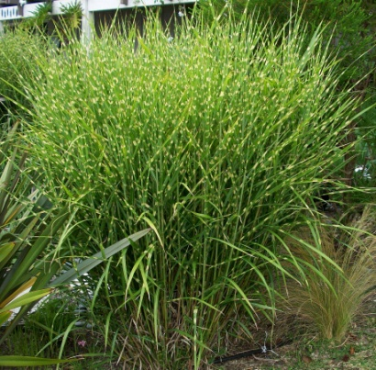
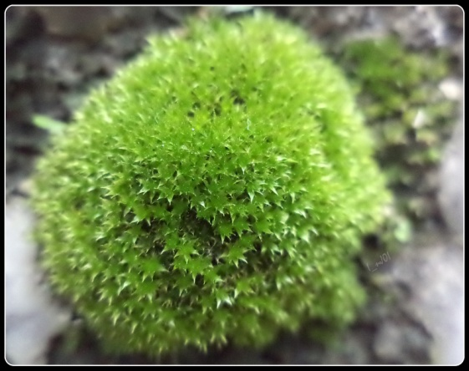
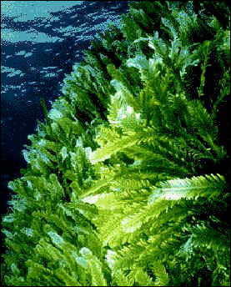
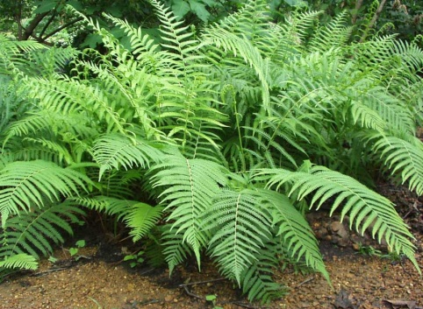
Kingdom Plantae
Eukaryote cells
“cell wall”
Multicellular
Immobile
Make food by photosynthesis
Asexual and sexual reproduction
*examples - multicellular algae, mosses, ferns, trees, grasses, flowers, etc.

Slide 21
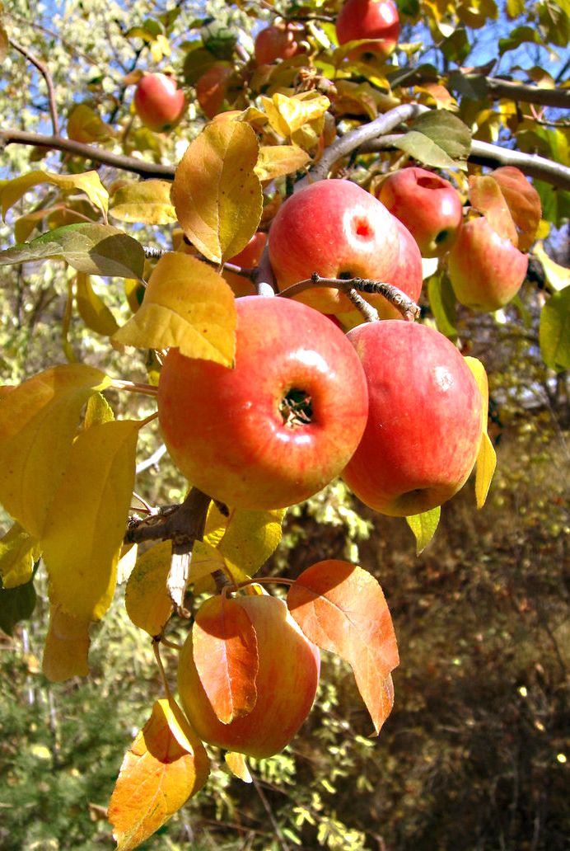

Kingdom Plantae
Key ability of plants is
photosynthesis:
The ability to make sugars from water and carbon dioxide using the energy available in sunlight.
Because plants can make their own food, they are the first step to many food chains.

Slide 22
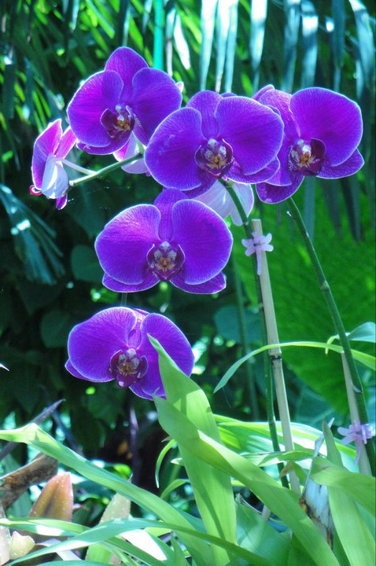
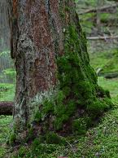
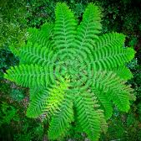
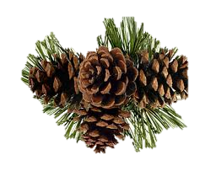
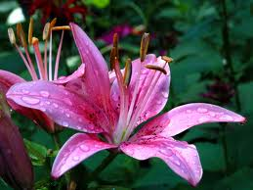
Kingdom Plantae
There are more than 250,000 plant species in the world.
The plants fall into four major groups:
Mosses
Ferns
Gymnosperms
Angiosperms

Slide 23
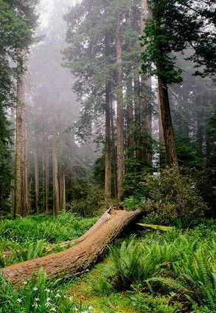
Kingdom Plantae
Ferns: the first group to evolve a vascular system and grow large
Do not produce seeds
Gymnosperms: First to produce seeds
Called “naked seeds” because the seeds are small and not covered in a fruit
Include pine trees, spruces, and other cone producing species
Angiosperms: the first group to evolve flowers
The most dominant group of plants on earth
Anything that produces a flower is an Angiosperm

Slide 24

Kingdom Plantae
FUN FACT!!
Question:
Why are trees tall?
Answer:
Trees are tall because they have to compete for light with other individuals (of their own and other species).
[Trees that grew short in the past did not leave descendants behind because they never reproduced. Only trees that grew tall succeeded, so natural selection produced the giant trees we see today]

Slide 25
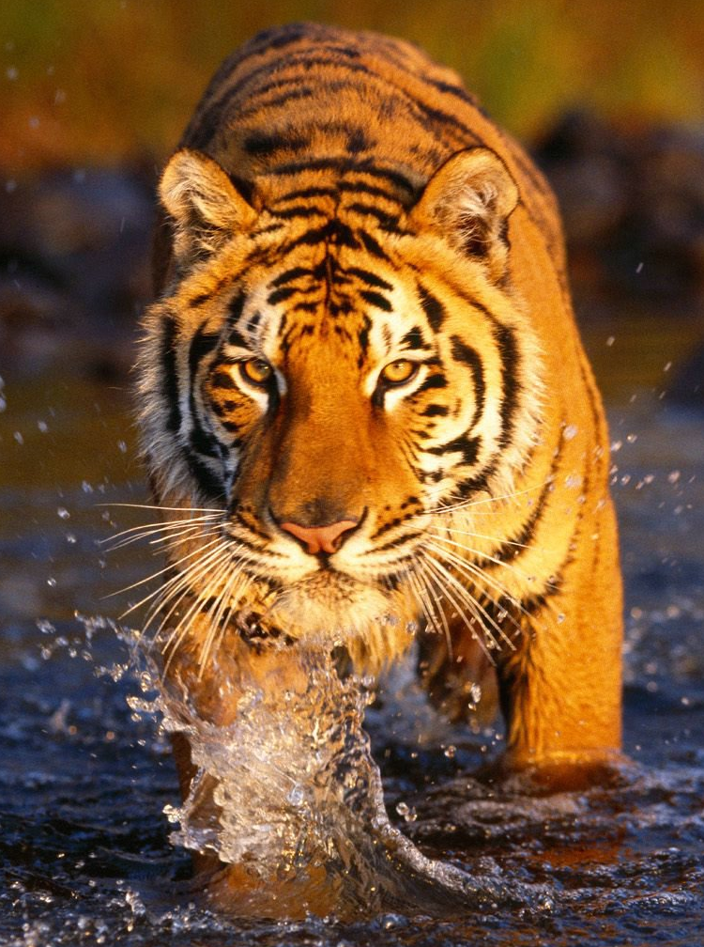
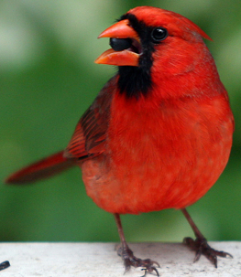
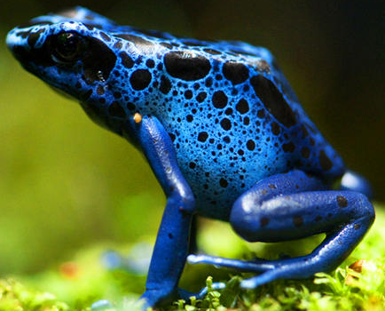

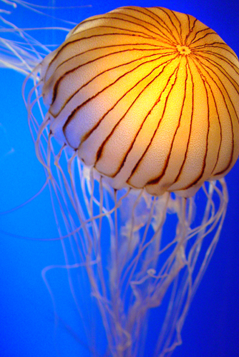
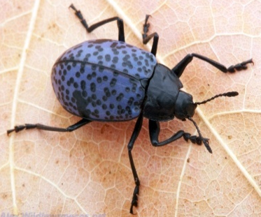
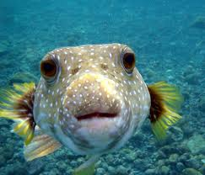
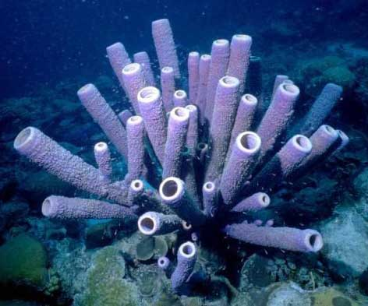
Kingdom Animalia
Eukaryote cells
Multicellular
Mobile
Eat others or plants
Sexual and asexual reproduction
*examples - sponge, jellyfish, insect, fish, frog, bird, tiger, man, etc.
http://biologypro0.tripod.com/id2.html
http://utahscience.oremjr.alpine.k12.ut.us/sciber00/7th/classify/sciber/5king2.htm

Slide 26

Kingdom Animalia
Kingdom Animalia:
Complex, diverse and have excellent mobility
Cells lack a cell wall
Do not photosynthesize

Slide 27


Kingdom Animalia
The bodies of most animals (except sponges) are composed of cells that make up tissues.
Each tissue is specialized to perform specific functions.
Tissues are organized into even more specialized organs that perform specific functions
Consider the Human Organ System
From Cells to Organism: Kingdom Animalia Example

Slide 28

Kingdom Animalia
Most animals are capable of complex and relatively rapid movement.
Most reproduce sexually, by means of differentiated eggs and sperm.
Most are diploid, meaning that the cells of adults contain two copies of the genetic material.

Slide 29










Kingdom Animalia
Researchers estimate that there are around 9 or 10 million species of animals on the Earth!
Animals vary greatly in size from a few cells to weighing many tons (like a blue whale or a giant squid).

Slide 30

Kingdom Animalia
Insects make up the most species by far!
We vertebrates are severely outnumbered and relatively inconsequential in the earth’s count of species.

Slide 31




SUMMARY! Domains and Kingdoms
DOMAINS divide all living things into 3 categories based on similar DNA sequences
Bacteria, Archaea, Eukarya
Domains
Within each Domain, there are more Kingdoms!
In the Domain Eukarya, there are 4 major Kingdoms
Protista, Fungi, Plantae, Animalia
Domain Eukarya

Slide 32





SUMMARY! Domains and Kingdoms
Kingdoms group together all forms of life that have certain fundamental characteristics in common.
We, people, belong to the Kingdom Animalia in the Domain Eukarya.

