Slide 1
Electromagnetic Waves and Material Interactions
Notes:
6.P.3.2 Explain the effects of electromagnetic waves on various materials to include absorption, scattering, and change in temperature. 6.P.3.3 Explain the suitability of materials for use in technological design based on a response to heat (to include conduction, expansion, and contraction) and electrical energy (conductors and insulators).

Slide 2
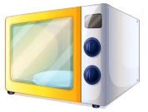
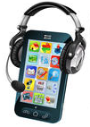
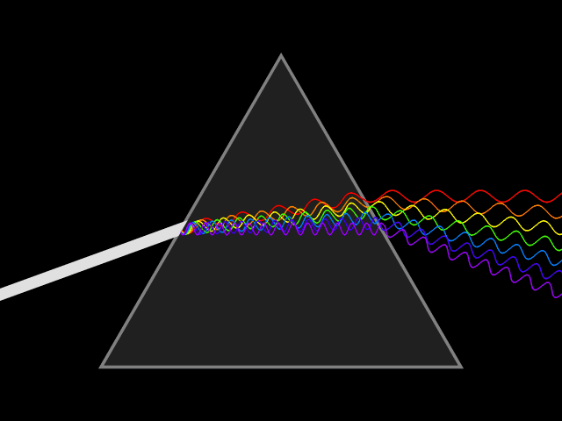

Light, microwave, x-ray, TV, and cell phone transmission are all kinds of electromagnetic waves.
Electromagnetic waves are a group of energy waves that are mostly invisible and can travel through empty space.
These energies bombard our bodies all day long, but we are only aware of a very small portion of them: visible light (colors), infrared light (heat), and ultraviolet (sunburn).

Slide 3
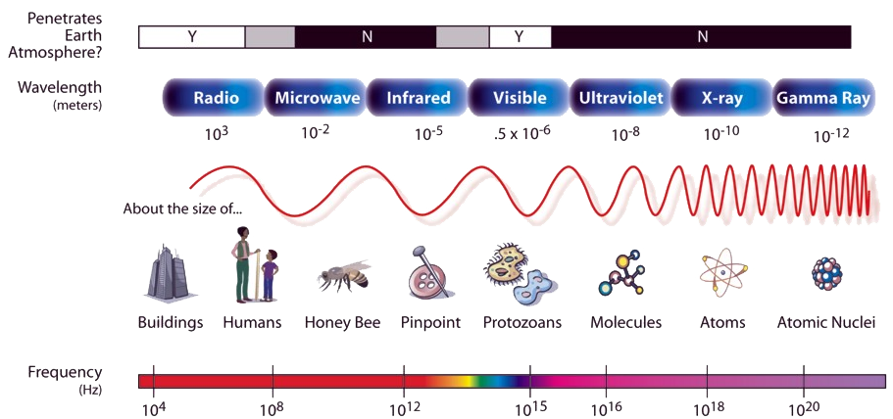

Slide 4
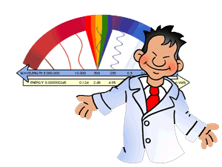
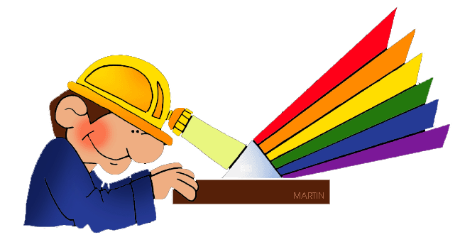
Electromagnetic energy is created by vibrations that produce waves.
Each electromagnetic wave emits a different level of energy. These energies travel silently at the speed of light and produce a “signature” wave – with a unique range of length, energy, and frequency – that scientists can identify and measure.

Slide 5

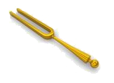
We can measure the energy of an electromagnetic wave by measuring its frequency.
Frequency refers to the number of waves a vibration creates during a period of time. In general, the higher the frequency, or number of waves, the greater the energy of the radiation.

Slide 6
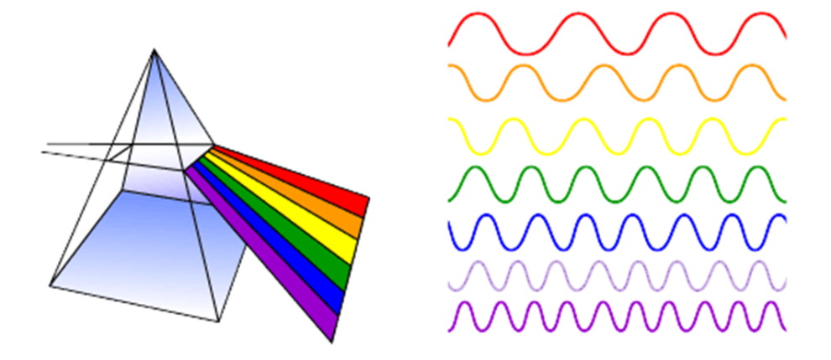
When we use the term “light”, we are referring to a group of electromagnetic waves called visible light.
Each individual wavelength within the spectrum of visible light wavelength represents a particular color. When light of that particular wavelength strikes our eye, we perceive that specific color sensation.

Slide 7

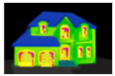
Another popular group of waves from the electromagnetic spectrum involves infrared.
Infrared radiation is a type of electromagnetic radiation that involves heat, or thermal radiation.
All objects emit (give out) and absorb (take in) thermal radiation.

Slide 8
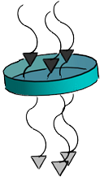
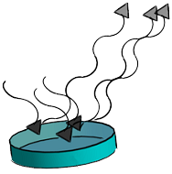
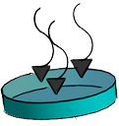
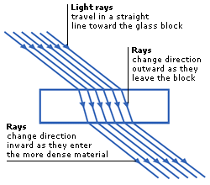
When light interacts with objects, it is either absorbed, reflected, transmitted, or refracted.
Transmission – The passage of light through a material.
Absorption – The loss of light as it passes through a material.
Refraction – The bending of light as they pass between mediums.
Reflection – The return of light by a material.

Slide 9
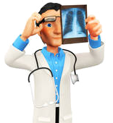
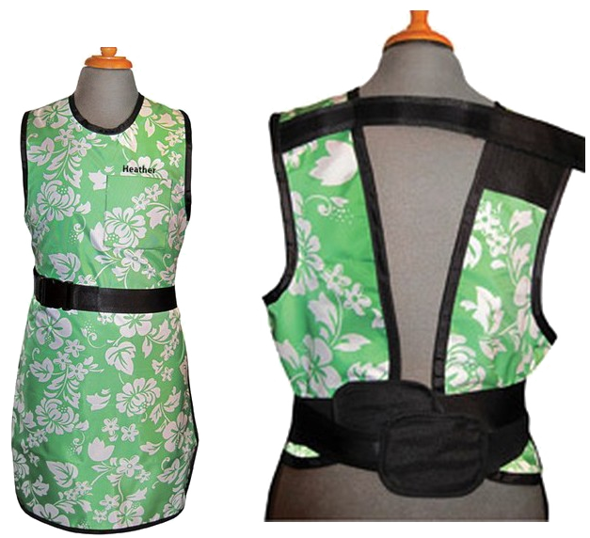
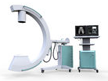
Let’s look at an example of absorption…
When you go to the dentist, one of the first things they do is obtain an x-ray of you. Unnecessary exposure of x-ray radiation can be harmful, so doctors try to minimize the area that those electromagnetic waves interact with your body by making you wear special protective clothing.

Slide 10
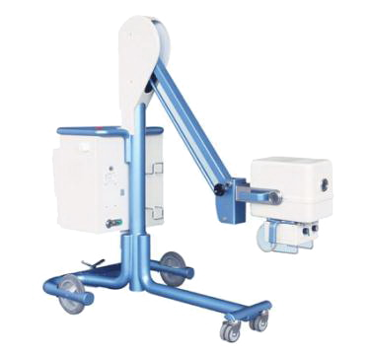
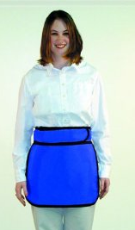
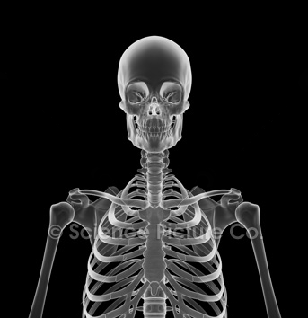
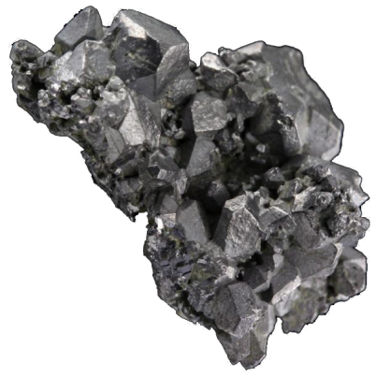
What do these special clothes do?
These protective clothes contain some amount of a dense element, lead, in them. The high density of this element allows x-rays to be absorbed by atoms in lead, decreasing the energy of the x-rays. Lead, in turn, shields your body from unnecessary radiation by absorbing x-rays.
Only the upper body was imaged because x-rays hitting the lower torso were absorbed by the lead apron.
Notes:
Lead also scatters the energy absorbed by x-rays

Slide 11
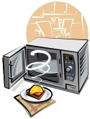
Another example of absorption of electromagnetic waves in our daily lives involve the use of a microwave.
Microwaves are widely used to quickly heat up food. Microwaves are also referred to as range of waves in the electromagnetic spectrum with a specific wavelength and frequency.

Slide 12
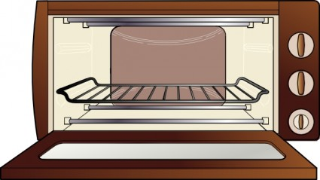


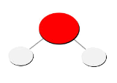

How do microwaves heat up food?
Microwaves utilize the fact that food contains water molecules. When a microwave is turned on, the energy from microwaves is absorbed by water molecules in food, making them vibrate. These vibrations give off heat, which warms up your food.
Water molecules absorb the microwaves, giving off heat as the molecules vibrate.

Slide 13
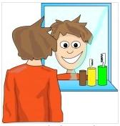
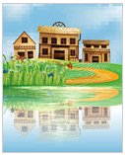
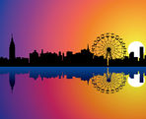
Let’s look at an example of reflection…
Reflection occurs when light is returned by an object. Although many objects reflect light, common examples include mirrors and smooth water surfaces.

Slide 14

How does an object reflect light in a mirror?
Reflection involves two rays, an incoming (incident) ray and an outgoing (reflected) ray.
When an incoming ray strikes a mirror, the ray changes direction. This ray is now reflected off the mirror.
The angle of incident rays and the
angle of reflected rays are equal in
all reflected light of smooth objects.

Slide 15
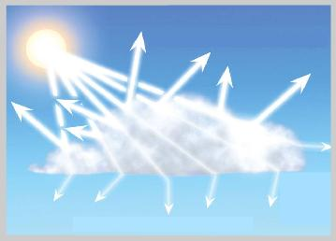
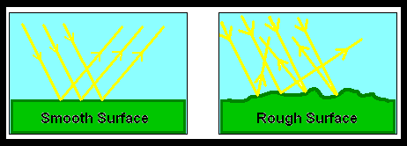
Reflection can also involve scattering of light…
When light strikes an object that has a rough surface, the light scatters everywhere instead of bouncing off at equal angles.

Slide 16

Let’s look at an example of transmission…
Transmission of light is the passing of light through an object. Objects have different levels of transmission. Opaque objects reflect or absorb all light, so you won’t be able to see behind opaque objects. Translucent objects allow only a part of the light through, letting you slightly see behind the object. Transparent objects pass all light through.

Slide 17
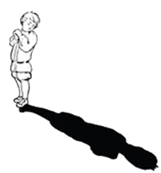
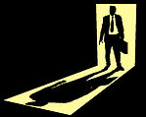
Why are shadows formed?
Shadows are formed when light is blocked by an object.
Shadows are produced when light hits an opaque object which prevents the light beams from passing through. The light beams are absorbed by the object and cast a shadow.

Slide 18
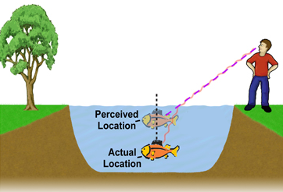
Let’s look at an example of refraction…
Refraction involves bending of light as it passes from one substance to another. A common example of refraction can be observed when you go fishing. Due to refraction, you perceive things that aren’t located in the proper location.

Slide 19
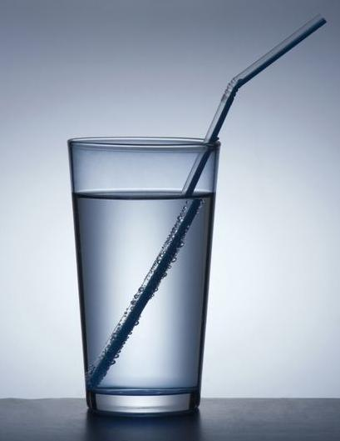
Why does refraction happen?
The bending of light is due to a change in its speed. When light passes from a less dense substance (such as air) to a more dense substance (such as water), it slows down and bends into the more dense material. On the other hand, when light passes from water to air, it speeds up and bends outwards.

Slide 20

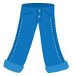
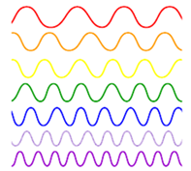

Light interaction with objects can involve combinations of absorption, reflection, transmission, and refraction.
A common example that has both absorption and reflection involves clothes. If you are wearing blue jeans, you see the color blue because the jeans absorb all other colors but reflect blue.

Slide 21
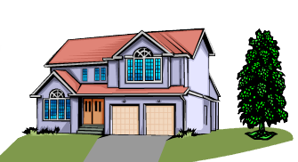
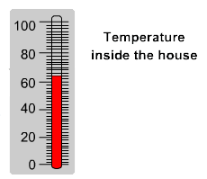
Electromagnetic waves can also change the temperature of an object.
Earlier, we saw an example of how microwaves can heat up food. Other electromagnetic waves can be used to change temperature of an object. As mentioned before, infrared radiation is a type of electromagnetic radiation that involves heat. When infrared waves come in contact with an object, the waves transfer heat to that object.
Temperature inside the house increased due to heating from the sun.

Slide 22
Materials are chosen for specific applications due to their special properties.
Materials that conduct heat readily are called thermal conductors. Materials that limit heat transfer are called thermal insulators.
Materials that allow flow of electrical current are called electrical conductors. Materials that limit the flow of electrical currents are called electrical insulators.

Slide 23



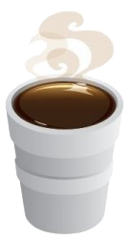
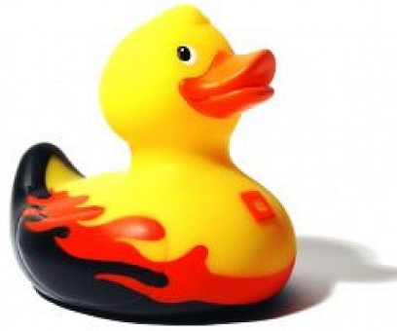
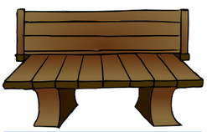
Conduction involves transferring heat between substances that are in direct contact with each other.
Good thermal conductors include metals such as aluminum, steel, and copper.
Good thermal insulators include nonmetals such as rubber, wood, and styrofoam.

Slide 24
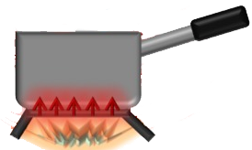
A popular example of conduction can be found in cooking.
When a pot is on the stove, heat is transferred from the stove to the pot. The pot is made of metal, so it is a good thermal conductor. Most pots have a handle made of rubber so you don’t feel heat when you pick up a pot from the handle. This is because rubber is a good thermal insulator and doesn’t allow heat to be transferred to the handle.

Slide 25
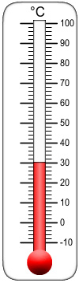
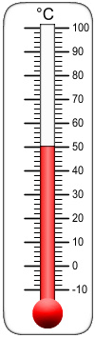

Materials can expand or contract due to presence or absence of of heat.
Thermometers are a great example that involve substances expanding and contracting due to varying temperature. Thermometers contain a special liquid, mercury, which is a good thermal conductor. The mercury molecules expand and get bigger as it gets warmer and get smaller as it cools down. This results in the liquid moving up when it’s warm, and drop down when it’s cold. The molecules expand as it gets warmer because the volume of the liquid increases as it’s heated and slowly decreases as it’s cooled.

Slide 26
Materials are also chosen for their electrical properties.
Most metals are good conductors of electrical current. Metals allow electrons to flow easily from one atom to another. Therefore, metals are commonly used in todays devices such as computers, phones, and TVs.
Electrical insulators do not let electrons flow easily from one atom to another. Electrical insulators are used to protect us from dangerous effects of electricity flowing through conductors. Good electrical insulators include nonmetals such as rubber, air, and wood.

Slide 27
Summary
Electromagnetic Waves – Group of energy waves that are mostly invisible and can travel through empty space.
Frequency – Number of waves a vibration creates during a period of time.
Visible Light – Range of electromagnetic spectrum that can be detected by the human eye.
Infrared – Type of electromagnetic radiation that involves heat.
Absorption – The loss of light as it passes through a material.
Reflection – The return of light by a material.
Transmission – The passage of light through a material.
Refraction – The bending of light as they pass between mediums.
Translucent – Allow only a part of the light through.
Opaque – Reflect or absorb all light.
Thermal Conductors – Materials that conduct heat readily.
Thermal Insulators – Materials that limit heat transfer.
Electrical Conductors – Materials that allow flow of electrical current.
Electrical Insulators – Materials that limit the flow of electrical current.

