Slide 1
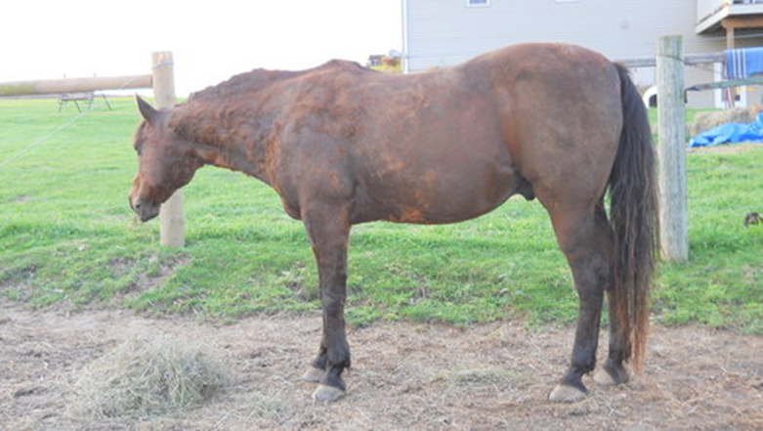
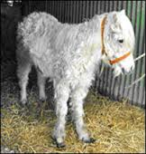
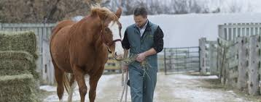
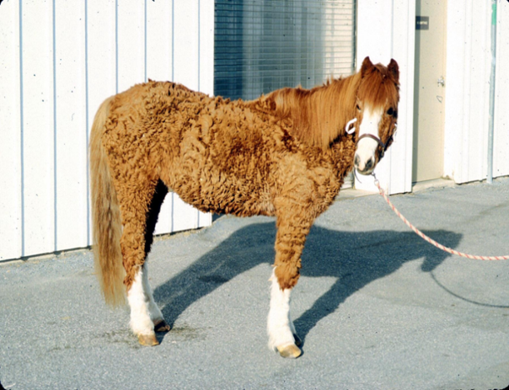
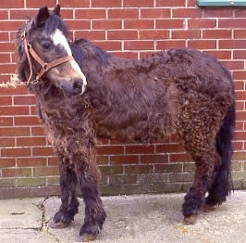
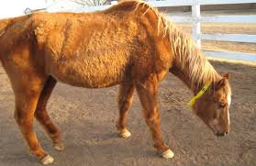
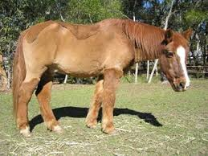
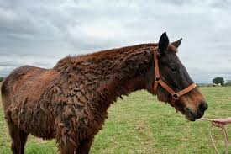
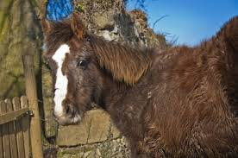
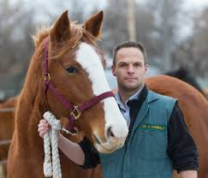
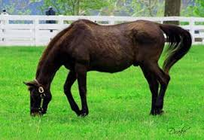
Equine Cushing’s Disease
Pituitary Pars Intermedia Dysfunction (PPID)

Slide 2
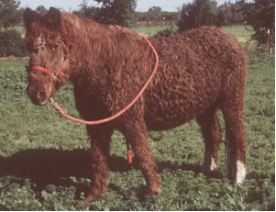
Cabby
A 20-year-old Morgan gelding who is a great all-around horse. Cabby started to exhibit a wooly coat that didn't shed. Since he came from the mountains, his owners attributed this to his previous environment. Cabby also showed signs of muscle wasting and lethargy; which was believed due to the heavy coat and minimal exercise.
Could these observations tell us something else about Cabby.

Slide 3
What is Cushing’s Disease?

Slide 4
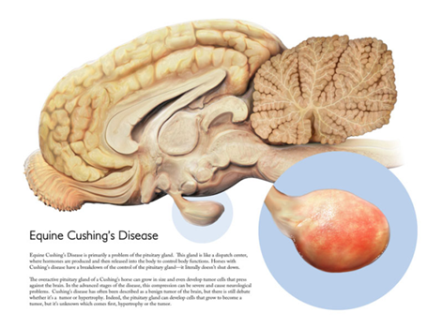
What is Cushing’s Disease?
More accurately termed “Pituitary Pars Intermedia Dysfunction”
Occurs when a tumor, pituitary adenoma, develops in the pituitary gland
Affects the intermediate lobe
The pituitary gland is a gland that sits at the base of the brain.
Responsible for almost all of the body’s endocrine systems.
Notes:
http://www.thehorse.com/articles/12534/cushings-disease-diagnosis

Slide 5
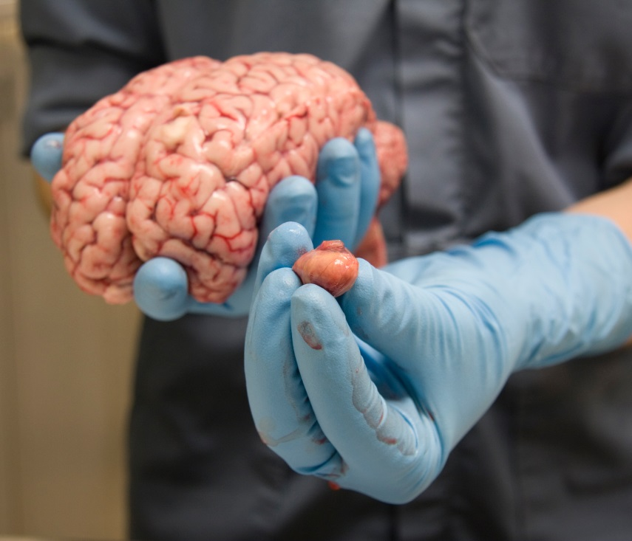
Tumor Growth in Cushing’s Disease
Sends inappropriate signals to the rest of the body to secrete excessive hormones
Primarily a stress hormone called cortisol
Too much may compromise the immune system making the horse more susceptible to infections
Notes:
http://words.usask.ca/wcvm/2014/09/team-explores-radical-therapy-for-cushings/

Slide 6
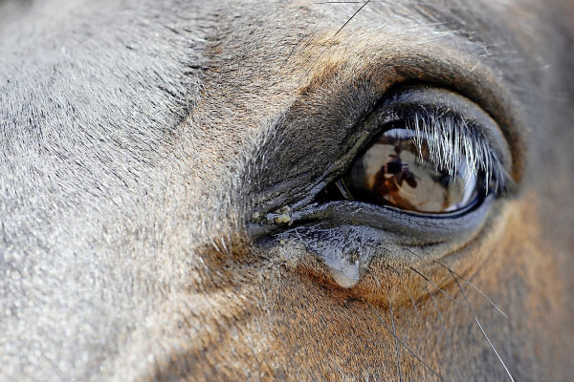
Tumor Growth in Cushing’s Disease
Can put pressure on the adjacent hypothalamus.
Controls body functions such as: body temperature, thirst, hunger, and other homeostatic systems.
Can also press onto the optic nerve causing blindness.

Slide 7
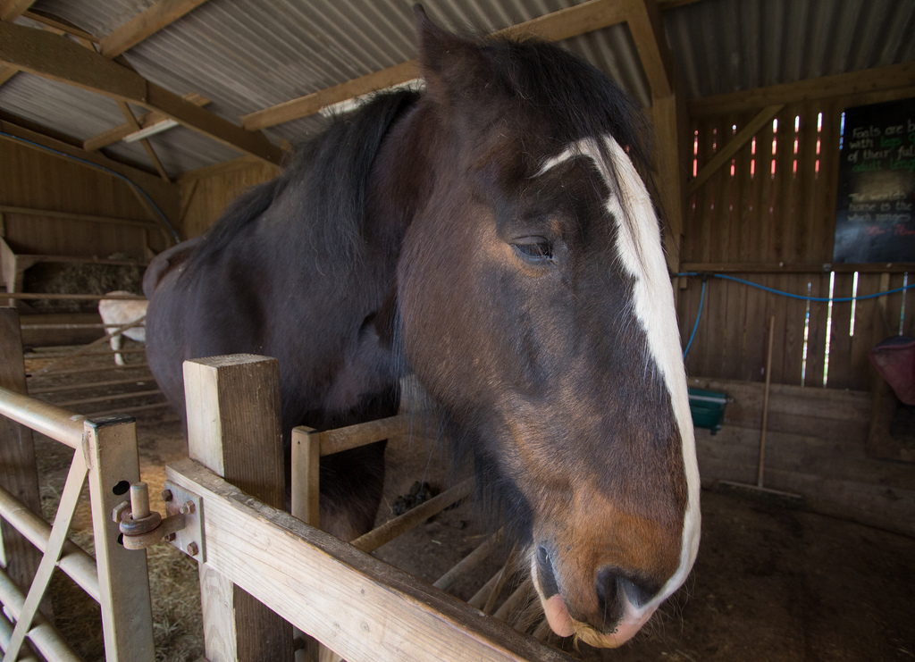
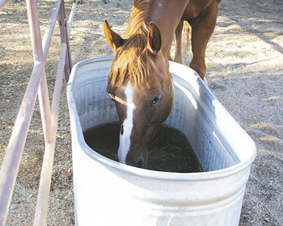
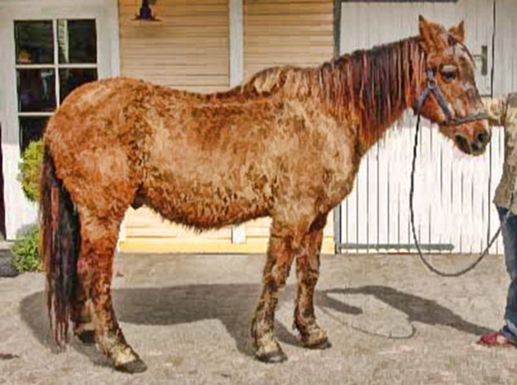
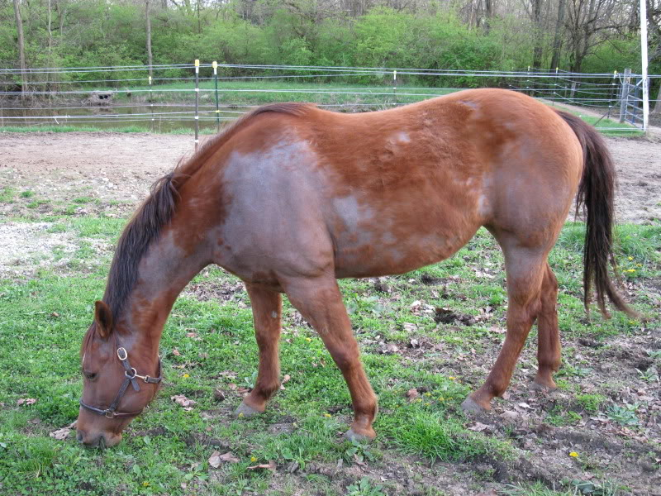
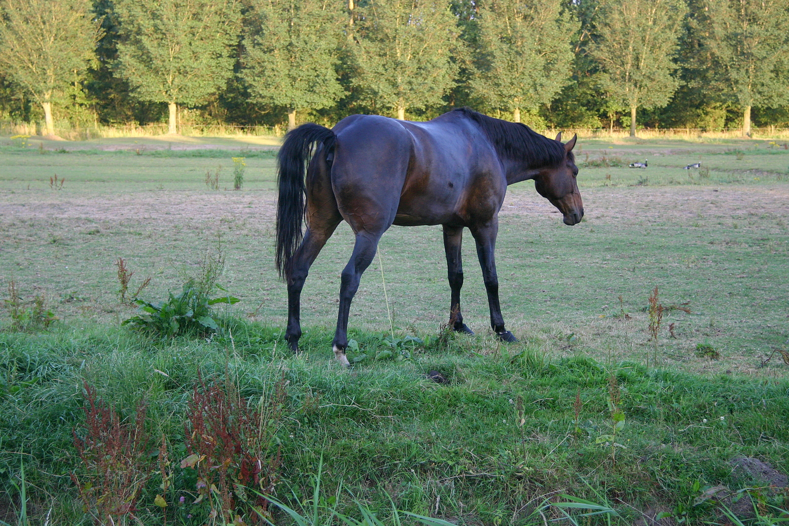
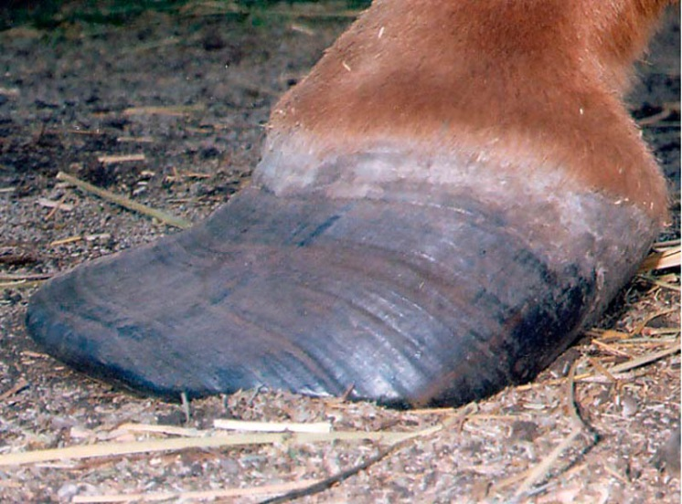
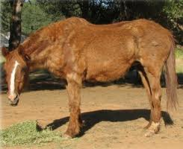
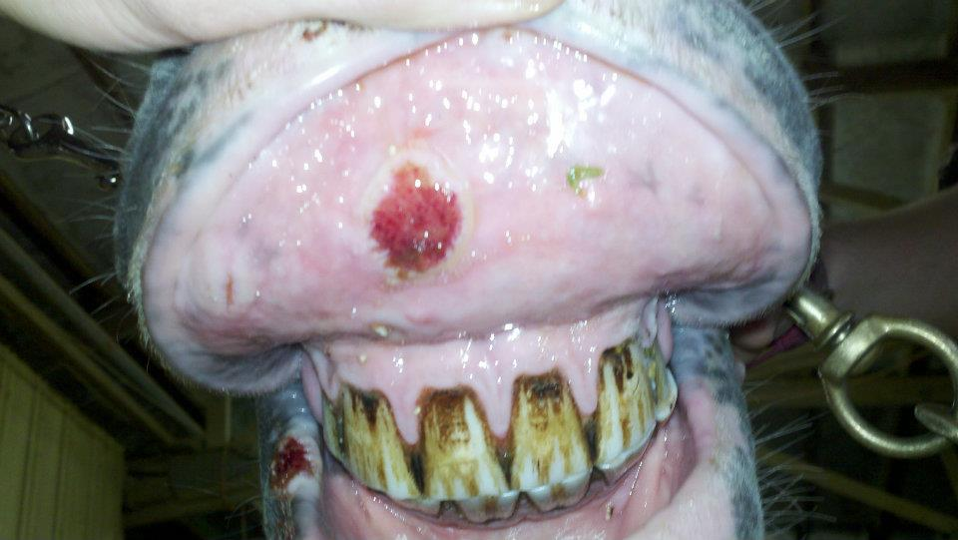
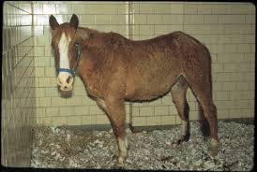
Signs of Cushings
Laminitis
Weight loss
Ulcers in mouth
Excessive thirst
Excessive urination
Hirsutism and abnormal shedding
Changes in body shape
Prone to infection
Depression or Lethargy

Slide 8
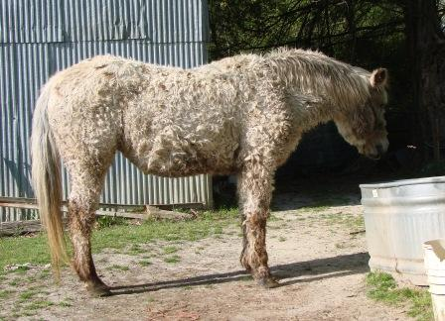
Signs Continued
Hirsutism or abnormal shedding is the most noticeable symptom
Horses may still have their winter coats in the summer months.

Slide 9
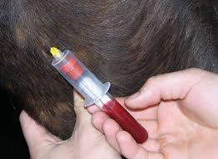
Cabby
Recall Cabby’s Symptoms
List them in your notes or share with a neighbor
Should Cabby be evaluated for Cushing’s Disease?

Slide 10
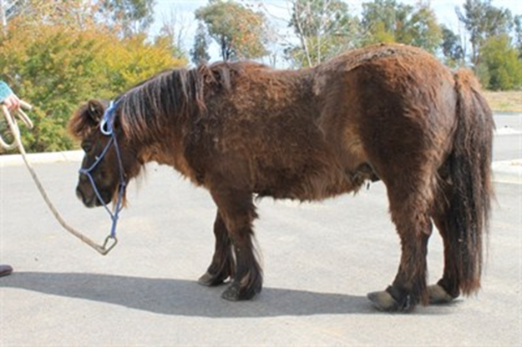
Horses Commonly Affected
Over 7 years of age
More females than males
Ponies more prone than horses

Slide 11
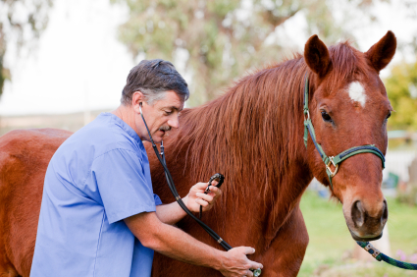
Diagnosis
Clinical signs are largely used to help diagnose Cushing’s Disease
A veterinarian will also complete a
Physical exam
Complete blood profile
Blood tests
Notes:
Video at http://www.thelaminitissite.org/ppid.html

Slide 12
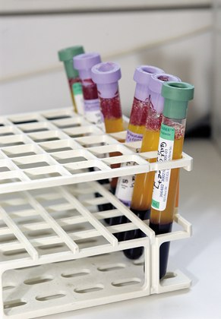
Testing
Typically performed by diagnostic laboratories
Adrenocorticotropic Hormone (ACTH)
Most common diagnostic
Measures ACTH in blood plasma
Higher concentrations in horses with Cushing’s
Insulin
In conjunction with ACTH
Measure fasting insulin levels
Laminitis indicator
Overnight Dexamethasone-suppression test (ODST)
Similar results to ACTH
Cannot be used in Autumn
Requires two visits

Slide 13
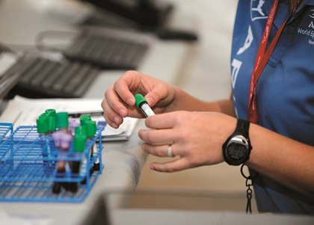
Future Tests
Domperidone
Dopamine blocker stimulates secretion of ACTH
Horses with Cushing’s have a greater response
Still in validation phase
α-Melanocyte Stimulating Hormone (α-MSH)
Measures breakdown product of ACTH
More specific test for dysfunction
Still in research phase, not commercially available
Thyrotropin-Releasing Hormone (TRH) Stimulation
Earlier indicator of PPID
Measures ACTH before and after administering TRH
Clinical trials phase

Slide 14
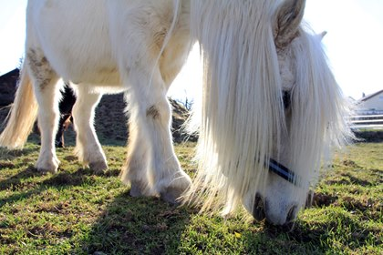
Diagnosis
Diagnosis is key to disease management
No test is 100% accurate
Veterinarians are working on improving early detection and diagnosis
Notes:
http://www.ivis.org/proceedings/aaep/2006/pdf/z9100106000060.pdf

Slide 15
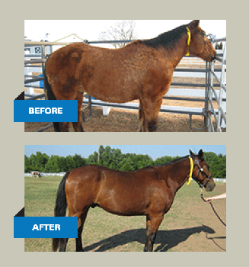
Treatment - Medication
Incurable
Controlled with medication and management
Pergolide: Prascend
Most popular choice, but expensive ($2/day)
Controls the output of the hormone ACTH
Mimics the action of dopamine
Horses generally remain on the drug for life
Cyproheptadine: antihistamine
Used in combination with Pergolide
Decreases ACTH secretion
Notes:
http://ecirhorse.org/index.php/cushing-s-disease/treatment-of-cushing-s

Slide 16
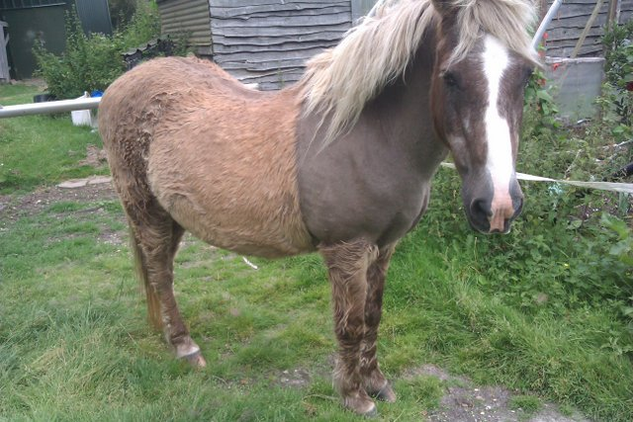
Treatment - Management
Diet:
Low carbohydrate/high fat
Limit lush pasture
Parasite Control
Dental Care
Farrier Care:
More prone to laminitis
Grooming:
Body clipping keeps shaggy-coated horses cool in warm/humid weather

Slide 17
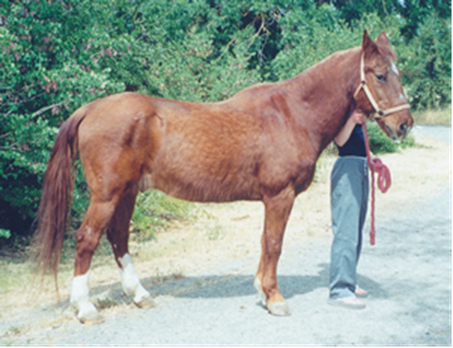
Back to Cabby
Once diagnosed, Cabby started pergolide treatment and his owners noticed a substantial difference.
"He is almost back to normal. His muscles filled in, he's perky and he's lost the big shaggy coat."

Slide 18
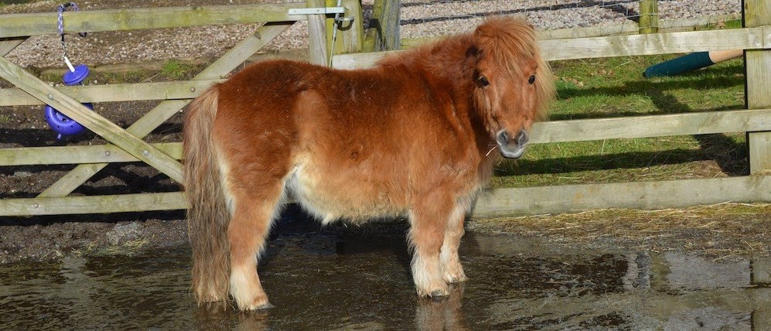
Wrapping it Up
Cushing’s Disease is becoming more commonly diagnosed because of:
Better awareness of the disease
Convenient diagnostic testing
Increase in older horses

