Slide 1
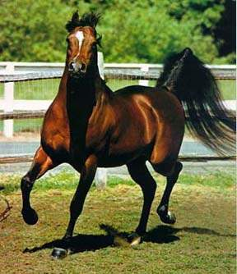
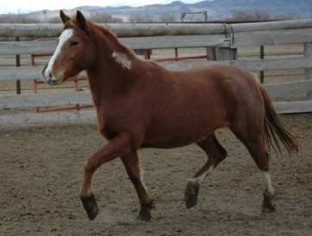
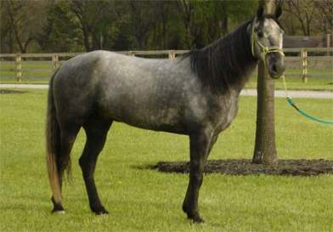

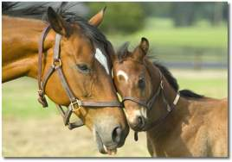
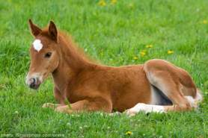
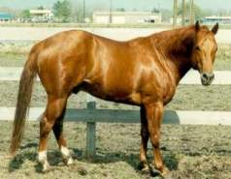
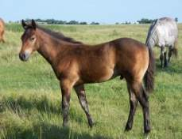
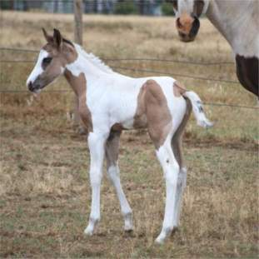
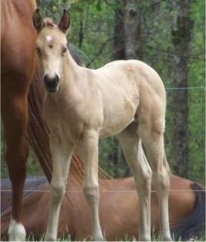
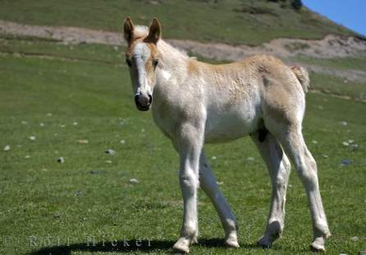

Slide 2
Objectives
Terminology
Breeds
Management Practices
Feeding and Nutrition
Animal Behavior
Animal Growth and Development
Animal Health
Selection of Horses

Slide 3
Terminology

Slide 4
Stallion
Sexually mature male
Arabian

Slide 5
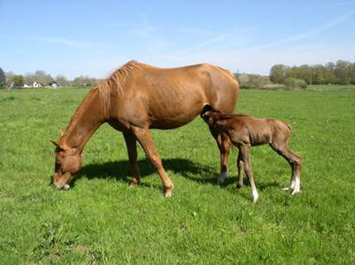
Mare
A sexually mature female
A female who has foaled or
A female 4 years of age or older.
Quarter Horse

Slide 6
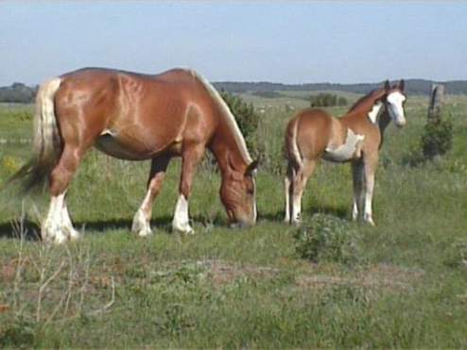
Broodmare
A female used for breeding purposes.
Belgian

Slide 7
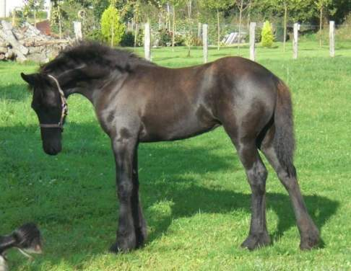
Filly
An immature female
Friesian

Slide 8
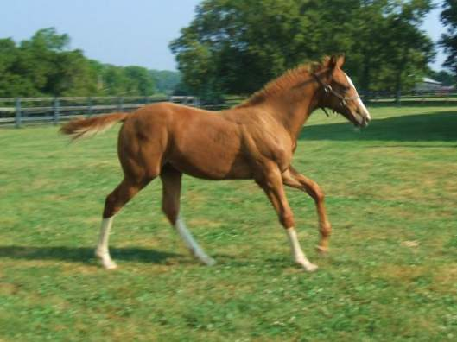
Colt
An immature male
Thoroughbred

Slide 9
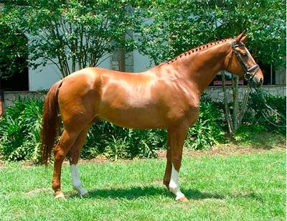
Gelding
A castrated male
Hanoverian

Slide 10
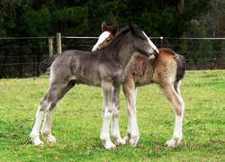
Foal
A young horse of either sex, still nursing
Shire

Slide 11
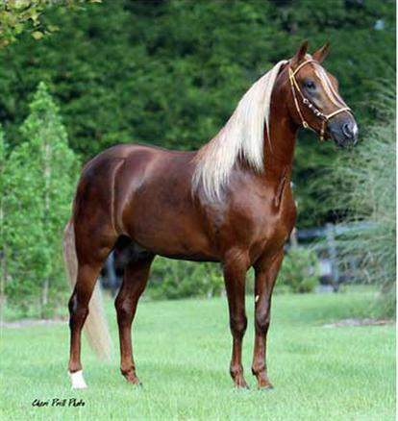
Stud
A sexually mature male or
A collection of breeding stallions at the same location.
Paso Fino

Slide 12
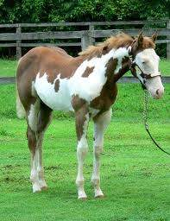
Weanling
Weaned horse, either sex, less than 1 year of age.
Overo Paint
Back to Objectives

Slide 13
Breeds

Slide 14
Light Horses

Slide 15
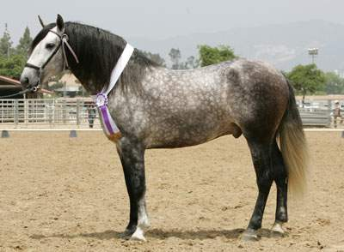
Andalusian
Developed on the Iberian Penisula
Primarily gray with long, thick mane and tail, and a slightly convex face
Most often used for dressage and show jumping

Slide 16
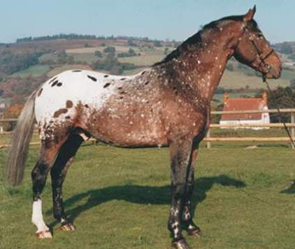
Appaloosa
Developed by the Nez Perce people of the Northwest
Distinctive characteristics: mottled skin, eye encircled by white, hooves are narrowly striped vertically in black and white
General purpose riding horse

Slide 17
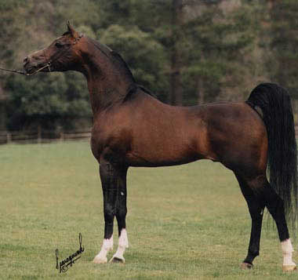
Arabian
Developed on the Arabian Penisula
Distinctive head shape and high tail carriage
General purpose horse that excels in endurance riding

Slide 18
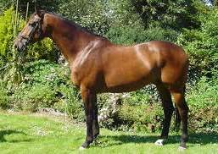
Dutch Warmblood
Developed in the Netherlands
Warmblood type – cross of light and draft horse
Excel in dressage and jumping

Slide 19
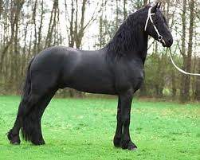
Fresian
Developed in the Netherlands
Black horses with long, thick, wavy manes and tails, and feathers on lower legs
High-stepping trot
Used in harness and dressage

Slide 20
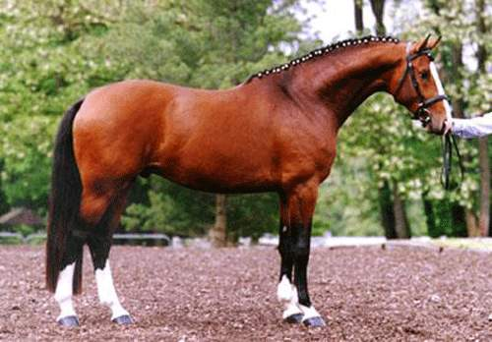
Hanoverian
Developed in Germany
Warmblood
Popular Olympic mount
Used for dressage, jumping, and eventing

Slide 21
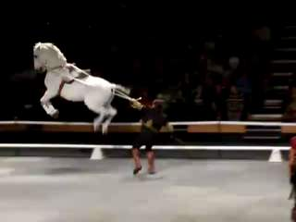
Lipizzan
Developed in Austria
Born dark, bay or black, and become progressively grayer with age
Known for classical dressage, specifically “airs above the ground”
Notes:
VIDEO – click image to play

Slide 22
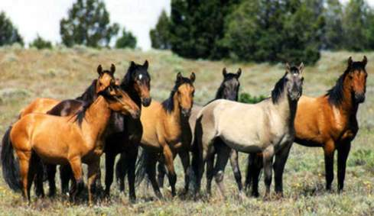
Mustang
Descendants of horses brought to America by the Spanish
Can be any color
Small (no more than 15 hands), tough horse

Slide 23
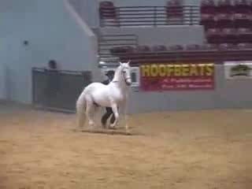
Paso fino
Developed in Latin America
Smaller horse (average 15 hands) of any color
General purpose riding horse
Distinguished by their 4-beat lateral gait
Notes:
VIDEO – click image to play

Slide 24
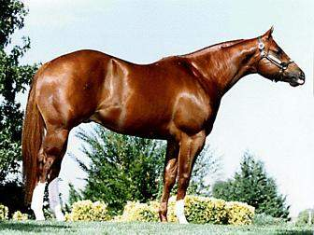
American Quarter Horse
Developed in the United States
Compact, stocky, and well-muscled
Highly versatile riding horse with great speed over short distances

Slide 25
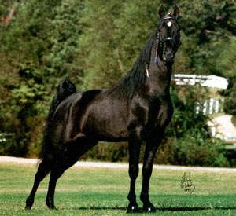
Tennessee Walking Horse
Developed in the Southern United States
Trail and pleasure riding horse
Known for naturally over-striding and their 4-beat “running walk”

Slide 26
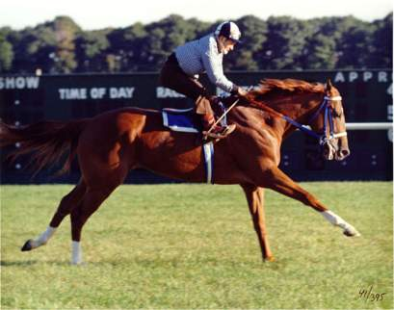
Thoroughbred
Developed in England
High withered, lean body, with long legs
Typically bay, brown, black, or gray
Bred for agility and speed

Slide 27
Draft Breeds working horses

Slide 28
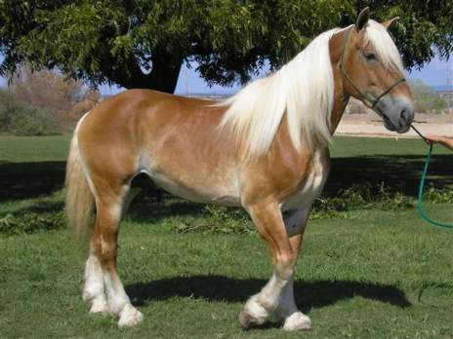
Belgian
Developed in Belgium
Predominant color is light sorrel with flaxen mane and tail.
16.2 – 18 hands, 1800 – 2200 lbs
The strongest of the draft breeds with less leg action than other draft breeds

Slide 29
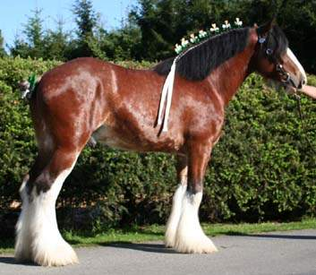
Clydesdale
Developed in Scotland
Bay with extensive white markings and “feathering” on the lower legs
16 - 18 hands, 1800 - 2000 lbs
Active gaits

Slide 30
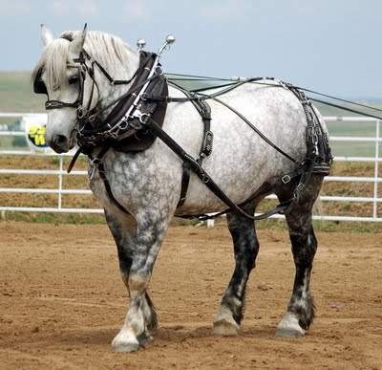
Percheron
Developed in France
Usually black and gray
16.2 – 18 hands, 1900 – 2600 lbs

Slide 31
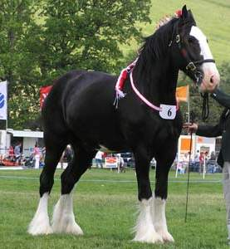
Shire
Developed in England
Black, bay, or gray
Average of 17.2 hands
Holds the record for the largest horse

Slide 32
Pony Breeds

Slide 33
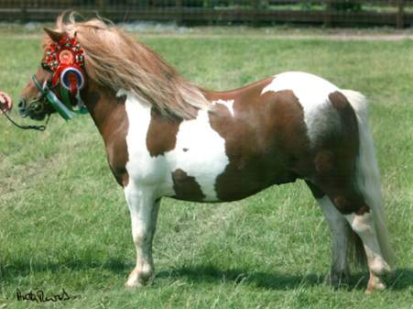
Shetland Pony
Originating in the Shetland Islands
Maximum height of 11.2 hands
Dished face with long, thick manes and tails and double coat
Used for riding and driving
Strongest of all pony breeds

Slide 34
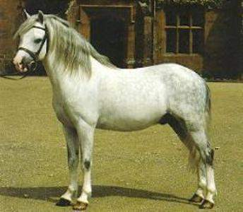
Welsh Pony – riding Type
Originated in Wales
Maximum height 14.2 hands
Small dished-faced head with large eye
Athletic horse with elegant movement
Popular pleasure riding, driving, showing, and jumping horse

Slide 35
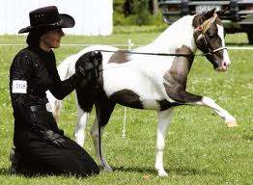
Miniature Horse
Developed in Europe for nobility
9.2 hands and under
Should exhibit same physical characteristics of a horse relative to body size

Slide 36
Color Breeds

Slide 37
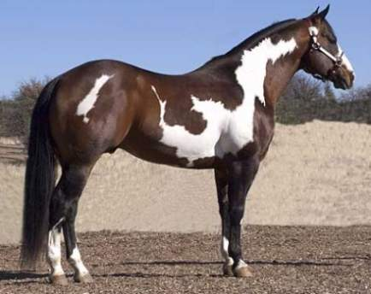
American Paint Horse
Developed in the United States
General purpose riding horse
Stock horse conformation
Two basic color patterns: tobiano and overo

Slide 38
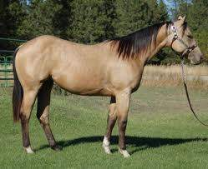
Buckskin
Tan or gold colored coat with no primitive markings (dorsal stripe, shoulder stripes, zebra striping)

Slide 39
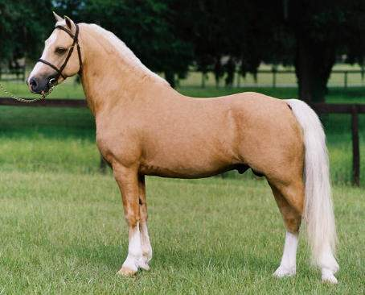
Palomino
From the United States
Any body type horse with golden body and white mane and tail
Back to Objectives

Slide 40
Management Practices

Slide 41
Methods of Identification
Freeze branding
Hot Iron Branding
Lip Tattooing
Chestnuts
Micro-Chipping
Color

Slide 42
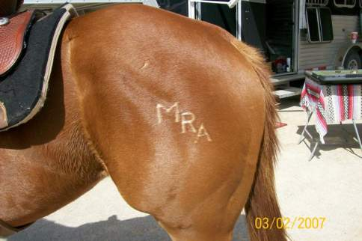
Freeze Branding
Irons cooled in liquid nitrogen and placed on the skin 8-16 seconds to kill skin pigment cells or hair growth follicle on light colored horses.

Slide 43
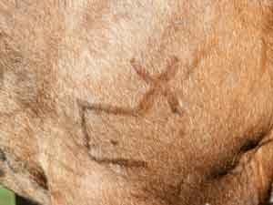
Hot Iron Branding
Use of a heated piece of metal to impart a permanent identifying mark.

Slide 44
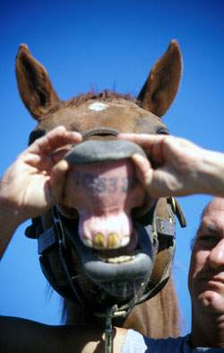
Lip Tattooing
The Jockey Club, responsible for all Thoroughbred registrations requires a horse to be tattooed on the upper lip with its permanent registration number prior to or upon its first start at a racetrack.

Slide 45
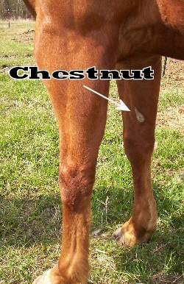
Chestnuts
Dark oval-shaped areas on the insides of the hocks and just above the knees.
Unique identifier similar to fingerprints in humans

Slide 46
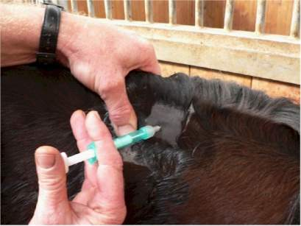
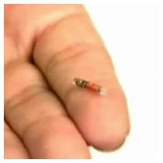
Micro-Chipping
Implantation of a computer microchip encoded with the individual’s registration number.

Slide 47
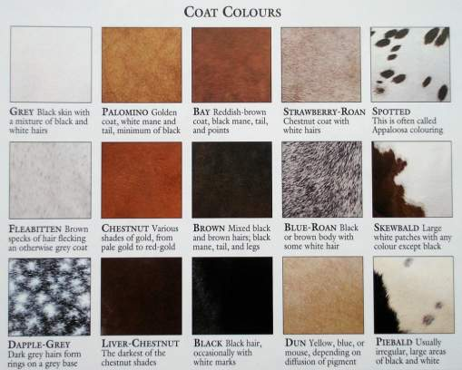
Color
Most common means of identification
Includes white color markings and other unique features such as hair whorls and scars
Some breeds are established based on color

Slide 48
Horse Color
Is the sum of body color and point color.
Points are the mane, tail, lower legs, and ear rims.
The lower leg is the most accurate indication of point color since mane and tail may fade.
Horse colors can be broken into two main categories: with black points and without black points

Slide 49
Colors Without Black Points

Slide 50
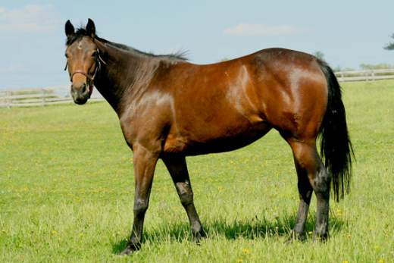
Brown
A black horse with tan highlights at the muzzle, flanks, underbelly, and girth areas.

Slide 51
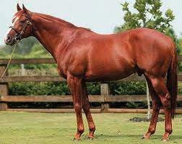
Chestnut/Sorrel
Body any shade of red ranging from very dark(liver chestnut) to bright red(red sorrel) to very light red(blond sorrel).

Slide 52
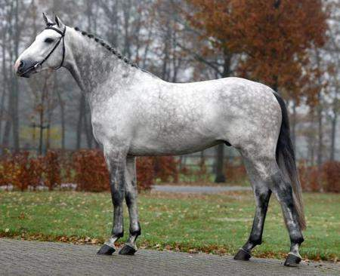
Gray
A horse with black skin but white or mixed dark and white hairs.
Can be born any color and lighten as they age
Most will eventually gray out to either a complete white or a "fleabitten" hair coat.

Slide 53




Patterns of Gray
“White-gray”: a completely white hair coat, but with underlying black skin
Flea Bitten: a white hair coat with small speckles or "freckles" of red-colored hair throughout
Steel gray: dark gray/silver coat
  An intermediate stage often seen in horses born black or dark bay
Dapple: dark rings with lighter hairs on the inside of the ring, scattered over the entire body

Slide 54
Color With Black points

Slide 55

Black
Black points and black body

Slide 56

Bay
bodies that are some shade of red from nearly yellow to nearly black
the red hair usually gives the coat a brilliance and sheen

Slide 57

Dun
Body color ranging from sandy yellow to reddish-brown
Primitive markings (dorsal stripe, shoulder stripes, zebra stripes on legs)
Usually darker faces

Slide 58



Roan
Roan: an even mixture of colored and white hairs on the body, while the head and "points” are more solid-colored.
Bay roan – bay base coat
Red/strawberry roan – chestnut/sorrel base coat
Blue roan – black base coat

Slide 59





Facial Markings
Bald Face: a very wide blaze, extending to or past the eyes
Strip: a narrow patch of white down the face from the forehead to the muzzle
Blaze: a wide patch of white down the face covering the full width of the nasal bones
Snip: a narrow patch on the muzzle, between the nostrils
Star: a white mark between or above the eyes

Slide 60

Leg Markings
Coronet: a white strip covering the coronet band
Pastern: white from the coronet to the pastern
Fetlock or ankle: white from the coronet to the fetlock
Sock or Half-Socking: white from the coronet to the middle to the cannon
Stocking: white from the coronet to the knee

Slide 61

Hoof Care
No hoof, No horse!
Hooves should be cleaned daily to remove muck and debris and to check for injuries
Hooves grow continually and should be trimmed every four to six weeks beginning at 3-4 months of age.
  This ensures the horse can distribute his weight evenly, move freely, and remain sound.

Slide 62

Facilities
Board or slick wire fence is preferred to barbed wire.
Barn should be clean, well ventilated and as indestructible as possible.
Pens should be sturdy and latches secure.

Slide 63

Safety Around horses
Be aware of the fight or flight response innate to the horse.
Avoid rapid movements and be aware of the horse’s movements
When moving around the horse, stay close enough to have one hand on it or out of kicking range.
Back to Objectives

Slide 64
Feeding & Nutrition

Slide 65

Amount of Feed
Equine usually consume 1-3% of their body weight per day
  Dependent upon age and activity level
At least 1% of this should be in the form of long-stem roughage
Any remaining nutrient requirements should be met with a balanced ration

Slide 66

Forages
Under natural conditions, horses spend most of the day grazing.
Good quality roughage will provide the majority of a horse’s nutrient requirements
It can also help prevent:
  Digestive problems such as colic
  Vices associated with boredom
  Calcium/phosphorus imbalances

Slide 67
Ca : P ratio
An imbalance of calcium and phosphorus can lead to severe skeletal abnormalities.
The ideal calcium to phosphorus ratio is the range of 1.2 :1 to 2:1.

Slide 68

Feeding Guidelines
Horses are designed to nibble.
The digestive health of a horse is enhanced with frequent small feedings
If the concentrate exceeds .5% of body weight in the ration, you should feed grain in 2 or more feedings.
Meals should be fed 10 -14 hours apart.

Slide 69

Water
Provide fresh, clean water at all times
A horse will typically consume 10 to 12 gallons of water a day.
Back to Objectives

Slide 70
Animal Behavior

Slide 71

Ingestive Behavior
Refers to horses’ eating and drinking habits
Forage or graze 5 -10 hours a day
  Primarily around dawn and sunset
Selective grazers – select the most tasty part of a the plant or hay and leave less desirable portions.

Slide 72

Eliminative Behavior
Some horses are not particular about where they defecate or urinate, while others have preferred elimination areas.
Horses will avoid soiled areas
  Mowing and dragging maximize pasture utilization and help kill parasites
  Rotating pastures will refresh these areas.

Slide 73

Investigative Behavior
An outgrowth of natural curiosity
To avoid injury, pastures and barn aisles should be kept free of objects and equipment.

Slide 74

Social Facilitation
Tendency of animals in a herd to do the same thing at the same time, such as walk to the watering trough.
Vigilance - horses are prey animals and thus are keenly alert to signs of danger.
  Because of this, at least one horse in the herd will often stand lookout.

Slide 75

Care-Giving behavior
Important because it creates social bonds
An example of care-giving behavior is a mare nickering for her foal to move closer to her for protection from perceived threats

Slide 76

Care-seeking behavior
A young foal nickering for its dam or separated horses calling for each other.

Slide 77

Sexual behavior
“Long-day breeders” - mares begin cycling during early spring, are most fertile during the summer and enter “reproductive quiescence” during colder months
Estrus – “heat” lasts three to seven days each 21-23 days during breeding seasons.
Signs that a mare is in heat include frequent urination and lifting her tail and “winking”(opening and closing) her vulva.

Slide 78

Agonistic Behavior
Behavior associated with conflict or fighting, including anger, aggression, submission, and flight from conflict.
Signs may include pinning ears, lunging, nipping, biting, wheeling, and kicking.

Slide 79

Contactual Behavior
Seeking of affection or protection through physical contact with other animals.
One example is when horses huddle together for added protection from the elements.
Back to Objectives

Slide 80
Animal Growth and development

Slide 81

Height
Measured in hands at the withers.
1 hand=4 inches

Slide 82

Determining Age by teeth
Teeth erupt continually and are worn down by grazing.
  Incisors show changes as the horse ages: a distinct wear and growth pattern and changes in the angle at which the chewing surfaces meet.
Becomes less precise in older horses
Notes:
More information and activities at http://peer.tamu.edu/VBB/ScienceTeacherResources.asp under dental health

Slide 83

Puberty and Gestation
Age at puberty:
  Stallions: average15 months (range 12-24)
  Mares: average 20 months (range 15-24)
  Breed, genetics and nutrition can affect this greatly
Length of Gestation: 336 days
Back to Objectives

Slide 84
Animal Health

Slide 85
Diseases

Slide 86

Encephalomyelitis
Common name: “sleeping sickness”
System affected: nervous
Pathogen type: viral
Type of Horse: all ages, all types
Vaccine: EEE, WEE, VEE
Symptoms: high fever, hypersensitivity, paralysis

Slide 87

Influenza
Common name: “flu”
System Affected: respiratory
Pathogen type: viral
Type of horse: young and stressed
Vaccine: influenza
Symptoms: high fever, cough, loss of appetite

Slide 88

Rhinopneumonitis
Common name: “rhino” or “herpes”
Pathogen type: viral
System affected: respiratory and reproductive
Type of Horse: mares late gestation; young foals
Vaccine: EHV-1and EHV-4
Symptoms: Mares-abort; foals- fever, lethargy, cough, nasal discharge

Slide 89


Strangles
Common name: “equine distemper” or “shipping fever”
System Affected: respiratory
Pathogen Type: bacterial
Type of Horse: young foals
Vaccine: none
Symptoms: thick nasal discharge, swollen lymph nodes in jaw area, fever, depressed appetite

Slide 90
Parasites

Slide 91

Ascarids
Area Affected: intestines, lungs, liver
Type of Horse: young foals especially
Consequences: abdominal pain; digestive problems

Slide 92


Bots
Area Affected: gastrointestinal tract
Type of Horse: all ages & types
Consequences: stomach problems in large numbers
Bot eggs

Slide 93

Strongyles
Area Affected: gastrointestinal tract
Type of Horse: all ages and types
Consequences: SERIOUS!! Multiple digestive and systemic problems
Back to Objectives

Slide 94
Selection of Horse

Slide 95

Value Determining Characteristics
Temperament: the overall attitude of the horse.
Soundness- The level of freedom from any abnormal deviation in structure or function that interferes with the usefulness of the individual.
Conformation- Structure, form, and symmetrical arrangement of parts as applied to a horse.

Slide 96

Value Determining Characteristics
Level of training- a higher level of training equates to a higher price
Breed- the preference of the person purchasing the horse, dependent upon the style of riding to be pursued
Age- prime years generally fall between 5 and 15, depending on the event the horse is used for

Slide 97

Value Determining Characteristics
Gender – breeding prospects may be of higher value
Pedigree- the ancestry of an animal. Fewer generations between your animal and a champion = higher value.
Quality- overall refinement, smoothness and style
Size- literal size or how well the horse fits the breed standard

Slide 98

Muscle evaluation
Point of Shoulder
Chest
Forearm
Gaskin
Stifle
Hip
Loin
Back to Objectives

Slide 99
References
http://extension.missouri.edu/p/G2807
http://www.ag.ndsu.edu/pubs/ansci/horse/as953w.htm
http://www.equisearch.com/horses_care/health/behavior/categories_equine_behavior_022309/2/

