Slide 1
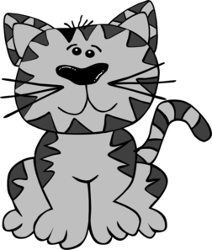
Feline breeds
purrrr!

Slide 2
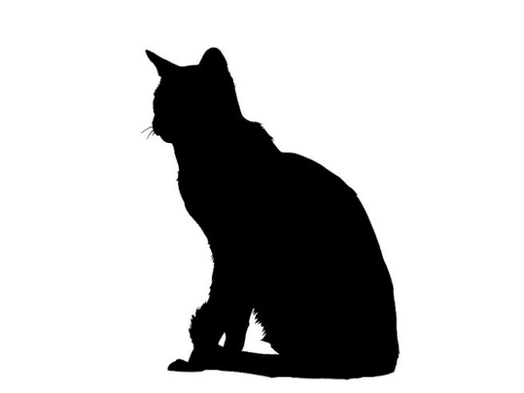
Shorthair Breeds

Slide 3
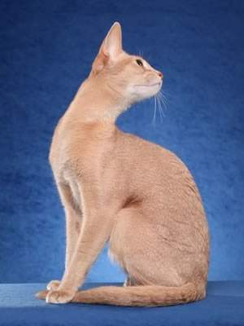
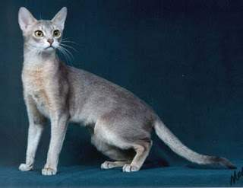
Abyssinian
Short Haired
Medium Sized
Ticked coats
Common colors: Ruddy, Red, Blue and Cream

Slide 4
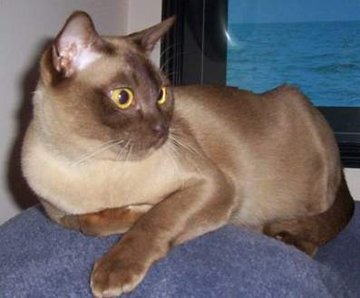
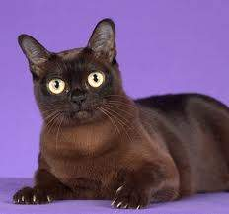
Burmese
Shorthair
Round head and eyes
Many colors are recognized, but the most common ones are:
sable
champagne
blue
platinum

Slide 5
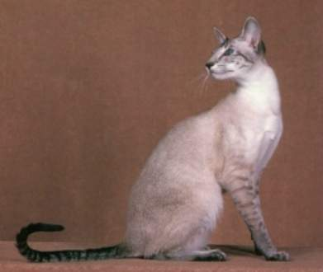
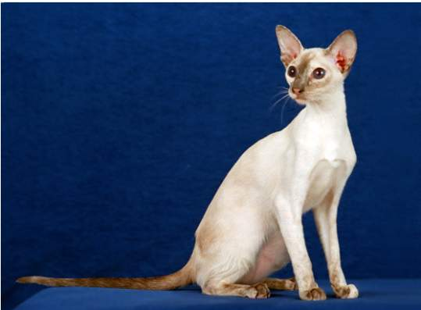
ColorPoint Shorthair
Shorthair
Crossed with Siamese to reach new point colors
Head and body identical to Siamese
Appear in red point, cream point, lynx point and tortie point

Slide 6
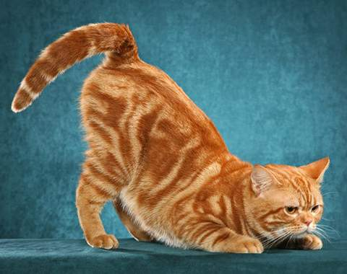
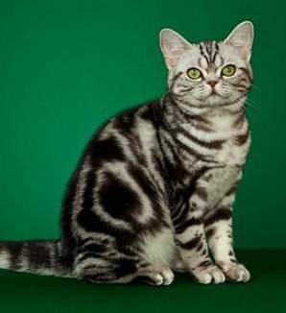
Domestic Shorthair
Shorthair
Not purebred cats; are of mixed ancestry
Can produce kittens of the same features (coat, size and temperament) while a random-bred cat cannot
Many colors and patterns

Slide 7
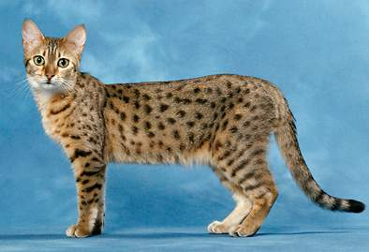
Egyptian Mau
Shorthair
Active, athletic cats
Spotted tabby pattern resembles a wild cat
Fastest domestic breed of cat
Come in colors such as bronze, silver, and black smoke

Slide 8
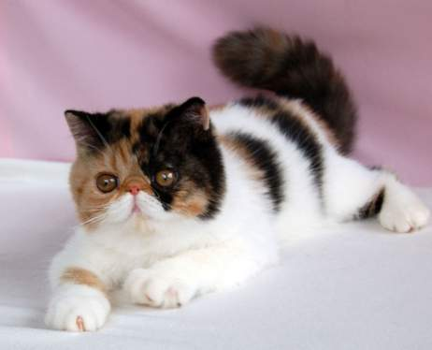
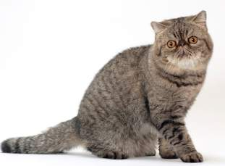
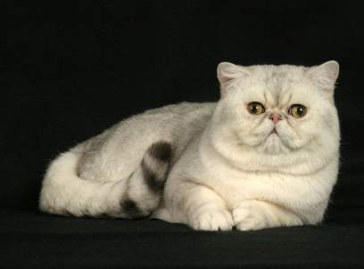
Exotic Shorthair
Shorthair
Cross between Persians and various other shorthaired breeds
Found in the same wide variety of colors and patterns as the Persians

Slide 9
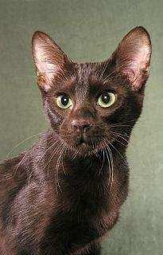
Havana Brown
Shorthair
Very rare breed
Large forward-tilted ears
Oval, green eyes
Most are a chocolate brown color

Slide 10
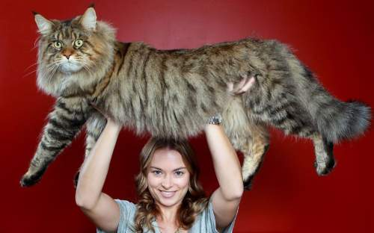
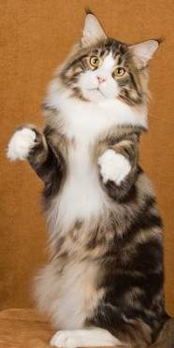
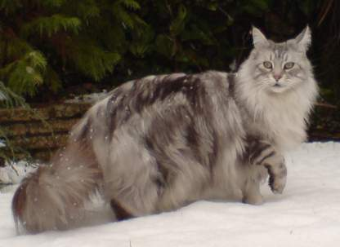
Maine Coon
Longhair
Large bodied breed
Ears are well tufted inside
Large, well tufted paws for walking on snow
Tail is as long as torso
Wide range of colors and patterns

Slide 11
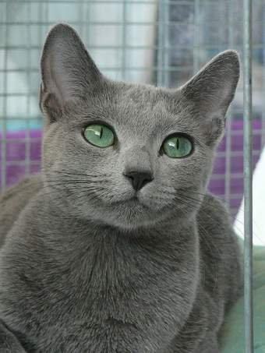
Russian Blue
Shorthair
Long legs and body
Brilliant green eyes
Silvery blue coat

Slide 12
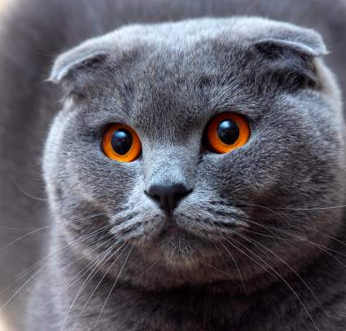
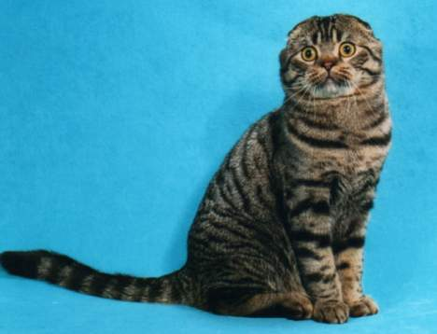
Scottish Fold
Shorthair
Ears ‘fold’ forward
Large round eyes
Round face and body
Any color or pattern

Slide 13
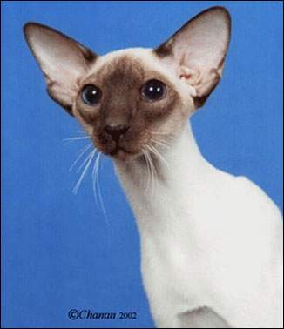
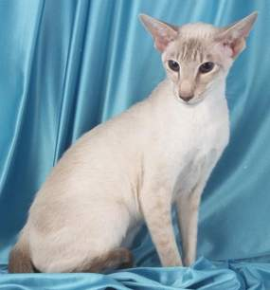
Siamese
One of the oldest breeds of cats
Distinctive facial shape
Blue eyes
Colored points and light colored body

Slide 14
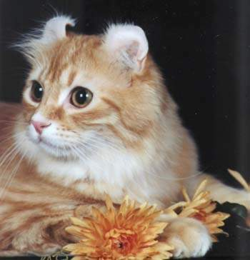
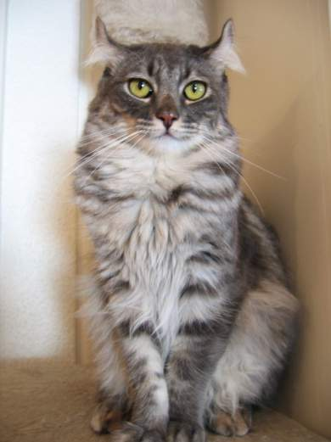
American Curl
Long or Short hair
Medium sized
Ears ‘curl’ backwards
Any color or pattern
Notes:
http://www.cfa.org/Breeds/BreedsAB/AmericanCurl.aspx

Slide 15
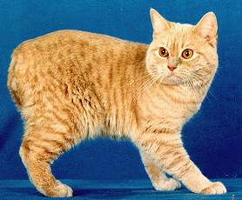
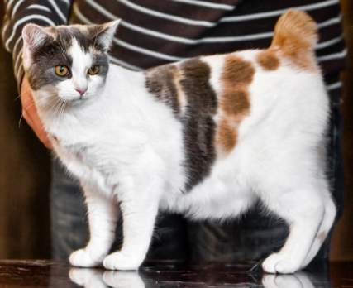
Manx
Longhair or Shorthair
Stocky body
Lack of a long tail; may be completely tailless or have a small, stumpy tail
All colors and patterns exist in both coat lengths

Slide 16
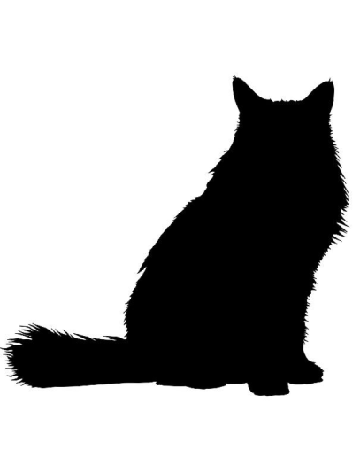
Longhair Breeds

Slide 17
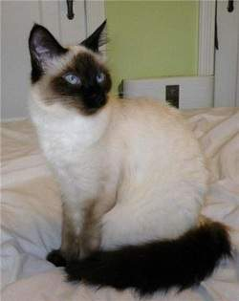
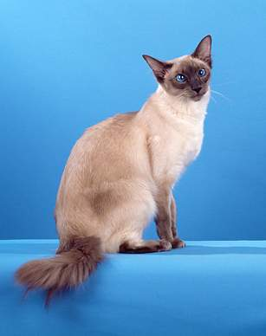
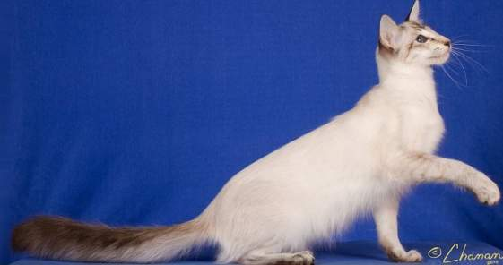
Balinese
Longhair
Siamese descent
Blue eyes
Solid point colors: seal, blue, lilac, chocolate, lynx, red, cream, tortoise

Slide 18
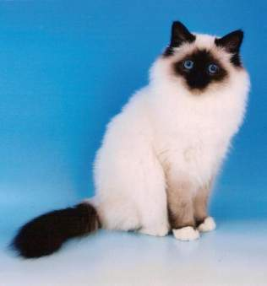
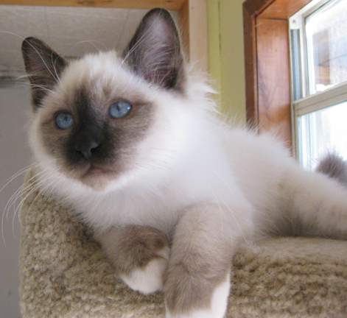
Birman
Longhair
Pointed with white paws
Blue Eyes
Body should be eggshell or golden in color

Slide 19
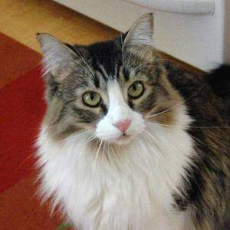
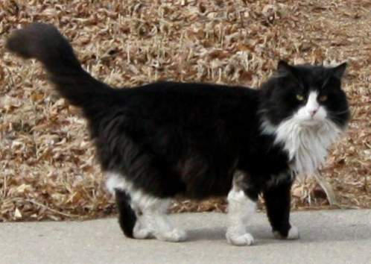
Domestic Longhair
Longhair
Heavier body and dense overcoat
Needs daily grooming and house cleaning
Any colors or patterns

Slide 20
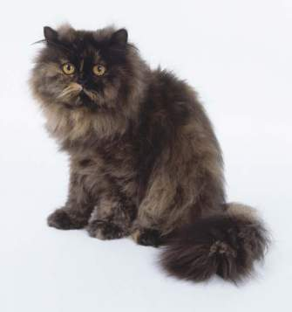
Persian
Exotic bodytype
Smaller ears
Large round face
Very long, fluffy hair
Any color or pattern

Slide 21
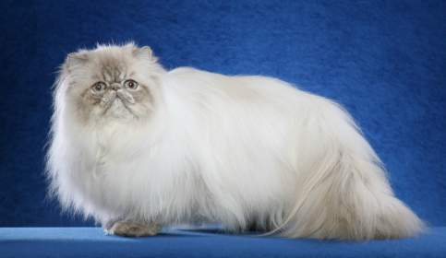
Persian Himalayan
Identical to the Persian, with the exception of:
blue eyes and point coloration:
Fur of body is white/cream
points come in many different colors such as seal, blue, lilac, cream chocolate or red

Slide 22
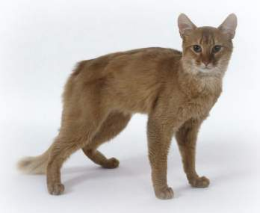
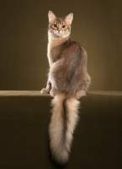
Somali
Longhaired Abyssinian
Bushy tail
Common Colors:
blue, fawn, red, ruddy

Slide 23
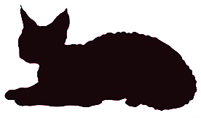
Curly Coat Breeds

Slide 24
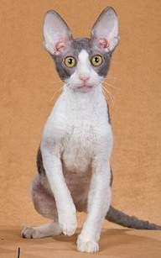
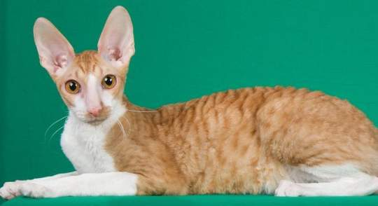
Cornish Rex
Shorthair
Soft, wavy, curly hair
“Rex” refers to the curled, crimped or rippled hair
Bat-like ears
Round eyes
Many colors and patterns

Slide 25
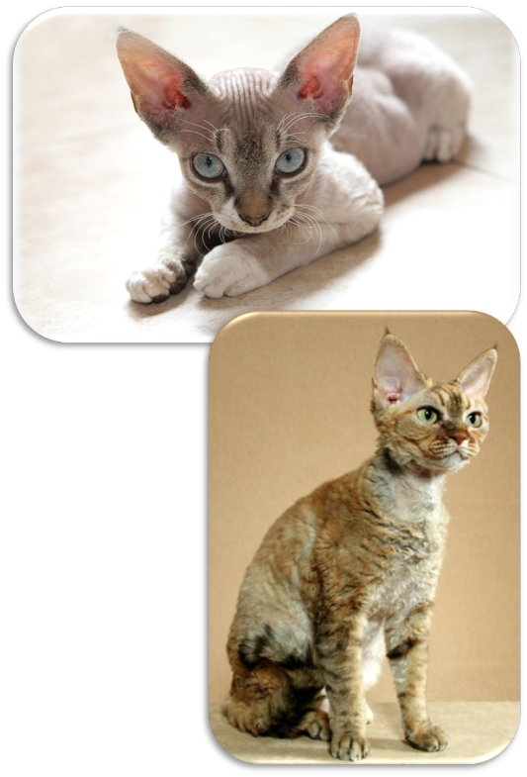
Devon Rex
Shorthair
Large pointed ears
Breed made because of a natural genetic mutation
Face has an “elfin” look
Wide variety of patterns and colors

Slide 26
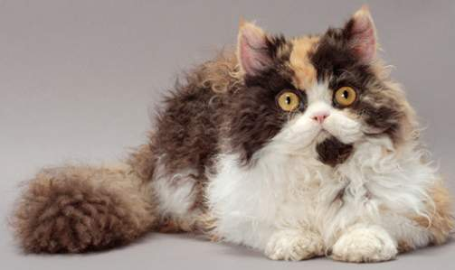
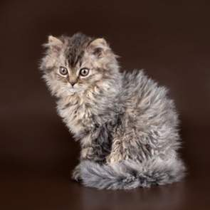
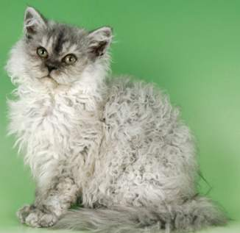
Selkirk Rex
Longhair, Curly coat
Round, stocky body
Curling is strongest on flanks, tummy and neck
The back has the least amount of curling
Wide variety of colors and patterns

