Slide 1
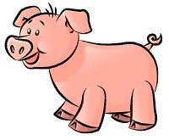
Fetal Pig Dissection

Slide 2
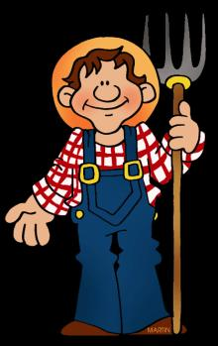
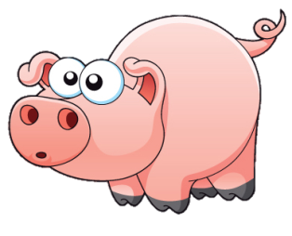
What do you think humans have in common with the pig?
https://ferrebeekeeper.files.wordpress.com/2014/03/farmer-clip-art-4.gif
http://www.clipartpanda.com/categories/pig-in-mud-cartoon

Slide 3
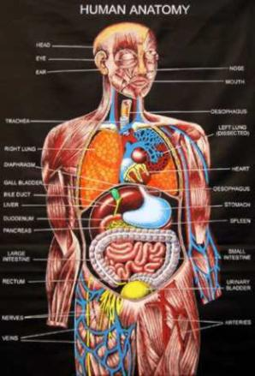
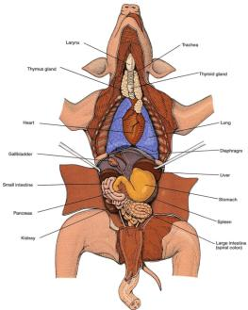
Humans and Pigs may be closer than you think!
Both are mammals
We share common body systems
The anatomy of the pig is close to that of humans
The fetal pigs will tell us more about our own bodies and give us a way to explore!
http://www.fanpop.com/clubs/human-anatomy/images/10358267/title/human-anatomy-photo
http://www.biologycorner.com/pig/fetal_pig02.jpg

Slide 4
SAFETY FIRST!
NEVER point sharp objects at yourself or others
Always cut/make incisions away form yourself and others
No horseplay in the lab
Properly mount specimens to the dissection pan
Wash hand at the end of each class period
Don’t remove any specimens from the classroom
Properly dispose of any materials
Clean up area

Slide 5
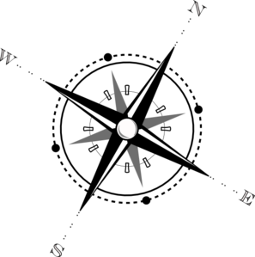
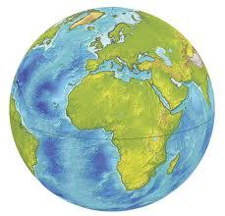
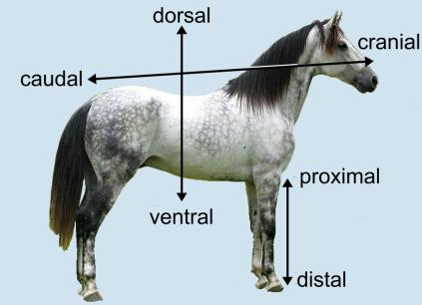
Descriptive words are used to describe “where” on an animal.
Like using North, South, East, or West for locations on a map.
Anatomical Descriptive Terms

Slide 6
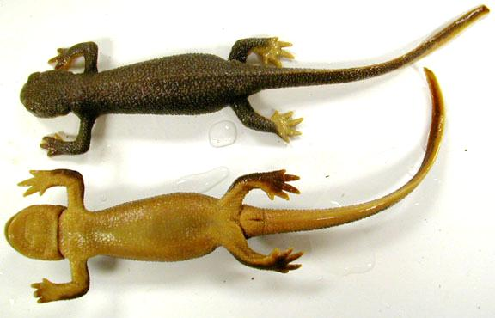
Dorsal/Ventral:
Dorsal -- toward the back
Ventral -- toward the front/belly
Separated by the frontal plane
Dolphin’s Dorsal fin
Dorsal
Ventral
V
entral

Slide 7
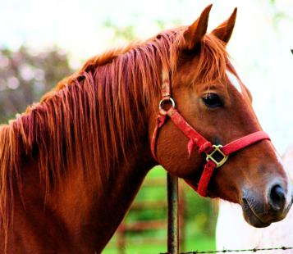
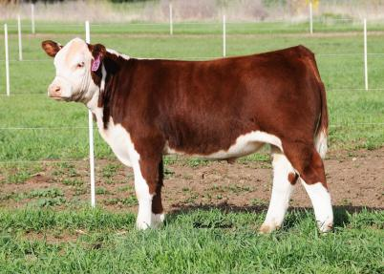
Cranial/Rostral/Caudal:
Cranial -- toward the head
Rostral -- toward the nose/beak
Caudal -- toward the tail
Separated by the transverse plane
Rostral
Cranial
Caudal
Cranial
Rostral

Slide 8
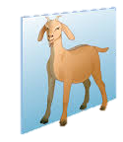
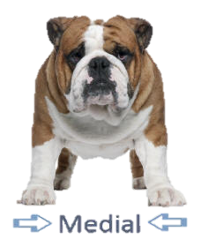
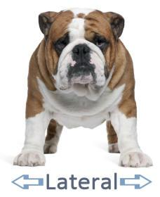
Medial/Lateral:
Medial – directed toward the midline (sagittal plane)
Lateral -- directed away from the midline (sagittal plane)
Sagittal Plane

Slide 9
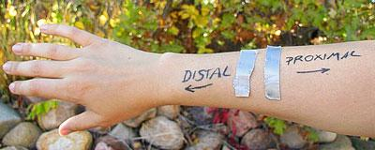
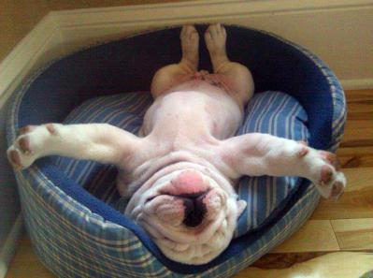
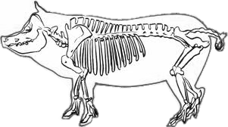
Proximal/Distal:
Proximal -- located close to the sagittal line of the body.
Distal -- located away from the sagittal line of the body
Proximal
Distal

Slide 10
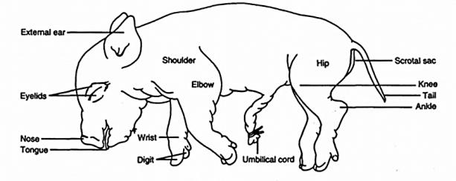
External Anatomy
Skin
Nose
Tongue
Eyelids
External Ear
Digits
Umbilical Cord
2 umbilical arteries
Umbilical vein
Teats
Anus
Identify the Sex
Male – Scrotal Sac (ventral to anus) and Urogenital Opening
Female – Urogenital opening (ventral to anus) and genital papilla

Slide 11
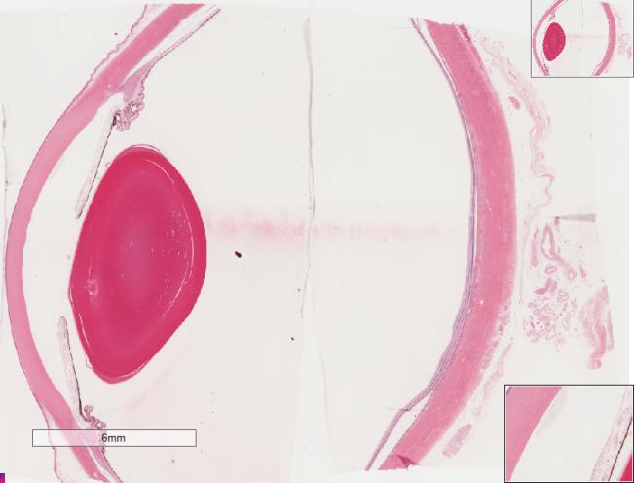
DEMO SLIDE BOX 23 Commercial slide. Eye, monkey
Alternative human eye
posterior
chamber
anterior
chamber
Sclera
vitreous
space
lens
Sclera
Cornea
iris

Slide 12
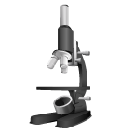
Let’s take a Closer Look!
Skin
Skin
Umbilical cord
Tongue
Fetal and Placental membranes
Eye
Fingertip

Slide 13
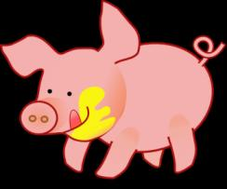
Digestive Tract (Gastrointestinal Tract)
Goal: To get nutrients into the body via the breakdown of food into smaller molecules and to excrete waste
Mouth
Teeth
Tongue
Parotid Gland
Sublingual Gland
Mandibular Gland
Epiglottis
Upper GI
Esophagus
Liver
Stomach
Gallbladder
Pancreas
Spleen
Lower GI
Small intestine
Larger Intestine
Rectum
Anus
http://www.clker.com/clipart-15593.html

Slide 14
Mouth
Teeth: Helps aid in chewing of good
Tongue: Muscle covered in mucous membranes with areas used for tasting. Papillae are the small bumps on the tongue (taste buds)
Epiglottis: Flexible flap at the larynx. Acts as a switch to allow air into the larynx and food into the esophagus.
http://www.biologycorner.com/pig/fetalpig_mouth2.jpg

Slide 15
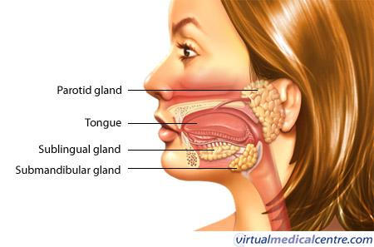
Glands of the Mouth
Parotid Gland : Largest of the salivary glands located anterior and inferior to the ear.
Sublingual Gland: One of the salivary glands; located under the floor of the mouth. Mandibular Gland: One of the salivary glands inferior to the mandible.

Slide 16
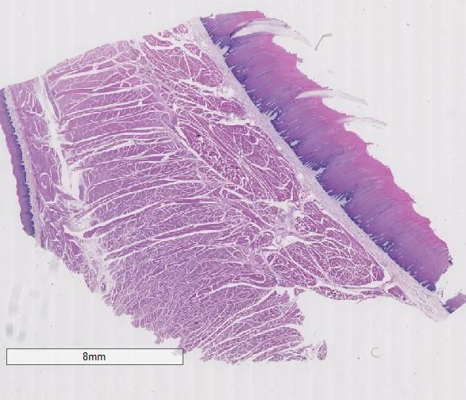
Slide #22 (BV3-113a1) – Tongue, bovine.
Top of tongue
skeletal
muscle
Bottom
epithelium

Slide 17
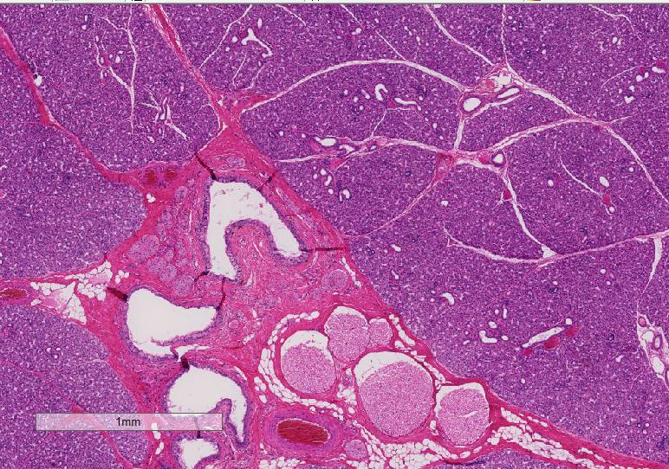
Demo Slide #186 (SP-1-108). Parotid salivary gland, sheep
striated duct
interlobular
duct
Nerve
bundles
epithelium

Slide 18
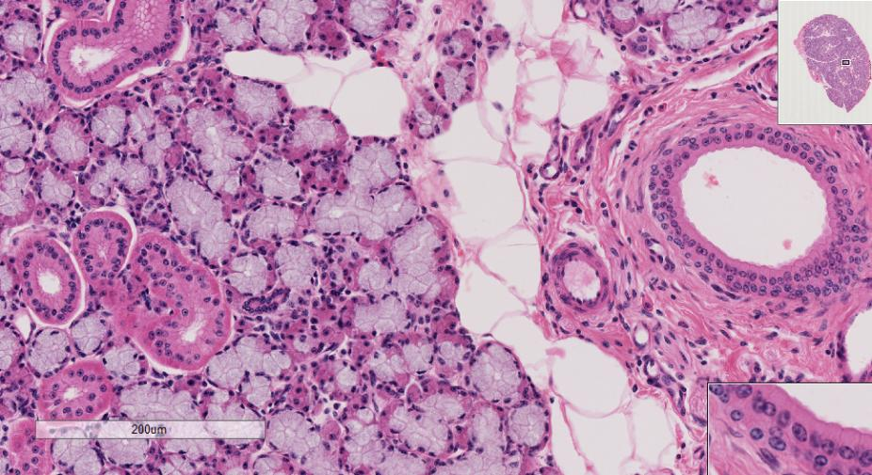
DEMO SLIDE BOX 183 (BV-1-85A)- Mandibular salivary gland, cow.
White fat
Striated duct

Slide 19
Upper GI Lower GI
Esophagus: Long thin muscular tube, connects pharynx to the stomach. Moves bolus (wad of food) via peristaltic contractions. Posterior to the trachea
Liver: functions in digestion, metabolism, and storage of nutrients. Bile is produced which helps emulsify fats
Stomach: Food storage and digestion
Gallbladder: Holds bile until needed to digest fatty acids
Pancreas: Excretes enzymes to break down proteins, lipids, and carbohydrates. Also produces insulin
Spleen: Brown, flat, oval organ that filters and stores blood
Small intestine: Absorbs 90% of the nutrients from the food we eat. Very long, but SMALL in diameter
Duodenum: receives chyme (Partially digested food) from stomach. Enzymes form the pancreas, liver, and gallbladder mix here for chemical digestion
Jejunum: middle section
Ileum: where remaining nutrients are absorbed
Large intestine: Absorbs water and vitamins while converting digested food into feces. Short but LARGE in diameter
Rectum: Where feces wait to be expelled
Anus: Feces is expelled

Slide 20
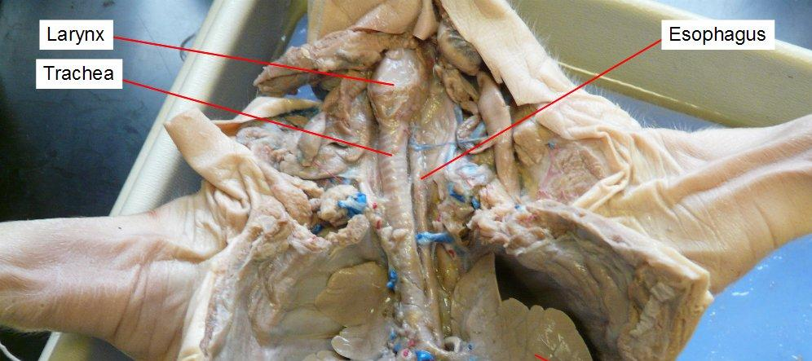
GI TRACT
Larynx
Trachea

Slide 21
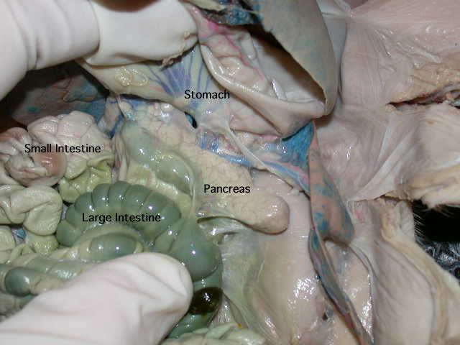
http://www.anselm.edu/homepage/jpitocch/genbios/fetalpig.html

Slide 22
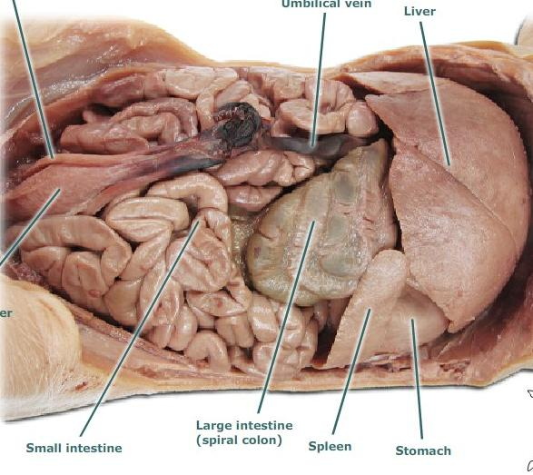
https://animalplanet.wikispaces.com/Snyder-Crago+Mouth+Anatomy

Slide 23
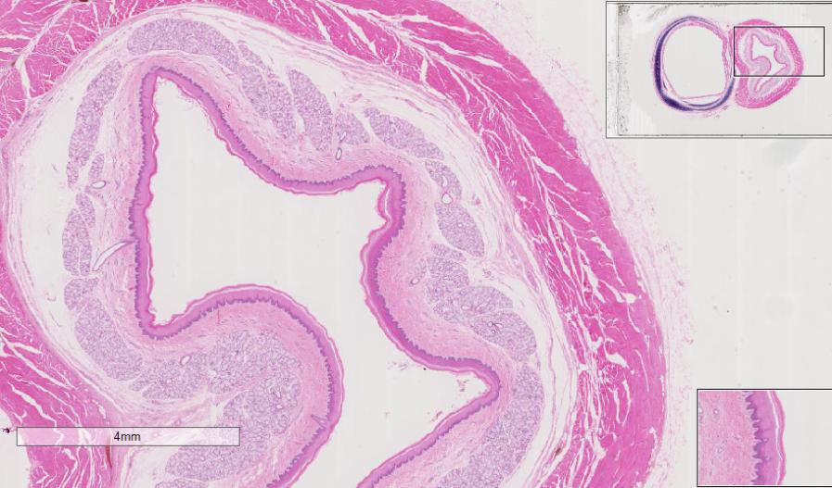
Slide #71 (Pf5-73/205). Esophagus and trachea, pig.
stratified squamous
epithelium
mucous membrane

Slide 24
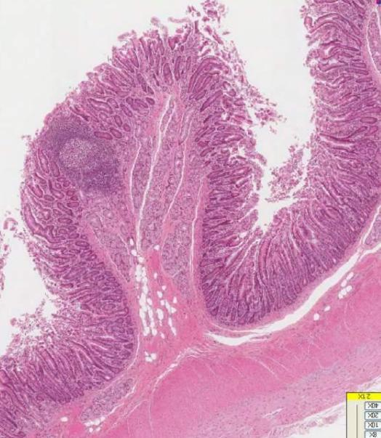
Duodenum
152
Villi
Smooth Muscle
Fat Cells

Slide 25
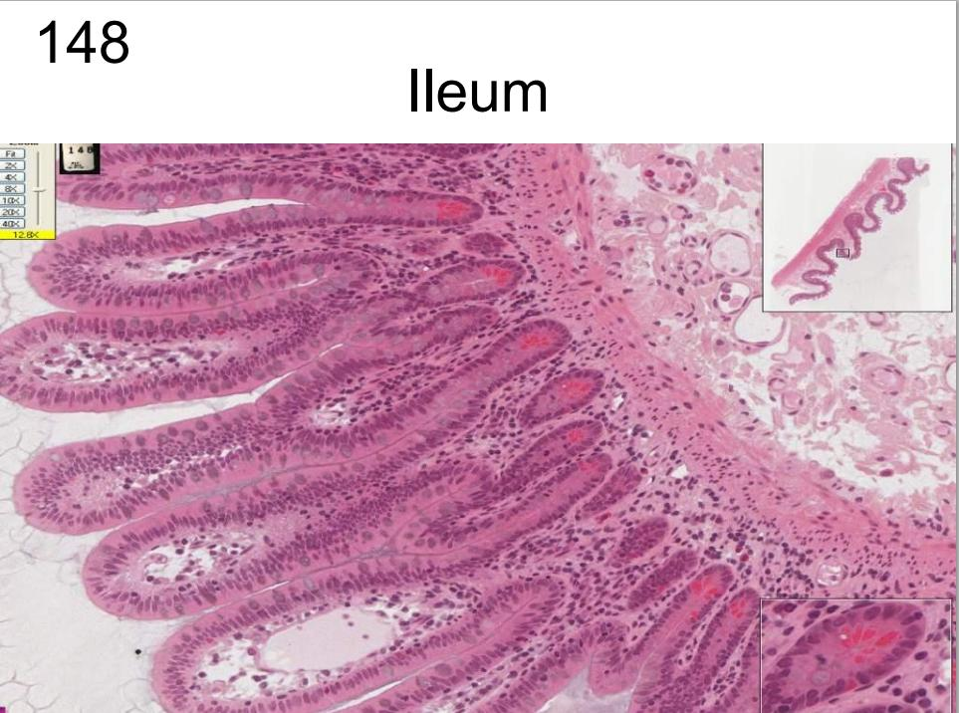
148

Slide 26
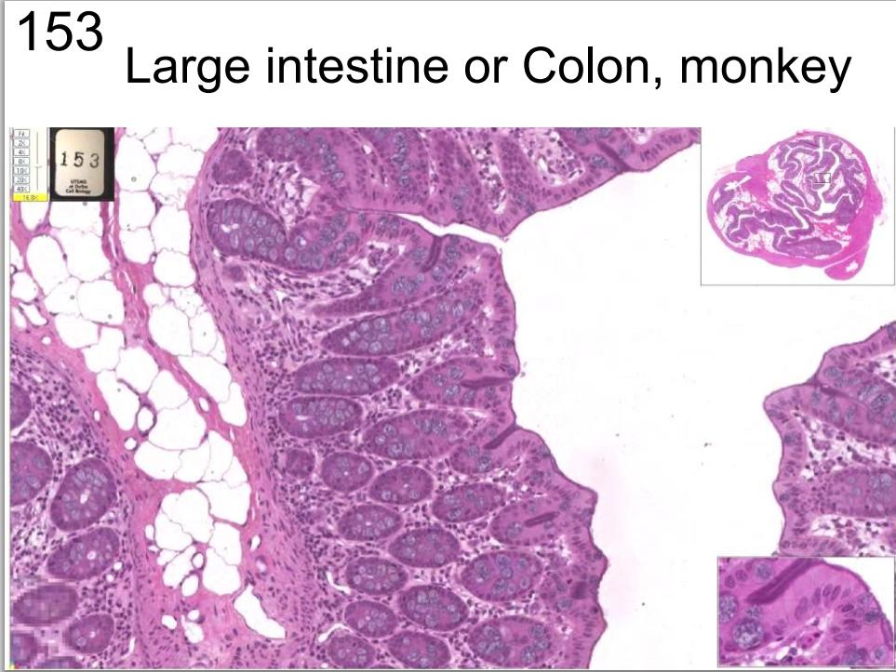
153

Slide 27
Let’s take a Closer Look!
Submandibular gland
Esophagus
Spleen
Liver and Spleen
Bile Duct and portal vein
Gallbladder
Pancreas
Ileum
Duodenum
Liver

Slide 28
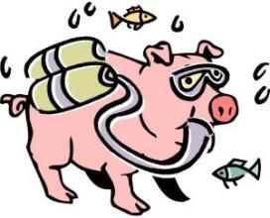
Respiratory Tract
Goal: To remove carbon dioxide from the blood and replace it with oxygen
Works in conjunction with the circulatory system
Organs:
Upper Tract
Nose with nares
Pharynx
Larynx
Lower Tract
Trachea
Lungs which contain the bronchi, bronchioles, and alveoli
Diaphragm

Slide 29
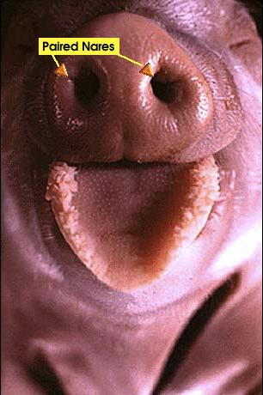
Nose
Air enters the respiratory system through the paired nares or nostrils
Two nasal passages: separated by bone
Used for smell
Hair and mucous membranes clean out particles
Carbon dioxide is expired through the nares
http://www.whitman.edu/academics/courses-of-study/biology/virtual-pig/respiratory-system

Slide 30
Pharynx and Epiglottis
Nasopharynx
Above the soft palate
Leads from the nose to the trachea for breathing
Laryngopharynx
Upper border of the glottis
Helps guide food and air
Epiglottis
Small flap of cartilage
Lies above the pharynx
Allows for air to flow into larynx and trachea
Directs food into the esophagus

Slide 31
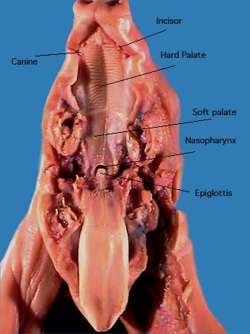
laryngopharynx
http://www.anselm.edu/homepage/jpitocch/genbios/fetalpig.html

Slide 32
Larynx
Large hard structure attached to the trachea
Contains the vocal cords
As air passes through the vocal cords vibrate and produce sound
http://faculty.clintoncc.suny.edu/faculty/michael.gregory/files/bio%20102/bio%20102%20laboratory/fetal%20pig/Mouth_and_neck_region_4.jpg

Slide 33
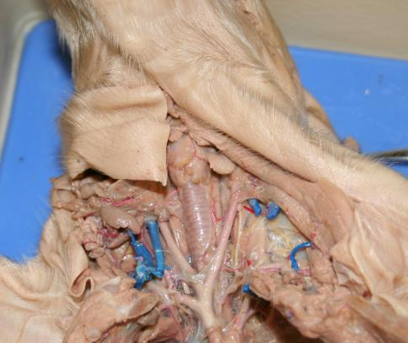
Trachea
Windpipe
Connects larynx to lungs
Contains cartilage rings that prevent trachea from collapsing
Extends into the thoracic cavity
Branches into bronchi
Allows air into the lungs
Anterior to the esophagus
https://www.google.com/search?q=trachea+fetal+pig&espv=2&biw=972&bih=854&source=lnms&tbm=isch&sa=X&ei=qAQ4VKTyO4_o8AHl4oC4Ag&ved=0CAYQ_AUoAQ#facrc=_&imgdii=ZJMqXEEmRUJLqM%3A%3BLYjzE16FarDrrM%3BZJMqXEEmRUJLqM%3A&imgrc=ZJMqXEEmRUJLqM%253A%3BREGnqwdLFxjyuM%3Bhttp%253A%252F%252Fclassconnection.s3.amazonaws.com%252F244%252Fflashcards%252F2198244%252Fjpg%252Fpulmonary_trunk1352727288605.jpg%3Bhttp%253A%252F%252Fwww.studyblue.com%252Fnotes%252Fnote%252Fn%252Fpig-functions%252Fdeck%252F4427531%3B1058%3B794

Slide 34
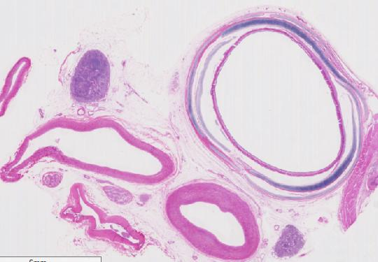
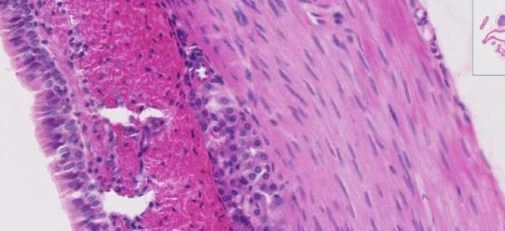
DEMO SLIDE BOX 81 – Trachea and elastic artery, pig.
“C” shaped rings of hyaline cartilage,
Lymph node
elastic
artery
nerve
companion vein
muscle
Plasma cells

Slide 35
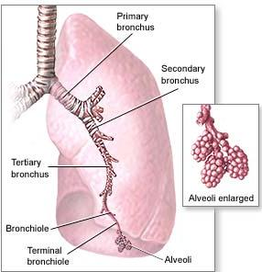
Lungs
Branching of the trachea to bronchi to lungs
Located on either side of the heart
The bronchi divide into bronchioles
Bronchioles branch into alveolar sacs
Alveolar sacs are bunches of alveoli
Alveoli hold air and tightly bound in
blood vessels; allows for gas exchange

Slide 36
Lungs continued
Sectioned into lobes
Right lung is larger (4 lobes)
cranial, medial, caudal, and accessory lobes
Left lung is smaller because of space taken up by the heart (2 lobes)
apical and caudal lobe

Slide 37
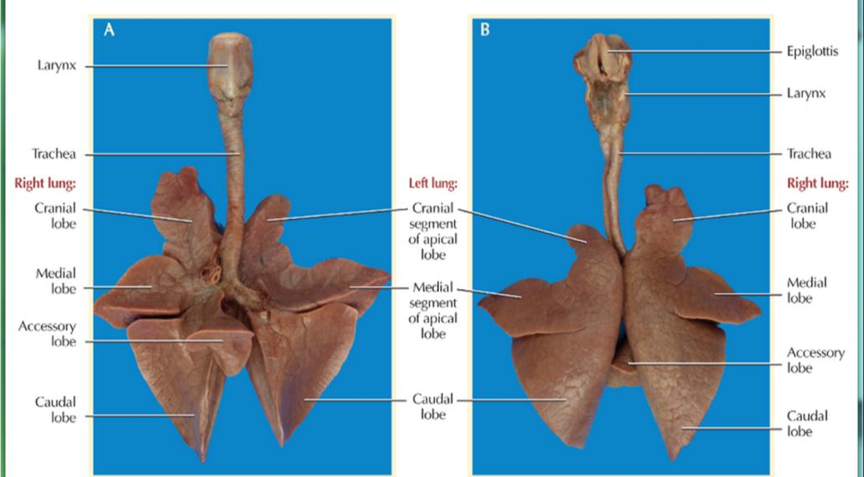
https://www.inkling.com/read/dissection-guide-atlas-fetal-pig-smith-schenk-3rd/chapter-6/the-thoracic-cavity

Slide 38
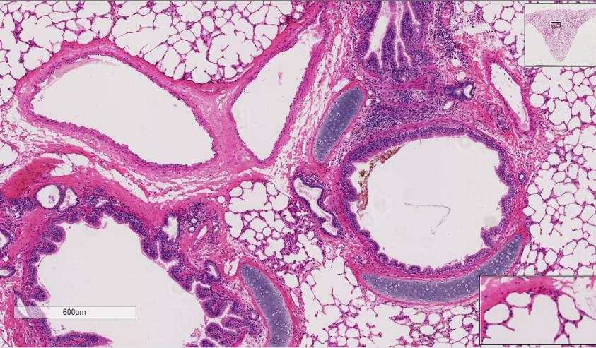
Slide #72(SP-1-81). Lung, sheep.
smaller intrapulmonary bronchi.
plates of hyaline cartilage.
artery
vein
glands
alveolar sacs

Slide 39
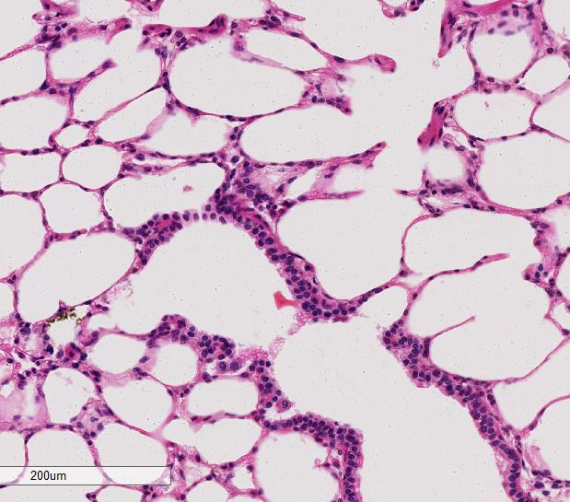
Slide #72(SP-1-81). Lung, sheep.
alveolar duct
alveolar
sacs
respiratory
bronchiole
terminal
bronchiole

Slide 40
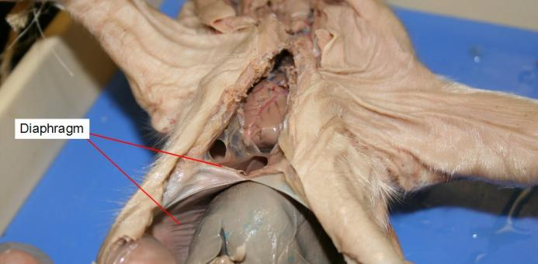
Diaphragm
Below the lungs
Thin muscular sheet of tissue
Only in mammals
Expands to allow air in (diaphragm contracts)
Compresses to expel air (diaphragm relaxes)
Separates the chest and abdominal cavities
http://faculty.clintoncc.suny.edu/faculty/michael.gregory/files/bio%20102/bio%20102%20laboratory/fetal%20pig/Respiratory_system_5.jpg

Slide 41
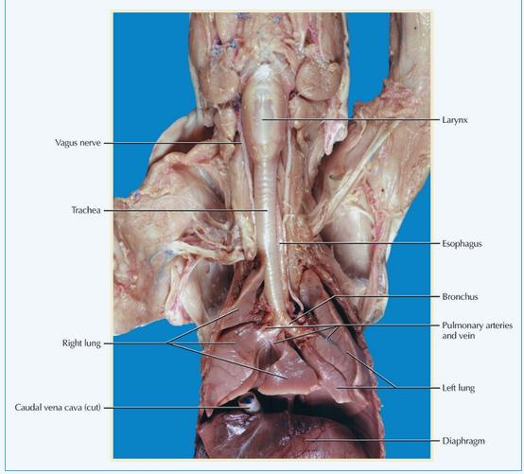
https://www.inkling.com/read/dissection-guide-atlas-fetal-pig-smith-schenk-3rd/chapter-6/the-thoracic-cavity

Slide 42
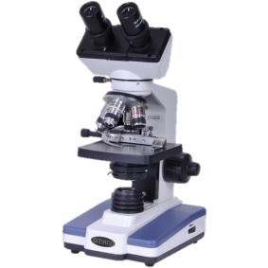
Let’s take a Closer Look!
Cross section of the Trachea
Nasal Tract
Lungs
Esophagus and Trachea
Larynx
Lung
Larynx, Esophagus, and Glands

Slide 43
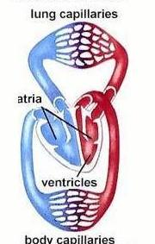
Circulatory System
Allows blood, nutrients, oxygen and other gases, and hormones to flow throughout the body
Mammals (including humans)
Double loop system
4 chambered heart
Organs
Heart
Lungs
Arteries
Veins
http://www.ideacenter.org/contentmgr/showdetails.php/id/1113

Slide 44
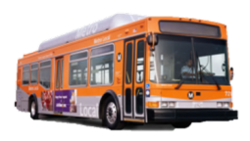
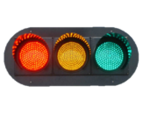
Think of it like a highway
Blood: Transports cells just like a
bus transports people
Heart: Controls the flow of blood like a traffic control light
Blood Vessels: lead the flow of blood through the body like roads lead

Slide 45
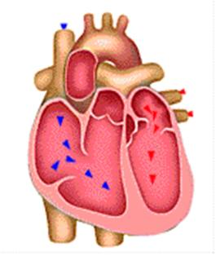
Heart
Muscle used to pump blood
4 chambers in mammals
Right Atria
Right Ventricle
Left Atria
Left Ventricle
Atria pump blood to ventricles
Ventricles pump blood out of heart and into circulatory system
Valves prevent backflow of blood

Slide 46
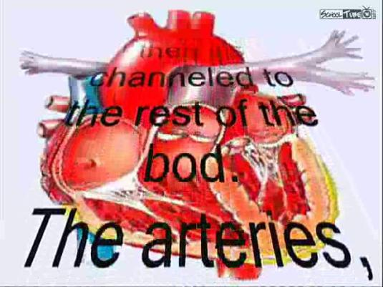
It’s more fun to sing
Notes:
https://www.youtube.com/watch?v=D8LK34hoVpU

Slide 47
226

Slide 48
Heart with Valve

Slide 49
**REMEMBER IT IS ALWAYS THE LEFT
AND RIGHT OF THE PIG**
https://district.bluegrass.kctcs.edu/shirley.whitescarver/BIO139Lab/BIO139/139Lab2/Lab2PigHeartLables.html

Slide 50
Path of the Blood
Oxygenated blood from the lungs enters from the pulmonary veins into the left atria, pumped through the mitral valve, and into the left ventricle.
Then it is pumped through the aortic valve where it leaves through the Aorta to the be taken to the rest of the body
Once circulated around the body the deoxygenated blood enters through the Superior Vena Cava from the top of body and Inferior Vena Cava from the bottom of body all into the right atria.
It is then pumped through the tricuspid valve into the right ventricle
Pumped through the pulmonary valve into the pulmonary artery to the lungs to be oxygenated.
Once oxygenated it will return through the pulmonary artery.

Slide 51
Lungs
Provide oxygen to the blood and remove carbon dioxide from the blood
Exchange of gases takes place in the alveolar sacs
http://en.wikipedia.org/wiki/Pulmonary_circulation

Slide 52
Blood
Liquid that circulates in the blood vessels, transporting oxygen, carbon dioxide, waste, and hormones around the body.
Blood contains
(leukocytes)- fight against infections
Red blood cells (erythrocytes) – transport oxygen
Platelets (thrombocytes)- assist in clotting
Plasma- liquid that suspends proteins and the solid components of blood
White Blood Cells

Slide 53
Blood Vessels
Veins- carry blood to the heart
Arteries- carry blood away from the heart
Capillaries – small pathway that connects arteries to veins
Only one blood cell wide
https://www.studyblue.com/notes/note/n/emt-basic/deck/5473108

Slide 54
Slide #16 (Pmi 7A). Blood vessels, pig
endothelium (which is simple squamous epithelium
media

Slide 55
Blood Cells Labeled

Slide 56
Let’s Take a Closer Look
Peripheral Blood Smear
Red Bone Marrow Smear
Heart, Epicardium
Heart, Endocardium
Blood 1
Blood 2
Blood 3
Bone Marrow
Heart with Valve
Heart Muscle
Heart
http://www.microscope-microscope.org/basic/microscope-images/138-microscopes-lg.jpg

Slide 57
Reproductive System
Expands the population of a certain species
Male and
female reproductive
tracts are different
Males-produce
testosterone and sperm
Females- produce
oocytes

Slide 58
Male Repro Tract
Testes – produce sperm
Penis - deposits semen into female reproductive tract. Expels urine from the body.
Cremaster muscle –pulls the testes
closer to the body to keep
warm
Scrotum -
houses the testes
Bulbourethral Gland -
gives off seminal
fluid to urethra

Slide 59
Spermatic cord - contains Vas deferens, spermatic artery and vein, lymphatic vessels, and leads to the epididymis
Epididymis- stores sperm
Seminiferous tubules – sperm produced
Vas deferens- transports sperm to urethra
Urethra – receives seminal secretions form the testes. Drains excretory products from the bladder
Prostate- secretes fluid that carries sperm

Slide 61
Female Repro Tract
Ovaries- Produces oocytes (eggs)
Oviduct- receives mature oocytes at ovulation; site of fertilization
Uterine Horns- Site of implantation and embryonic development
Vagina- receives penis during copulation; serves as part of birth canal
Urogenital Sinus- chamber in which the vagina and urethra meet

Slide 63
DEMO SLIDE BOX #208 – Cervix, sow.
complex folds of the luminal surface of the cervix.

Slide 64
Slide #183 (PG-1-84). Mammary gland, sow.
lactiferous duct
ducts

Slide 65
Let’s Take a Closer Look
Ovary 1
Ovary 2
Ovary 3
Uterus
Vagina
Testis
Seminal Vesicle
Prostate
Testis 2
http://nerdbranding.com/product/microscope/

Slide 66
Urinary System
Eliminates wastes from the body, regulates blood volume and pressure, controls levels of electrolytes and metabolites, and regulates blood pH
Organs
Adrenal Glands
Kidneys
Ureter
Bladder
Urethra
Adrenal
Gland
Kidney
Ureter
Bladder
Urethra
http://memorize.com/urinary-system-pig-2/h4nsyh4ns

Slide 67
Adrenal Glands
Sit on top of the kidneys
2 total
2 Parts
Adrenal Cortex- outer part that produces hormones vital to life, such as cortisol (metabolism) and aldosterone (blood pressure)
Adrenal Medulla- inner part that produces nonessential hormones, such as adrenaline (stress)
http://http://blog.lib.umn.edu/clar0841/psychblog/4/

Slide 68
Kidneys
Two kidneys
Remove waste and excess water from the blood
Keep proper balance of salts and acids
Nephrons are functional unit
Filter the blood
Water and waste removed
Blood, waste and water enter kidney through the Renal Artery
Blood cleaned of waste and excess water leave kidney through Renal Vein.
http://www.kidney.org.au/KidneyDisease/Howourkidneyswork/tabid/590/Default.aspx

Slide 69
Kidney

Slide 70
Ureter, Bladder, and Urethra
Ureter
One from each kidney
Carries urine from
kidney to bladder
Strong muscular tube
Bladder
Hollow organ
Expands as it is filled
Urethra
Takes urine from the bladder to be eliminated

Slide 71
Ureter

Slide 72
Urinary Bladder

Slide 73
Let’s Take a Closer Look
Kidney 1
Kidney 2
Ureter
Bladder
Ureter 2
Adrenal gland
Kidney 3
http://www.biologyjunction.com/microscope_lab1.htm

Slide 74
Who would have thought a pig would be so closely related to a human??!!
https://www.google.com/search?q=pig+and+farmer+friend+cartoon&espv=2&biw=1197&bih=753&source=lnms&tbm=isch&sa=X&ei=5khRVOqeA4upgwS7n4HQBw&ved=0CAYQ_AUoAQ#tbm=isch&q=human+in+mud+cartoon&imgdii=_

Slide 75
References
http://peer.tamu.edu/
http://www.whitman.edu/academics/courses-of-study/biology/virtual-pig/respiratory-system
http://www.thepigsite.com/pighealth/article/9/respiratory-system
http://www.anselm.edu/homepage/jpitocch/genbios/fetalpig.html
http://www.upt.pitt.edu/ntress/Bio1_Lab_Manual_New/fetal_pig_respiratory_intro.htm
https://www.inkling.com/read/dissection-guide-atlas-fetal-pig-smith-schenk-3rd/chapter-6/the-thoracic-cavity
http://faculty.clintoncc.suny.edu/faculty/michael.gregory/files/bio%20102/bio%20102%20laboratory/fetal%20pig/Respiratory_system_5.jpg
http://bioserv.fiu.edu/~walterm/human_online/labs/fetal_pig/fetal_pig_anatomy.htm
http://www.shsu.edu/~agr_www/documents/FetalPigDissectionLab_000.pdf
https://www.inkling.com/read/dissection-guide-atlas-fetal-pig-smith-schenk-3rd/chapter-7/reproductive-system

Slide 76
The End

