Slide 1
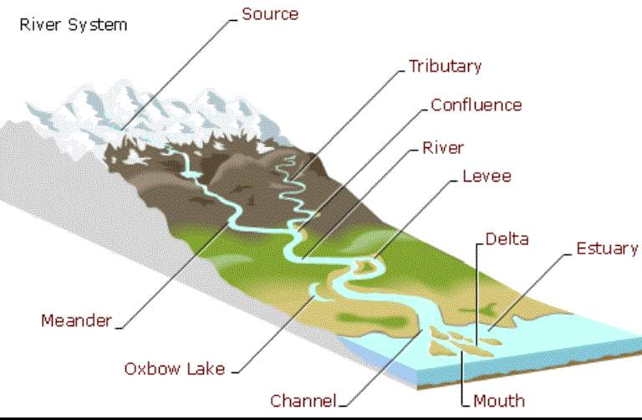
Check Answers Here
Notes:
Note: All references for information and pictures are in the notes’ section of the slides.
http://greenfieldgeography.wikispaces.com/IGCSE+Rivers

Slide 2
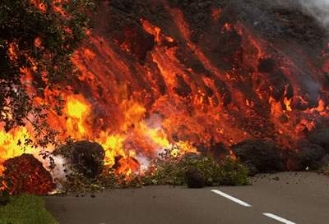
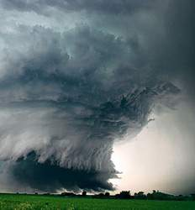
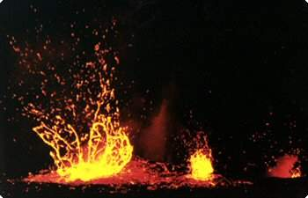
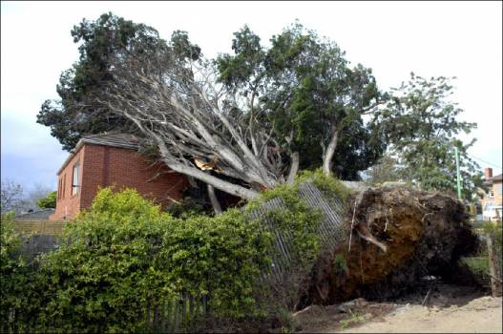
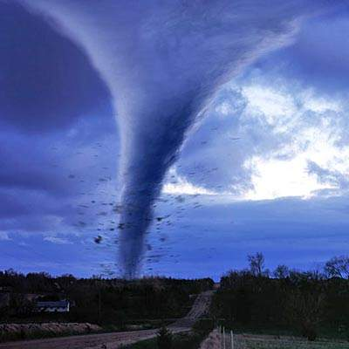
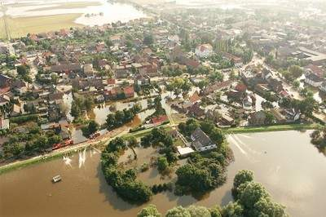
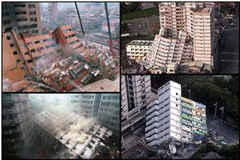
Natural Hazards
Natural events that threaten lives, property, and other assets or,
Elements of the physical environment, harmful to man and caused by forces extraneous to him or,
All atmospheric, hydrologic, geologic, and wildfire phenomena that have potential to affect humans, their structures, or their activities adversely
Can be predicted
Examples are floods, fires, earthquakes, tornadoes, and windstorms
Notes:
http://www.oas.org/dsd/publications/unit/oea54e/ch05.htm
http://www.fema.gov/areyouready/natural_hazards.shtm
http://www.hilo.hawaii.edu/~nat_haz/- volcano image
http://www.free-islamic-course.org/NaturalDisasterorDivinePunishment.html- tornado image
http://www.google.com/imgres?q=natural+hazards&um=1&hl=en&rls=com.microsoft:en-us:IE-SearchBox&biw=1143&bih=799&tbm=isch&tbnid=TPULoqo9bD2AVM:&imgrefurl=http://www.infobarrel.com/Effects_of_Natural_Hazards&docid=qiZ9sEh8Z2L5iM&imgurl=http://www.infobarrel.com/media/image/1378.jpg&w=338&h=226&ei=lKIQT4bmHaPnsQL4rrDWAw&zoom=1&iact=rc&dur=390&sig=106044334367567235812&page=1&tbnh=148&tbnw=181&start=0&ndsp=20&ved=1t:429,r:10,s:0&tx=98&ty=63- earthquake image
http://www.windows2universe.org/teacher_resources/main/frameworks/esl_bi8.htmlp-fire image
http://conhaz.org/- flood image
http://www.agu.org/focus_group/NH/awards/- storm image
http://mycrappyneighbor.com/2011/04/23/tree-falls-on-neighbors-home-who-pays/

Slide 3

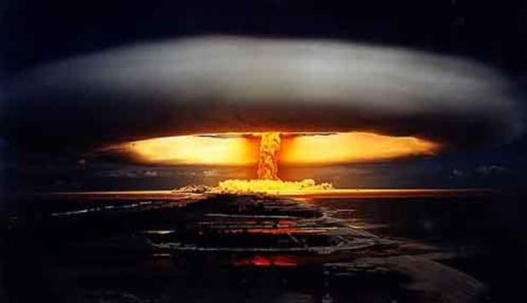
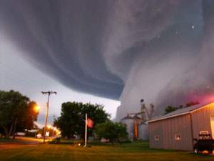
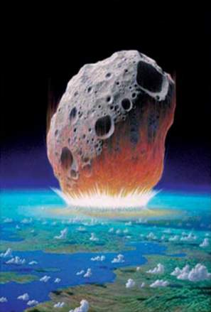
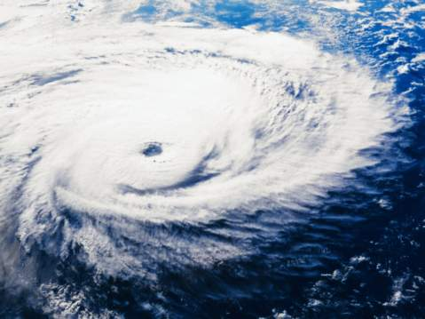
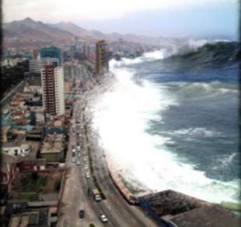
Catastrophic Events
Sudden, natural or man-made, situations where change and destruction may occur without prior knowledge or preparation
Notes:
http://solreka.com/blog/2012/why-world-will-end-dec-21-2012-part-2/
http://webhost.bridgew.edu/cbloch/disturbance.htm
http://www.21122012.net/catastrophic-events.html
http://www.doobybrain.com/
http://www.provencherclaims.com/catastrophesolutions.aspx
http://wastetimepost.com/17dcbc7cda7/catastrophic%20events

Slide 4
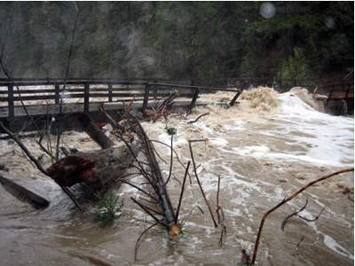
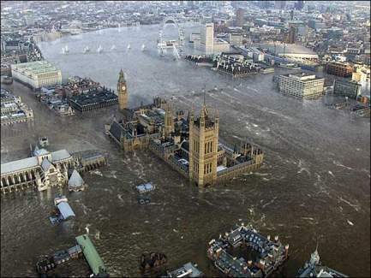
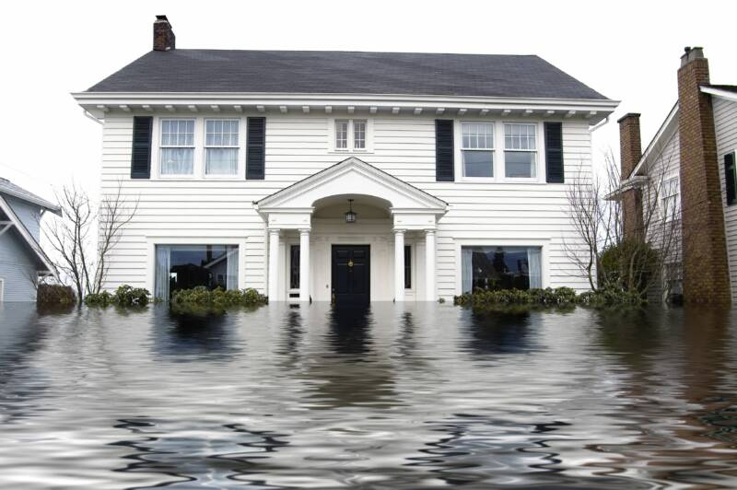
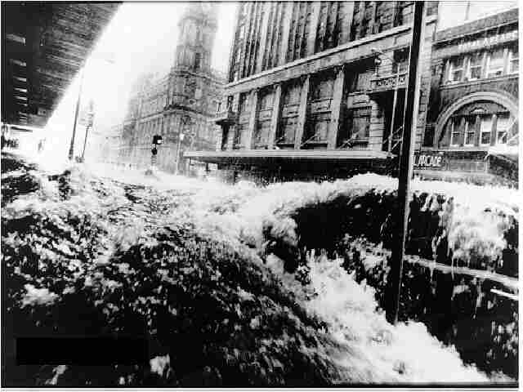
Floods
Notes:
http://slvgis.info/Pre_disaster_mitigation/Public%20Event%20Flyer_SLV_%20HMP_files/SLV%20Mitigation%20Plan.html
http://www.indiatalkies.com/2011/01/killed-australia-floods.html
http://www.planetperformance.org/floods/floods.htm
http://squarecowmovers.com/2011/01/356/flooded_house1/

Slide 5
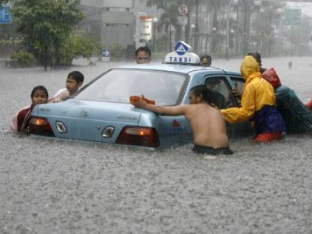
Floods
Flooding happens during heavy rains, when rivers overflow, when ocean waves come onshore, when snow melts too fast or when dams or levees break.
Flooding may be only a few inches of water or it may cover a house to the rooftop.
Notes:
http://sciencepolicy.colorado.edu/socasp/weather1/myers.html
http://www.fema.gov/kids/floods.htm
http://globalastrologyblog.blogspot.com/2010/10/cardinal-crisis-venus-retrograde-mars.html

Slide 6
Floods
Floods that happen very quickly are called flashfloods.
Flooding is the most common of all natural hazards.
It can happen in every U.S. state and territory.
Notes:
http://www.fema.gov/kids/floods.htm
http://globalastrologyblog.blogspot.com/2010/10/cardinal-crisis-venus-retrograde-mars.html

Slide 7
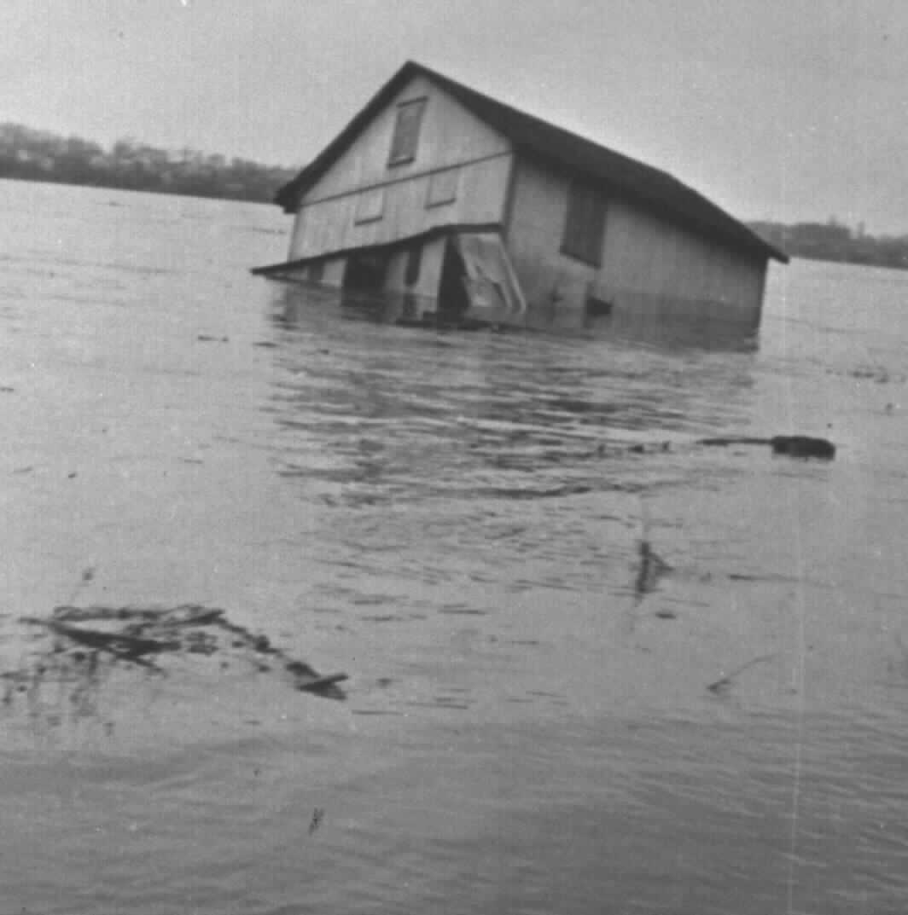
Environmental Impact of Floods
Floods are important in maintaining ecosystem habitats and soil fertility.
Human attempts at managing flood prone areas disrupt the natural flood cycle.
Notes:
http://sciencepolicy.colorado.edu/socasp/weather1/myers.html
http://climate.met.psu.edu/features/Floods/PEMA_flood.php

Slide 8
Environmental Impact of Floods
Activities such as drainage of wetlands and land clearance for farming; upstream development that replaces natural vegetation with paved asphalt; and construction of channels, levees, reservoirs change the flood cycle and often result in increases runoff, destruction of riparian habitat, and increased water pollution
Notes:
http://sciencepolicy.colorado.edu/socasp/weather1/myers.html
http://climate.met.psu.edu/features/Floods/PEMA_flood.php

Slide 9
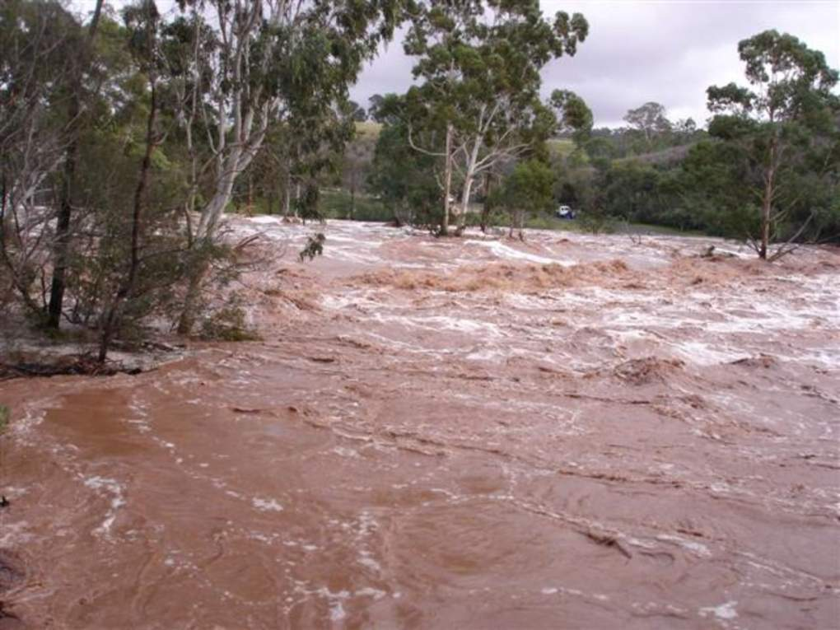
Effects of Floods
Floods destroy drainage systems causing raw sewage to spill out into bodies of water.
Buildings can be destroyed which can lead to many toxic materials such as paint, pesticide and gasoline being released into the rivers, lakes, bays, and ocean, killing marine life.
Floods cause significant amounts of erosion to coasts, leading to more frequent flooding if not repaired.
Floods positively impact the environment by spreading sediment containing nutrients to topsoil.
Notes:
http://www.osundefender.org/?p=11670

Slide 10

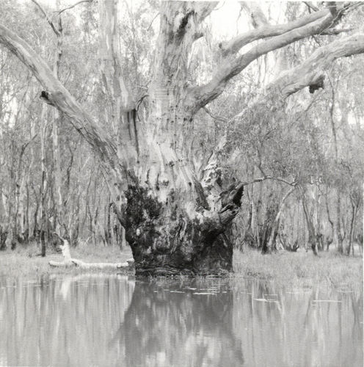
Effects of a Flood on the Ecosystem
Plants
  On dry land, plant life can benefit from the sudden appearance of a large quantity of flood water.
  Water stored underground will be replenished by the floodwater, while soil above ground will be able to soak up the water.
  Plants will be able to receive water as a result.
  The nutrients carried by the flood water can also revive deprived plants and aid in the germination of seeds.
Notes:
http://www.panoramio.com/photo/1873261

Slide 11
Effects of a Flood on the Ecosystem
Plants Continued
  Flood water may prove a new lease on life for an area.
  The soil is likely to be more fertile, leading to a suitable area in which to grow crops.
  Flooding can kill woody and herbaceous plants.
Notes:
http://www.ehow.com/list_7494478_effects-flood-ecosystem.html
http://www.uwex.edu/ces/ag/issues/effectsoffloodingonplants.html
http://www.panoramio.com/photo/1873261

Slide 12
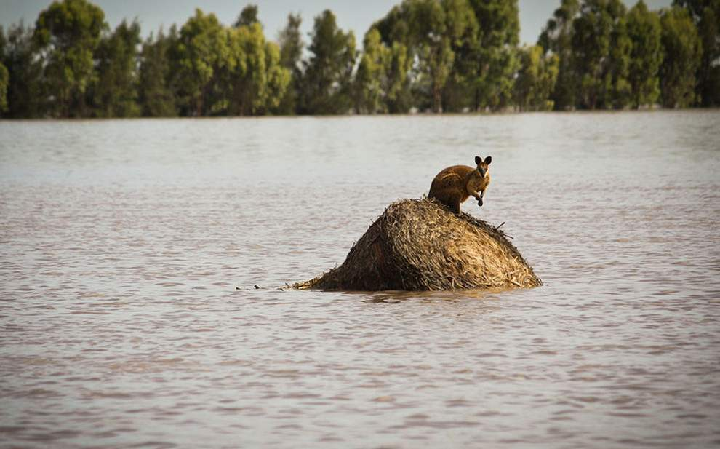
How Flooding Affects Animal Breeding
The environment in are areas where floods have occurred are more suitable for the reproduction of species of birds and some other animals.
Fish can breed and give birth in the areas where flood water stays for an extended duration.
Notes:
http://newshopper.sulekha.com/australia-flooding_photo_1653518.htm

Slide 13
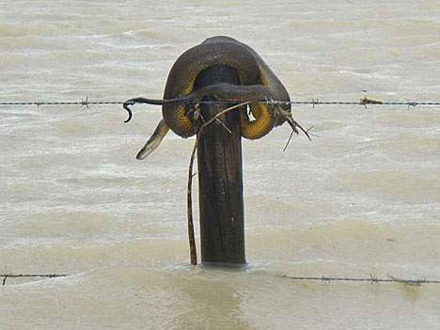
Animals
Flooding forces many wild animals from their natural habitats.
Domestic animals are also left without homes after floods.
Rats may be a problem during and after a flood.
The large amounts of pooled water lead to an increase in mosquito populations.
Notes:
http://www.bt.cdc.gov/disasters/floods/pdf/animals.pdf
http://happythreads.com.au/2011/01/13/the-queensland-floods/

Slide 14
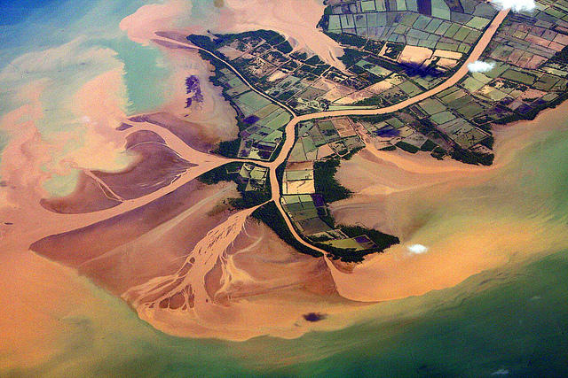
Effects of Floods on Water-Based Ecosystems
Coral reefs are particularly at risk from the runoff from floods.
This runoff contains sediment and products such as pesticides and fertilizers, and will carry these into the ocean ecosystem.
Habitats may be destroyed, and animal and plant life are is likely to suffer.
  Sediment may obscure the sunlight which inhibits photosynthesis of marine plants.
Notes:
http://www.flickr.com/photos/thirnbeck/4542268075/

Slide 15
Effects of Floods on Water-Based Ecosystems
There are some benefits of flooding on the ocean ecosystems
  The sudden appearance of an overflow of water can wash away unneeded salt, alongside man-made products like chemical waste.
  This helps the flora and fauna thrive.
  The flood water can also sweep away junk and debris which may have accumulated by the side of rivers.
Notes:
http://www.ehow.com/list_7494478_effects-flood-ecosystem.html
http://www.flickr.com/photos/thirnbeck/4542268075/

Slide 16
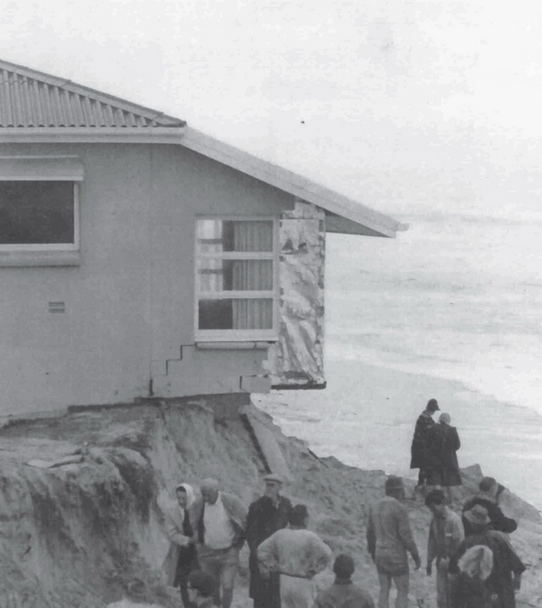
Flood-Related Erosion
The collapse or subsidence of land along the shore of a lake or other body of water as a result of undercurrents of water exceeding anticipated cyclical levels
or suddenly caused by an unusually high water level in a natural body of water, accompanied by a severe storm,
or by an unanticipated force of nature, such as a flash flood or an abnormal tidal surge, or by some similarly unusual and unforeseeable event which results in flooding.
Notes:
http://www.fema.gov/plan/prevent/floodplain/nfipkeywords/flood_related_erosion.shtm
http://world-geography.org/221-erosion.html

Slide 17
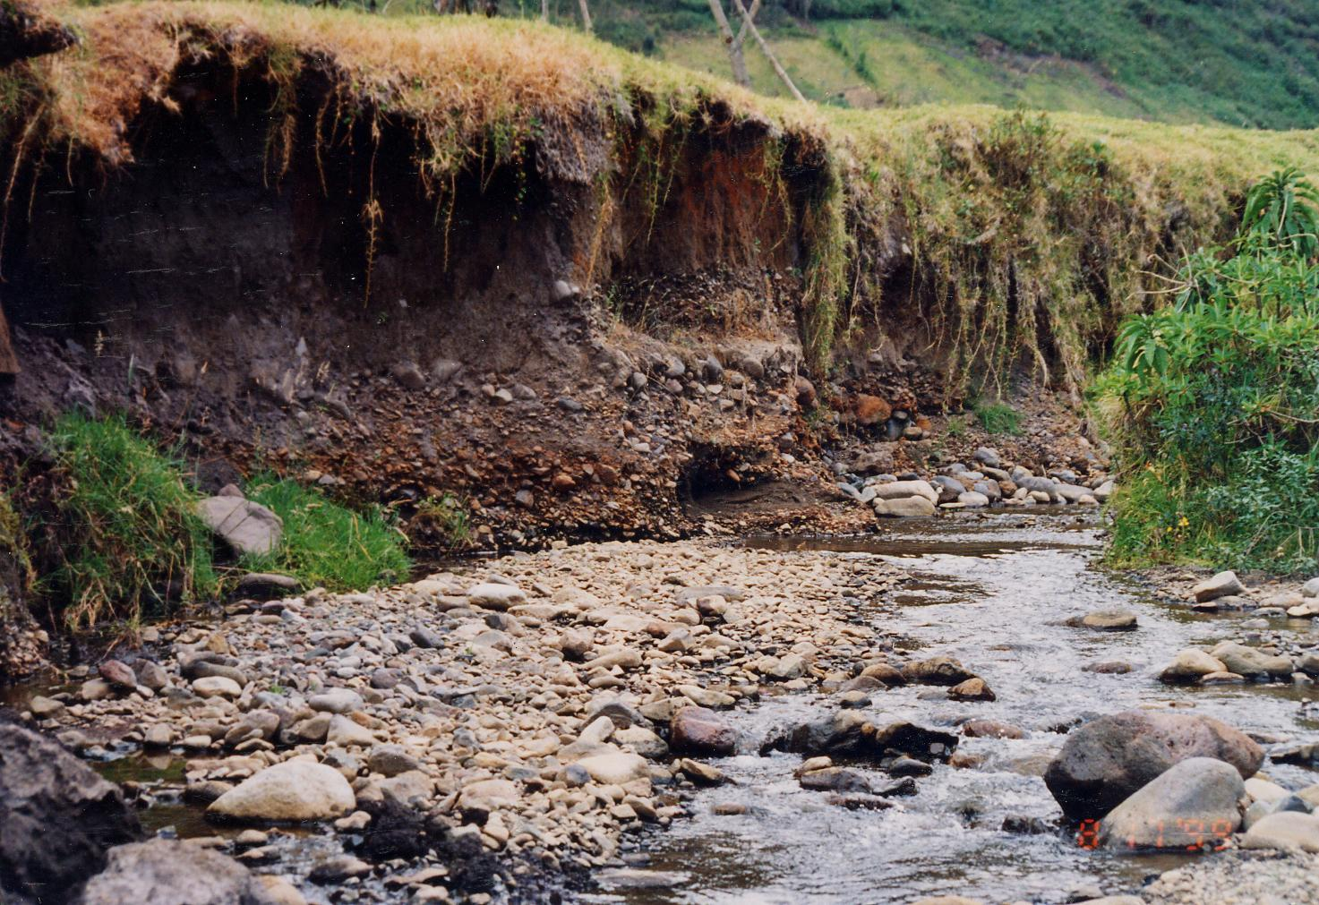
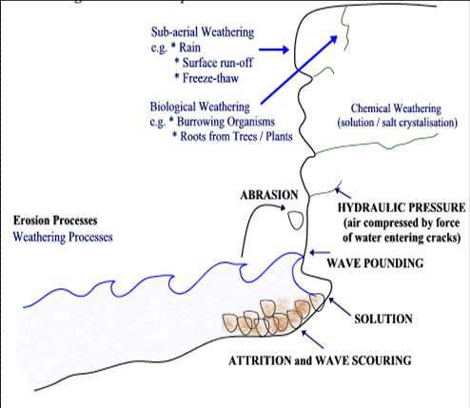
Erosion
Lateral erosion widens the river channel while vertical erosion deepens it.
There are four types of erosion:
  Corrasion or abrasion
  Attrition
  Solution or corrosion
  Hydraulic Action
Notes:
http://khsgeography.blogspot.com/2010_01_01_archive.html
http://itu205.ut.tu-berlin.de/wrh/persons/gunkel/gunkel_eng.html

Slide 18
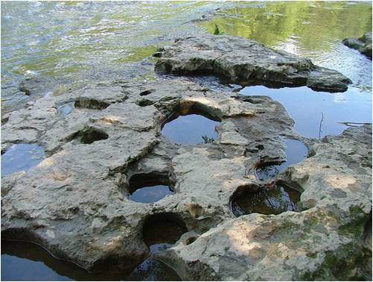
Erosion
  Corrasion or abrasion
    The grinding of rock fragments carried by the river against the bed and banks of the river.
    The power of the grinding is greater during floods when large fragments of rock are carried along the river bed eroding the bed and the banks.
Notes:
http://golearngeo.wordpress.com/2010/04/23/river-landform-erosion/

Slide 19
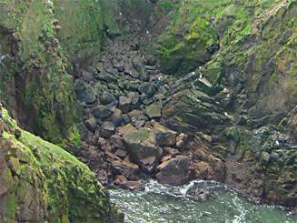
Erosion
  Attrition
    The knocking of rock fragments in the water against one another.
    The fragments are broken into smaller pieces and become smoother along the process.
Notes:
http://www.bbc.co.uk/scotland/education/geog/coastline/standard/physical/process/erosion/?topic=attrition&select=image

Slide 20
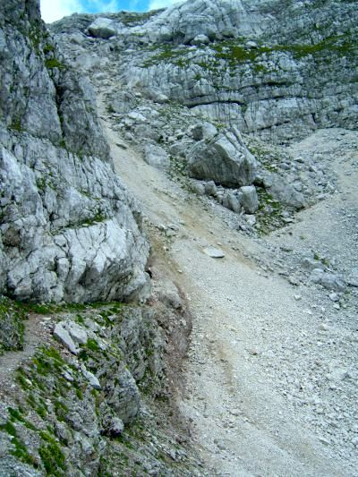
Erosion
  Solution or corrosion
    The process by which river water reacts chemically with soluble minerals in the rocks and dissolves them.
Notes:
http://www.lamanauskas.lt/karst.php

Slide 21
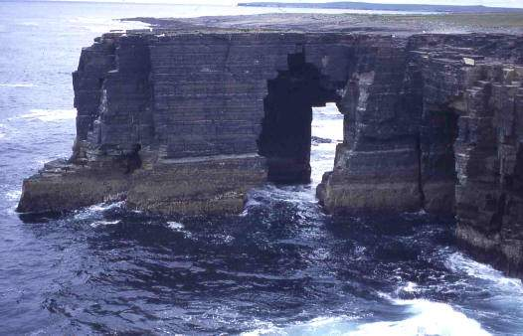
Erosion
  Hydraulic Action
    The breaking down of rocks and dragging them away from the bed and banks by the force of the running water itself.
Notes:
http://www.landforms.eu/orkney/cave.htm

Slide 22

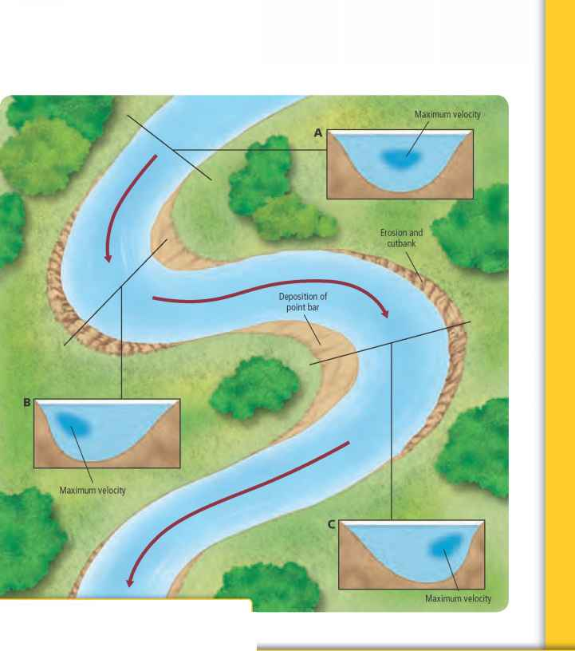
Deposition
The opposite of erosion, deposition is where a river lays down or drops sediment or material that it is carrying.
Some types of deposition include:
  Pebbles or stones
  Mud and sand and silt
  Large boulders or stones
  Tree branches
  Pollution like cans, bottles, wrappers, etc.
Notes:
http://www.briangwilliams.com/geology/visualizing-erosion-and-deposition-in-a-meander.html

Slide 23
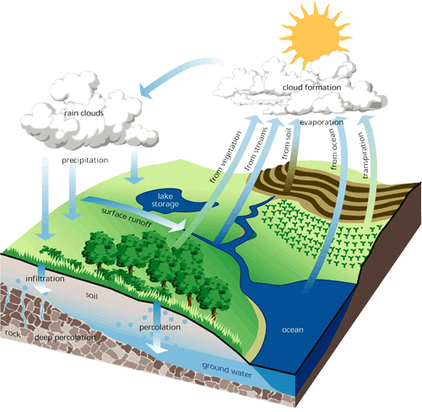
Rainwater rushes down the mountain and into lakes and rivers and then it will continue down to the sea.
Some will seep into the ground as groundwater. Groundwater will eventually seep into lakes and rivers and finally the sea.
Notes:
http://library.thinkquest.org/C0110238/Lessons/2-8.htm
http://www.sylvansource.com/hydrologic.html

Slide 24
Upper Course
Here the river channel is small, narrow, rough, and usually shallow,
The stones and rocks increase wetted perimeter,
And the volume of water is low as there are very few tributaries flowing into it.
Notes:
http://library.thinkquest.org/C0110238/Lessons/2-8.htm
http://greenfieldgeography.wikispaces.com/IGCSE+Rivers

Slide 25
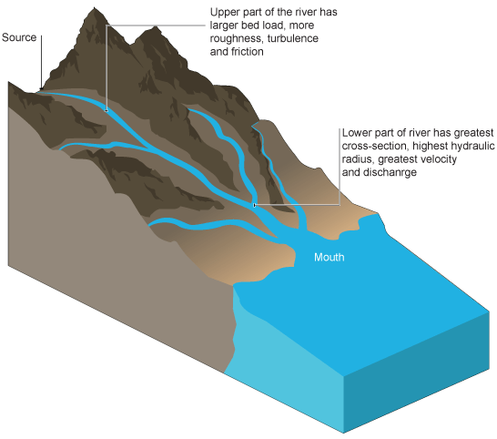
Middle Course
Here the river channel is both wider and deeper,
Its cross-section is asymmetrical,
And a steep river cliff develops on the concave bank and a gentle slip-off slope on the convex bank.
Notes:
http://greenfieldgeography.wikispaces.com/IGCSE+Rivers

Slide 26
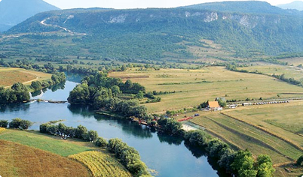
Lower Course
Here the river channel is at its widest and deepest,
It has the largest volume of water and load because of tributaries,
And there is lateral erosion along this course.
Notes:
http://www.bosniaherzegovina.dzaba.com/adventure.html

Slide 27
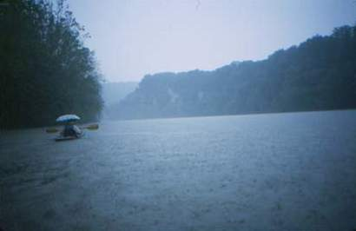
Weather Conditions Affect Water Flow
When there is a lot of heavy rainfall and it lasts a long time, there will be a lot of run-off.
Because of this water reaches the river quickly.
During this period the ground can no longer soak up water and flooding can occur.
Notes:
http://www.themouseworks.com/2003-new-river-kayak-trip.htm

Slide 28
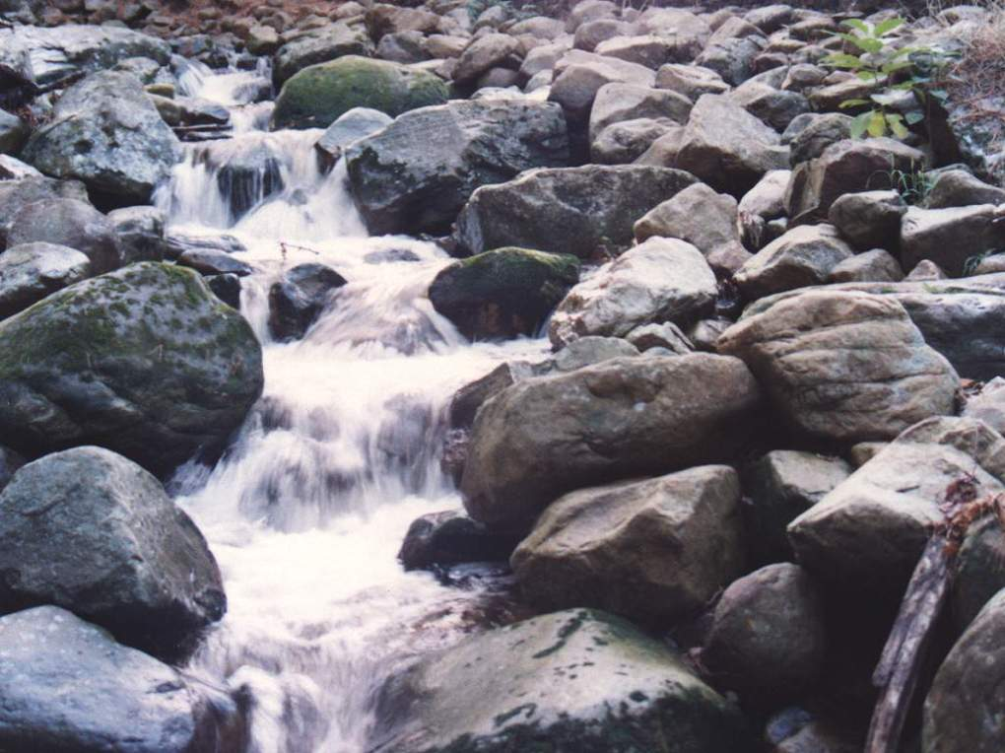
If there are rocks in the river are they:
Permeable
  Permeable rock will allow water infiltration to occur.
  This reduces run-off and the chances for flooding.
Or impermeable
  Impermeable rock does not allow water to pass through it.
  This causes lots of run-off.
Notes:
http://www.capetownskies.com/full-size-favourites/index2.htm

Slide 29
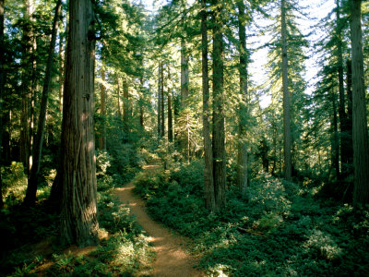

Land Use:
Trees delay water by intercepting it. This reduces run-off.
Land that is built on will have more run-off because the ground is covered by impermeable surface like tarmac and concrete.
Notes:
http://www.sodahead.com/living/whats-your-favorite-tree/question-873317/?link=ibaf&q=tree&imgurl=http://artfiles.art.com/5/p/LRG/27/2706/Y81ND00Z/james-p-blair-woodland-path-winding-through-a-grove-of-sequoia-trees.jpg
http://www.123rf.com/photo_5850239_night-city-on-the-river.html

Slide 30
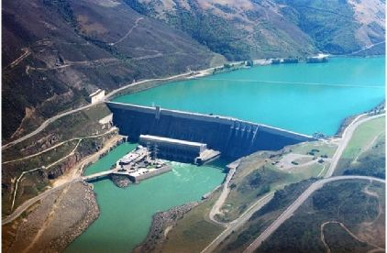
Dams
Dams will hold floodwaters back.
Notes:
http://www.acousticview.com/solutions.php?solution=5

