Slide 1
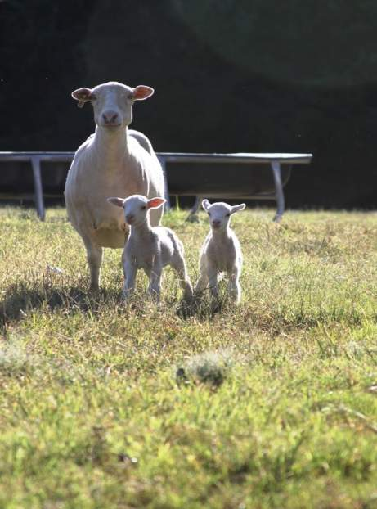
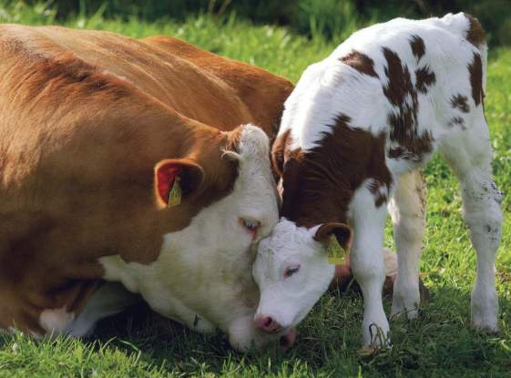
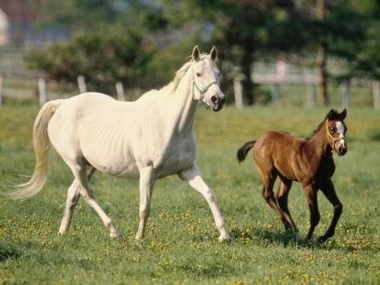
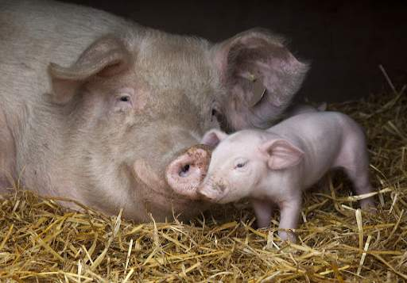
Female Reproduction

Slide 2
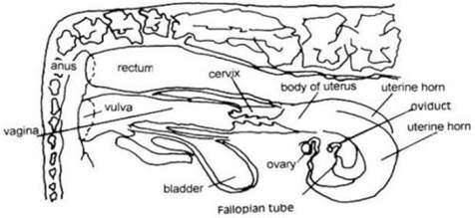
Female Reproduction
Job of the female reproduction system:
Produce an fertile egg
Produce hormones
Reset the ovulation cycle
Transport the egg and sperm to the site of fertilization
House, protect, and grow a fetus and placenta
Birthing of the fetus

Slide 3
Important Terms
Estrous vs. Estrus
Estrous: the entire cycle that occur between when the animal goes into heat and ovulation.
Estrus: the period of standing heat. The female is sexually receptive to the male.
Ovulation: Occurs when the egg is released from the follicle to be fertilized.
Oocyte = egg
Ovarian Fossa: The spot of ovulation in the mare.
Luteolysis: Dying of the Corpus Luteum
Foliculogenesis: Process where immature follicles develop into mature follicles

Slide 4
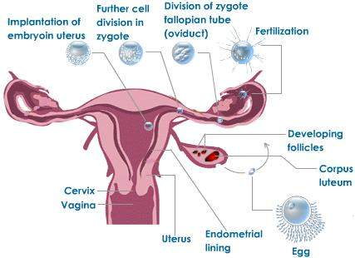
Female Reproductive Tract
The female reproductive tract can be described as: tubular or a series of tubes
The tubular organs of the female reproductive tract are:
Vagina
Uterus
Cervix
Oviducts
The tract is lined by a
layer called: Muscularis layer
Function:
transport sperm and egg to the site of fertilization
contractions of the tract
pushing the fetus out of the body during birth

Slide 5
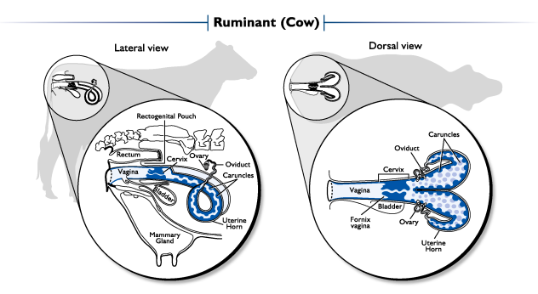
Female Reproduction Organs
Important Organs:
Vulva and Vagina
External Genitalia
Cervix
Uterus
Uterine Horns
Ovary
Follicle
Oviduct

Slide 6
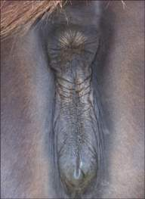
Vulva and Vagina
Vagina:
Location: Connects to the cervix to external genitalia
Function:
Birth canal
Place where sperm is deposited
Site of urination
Species Differences:
Only the bull and ram will deposit sperm here
Boar and Stallion deposit sperm in the cervix at the opening of the uterus
Vulva:
External tissue of the female reproductive tract
Receives the penis during copulation
Organs:
Left and Right Labia: 1st defense against bacteria entering the reproductive tract
Anus
Left Labia
Vulva
Right Labia

Slide 7
Cervix
Description:
Forms a VERY tight barrier between itself and the uterus
Different shapes for different species
Location: Between the Vagina and Uterus
Function:
Lubrication for sperm transport
Flushing of the Fetus
Barrier against bacteria entering the uterus
Species Differences in the Shape of the Cervix:
Cow, Ewe, Nanny: Annular Rings
Sow: Corkscrew Shape
Mare: Longitudinal Folds
Species Differences between Males:
Stallion and Boar will deposit sperm here at the opening of the cervix
Ram and Bull deposit sperm in the vagina

Slide 8
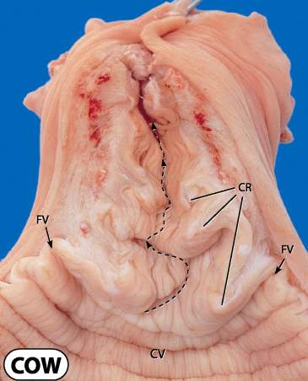
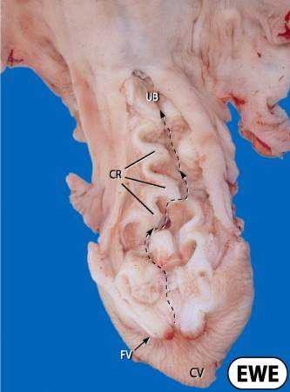
Cervix of a Cow, Ewe, or Nanny
Annular Rings
Annular rings

Slide 9
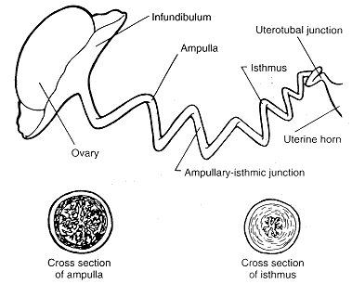
Oviduct
Location: In between the Ovary and Uterine Horn
Function:
Transport of the ovulated egg and sperm
Fertilization
Early embryo development
Consists of:
Infundibulum: “Catchers Mit”
Surrounds the ovary to catch ovulated eggs and put them in the oviduct
Ampulla
Moves the egg and sperm through the oviduct
Ampullary-Isthmic Junction (AI Junction)
Site of Fertilization
Isthmus
Joins with the Ampulla to the Uterine Horn
Uterotubal Junction:
Joins the Oviduct to the Uterine horn
Species Difference:
Horse:
Has a specialized oviduct that only allows fertilized eggs into the uterus

Slide 10
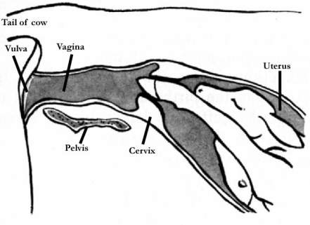
Uterus
Location: Between the Oviduct and the Cervix
Function:
Sperm transport
Control of follicle growth cycles
House and grow the embryo
Expulsion of the fetus
Consists of:
Body and two uterine horns
Types of Uterine Horns
Simplex
Duplex
Bicornuate

Slide 11
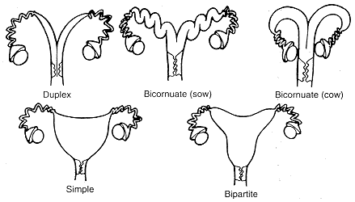
Uterine Horns
3 different types:
Simplex
Uterine body has NO uterine horns
Example: primates and humans
Duplex
Two cervices that form into two uterine bodies and two uterine horns
Example: marsupials and rabbits
Bicornuate
Two uterine horns
Depending on the species will either have poorly developed uterine horns or highly developed horns
Development depends on litter size
Larger the litters the longer and more developed the uterine horns
Smaller the litters the shorter and less developed the uterine horns
Example: ALL Livestock
Sow, Bitch, Queen: Highly Developed Uterine Horns
Cow, Ewe, Mare: Poorly Developed Uterine horns

Slide 12
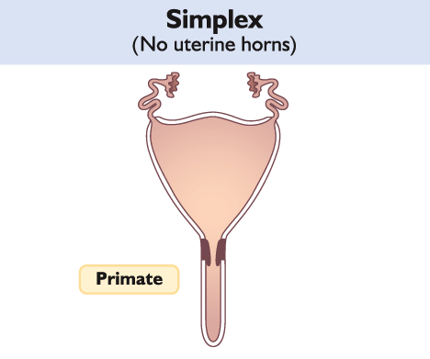
Uterine Horn
Oviduct
Uterine Body

Slide 13
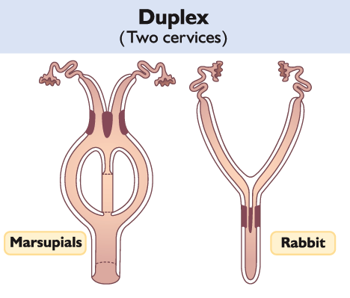
Uterine Horn
Oviduct
Cervix 1
Cervix 2
Uterine Body
Cervix 1
Cervix 2

Slide 14
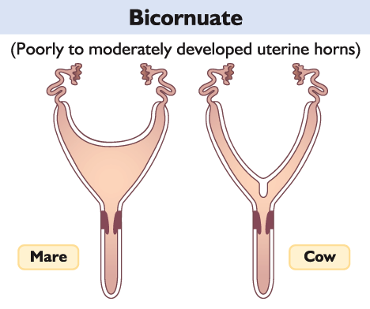
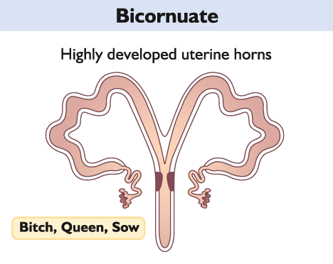
Uterine Horn
2 Uterine Horns
Uterine Body
Cervix
Oviduct
Uterine Horn

Slide 15
Female Reproduction Video
Female Reproduction video

Slide 16
Hormones
What is a hormone?
Definition: a chemical messenger that travels to specific organs and prompts a specific response from the organ
Characteristics of Hormones:
Low amounts are secreted
Important Hormones:
Estrogen
Progesterone
Follicle Stimulating Hormone (FSH)
Luteinizing Hormone (LH)

Slide 17
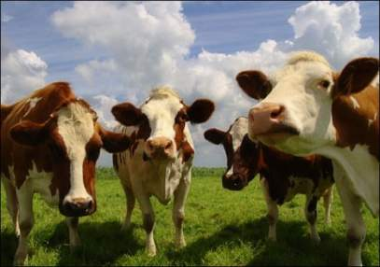
Hormones
Estrogen
Produced by: Ovary (Follicle)
Function:
Regulate reproductive cycling
Behavioral displays during estrus
Progesterone
Produced By: Ovary (Corpus Luteum)
Function:
Essential for the maintenance of pregnancy
Follicular Stimulating Hormone (FSH)
Produced by: Anterior Pituitary in the brain
Function:
Causes follicular growth in the ovary
Luteinizing Hormone (LH)
Produced by: Anterior Pituitary in the brain
Function:
Responsible for causing ovulation
Stimulating the Corpus Luteum(Follicle stage) to secrete progesterone

Slide 18
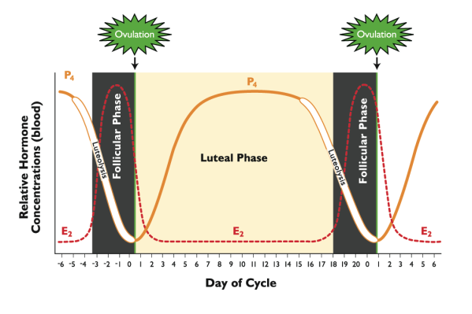
Estrous Cycle: Phases
Follicular Phase:
Proestrus and Estrus
Ends at the time of ovulation
Peak Estrogen
Luteal Phase
Diestrus and Metestrus
Starts at the beginning of ovulation
Peak Progesterone
Luteolysis: Dying of the Corpus Luteum
P₄ = Progesterone
E₂ = Estrogen

Slide 19
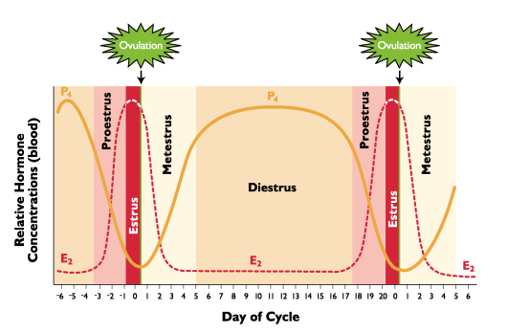
Estrous vs. Estrus
Estrous: the entire cycle that occur between when the animal goes into heat and ovulation.
Estrus: the period of standing heat. The female is sexually receptive to the male.
Luteal Phase:
Diestrus:
Peak Progesterone Production
Proestrus
Formation of follicles
Follicular Phase:
Estrus
Sexual receptivity
Peak Estrogen secretion
Metestrus
Corpus Luteum Formation
P₄ = Progesterone
E₂ = Estrogen

Slide 20
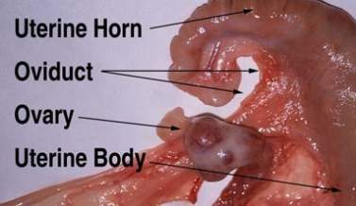
Ovary
Location: Connected to the oviduct
Function:
Storage site of the immature follicles
Produce the ooctye(egg)
Produce hormones:
Estrogen
Progesterone
Follicle:
The follicle is produced in the Ovary
Houses the egg until ovulation.
Species Difference:
Horse:
The horse will ovulate in the same place every cycle
The horses ovary has an Ovarian Fossa which is the spot of ovulation in the mare

Slide 21
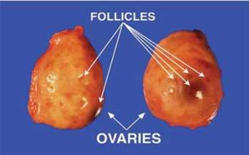
Follicle
Ovulation: Occurs when the egg is released from the follicle to be fertilized.
Foliculogenesis: Process where immature follicles develop into mature follicles
Follicle Description:
Every female is born with a certain amount of eggs or oocytes that are stored in the ovary
The follicle is produced by the ovary
Each follicle contains 1 egg or oocyte
The follicle produces estrogen

Slide 22
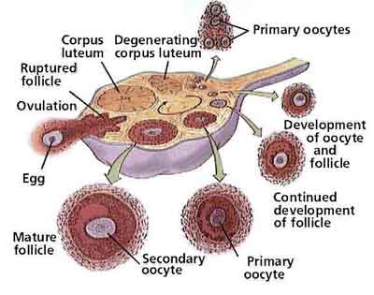
Follicle Continued
Stages of Foliculogenesis:
Primary Oocyte
Secondary Oocyte
Mature Oocyte
Corpus Hemorragicum
Ruptured Follicle
Ovulation
Corpus Luteum
Corpus Albicans
Degenerating Corpus Luteum

Slide 23
Follicle Continued
Follicle Stages Before Ovulation:
Primary Follicle:
Most immature form of a follicle
Secondary Follicle:
Matured follicle
More outer cell layers surrounding the follicle
Mature or Graafian Follicle
1st stage to be capable of ovulation
1st stage to be capable of fertilization

Slide 24
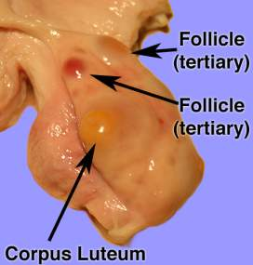
Follicle Continued
Foliculogenesis after Ovulation:
Corpus Hemorrhagicum
Known as the “bloody body”
This is caused by the follicle ovulating (Releasing the egg) causing it to bleed and look like a “bloody body”
Corpus Luteum
Yellow body
Produces Progesterone
Progesterone is REQUIRED for pregnancy
Corpus Albicans
Scar tissue
This tissue forms on the ovary after the corpus luteum regresses and disappears (luteolysis)

Slide 25
Pathway for the ovulating female that’s egg will NOT be fertilized
The Estrus cycle begins.
The follicle begins to grow with the stimulation of FSH and increasing amounts of LH from the brain.
Once the follicle has fully matured into a Graafian follicle, FSH will be stopped and LH will peak.
The follicle will rupture and ovulation occurs (releasing of the egg) and a Corpus Hemmoragicum (Bloody Body) forms.
The Corpus Hemmoragicum will turn into a Corpus Luteum that begins producing progesterone.
If the female is not pregnant, the corpus luteum will die and turn into a Corpus Albicans (scar tissue will form where the corpus luteum was).
The released egg will pass through the oviduct not fertilized and die.
Since the body does not receive signals that the female is pregnant, the cycle will be restarted.

Slide 26
Pathway for the ovulating female that’s egg will be fertilized
Female begins her estrus cycle and is receptive to the male.
The follicle begins to grow with the stimulation of FSH and increasing amounts of LH from the brain.
Once the follicle has fully matured into a Graafian follicle, FSH will be stopped and LH will peak.
The follicle will rupture and ovulation occurs (releasing of the egg) and a Corpus Hemmoragicum (Bloody Body) forms.
The Corpus Hemmoragicum will turn into a Corpus Luteum that begins producing progesterone.
The released egg will be caught by the infundibulum and enter the oviduct.
The male deposits sperm in either the vagina or cervix depending on the species.
The sperm travel through the cervix into the uterus or uterine body.
The sperm swim into the oviduct and fertilize the ovulated egg in the Ampulla-Isthmic Junction (AI Junction).
The fertilized egg will travel into the uterus where it will attach and grow into a fetus.
After the Fetus is fully matured the female will give birth.

Slide 27
Reference Websites used
Hormone Reference
Female Organ Reference

