Slide 1
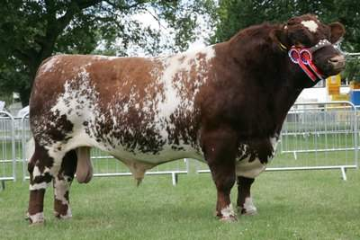
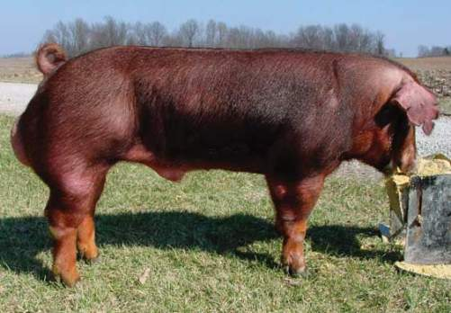
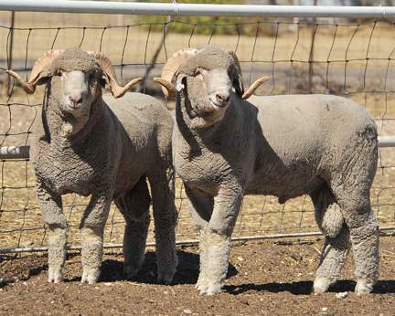
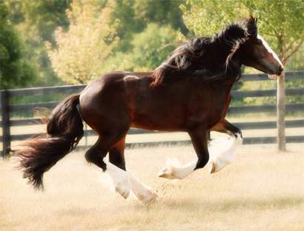
Male Reproduction

Slide 2
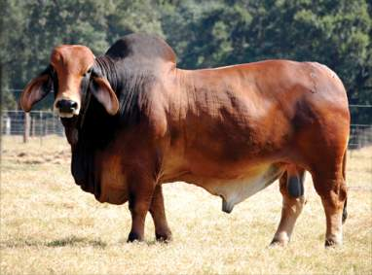
Male Reproduction
Function:
Produce and deliver fertile sperm to the female reproductive tract
Produce the hormone Testosterone
Job:
Fertilize the female egg

Slide 3
Important Terms
Fibroelastic Penis vs. Vascular Penis
Fibroelastic: uses the sigmoid flexure and retractor muscle to become erect
Vascular: will fill with blood to become erect
Thermoregulation: regulation of the temperature of the testes to support fertile sperm production
Cryptorchidism: when one or neither testes descend into the scrotum during the fetal stages
Convoluted: contains many veins
Vasectomy: procedure to sterilize a male
Spermatogenesis: formation and growth of sperm

Slide 4
Hormone
Testosterone
Produced by:
Leydig Cells (found in the testicles)
Function:
Promotes spermatogensis
Promotes secondary sex characteristics
Example: horn growth or bright colored feathers in male birds

Slide 5
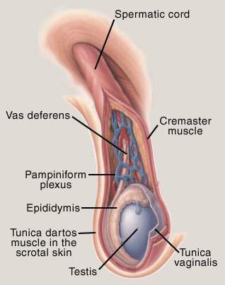
Male Reproduction
Important Organs:
Scrotum
Tunica Dartos
Spermatic Cord
Ductus Deferens/Vas Deferens
Pampiniform Plexus
Cremaster Muscle
Testicles
Epididymis
Penis
Fibroelastic vs. Vascular

Slide 6
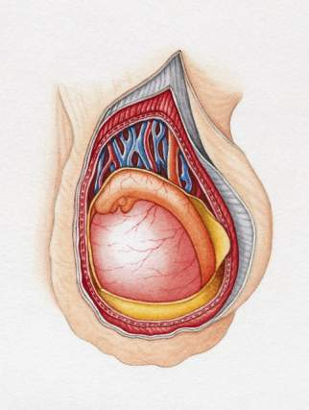
Scrotum
Houses the testes
Function:
Protection
Temperature Regulation (thermoregulation)
Movement of the testes
Layers:
Skin
Sweat Glands located here
Thermal Receptors
Tunica Dartos Muscle
Assists in thermoregulation
Tunica Dartos
Skin
Epididymis
Testes

Slide 7
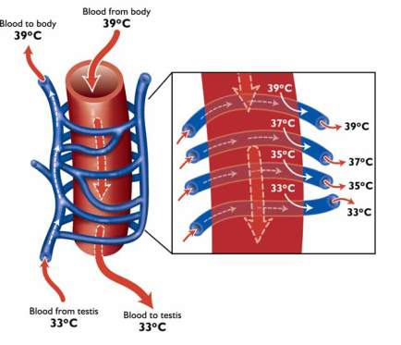
Spermatic Cord
Description: highly convoluted
Function:
Suspend the testes in the scrotum
Provide heat cooling system
Houses:
Ductus Deferens/Vas Deferens:
Move fertile sperm from the tail of the epididymis to the penis for ejaculation
This is cut and causes a Vasectomy
Pampiniform Plexus
Composed of a testicular artery and veins that cool the blood before circulating throughout the scrotum
Cremaster muscle
Supports the testes
Muscle that will pull testes up during a fight or flight situation
Holds testes up for a short period of time
Pampiniform Plexus

Slide 8
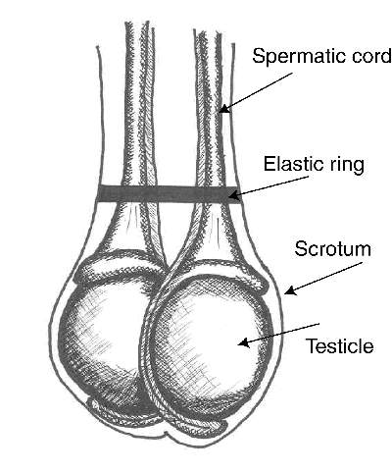
Testicles
Function:
Produce Sperm
Produce the hormone Testosterone
Produce 1-25 Billion sperm
Must be 3-6 degrees cooler than the body to keep sperm alive
Takes 45-60 days to produce fertile sperm

Slide 9
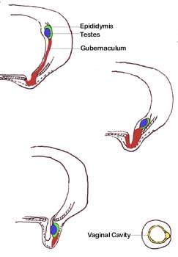
Testicular Descent
In the Fetal stage the testes will descend into the scrotum
This is important for proper sperm production and temperature control
Gubernaculum:
Pulls the testes through the Inguinal Ring into the scrotum
Inguinal Ring:
Ring that is the opening between the body and scrotum
Cryptorchidism:
Def: Failure of one or both of the testes to descend through the inguinal ring into the scrotum
Unilateral Cryptorchidism: one testis does NOT descend into the scrotum
Results in reduced fertile sperm concentration NOT infertile
Bilateral Cryptorchidism: Neither testes descend into the scrotum
Results in Sterility/Infertility
Inguinal Ring

Slide 10
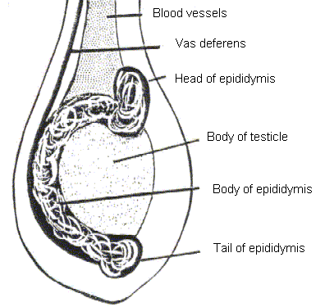
Epididymis
Function:
Sperm Transport
Sperm Maturation
Storage of Sperm
3 Components:
Head (Caput)
Body (Corpus)
Tail (Cauda)
Ductus Deferens

Slide 11
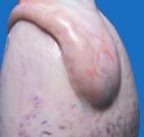
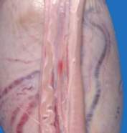
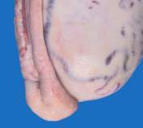
Epididymis Continued
Head (Caput)
Entry point of produced sperm from the testes
Sperm are NOT motile
Sperm are NOT fertile
Body (Corpus)
Maturation of Sperm
Some expression of motility
Some expression of fertility
Tail (Cauda)
Sperm Storage
Sperm are motile
Sperm are fertile
5-10 ejaculations are stored
Sperm can bind to an egg

Slide 12
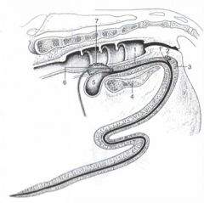
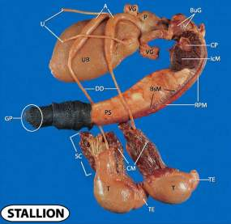
Penis
Fibroelastic Penis
Organ of fertilization of the female
2 Types:
Fibroelastic Penis
Sigmoid Flexure (S-curve)
Rectractor Penis Muscle
Vascular Penis
Species Differences:
Fibroelastic Penis:
Boar, Bull, and Ram
Vascular Penis
Stallion and Humans
Sigmoid Flexure
Retractor Penis
Muscle
Vascular Penis

Slide 13
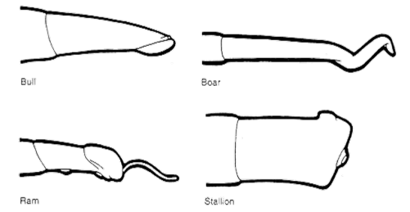
Species Differences
Bull
Fibroelastic Penis
Ram
Fibroelastic Penis
Filiform Appendage
Boar
Fibroelastic Penis
Nonpendulous & Inverted testicles (tail of epididymis is above the head of the epididymis)
Cork Screw Shape (match for the sows corkscrew cervix)
Stallion
Vascular Penis
Bell Shaped Penis
NO Sigmoid Flexure

Slide 14
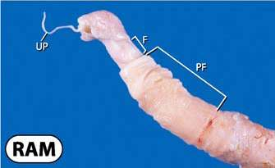
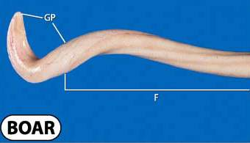
Penis Continued
Fibroelastic Penis:
Extends in length by a muscle to penetrate the female
Retractor Muscle
Helps with erection
Sigmoid Flexure
‘S curve’ that holds penis within the body when not erected or helps extend the penis when erected
Examples: Bull, Boar, and Ram
Species Differences:
Ram:
Filiform Appendage: Sprays sperm within the vagina for better chance of fertilization
Boar:
Corkscrew shaped penis: Matches the sows corkscrew shaped cervix
Filiform appendage

Slide 15
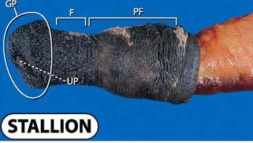
Penis Continued
Vascular Penis
Penis fills with blood to become erect
Does NOT include sigmoid flexure
Examples:
Stallion
Human

Slide 16
Sterilization Techniques
Castration
Removal of the testicles
Vasectomy
Cutting or severing of the Ductus Deferens
Shortening of Spermatic cord
Shortening of the spermatic cord to raise the testicles closer to the body
Raising the testicles closer to the body will cause the temperature to become too hot causing sperm to die or become sterile

Slide 17
Thermoregulation
Thermoregulation is important for the survival of fertile sperm
Sperm will die if:
Testes become too hot
Testes need to be 3-6 degrees cooler than the body
Heat will damage DNA within the sperm
Heat will cause lower levels of fertility
Testes become too cold
Come in contact with blood
Ways of thermoregulation
Thermoreceptors located on the scrotum sends messages to the brain when too hot or too cold
Will cause panting to help dissipate heat from the body
Sweat glands located on the scrotum will allow for cooling
Tunica Dartos Muscle:
Muscle layer beneath the skin of the scrotum will expand when too hot and will lift the testes up towards the body if too cold

Slide 18
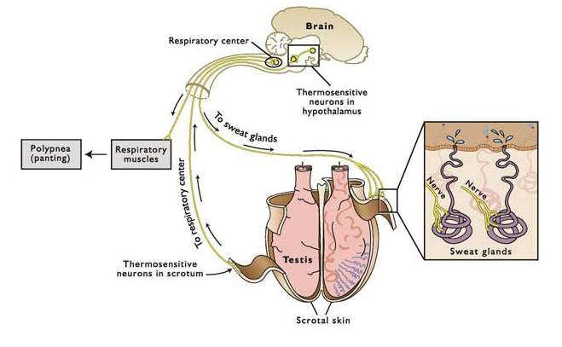
Thermoregulation Continued
How Thermoreceptors and sweat glands communicate with the brain

Slide 19
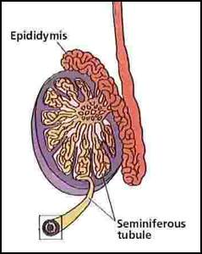
Spermatogenesis
Definition: formation of Sperm
Sperm are formed and grow within the testes
Within the testes sperm are grown inside of the seminiferous tubules within the lobules
2 Cell Types:
Leydig Cells:
Produce testosterone
Located outside the seminiferous tubules
Sertoli Cells:
Protect and aid in growing sperm
Aid in Spermatogenesis
Located inside the seminiferous tubules
Ductus Deferens
Testes

Slide 20
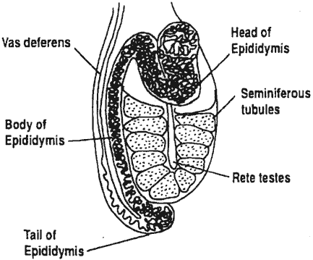
Sperm Transport
Seminiferous Tubules
Epididymis
Head
Body
Tail
Vas Deferens
Penis
Into the Female Tract
Penis

Slide 21
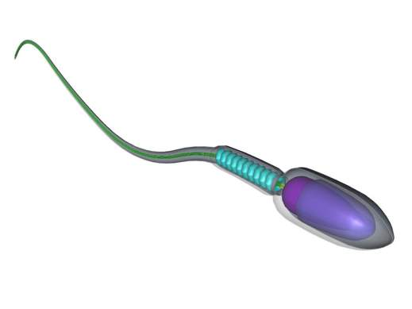
Sperm Anatomy
Head:
Carries the DNA
Mid-Section (neck)
Structure
Holds the head to the tail
Tail
Motor
Drives the sperm throughout the male reproductive tract and female reproductive tract to the site of fertilization
Mid-Section
Head
Tail

Slide 22
Sperm Measurements
Sperm is measured by Volume (mL) and Concentration (x10⁶/mL)
Species differences:
Species | Volume (mL) | Concentration (x10⁶/mL)
Ram | 1 | 2000
Bull | 10 | 1000
Stallion | 100 | 500
Boar | 200 | 250

