Slide 1
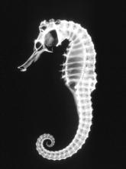
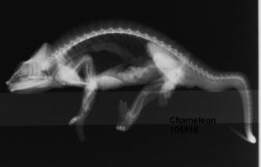
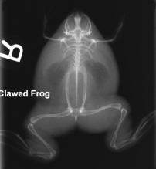
Comparative Anatomy at the Houston Zoo
Radiographic Images submitted by: Betsy McCauley, ARRT
TAMU College of Veterinary Medicine and Biomedical Sciences
Veterinary Medical Teaching Hospital

Slide 2
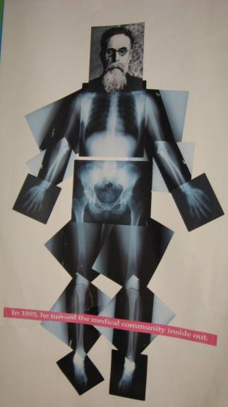
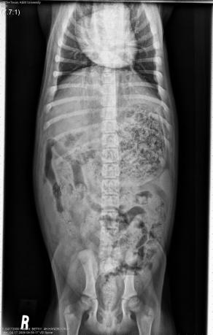
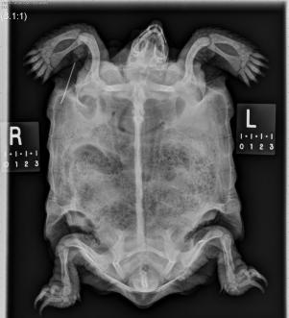
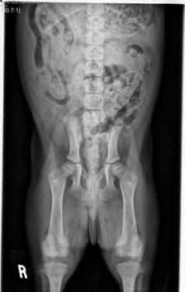
Medical Radiology 1895-2013
Roentgen “Father” of Radiology
Dog- 2 views of the abdomen, pelvis and legs

Slide 3
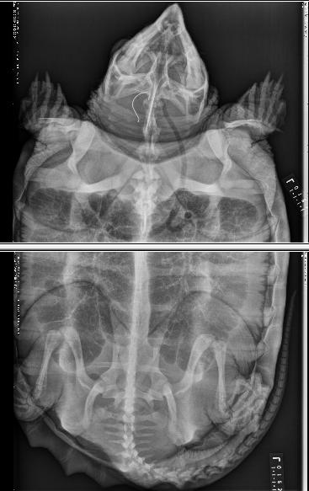
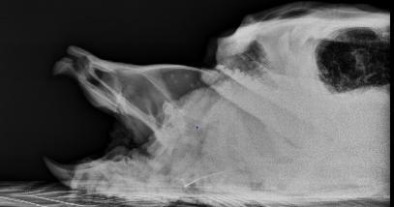
When imaging animals, it may take 2 or more images .
Snapping turtle

Slide 4
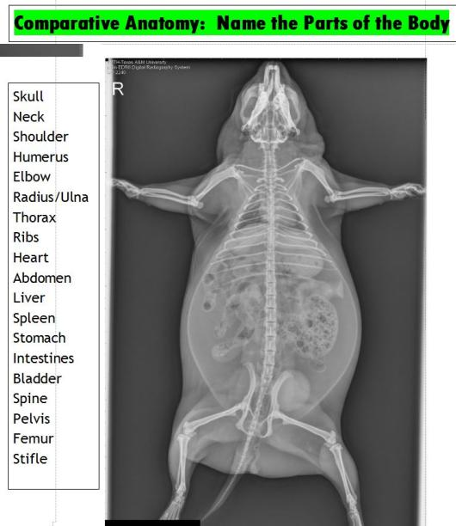
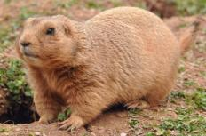
Prairie Dog

Slide 5
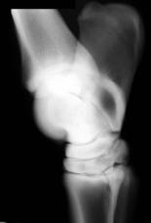
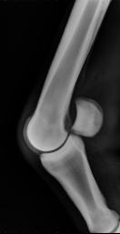
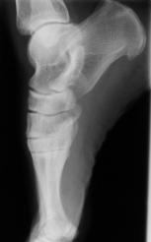
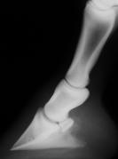
Comparative Anatomy : Horse to Human
Carpus
Metacarpus
Phalanges
Elbow
Stifles
Tarsus
Metatarsus

Slide 6
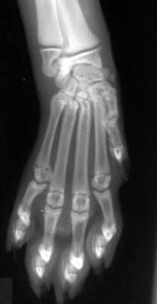
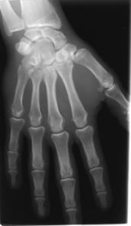
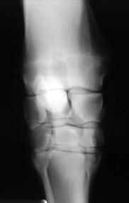
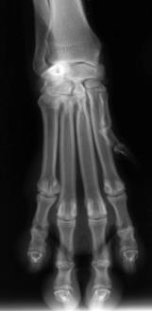
The Hand or: Carpus, Metacarpus and Phalanges
Horse Carpus or “Knee”
Dog Paw
Cat paw

Slide 7
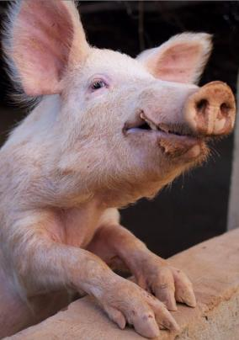
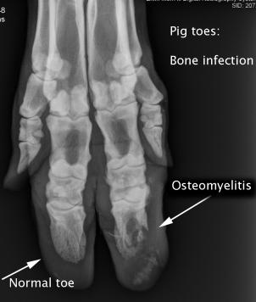

Slide 8
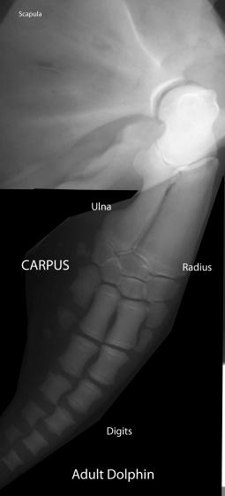
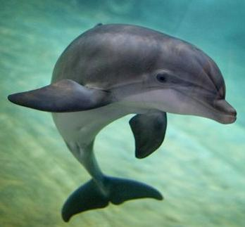
Dolphin Front Flipper

Slide 9
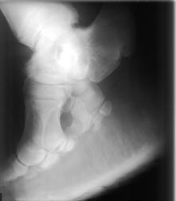
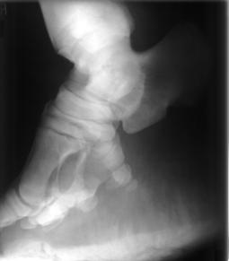
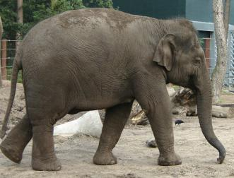
Elephant Tarsus and Metatarsal bones

Slide 10
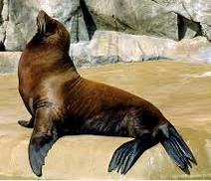
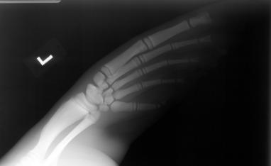
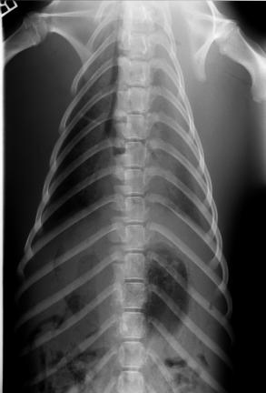
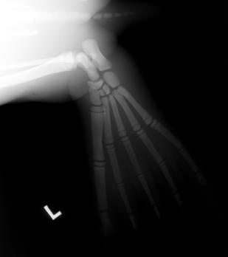
Sea lion

Slide 11
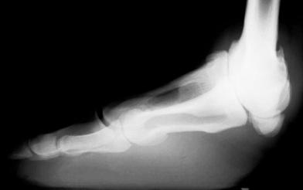
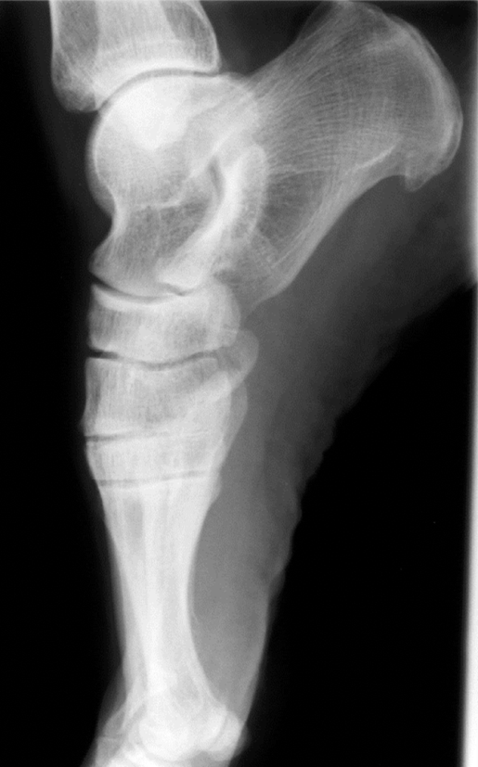
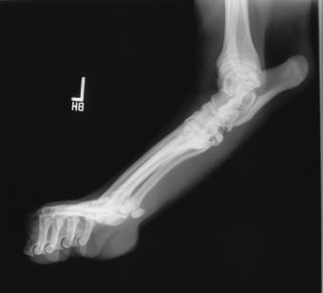
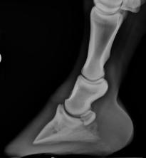
Camel
Human
Humans and camels walk plantigrade. Other animals walk on their toes
Horse
Cat

Slide 12
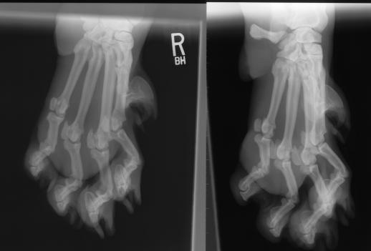
Tiger Paws!

Slide 13
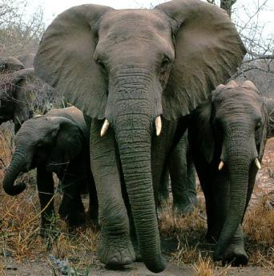
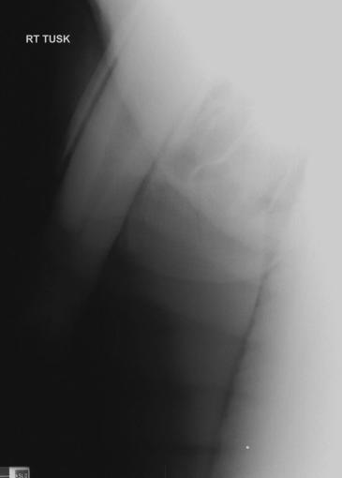
African elephant

Slide 14
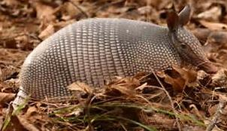
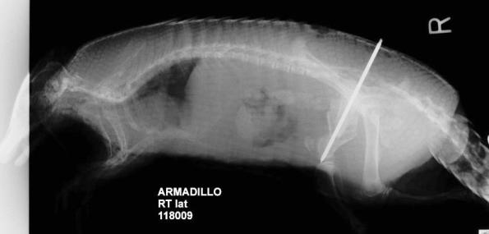

Slide 15
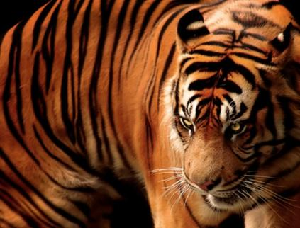
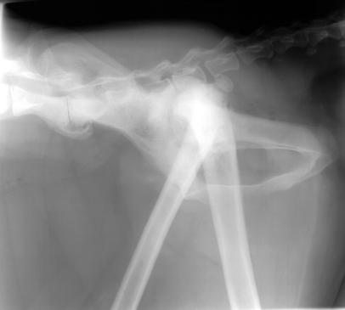
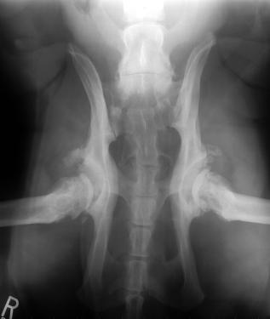
Arthritic Hips in Big Cat

Slide 16
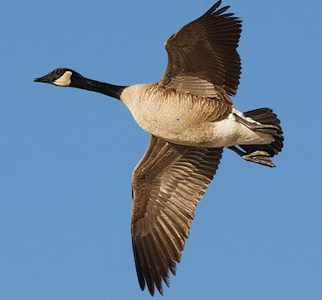
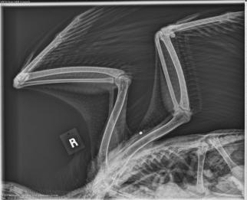
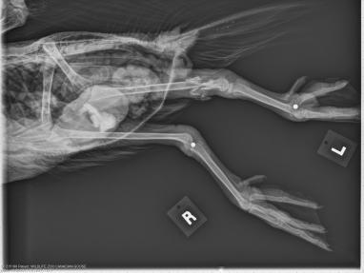
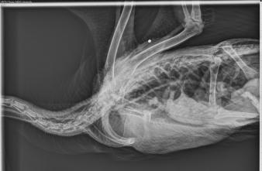
Canadian Goose Injured: fractured leg

Slide 17
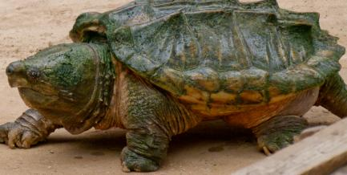
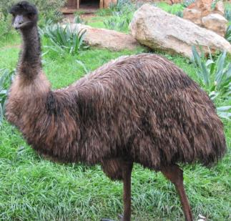
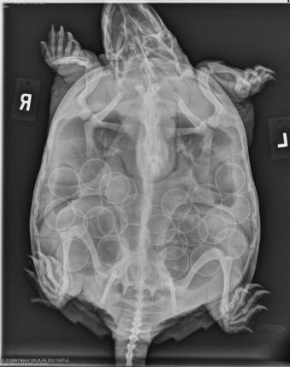
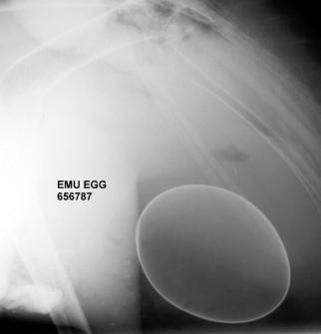
Eggs

Slide 18
Love birds or Sun Conure

Slide 19
Duck with Egg

Slide 20
Animals will swallow things they
should not have ;
Turtle with Fish Hook
Seal with Fish Hook

Slide 22
Turtle that eats rocks and mud

Slide 23
Snake: Boa constrictor

Slide 24
Skull: sinus and Teeth
Rhinoceros

Slide 28
Tiger

Slide 29
Giraffe

Slide 30
Rabbit

Slide 31
Sea Turtle

Slide 32
Sea lion

Slide 33
Stingray

Slide 34
Triggerfish

Slide 35
Tucan Bird

