Slide 1
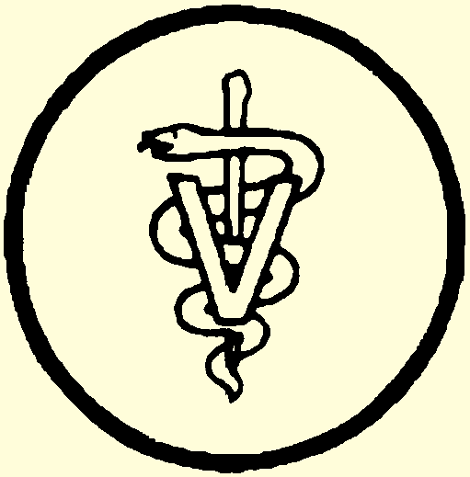
The Human-Animal Bond
Veterinary Medical Applications

Slide 2
What is The Human-Animal Bond?
What is the relationship between animals and humans?
What does this mean to you?
How is it important to a veterinarian?

Slide 3
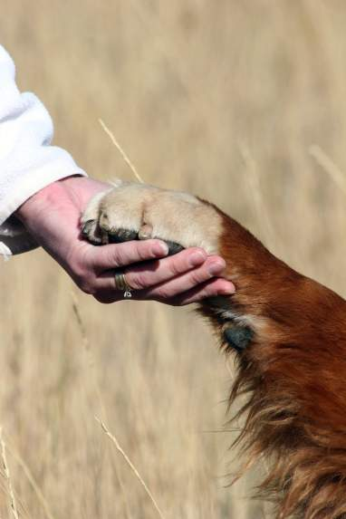
What is The Human-Animal Bond?
The mutually beneficial relationship between people and animals that is influenced by behaviors that are essential to the health and well-being of both.

Slide 4
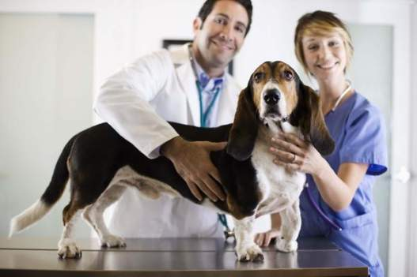
What is The Human-Animal Bond?
The veterinary assistant’s role in the human-animal bond is to maximize the benefits of this relationship between people and animals.

Slide 5
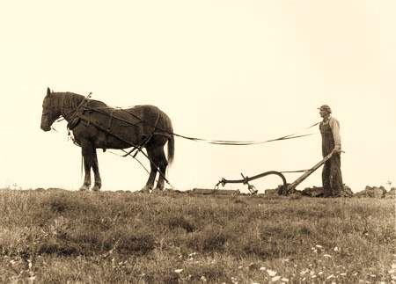
Importance of animals in society
Human-Animal bond has existed for thousands of years
Early American society was rural and people relied on their animals for transportation, farming, protection, clothing and food.
Notes:
Chapter I, Section 3
Faries, F.C. Jr., DVM, MS (1995). Veterinary assistant handbook. College Station, TX: Instructional Materials Service.

Slide 6
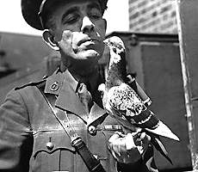
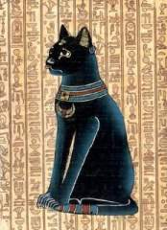
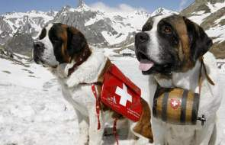

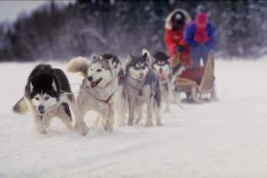
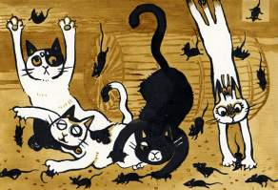
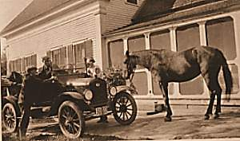
1790- St. Bernard's were the first Rescue dogs
1914- During WWI carrier pigeons were used
Ancient
Egyptians
Worshiped
Cats
Pets become
family members
1925- Working sled dogs were used to deliver diphtheria vaccines to Alaskans
Ancient Middle Easterners kept cats for hunting mice
1908- Mass production of automobiles decreases the need of horses for transportation
Click each picture to learn more!

Slide 7
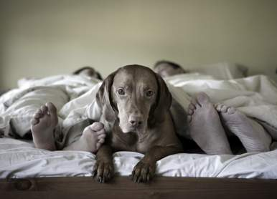
Importance of animals in society
The United States have become more urban over the years and no longer rely on animals for the same reasons.
People share new relationships with animals:
Companion Pets
Pleasure riding horses
Guide dogs
Law enforcement dogs
Notes:
Chapter I, Section 3
Faries, F.C. Jr., DVM, MS (1995). Veterinary assistant handbook. College Station, TX: Instructional Materials Service.

Slide 8
Importance of animals in society
Can you think of any other
human-animal relationships?

Slide 9
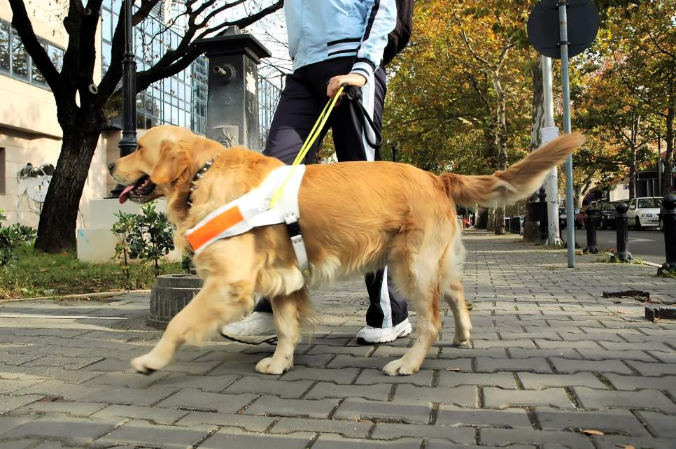
Importance of animals in society
Notes:
Guide Dogs
This guide dog may be assisting a blind or deaf owner during her daily activities.

Slide 10
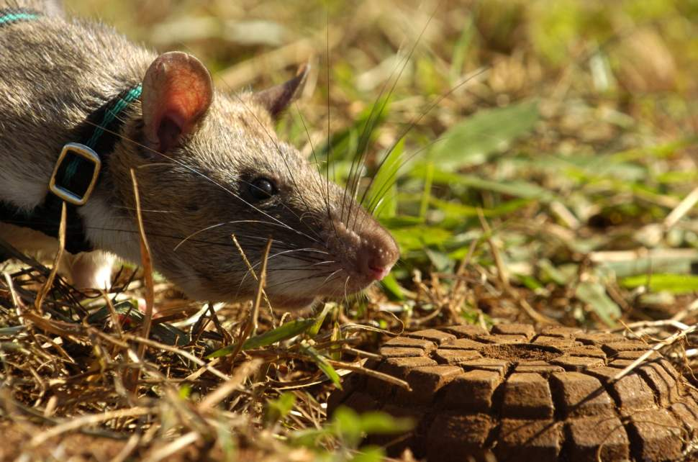
Importance of animals in society
Notes:
Bomb Sniffing Rats
These rats are used to detect land mine bombs. They are light enough that they do not set them off.

Slide 11
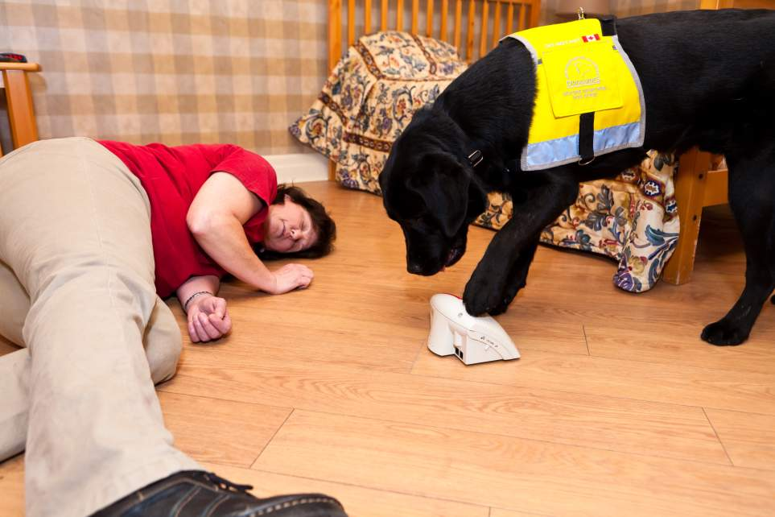
Importance of animals in society
Notes:
Seizure Alert/Response Dogs
This dog (in training) is alerting the life alert that his owner is having a seizure.

Slide 12
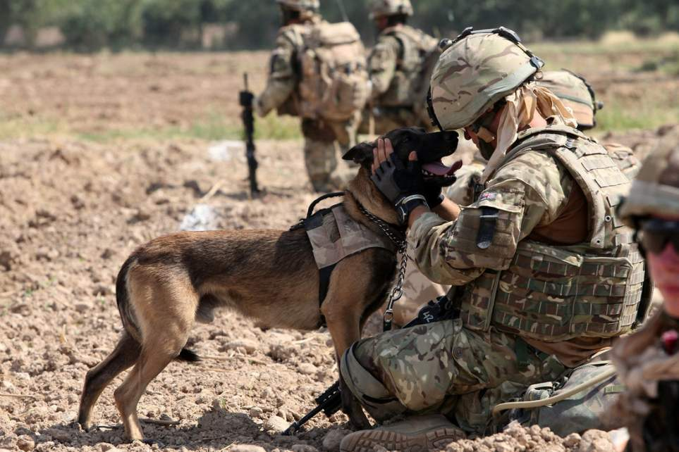
Importance of animals in society
Notes:
Military Dogs
These dogs can detect explosives and search for missing soldiers, among MANY other important responsibilities during war.

Slide 13
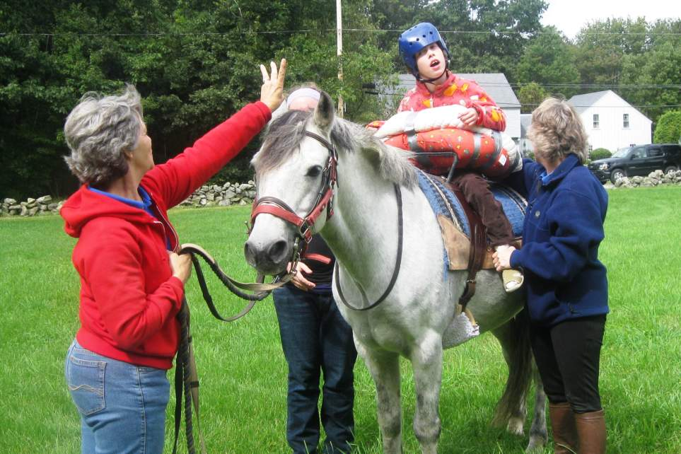
Importance of animals in society
Notes:
Therapy Animals
This horse is allowing this mentally and physically disabled child to develop increased balance and muscle control, improve concentration and short-term memory, and enhance their confidence and self-esteem.

Slide 14
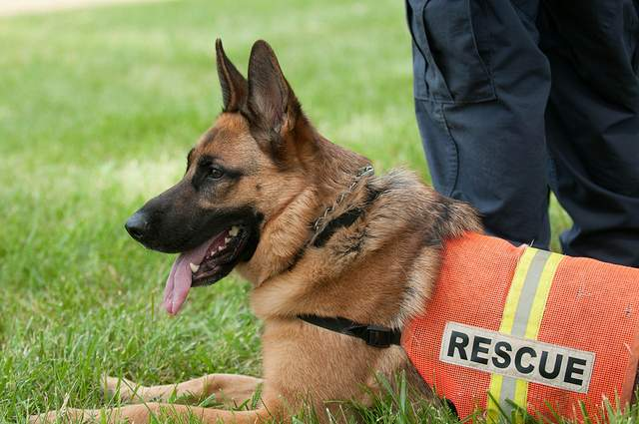
Importance of animals in society
Notes:
Search and Rescue Dogs
These dogs are able to find missing persons. Search and rescue dogs were used to find survivors during the 9/11 collapse in NY.

Slide 15
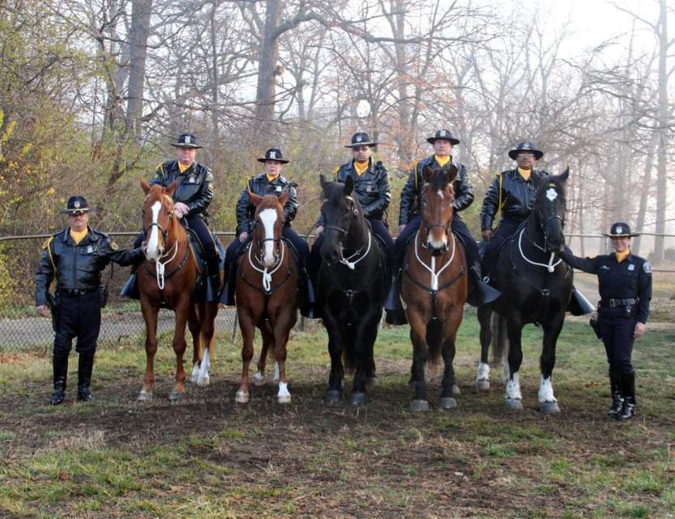
Importance of animals in society
Notes:
Law Enforcement Animals
These police officers are assisted by their equine partners in crime. Dogs are also used to capture dangerous criminals and sniff out explosives and drugs.

Slide 16
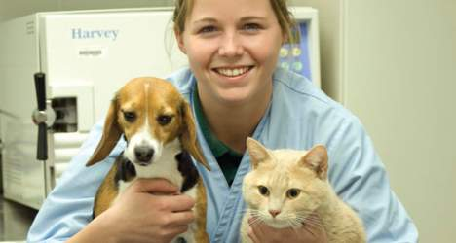
Interactions with Animals
As a veterinary assistant, your role when interacting with patients is to:
ensure the animal and veterinarian are both safe and at ease during the examination
calm anxious patients
ensure the well-being of the animal
Notes:
Chapter I, Section 2: Clinic Practice
Faries, F.C. Jr., DVM, MS (1995). Veterinary assistant handbook. College Station, TX: Instructional Materials Service.

Slide 17
Interactions with Animals
What are some other ways you SHOULD interact with the patients?
What are some ways you SHOULD NOT interact?

Slide 18
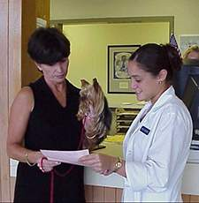
Interactions with Clients
As a veterinary assistant, your role, when interacting with clients, is to always:
Be eager to please clients
Remain calm when dealing
with an upset client
Have a professional
appearance and friendly expression
Have a positive attitude with clients
Notes:
Chapter II, Section 2
Faries, F.C. Jr., DVM, MS (1995). Veterinary assistant handbook. College Station, TX: Instructional Materials Service.

Slide 19
Interactions with Clients
Why might BAD interactions with clients impact the human-animal bond?

Slide 20
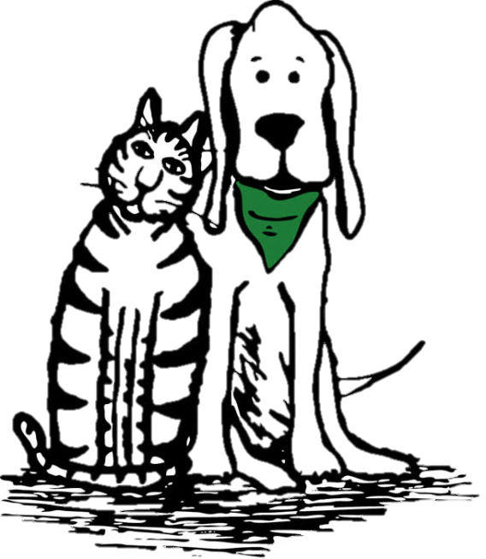
Animal Welfare and Animal Rights
Animal welfare laws focus on preventing
animal suffering.
People are expected to respect animals
and their needs, not out of kindness, but
out of justice and fairness.
This does not imply that animals should be treated as equals with people.
AVMA: “The Veterinarian’s Role in Animal Welfare”
Notes:
Chapter I, Section 3
Faries, F.C. Jr., DVM, MS (1995). Veterinary assistant handbook. College Station, TX: Instructional Materials Service.

Slide 21
Animal Welfare and Animal Rights
Animal Welfare
Based on the science of well-being and productivity of an animal. This involves the humane treatment of animals.
Animal Rights
Based on the philosophy that all animals have equal rights with humans. We would no longer be able to use animals for food, clothing or pets.
Notes:
Chapter I, Section 3
Faries, F.C. Jr., DVM, MS (1995). Veterinary assistant handbook. College Station, TX: Instructional Materials Service.

Slide 22
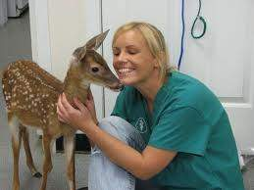
Are all policies and procedures guided by state regulation?
No! Other laws can be regulated by the practice, local, state or federal ruling such as:
Veterinarian and client relations
Disease laws
Food and feed laws
Drug laws
A veterinary assistant must understand what laws to follow while at work.
Notes:
Chapter I, Section 4
Faries, F.C. Jr., DVM, MS (1995). Veterinary assistant handbook. College Station, TX: Instructional Materials Service.

Slide 23
Ethics in Veterinary Medicine
What are Ethics?

Slide 24
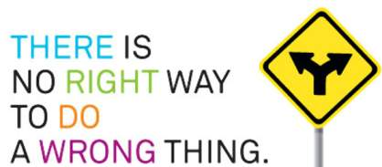
What are Ethics?
● Values relating to an action being right or
wrong.
Rules of conduct that protect clients,
patients and veterinary professionals.
● Moral principles

Slide 25
Important Principles of Veterinary Medical Ethics
Professional Behavior should always be practiced.
Veterinary-Client-Patient Relationship is of utmost importance.
Influences on Judgment should be made with consideration to the patient’s needs.
Medical Records are confidential.
View entire list of AVMA Principles of Veterinary Medical Ethics and extended descriptions

Slide 26
TEKS
Veterinary Medical Applications
2) The student researches current topics in veterinary medicine, recognizes the importance of animals in society, and discusses professional ethics and laws that relate to veterinary medicine. The student is expected to:
  (A) explain the human-animal bond and how to interact with clients and their animals;
  (B) identify trends, issues, and historical events that have influenced animal use and care;
  (C)describe the legal aspects of animal welfare and animal rights
  (D) evaluate the principals of veterinary medical ethics; and
  (E) review policies and procedures in veterinary medicine that are considered a reflection of various local, state, and federal laws.

