Slide 1
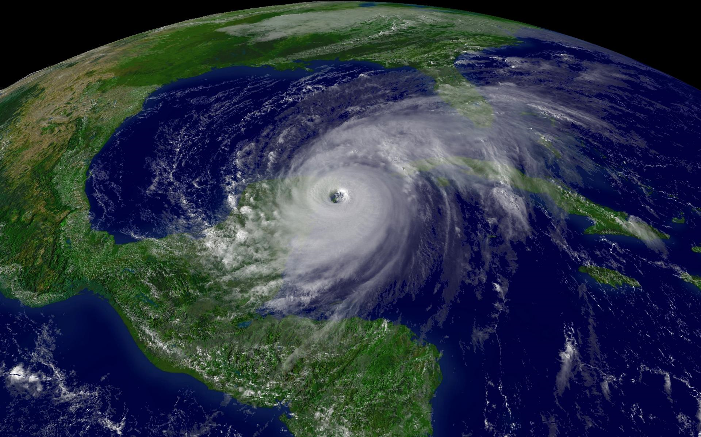
Hurricanes
Engines of destruction
http://dave.isom.us/wp-content/uploads/2012/01/Hurricane_Wilma_200510212015.jpg

Slide 2
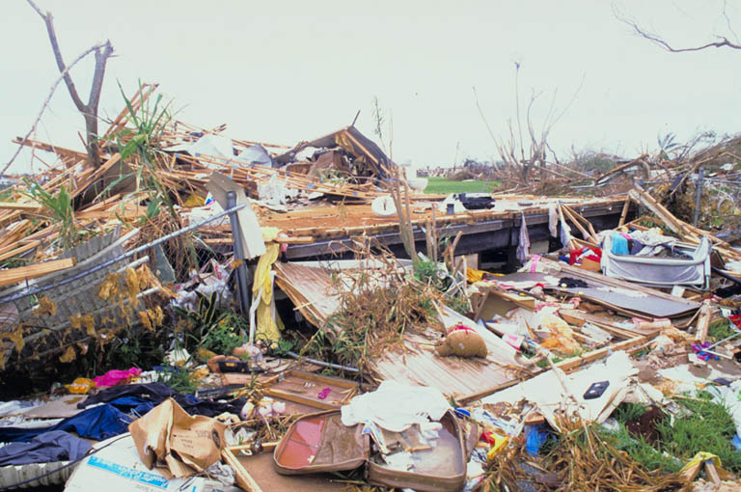
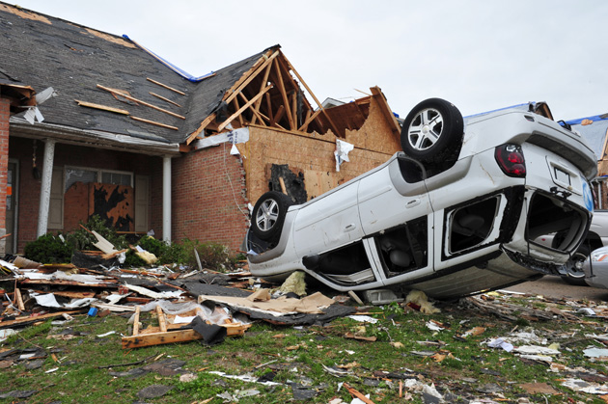
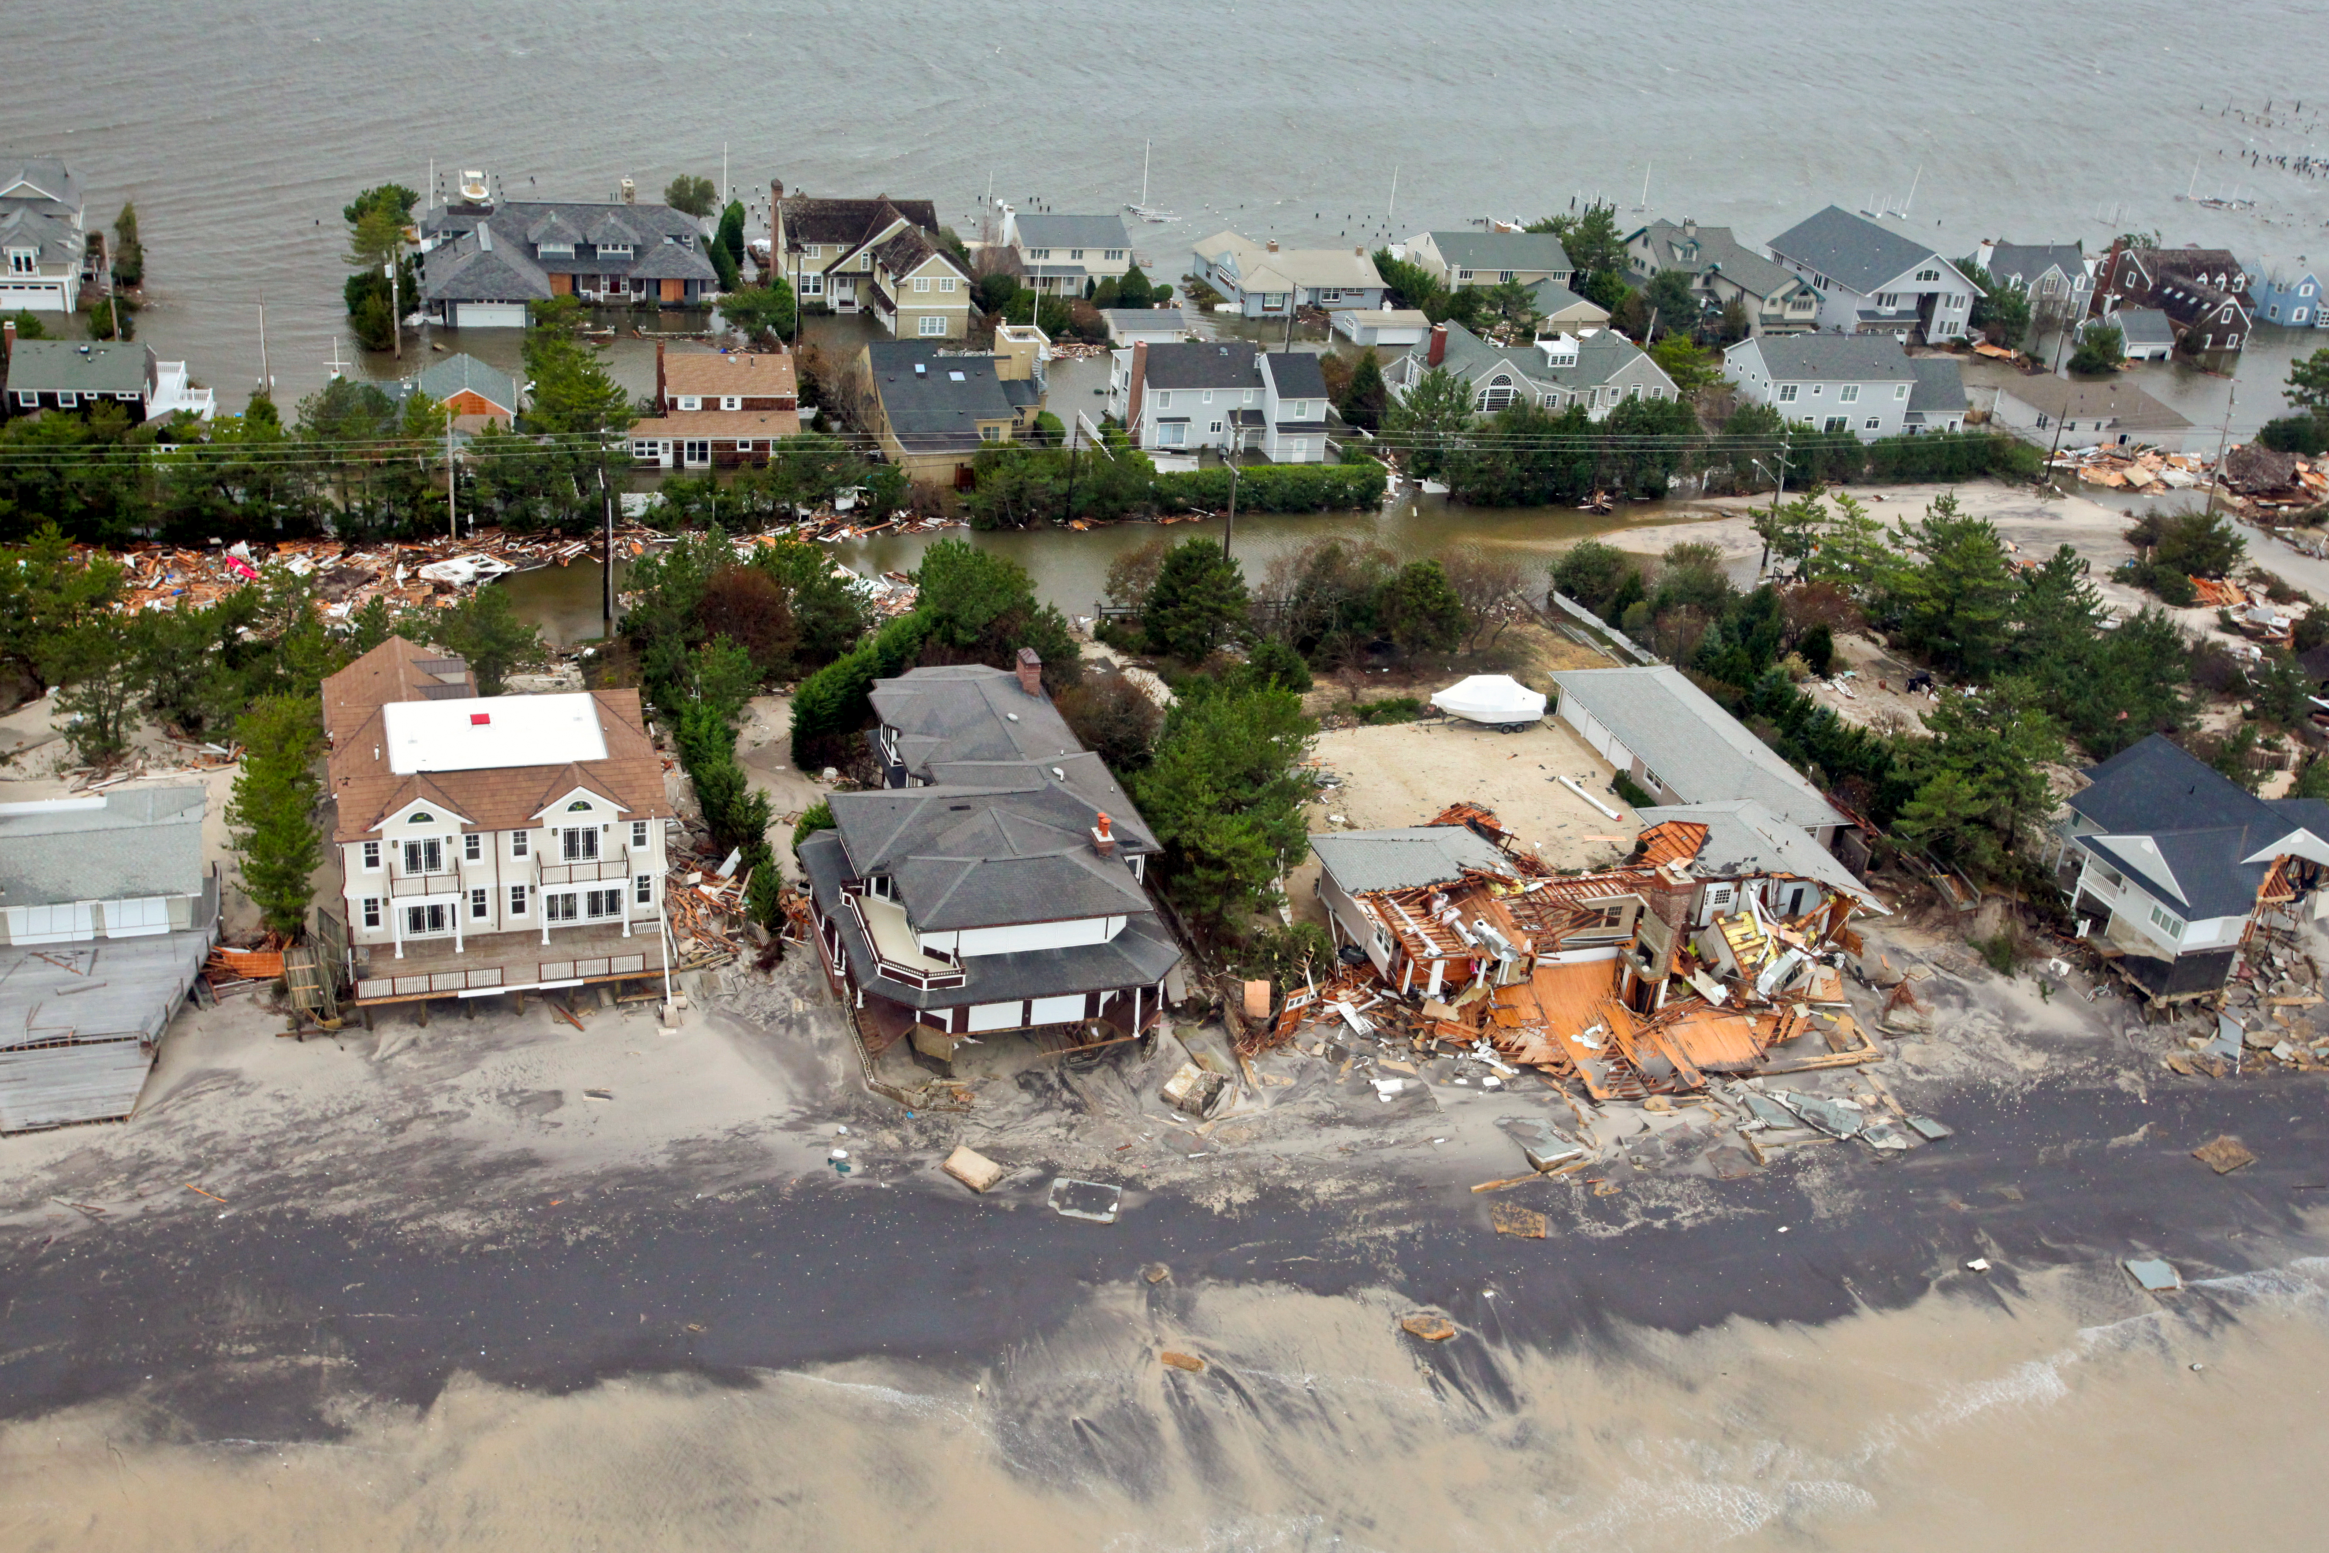

Slide 3
Your experiences
Have you ever experienced a hurricane? Describe what happened.
Name any hurricanes you have heard of.
What is the most destructive hurricane in history?
Notes:
1900 Galveston Hurricane is the deadliest in US history – between 8,000 and 12,000 died in this hurricane; the south, east and west sides of the city were destroyed as far as five blocks inland by a storm surge up to 15 feet high. An estimated 3,500 homes and buildings were destroyed.

Slide 4
What’s the difference?
Compare and Contrast Hurricanes with other strong storms.
Hurricane
Storm
Notes:
Similarities: strong winds, rain, thunder, lightning, tornadoes, dense clouds
Storm: interaction of cold and warm air masses in the atmosphere, occur in every region of the world, any season
Hurricane: rotating, low pressure system; winds of 74 mph or more, develops over warm, tropical waters, occur June through November
Students may not know many similarities and differences at this point; be sure to return to this chart at the conclusion of the lesson.

Slide 5
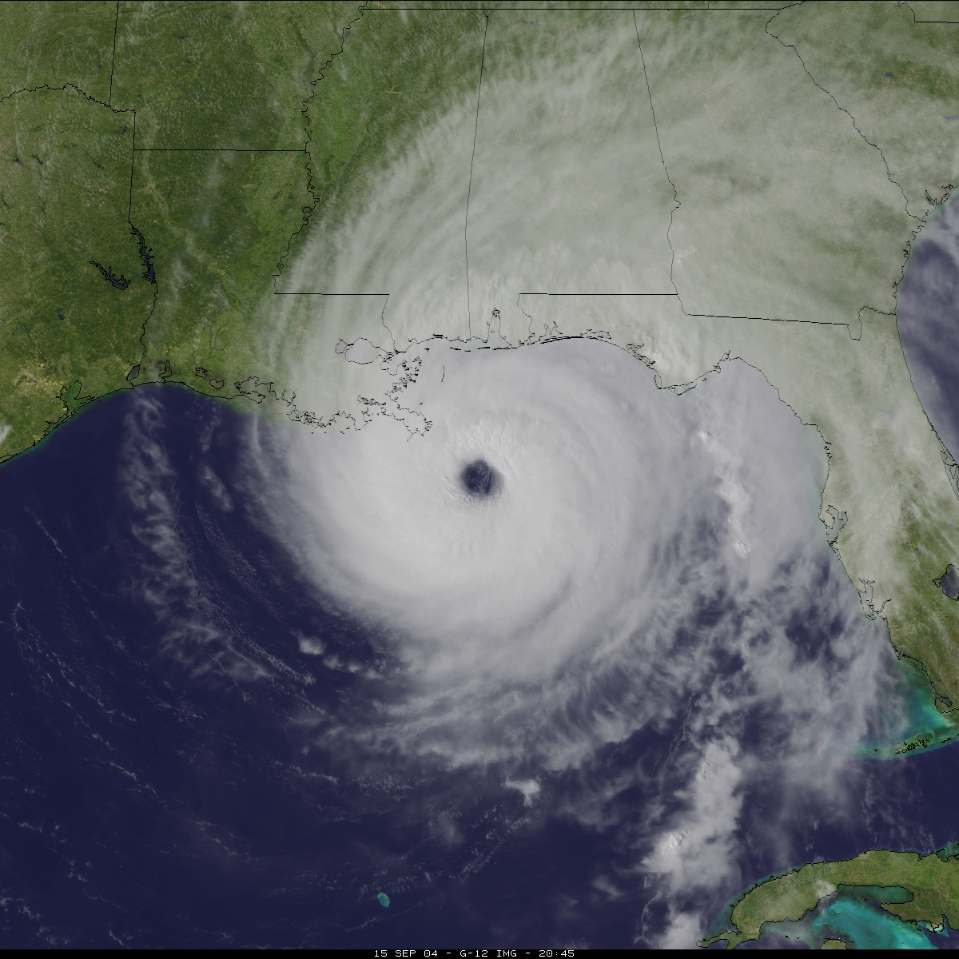
What is a hurricane?
A powerful, rotating storm that forms over warm oceans near the Equator
  Winds rotate counterclockwise at least 74 miles (119 kilometers) per hour, a huge amount of rain, low air pressure, thunder, and lightning
Known as
  Cyclones in the northern Indian Ocean and Bay of Bengal
  Typhoons in the western Pacific Ocean
http://tropic.ssec.wisc.edu/storm_archive/2004/storms/ivan/ivan04259-204500.jpg

Slide 6
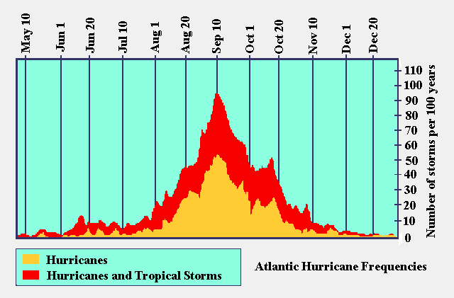
Hurricane season: June 1st – November 30th
  Northern Atlantic
Average five to six hurricanes per year
http://pmm.nasa.gov/sites/default/files/imageGallery/hurricane_depth.jpg

Slide 7
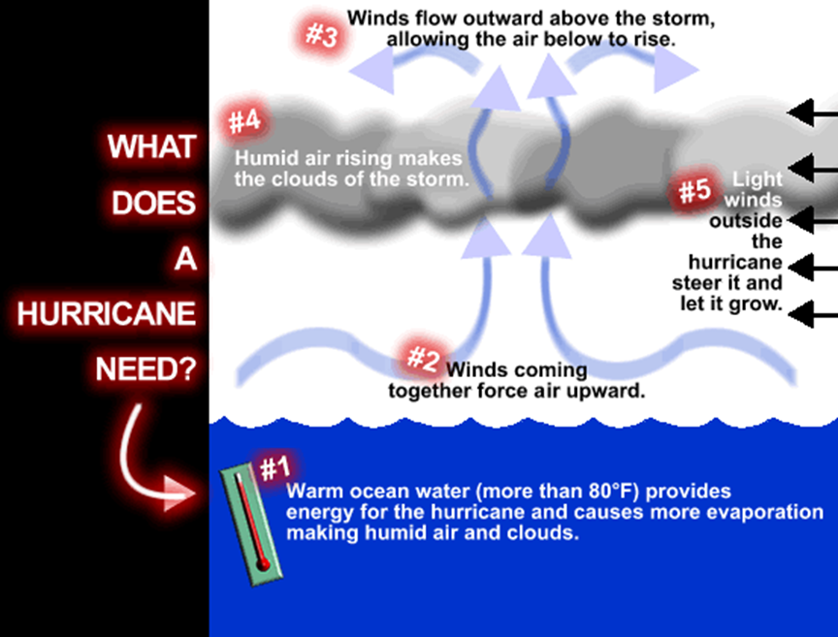
Formation
Conditions
  Low air pressure
  Warm temperatures
    > 80°
  Moist ocean air
  Tropical winds
Mr. Weathers tells us how!
https://youtu.be/qkzbbRPK2k4

Slide 8
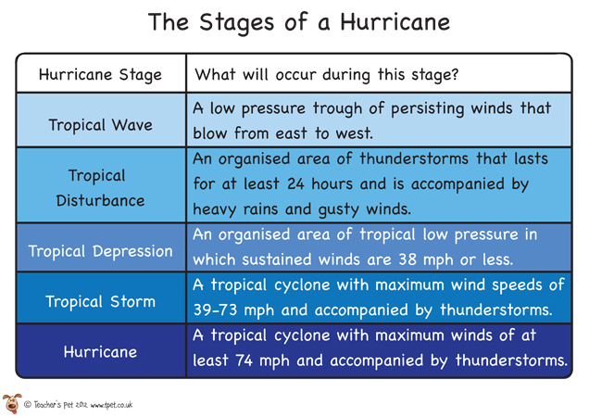
Hurricane Stages

Slide 9
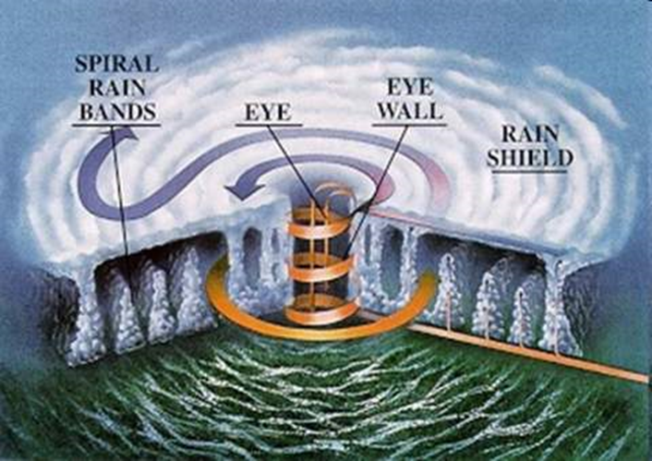
Eye - 20 to 30 miles wide, relatively calm, and little or no rain
  The warmest part of the storm
Eye Wall - a wall of thunderclouds, the most rain and the strongest winds (up to 225 mph)
  The smaller the eye, the stronger the winds.
Spiral Rain Bands - Long bands of rain clouds appear to spiral inward to the eyewall
  Can be hundreds of miles across
Anatomy of a Hurricane

Slide 10
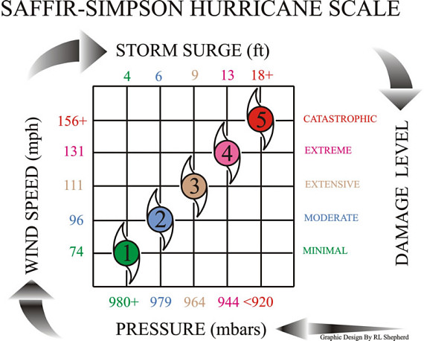
Classifying hurricanes
Saffir- Simpson Scale
Category 1 -- Winds 74-95 mph
Category 2 -- Winds 96-110 mph
Category 3 -- Winds 111-130 mph
Category 4 -- Winds 131-155 mph
Category 5 -- Winds over 155 mph
http://krisinternal.cordillera.tv/hurricane/hurricanescale.jpg

Slide 11
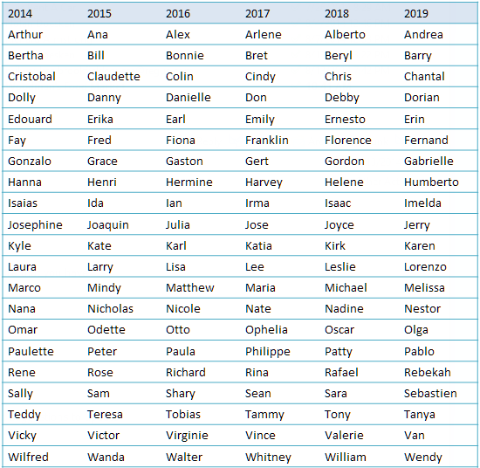
Naming Hurricanes
Why name hurricanes?
  May last for a week or more
  More than one storm at a time
  Prevents confusion
The first tropical storm of the season is given a name that starts with A, the second with a B, and so on
Women's and men's names are alternated
http://blogs.cdc.gov/publichealthmatters/files/2012/06/Atlantic-Hurricane-Names.jpg
Notes:
In 1979 a six year rotating list of Atlantic storm names was adopted .
Storm names are used to facilitate geographic referencing, for warning services, for legal issues, and to reduce confusion when two or more tropical cyclones occur at the same time
Through a vote of the World Meteorological Organization Region IV Subcommittee, Atlantic cyclone names are retired usually when hurricanes result in substantial damage or death or for other special circumstances

Slide 12
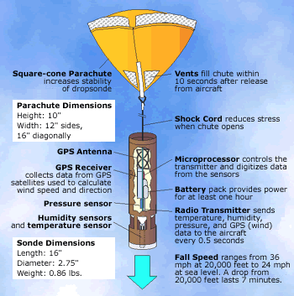
Tracking a hurricane
Click the Picture for a Video
Planes able to handle high winds and rain fly into the eye
A GPS locator (dropsonde) and tracking equipment is dropped into the eye
Wind speed, pressure, and location are recorded
Hurricane location is easily tracked, but the direction, speed, and intensity can change quickly.
http://earthobservatory.nasa.gov/Features/camex4/Images/dropsonde2.gif
Notes:
This will allow people at the National Hurricane center to interpret data that is collected to gage the strength of the storm and its path
The Hurricane Center will then keep close watch on the storm to predict where it will hit land
Great tracking activities: http://www.enchantedlearning.com/subjects/weather/hurricane/tracking.shtml

Slide 13
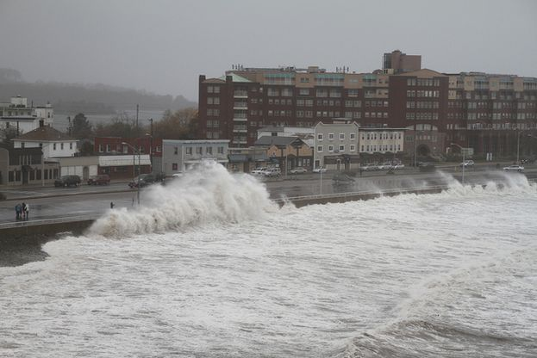
Signs of an approaching Hurricane
36 Hours Before Landfall
  First signs of the storm
  Pressure falls, breezy, swells 10 to 15 feet high
  White cirrus clouds visible
  Hurricane warning issued
24 Hours Before Landfall
  Overcast
  High winds (35 mph) rough, choppy seas
  Final storm preparations for individuals not evacuating

Slide 14
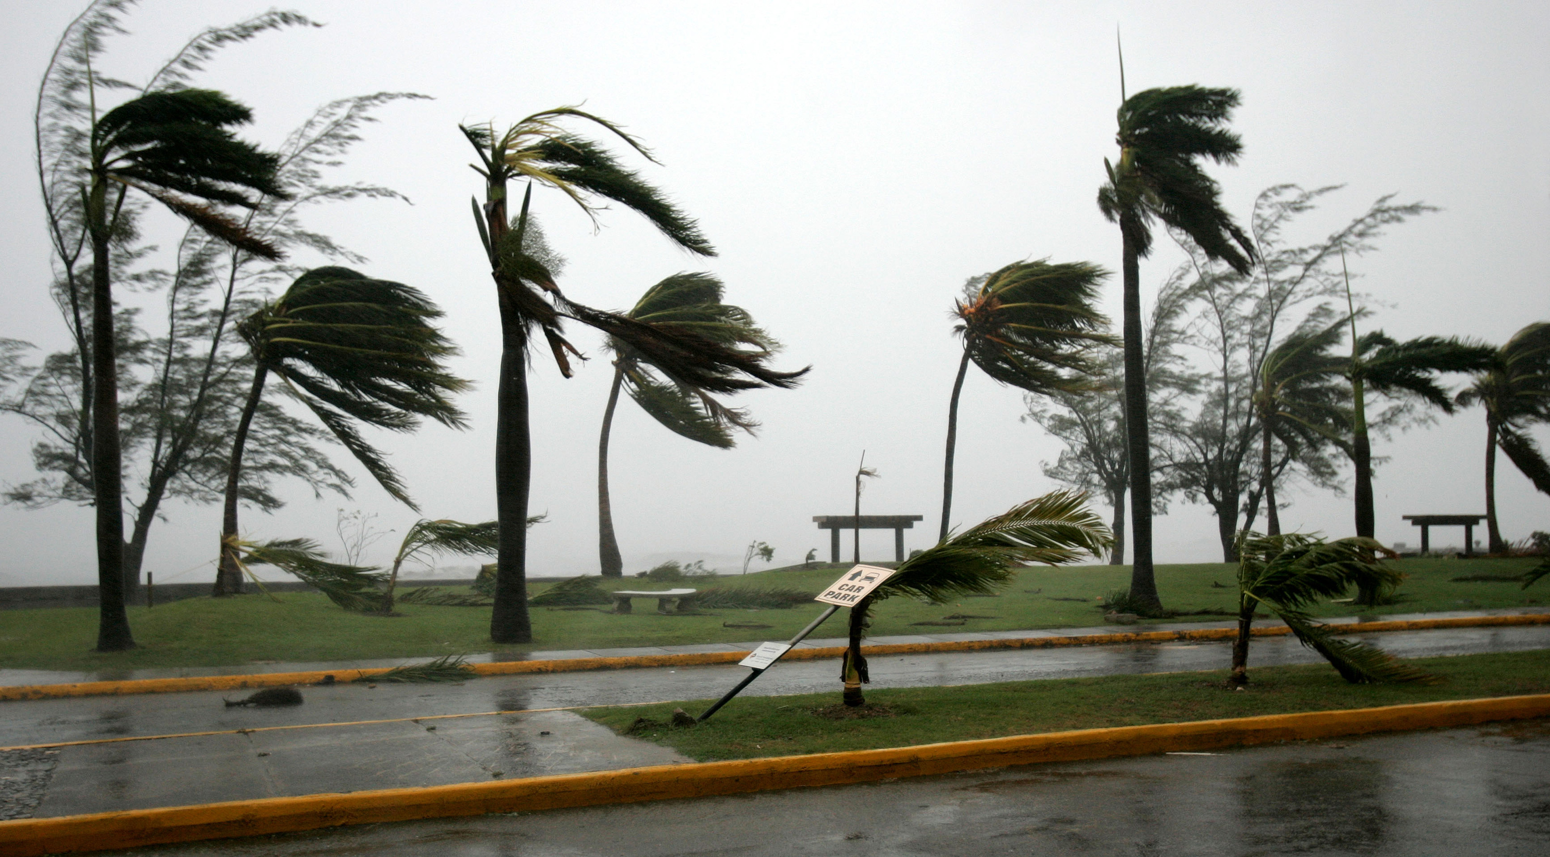
12 Hours Before Landfall
  Thick clouds with intense bands of precipitation
  Gale force winds of 74 mph
  Pressure is falling
6 Hours Before Landfall
  Winds of over 90 mph drive rainfall horizontally and carry heavy objects
  Storm surge has advanced above the high tide mark
http://www.hurricane-tracking.co.uk/hurricane_fay_maps/fay_080815_1700edt.gif

Slide 15
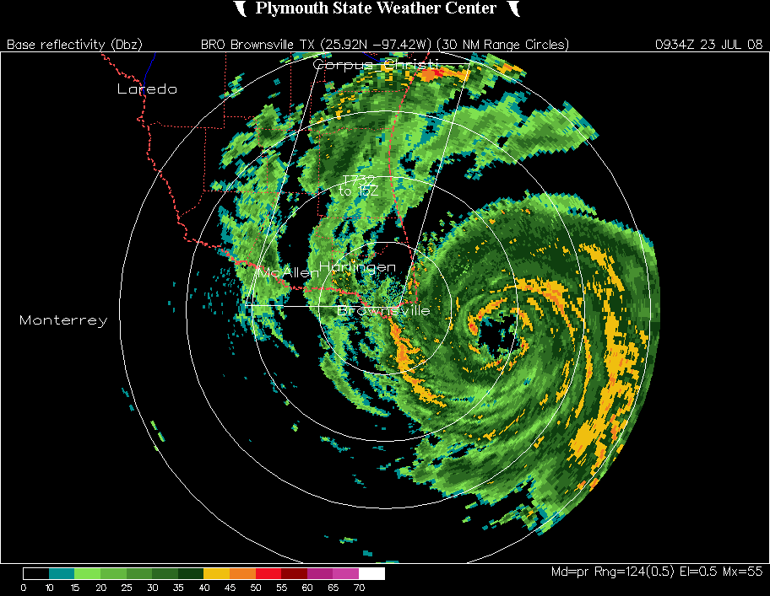
1 Hour Before Landfall
  Torrential rain
  15+ foot waves
  Flooding of low-lying areas
  Pressure continuously drops
  winds of over 100 mph
Landfall
  Worst storm conditions
  Hurricane's eye moves over land
    Wind and rain stop, blue sky, remains warm and humid - Continues for short time (depending on the eye size and storm speed)
  Eye passes, winds shift direction, and storm conditions return
36 hours after landfall conditions begin to stabilize
http://ziqum.com/wp-content/uploads/2011/08/Hurricane-Tracker.jpg

Slide 16

Ride out the storm!

Slide 17
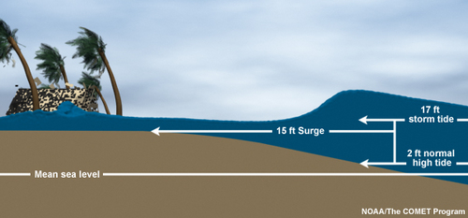
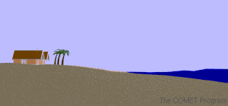

Hurricane impact
Storm surge
  Spiraling winds push water into a mound at the storm’s center which is carried onto land
  Causes major flooding - often the most devastating effect of a hurricane
  Measured by calculating the difference between high tide and storm tide (can be 15’ or more)
  Shallow coastlines experience more damage than deep coastlines

Slide 18
Storm surge

Slide 19
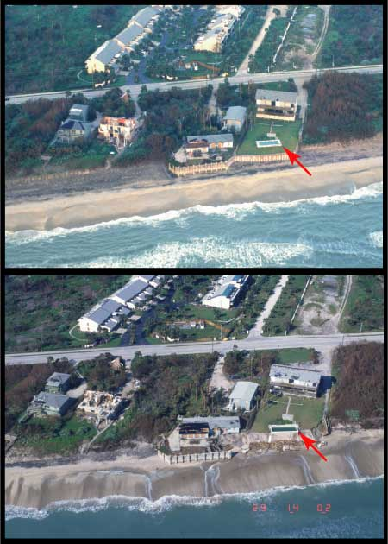
Hurricane impact
Coastal change
  Storm surge and large waves erode the beach and dune system and reshape the coastal landscape.
Types:
  Beach Erosion: waves and currents remove sand from the beach system.
  Dune Erosion: waves attack the front face of the sand dune, reducing the volume and elevation of the dune
  Overwash: waves exceed the elevation of the dune, sand is transported across island
Notes:
Dune erosion shown

Slide 20
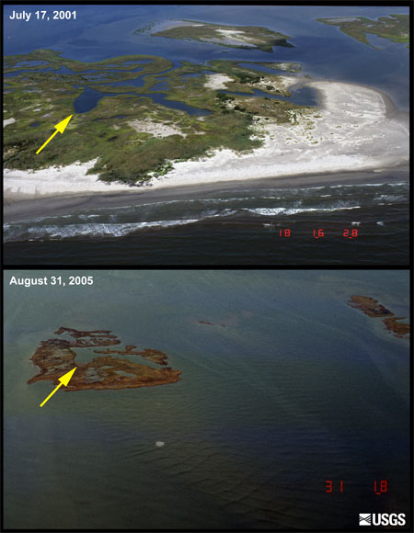
Coastal change continued
  Inundation and Island Breaching: the sandy profile located between the most seaward dune and the shoreline, is completely submerged under the rising storm surge; may carve a channel in the island
  Marsh Erosion: waves and currents erode the wetland soil, causing significant losses of land area
  Coastal Cliff Erosion: waves and currents on coastal cliffs may cause the base of coastal cliffs to erode, eventually undermining the cliff and causing slumping
Notes:
Marsh erosion

Slide 21
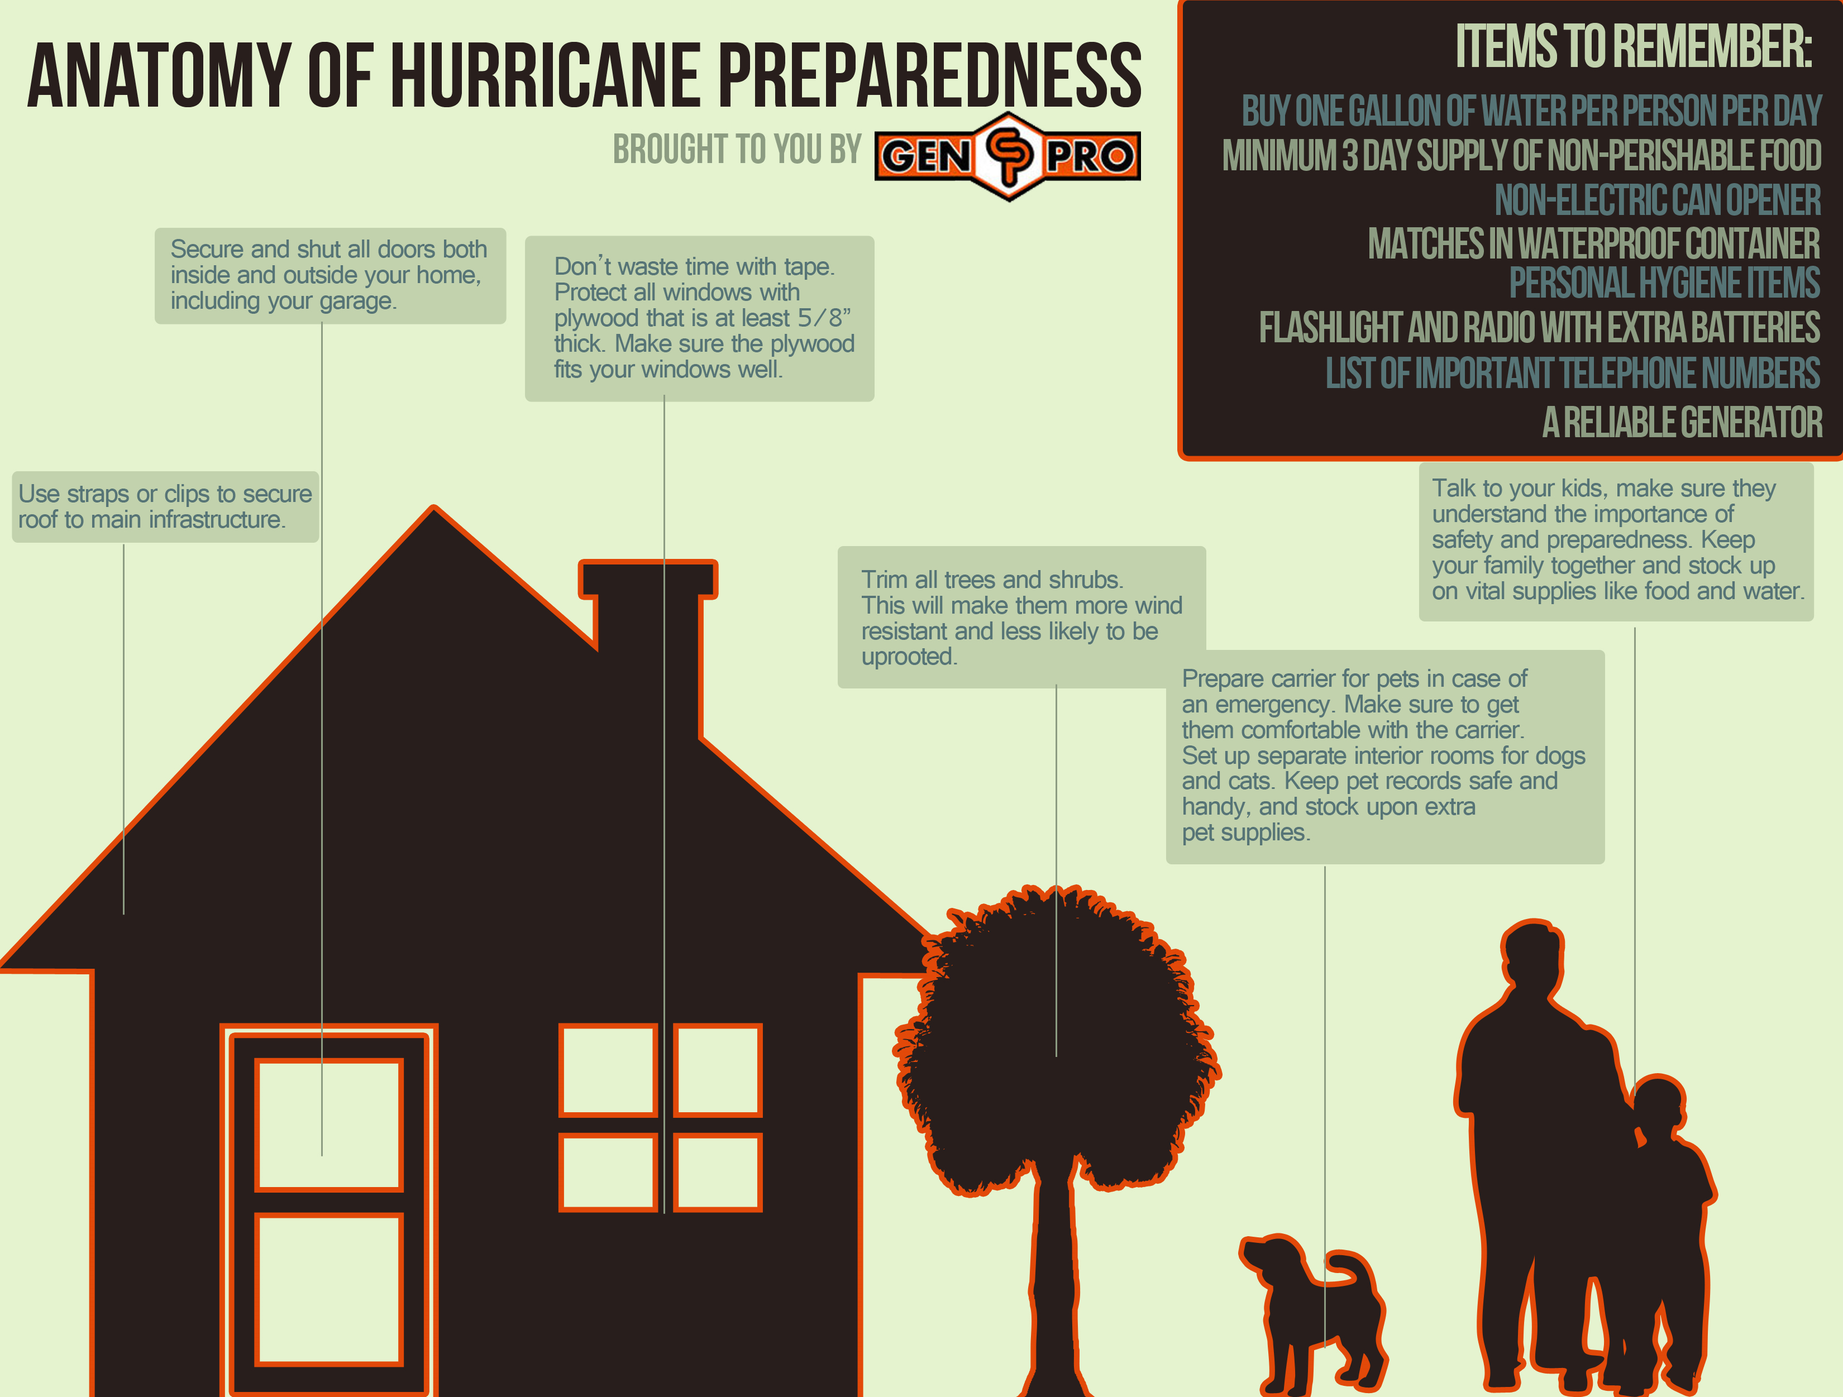
http://www.aagenpro.com/wp-content/uploads/2013/06/Houston-Hurricane-Preparedness-Guide.jpg

Slide 22
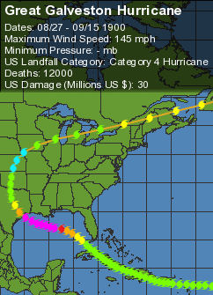
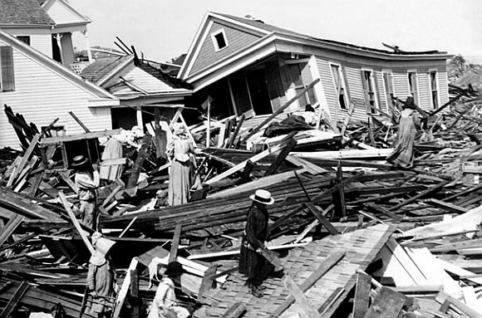
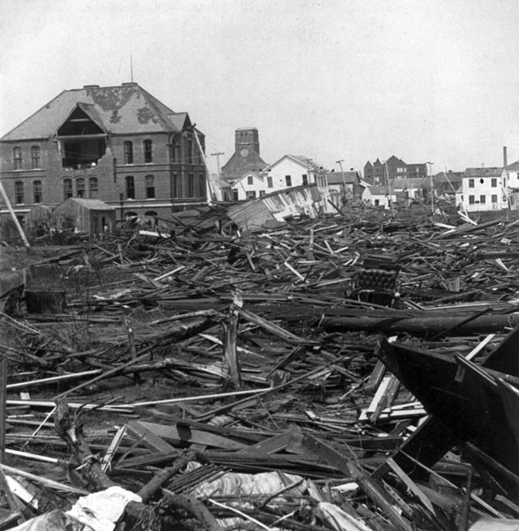
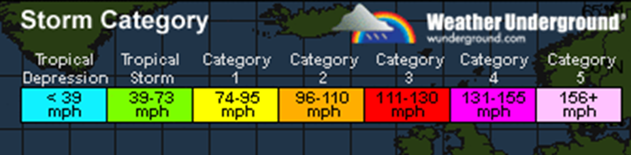
Deadliest Us Hurricane: great Galveston hurricane
http://3.bp.blogspot.com/_6E9M8zE9qnM/TSjZOBf07VI/AAAAAAAAADo/QizGMV9uMag/s1600/galveston3.jpg
http://im.rediff.com/news/2012/oct/30sd2.jpg

Slide 23
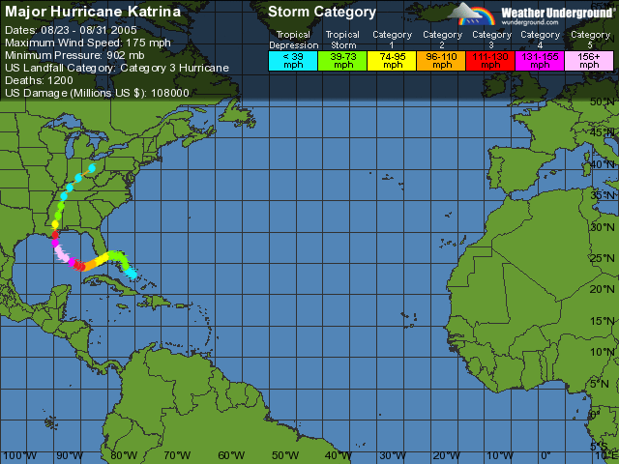
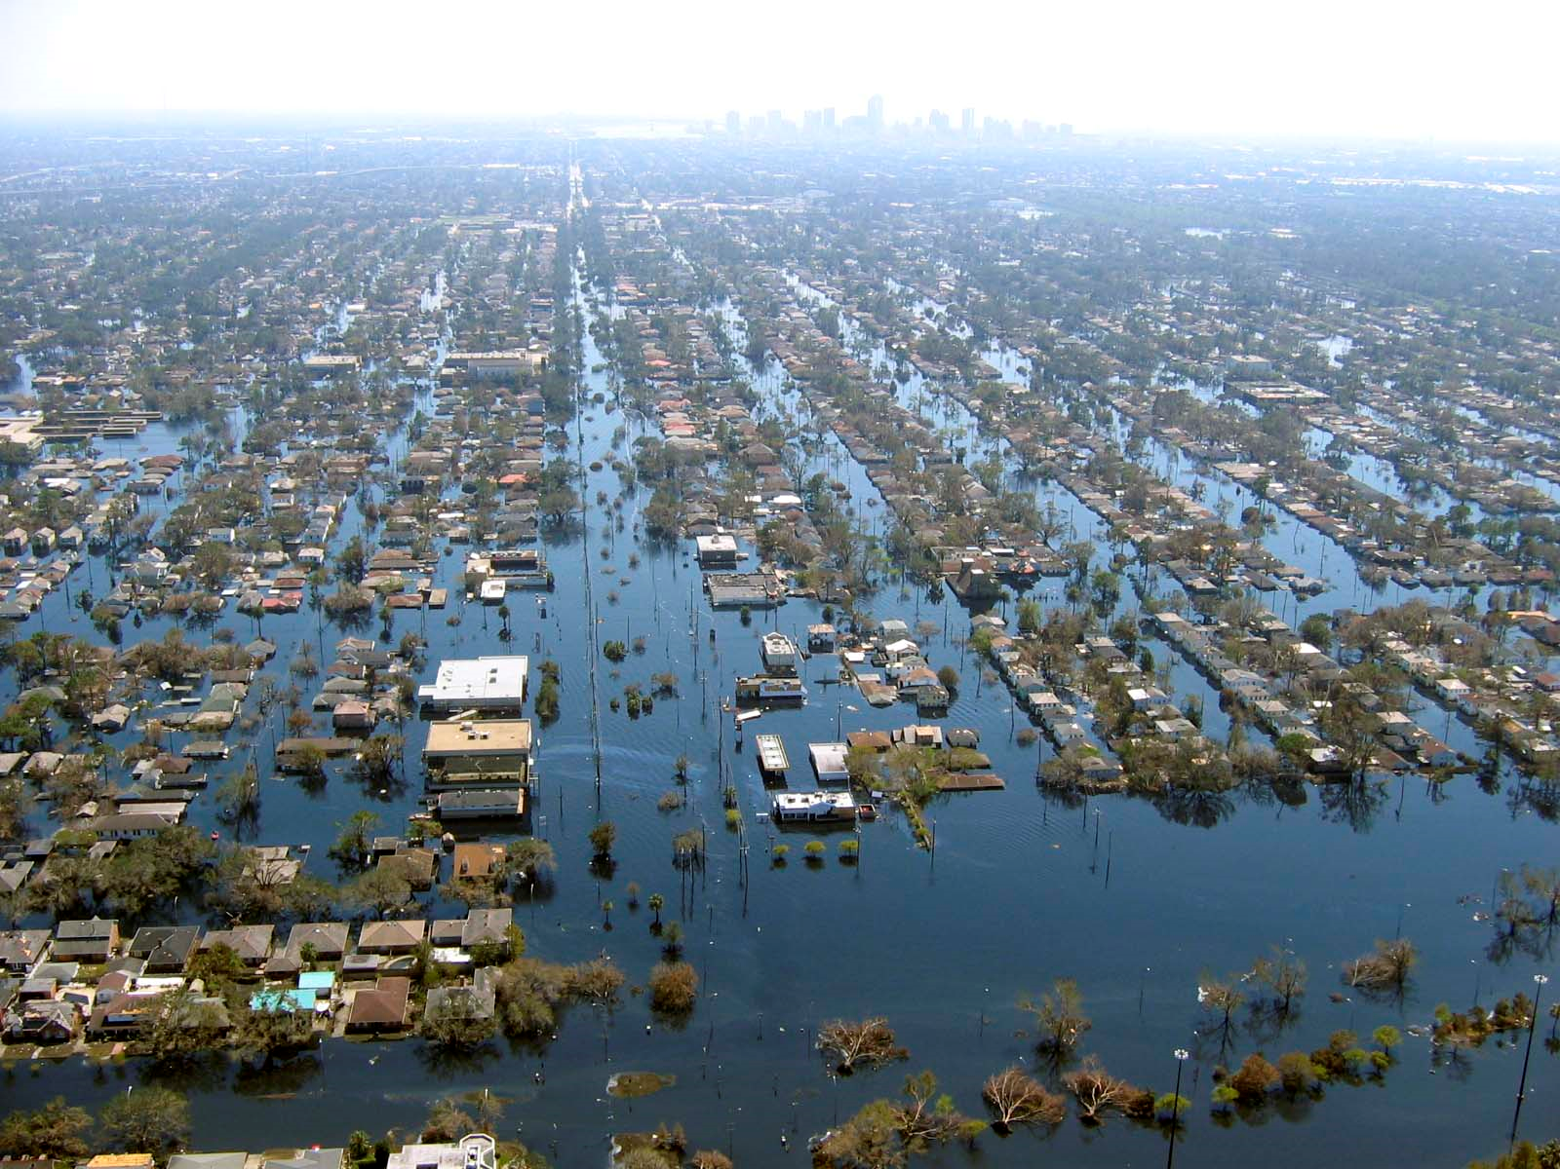
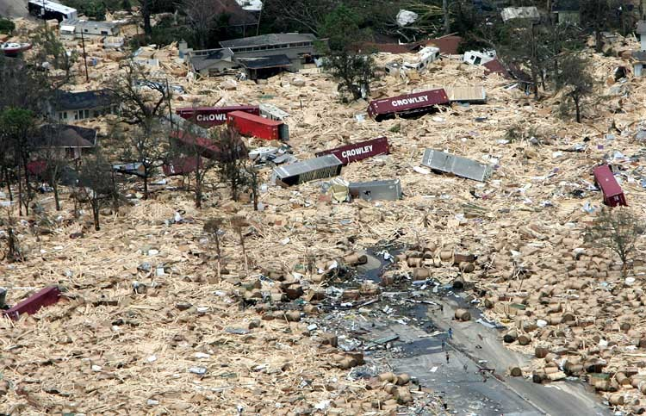
Hurricane Katrina
http://members.tripod.com/4christe/StorageArea.jpg
http://icons.wxug.com/data/dhc_archive_charts/at_2005_charts/at200511.gif
http://designintentions.files.wordpress.com/2010/10/katrina-damage2.jpg

Slide 24
Interesting Facts
Hurricanes spin counterclockwise due to the Coriolis effect.
  Stronger winds and more pressure on the eastern flank
  Storm surge to the east is also more severe
Hurricanes produce enough energy in one day to run the lights of Las Vegas for many years.
The Southern Hemisphere averages about half the number of hurricanes as the Northern Hemisphere.
Since 1944, only four planes have been lost flying into typhoons and hurricanes. No trace of these planes or their crew has ever been found

Slide 25
Review video
https://www.youtube.com/watch?v=zP4rgvu4xDE
Destruction Video
https://www.youtube.com/watch?v=H9VpwmtnOZc

Slide 26
References
http://www.hurricane.com/what-is-a-hurricane.php
http://www.history.noaa.gov/stories_tales/cline2.html
http://environment.nationalgeographic.com/environment/natural-disasters/hurricane-profile/
http://earthobservatory.nasa.gov/Features/Hurricanes/hurricanes_2.php
http://facts.randomhistory.com/hurricane-facts.html
http://www.usc.edu/org/cosee-west/March06Resources/Activities/Weather_Classroom_Hurricane_Teacher_Guide.pdf

