Slide 1
Activity Time!!!
Notes:
http://www.wallpaperpimper.com/wallpaper/Animal/Horses/Horse-16-EPFQYQ9LI2-1600x1200.jpg

Slide 2
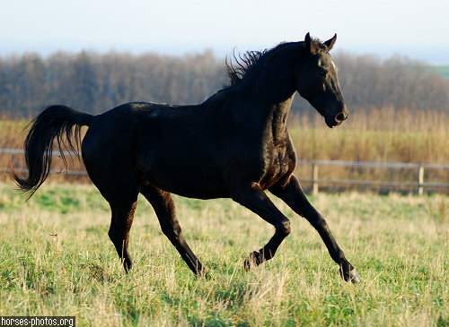
Penicillin is an antibiotic given to horses to treat certain bacterial infections. These injections are given IM. On your paper mark with an X where this injection could be given.
Notes:
http://www.ehow.com/how_2144102_give-injections-horses.html
http://stablemade.com/hproducts/drugs/penicillin.htm
Picture from horses-photos.org

Slide 3
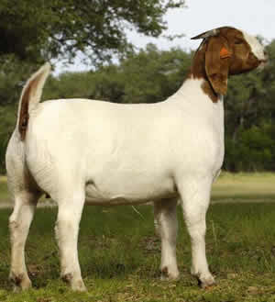
2. Where on this animal should you not do IM injections? Why shouldn’t you use this location?

Slide 4
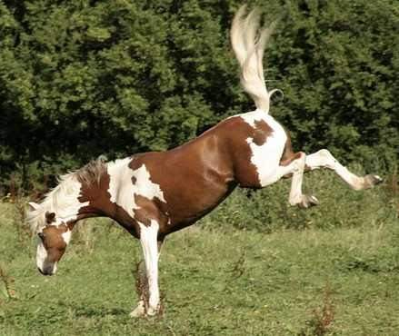
3. If you don’t want to be kicked by a horse, where should you probably give and IM injection?

Slide 5
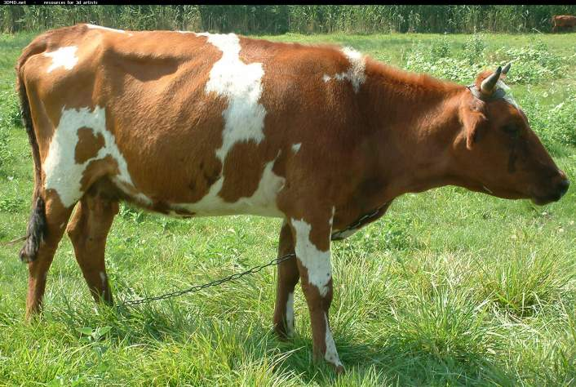
4. If we want a vaccine or medicine to be absorbed slowly we use a ____________ injection. Mark where on the animal shown that we can give this type of injection.

Slide 6
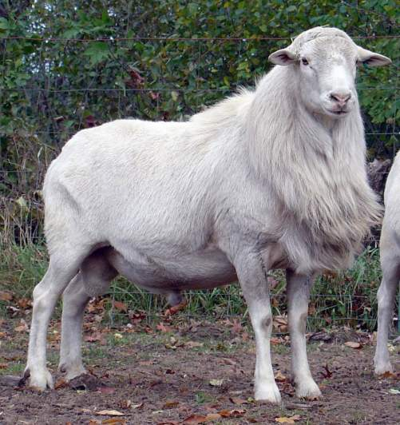
5. Mark on this animal the injection site that should be done by a veterinarian or someone with a lot of training.

