Slide 1
Investing 101
How To Make Your Money Work For You

Slide 2
Subject Layout
What is investing?
How does it work? (Compounding)
Risk Tolerance: Know Yourself
Types of Investments
Portfolios and Diversification

Slide 3
What is Investing?
Definition: The act of committing money or capital to an endeavor with the expectation of obtaining an additional income or profit.
Why is this important?
Letting your money work for you
Investing is NOT gambling
Why might it be important for you to invest?

Slide 4
Why Invest?
Retirement – would you like to retire early? At all? At your current lifestyle?
Pension programs - employer puts money into a pool of funds that is invested on the employee’s behalf
Becoming a thing of the past
Social security – government program paid for by income tax and given to retirees /disabled
funds under pressure due to aging population in the US
What money can you depend on for retirement?

Slide 5
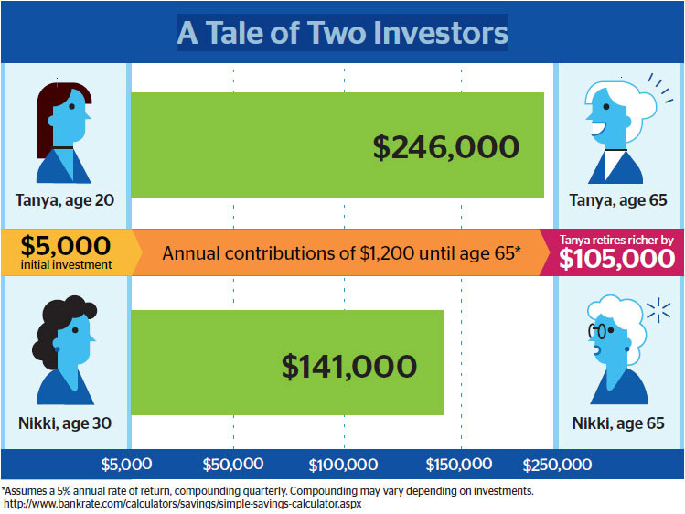
Why Invest?
Investing money now allows financial flexibility for your future
The earlier you start investing, the easier it will be to establish a large amount of money

Slide 6
How does investing work? Compounding 101
Compound interest - interest calculated on the initial principal and also on the accumulated interest of previous periods
Allows you to make money on the money you’ve made
For example, you invest $100.00 at 5% interest, compounded yearly. After the first year, you have $105.00 (100*1.05). In the second year, you will have $110.25 (105*1.05). Because of compound interest, you have made $5.25 in interest, compared to $5.00 in the first year
Formula: $P{[(1+i)}^{n}]$, where P = principal, i = interest rate, n = number of compounding periods

Slide 7
How does investing work? Compounding 101

Slide 8
Time and Compounding
The more time you have, the more money you can make
Example: Jim invests $15,000.00 at age 20, and Sally invests $15,000.00 at age 35. They both earn 5% interest, compounded yearly, and both plan on taking this money out at age 65.
Jim earns $P{[(1+i)}^{n}]$, 15000[(1 + .05)^(45)] = $134,775.12
Sally earns 15000[(1 + .05)^(30)] = $64,829.14
That is $69,945.98 difference!!!

Slide 9
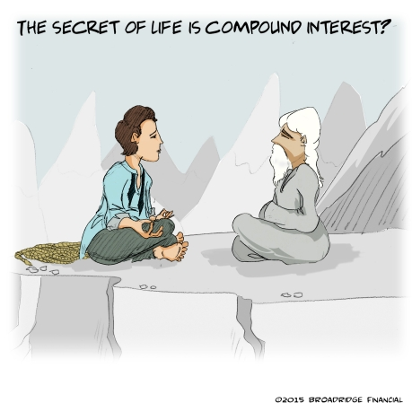
Time and Compounding
Compounding accelerates your earning power
Compounding maximizes your earing potential of your investments
You must leave the initial investment and interest earned alone for this to happen

Slide 10
Knowing Yourself: Risk Tolerance
A measure of how much risk you can handle as an investor
Factors which determine your risk tolerance?
Amount of money you have to lose
Your time frame
Emotional ability to handle risk
Determines what kinds of investments you should pursue
There is no right or wrong way to invest

Slide 11
Types of Investments
Bonds
Stocks
Mutual Funds
Alternative Investments

Slide 12
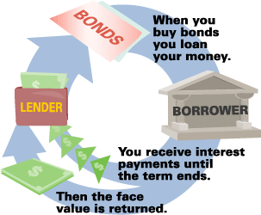
Types of Investments - Bonds
Definition: an interest-bearing security that obligates the issuer to pay the bondholder a specified sum of money, usually at specific intervals (known as a coupon), and to repay the principal amount of the loan at maturity
Wait, what? A bond is basically a loan given by you to another entity which is paid back with interest over the life of the bond.
Interest is paid throughout the bond life
Principal is paid back at the end of the life of the bond

Slide 13
Types of Investments - Bonds
For Example:
Your hometown decides to issue municipal bonds with a $100 face value to be paid back in ten years. This bond will pay 2.5% per year.
$100 * .025 = $2.50
$2.50 * 10 = $25.00
Total paid back to you: $100 + $25 = $125

Slide 14
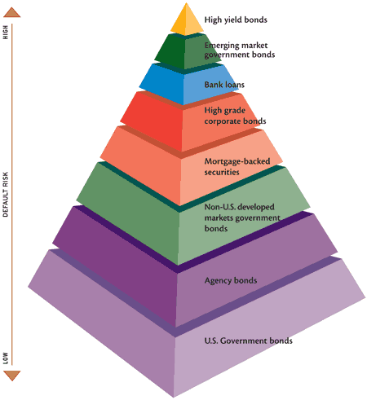
Types of Investments - Bonds
There are many different types of bonds:
U.S. Treasury Bonds – issued by the U.S. government, considered a safe investment
Agency Bonds – issued by agencies of the U.S. government or government sponsored enterprises
Municipal Bonds – issued by states, cities, counties, etc. to fund public projects
Corporate Bonds – issued by corporations
High Yield Bonds – issued by entities that have a low investment grade (they have a weaker ability to pay back the bond); generally results in a higher interest rate and higher yields

Slide 15
Types of Investments - Bonds
Bond Ratings
Definition – a grade given to a particular bond that indicates its credit quality
Range from AAA (the highest rating) to C or D (called “junk” bonds, the lowest ratings)
Private, independent services provide ratings, so indications may vary for the same rating
Major rating agencies in the U.S.: Moody’s, Standard & Poor’s, and Fitch

Slide 16
Types of Investments - Bonds
Bond Rating |  | Grade | Risk
Moody\’s | S&P/Fitch
Aaa | AAA | Investment | Highest Quality
Aa | AA | Investment | Strong Quality
A | A | Investment | Strong
Baa | BBB | Investment | Medium Grade
Ba, B | BB, B | Junk | Speculative
Caa/Ca/C | CCC/CC/C | Junk | Highly Speculative
C | D | Junk | In Default

Slide 17
Types of Investments - Bonds
Bonds are generally a very safe investment. What is the drawback?
Payback on bonds is usually lower than other types of investments
Bonds are a great investment for people who are risk averse
An investor who prefers an investment with lower risk.
Pay attention to grades; bonds can be as risky/riskier than stocks

Slide 18
Types of Investments - Stocks
Definition: A term used to describe the ownership certificates of any company
Also called: equities, shares
Stocks are volatile; their value fluctuates frequently (on a daily basis)

Slide 19
Types of Investments - Stocks
Why do companies issue stocks?
To raise money
Sell part of the company (AKA issuing stocks) – equity financing
Do not have to pay money back or make interest payments
Shareholders make money when the stock is worth more than they paid

Slide 20
Types of Investments - Stocks
Why do stocks make money?
You (as an owner) are entitled to a portion of the company’s profits
Paid out in the form of dividends
A sum of money paid regularly by a company to its shareholders out of profits (or reserves).
Where is the risk?
If the company goes bankrupt, there are no assets to claim

Slide 21
Types of Investments - Stocks
Risk
Shareholders are not guaranteed any return if the company goes bankrupt
No guarantee that shareholders will receive dividend payments
With no dividends, investors make money only through an increase in stock price
The bright side?
Stocks generally outperform other investments due to their higher risk
Historically, stocks average 10-12% returns

Slide 22
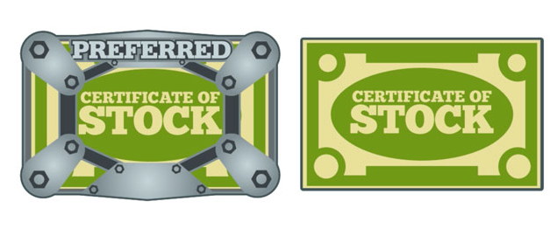
Types of Investments - Stocks
Two Main Types of Stock: Common and Preferred
Common stock – most commonly referred to
Represent ownership in a company and claim on profits
One vote per share
Higher Yields

Slide 23
Types of Investments - Stocks
Preferred Stock
Guaranteed a fixed dividend
In the event of liquidation, preferred shareholders are paid first
Do not have the same voting rights as common stockholders
May be callable (company can purchase shares from shareholders at any time for any reason)

Slide 24
Types of Investments - Stocks
Companies can also customize different classes of stock in any way they would like
Reasons for this may include wanting voting power to remain with certain people
Traditionally noted as Class A, Class B, etc.

Slide 25
Types of Investments - Stocks
Most stocks are traded on exchanges
Physical – trades are carried out on a trading floor
Virtual – composed of a network of computers
Purpose of the stock market – facilitate the exchange of securities between buyers and sellers
Reduces risk of investing because it brings buyers and sellers together

Slide 26
Types of Investments - Stocks
Different markets: Primary and Secondary
Primary market –securities are created and stocks are initially issued through IPO
Secondary Market – investors trade previously-issued stocks
What people refer to when talking about the stock market
Trading of a company’s stock does not directly involve that company
Examples: NYSE, Nasdaq, AMEX

Slide 27
Types of Investments - Stocks
Why do stock prices change?
Stocks are volatile and can change in price rapidly
Fundamentally, supply and demand determine the price of stocks
Earnings predominately affect investor evaluation of stocks, but there are other factors
There is no one theory that can explain stock prices

Slide 28
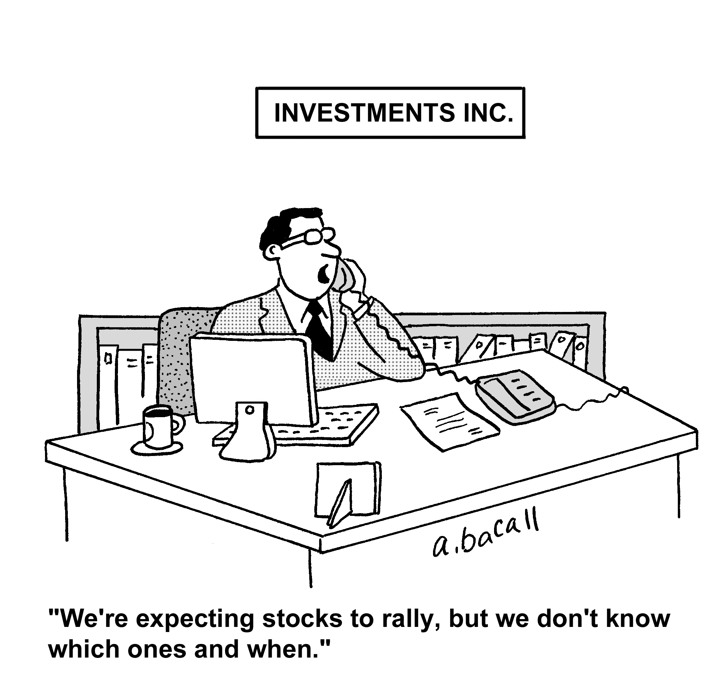
Types of Investments - Stocks
There are two ways to buy stocks:
Through a brokerage
Most common
Full-service brokers - expensive but manage your account
Discount brokerages - less expensive and provide less assistance
DRIPs & DIPs
Dividend reinvestment plans (DRIPs) and direct investment plans (DIPs) allow shareholders to purchase stock directly from the company

Slide 29
Types of Investments - Stocks
Buying stocks through a brokerage:
Step 1: Obtain a stock quote. This shows the bid (buy) price and the offer or ask (sell) price.
Step 2: If you are interested in buying a stock, you make a bid. If you are interesting in selling a stock, you would submit an offer or an ask.
Step 3: When a bid and offer match, a trade occurs.

Slide 30
Types of Investments - Stocks
How to read a stock table or stock quote
Week high and low price: highest and lowest prices stock has traded at in 52 weeks
Ticker: Alphabetic name unique to the stock that identifies it on exchanges
Company name and type of stock: with no symbols following company name, stock is common stock.

Slide 31
Types of Investments - Stocks
How to read a stock table or stock quote
Dividend per share:
Annual dividend payment per share
Price to Earning Ratio:
Current stock price divided by earnings per share from the last four quarters
Dividend Yield: Annual dividends per share divided by price per share

Slide 32
Types of Investments - Stocks
How to read a stock table or stock quote
Total number of shares traded for the day (in hundreds)
Close – last price traded at upon market closing for the day
Net change – change in stock price in dollars from previous day’s close
Daily High and Low: range of prices that stock has traded at throughout the day

Slide 33
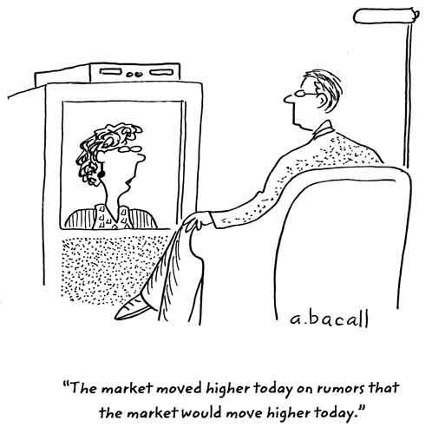
Types of Investments - Stocks
How to value a stock: very complicated and differs from person to person. Four principles impact value:
Supply and demand determine the price of stocks from moment to moment
Do not compare the value of individual stocks; rather, compare values of companies
Multiply the value of a stock by the shares outstanding to
Earnings are a major factor, but they are not the only factor
There is no one theory that can explain how stocks are valued.

Slide 34
Types of Investments – Mutual Funds
What is a mutual fund?
An investment vehicle that consists of a ‘pool’ of funds contributed by many investors in order to invest in stocks, bonds, and other assets.
These funds are managed by money managers

Slide 35
Types of Investments – Mutual Funds
Advantage of mutual funds:
Give small investors access to professional investment help by allowing them to invest in diversified portfolios
Disadvantage of mutual funds
Fees, which can limit profit

Slide 36
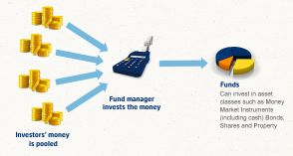
Types of Investments – Mutual Funds
Pooled Funds:
Aggregated investment from many individuals
Examples: mutual funds, pension funds
Advantages: Economies of scale - lower trading costs and professional management
Disadvantages: management fees/capital gains are spread evenly among investors, what is best for the group may not be what is best for an individual

Slide 37
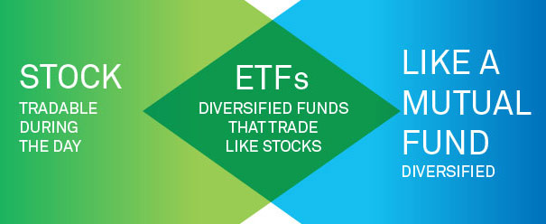
Types of Investments - ETFs
Definition: exchange-traded funds (ETFs) are an alternative to mutual funds that allow for more flexibility.
Trade on exchanges
Priced and available for trading throughout the business day
Generally have a slightly lower expense ratio than their mutual fund equal

Slide 38
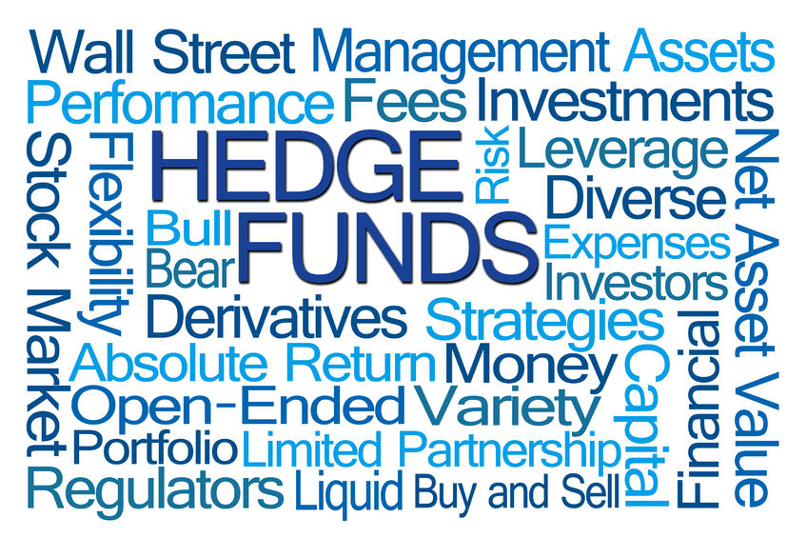
Types of Investments - Alternative
Several other types of investment vehicles available
Options, futures, FOREX, commodities, etc.
Usually very high risk and require specialized knowledge to be successful
First, create a good financial platform in lower-risk investments

Slide 39
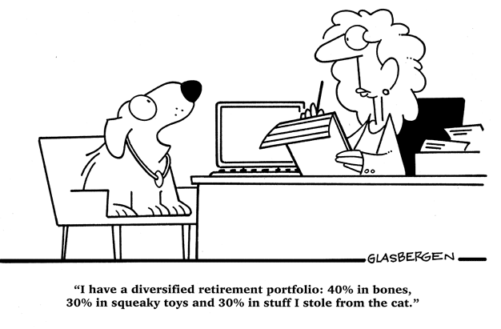
Portfolios and Diversification
Important for long-term goals such as retirement
Portfolio: a conglomerate of different financial assets which balances risk and return
Diversification: a risk management tool that mixes a large amount of investment mediums within a portfolio
Portfolios and diversification go hand-in-hand

Slide 40
Portfolios
What do portfolios include?
Any asset you own: tangible assets, equities, bonds, etc.
Think of like a pie chart
The asset mix should meet your risk tolerance and time horizon

Slide 41
Portfolios
Aggressive investment strategies: aim to make the highest returns
Investor should have high risk tolerance
Investor should have a longer time horizon
Generally have many equities

Slide 42
Portfolios
Conservative investment strategies: puts safety over returns
Investors should be risk averse
Investors should have a shorter time horizon
Consists mainly of cash and cash equivalents
Goal is to combat inflation to protect the value of the portfolio

Slide 43
Portfolios
Moderately Aggressive Portfolio: Balances risk and return
Investor should have an average risk tolerance
Investor should have a longer time horizon
Moderate amounts of equities, bonds, and cash and cash equivalents

Slide 44
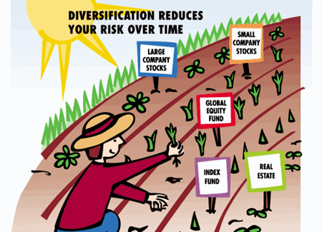
Diversification
Two categories of risk affect investments:
Systematic Risk: inherent to a market that is unpredictable; impossible to avoid
The Great Recession
Measured by a security’s beta:
>1 - more risk than the market
<1 - less risk than the market
Unsystematic Risk: company- or industry-specific risk inherent in all investments
Reduced by DIVERSIFICATION

Slide 45
Diversification
Using diversification to combat unsystematic risk
Portfolios include investments in unrelated industries
EXAMPLE: as an employee of United Airlines, you receive company stock every year. You realize that your portfolio is susceptible to risk if the airline company fails. What investments might you use to balance this risk?
Avoid investing in the airline industry or companies that do business with airline industries. Instead, invest in healthcare, clothing companies, or other, non-related industries.

Slide 46
Diversification
There are a lot of complicated ratios and opinions that allow for portfolios to be diversified
Understanding the basics of diversification is enough to invest safely

Slide 47
Conclusion
Compounding allows your money to make money
There is no wrong way to invest
Risk tolerance is a measure of how much risk you can withstand as an investor, and should be considered when choosing an investment

Slide 48
Conclusion
Bonds: a loan paid by you to a company that will be paid back with interest
Stocks: ownership in a company and rise in value with the company
Mutual funds: shared access of diversified investment mediums, may include fees
Portfolios should be diversified to combat risk

Slide 49
References
Investopedia Staff. "Investing 101: A Tutorial For Beginner Investors." Investopedia. Investopedia, 30 Mar. 2017. Web. 17 Apr. 2017.
Hayes, Adam. "Bonds." Investopedia. Investopedia, 11 Apr. 2017. Web. 17 Apr. 2017.
Investopedia Staff. "Stock." Investopedia. Investopedia, 30 Dec. 2015. Web. 17 Apr. 2017.
Investopedia Staff. "Mutual Fund." Investopedia. Investopedia, 28 Mar. 2017. Web. 17 Apr. 2017.
Investopedia Staff. "Diversification." Investopedia. Investopedia, 08 Jan. 2015. Web. 17 Apr. 2017.

