Slide 1
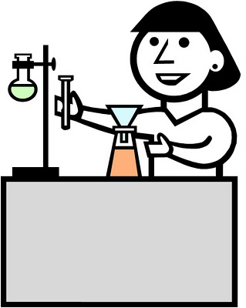
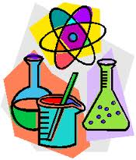
Safety and Tools in the Science Lab

Slide 2
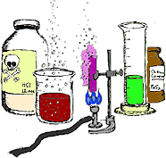
Tools in the Science Lab

Slide 3
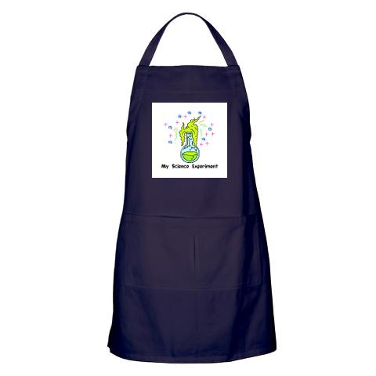
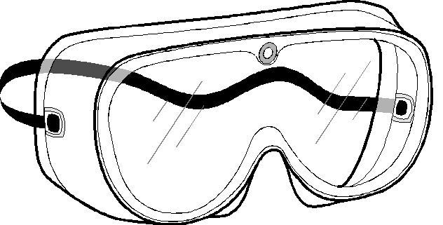
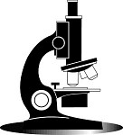
Tools- Lab Equipment
Lab Apron – wear this to protect your clothes from chemical spills
Goggles – protects eyes from chemicals
Microscope – used to observe very small objects you cannot see with your own eyes

Slide 4
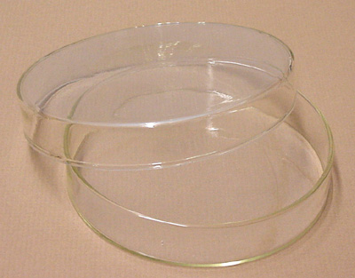
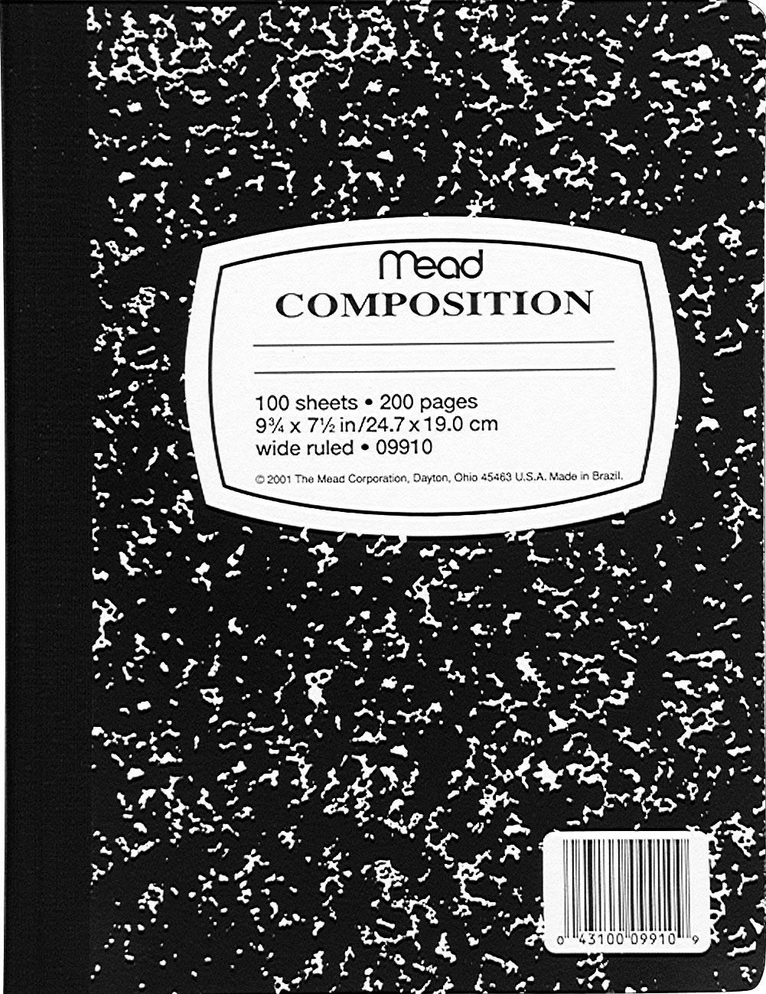
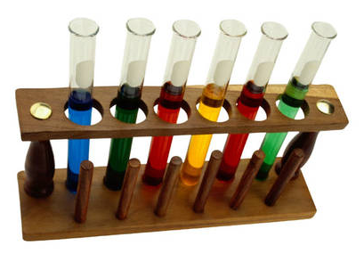
Tools- Lab Equipment cont’d…
Petri dishes- A shallow circular dish with a loose-fitting cover, used to culture bacteria or other microorganisms.
Journals/notebooks- for answering questions and recording data.
Test tubes- A clear, cylindrical glass tube usually open at one end and rounded at the other, used in experiments.
Notes:
http://www.answers.com/topic/petri-dish
http://www.answers.com/topic/test-tube

Slide 5
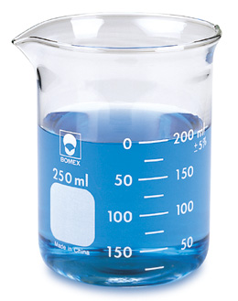
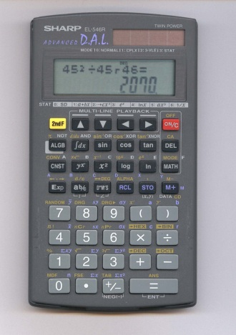
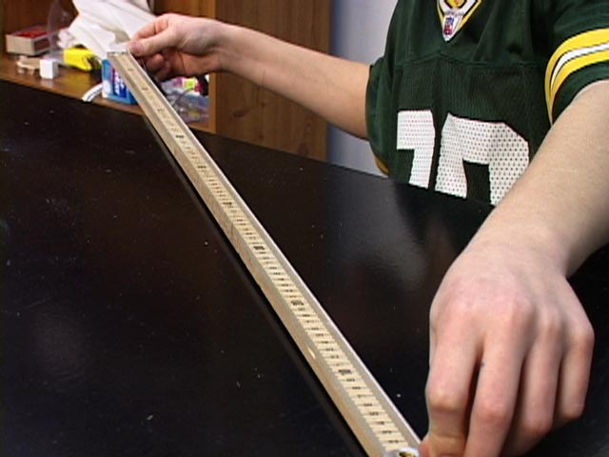
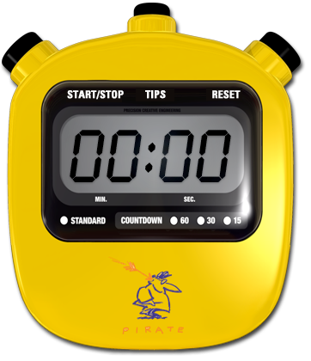
Tools- Lab Equipment cont’d…
Beaker – a wide cylindrical glass vessel with a pouring lip, used as a lab container and mixing jar
Meter Stick
Calculator
Computer
Stop watches and other timing devices
Notes:
http://www.answers.com/topic/beaker

Slide 6
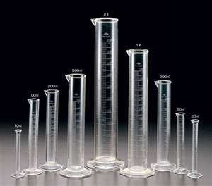
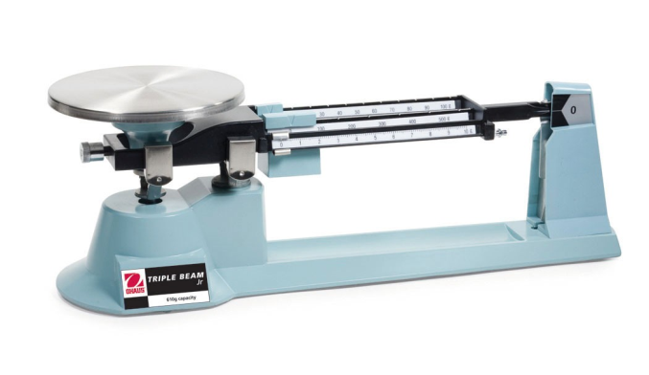
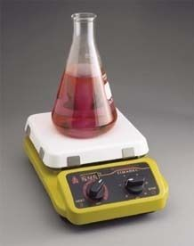
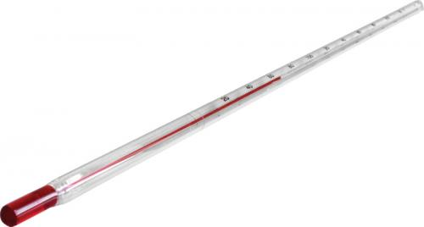
Tools- Lab Equipment cont’d…
Graduated cylinder – measures volume of liquid
Triple beam balance – measures mass of object
Thermometer – measures temperature
Hot Plate – heats liquid

Slide 7
Tools- Safety Equipment
Before the first day of lab be sure you are aware of the class safety rules and procedures.
You should also be aware of the location of an eyewash fountain, a safety shower, the fire blanket and extinguisher, a first aid kit and any other safety equipment available in your classroom.

Slide 8
Tools- Safety Equipment cont’d…
Fire Blanket
Used for when a person is on fire. (Never spray a person with a fire extinguisher because it can affect their ability to breathe.
Remove the blanket for its storage container.
Wrap it around the victim to smother the fire.

Slide 9
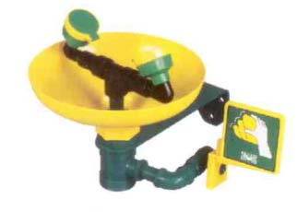
Tools- Safety Equipment cont’d…
Eyewash Fountain
Used when you get a chemical, like an acid, in your eye.
Run some water through the fountain before you use it.
Hold your eye open and run water over your eye for several minutes.
Someone will need to report the incident to the teacher so that they can assist you.

Slide 10
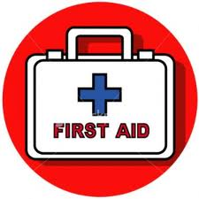
Tools- Safety Equipment cont’d…
First Aid Kit
Used for small injuries like cuts or small burns.
If you have cut finger, tell your teacher so that they can treat your wound.
You might have to use a bandage and then go to the nurse.

Slide 11
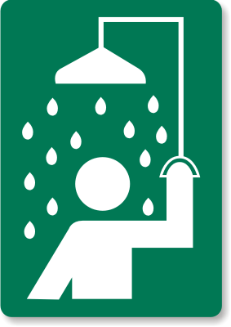
Tools- Safety Equipment cont’d…
Safety Shower
If you’re on fire or have spilled a chemical on yourself and it is covering your clothes.
To use, stand underneath the shower and pull the handle.
If there are chemicals on your clothes they may need to be removed in order to get all of the chemical off of your skin.

Slide 12
Tools- Safety Equipment cont’d…
Broken Glass – tell the teacher immediately
Safety Warning “Diamond”
RED is fire danger
YELLOW indicates reactivity danger
BLUE represents health hazards
WHITE signifies specific hazards (acids, bases, corrosive materials)

Slide 13
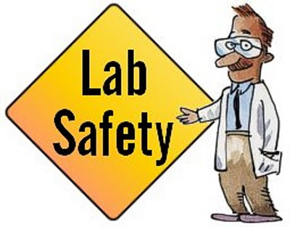
Safety in the Science Lab

Slide 14
How to be safe in lab!
Always wash your hands after doing an experiment so that you don’t get chemicals in your mouth, food for eyes!
Make sure to clean your desk before and after an experiment!
If you spill or break something, make sure you tell the teacher right away!
Don’t run around or play in the lab (No horseplay)!
Tie back long hair!

Slide 15
How to be safe in the lab!
Make sure you listen to your teacher and follow directions.
Measure things carefully!
Do NOT eat or drink anything without permission!
Be careful when handling hot or electrical appliances!
Remember Hot glass looks the same as Cold glass!
And ALWAYS wear your goggles when dealing with dangerous chemicals, glassware, or heat!

