Slide 1
Lesson Activity Instructions
Fill the box with a small layer of dirt on the bottom.
Blow air into the tiny balloon, tie it off, and put it in the middle of the box. Make sure you remember where you put it.
Put more dirt over the balloon until the balloon is completely covered and its surroundings too.
Using your pencil (sharpened), pop the balloon.
Observe what happens when the balloon is popped. Write down your observations on a separate sheet of paper.

Slide 2

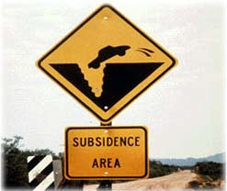
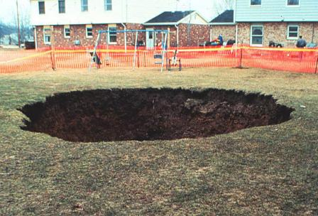
Land Subsidence in Texas

Slide 3
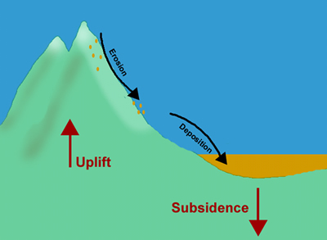
What is Subsidence?
The gradual caving in or sinking of an area of land
The opposite of subsidence is an uplift which causes elevation

Slide 4
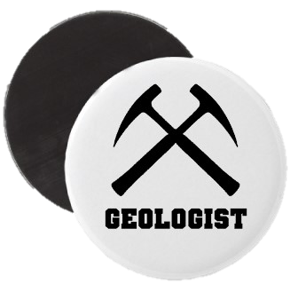
What is Subsidence?
Ground subsidence is of concern to geologists, geotechnical engineers, and surveyors
The slow subsidence of areas can cause as much damage as a land collapse, although spread out over a longer period of time.

Slide 5
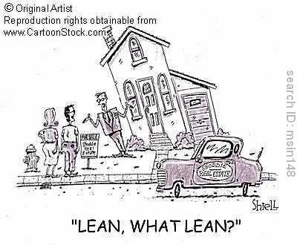

Slide 6

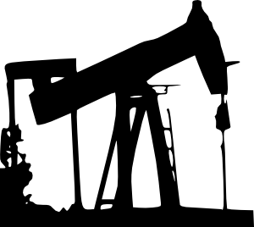
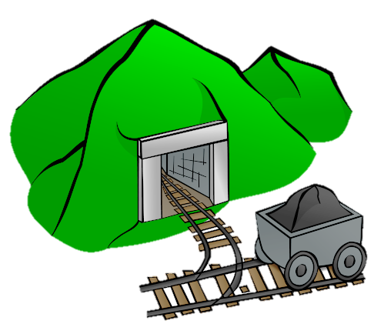
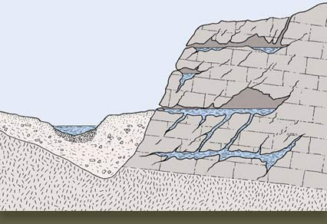
Reasons for Subsidence in Texas
Notes:
The reasons which are depicted in the pictures are Oil Drilling, Groundwater Removal, Mining, and Natural Reasons.

Slide 7
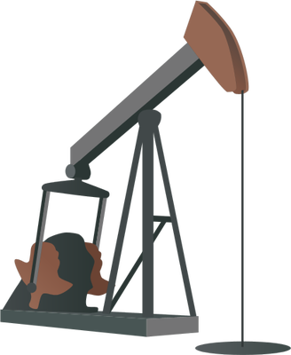
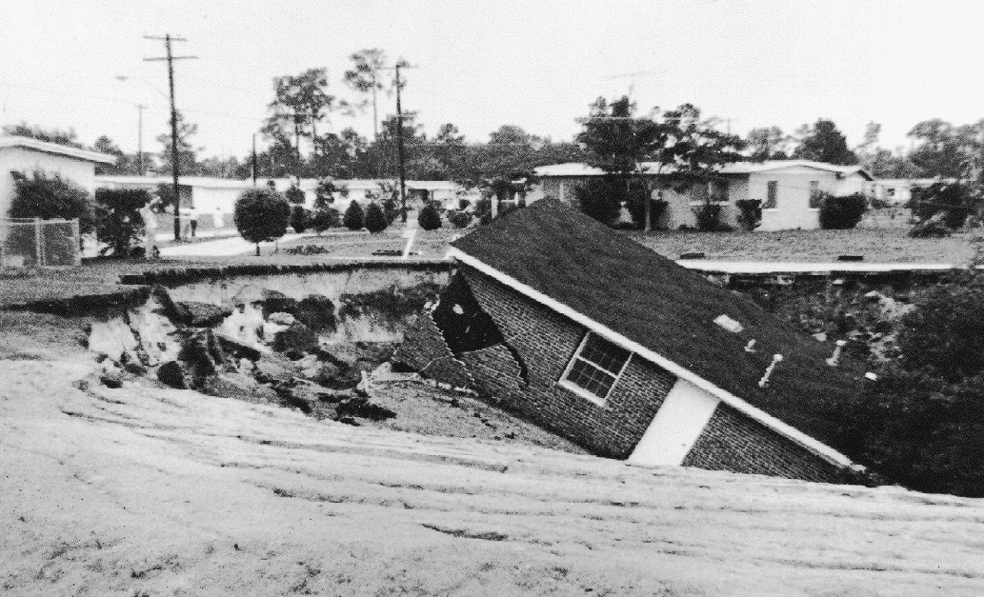
Drilling for Oil/Gas along the Gulf
When the oil in the ground decreases, there is an empty gap
The soil and dirt from the top falls down to fill in the gap, causing the ground to cave in = subsidence
Notes:
Ask students to brainstorm why this may be. This is a short snippet from Wikipedia.
“If natural gas is extracted from a natural gas field the initial pressure (up to 60MPa (600 bar)) in the field will drop over the years. The gas pressure also supports the soil layers above the field. If the pressure drops, the soil pressure increases and this leads to subsidence at the ground level.”

Slide 8
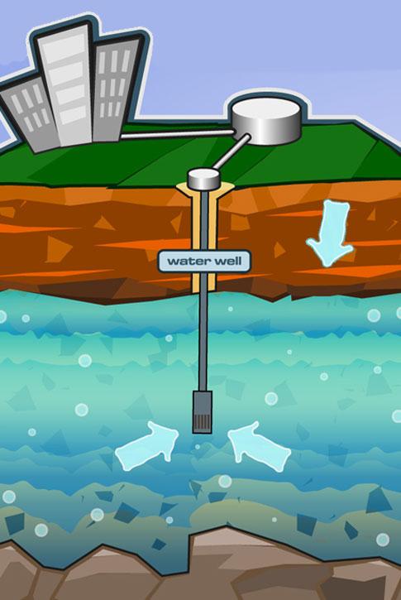
Removal of Groundwater
Again, groundwater is found several layers below the ground
When this water is used up, the top soil falls down to fill up the gap, causing the ground the cave in
Notes:
Go into detail about the cause of this. Ask students how they think the drought is affecting land subsidence.
The answer is that rainwater usually fills up the gaps. Now, due to the drought, the water is not being refilled, which causes the ground to cave in (subsidence).

Slide 9
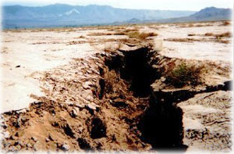
Removal of Groundwater
Groundwater removal is the main cause of subsidence in the greater Houston area
Notes:
When groundwater is removed and not refilled, such fissures as shown in picture may occur!

Slide 10
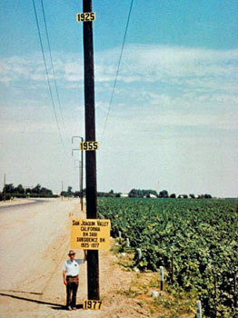
Interesting…but SCARY!
This is NOT from Texas, but it gives you an idea of how seriously groundwater removal affects elevation and causes subsidence!
The top sign shows where the land surface was back in 1925! Compare that to where the man is standing (about 1977).
Notes:
This is a picture of the San Joaquin Valley southwest of Mendota in the agricultural area of California. Years and years of pumping ground water for irrigation has caused the land to drop.

Slide 11
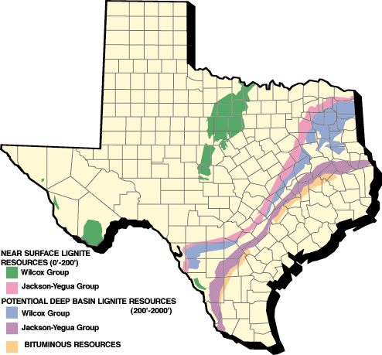
Mining
Subsidence occurs in the same manner as is the case with drilling for oil.
Notes:
The picture shows Texas mining areas.

Slide 12
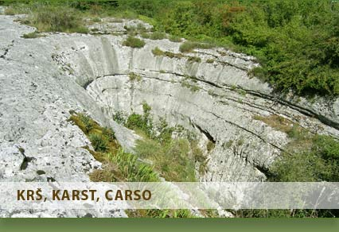
Natural Reasons
Some natural land subsidence occurs over long periods of time, due to the natural settling of sediments left over from millions of years ago
Dissolution of limestone is a natural reason for subsidence, but Texas does not have limestone

Slide 13
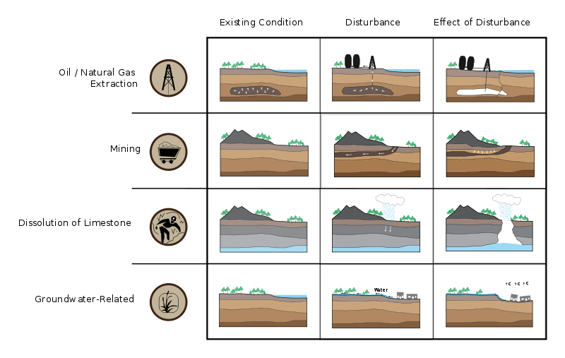
Summary of Causes:
Notes:
Ask students to guess each cause. Answers will come up as you right click.

Slide 14
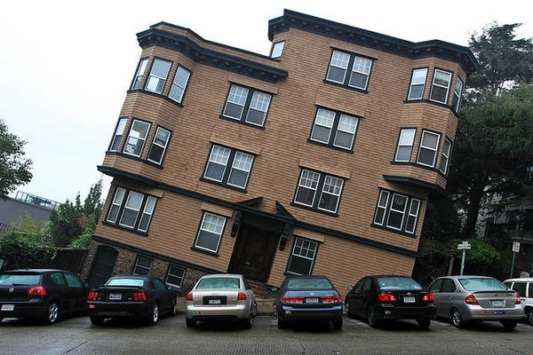
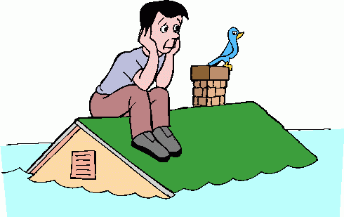
Effects of Subsidence?
Can you guess the effects depicted in the pictures above?
Notes:
Left side:
Damage to Structures
Right side:
Flooding

Slide 15
Damage to Structures
Land subsidence can cause:
changes in elevation
damage to structures such as storm drains, sanitary sewers, roads, railroads, canals, levees and bridges
structural damage to public and private buildings

Slide 16
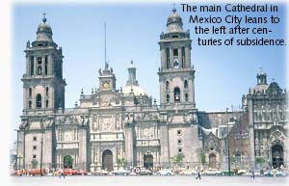
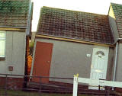
A house split in two in Coastal Texas due to subsidence

Slide 17
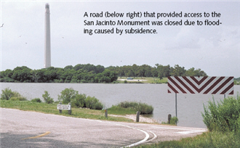
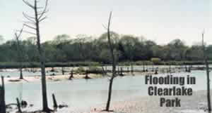
Flooding
Most commonly, subsidence is known for causing an increase in the frequency of flooding
When the ground caves in, the area is extremely vulnerable to flooding when it rains

Slide 18

10 of the World’s Largest Sinkholes Video
From http://www.youtube.com/watch?v=NVWI31sTcZ0

Slide 19

Where in Texas is Subsidence a Problem?

Slide 20
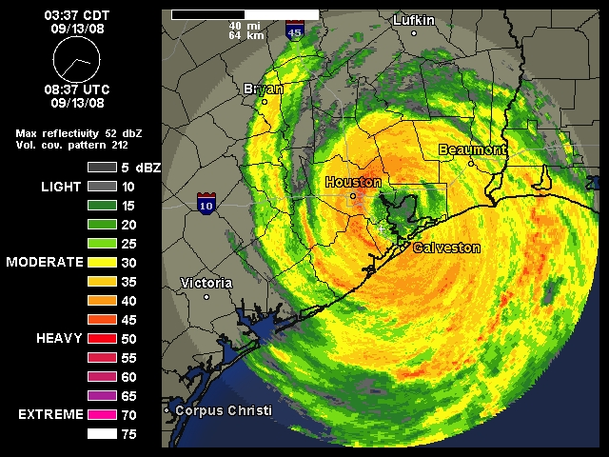
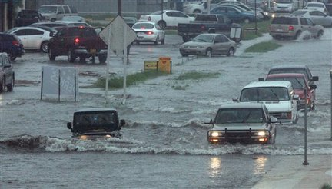
Coastal Area
The Coastal Area is the region where most rain storms/hurricanes come
Notes:
The picture on the right: Flooding caused in Texas due to Hurricane Ike. Subsidence made the flooding even worse!

Slide 21
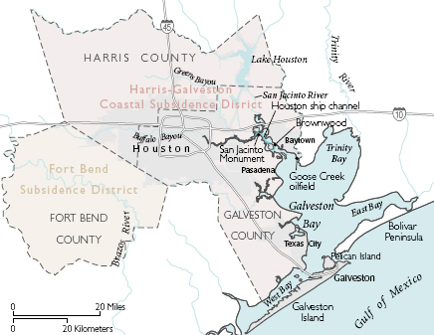
Coastal Area
The worst area hit by subsidence in Texas is north and west Harris county in the greater Houston area
From 1995 to 2000, this area recorded as much as 1 foot of subsidence
<http://www.sanjacintoriverauthority.com/facts/land-subsidence.html>
Notes:
Picture Caption:
Because of the growing awareness and concern of subsidence-related problems, the 1975
Texas legislature created the Harris-Galveston Subsidence District. Their mission is “to control subsidence and manage ground water resources in Harris and Galveston Counties through regulation of ground water withdrawal, conservation, and cooperation with surface water suppliers to assure adequate future supplies of water for beneficial uses.” More recently, the Fort Bend Subsidence District was created to monitor subsidence in inland areas west of Houston (Fort Bend County), where subsidence has accelerated because of extensive ground water use.

Slide 22
Coastal Area
How can subsidence be stopped?
Notes:
Class discussion:
Maybe even ask students to research on their own and share answers with class. Just based on the presentation alone, some ideas to point out include:
Just stop pumping water faster than it’s being replaced!
Ease up on drilling oil and gas.

Slide 23
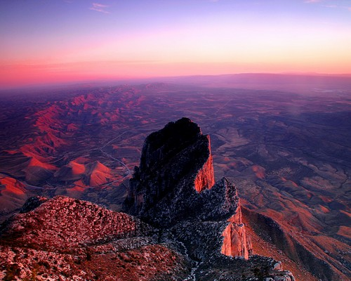
Not a problem in West Texas
West Texas is characterized with deserts and mountains
There is very little rain to cause flooding
Notes:
Picture: The Chihuahua Desert,
West Texas

Slide 24
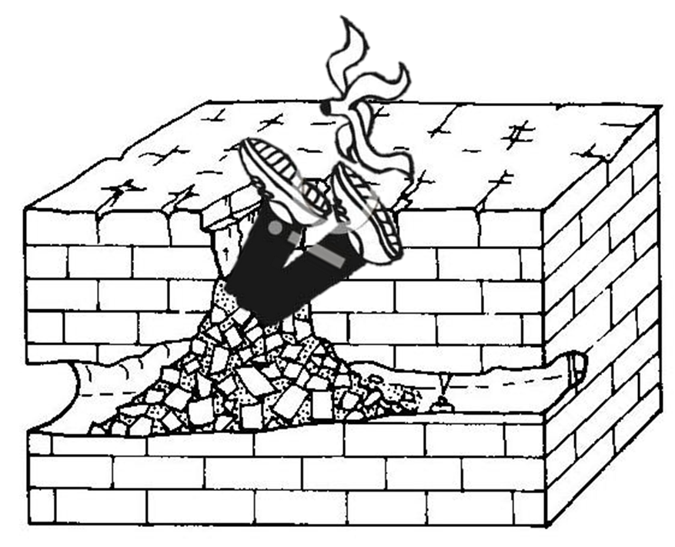
Stop land subsidence before it stops you.
- An awesome person.

